Slide 1

SmartCan
Mateen Nemati
Ross Kaplan
Shuyang Yu
Gaberiel Korgood

Slide 2
SmartCan
Function: reads height and weight information of the trash and sends that data to the cloud.
Technical details: IR sensor, scale, and Sparkcore.

Slide 3
What did we do for Beta test?
We posted our product on many social media websites like Facebook
We handed out flyers on the street
We established our own SmartCan website where people can view our product and sign up for the beta test

Slide 4
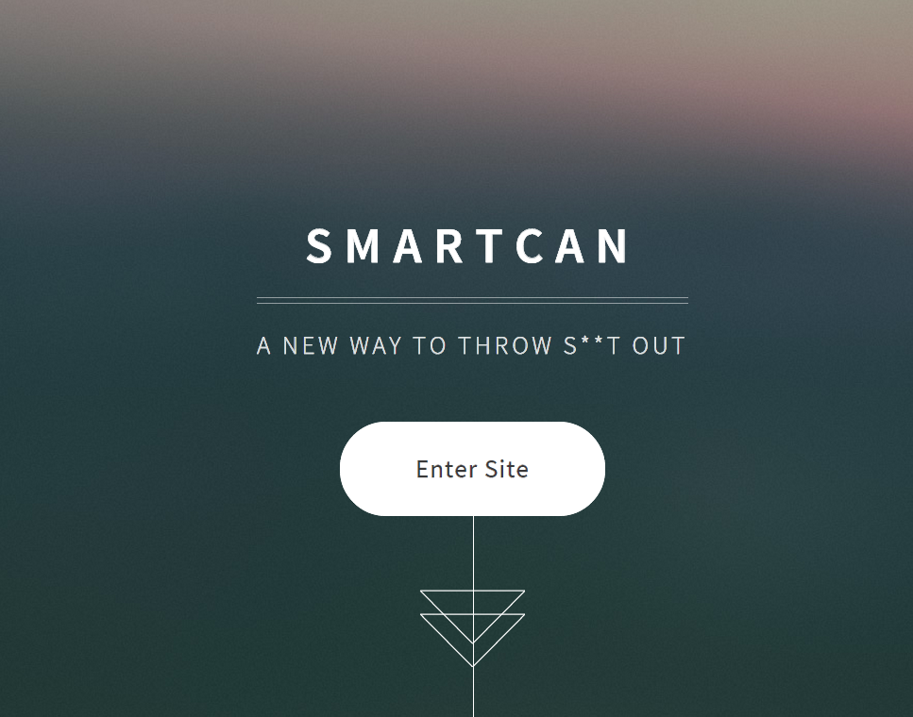
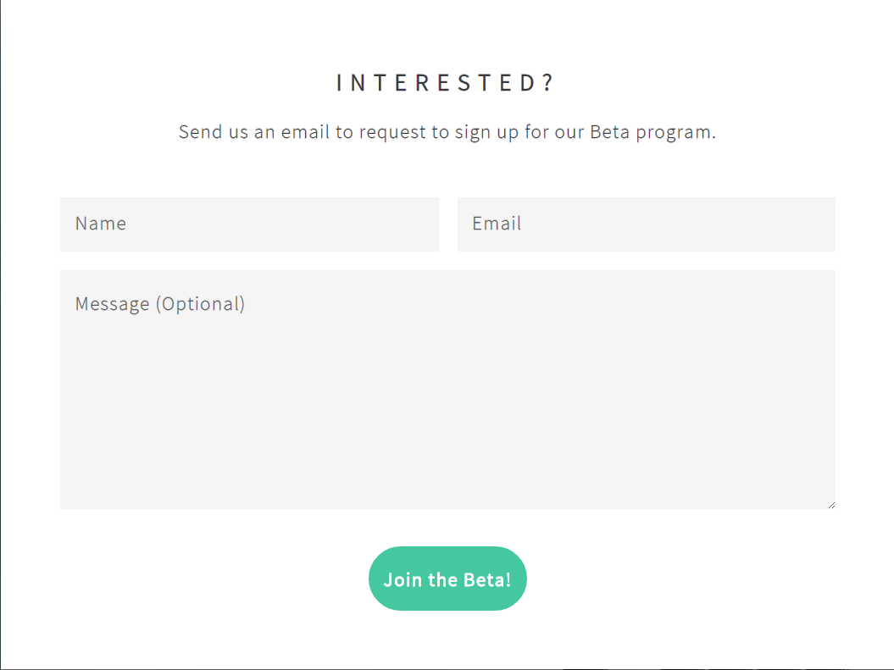
Smart Can Website

Slide 5
Responses from the beta test
“How accurate is the weight sensor at the upper range?”
“See if you're solving a real problem that people have every day.”

Slide 6
What did we learn from the Beta test
Our website was not clear enough and it lacked a lot of important information about our product, such as weight and height limits and accuracy at the upper extremes.
Ways the SmartCan can be useful to the consumer market

Slide 7
In the future
We will work to meet the demand of our customers based on the beta response.
Make more communications with potential customers
Improve the beta test on our SmartCan website.

