Slide 1
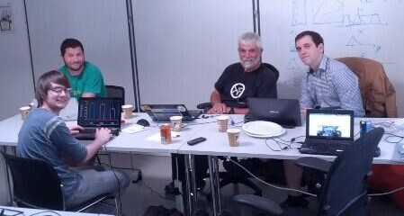
Figures → Data
Team:
Vincent Adam (vincentadam87), Thomas Branch (twighk),
Peter Murray-Rust (petermr), Ross Mounce (rossmounce)
github.com/rossmounce/hack4ac-figures

Slide 2
Scope
Today we were just looking at:
Bar charts
Histograms
(the low-hanging fruit)
...but the approach is extensible

Slide 3
Discovery
BMC
PLOS (& PLOS via figshare)
Figshare
PeerJ
http://figuresearch.askhermes.org
20,000+ CC BY bar chart-y figures available

Slide 4
Tools
OpenCV
Github & etherpad for collaboration
Canny algorithm
...trying to recreate ReVision
(no public code)
http://vis.berkeley.edu/papers/revision/

Slide 5
Results
An annotated corpus of 40 figures
Three different approaches

Slide 6
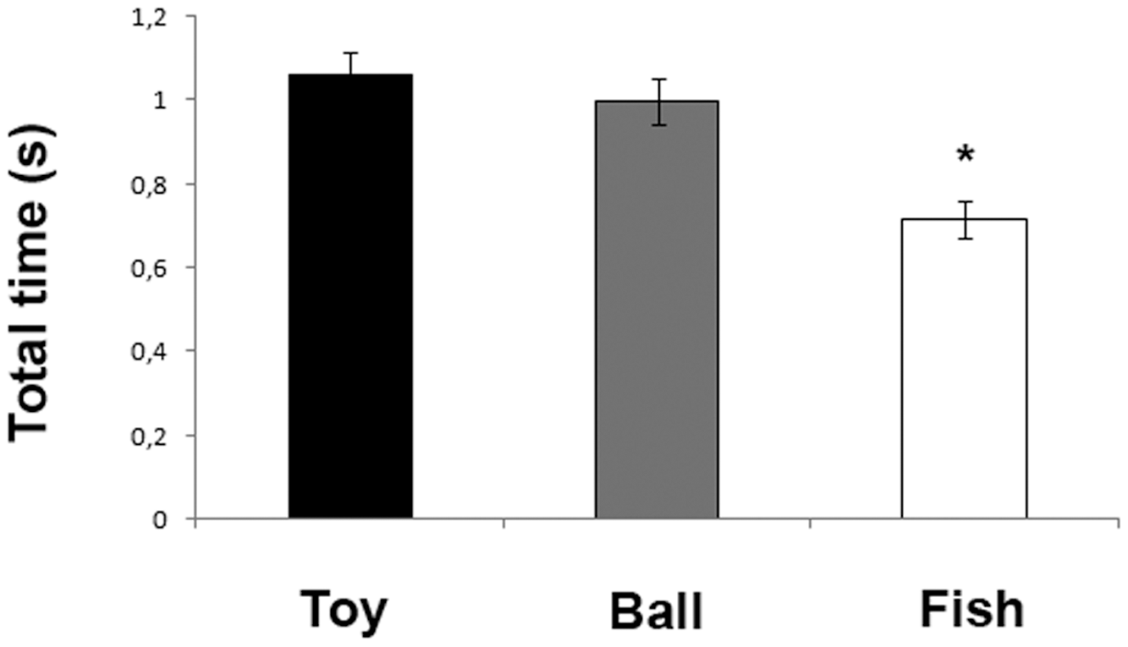
Best figure EVER

Slide 7
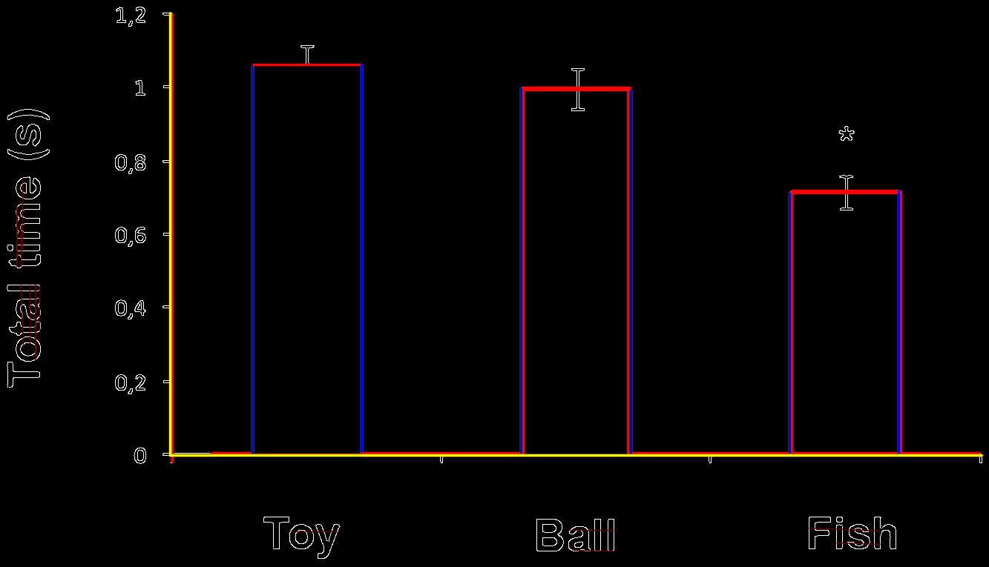
Approach A (Thomas)
Actual numbers (data) extracted too for each bar :)

Slide 8
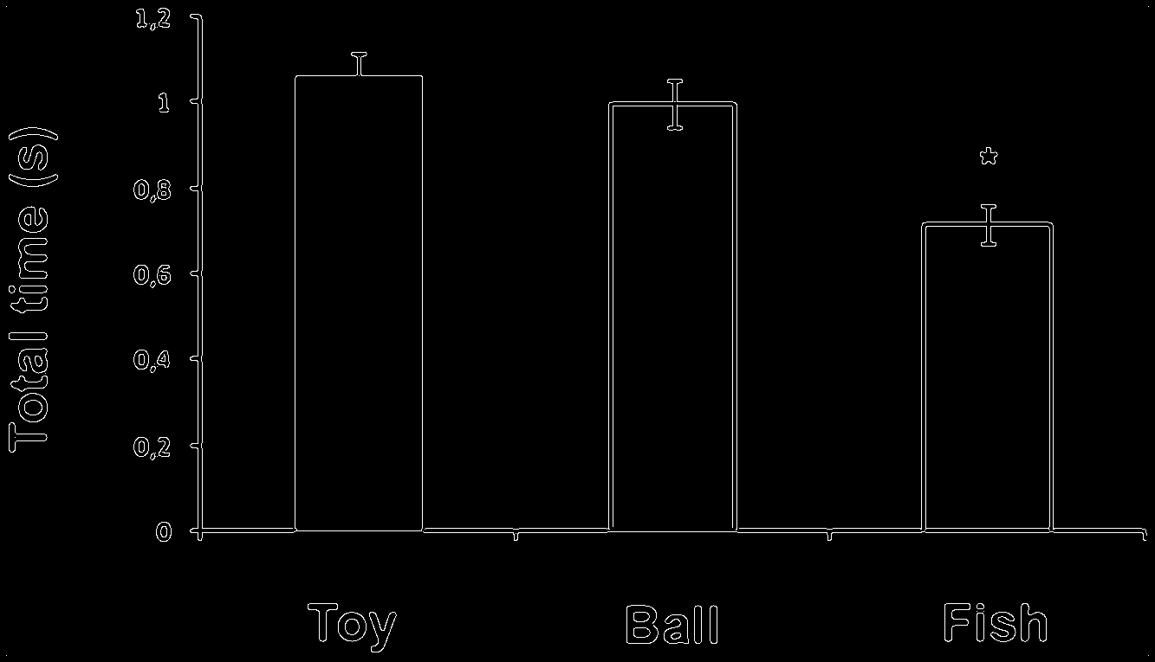
Approach B (PMR's Canny)

Slide 9
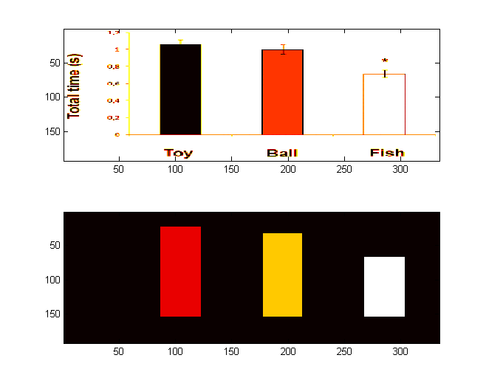
Approach C (Vincent)
(Using bilateral filtering)

Slide 10
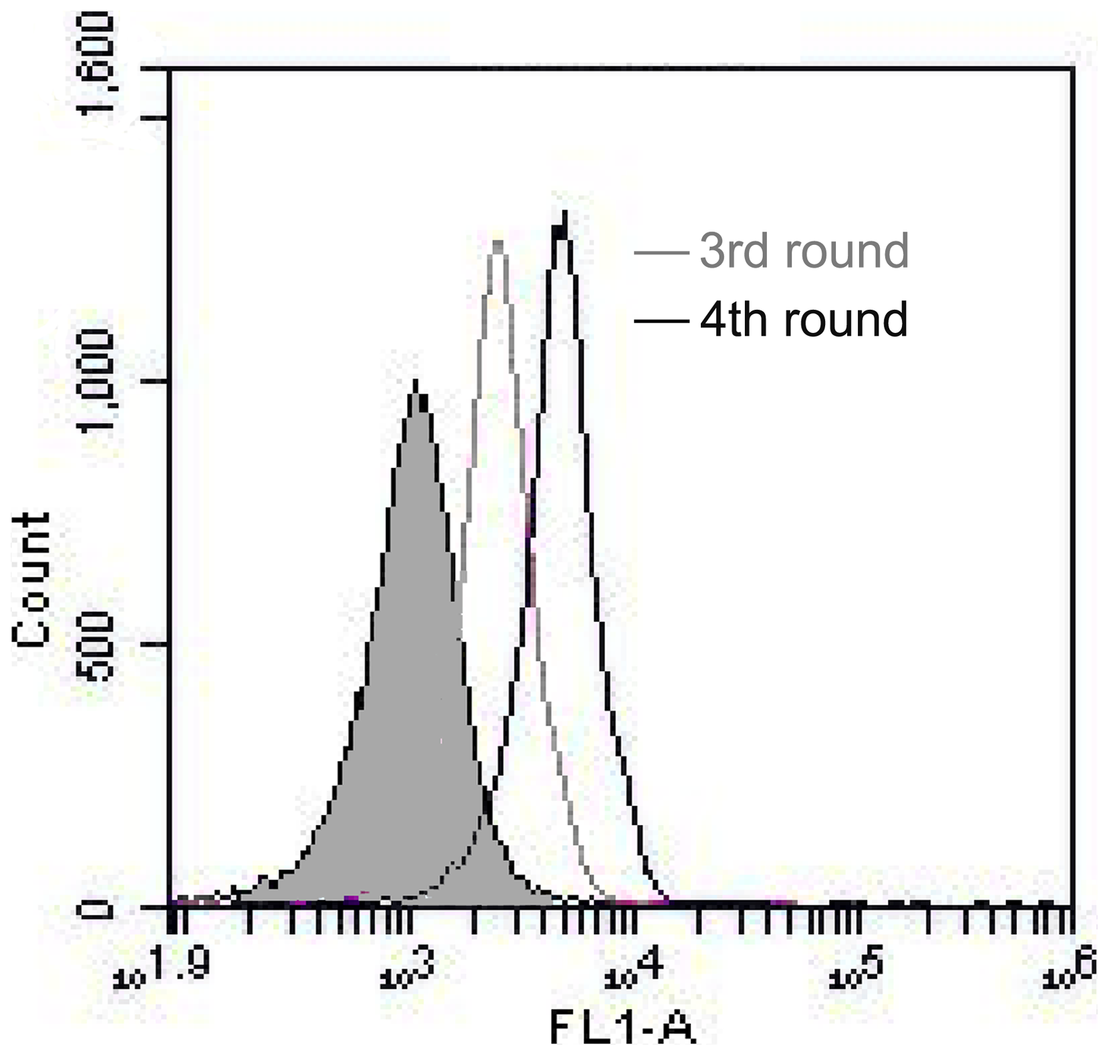
Some figures are just awful
WTF!

Slide 11
Loads of stuff to carry on with
https://github.com/rossmounce/hack4ac-figures

