Slide 1
KARMALAND
Where dreams come true

Slide 2

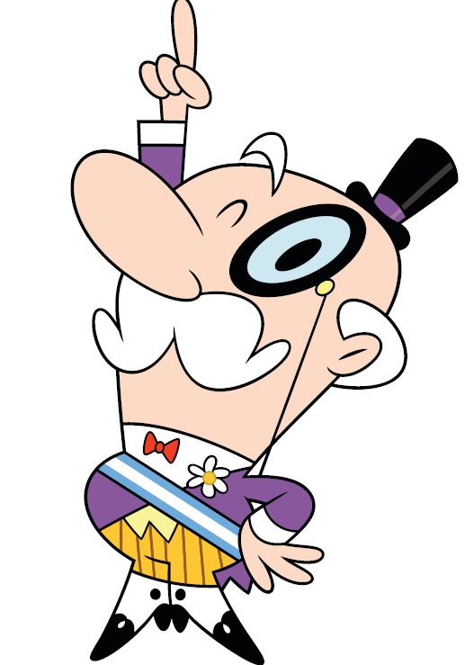

Slide 3


Slide 4
John
Peter
Ethel
Giving Annie chocolate
Taking the bins out
Picking up litter

Slide 5
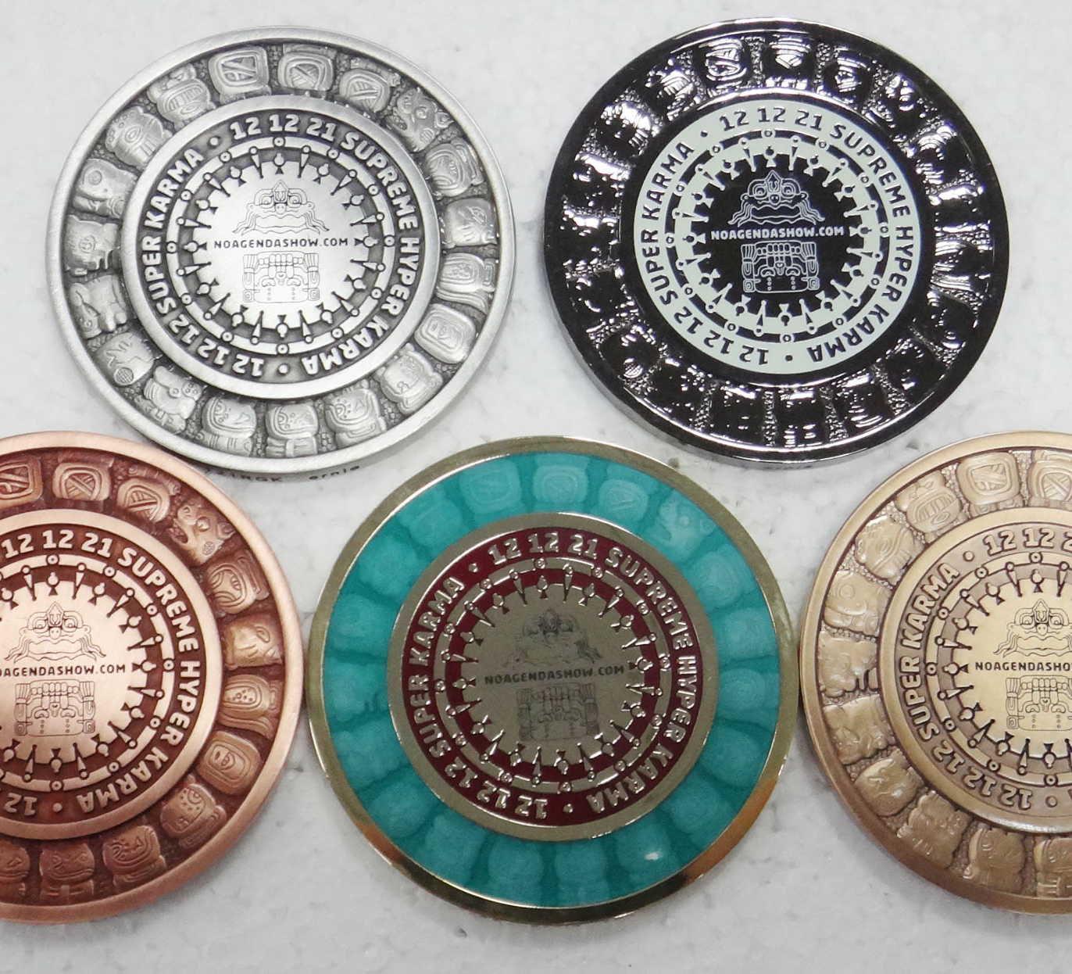
Earn Karma coins by doing good deeds!

Slide 6






Notes:
People who earned “karma” can give k votes on different plans to improve the city.

Slide 7

Plant trees!

Slide 8
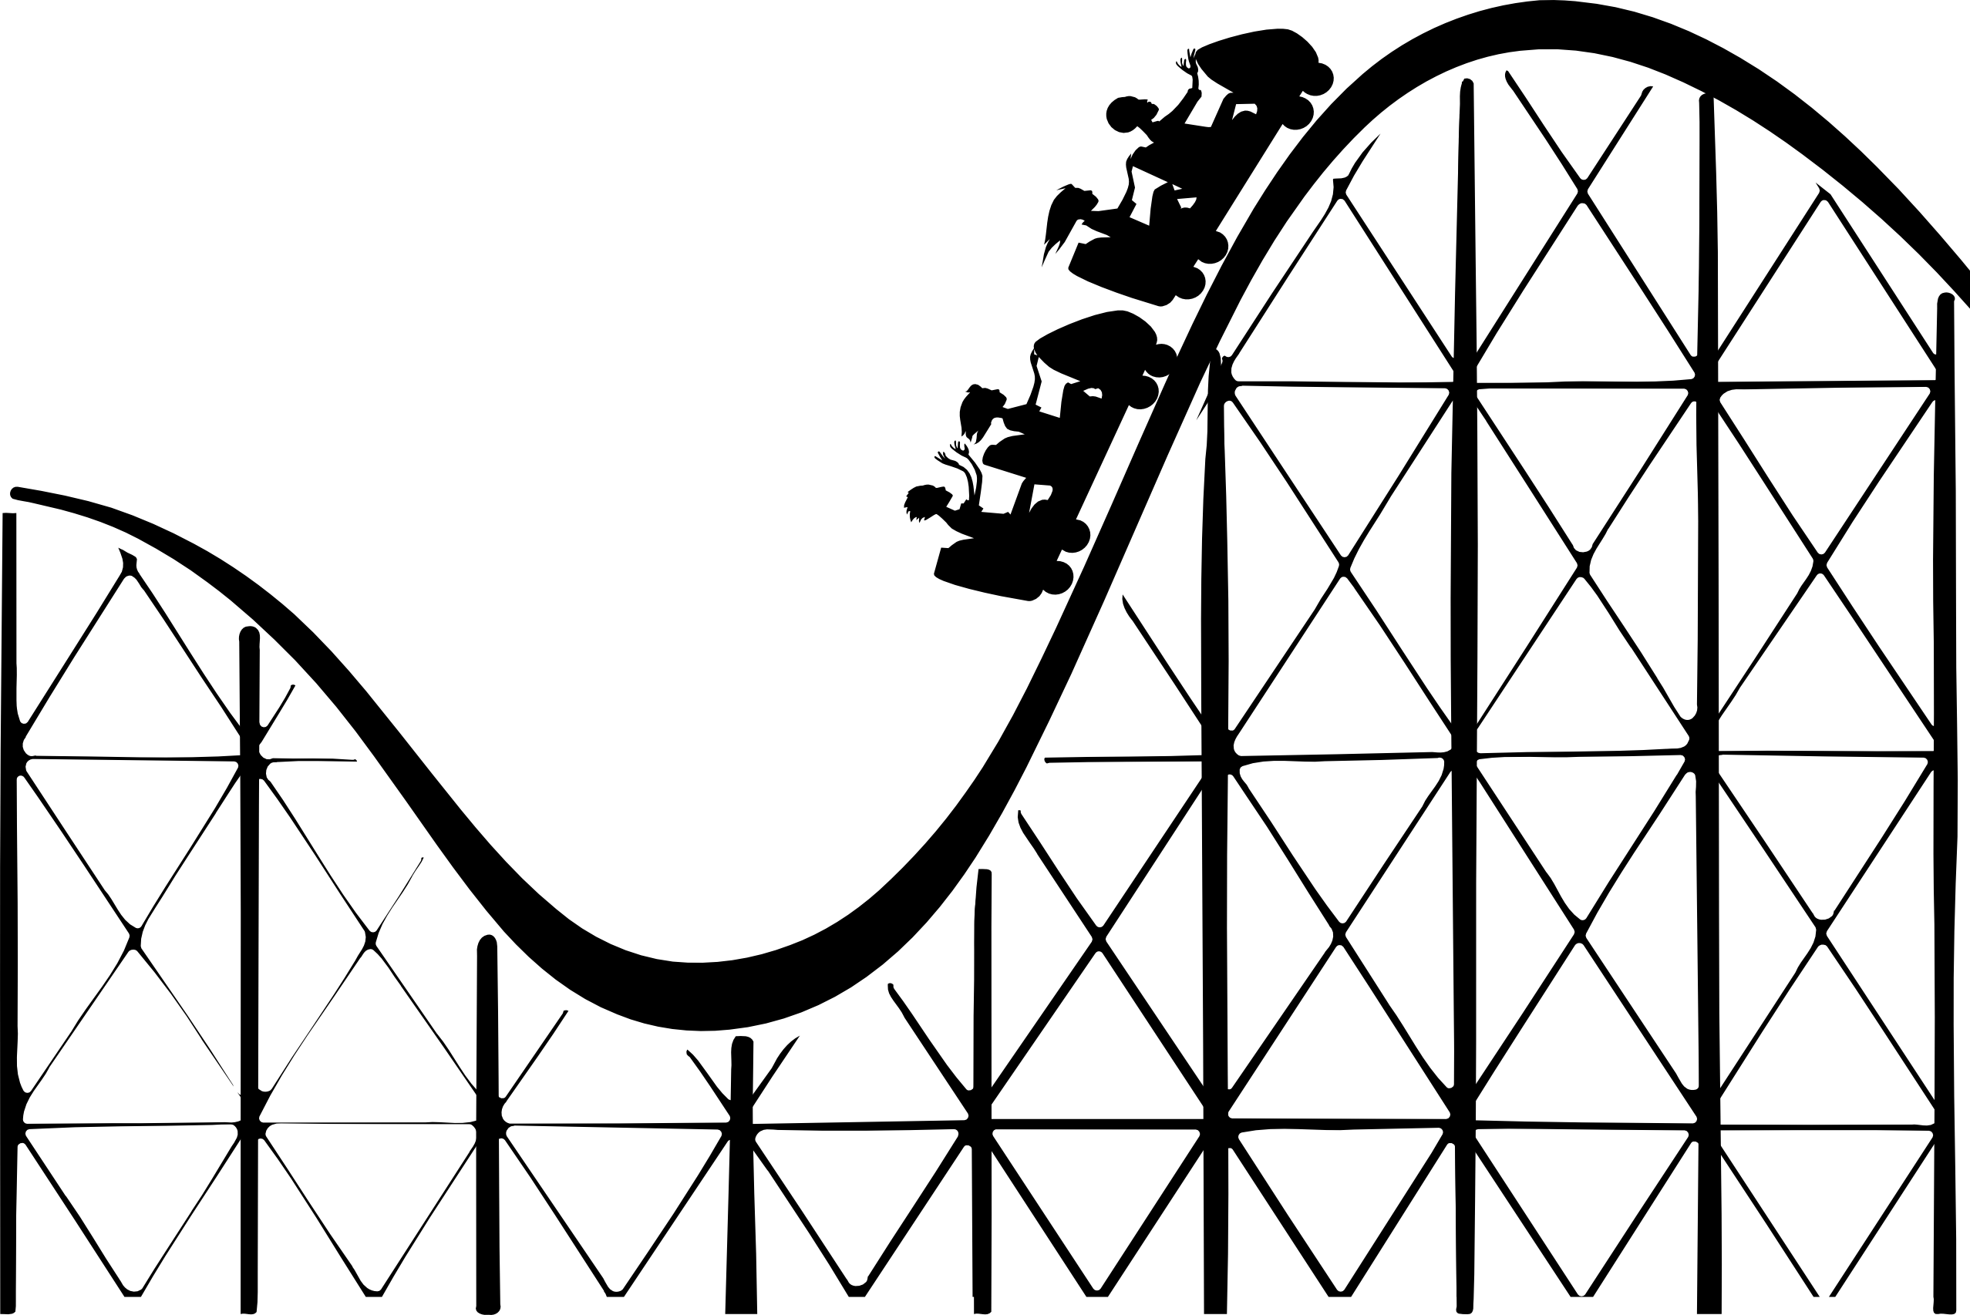
Build a roller-coaster!

Slide 9
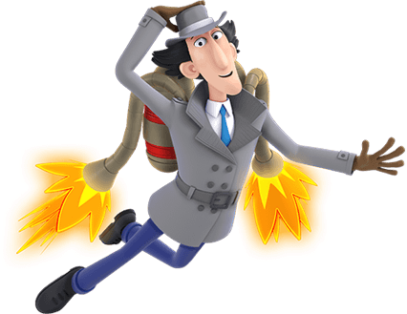
Jetpacks for everyone!

Slide 10


