Slide 1










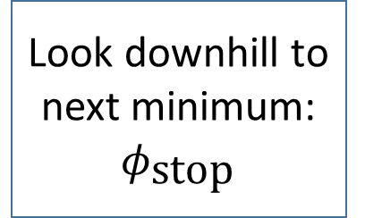












$φ_{0}=0$ (B) or nearest peak (A)
Is SRA valid?
no
Continue
Reheat?
yes
$$N_{e}$$
Continue
$$<55$$
$$N←0$$
yes
true
$$≥55$$
Generate potential as GRF
Look downhill to next minimum:
$$φ_{\text{stop}}$$
$$ρ_{Ω}≪0$$
Search for breakdown of SRA: $φ_{\text{end}}$
Find $φ_{\text{exit}}$
Initialization
false
for i = 0 to N
Decide whether or not to do instanton calculation
Find minimum of the next potential basin
$$n←0$$
A
Stochastic eternal
inflation
Find regions with stochastic eternal inflation
No viable tunneling
False vacuum
eternal inflation
Check stochastic eternal
$$V_{n}<V_{n−1}$$
$$V_{n}>0$$
$$<N_{max}$$
A
$$N+n$$
$$N←N+1$$
$$N_{max}$$
Tunnel to neighboring basin
true
no
$$n←n+1$$
Reheat?
yes
Check for false vacuum eternal
inflation
$$≥55$$
$${max⁡(N}_{e})$$
Compute maximum no. of e-folds
Topological eternal
inflation
Meas. A
yes
$$<55$$
Compute tunneling rate for barrier
false
Stochastic second derivative check
$$\log{λ≪0}$$
no
true
Hawking Moss
yes
Compute Hawking-Moss transition rate
Bounded $λ$ large?
small
Compute full instanton
no
Check for topological eternal
inflation
Fluctuation
large
Tunneling is viable
yes
$$n←0$$
no
$N_{e}, n_{s}, α, n_{t}, Ω, ρ_{vac}, …$
# eternal inflation epochs
# e-folds stochastic eternal
Topological eternal?
Status flags if discarded
Compute observables
Data collection

