Slide 1
AutoBench
Architecture & Design Overview
A pure-Python, HTTP-only service that deploys and evaluates agent benchmarks
on a Rossoctl cluster, alongside the workloads it benchmarks.
Last modified 2026-10-05 20:12 EDT
1

Slide 2
Agenda
What this deck covers, in order
1
Overview & key design decisions
6
Benchmark catalog & run lifecycle
what the Service is, and the seven choices that shape it
6.1 the three benchmarks and the REST flow that drives them · 6.2 what each image bakes in · 6.3 one task end to end · 6.4 who decides what happens inside it
2
Auto-benchmarking design motif
7
The three benchmarks — what they measure
the shape of the system, before the wiring detail
7.1 the difficulty ladder · 7.2 what each stresses · 7.3 the three compared · 7.4 the traps · 7.5 picking one · 7.6 what it costs · 7.7 the rate card · 7.8–7.9 six efficiency figures
3
Architecture
8
The canonical 12-run matrix
client, Service, and the per-cluster instance selected by JWT iss
8.1 what the 12 runs parameterize · 8.2 what each band established · 8.3 what they measured
4
Architecture with workload specific components
9
Cross-platform & plugin overhead
4.1 inside the workload: sidecar, user simulator, IBAC judge · 4.2 how interception is wired
9.1 OpenShift vs KinD, like-for-like · 9.2 what AuthBridge costs
5
The two-token auth model
10
What the Service can & cannot enact
why the caller's token is never forwarded upstream
the HTTP-only boundary, made explicit
2

Slide 3
1. Overview & Key Design Decisions
What it is
Key design decisions
Deploys a benchmark's MCP tool + A2A agent, runs the evaluation, reads results, and exports them — all over HTTP.
Objectives
  • Automate benchmarking lifecycle operations
  • Cross-user/cluster sharing of benchmark run results
  • Easy to install on a cluster and run against it: KinD or OpenShift
  • Asynchronous parallel benchmark runs
  • Secure, scalable, auditable & resilient
3 benchmarks
  • gsm8k — single-turn: one prompt in, one answer out, no dialogue partner
  • tau2 — multi-turn: a server-side user simulator LLM plays the customer
  • appworld — long-horizon: many API calls across simulated apps
Client contract
  • Point at a hostname, send Authorization: Bearer <caller JWT> — same from kind to prod
Pure-Python, HTTPS-only to Rossoctl
No shell-out: smaller image, no injection surface, structured errors, testable.
Two-token auth model
Caller JWT attributes + routes only (never forwarded); Service mints its own benchmarker (ROPC) token to Rossoctl.
iss is the trust anchor
The JWT issuer selects the per-instance config — no separate instance argument, so no confused-deputy escape.
Per-request ROPC login
Fresh Service token every request — no expiry handling.
iss-keyed per-instance config
One file per issuer: Rossoctl URL, benchmarker cred, MLflow/S3, optional Keycloak backchannel.
Enact only what the API allows
Deploy/run/report/export — now including AuthBridge plugin presets (layer-3). Only workload Secrets remain out-of-band: prechecked and reported (424), never silently ignored.
MLflow with Service; S3 in the cloud
MLflow runs on the Service's own cluster (the traces it emits and reads); S3 is an external cloud service — the shared cross-cluster sink for results.
3

Slide 4
2. Auto-Benchmarking Design Motif
One client, one Service, N workload deployments — and every result ends up in one place
AutoBench Client
Workload Deployment Instances
1
Benchmark workload (agent + MCP)
AutoBench Service
Deployment helper for the benchmark workload
2
3
4
6a
8
5
7
Shared store of benchmark run results
Experiment Tracker
Telemetry Collector
6b
1 Client → Service
2 Service → deployment helper: create the benchmark workload
3 helper → benchmark workload
4 Service → benchmark workload: run and monitor execution
5 Service → Experiment Tracker: emit the trace
6a workload → Telemetry Collector · 6b collector → Tracker
7 Experiment Tracker → Service: read the records back
8 Service → shared store: export the run's artifacts
4

Slide 5
3. Implementation Architecture: Kubernetes-Based Benchmark Workloads
Relations between client, service, cluster-specific Keycloak / Rossoctl / workload, MLflow & S3
AutoBench Client
off-cluster (host / CI)
Per-cluster instance — selected by JWT iss (ykt3 · kind · …)
1
Keycloak
issuer + backchannel
2
Benchmark Workload
AutoBench Service
  • pure-Python · async
  • iss-keyed InstanceRegistry
  • per-request ROPC login
  • deploy / run / report
3
MCP tool
exgentic-mcp-<benchmark>
6
Rossoctl
backend API (server-side ops)
5
A2A agent
exgentic-a2a-tool_calling-<b>
4
10
7
9
8a
S3
cloud (external)
MLflow
same cluster as Service
OTEL collector
forwards agent spans → MLflow
8b
1 Client logs in to Keycloak (ROPC) → caller JWT
2 Client → Service: Authorization: Bearer <caller JWT>
3 Service validates JWT (JWKS) + mints its own
benchmarker token (ROPC, via backchannel)
4 Service → Rossoctl: deploy / list agents + tools
5 Rossoctl creates the MCP tool + A2A agent in-cluster
6 Service drives the MCP session + the A2A call itself;
the agent only issues execute_tool inside that session
7 Service emits the Agent.Session trace → MLflow (first)
8a A2A agent → OTEL collector · 8b collector → MLflow
(optional workload spans — off by default)
9 Service reads back Agent.Session traces (MLflow)
10 Service exports run.json / report.* (S3)
5

Slide 6
4.1 Architecture with Workload Specific Components
Inside the Benchmark Workload — what every benchmark has, and what only some of them add
LLM gateway (per instance) · any LLM or LiteLLM service · Internet cluster → an Internet service; intranet cluster → either
8
3
4
IBAC judge
an LLM call
A2A agent pod
MCP tool pod
agent container
exgentic-a2a-tool_calling-<b> · the LLM loop
user simulator LLM
tau2 only · plays the customer
1
AutoBench Service
7
5
AuthBridge sidecar
proxy · only with --plugin-preset
MCP server
exgentic-mcp-<benchmark> · tasks + evaluation
6
2
Benchmark Workload — one per benchmark, namespace team1
Which components a benchmark actually gets
1 Service → agent: send_prompt, once per task
2 Service → MCP server: list_tasks, create_session,
evaluate_session, delete_session (the verdict)
3 agent → gateway: N real chat calls per task
4 tau2 only: the user simulator is a 2nd LLM
5 with a preset: the agent's MCP calls go via the sidecar
6 sidecar → MCP server, once authorized
7 sidecar → judge, per isAction call
8 the judge is itself an LLM call
Dashed outline = present only in some configurations.
No preset: 5 + 6 become one direct agent → MCP call.
benchmark
MCP tool image
LLMs per task
tool calls
gsm8k
exgentic-mcp-gsm8k
1 (agent)
~1
tau2
exgentic-mcp-tau2
2 (+ user simulator)
~11
appworld
exgentic-mcp-appworld
1 (agent)
~15
+ any preset
unchanged
+1 IBAC judge call per action
—
6

Slide 7
4.2 How Interception Is Wired — and How It Silently Isn't
The sidecar sees traffic only because of two env vars; a plausible config takes it back out of the path
Interception is a blanket forward proxy plus an allowlist — not a tool-aware hook. Three settings decide what the sidecar actually sees:
HTTP_PROXY = HTTPS_PROXY = http://127.0.0.1:8081
the OPERATOR injects this into the agent pod when AuthBridge is enabled — 127.0.0.1:8081 IS the sidecar, so by default every outbound HTTP call the agent makes is captured
no_proxy = LLM gateway, OTEL collector, Keycloak
instance config — the hosts that stay DIRECT. This is the only reason flow 3, the agent's own chat calls, does not go through the sidecar
judge_inference: false
IBAC's own default — even proxied inference is not judged. BOTH this and no_proxy would have to change for the agent's model calls to be authorized
✓ Through the sidecar
✗ Direct — the plugins never see it
• agent → MCP tool calls (flows 5 → 6) — the interception point
• tools/call → isAction=true → one IBAC judge call each (flow 7)
• inbound A2A message/stream → a2a-parser, isAction=false,
so the Service's send_prompt is logged but never judged
• agent → LLM gateway (flow 3) — named in no_proxy, and
judge_inference: false would exempt it even if proxied
• Service → MCP server (flow 2) — a different pod; the Service
does not dial through the agent's proxy
• MCP tool → gateway (flow 4, tau2's user simulator) — different pod
A ready sidecar proves nothing about enforcement — the double bypass we actually shipped:
1. workload_llm.disable_proxy: true makes the SERVICE inject HTTP_PROXY="" first
2. the operator adds a var only when ABSENT → it skips HTTP_PROXY, but still sets HTTPS_PROXY
3. MCP_URL is http:// → tool calls take the empty HTTP_PROXY and go direct
4. no_proxy carried .svc.cluster.local → the same calls are excluded a second time
Result: sidecar ready = True, pipeline ConfigMap rendered, plugins loaded — and the judge called ZERO times, on both clusters.
Verify by COUNTING judge chat completions across a run. IBAC emits no log line of its own, so a healthy sidecar log proves nothing — and initialize / tools/list are isAction=false and legitimately never reach the judge, so a zero count only means something if real tool calls occurred. Working config: leave disable_proxy off, keep the NAMED hosts in no_proxy, drop the WILDCARDS (.svc, .svc.cluster.local).
7

Slide 8
5. The Two-Token Auth Model
Why the caller's token is never forwarded upstream
Caller JWT (inbound)
Service token (outbound)
Presented by the client as Authorization: Bearer.
  • Used ONLY to attribute (preferred_username) and route (iss → instance)
  • Signature validated via the issuer's JWKS
  • aud / exp deliberately lenient in the dev/ops context
  • NEVER forwarded to Rossoctl
benchmarker is special:
  • A caller JWT with preferred_username == benchmarker authorizes config ops (GET/PUT /config)
Minted by the Service per request via ROPC (password grant) using the instance's benchmarker credential.
  • Always fresh → no expiry handling
  • Presented to Rossoctl for all cluster-facing ops
  • The Service acts under its OWN identity, not the caller's
Backchannel split (iss ≠ dialed host):
  • When the iss host is unreachable (in-cluster kind), JWKS + token come from a configured backchannel URL; iss is matched, never dialed
Implication: at the Rossoctl / cluster layer every action appears as the Service's identity — so per-user attribution & audit live in the Service, keyed on (iss, preferred_username).
8

Slide 9
6.1 Benchmark Catalog & Run Lifecycle
Catalog (static registry)
Lifecycle (REST)
gsm8k
single-turn · needs hf-secret + openai-secret
POST /benchmarks/{n}/deploy
create MCP tool + A2A agent → 201
GET /benchmarks/{n}/status
poll until tool_ready & agent_ready
tau2
multi-turn · user-simulator LLM runs server-side in the MCP pod · raise timeout
POST /benchmarks/{n}/runs
precheck → 202 run_id (409 not deployed · 424 secret missing)
appworld
long-horizon across simulated apps · runs e2e · raise task_timeout_seconds
GET …/runs/{id}
poll pending → running → succeeded / failed
GET …/runs/{id}/report
MLflow records + artifacts (409 if MLflow unset)
download from S3
run.json · report.* · token_report.* · span_report.* · manifest.json
9

Slide 10
6.2 What Each Benchmark Bakes In — and What It Needs From Us
The MCP image carries the benchmark itself; only the credentials and quirk overrides come from tool_env
 | MCP tool image | what the image bakes in | what tool_env must add
gsm8k | exgentic-mcp-gsm8k | the HuggingFace loader, pinned to main/test — those 1,319 rows fetched at pod startup | HF_TOKEN (from hf-secret), plus EXGENTIC_SET_BENCHMARK_RUNNER=direct
tau2 | exgentic-mcp-tau2 | tau2-bench at tag v0.1.3 + its retail domain (114 tasks), and a user-simulator LLM | OPENAI_API_KEY (from openai-secret) + EXGENTIC_SET_BENCHMARK_ACTION_TIMEOUT=1000 — the simulator makes its own inference calls (flow 4)
appworld | exgentic-mcp-appworld | the whole app-suite sandbox at upstream commit edc96012, under a CUSTOM tool-per-API adapter; test_normal split | nothing beyond BENCHMARK_NAME — upstream's .env.appworld is explicitly empty
One agent image serves all three
exgentic-a2a-tool_calling:latest is the only key in every agents={...} map; per benchmark it only gains a -<benchmark> name suffix. So the benchmark lives in the MCP pod, and the subject under test is the same binary every time.
The LLM base is never baked in
OPENAI_API_BASE is injected per deploy from the instance's workload_llm.api_base, and tau2's simulator model from the run's model — a deploy with no gateway configured is rejected with 422 rather than defaulting.
Two traps in that last column: appworld REJECTS the same action-timeout override tau2 needs and crashes at startup with "Unknown benchmark override 'action_timeout'" — the env is per-benchmark, not a shared default. And hf-secret must EXIST for gsm8k even though the dataset is public: without it the MCP pod sits in CreateContainerConfigError and the agent crash-loops. Missing secrets surface as a 424 on the run precheck, naming exactly what to provision.
10

Slide 11
6.3 One Task, End to End
The same system in time — and every model call and tool call lives inside ONE A2A turn
who | step | span it appears as
Service | create_session(task_id) → MCP pod | MCP.CreateSession
Service | send_prompt(task text; session_id in A2A request metadata) → agent — ONE message, once per task | Agent.Call
agent | connect_mcp — tools/list → MCP pod (per task, not per pod; ~40–50 ms) | connect_mcp
agent | create_agent (~12–15 ms warm, up to 5.2 s on a cold pod) | create_agent
agent | initial_observation — local, no I/O, ~70 µs | execute_tool initial_observation (never counted)
agent | LOOP: chat(model) → execute_tool(…) → MCP pod → observation → chat → … | chat <model> · execute_tool <tool>
agent | returns its final message, when the model asks for no further tool | (the runner discards the text)
Service | evaluate_session → MCP pod: the verdict, read off the session's final state | Evaluator.Evaluate
Service | delete_session → MCP pod, in a finally | (no span)
One A2A turn per task
Everything the agent does happens inside that single streaming request. Its POST / span brackets it, so Agent.Call − POST / is the Service's own cost: a median 16.3 ms of a 2.5 s gsm8k task, 15.9 ms of a 40 s tau2 one.
The Service issues no tool call
Its MCP traffic is list_tasks / create_session / evaluate_session / delete_session. execute_tool is the AGENT's outbound call, named by the agent — the Service never learns a tool's name.
The session id joins the two halves
It travels in A2A request metadata, never in the prompt text — which is why the agent's tool calls mutate the session the Service will grade, and why prose alone fails a gsm8k task.
11

Slide 12
6.4 Who Decides What Happens Inside a Task
The sequence of model calls and tool calls is defined nowhere — the model produces it, step by step
component | defines | does NOT define
MCP pod | the task list; each task's initial state and instruction; the TOOL SURFACE — names, schemas, semantics, the observations tools return; the EVALUATOR (evaluate_session → verdict) | any ordering. It answers calls; it never asks for one
agent runtime (in the agent image) | the LOOP — model → tool → observation → model — and when to stop | which tool, with which arguments
the Service | one prompt per task (runner/prompt.py: the task text plus optional context, no tool instructions), the session lifecycle, the per-task timeout, the telemetry | anything about the trajectory
the model | EVERY step | —
Selection is deterministic. Execution is not.
Same task id, same model, same platform, two different legs: tau2 task 7 took 12 chat / 12 tool in one and 10 / 10 in the other; appworld 3d9a636_3 took 24 / 12 and 20 / 10. Of tasks appearing in more than one leg, 14 of 20 tau2 and 10 of 10 appworld differ, while all 20 gsm8k tasks agree — 1 chat / 1 tool leaves nothing to vary.
The stop signal comes from the MCP pod, not from us
No terminal tool name exists anywhere in the Service. The agent reads the tool declarations at connect_mcp, and gsm8k's whole first model call is 320 input tokens — system prompt, task text and every schema. It lands: submit 172/172 on gsm8k, finish 41/49 on appworld (the rest stopped on the agent's own defect), while tau2 has NO terminal tool — 60/60 end on message.
Why it matters downstream: grading reads the session's FINAL STATE, never a reference trajectory — so a task can pass by two routes at different token cost. Per-task cost and latency are distributions, which is why the reports carry CV columns; and an appworld gap between platforms is not automatically a platform difference.
12

Slide 13
7.1 The Three Benchmarks — a Difficulty Ladder
Not interchangeable suites: each costs ~an order of magnitude more than the last
 | gsm8k | tau2 | appworld
MODEL (the default) | Azure/gpt-5-mini | aws/claude-sonnet-5 | gemini-2.5-pro
its rate, in / out $ per 1M | 0.25 / 2.00 | 1.52 / 7.60 | 1.25 / 10.00
What it tests | multi-step arithmetic | multi-turn dialogue + tools | long-horizon app automation
Task rows measured | 172 of 172 | 60 of 60 | 49 of 50 (1 timed out)
Rows with lost telemetry | 0 | 0 | 0
Pass rate | 0.98 | 0.90 | 0.00
Input tokens / task | 343 | 87,935 | 291,509
Output tokens / task | 170 | 2,071 | 26,950
Cost / task, at those rates | $0.00053 | $0.149 | $0.634
LLM calls / task | 1.1 | 11.1 | 30.2
Tool calls / task | 1.1 | 11.1 | 14.9
Median task latency | 2.5 s | 48 s | 222 s
Slowest task seen | 15 s | 75 s | 591 s
Task pool | 1,319 (main/test split) | 114 (retail domain) | 168 (test_normal split)
Read the MODEL row before any dollar figure: the three rungs do not run the same model, and each default is dearer than the one below it — so no cost here transfers to another model. The scale gap is the headline: a tau2 task costs ~256× the input tokens of a gsm8k task, an appworld task ~850× — and in MONEY 282× and 1,195×, because that model change compounds with the token growth (7.6, 7.8). A 50-task gsm8k run is half a minute and 2 cents; a 20-task appworld run is ~25 minutes, millions of tokens and dollars. Budget by benchmark, not by task count.
13

Slide 14
7.2 What Each Benchmark Stresses
Why all three are in the matrix, and what a result from each does and does not tell you
gsm8k — the canary
gsm8k — the canary
tau2 — the discriminator
tau2 — the discriminator
appworld — the stress test
appworld — the stress test
• One prompt in, one answer out — no dialogue partner.
• ~1 real LLM call + 1 tool call: the simplest agentic loop.
• Stresses almost nothing about the platform — which is the point.
• A failure here means INFRASTRUCTURE: deploy, auth, LLM reach, telemetry.
• Saturates near 1.0, so it cannot discriminate models. Never read it as one.
• Deterministic enough that task 0 costs 320 input tokens on every cluster — we use that to prove two environments are comparable.
• Cheap enough to run often: a 50-task leg is ~24 K tokens — 0.1% of the whole 12-run matrix's bill, and less than a SINGLE appworld task (see 7.5).
• Multi-turn: a server-side USER SIMULATOR LLM plays the customer.
• Two models talk to each other, plus ~11 tool calls per task.
• Domain is retail (114 tasks) — the library default, never recorded in artifacts.
• The only leg where model choice dominates: 0.1 with gpt-5-mini vs 0.9 with claude-sonnet-5 on the SAME 10 tasks.
• Episodes are nondeterministic: the same 10 tasks scored 0.90 on one cluster and 1.00 on the other, in the same matrix.
• At n=10 one task moves pass_rate by 0.10 — it cannot resolve less than that.
• 22% of a task's wall time sits INSIDE tool calls — that is the simulator generating, server-side, and its tokens appear in no report of ours.
• Realistic chores across simulated apps: discover APIs, chain many calls.
• ~30 LLM calls, ~15 tool calls, ~290k input, ~3.7 min per task.
• Evaluation is PROGRAMMATIC unit tests over final app state — no LLM judge.
• Pass rate 0.0 is honest, not broken: runs complete and tokens record — the agent just does not finish the job.
• 41 of 49 measured tasks call finish: it believes it is done and the assertions disagree. No verification pass.
• Its job here is pipeline stress: long contexts, big traces, real timeouts.
• Two model calls per tool call — tool shortlisting, which only bites with an API surface this large. The first carries 67% of the input tokens.
14

Slide 15
7.3 The Three Benchmarks Compared — Task, Purpose, Worth
They differ in the SHAPE of a task, not just its size — which is what makes the ladder a ladder
 | gsm8k | tau2 | appworld
A task IS | one grade-school word problem, answered in text | one retail customer-service conversation vs a simulated user | one multi-app scenario automated through an API surface
Turn structure | 1 model call, ~1 tool call | ~11 calls alternating with a USER SIMULATOR in character | ~30 calls, each re-sending the whole conversation
Ends when | the answer is emitted | the dialogue resolves, or policy is violated | the goal state is reached — or the 600 s task timeout kills it
Scored by | exact numeric match | task completion + policy compliance (tau2's own scorer) | appworld's state assertions, all-or-nothing
It exists to test | that the PLUMBING works: deploy, auth, telemetry, S3 | that the agent HOLDS STATE across turns and uses tools under a policy | that the agent survives LONG HORIZONS: context growth, timeouts, partial failure
A result is worth | a go/no-go on infrastructure. It saturates near 1.0, so it cannot rank models | a genuine model/config comparison — it discriminates, and 0.90 leaves headroom both ways | a stress signal, not a capability score: at 0.00 it tells you what BREAKS, not who is better
Watch out for | 1.0 proves nothing about the agent | its user simulator is billed but NOT in our telemetry | long tasks can hit the 600 s timeout, and a killed task leaves NO report row
gsm8k is a SMOKE TEST WITH A SCORE — reading its 0.98 as a model measurement is the most common misreading of these numbers. tau2 is the only rung that discriminates, and it fails informatively: a wrong answer, a policy violation and a dropped thread are different failures. appworld earns its place precisely BECAUSE it fails — it is the only leg that has ever exposed a timeout, a context limit or a cache effect before a user did.
15

Slide 16
7.4 Reading the Numbers — Five Things That Mislead
Every one of these cost us a wrong conclusion first
1. pass_rate = evaluated_pass / total
A task that ERRORS before evaluation counts as not passed, so a low rate can mean “failed the task” or “never got judged”. Check the error column too.
2. The llm column changed meaning between agent versions — never compare across it
Agents up to exgentic 0.3.5.dev131 issued a max_tokens=1 capability probe counted as a chat span, so THEIR llm=2 on gsm8k means ONE real call. The current agent sends no such probe — verified absent across all 2,338 chat spans of these two matrices. Current runs count real calls 1:1, with no offset to subtract.
3. Implausibly small tokens = lost telemetry, and tokens == 0 will not catch it
Use the structural test: llm <= 1 with tool >= 2 is impossible, since each tool call needs a preceding model turn. A zero-check misses the cases that matter — while the probe existed it was the span that SURVIVED the loss, carrying 8/1 on claude-sonnet-5 and 1/0 on gemini. The structural pair holds across agent versions; it is what the generators use.
4. Output varies MORE than input, in most runs
Measured OUT CV > IN CV in 16 of the 22 legs that ran more than one task. On a one-call model gsm8k's prompt is near-constant while answer length swings (IN 0.06-0.09 vs OUT 0.55-0.99); gpt-4.1 needs tool round-trips and varies on the input side too (IN 0.38-0.44). Only long-horizon appworld is input-led, in all four of its legs. Read the CV, not the mechanism.
5. Task selection is deterministic
A run takes the first max_tasks tasks, so the same task_id is the same task across runs and clusters, and a smaller run is a prefix of a larger one. That is what makes cross-platform comparison like-for-like — seven legs matched to the byte.
16

Slide 17
7.5 Picking a Benchmark — and What That Leg Costs
The actionable summary: what each benchmark is FOR, and the bill it hands you — in tokens and in dollars
If you want to … | use | costs
check a cluster / deploy / auth / telemetry path works | gsm8k, 1–10 tasks | < $0.01
exercise concurrency and volume cheaply | gsm8k, 50 tasks at p=4 | $0.02
compare models meaningfully | tau2 — it discriminates; gsm8k saturates | $1.60 / 10
stress long contexts, long tasks, timeouts | appworld | $3.10–3.40 / 5
get a fast signal that nothing regressed | gsm8k — if it fails, fix infrastructure | < $0.01
leg (v1.35) | tok OCP | $ OCP | tok KinD | $ KinD
#1 gsm8k, 1 task | 406 | $0.0003 | 406 | $0.0003
#2 gsm8k, 10 tasks | 5.1 K | $0.005 | 5.1 K | $0.005
#3 gsm8k, 50 tasks p=4 | 24 K | $0.020 | 25 K | $0.022
#9 tau2, 10 tasks | 0.96 M | $1.59 | 0.94 M | $1.56
#10 tau2, 20 tasks p=4 | 1.74 M | $2.88 | 1.77 M | $2.93
#11 appworld, 5 tasks | 1.55 M | $3.10 | 1.71 M | $3.39
#12 appworld, 20 tasks p=4 | 6.47 M | $12.63 | 5.87 M | $11.94
all 12 legs | 10.8 M | $20.25 | 10.3 M | $19.87
Budget by benchmark, not by task count
The eight gsm8k legs together are 0.2% of the matrix's bill on both platforms. appworld's two legs are 78% of it on OpenShift (77% on KinD); tau2's two are 22% (23%). A 50-task gsm8k leg costs 2 cents — about a thirtieth of a SINGLE appworld task.
The same work, close to the same bill — not by law
The two totals land within 2% ($20.25 / $19.87), #12 within 6%: the same request bodies through one gateway. But appworld turn counts are nondeterministic (21 tasks completed on OpenShift, 20 on KinD), and a cluster whose tasks run longer before the 600 s timeout bills more for the same work. Size appworld on YOUR cluster.
And the totals UNDERSTATE it three ways: a task killed by the per-task timeout burns tokens but leaves no report row, so appworld's one timed-out task is missing from the numbers above. tau2's user simulator runs in the MCP pod, which is not instrumented — its inference is billed by the gateway and counted nowhere here. And a leg that replays the gateway's completion cache re-reports stored usage for calls that were never made upstream. 7.7 puts a dollar figure on the fourth: the IBAC judge, which the agent's spans never see.
17

Slide 18
7.6 The Cost Model — Tokens, Models, Money
What a task costs in tokens AND in dollars, and why the two rankings disagree
per task, pooled | gsm8k | tau2 | appworld
MODEL (the default) | gpt-5-mini | claude-sonnet-5 | gemini-2.5-pro
its rate, in / out $ per 1M | 0.25 / 2.00 | 1.52 / 7.60 | 1.25 / 10.00
LLM calls | 1.11 | 11.10 | 30.22
input tokens | 343 | 87,935 | 291,509
output tokens | 170 | 2,071 | 26,950
total tokens | 513 | 90,006 | 318,459
× a gsm8k task, in TOKENS | 1× | 175× | 621×
cost at our gateway's rates | $0.00053 | $0.149 | $0.634
× a gsm8k task, in DOLLARS | 1× | 282× | 1,195×
cost of 100 tasks | $0.05 | $14.94 | $63.39
input share of tokens | 67% | 98% | 92%
input share of COST | 32% | 89% | 57%
median task latency | 2.5 s | 48 s | 222 s
… of it inside model calls | 82% | 60% | 95%
pass rate | 0.98 | 0.90 | 0.00
same 5 gsm8k tasks, p=4 | gpt-4.1 | gpt-5-mini
pass rate (OCP / KinD) | 0.80 / 0.80 | 1.00 / 1.00
LLM calls per task | 2.8 – 3.0 | 1.0
input tokens per task | 782 – 835 | 313
output tokens per task | 63 | 201 – 214
total tokens per task | 844 – 898 | 514 – 527
cost per task | $0.0021 – 0.0022 | $0.00048 – 0.00051
Same five tasks: gpt-4.1 costs 4.6× gpt-5-mini
Mean of its 2 legs against gpt-5-mini's 8; leg-to-leg the ratio spans 3.3×–6.6×, because gpt-5-mini's output length swings with reasoning effort. The reasoning model answers in ONE call; gpt-4.1 needs ~3 tool round-trips. On our card the INPUT side decides it alone — 2.6× the tokens at 8× the price is a 21× input bill, and the output side cannot offset it (gpt-5-mini emits 3.3× more output at a quarter the rate, so the two output bills land within 24% of each other).
cost per task = (input tokens × P_in + output tokens × P_out) / 1 M — which model is cheaper is a property of the PRICE LIST, not of the models: compute it for your own rates. Money AMPLIFIES the difficulty ladder rather than tracking it (tau2 175× a gsm8k task in tokens but 282× in dollars; appworld 621× but 1,195×), because the harder benchmarks also run the dearer models — a budget scaled off the token ratios is short by 1.6–1.9×.
18

Slide 19
7.7 The Rate Card — and Which Way the Dollars Are Wrong
Read off the gateway's admin UI on 2026-09-17 and kept in reference/model_prices.json — posted rates, not an invoice
model (as report.ndjson records it) | provider | in $/1M | out $/1M | out/in | used by
Azure/gpt-5-mini-2025-08-07 | azure | 0.25 | 2.00 | 8.0× | gsm8k default
gemini-2.5-pro | vertex_ai | 1.25 | 10.00 | 8.0× | appworld
aws/claude-sonnet-5 | bedrock | 1.52 | 7.60 | 5.0× | tau2
Azure/gpt-4.1 | azure | 2.00 | 8.00 | 4.0× | leg #4, AND the IBAC judge
Output is priced 4–8× input at every provider
That one fact explains the counter-intuitive results: a reasoning model's verbosity is charged at the expensive end, so a model can win on token count and lose on the bill. Read the input-share-of-COST row, not the share of tokens, to find the driver.
Too LOW: the IBAC judge is not in our telemetry
The judge makes ~1 completion per authorized tool call, on Azure/gpt-4.1 — the dearest model on the card — against a FIXED 1,577-char system prompt that does not shrink with the task. That is ≥ $0.00111 per call, which is 2.6× the entire gsm8k task it is authorizing ($0.00043), and 1.7×–3.4× the agent's whole bill across legs #6–#8. On the plugin legs IBAC is not overhead on the bill; it IS the bill. tau2's user simulator is invisible the same way: same model as the agent, but inside the uninstrumented MCP pod.
Too HIGH: an unmodelled cache discount
The gateway REPORTS cached input (usage.prompt_tokens_details.cached_tokens, verified by probe) but publishes no cached-input rate, and report.ndjson stores one undifferentiated llm_input_tokens — so no past run can be re-priced. The exposure is capped by input's share of the bill: if cached input were FREE, tau2 would floor at $0.0157 a task instead of $0.149 and appworld at $0.270 instead of $0.634, while gsm8k barely moves. That ordering is structural — caching pays off on a long re-sent prefix, which is what makes input dominate.
19

Slide 20
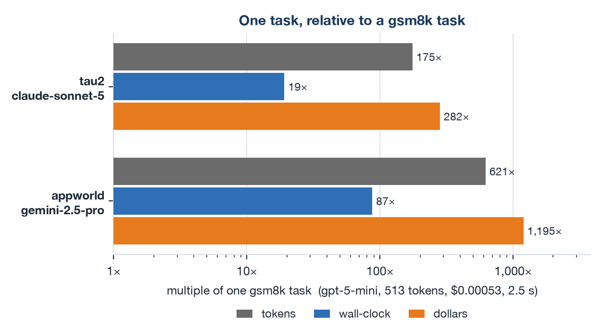
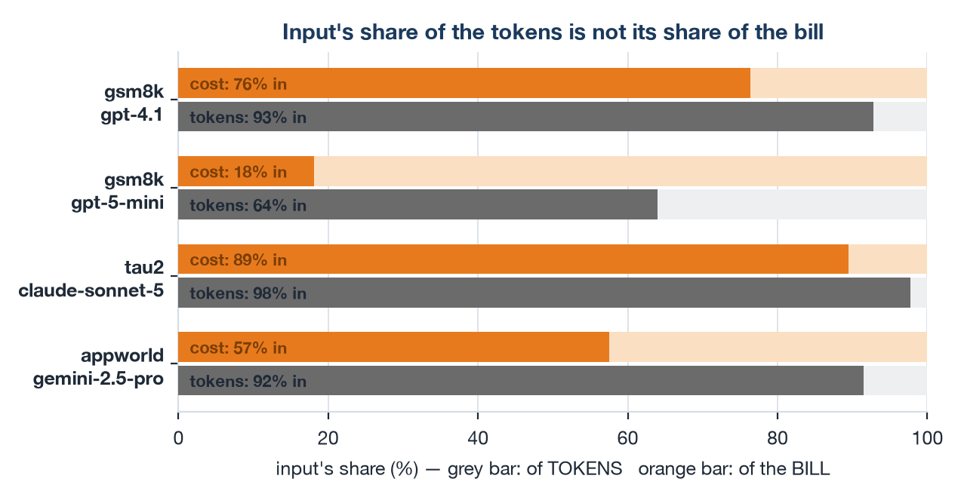
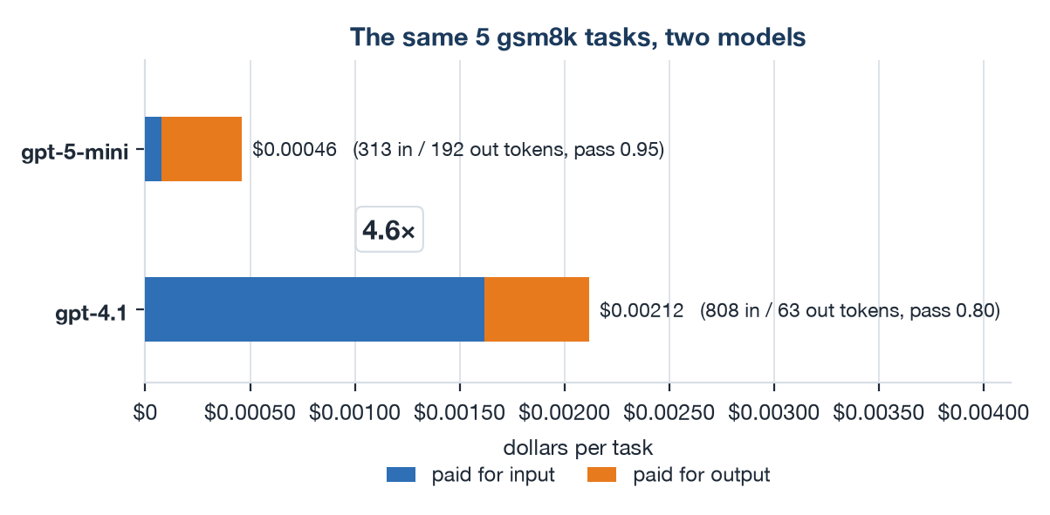
7.8 Token- and Cost-Efficiency — Where the Money Actually Goes
Measured on the v1.35 pair (281 task rows) at the rate card in 7.7 — one take-away per figure
Read the share of the BILL, not the share of tokens
Output is priced 4–8× input on every model we use, so the token split misstates the bill every time: gsm8k on gpt-5-mini is 64% input by tokens and only 18% by cost.
Model choice is settled on the input side
gpt-4.1 costs 4.6× gpt-5-mini on the identical 5 gsm8k tasks, and the input side decides it alone: 21× the input bill, against an output bill the two models split within 24%.
Money climbs the ladder faster than tokens
Money climbs the difficulty ladder faster than tokens do: tau2 is 175× a gsm8k task in tokens but 282× in dollars, appworld is 621× a gsm8k task in tokens but 1,195× in dollars — so a budget scaled off the token ratios is short by 1.6–1.9×.
20

Slide 21
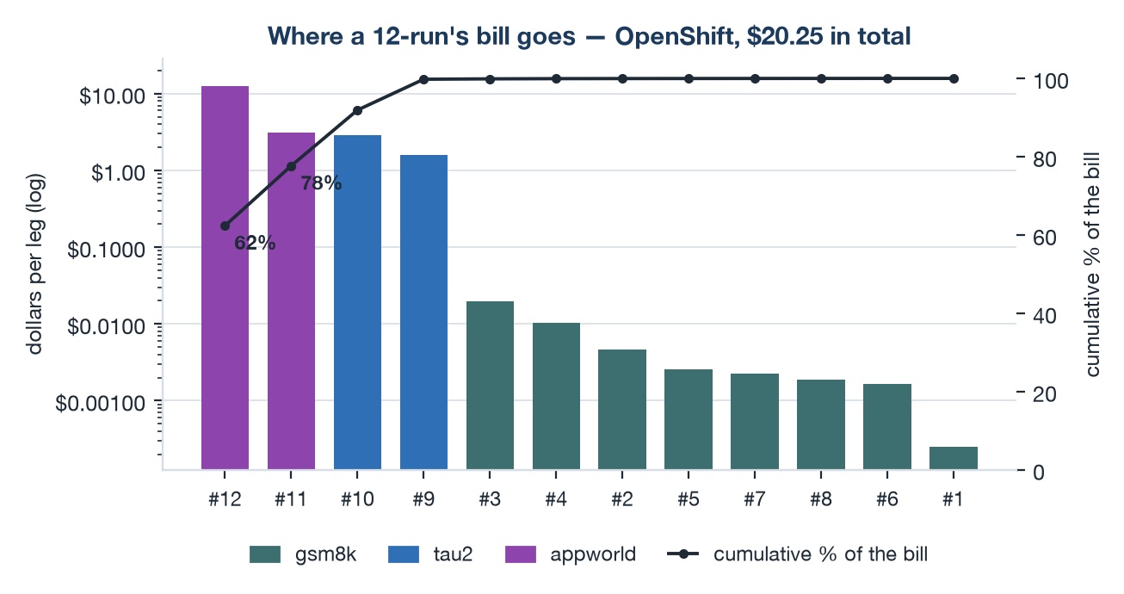
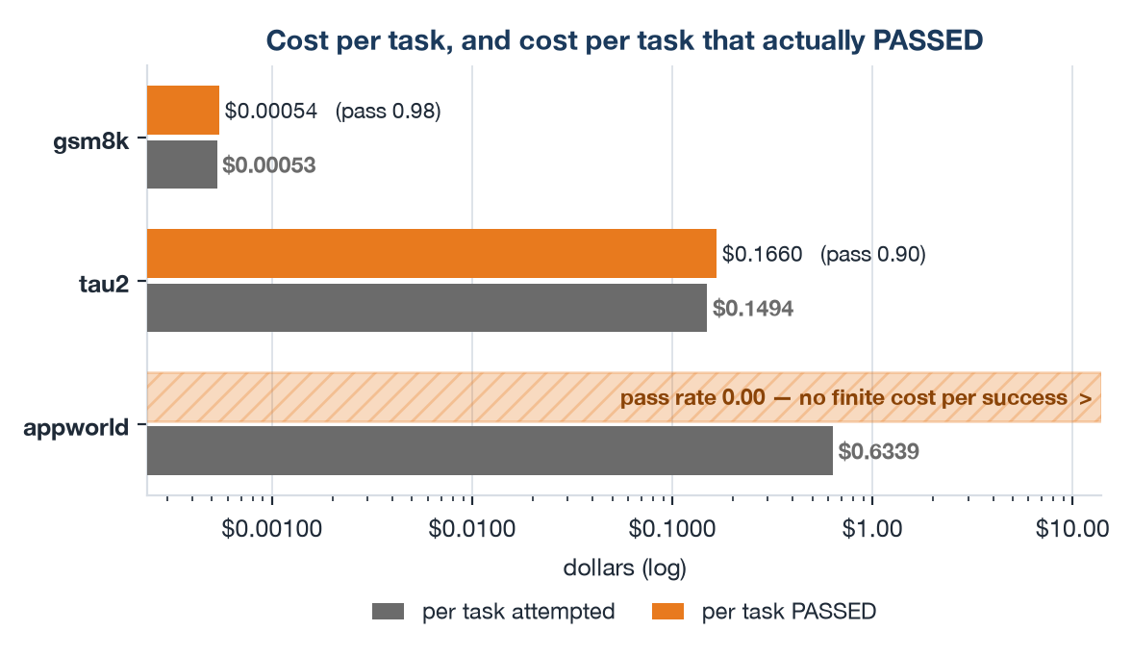
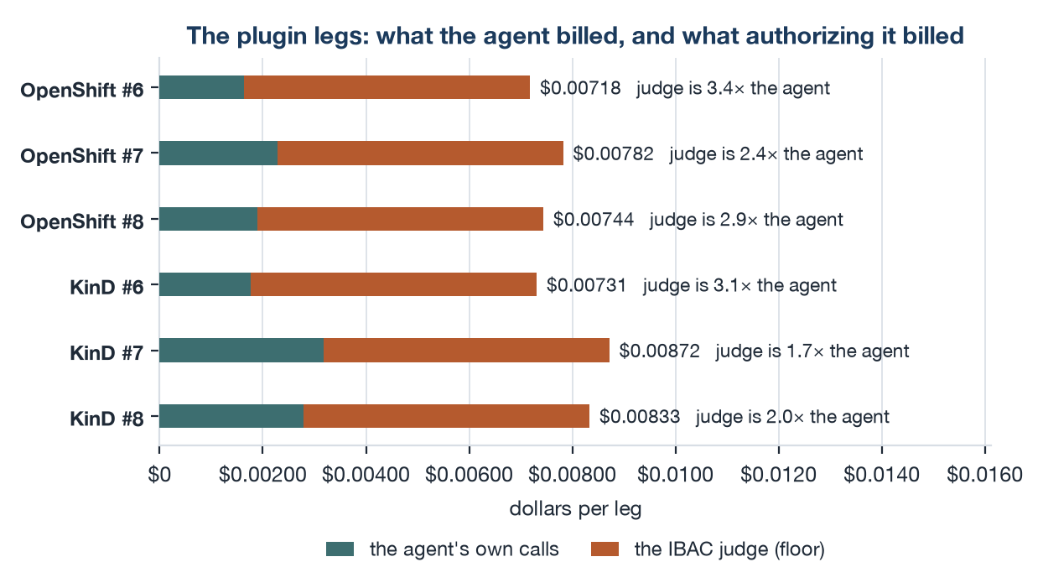
7.9 Token- and Cost-Efficiency — What To Budget, and What To Divide By
Same three rules every time: budget by benchmark, divide by successes, count what is billed off-telemetry
Two legs of twelve are most of the bill
Two of the twelve legs are 78% of a matrix's bill, while all 8 gsm8k legs together are 0.2% of it — so budget by benchmark, not by task count.
On the plugin legs, the check outcosts the work
One IBAC judge completion costs at least $0.00111 — 2.6× the entire gsm8k task on gpt-5-mini it is authorizing — so across legs #6/#7/#8 the judge bills 1.7–3.4× what the agent does.
Efficiency only means anything per SUCCESS
Dividing by the pass rate is what turns a token count into an efficiency figure: gsm8k $0.00053 per task becomes $0.00054 per PASS; tau2 $0.1494 per task becomes $0.1660 per PASS — and appworld has no finite cost per success at all, because it passed nothing.
21

Slide 22
8.1 The Canonical 12-Run Matrix
One fixed set of 12 request bodies — the same on every platform, every version
# | benchmark | tasks | parallel | what it varies
1 | gsm8k | 1 | 1 | baseline — the smoke test
2 | gsm8k | 10 | 1 | volume, still serial
3 | gsm8k | 50 | 4 | volume + concurrency
4 | gsm8k | 5 | 4 | model swap → Azure/gpt-4.1
5 | gsm8k | 5 | 4 | AuthBridge preset: auth-only
6 | gsm8k | 5 | 4 | AuthBridge preset: ibac-only
7 | gsm8k | 5 | 4 | AuthBridge preset: full (enforce)
8 | gsm8k | 5 | 4 | full + per-plugin override ibac:observe
9 | tau2 | 10 | 1 | multi-turn + user simulator
10 | tau2 | 20 | 4 | multi-turn under concurrency
11 | appworld | 5 | 1 | long-horizon, gemini-2.5-pro
12 | appworld | 20 | 4 | long-horizon under concurrency
Why a FIXED matrix: task selection is deterministic, so the same leg run anywhere executes the same tasks in the same order. That is what makes a difference attributable to the platform rather than to the workload. Every leg deploys fresh, because only a NEWLY CREATED pod re-pulls :latest. Driven by one command (reference/run-12.py): about an hour of run time per platform, plus the deploys and ~40 min of gateway-cache gaps. The generated documents in docs/results/ derive every number from the mirrored artifacts.
22

Slide 23
8.2 The 12 Runs Compared — What Each Band Established
Each leg changes exactly ONE thing against the leg before it, so a difference has one candidate explanation
legs | what they parameterize | what having run them established
#1–#3 | gsm8k 1 → 10 → 50 tasks, p=1 → 4 (volume, then concurrency) | the pipeline is stable and DETERMINISTIC: 7 of 12 legs have byte-identical input-token totals across two unlike clusters — the strongest like-for-like check available
#4 | gsm8k on Azure/gpt-4.1 (model swap, identical tasks) | the only clean model comparison in the matrix: gpt-4.1 costs 4.6× gpt-5-mini for no pass-rate gain at this difficulty, and the INPUT side decides it alone (7.7)
#5–#8 | AuthBridge auth-only / ibac-only / full / full + per-plugin override, same 5 tasks | plugin cost lands in the IBAC JUDGE on both clusters: +1.36 s/task on OpenShift, +1.48 s on KinD — the sidecar and every other layer are below the noise floor (9.2)
#9–#10 | tau2 10 → 20 tasks, p=1 → 4 (multi-turn, then under load) | multi-turn works end to end, user simulator included — and tau2 is where pass rates carry information (0.85–1.00 across sides)
#11–#12 | appworld 5 → 20 tasks, p=1 → 4 (long horizon, then under load) | the limits are real and they are UPSTREAM: a 0.00 pass rate, the matrix's only timeout, and ~77% of the whole matrix's bill in two legs
What the matrix as a whole is worth
Not the pass rates — that the SAME 12 request bodies produce comparable measurements on two unlike clusters. On the v1.35 pair: token capture complete (0 of 281 rows lost their usage span), every task reached the model (0 health-probe losses), nothing lost to infrastructure, 8 of 12 pass rates identical. The 4 that differ are each one task — one task moves a 5-task leg by 0.20.
So read the per-CAUSE table, then the rate
A task lost to a socket and a task lost to a wrong answer land in the same denominator and only one says anything about the agent — which is why every report buckets them (OCP/KinD: per-task timeout 0/1, upstream agent defect 4/4, wrong answer 1/1). Two further limits: absolute LATENCY travels only approximately (up to 1.7× apart between our clusters), and the DEPLOY, not the task, is the unit of replication — adding tasks tightens the wrong interval.
23

Slide 24
8.3 What the 12 Runs Measured
v1.35 on OpenShift (single-cluster, ykt3) — 141 tasks, all 12 legs succeeded
# | bench | pass | err | wall | input tokens
1 | gsm8k | 1.00 | 0/1 | 4 s | 320
2 | gsm8k | 1.00 | 0/10 | 29 s | 3,166
3 | gsm8k | 1.00 | 0/50 | 34 s | 15,684
4 | gsm8k | 0.80 | 0/5 | 9 s | 3,908
5 | gsm8k | 1.00 | 0/5 | 6 s | 1,564
6 | gsm8k | 1.00 | 0/5 | 6 s | 1,564
7 | gsm8k | 0.80 | 1/5 | 9 s | 1,564
8 | gsm8k | 1.00 | 0/5 | 7 s | 1,564
9 | tau2 | 0.90 | 0/10 | 511 s | 936,612
10 | tau2 | 0.90 | 0/20 | 282 s | 1,695,959
11 | appworld | 0.00 | 1/5 | 1284 s | 1,420,531
12 | appworld | 0.00 | 3/20 | 1402 s | 5,949,228
gsm8k nearly saturates: 6 of 8 legs at 1.00
#4's gpt-4.1 swap and #7 each lose one task of five — two of 86, both the model's own answers. Read the CAUSE, not the rate: nothing on this side was lost to the plumbing.
tau2 is the leg that moves
0.90 and 0.90 here, 1.00 and 0.85 on KinD. Episodes are nondeterministic: at n=10 one task is worth 0.10, so it cannot resolve less.
appworld 0.00 is the honest result
Runs complete, tokens record, evaluation says the goal was not met — most tasks self-declare finish (41 of 49, both platforms). All 4 errors here are the agent's own defect; none hit the 600 s timeout. err reads run.json.
0 rows lost attribution, 0 tasks lost to infrastructure
No task died to the health probe, the gateway, the judge or transport. v1.35 caps each agent LLM call at 120 s, so a stalled gateway call is cut and retried, not waited out.
10.0M input / 728k output tokens
over 3,583 s of run time — appworld alone is 73% of the input, on 25 of 141 rows.
24

Slide 25
9.1 OpenShift vs KinD — Like-for-Like
Same 12 request bodies, same Service version, verified-identical instance config
# | bench | pass OCP | pass KinD | in OCP | in KinD | input
1 | gsm8k | 1.00 | 1.00 | 320 | 320 | identical
2 | gsm8k | 1.00 | 1.00 | 3,166 | 3,166 | identical
3 | gsm8k | 1.00 | 1.00 | 15,684 | 15,684 | identical
4 | gsm8k | 0.80 | 0.80 | 3,908 | 4,177
5 | gsm8k | 1.00 | 1.00 | 1,564 | 1,564 | identical
6 | gsm8k | 1.00 | 0.80 | 1,564 | 1,564 | identical
7 | gsm8k | 0.80 | 1.00 | 1,564 | 1,564 | identical
8 | gsm8k | 1.00 | 1.00 | 1,564 | 1,564 | identical
9 | tau2 | 0.90 | 1.00 | 936,612 | 916,576
10 | tau2 | 0.90 | 0.85 | 1,695,959 | 1,726,957
11 | appworld | 0.00 | 0.00 | 1,420,531 | 1,564,276
12 | appworld | 0.00 | 0.00 | 5,949,228 | 5,349,900
8 of 12 pass rates identical; the 4 deltas split 2–2
Each is one task. The per-CAUSE table says why: wrong answers 1 to 1, agent defects 4 to 4, one appworld timeout on KinD — and nothing lost to infrastructure on either side.
7 legs byte-identical on input tokens
320 / 3,166 / 15,684 / 1,564 ×4. Deterministic task selection plus the same model means identical work — the strongest available proof this is a like-for-like comparison, not merely a similar one.
#6 and #7 are in that set with different pass rates
Identical input tokens with different pass rates is not a contradiction: same prompts, different answers. Tokens prove the WORK matched; they say nothing about whether it was right.
Wall time: 3,583 s OCP vs 3,791 s KinD
Within 6% overall. The short gsm8k legs differ by up to 2× either way (seconds, mostly startup); the long tau2 and appworld legs stay within 15%.
0 lost-attribution rows and 0 probe failures on both sides
141 OCP rows against 140 KinD. The one-row gap is a KinD appworld task that timed out before the Service wrote a row — not lost telemetry.
25

Slide 26
9.2 What AuthBridge Costs — Almost All of It Is the Judge
The designed 13-leg experiment (n=50, crossover replicates, gateway cache spaced), v1.35
non-LLM s / task (steady) | OpenShift | KinD | OCP step | KinD step
baseline (AuthBridge off) | 0.168 | 0.097 | — | —
auth-only | 0.214 | 0.130 | +0.05 | +0.03
ibac-only | 1.569 | 1.610 | +1.36 | +1.48
full (auth + ibac) | 1.584 | 1.602 | +0.01 | −0.01
full + ibac:observe | 1.583 | 1.607 | −0.00 | +0.00
Both clusters put the cost in the JUDGE
+1.36 s/task on OpenShift, +1.48 s on KinD; the sidecar's presence costs 0.03–0.05 s and every other layer is noise. With the judge engaged the same condition lands within 3% on the two clusters (1.57 / 1.61 s). Still name the cluster: on KinD ~0.26 s of each judged call is the node's DNS being retried.
Not a timeout — we checked
A timeout piles values on a round number. Judged tasks run 0.21–9.63 s (OpenShift) and 0.12–7.75 s (KinD) around a ~1.6 s median, no 0.1 s bin above 12%: variable latency. The tail is the judge, itself an LLM call — so engaging it costs reproducibility, not only latency.
does the finding travel? | OpenShift | KinD | travels?
Which layer costs anything | the judge | the judge | YES
Serial tool calls judged (p=1) | 10 / 10 | 10 / 10 | YES
Judged / tool-call ratio, n=50 | 0.94–1.00 | 0.96–1.02 | YES
tau2 measured / projected | 1.66× | 2.01× | PARTLY
Between-deploy noise floor | 0.02 s | 0.12 s | NO
Sidecar CPU / memory | no data | no data | —
One flag decides whether the study measures anything
Every gsm8k leg sends the SAME 50 prompts and the gateway replays completions for ~10 min: unspaced, later legs measure the cache, in run order — the shape of a plugin effect. BM_CACHE_GAP=900 spaces them. The check needs no statistics: the conditions NEST, so no sidecar leg can beat a sidecar-free one. Clear by 1.3× on both clusters.
The deploy is the unit of replication, not the task
A per-task interval measures variance WITHIN one deploy. The honest floor is between two deploys of one condition, and it exceeds every step but the judge's — so presets cannot be RANKED at any task count; add deploys, not tasks. Cut the other way: at σ ≈ 0.02 s (OpenShift) and 0.13 s (KinD) two deploys already resolve a 1 s effect, so the small steps are genuinely small rather than unresolved.
26

Slide 27
10. What the Service Can & Cannot Enact
The HTTP-only boundary, made explicit
✓ Enacts over HTTP
✗ Out-of-band (reports, doesn't do)
  • Deploy MCP tool + A2A agent (CPU/mem, image, env)
  • Deploy-time model swap (per-experiment agent)
  • authbridge_enabled → inject the sidecar (layer-2)
  • plugin_preset / plugins / on_error → AuthBridge layer-3
    → pluginPreset/plugins/onError; operator renders ConfigMap
  • Run benchmark sessions; collect pass/fail + latency
  • Emit + read MLflow traces; export to S3
  • Service-owned config: MLflow + S3 via PUT /config
    benchmarker only
  • Cluster Secrets (hf-secret, openai-secret)
    operator provisions; run precheck returns 424 naming it
  • AuthBridge CLUSTER config — ibac judgeEndpoint / judgeModel
    in the platform-config ConfigMap, not the agent API
  • Any cluster-level API call — Rossoctl does these server-side
Principle:
  • Never silently ignore an un-enactable request —
    precheck (424) or reject (422), with an actionable reason
Cluster-agnostic by construction: the same chart installs on KinD and OpenShift, with the Service and its workloads on one cluster.
27

