Slide 1
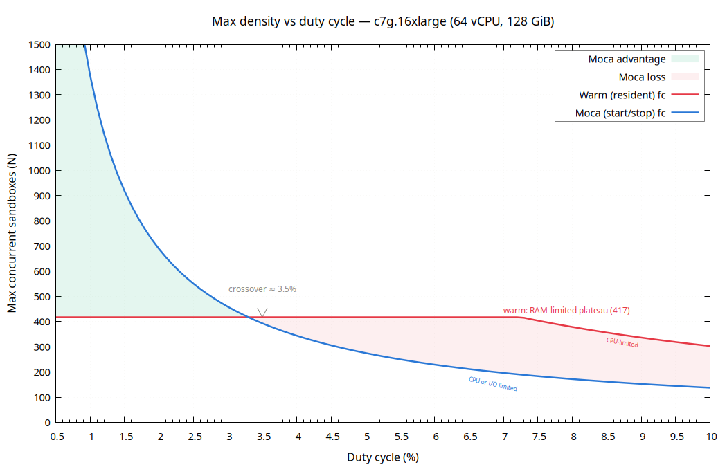
Max Sandbox Density vs Duty Cycle — c7g.16xlarge (64 vCPU, 128 GiB)
Warm: CPU = N × D × 2.112 vCPU; RAM = N × 0.307 GiB (duty-invariant). Moca: CPU = N × D × 4.65 vCPU; RAM = N × 0.07 + N × D × 1.16 GiB. Crossover at D ≈ 3.5 %: below this duty, Moca packs more sandboxes; above, warm wins. Source: moca-side-by-side-report.md

