Slide 1
FeeLens
What a prospect's portfolio really costs, with the source of every figure.
Proposal for Safe Capital · how it works, how accurate it is, how to use it, where it runs, what it costs
Lugano, November 2026
Notes:
Goal of the meeting: walk through the app step by step, say honestly what is ready and what is not, and propose a supervised pilot.

Slide 2




IN SHORT
Four things to know
What it does
Every figure has its source
Reads statements, cost reports, price lists and KIDs from any bank. Works out the all-in annual cost and compares it with your proposal.
One click on a number shows the calculation and the exact spot on the page it came from. A missing cost stays missing, never zero.
It assists the analyst, it does not replace them
Proposal: a 3-month pilot
Finds 87% of fees on real pages (91% on pages it had never seen). A person accepts each figure before it counts, and two people check every report.
On a Safe Capital machine, 10 prospects, CHF 3,000. Then an annual licence from CHF 9,000.

Slide 3



THE PROBLEM
A client's costs sit in three places
Debited from the account
Inside the products
In the trades
Management or advisory, custody, account fees, VAT. In cash statements and the annual cost report.
Ongoing costs of funds and ETFs (TER/OCF), the margin in structured products. Never on the account: they are in the KID.
Brokerage, FX, stamp duty, transfer fees. In the price list of the bank that books the account.
Today an analyst spends hours putting these pieces together, and a cost they cannot find often ends up as zero. FeeLens collects them, cites them and says what is missing.

Slide 4






HOW IT WORKS
Your tariff once, then five steps for every client
1
2
3
4
5
Your tariff
Documents
Check values
Costs
Compare
Report
Once only: Safe Capital's fees, custody, FX, VAT.
Upload the client's PDFs (scans too) or Excel files.
Every value read, boxed on the page. Accept, correct or reject.
Known annual cost, what is missing, points to review.
Same holdings at your tariff. Saving as a lower bound.
A senior approves; PDF in Italian or English.
No source, no verified figure.
Missing is never zero.
No comparable service, no savings claim.
The three product rules

Slide 5
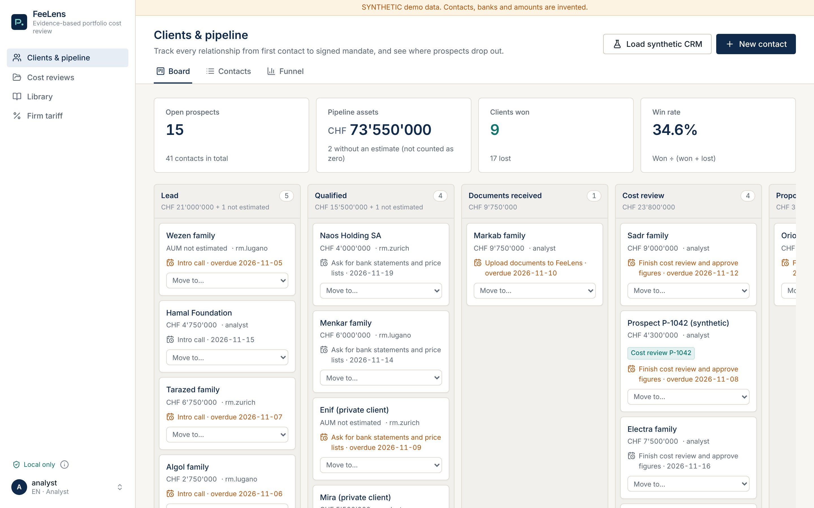
TUTORIAL · 1 CLIENTS
Start from your clients: every relationship and where it stands
1
"Cost reviews" in the menu
3
All cost reviews in progress, with assets, known cost and saving.
1
2
The "Cost review" chip
One click opens that client's review.
3
"New contact"
A prospect starts here; the funnel shows where prospects drop out.
2
Notes:
The CRM is the home page, as requested. The contacts shown are synthetic.

Slide 6
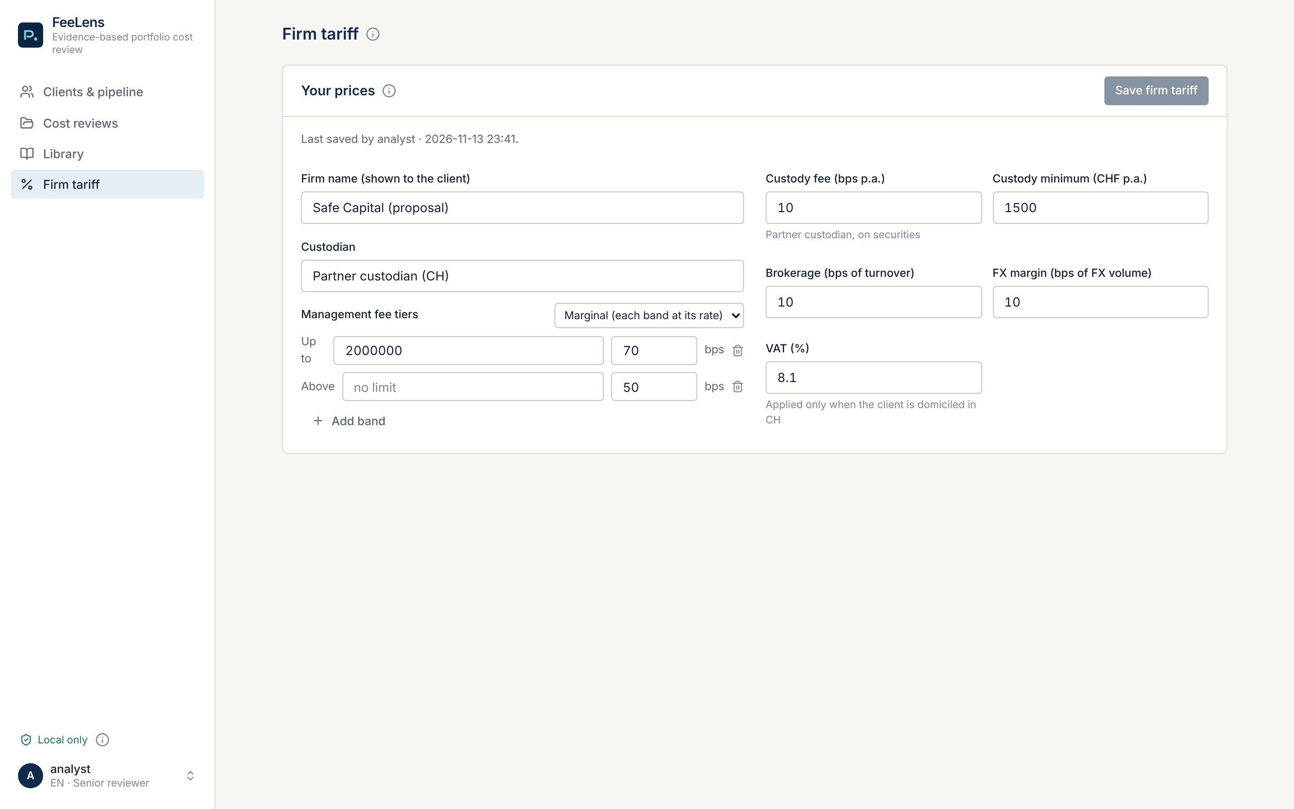
TUTORIAL · 2 YOUR TARIFF
Safe Capital's tariff is entered once
1
"Firm tariff" in the menu
4
Your prices, for the whole firm.
1
2
Management fee bands
3
Marginal or on the whole portfolio, as in your agreement.
2
3
Custody, trading, FX, VAT
With the partner custodian's annual minimum.
4
"Save firm tariff"
Seniors only. Every new review starts from it; one case can still be adjusted.
Demo prices, not Safe Capital's tariff.
Notes:
Prices shown: synthetic demo tariff. In the pilot we enter your real tariff together.

Slide 7
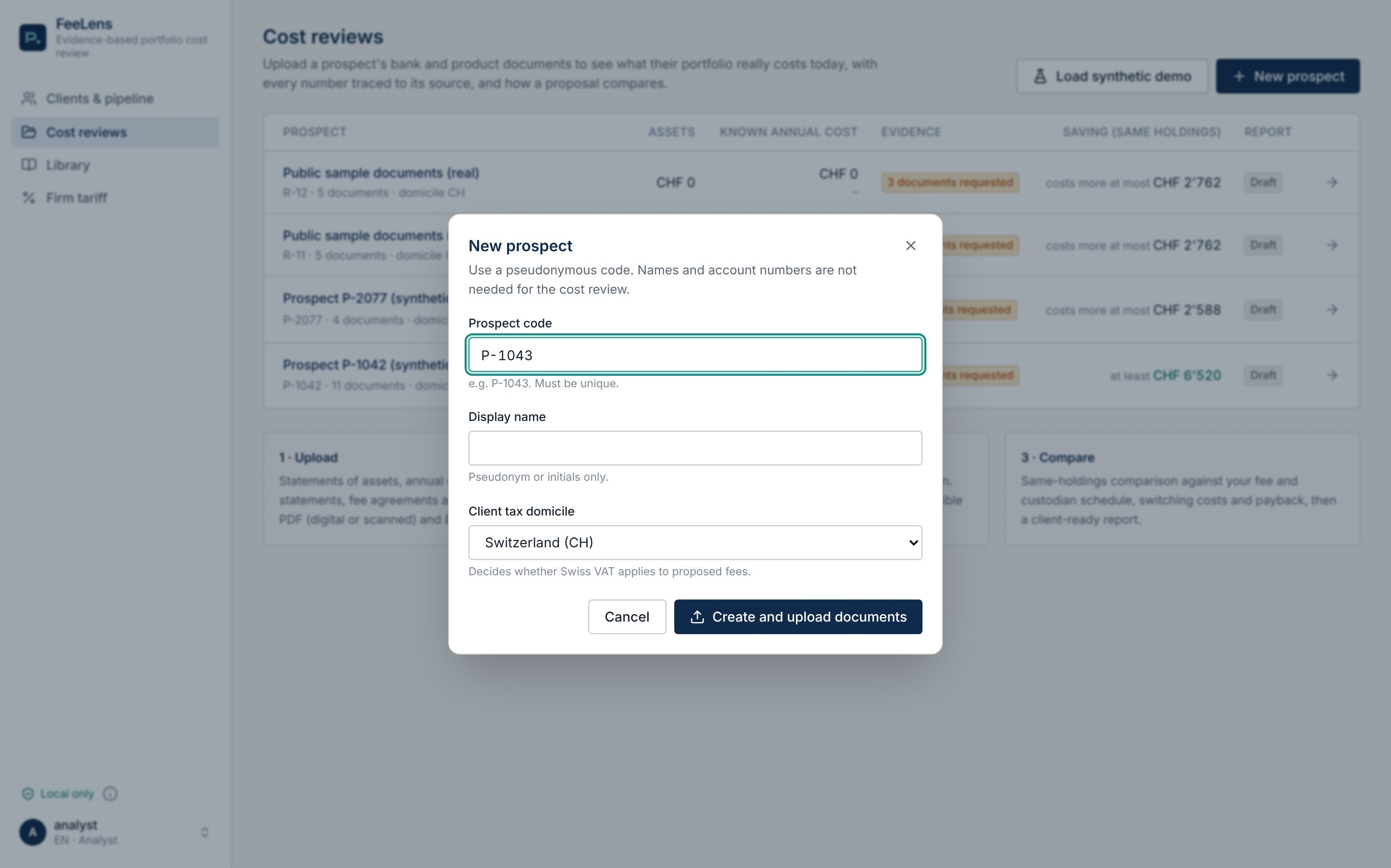
TUTORIAL · 3 NEW REVIEW
New review: a code, not a name
1
Type a code, e.g. P-1043
Names, account numbers and IBANs are not needed. Less personal data, less risk.
2
Pick the tax domicile
Decides whether 8.1% Swiss VAT applies to the proposed fees.
1
3
"Create and upload documents"
Opens the documents page straight away.
2
3

Slide 8
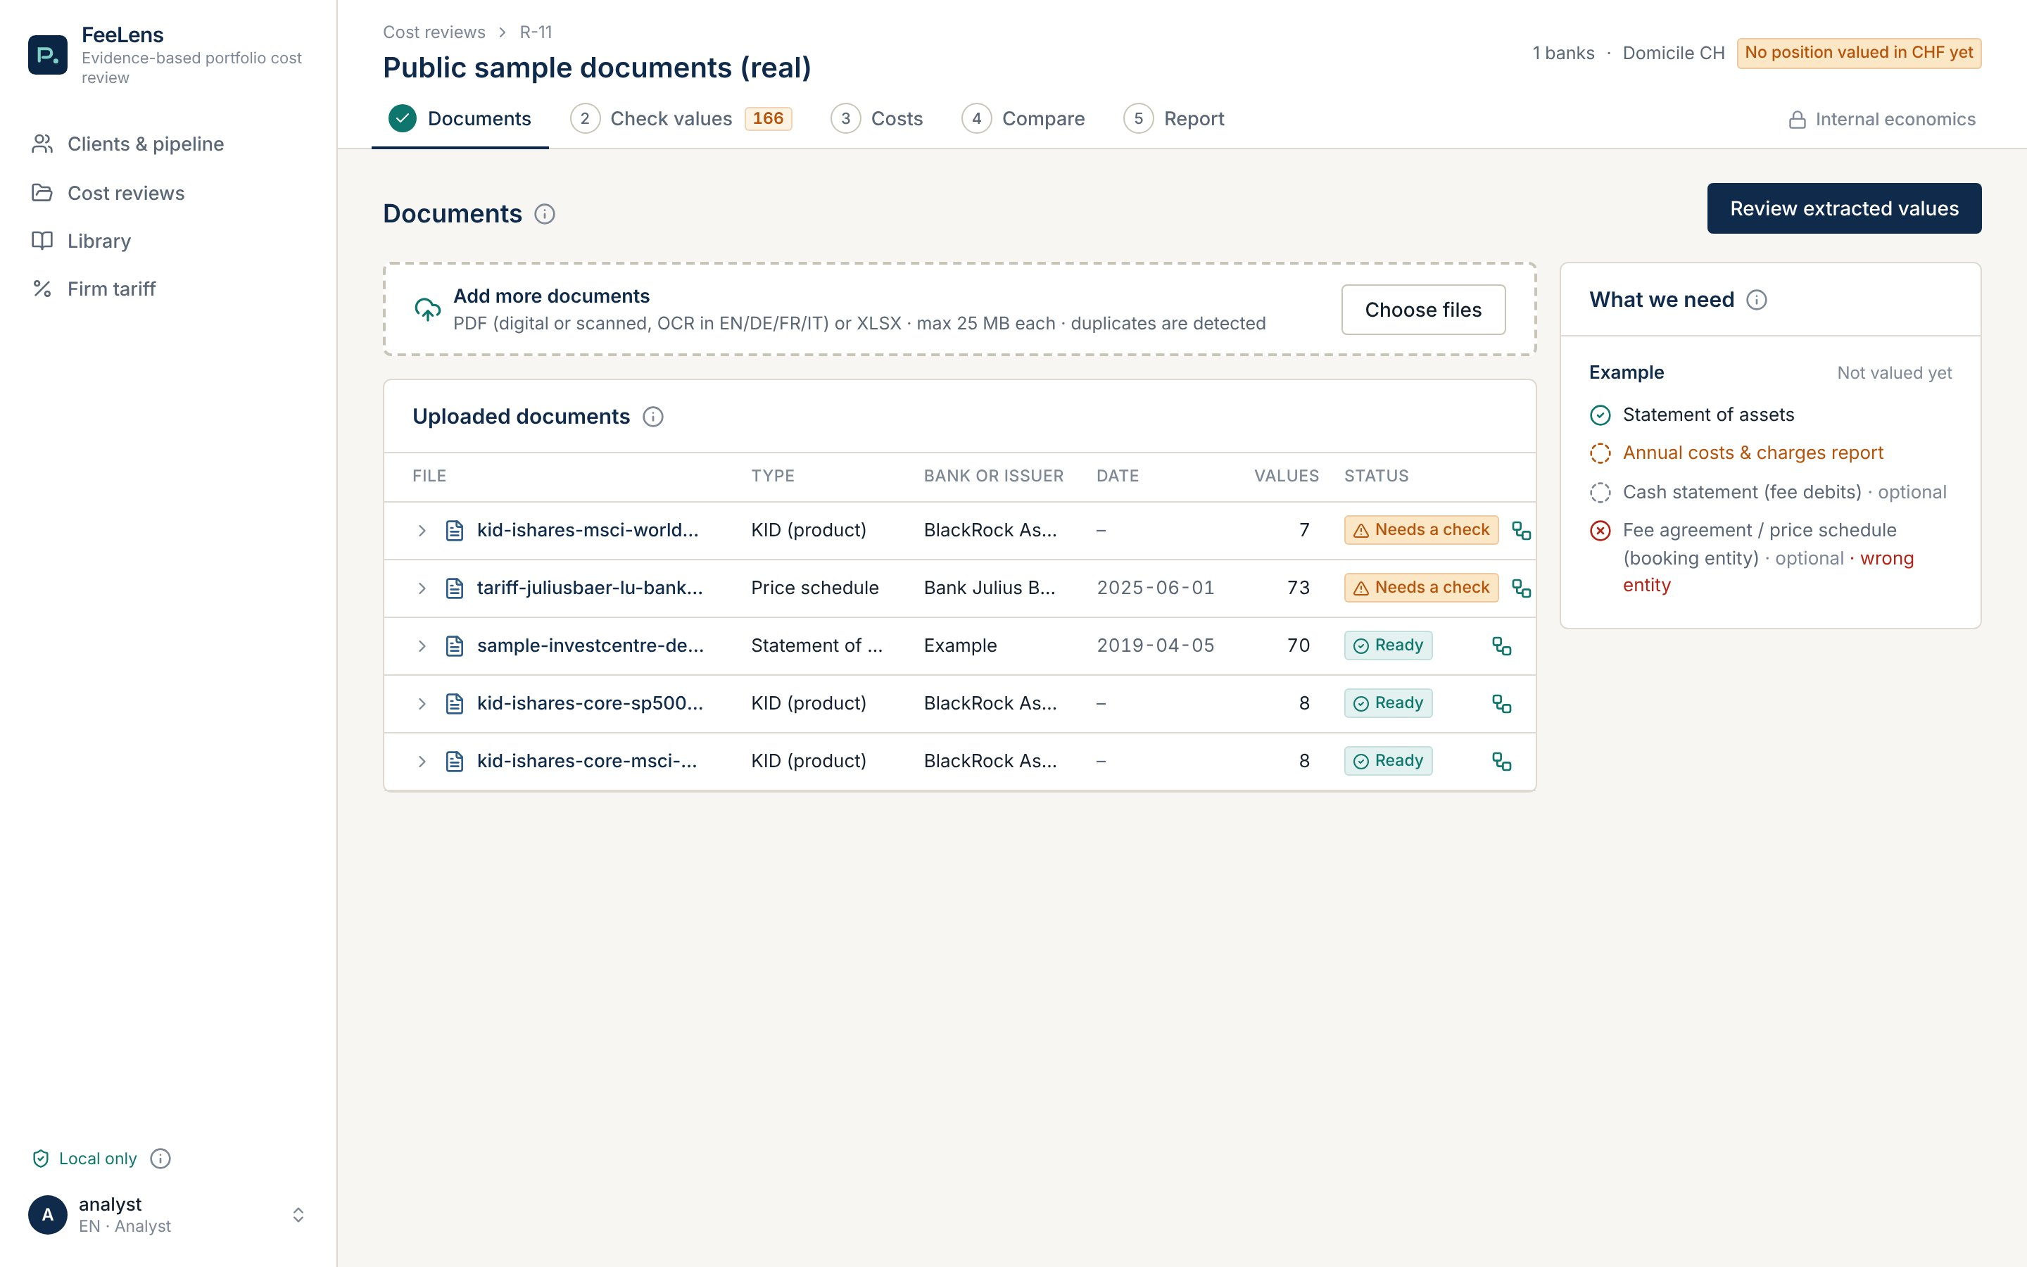
TUTORIAL · 4 DOCUMENTS
Upload everything: one line per file, with what was read
1
"Choose files" or drag
Digital or scanned PDFs (OCR in IT, DE, FR, EN) and Excel. Duplicates are detected.
4
1
2
Type, bank, date, values
Recognised on their own: statement, KID, price list... and how many values were read.
3
2
3
"Needs a check" in amber
A scan or a price list with several columns asks for a confirmation.
4
"Review extracted values"
The next step.
Real public documents: AJ Bell demo report, iShares KIDs (one re-scanned as an image), Julius Baer Europe price list.

Slide 9
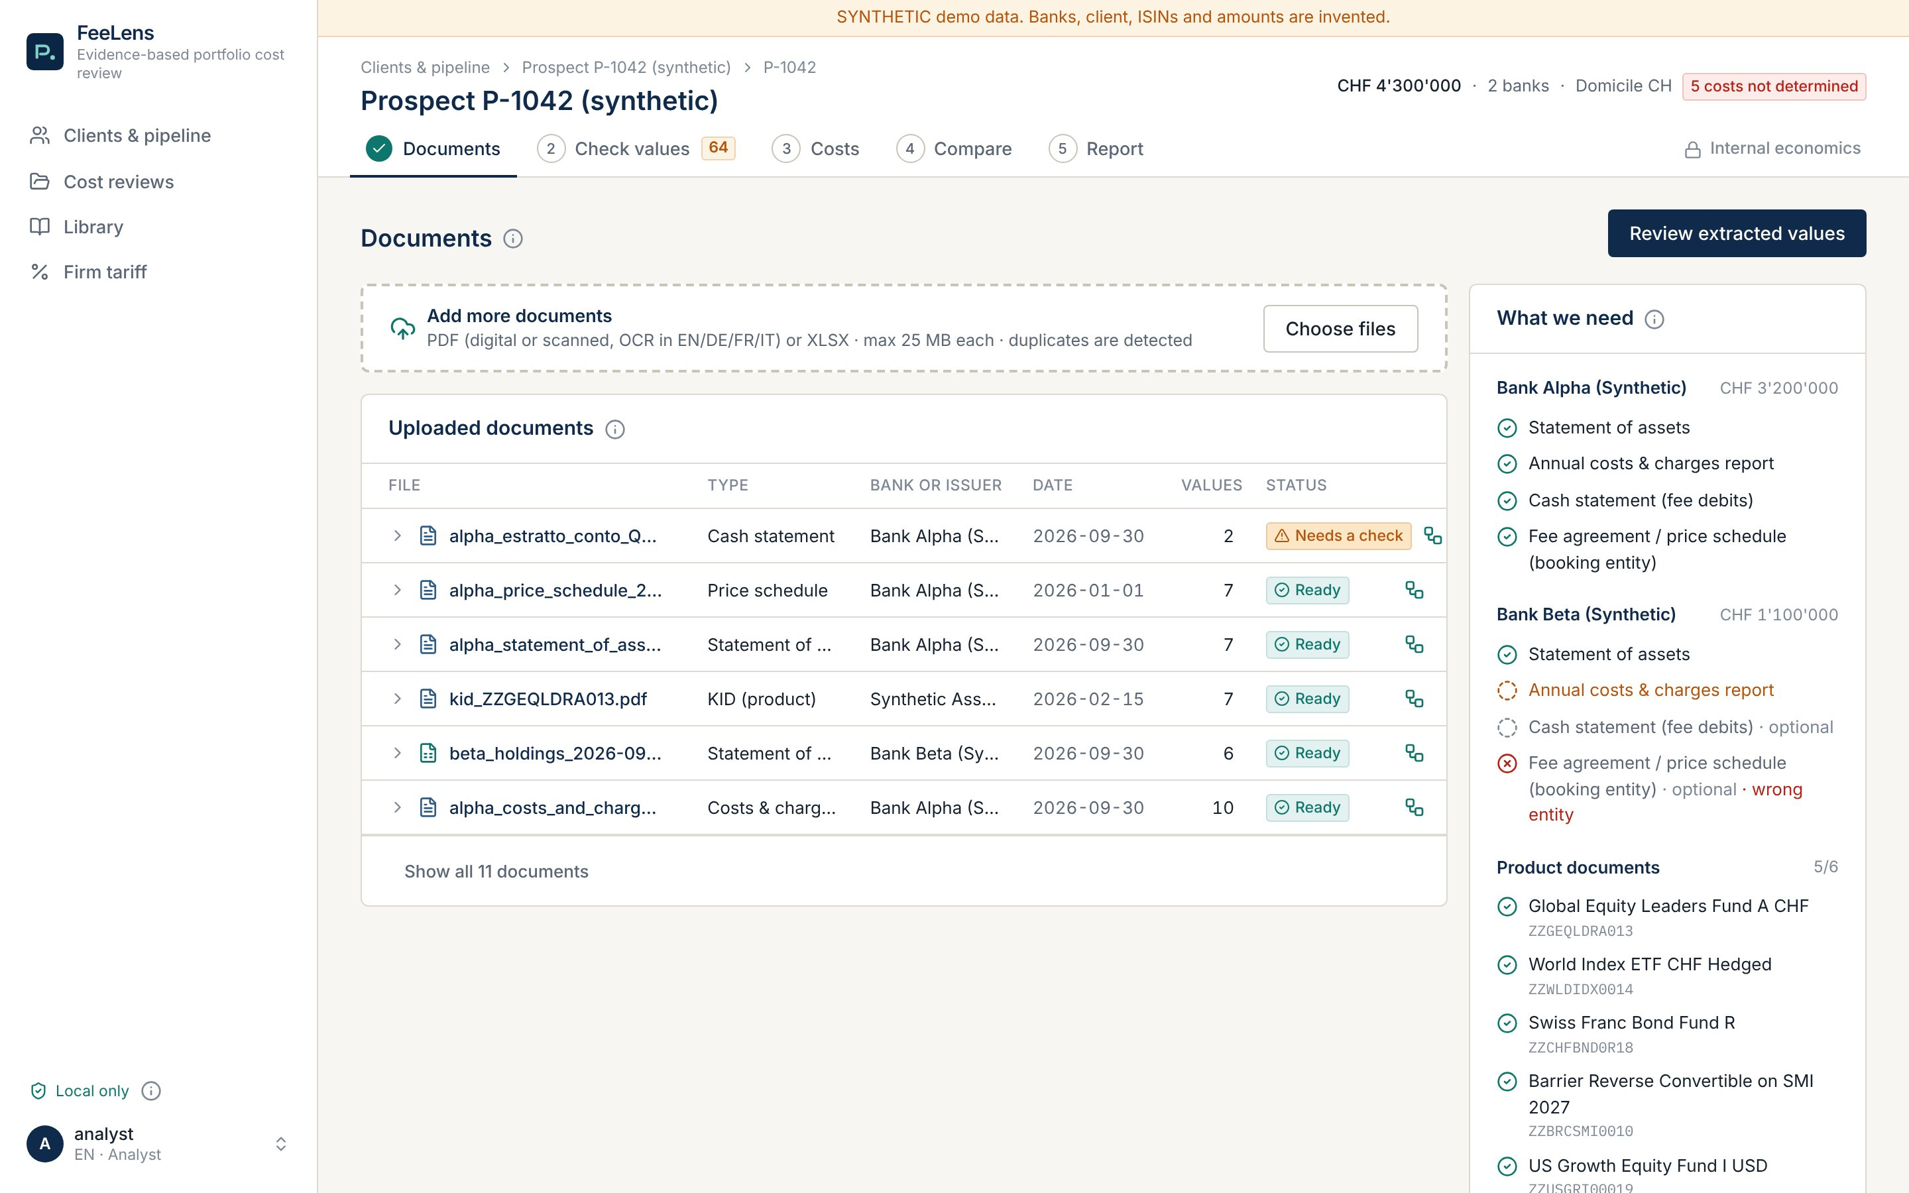
TUTORIAL · 4 DOCUMENTS
"What we need": the missing documents, bank by bank
1
Green tick = document present
Statement, cost report, cash statement, price list per bank, KID per product.
2
Amber circle = missing
1
Here the second bank's cost report: those costs stay "not determined".
3
"Wrong entity"
2
The price list belongs to another entity of the bank: tariffs apply only where the account is booked.
3
Synthetic prospect P-1042

Slide 10
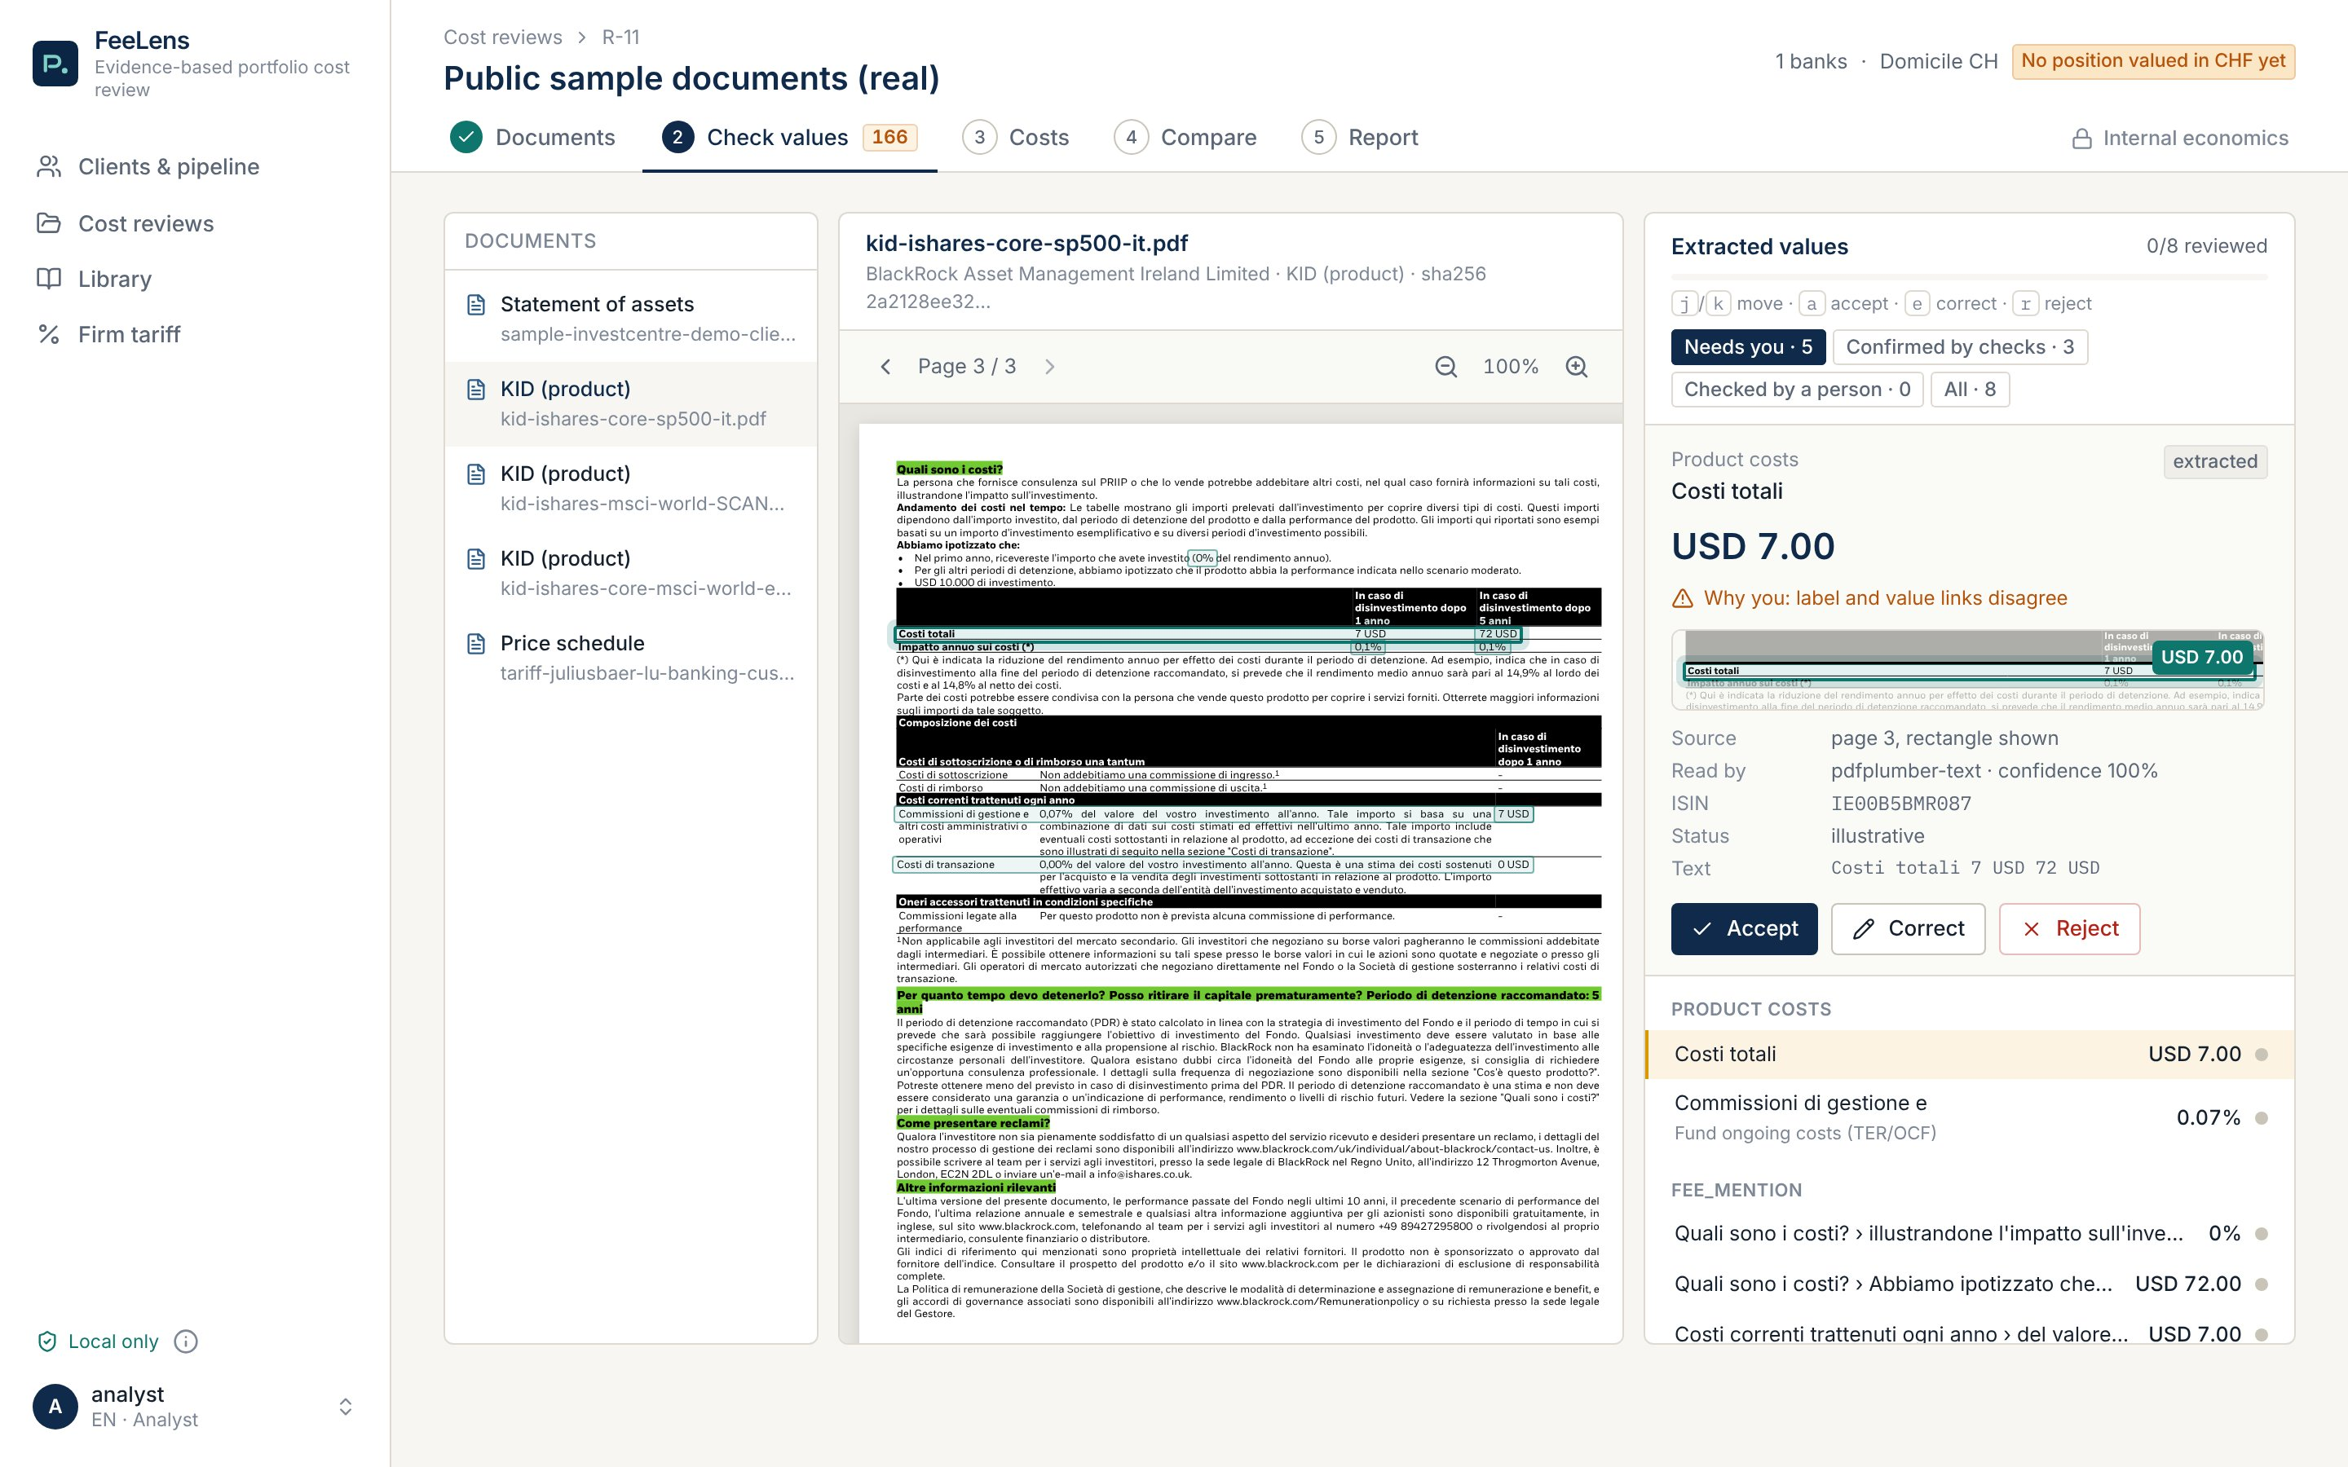
TUTORIAL · 5 CHECK VALUES
Values that need you come first, each on its page
1
"Needs you · 5"
Doubts first; values the checks confirmed are kept apart.
1
The box on the page
2
3
Shows the exact row the value came from.
2
3
Value and reason
"Costi totali USD 7.00" is an amount on a USD 10,000 example, not a rate. Label and value disagree, so the analyst decides.
4
4
"Reject"
The example amount stays out of every total. The right rate, 0.07%, is below. Keys: a, e, r, j/k.
Real public documents: KID iShares Core S&P 500 UCITS ETF (IT), BlackRock.
Notes:
A real KID (iShares Core S&P 500, Italian). The app keeps the amount's currency and does not treat it as an annual cost: it flags it and asks a person.

Slide 11
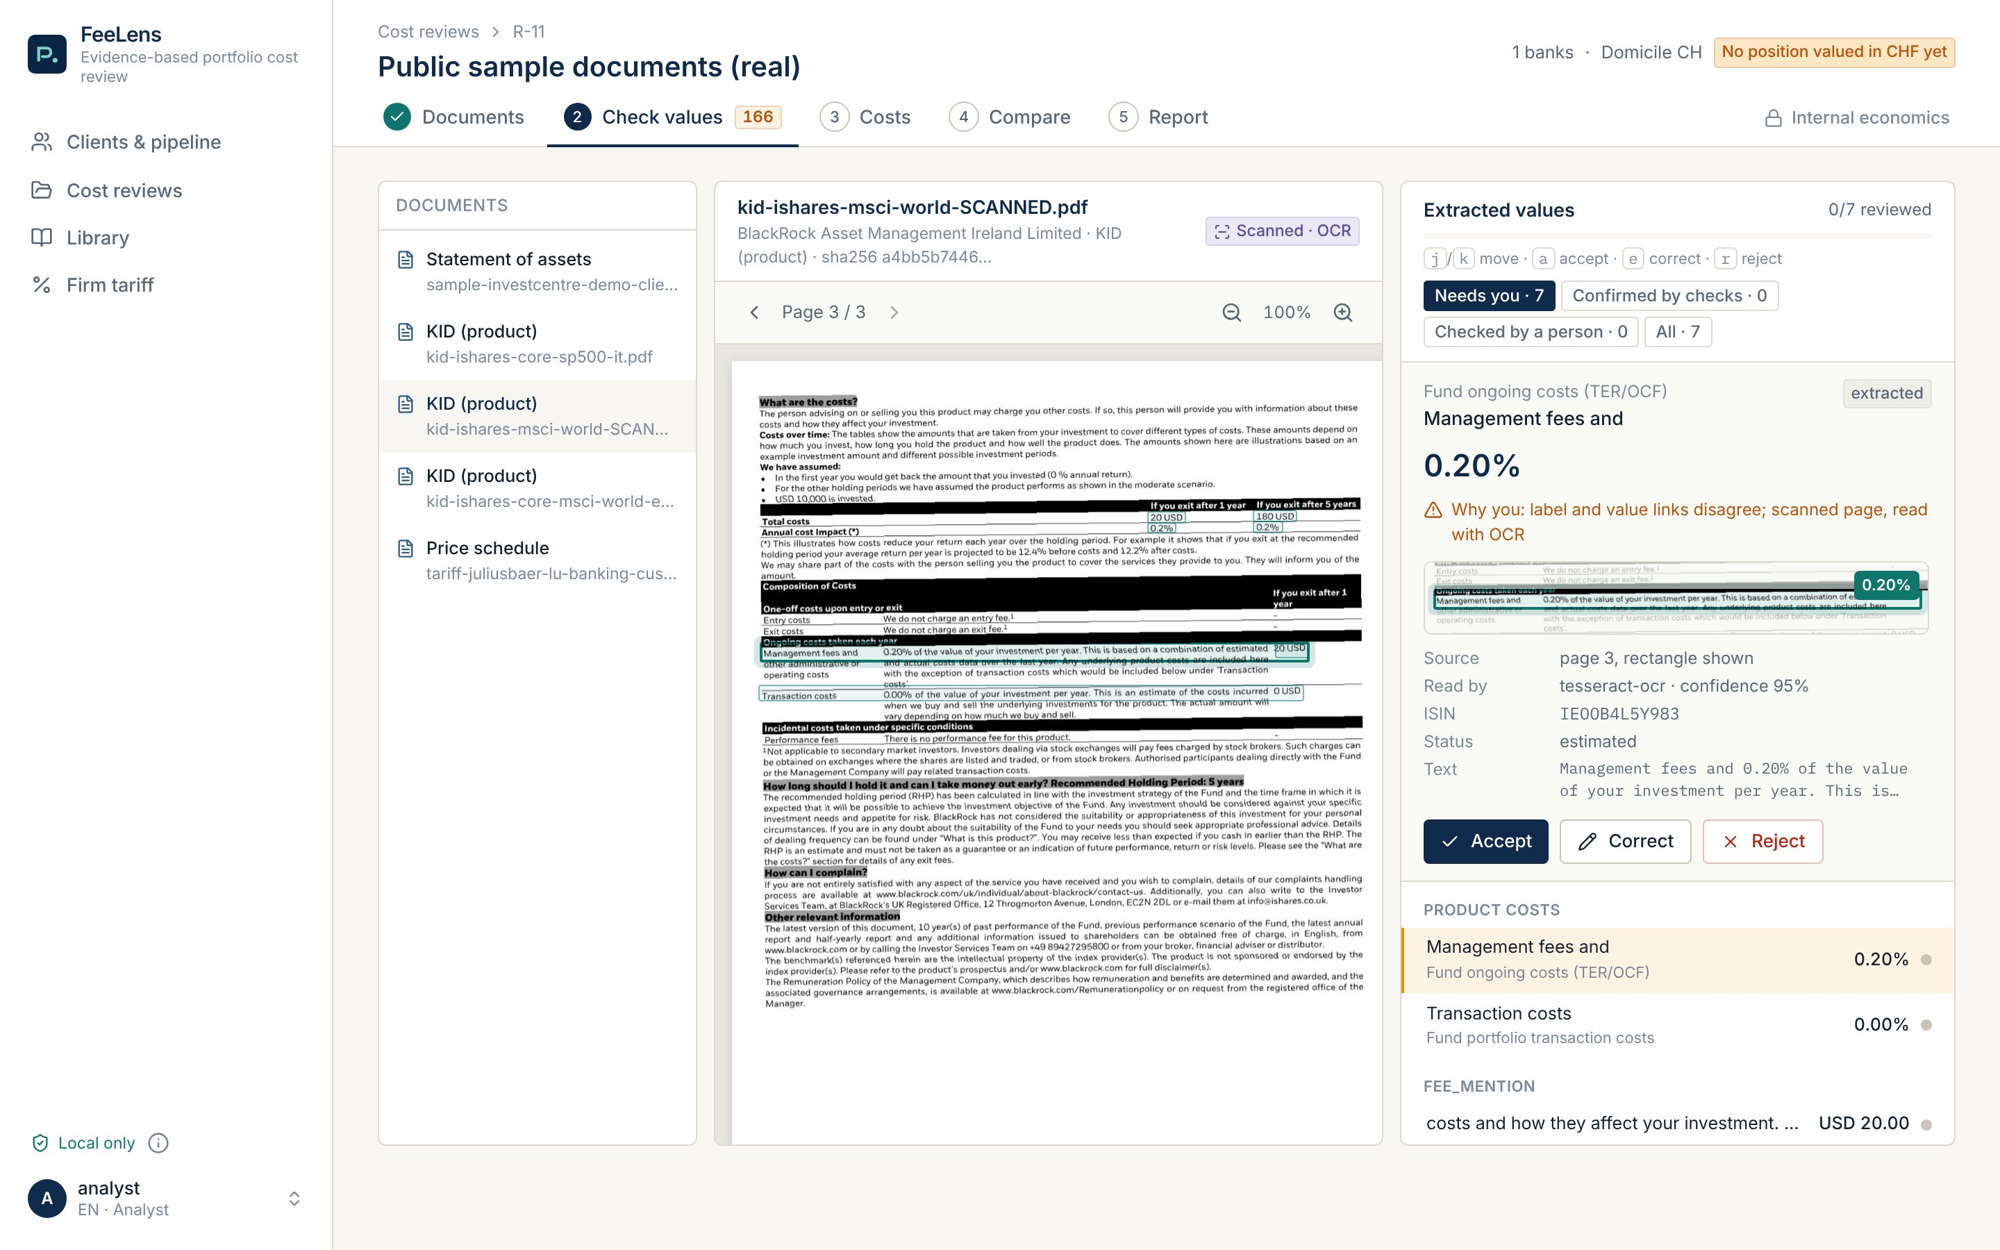
TUTORIAL · 5 CHECK VALUES
Edge case: a scanned page
1
"Scanned · OCR"
The text is rebuilt from the image, on your machine, with no outside service.
1
2
Who read it and how sure
tesseract-ocr, 95%. Status "estimated" until a person confirms.
3
Compare with the image
3
2
0.20%: correct. Accept and move on.
Real public documents: iShares Core MSCI World KID (EN), printed to an image to simulate a scan.

Slide 12
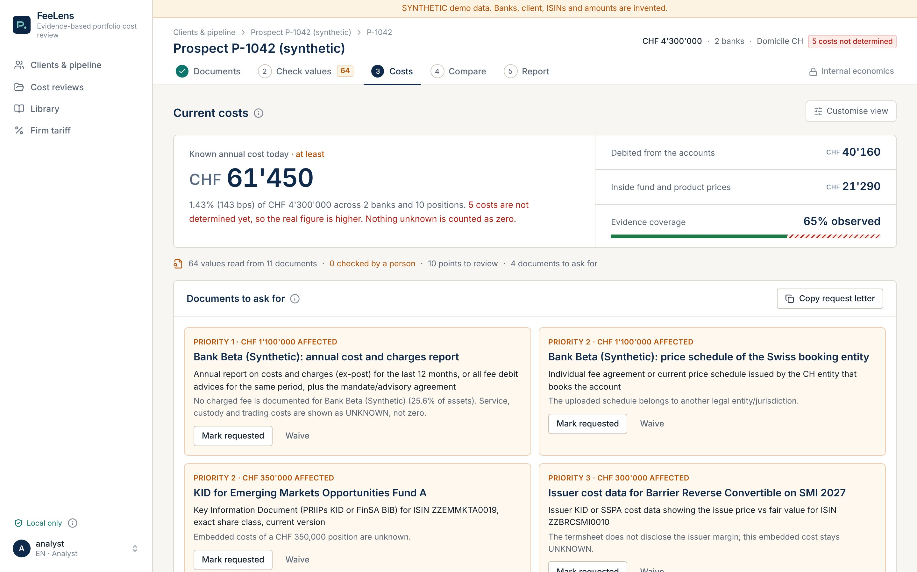
TUTORIAL · 6 COSTS
The answer first, then the documents to ask for
1
Known annual cost
CHF 61,450, 1.43% of assets, "at least".
2
5 costs not determined
1
The true cost is higher: we do not invent it or count it as zero.
2
3
3
Evidence coverage
4
How much of the cost comes from an actual document.
4
"Documents to ask for"
By priority, with the assets affected. "Copy request letter" for the client or the bank.

Slide 13
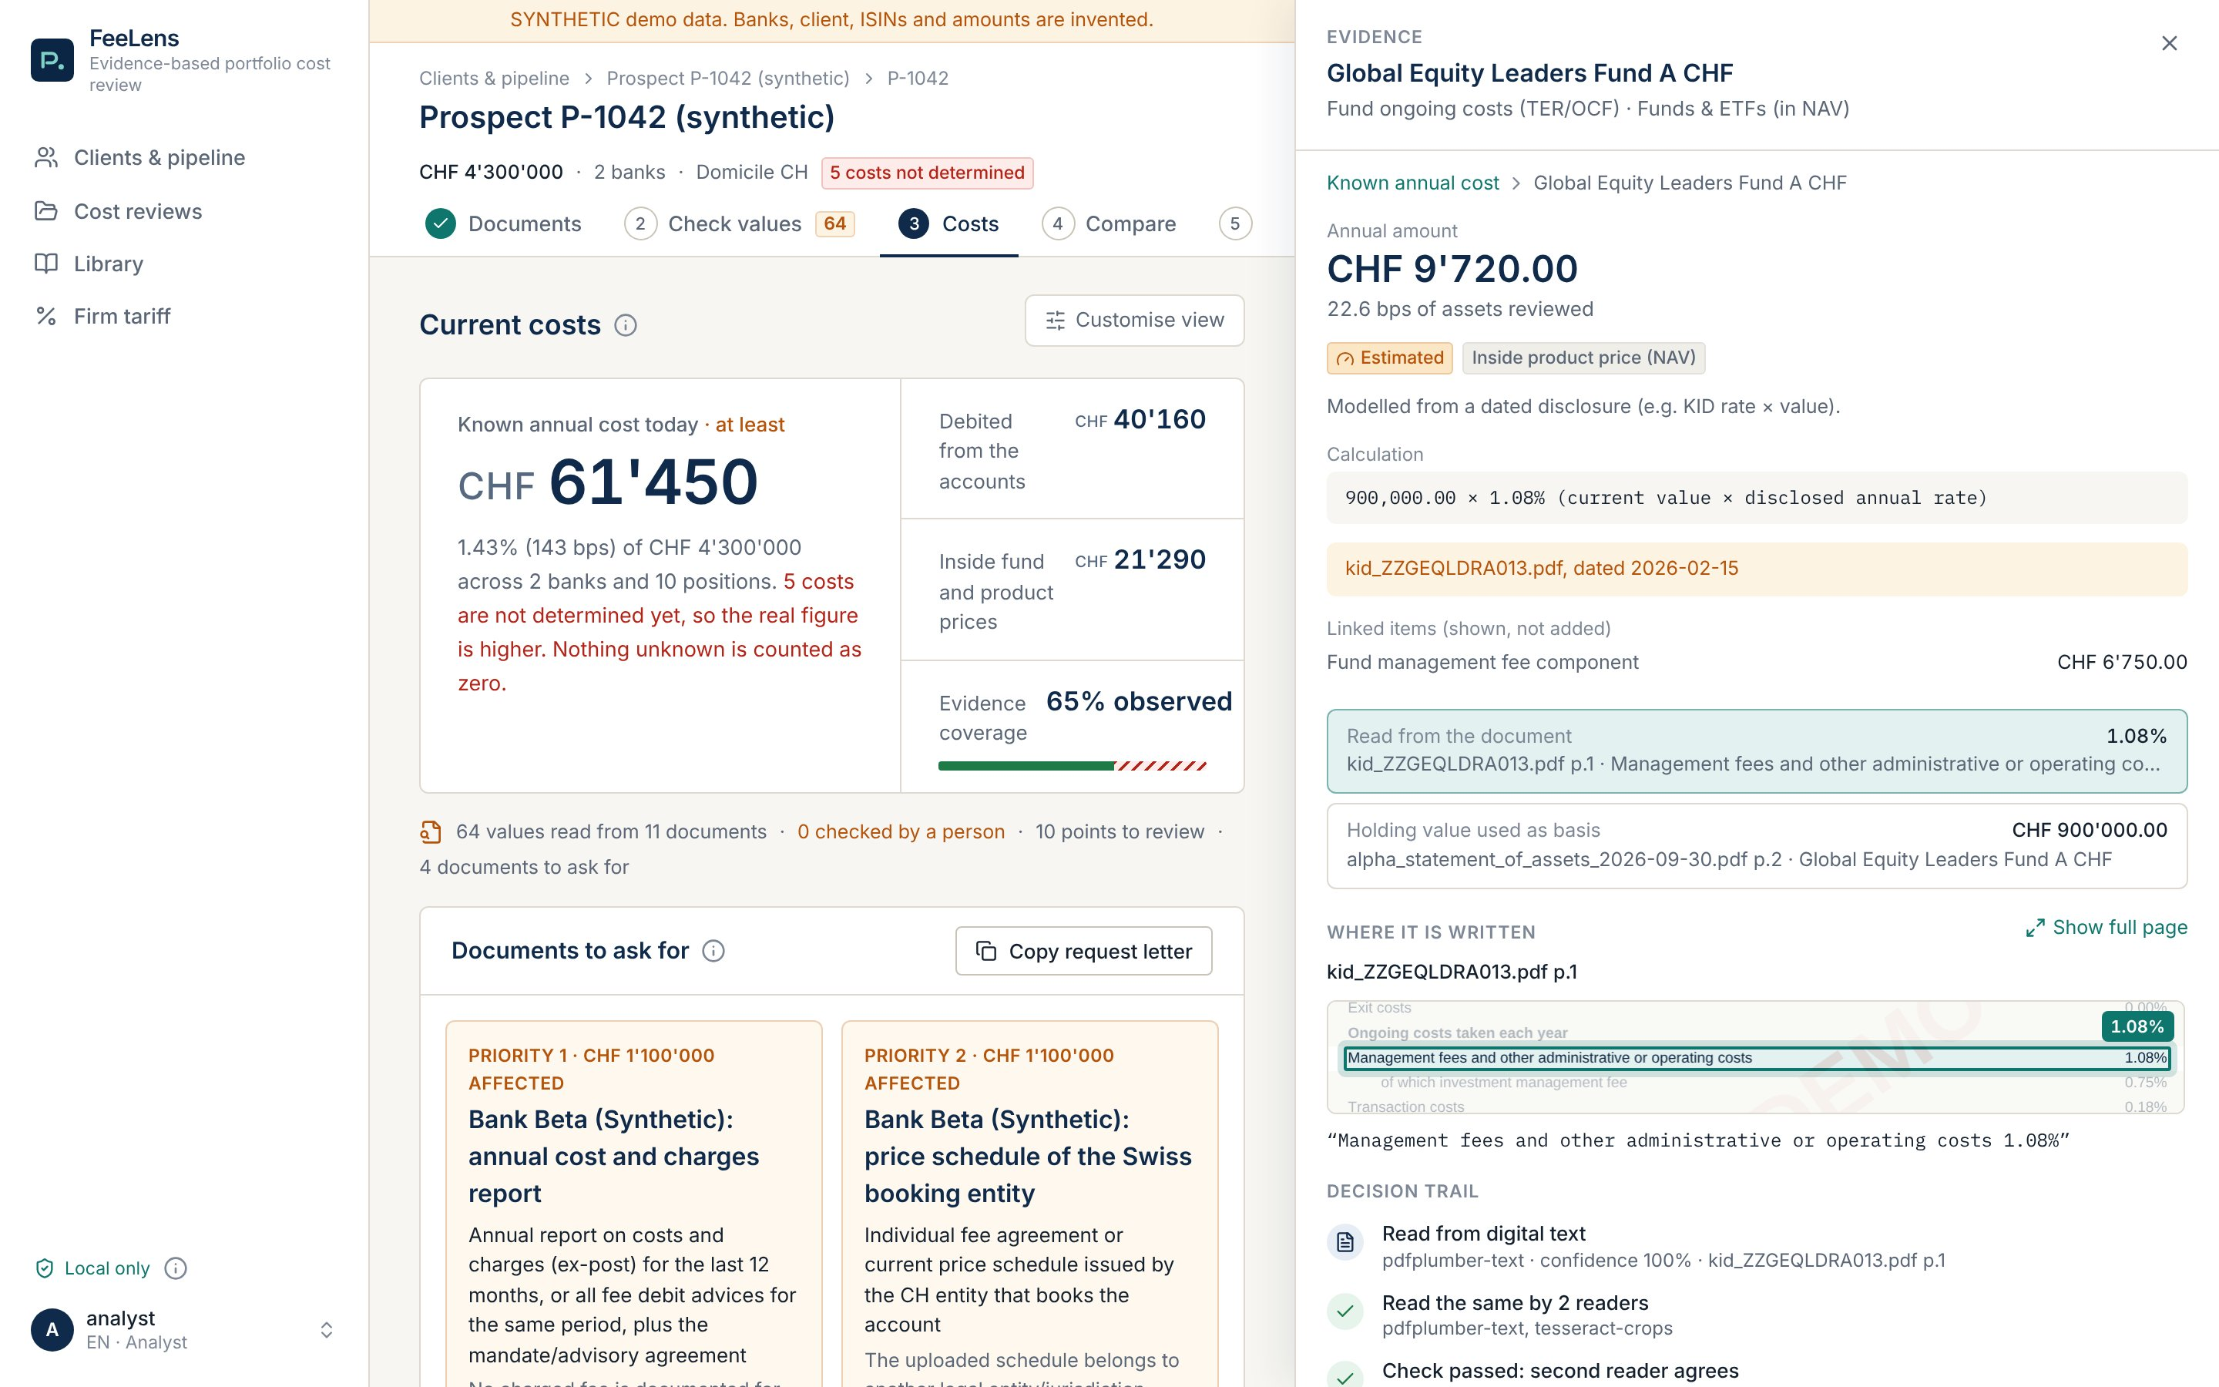
TUTORIAL · 6 COSTS
One click on a number: calculation, source and who checked it
1
The calculation
900,000 × 1.08%: holding value times the fund's ongoing cost.
2
The rate, read from the KID
1
With document and page.
3
The basis, read from the statement
2
Same holding, same ISIN.
3
4
Where it is written
The page crop; "Show full page" for context.
4
5
Decision trail
5
How it was read, which checks passed, who accepted it.
Notes:
The management fee inside the ongoing charge (OCF) counts once: 1.08%, not 1.08% + 0.75%. See "Linked items (shown, not added)".

Slide 14
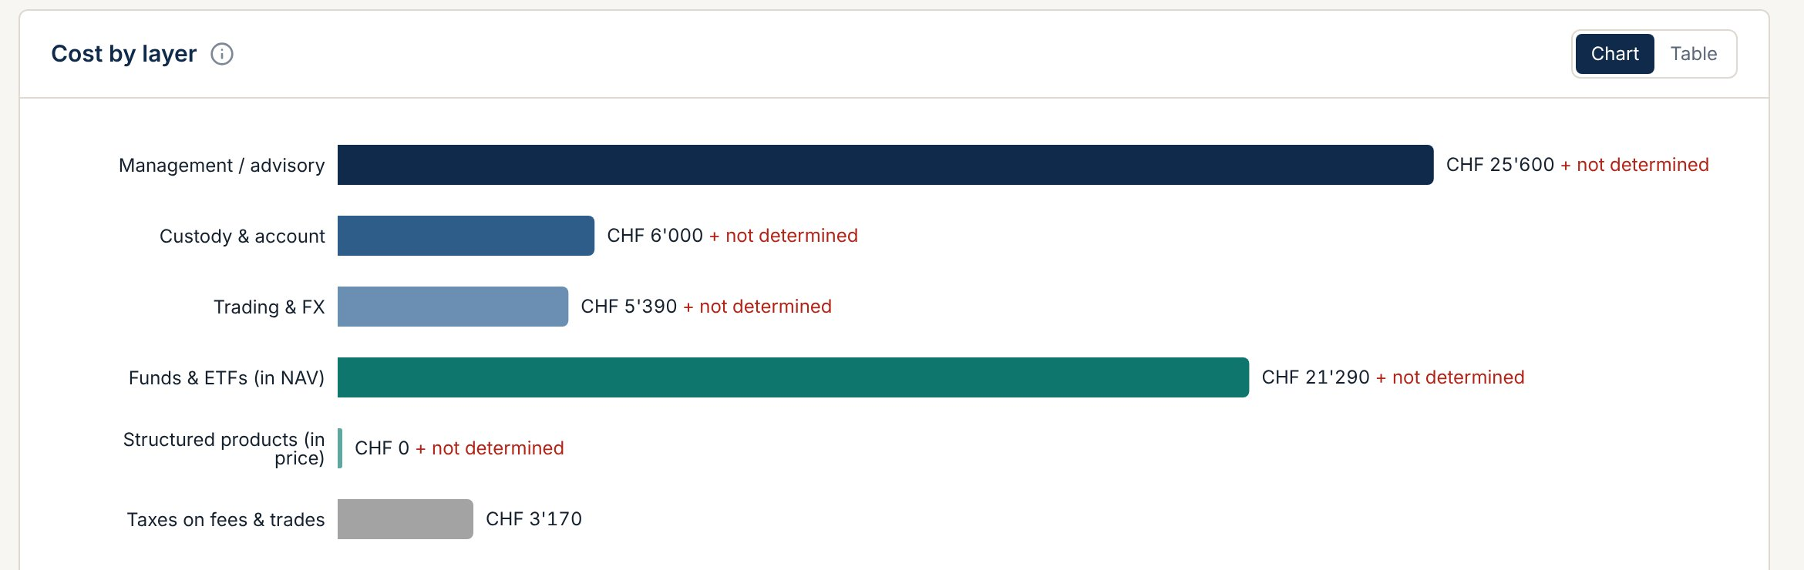
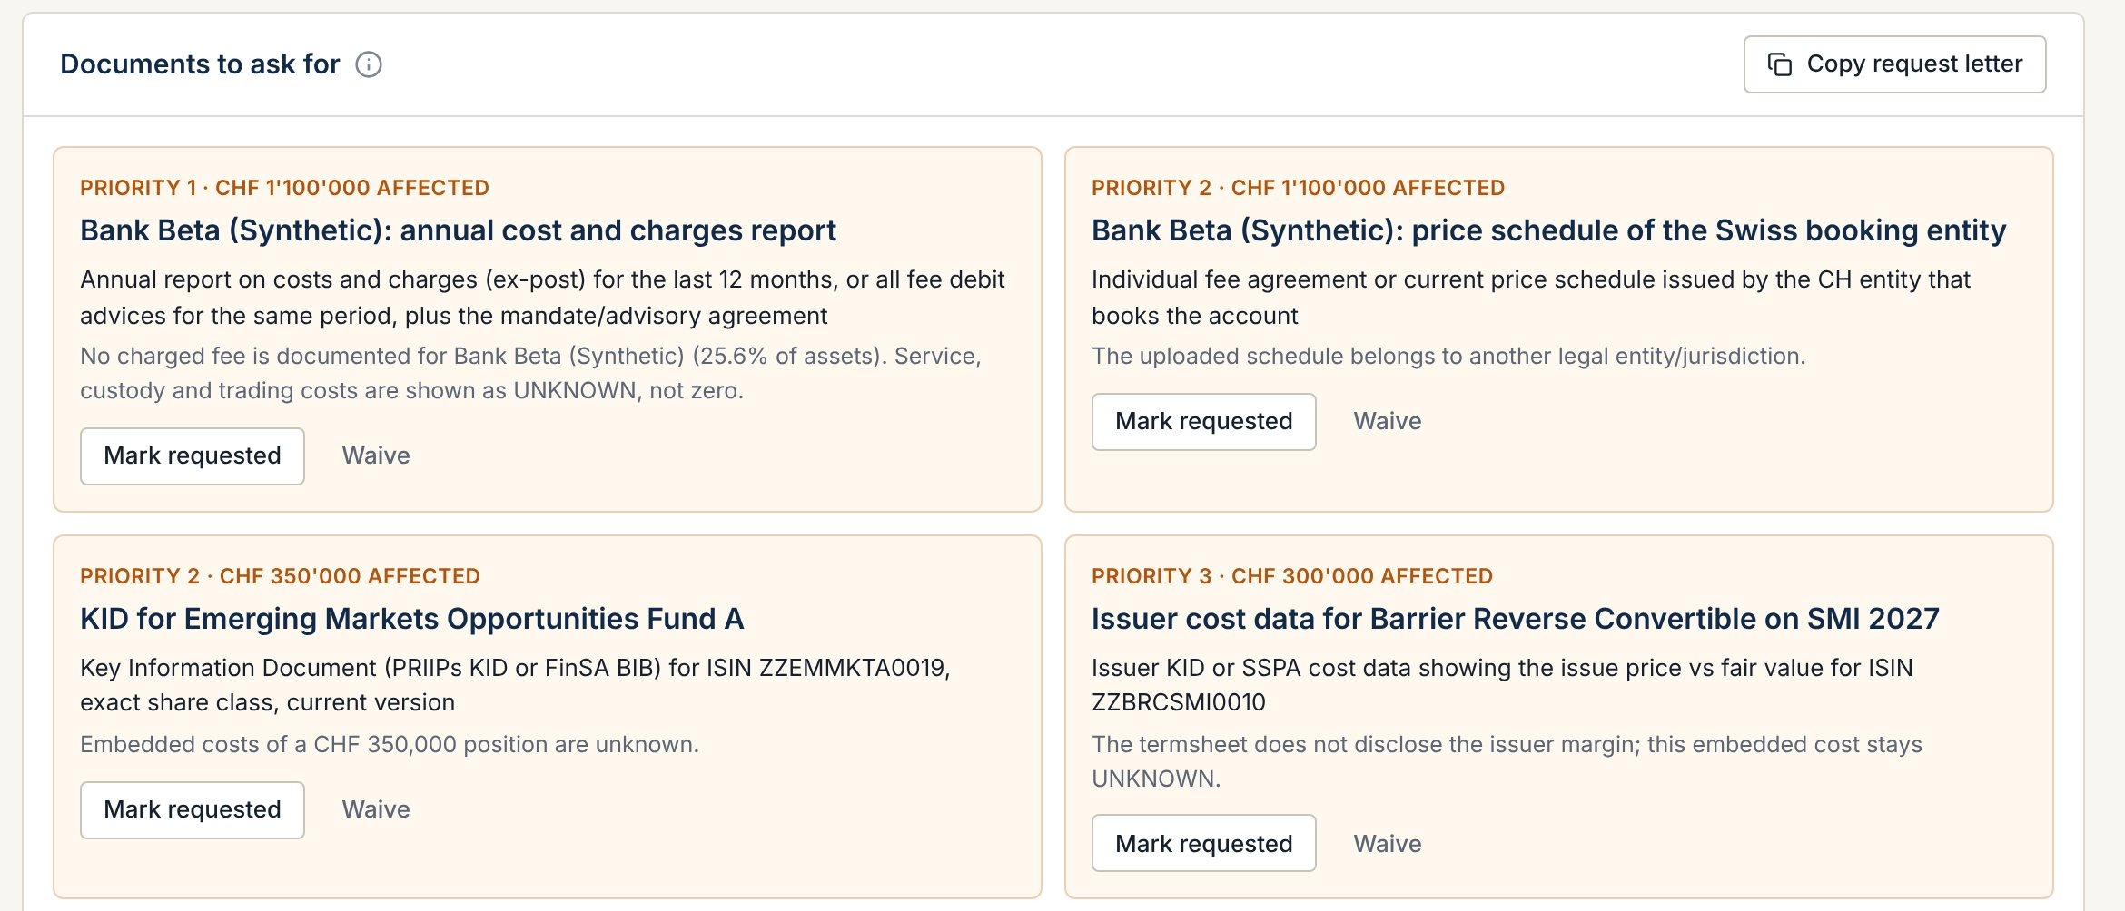
TUTORIAL · 6 COSTS
Missing is never zero: the app asks for the document
1
Bars with "+ not determined"
That part of the cost has no document yet. It is not counted as zero.
2
"Documents to ask for", by priority
For each gap: which document is needed and how much of the assets it affects (e.g. CHF 1,100,000).
3
"Copy request letter"
A ready letter for the client or the bank. "Mark requested" keeps track.
Synthetic prospect P-1042

Slide 15
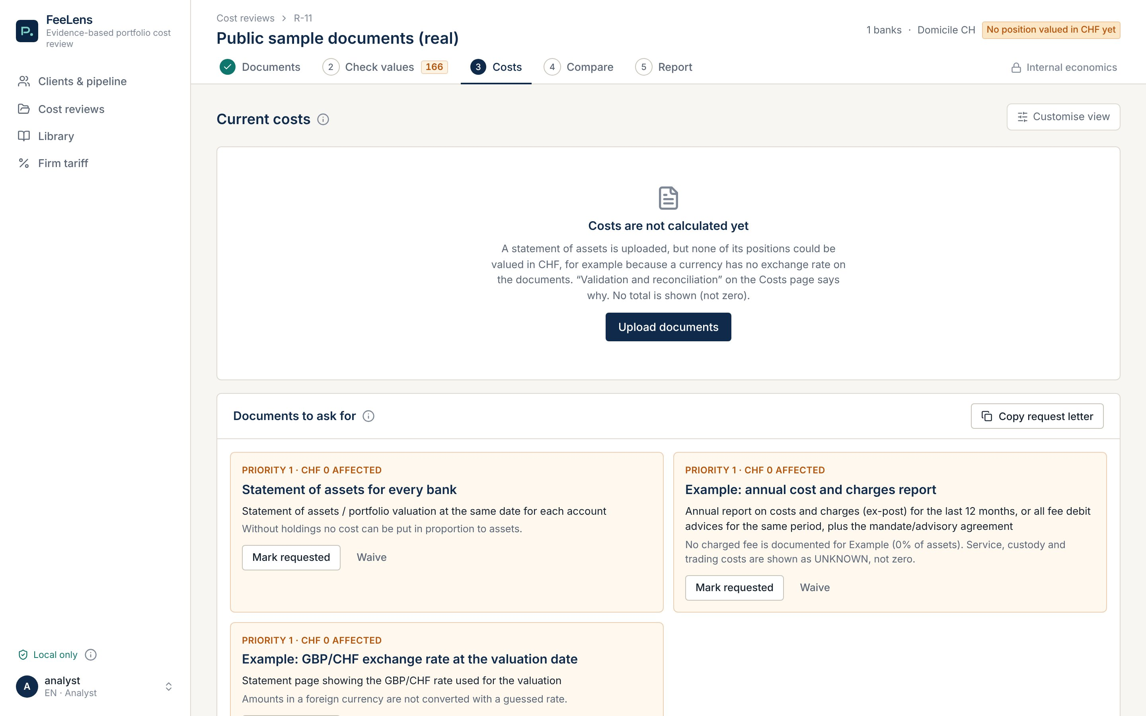
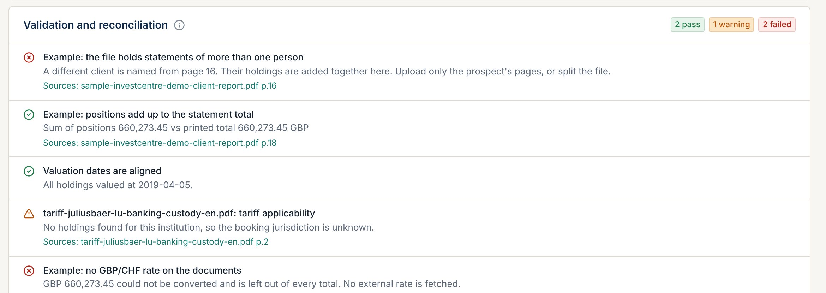
TUTORIAL · EDGE CASES
On real documents the app stops and says so
3
4
1
1
Costs are not calculated yet
The statement is in GBP with no GBP/CHF rate on the documents: no total, rather than a wrong one.
2
No invented FX rate
No rate fetched from the internet: the page with the rate is requested.
2
3
Two people in one file
Another client appears from page 16. Upload only your prospect's pages.
4
Reconciliation
Real public documents: AJ Bell demo client report (UK), 26 pages, two fictitious clients.
Sum of holdings = printed total (660,273.45 GBP): passed.

Slide 16
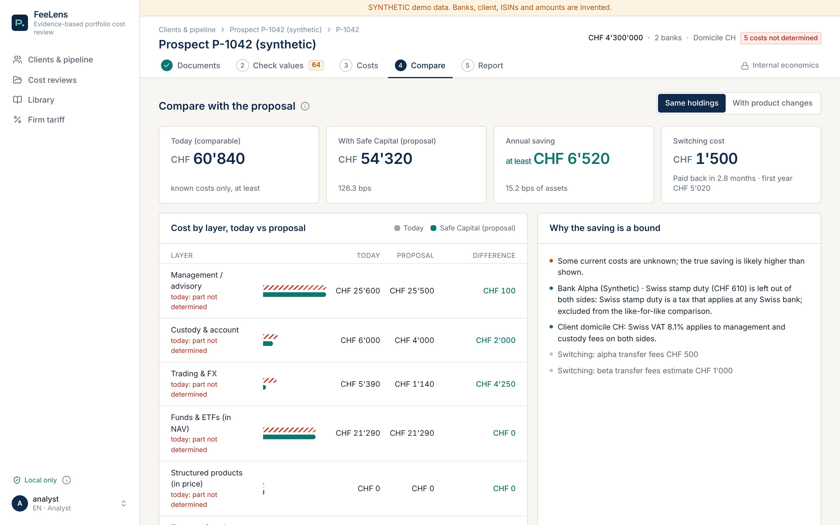
TUTORIAL · 7 COMPARE
Like-for-like comparison: the saving is a lower bound
1
"Same holdings"
Same securities at your tariff. "With product changes" is a separate second scenario.
1
2
3
2
Saving "at least" CHF 6,520
On known costs only, with VAT and stamp duty treated the same on both sides.
4
3
Switching cost
CHF 1,500, paid back in 2.8 months.
4
Why it is a bound
Explained in plain words you can repeat to the client.
Synthetic prospect P-1042

Slide 17
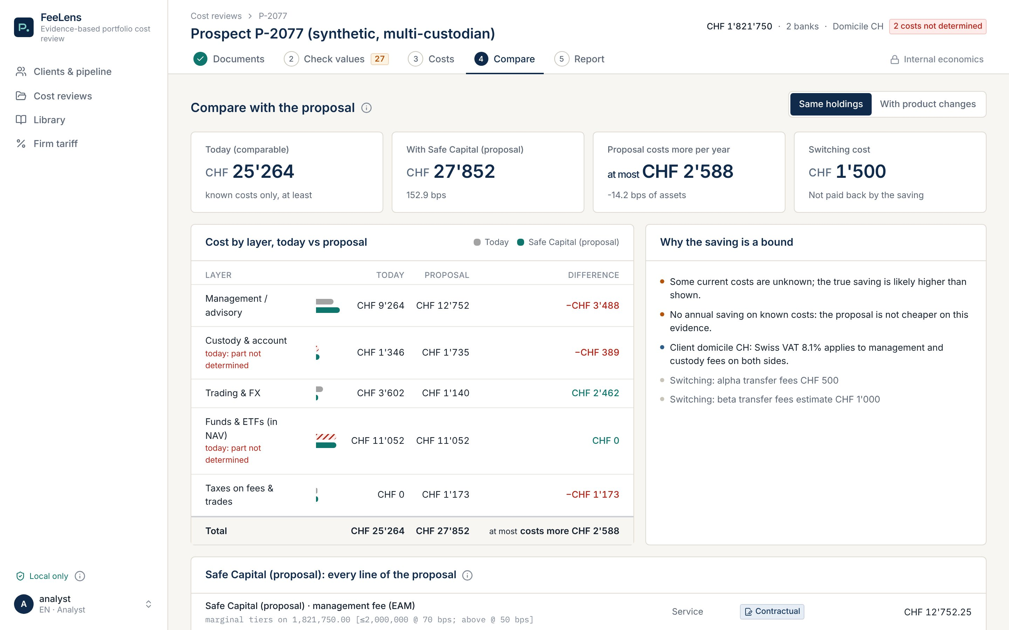
TUTORIAL · 7 COMPARE
Edge case: when your proposal costs more, it says so
1
"Proposal costs more per year"
At most CHF 2,588. Never shown as a saving.
1
2
No saving on known costs
Useful before the meeting: better you find out than the client.
2
Synthetic prospect P-2077: Italian bank in EUR and US broker in USD.

Slide 18
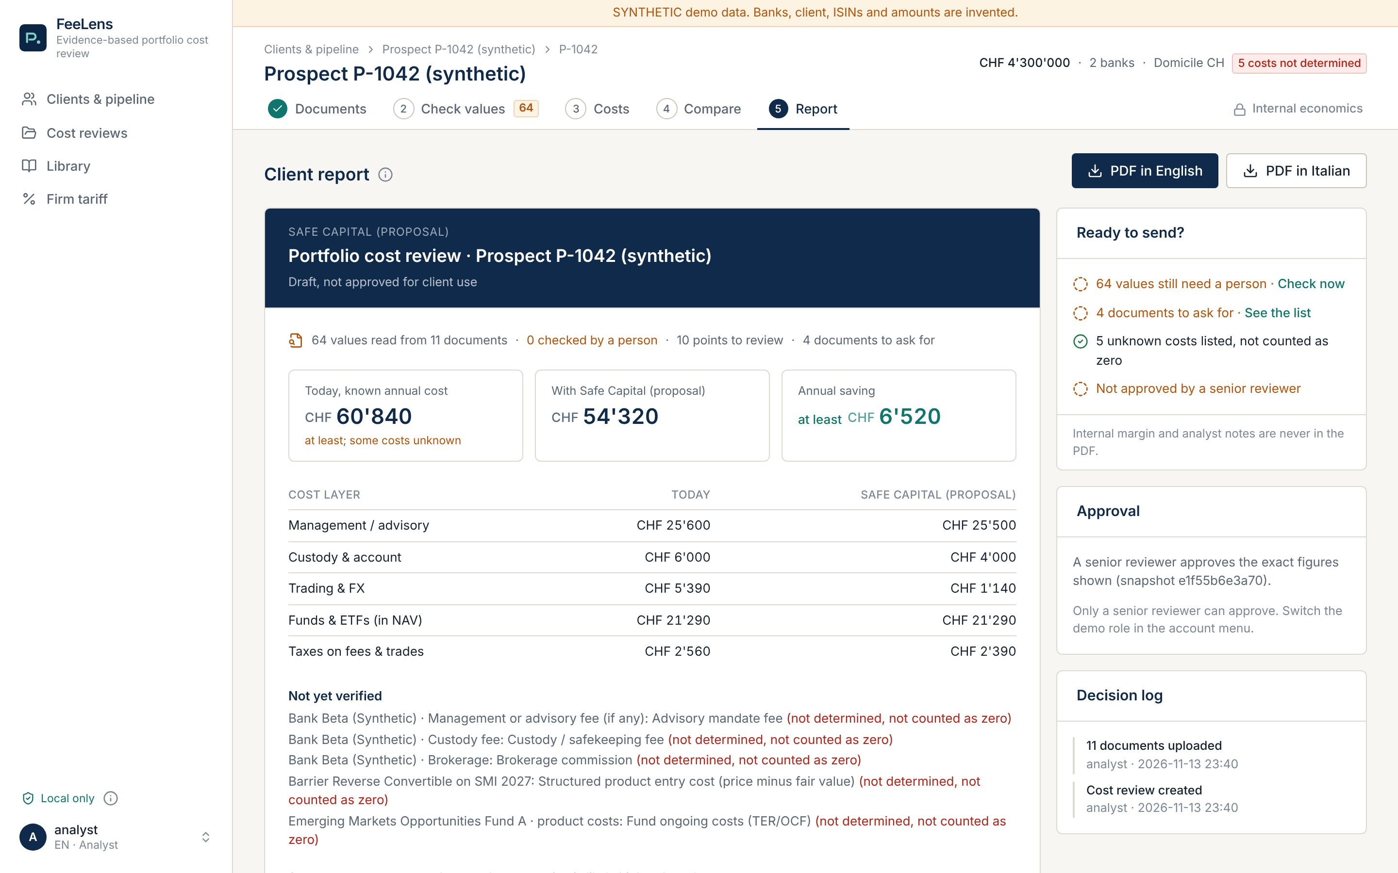
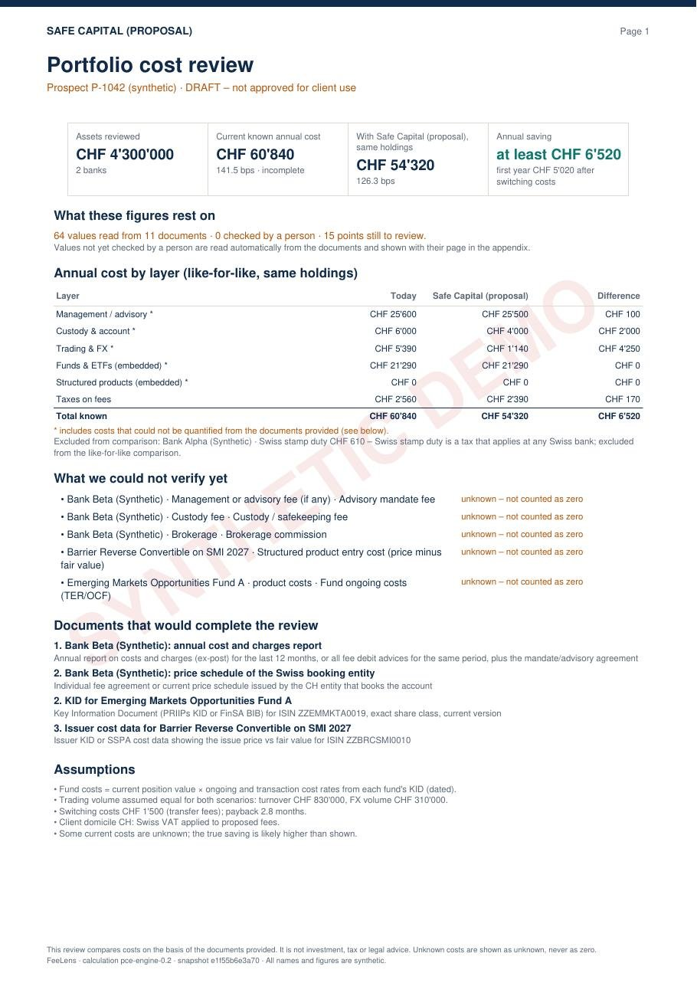
TUTORIAL · 8 REPORT
The client report: ready to send, approved by a senior
1
"Ready to send?"
What is still open, with a link to do it.
3
1
2
Approval
Only a senior approves the exact figures shown.
3
PDF in Italian or English
2
The same content, in the client's language.
4
4
"Not yet verified"
PDF page 1
Missing costs are written in the report, not hidden.
Your internal margin is on a separate page, for seniors only, and never enters the report (checked by automated tests).

Slide 19
EDGE CASES
What the app does, what the analyst does
Situation | The app | The analyst
Scanned page | Reads with local OCR, marks "OCR", status estimated | Confirms each value on the image
Missing cost | "Not determined", never zero; total "at least" | Requests the document (ready letter)
Doubtful value | In "Points to review", with the reason | Accepts, corrects or rejects
Total that does not add up | Reconciliation alarm with the page | Resolves it before anything else
Two clients in one file | "More than one person" alarm | Uploads only the right pages
Currency with no FX rate | Leaves the amount out, never guesses a rate | Provides the page with the rate
Price list of another entity | "Wrong entity": the tariff does not apply | Requests the right price list
Fee inside the TER | Counted once (1.08%, not 1.83%) | —

Slide 20
METHOD
Every figure is read twice, or a person checks it
Upload
Read each page
Find every fee
yes
Verified
Checks pass?
several files at once
text, or local OCR
row, column, page box
with its page and box
second reading agrees, sums tie
How we measure it
Check values
in doubt
One scorer (pce.evaluation), the same pages for every version.
Found only if the value is identical and on the right row.
Error: a figure shown as verified that is wrong. A person still accepts it before it counts.
95% ranges: 1,000 resamples by page; by document gives the same range.
19 pages labelled after the reader was frozen: no tuning to the test.
analyst confirms on the page
Cost ledger and client report
each fee counted once (AMF inside OCF); an unknown cost is never shown as 0
813
distinct fees
130
public KIDs
4
real statements
2
synthetic prospects
62 real public pages, 11 scanned
the fund's ongoing cost
holdings and assets
15 documents, scans too
Notes:
Details: "FeeLens accuracy study" and the independent re-check of 13 Nov 2026. All data is public or synthetic. 896 labelled rows = 813 distinct fees (some scans duplicate digital pages).

Slide 21
WHAT WE TEST ON
414 real public documents, none from a client
Document type | Files | CH / IT | Coverage
Bank price lists, custody tariffs | 87 | 48 / 20 | Good · 38 Swiss banks
Fund, ETF and Swiss KIDs | 146 | 15 / 5 | Good
Structured products, insurance | 62 | 19 / 16 | Good
Ex-ante costs, retrocessions | 27 | 11 / 2 | Good
Mandate contracts | 6 | 4 / 2 | Templates only
Factsheets, prospectuses | 57 | 8 / 1 | Cross-check only
Reading guides, specs | 15 | 6 / 2 | Layout only
Holdings statements | 5 | 0 / 0 | Gap
Ex-post cost reports | 7 | 0 / 1 | Gap
Trade and fee advices | 2 | 0 / 0 | Gap
What this means
Bank prices and product costs: well covered, in Italian and for Ticino too.
Statements and cost reports with real figures: Swiss and Italian banks do not publish them.
For those we use synthetic look-alikes with exact answers, and the pilot on your documents, on your machine.
Every file downloaded from its public source and fingerprinted (SHA-256). BancaStato and UBS block automated access: we do not get around it.

Slide 22
ACCURACY
Today: 87% of fees found, and a person confirms them before they count
87%
91%
7.3%
91%
of fees found on 62 real pages
on pages it had never seen
of figures marked verified are wrong
fund ongoing costs read automatically, 130 KIDs
range 80 to 92%
19 pages labelled later
range 4.6 to 10.5%
none wrong
What the "wrong" figures are (13 Nov check, 51 figures)
What this means for you
Kind | Figures | What we do
Not fees (example amount, card limit, 52-week high) | 22 | Filter them out (next piece of work)
Real fees missing from the answer key | 26 | Add them: the true error is lower
True misreads (e.g. "0 ,20%" read as 20) | 3 | Stopped by a person's check
Only about 5% of fees enter totals with nobody looking: on those, no errors found.
The rest is shown on its page: the analyst confirms instead of searching. A senior approves every report.
Swiss and Italian statements are not public: the pilot measures on yours.
Found by type: price lists and custody 91%, KIDs 90%, statements and cost reports 74%, scans 54% (70% with the optional RapidOCR reader).
Notes:
Run of main on 14 Nov 2026 (after the 13 Nov evening improvement), same method independently re-checked on 13 Nov: no leakage. "87%" counts every figure the app shows, including those a person must still accept. The 90% quoted before came from the lab harness, not the app.

Slide 23
PROGRESS
In one week: from 4% to 87% of fees found
What changed
13 Nov
Optional RapidOCR scan reader: scans from 54% to 70%
13 Nov
Fee vocabulary and table headings: from 82% to 87%
13 Nov
Several documents read at once: 29 files in 12 s instead of 43 s
13 Nov
Independent re-check: same numbers, no leakage
12 Nov
Statements: Fidelity US 34 of 34 holdings; 0 silent asset errors
The same 62 hand-checked pages each time, always the real app. Ranges today: 87% (80 to 92), 7.3% (4.6 to 10.5). On 19 unseen pages: 91%.
12 Nov
Reader that follows rows and columns: from 4% to 82%
Next step: drop numbers that are not fees, a table reader for tiered tariffs, RapidOCR in the standard install, better cost reports. In the pilot we measure with the same scorer on your pages.

Slide 24
SPEED
Several documents read at once: a full client pack in seconds
12 s
for a 29-file client pack (was 43 s)
How it works
Each file is read on its own core; the scanned pages of one file too.
Progress shows file by file: you can start checking the first one.
All local. A 4-core PC is enough; the free public demo has 1 and does not speed up.
Measured on a 4-core machine, same reader and same results before and after.

Slide 25
IS IT READY?
Ready for a supervised pilot, not for unchecked use
Ready today
Before the first real document
✓
Reads statements, KIDs, price lists, cost reports, several at once; scans with OCR
○
Personal sign-in with two-factor (MFA)
us
✓
Source and box for every figure; decision trail
○
Delete on the client's request
us
○
Encrypted disk, tested backup, retention
us
✓
Alarms: totals, two people, missing FX, wrong entity
○
Log of who views and downloads what
us
✓
Like-for-like comparison, IT/EN PDF report with approval
○
Where the pilot runs
Safe Capital
✓
No data leaves the machine (no outside AI)
○
Impact assessment (DPIA), consent, compliance sign-off
Safe Capital
Notes:
Reference: docs/READINESS.md, gates G2 to G9. The public demo on Render is never used with client documents.

Slide 26



WHERE IT RUNS
The code runs at your office or in Switzerland, never on a public service
A · A Safe Capital computer
B · Server in Switzerland
C · Public demo
Recommended for the pilot
After the pilot, for more users
Never for client data
Everything stays in your office
Encrypted disk, backups on your systems
An existing PC is enough; new: CHF 1,500 to 2,500
Infomaniak or Exoscale (Swiss data centres)
Azure Switzerland if you use Microsoft 365
Personal sign-in with MFA, database, backups
Synthetic data only, to show the app
Resets on every restart
Not an option for real work
In every case: documents are read on the machine itself. No text, image or number is sent to ChatGPT, a cloud OCR or any other service.

Slide 27






PERSONAL DATA
How we treat your clients' data
Codes, not names
Local only
Named users with MFA
A review uses a code (P-1043). Names, IBANs and account numbers are not needed.
No outside AI. Public lookups, if switched on, send ISINs only.
Every analyst has their own sign-in; leavers are removed the same day.
Deletion and retention
Audit log
Consent and DPIA
On request at once; otherwise 90 days after the meeting with no mandate (proposal, you decide).
Who uploads, views, corrects, approves, downloads. Logs never hold document text.
The client hands over documents for this purpose, with written consent. Safe Capital signs the DPIA.
To confirm with your counsel: Swiss FADP arts. 7, 8, 19, 24; FinIA art. 69 (secrecy); FINMA Guidance 08/2024 on AI. Not legal advice.
Notes:
MFA sign-in, deletion, encryption/backup and the view log are still to be finished before the pilot (see the readiness slide).

Slide 28
HOW TO USE IT
A typical review at Safe Capital
1
2
3
4
5
6
First meeting
Upload
Check
Missing documents
Four eyes
Second meeting
The client signs consent and hands over statements, cost report, price lists.
Code, domicile, files. A few minutes.
Assets first (alarms), then every cost figure: confirm, correct or "unknown".
Request letter to the client or the bank.
A second person checks total, saving and comparison basis, then approves.
The approved report, in the client's language.
Adviser
Analyst
Analyst
Analyst
Senior
Adviser
Target: under 2 hours of analyst time per prospect, every figure checked. A full comparison today probably takes 6 to 10 hours (our estimate: to be timed with you on a real case).

Slide 29
PILOT
Supervised pilot: 10 prospects or 3 months
Before
During
After
Install on one of your computers
Half-day training
Analysts and reviewer named
Consent and DPIA signed
Only documents handed over for this purpose
Every figure checked, every correction recorded
We review the reports with the analyst
Pilot report (numbers only, no names)
Decision: widen, fix or stop
Criteria to move to full use (proposal)
0
8 / 10
10 / 10
< 2 h
wrong figures in any delivered report
prospects with annual cost within 5% even before review
prospects with assets within 1%
of analyst time per prospect
The pilot stops at once on any data incident or any wrong figure found in a report already delivered.

Slide 30
PRICE
PROPOSAL · TO CONFIRM
What it costs: a pilot, then an annual licence
Pilot
Essential
Professional
CHF 3'000
CHF 9'000
CHF 18'000
once, 3 months
a year (CHF 750 a month)
a year (CHF 1,500 a month)
Up to 10 prospects
Install at your office and training
We review reports with you
Pilot report
100% credited to year 1
3 users, 40 analyses a year
Swiss hosting or your machine
Updates, new bank layouts, backups, support
Extra analysis CHF 200
10 users, 150 analyses a year
Same services, priority support
Extra analysis CHF 120
Setup after the pilot: CHF 5,000 once (users with MFA, your tariffs and templates, logo, IT/EN reports); half price for Safe Capital. Founding customer: 25% off year 1 and price held for 2 years, for a reference and anonymised pilot numbers. Prices exclude 8.1% VAT.
Notes:
Source: doc "FeeLens pricing for Safe Capital" (13 Nov 2026). Proposed prices, not yet approved by Ale. One analysis = one prospect, all their documents, until the report is approved; re-running it within 12 months is free.

Slide 31
PRICE
Why this price is fair
~CHF 225
0.45%
< 2 h
per analysis on Essential
fee on one CHF 2m mandate pays the yearly licence
of analyst time per prospect, every figure checked
CHF 9,000 / 40 analyses
CHF 9,000 / CHF 2,000,000
target; today we estimate 6 to 10 h, to time with you
Why not a price per document
Market anchors
It pushes people to leave documents out: hidden costs stay hidden.
A prospect with 30 PDFs would cost 6 times a tidy one.
You pay per analysis: one prospect, all their documents.
InvestGlass (CRM, Geneva): CHF 100 to 500 per user a month.
We found no Swiss tool that publishes a price for this job.
Our computing cost per analysis is near zero: no paid AI.
Source: investglass.com, opened 13 Nov 2026. The other figures are arithmetic on the proposed prices.

Slide 32
NEXT STEPS
What we need from you to start
1
How many cost reviews a month do you expect? (picks Essential or Professional)
Proposed timeline
2
How long does a cost comparison take today, in hours? (we time one case)
Weeks 1-3: we finish MFA sign-in, deletion, encryption and log; you do DPIA and consent.
Week 4: install and training.
Months 2-4: pilot on 10 prospects.
End: report and joint decision.
3
Pilot on your computer or straight on a Swiss server? Do you use Microsoft 365?
4
Who are the analyst and the second reviewer (four eyes)?
5
Who signs the DPIA, the consent text and the retention period?
6
Does the second family office want to join the pilot?
Notes:
The timeline is an estimate: it depends on when the DPIA is signed and which machine is chosen.

Slide 33
Every figure with its source.
What is missing stays visible. The saving is a floor, never a promise.
Proposal: 3-month supervised pilot, CHF 3,000.

Slide 34
APPENDIX
Where the numbers and pictures come from
Screenshots
FeeLens app, main version of 13 Nov 2026 with the firm tariff, run locally. Prospects P-1042 and P-2077 are synthetic (banks, ISINs and amounts invented).
Real documents
AJ Bell demo client report (investcentre.co.uk); BlackRock iShares Core S&P 500 (IT) and Core MSCI World (EN) KIDs; Julius Baer Europe custody price list (2025). Public documents, fictitious clients.
Accuracy
62 real pages, 813 distinct fees checked by hand; main re-run on 14 Nov 2026 (method independently re-checked on 13 Nov); 130 public KIDs; 4 public statements (Fidelity US and UK, AJ Bell, Edward Jones). Speed: 4 cores, 13 Nov 2026.
Prices
Doc "FeeLens pricing for Safe Capital", 13 Nov 2026: proposal to confirm. Market reference: investglass.com.
Limits
Sample chosen to cover document types, one annotator; Swiss and Italian statements are not public: the pilot is the real test.

