Slide 1

A free portfolio cost check, ready in minutes
How the Portfolio Cost Engine would work for Safe Capital
Briefing for Massimo · November 2026
Concept and demo · every figure in this deck is synthetic
Notes:
Purpose of this deck: show, without technical detail, how a prospect's bank documents become a clear, evidence-backed cost picture and a fair comparison with Safe Capital. Everything shown is a concept with synthetic data; no real client, bank or saving is represented.

Slide 2







Clients rarely know what their portfolio really costs
The costs are spread over many documents, and some are never shown as a charge
“My bank charges me about half a percent… I think. I’ve never added it all up.”
Bank fee statement
Mandate & tariff
management and custody debits
rates, tiers, minimums, VAT
Trades & FX
Fund prices
brokerage, third-party, FX margin
ongoing charges taken inside the price
Structured notes
Insurance wrappers
Typical prospect remark (illustrative, not a real quote)
margins built into the issue price
policy fees on top of the funds
Notes:
The core problem: no single bank document shows the all-in cost. A holdings statement does not show fees; fund costs are deducted inside the fund price and never appear as a debit; structured products and insurance wrappers add their own layers. Prospects therefore usually underestimate what they pay.

Slide 3



Our offer: an evidence-based cost check, free for the prospect
1. The client hands over documents
2. A cost picture within minutes
3. A fair comparison with Safe Capital
Statements, fee reports and contracts from one or more banks: PDF, scans or Excel.
The engine reads the documents and builds a first draft of the annual all-in cost. An analyst checks it.
Same holdings, Safe Capital's fee plus the custodian bank's fees, switching costs included. On one page.
Three rules we never break: every number links to its source page · a missing cost is never counted as zero · no saving is claimed unless the service is comparable
Notes:
'Minutes' is the design target for the automatic first draft, not a measured result yet. The analyst review adds time depending on how complete the documents are. The three rules are what make the result defensible in front of a client.

Slide 4






Five steps from a pile of documents to a client-ready report
Upload
Read & check
Find product costs
Calculate
Compare & report
Files go into a private, encrypted workspace for this prospect
Positions, ISINs and fees are extracted, each tied to its page
Official fund documents give each fund's ongoing cost
Annual cost per layer: proven, estimated, missing
Safe Capital scenario, payback, one-page report
A Safe Capital analyst checks flagged values after step 2 and approves the report after step 5. Nothing reaches the client without a person signing it off.
Notes:
Steps 2 to 4 are automatic. The software never sends anything to a client by itself; it prepares, a person decides.

Slide 5



What the client brings: three essentials, the rest makes it sharper
Essential
Helpful
Holdings / portfolio valuation
Custody and trading tariff
Transaction list (12 months)
FX confirmations
Rebate / retrocession disclosure
Structured product termsheets
Insurance policy, if funds sit in a wrapper
per bank, recent date
Fees charged in the last 12 months
fee statement or annual cost report
Mandate or advisory contract
the agreed rates and what they cover
Accepted: PDF, scans or phone photos, Excel, CSV. If something is missing, the engine drafts the request for the client.
Notes:
With only the three essentials we can already show bank-level costs and fund costs. The helpful documents turn estimates into proven figures, especially for trading, FX and rebates.

Slide 6
Costs sit in three layers, and only the top one shows up as a debit
Bank & service layer
Management or advisory fee, custody, brokerage, FX
Visible: debited from the account
Product layer
Fund ongoing charges, fund trading costs, structured note margins
Hidden: taken inside the product price
Wrapper & one-off layer
Insurance policy fees, entry or exit fees, transfer costs, stamp duty
Occasional or contract-specific
The product layer is the one most clients never see, and often the largest after the management fee.
Notes:
This is the central idea for clients. Fund costs are not wrong or hidden on purpose, they are simply deducted inside the fund price, so they never appear on a bank statement. The engine makes them visible using the official product documents.

Slide 7
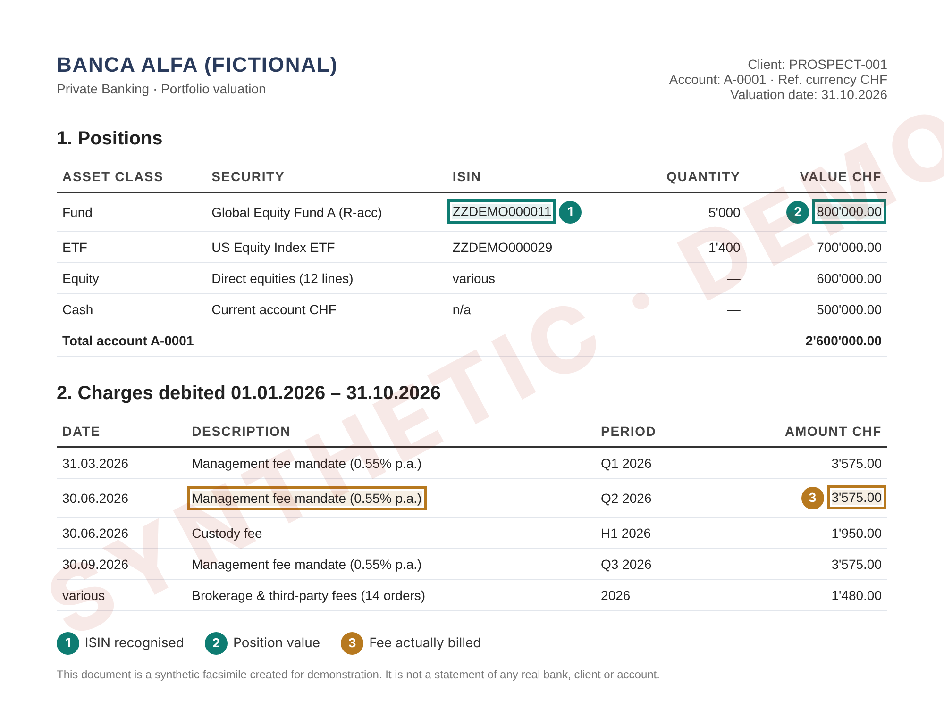
Every number keeps a link to the page it came from
1
Security recognised
The ISIN identifies the exact fund and share class.
2
Position value
Used to turn a fund's cost percentage into francs.
3
Fee actually billed
Proven cost: date, period and amount kept with the page reference.
Example is a synthetic facsimile. Real bank layouts differ by bank and language; each new layout is tested before use.
Notes:
Born-digital PDFs are read directly; scans and photos go through OCR (text recognition) and are flagged for a human check. Every extracted value remembers its file, page and position so anyone can click it and see the original.

Slide 8
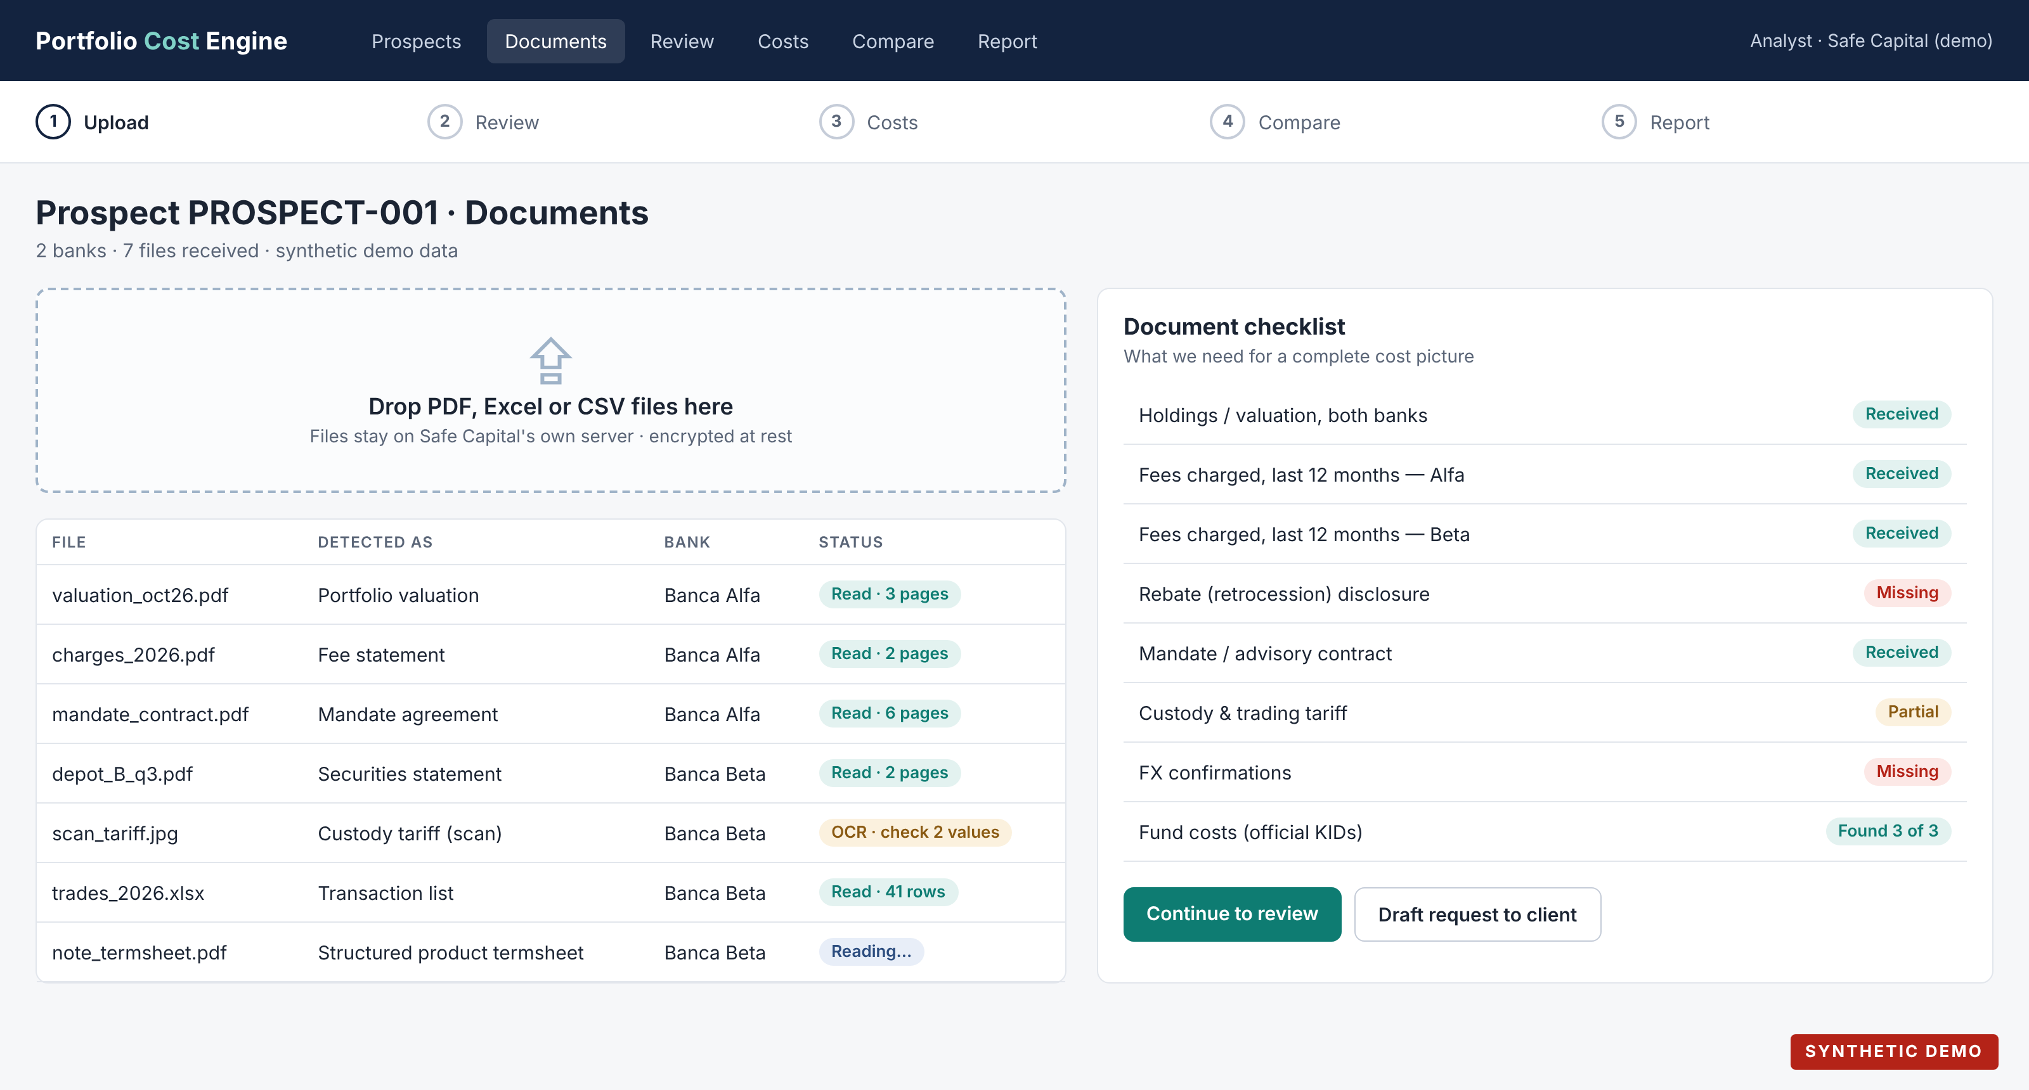
Step 1 · Upload: the checklist shows at once what is still missing
Notes:
Mockup with synthetic data. Each file is recognised automatically (valuation, fee statement, contract, scan). The checklist on the right tells the analyst which documents to ask for before the meeting ends.

Slide 9
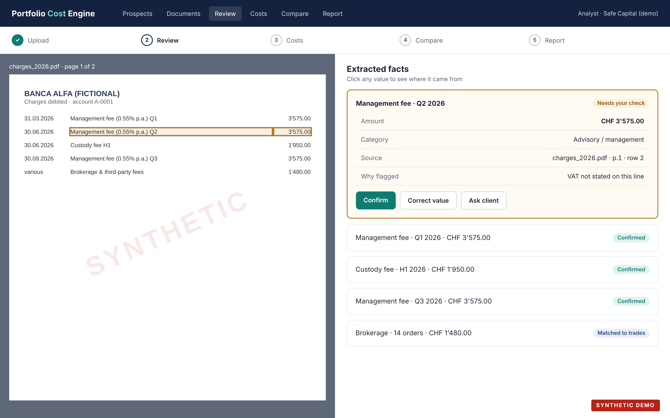
Step 2 · Review: the analyst confirms values next to the original page
Notes:
Left: the original document with the value highlighted. Right: what the engine extracted. Uncertain values (here, VAT not stated) are flagged and need one click to confirm, correct, or turn into a question for the client. Every correction is logged with who, when and why.

Slide 10




Fund costs come from the official KID of the exact share class
ISIN on the statement
Exact share class
Official KID / factsheet
Ongoing cost
ZZDEMO000011
Global Equity Fund A, R-acc
issuer's document, dated
1.08% per year
Worked example (synthetic)
Why the exact class matters
The same fund can have several share classes with different costs. If the class can't be confirmed, the engine marks the cost as missing instead of guessing.
Ongoing charges 1.08%, of which management fee 0.75%
The 0.75% is already inside the 1.08%: counted once
CHF 800'000 × 1.08% = CHF 8'640 per year, marked estimated
Notes:
KID = Key Information Document, the official cost sheet funds must publish. Only the client's ISIN is looked up, never their name or amounts. The KID's example amounts are illustrations, not what the client actually paid, so we use the percentage applied to the client's real position value and label it 'estimated'.

Slide 11


Each cost is counted once, and a missing cost is never treated as zero
Counted once
Missing ≠ zero
A fund's management fee is part of its ongoing charges
An all-in fee may already include custody
A KID's total is the sum of its parts, not an extra
A rebate counts only if it was actually paid back
Gaps are shown in red, and the engine drafts the request:
Please ask Banca Beta for:
Rebate (retrocession) disclosure 2026
FX confirmations, last 12 months
Why: without them, FX and rebates stay estimated, so the saving shown is a range, not a firm figure.
Notes:
These two rules protect Safe Capital's credibility. Adding a fund's management fee on top of its ongoing charges would overstate the client's cost; treating an unknown FX margin as zero would understate it. Both would make the comparison unfair.

Slide 12
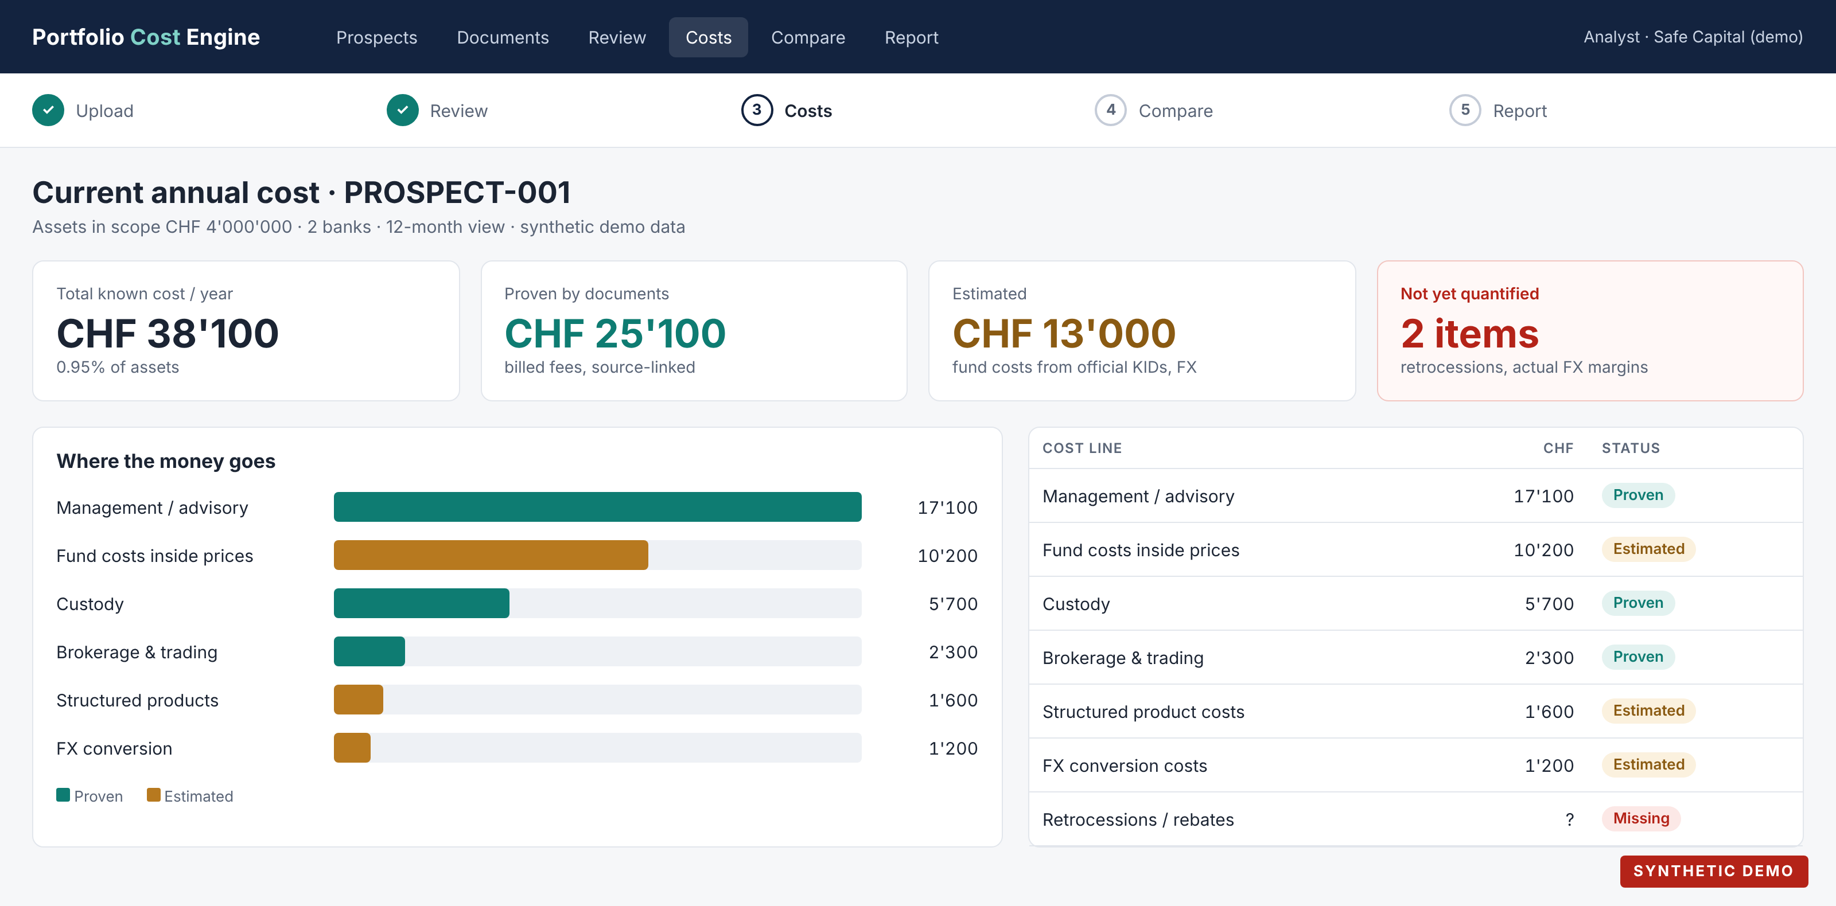
Step 3 · Costs: the full picture, split into proven and estimated
Notes:
Synthetic prospect with CHF 4 million across two banks. Known annual cost CHF 38'100 (0.95%). CHF 25'100 is proven by billed fees; CHF 13'000 is estimated from official fund documents and tariffs; two items remain unquantified and are shown, not hidden. Clicking any line opens the source page.

Slide 13
Step 4 · Compare: same holdings first, a new portfolio kept apart
Today
CHF 38'100
0.95%
Same holdings
CHF 32'540
0.81%
New portfolio
CHF 23'740
0.59%
Safe Capital columns include the custodian bank's fees: assets stay at a bank, Safe Capital manages them. The new-portfolio case changes products and risk, so it is not a like-for-like saving.
Notes:
Safe Capital is an external asset manager: the client's assets stay at a custodian bank, so every Safe Capital scenario adds Safe Capital's fee AND the custodian bank's custody, trading and FX fees. VAT on fees depends on the client's domicile. Same-holdings comparison: identical positions, Safe Capital's advisory fee plus the custodian's terms. This is the fair headline. The new-portfolio case (e.g. cheaper share classes or ETFs) can show a larger difference but needs a suitability review and must never be presented as a pure fee saving. Figures are synthetic.

Slide 14

Year one: switching costs are included, so the payback is honest
 | Same holdings | New portfolio
Annual difference | CHF 5'560 | CHF 14'360
One-off switching costs | – CHF 8'000 | – CHF 8'000
Net result in year one | – CHF 2'440 | + CHF 6'360
Payback | about 17 months | about 7 months
Why show a negative year one?
Because a client will find out anyway. Showing the switching cost and the payback period up front makes the recommendation credible, and the saving from year two onward speaks for itself.
Switching costs (transfer, exit, taxes) come from the banks' quotes; here they are a synthetic placeholder. VAT on fees depends on the client's domicile and is applied per client.
Notes:
Payback = one-off switching cost ÷ annual difference × 12. Same holdings: 8'000 ÷ 5'560 × 12 ≈ 17 months. New portfolio: 8'000 ÷ 14'360 × 12 ≈ 7 months. All synthetic. Safe Capital's own margin on the prospect is computed on a separate internal screen and never appears in client material.

Slide 15

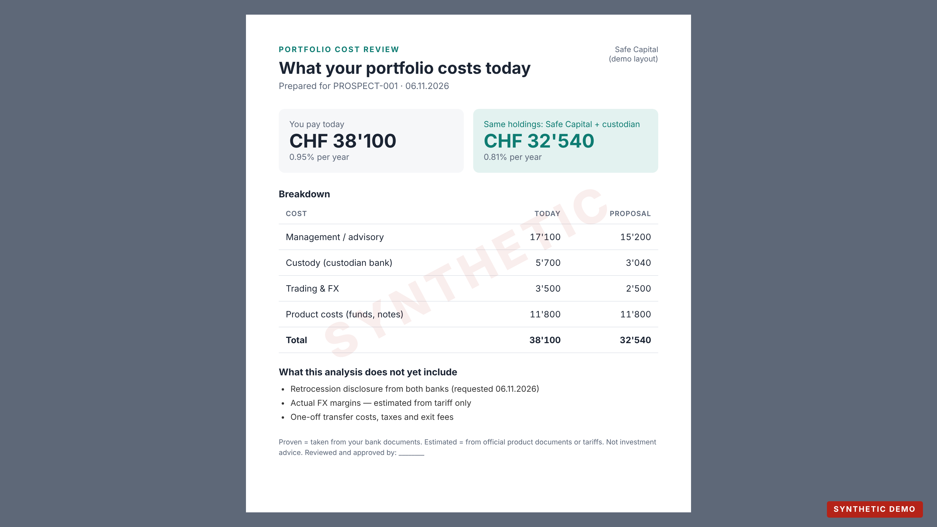


Step 5 · Report: one page for the client, the margin stays internal
On the page
Today vs Safe Capital, the breakdown, what is proven and what is estimated
Also on the page
What is still missing, in plain words
Never on the page
Safe Capital's internal margin and profitability view
Before it leaves
An approver signs it off; the version is frozen
Notes:
The report is a PDF generated from approved numbers only. It states that it is not investment advice. The internal profitability screen uses separate permissions.

Slide 16



Where it runs: on Safe Capital's own infrastructure by default
A · In the office
B · Swiss private hosting
C · External AI services
One secured computer or server at Safe Capital. Simplest for a pilot: documents never leave the building.
A dedicated server with a Swiss provider under a data-processing contract. For several users and offices.
Only for hard-to-read pages, only with explicit approval, and only on redacted excerpts.
Recommended for the pilot
Option for production
Off by default
The only thing that goes to the internet: public fund codes (ISINs) to fetch official product documents. No names, no amounts, no statements.
Notes:
Hosting in Switzerland helps but does not by itself make the processing compliant; contracts, access control and retention matter as much. The final choice should be made with Safe Capital's compliance officer.

Slide 17





Client files stay confidential from upload to deletion
Client consent
Only what is needed
Encrypted
The client signs a short authorisation before any upload
Names can be blacked out; costs need no identity
In storage and in transit; separate space per prospect
Named access
No public AI on raw files
Deleted on schedule
Personal logins, two-factor, every view logged
Unless Safe Capital explicitly approves a provider
Retention period agreed up front, then erased
Swiss Federal Act on Data Protection (revised, in force since 1 September 2023) applies. Bank-client confidentiality and outsourcing rules must be checked by Safe Capital's counsel; this slide is not legal advice.
Notes:
Pseudonymised data can still be personal data. A data-protection impact assessment may be needed; that decision belongs to Safe Capital with its counsel.

Slide 18

The engine reads and calculates; people make the judgements
Automatic
A person at Safe Capital
Recognise each document and bank
Extract positions, ISINs and fees
Fetch official fund cost documents
Calculate costs in CHF and %
Flag gaps and draft the client request
Produce the report draft
Enter Safe Capital's and the custodian's fees (once)
Confirm values the engine flags
Decide if a comparison is like-for-like
Approve and sign the client report
Present it and talk to the client
Notes:
Manual configuration is mostly one-time: Safe Capital's tariff, custodian terms and the report template. Per prospect, the human effort depends on document quality.

Slide 19
Delivery in phases, with a real pilot case before any production use
Now
Phase 1
Phase 2
Phase 3
Demo
Pilot
Harden
Production
Working concept on synthetic documents; this deck
1–3 anonymised real prospects; measure accuracy and time
More bank layouts, security review, user logins
Live at Safe Capital after compliance sign-off
Durations are set after the pilot, once we know how many bank formats Safe Capital's prospects bring.
Notes:
We deliberately do not promise dates before seeing real documents: the number of different bank layouts drives the effort.

Slide 20
Six decisions we need from Safe Capital to start the pilot
1
One anonymised real case
2
Safe Capital's pricing
holdings, 12 months of fees, the contract
advisory fee, custodian partner and their tariffs
3
Comparison policy
4
Where it runs and who sees it
same holdings only, or also a new-portfolio case
office machine or Swiss hosting; named users
5
Client consent and retention
6
Legal entity on client material
wording of the authorisation; how long we keep files
which Safe Capital entity and licence to cite
Notes:
Decision 6: the public commercial register lists Safe Capital Management SA and Safe Capital Holding SA in Lugano. Safe Capital's website states FINMA authorisation with OSIF supervision, but this has not yet been checked in the FINMA register; Safe Capital should confirm exactly what to cite before anything goes to a client.

Slide 21

Next step: run one anonymised real case
No source, no verified figure · Missing is never zero · No comparable service, no savings claim
Notes:
Ask: one anonymised prospect file and Safe Capital's fee schedule. With those we can run the pilot and replace every synthetic figure in this deck with a real, source-linked one.

