Slide 1



FeeLens
See what a portfolio really costs. In minutes, with proof.
Briefing for Massimo · Safe Capital, Lugano · November 2026
Upload
Verify
Compare
Concept and working demo · synthetic client figures · real public bank documents
Notes:
FeeLens reads a prospect's bank and product documents, finds every cost with its source and compares it fairly with Safe Capital's offer. Client figures are synthetic (demo prospect P-1042); the bank and fund documents shown are real public documents.

Slide 2






More than a third of the cost never shows up as a debit
THE PROBLEM
CHF 61'450
real yearly cost, at least
Where the costs sit
Fee advices
management, custody
Contracts and tariffs
rates, tiers, minimums
CHF 40'160
what the bank lists as charged
Trades and FX
commissions, FX margins
Fund prices
ongoing charges in NAV
debited 65%
hidden 35%
Structured products
issuer margin
CHF 21'290 are fund costs taken inside the price. And Bank Beta's own fees are still unknown.
Insurance wrappers
policy charges
In orange: never visible as a debit.
Notes:
Synthetic figures from the demo engine (prospect P-1042, CHF 4.3m at two banks). Known cost CHF 61'449.60 (143 bps): debited 40'159.60, inside fund prices 21'290. Clients see debits only; fund costs sit inside the price and never appear.

Slide 3




Three steps, a result you can prove
WHAT FEELENS DOES
1 · Upload
2 · Verify
3 · Compare
Statements, cost reports and contracts from any bank: PDF, scans, Excel.
Every cost is extracted with its page, checked against other documents and labelled.
Same holdings with Safe Capital and its custodian bank, switching costs included.
OUTPUT Documents sorted by bank, type and period
OUTPUT Cost ledger with source and status
OUTPUT One-page client report
No source, no verified figure
Missing is never zero
No comparable service, no savings claim
Notes:
The three rules make the result defensible in front of a client and compliance.

Slide 4





Six steps: who does what, and what each step produces
THE PROCESS
1
2
3
4
5
6
Consent and documents
Automatic reading
Cross-checks
Confirm uncertain values
Costs and scenarios
Approve and report
Client
Automatic
Automatic
Analyst
Automatic
Analyst
OUTPUT
OUTPUT
OUTPUT
OUTPUT
OUTPUT
OUTPUT
Signed authorisation, files uploaded
Positions and fees, each with its page
Result per check, gaps listed
Values confirmed or questions to the client
Current cost, proposal, payback
Client report + request letter
~10 min
seconds per page
seconds
a few minutes
seconds
minutes
Green: automatic. Grey: a person at the client or Safe Capital. Nothing reaches a client without approval. Times are design targets, to be measured in the pilot.
Notes:
If documents are missing, step 3 drafts a letter to the bank; when they arrive the analysis updates.

Slide 5






What is needed to start
REQUIREMENTS
From the client, per case
From Safe Capital, once
Technical
Statement of assets per bank
Advisory or management tariff
One secured office PC (pilot) or a Swiss server
Annual cost report, or 12 months of fee advices
Partner custodian bank and its tariff
Named logins with two-factor
Mandate contract, if any
Consent wording and retention period
No external AI on raw files
Signed consent
Who approves reports
Internet only to fetch public KIDs
Banks' mandate fees (UBS, Julius Baer) are not public: they only come from the client's contract.
Notes:
One-time setup: Safe Capital tariff, custodian, report template. Per case, effort depends on document quality.

Slide 6




What banks publish, and what only the client has
THE SOURCES
Public documents used
DOCUMENT | PUBLIC? | WHAT WE FOUND | WHERE FEELENS GETS IT
Bank price list | Yes | Julius Baer Europe, ZKB, Raiffeisen Locarno. UBS publishes one but blocks automated download | Bank website; date and entity checked
Fund KID | Yes | Every share class, e.g. iShares Core MSCI World | Official source, by ISIN
Mandate fee | No | Julius Baer: “not part of this document”; UBS Manage: no rates | Client's contract or fee advices
Statement of assets | No | No public specimen from UBS or Julius Baer | The client
Annual cost report | On request | UBS: cost details “on request” from the advisor | Letter to the bank drafted by FeeLens
Logos are reproduced from the public documents only to identify their source; no partnership or endorsement is implied.
Notes:
Checked on 6 November 2026. UBS Switzerland AG FinSA page: cost details are provided on request. The UBS price list exists but the site refuses automated download: download it manually.

Slide 7
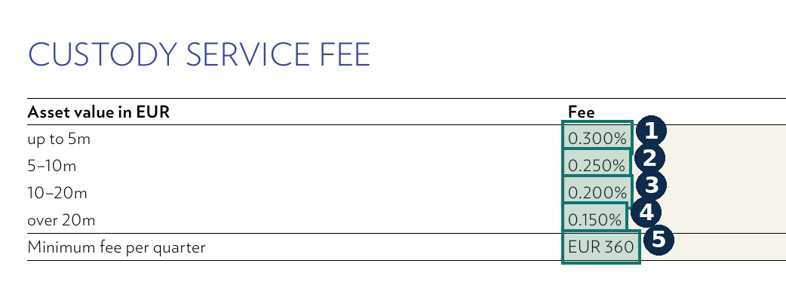

Julius Baer: from price list to data, field by field
REAL DOCUMENT · PRICE LIST
ORIGINAL PAGE, ZOOMED IN
Schedule of prices and services, banking and custody
Bank Julius Baer Europe S.A., Luxembourg · PU00505EN · June 2025 · English · 9 pages
COVER, P.1
EXTRACTED DATA
1
Custody up to 5m
0.300% p.a.
Contractual
p.3
Valid only for Luxembourg-booked accounts. For a Swiss-booked client FeeLens rejects this tariff.
2
Custody 5–10m
0.250% p.a.
Contractual
p.3
3
Custody 10–20m
0.200% p.a.
Contractual
p.3
4
Custody over 20m
0.150% p.a.
Contractual
p.3
5
Minimum per quarter
EUR 360
Contractual
p.3
Notes:
Source: juliusbaer.com/fileadmin/legal/schedule-of-prices-and-services-banking-and-custody.pdf, downloaded 6.11.2026. Green boxes are the values FeeLens extracts, with their position on the page. The same document also gives FX spot up to 3% (p.6) and transfer EUR 100 per position (p.8), used to estimate switching costs.

Slide 8
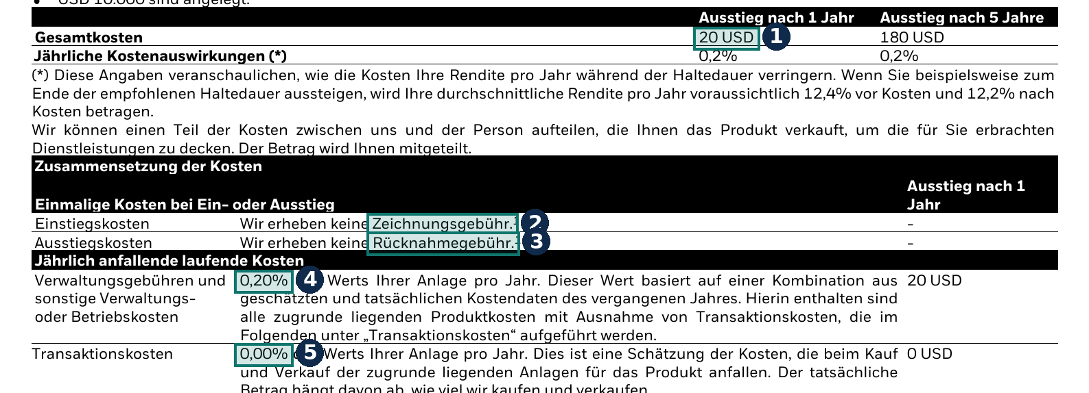
An official KID: the fund's costs in five fields
REAL DOCUMENT · FUND KID
ORIGINAL PAGE, ZOOMED IN
iShares Core MSCI World UCITS ETF · Basisinformationsblatt
BlackRock Asset Management Ireland · IE00B4L5Y983 · USD Acc · 3 September 2026 · German · page 3 of 3
How it is used
Estimated cost = ongoing costs × position value
Example: CHF 500'000 × 0.20% = CHF 1'000 a year, labelled “Estimated”.
EXTRACTED DATA
1
Total cost, 1 year, on USD 10'000
USD 20
Illustration
p.3
2
Entry charge
none
Contractual
p.3
3
Exit charge
none
Contractual
p.3
4
Ongoing costs
0.20% p.a.
Estimated
p.3
5
Transaction costs
0.00% p.a.
Estimated
p.3
Notes:
Source: PRIIPs KID for IE00B4L5Y983, created 3.9.2026 (copy at fsl.lv1871.de). KIDs are public for every fund and FeeLens fetches them by ISIN: the only thing that goes online is the public ISIN.

Slide 9
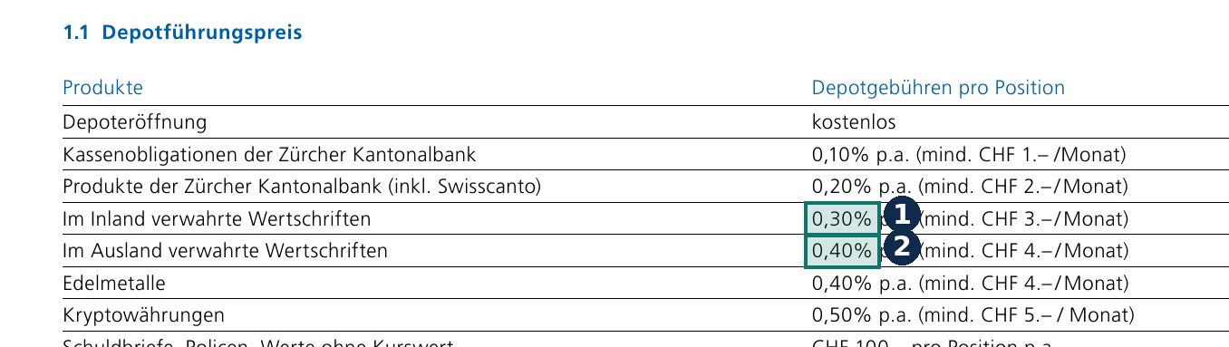
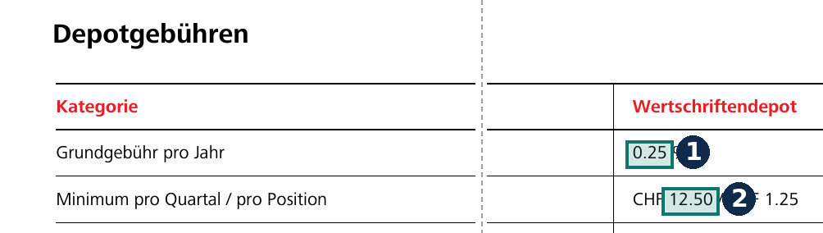
Two Swiss banks, the same line: custody
REAL DOCUMENTS · SWISS PRICE LISTS
Preisübersicht Anlagegeschäft · prices from October 2025 · German
Dienstleistungspreise Anlegen · from 1 January 2025 · German
1
Securities held in Switzerland
0.30% p.a., min CHF 3/month
p.1
1
Securities account, base fee
0.25% p.a.
p.2
2
Securities held abroad
0.40% p.a., min CHF 4/month
p.1
2
Minimum per quarter
CHF 12.50
p.2
Example: CHF 1m of foreign securities at ZKB = CHF 4'000 a year in custody alone, plus VAT for Swiss-domiciled clients.
Notes:
Sources: zkb.ch (Preisübersicht Anlagegeschäft, October 2025) and raiffeisen.ch (Raiffeisenbank Locarno, January 2025), downloaded 6.11.2026. Shown as examples of public documents; no comparison between banks is implied.

Slide 10



Every extracted value becomes one of five kinds of data
DATA
Positions
Fees charged
Contract terms
Product costs
Evidence
ISIN and class
Quantity, price, value
Currency, date
Type and period
Base and rate
Amount, VAT
Rates and tiers
Minimums
Entity and validity
Ongoing costs
Transaction costs
KID date
File and page
Box on the page
Who confirmed it
EVERY COST HAS A STATUS
Observed
Contractual
Estimated
Not a paid cost
Not determined
The first three count in the total. “Not determined” is never zero: that is why savings are always “at least”.
Notes:
The data model is the same for every bank: that is what makes the tool generic.

Slide 11


Before trusting a number, documents are checked against each other
RECONCILIATION
Do the numbers add up?
Billed = agreed?
Is the source valid for this client?
Pass
Alpha positions = printed total, 3'200'000
Pass
Advisory = 3.2m × 0.80%
Rejected
Tariff of a Luxembourg entity for a Swiss account: rejected
Pass
Beta positions = printed total, 1'100'000
Pass
Custody = 3.0m × 0.20%
Pass
KID costs within 2.6% of the bank's estimate
Pass
All valued on 30.09.2026
Pass
Quarterly debits × 4 = annual report, counted once
Note
Retrocessions CHF 3'900: already in fund costs, not added
Mismatches stay visible to the analyst: never forced to agree. Figures from synthetic prospect P-1042.
Notes:
These are the checks the demo engine actually ran on the synthetic documents.

Slide 12
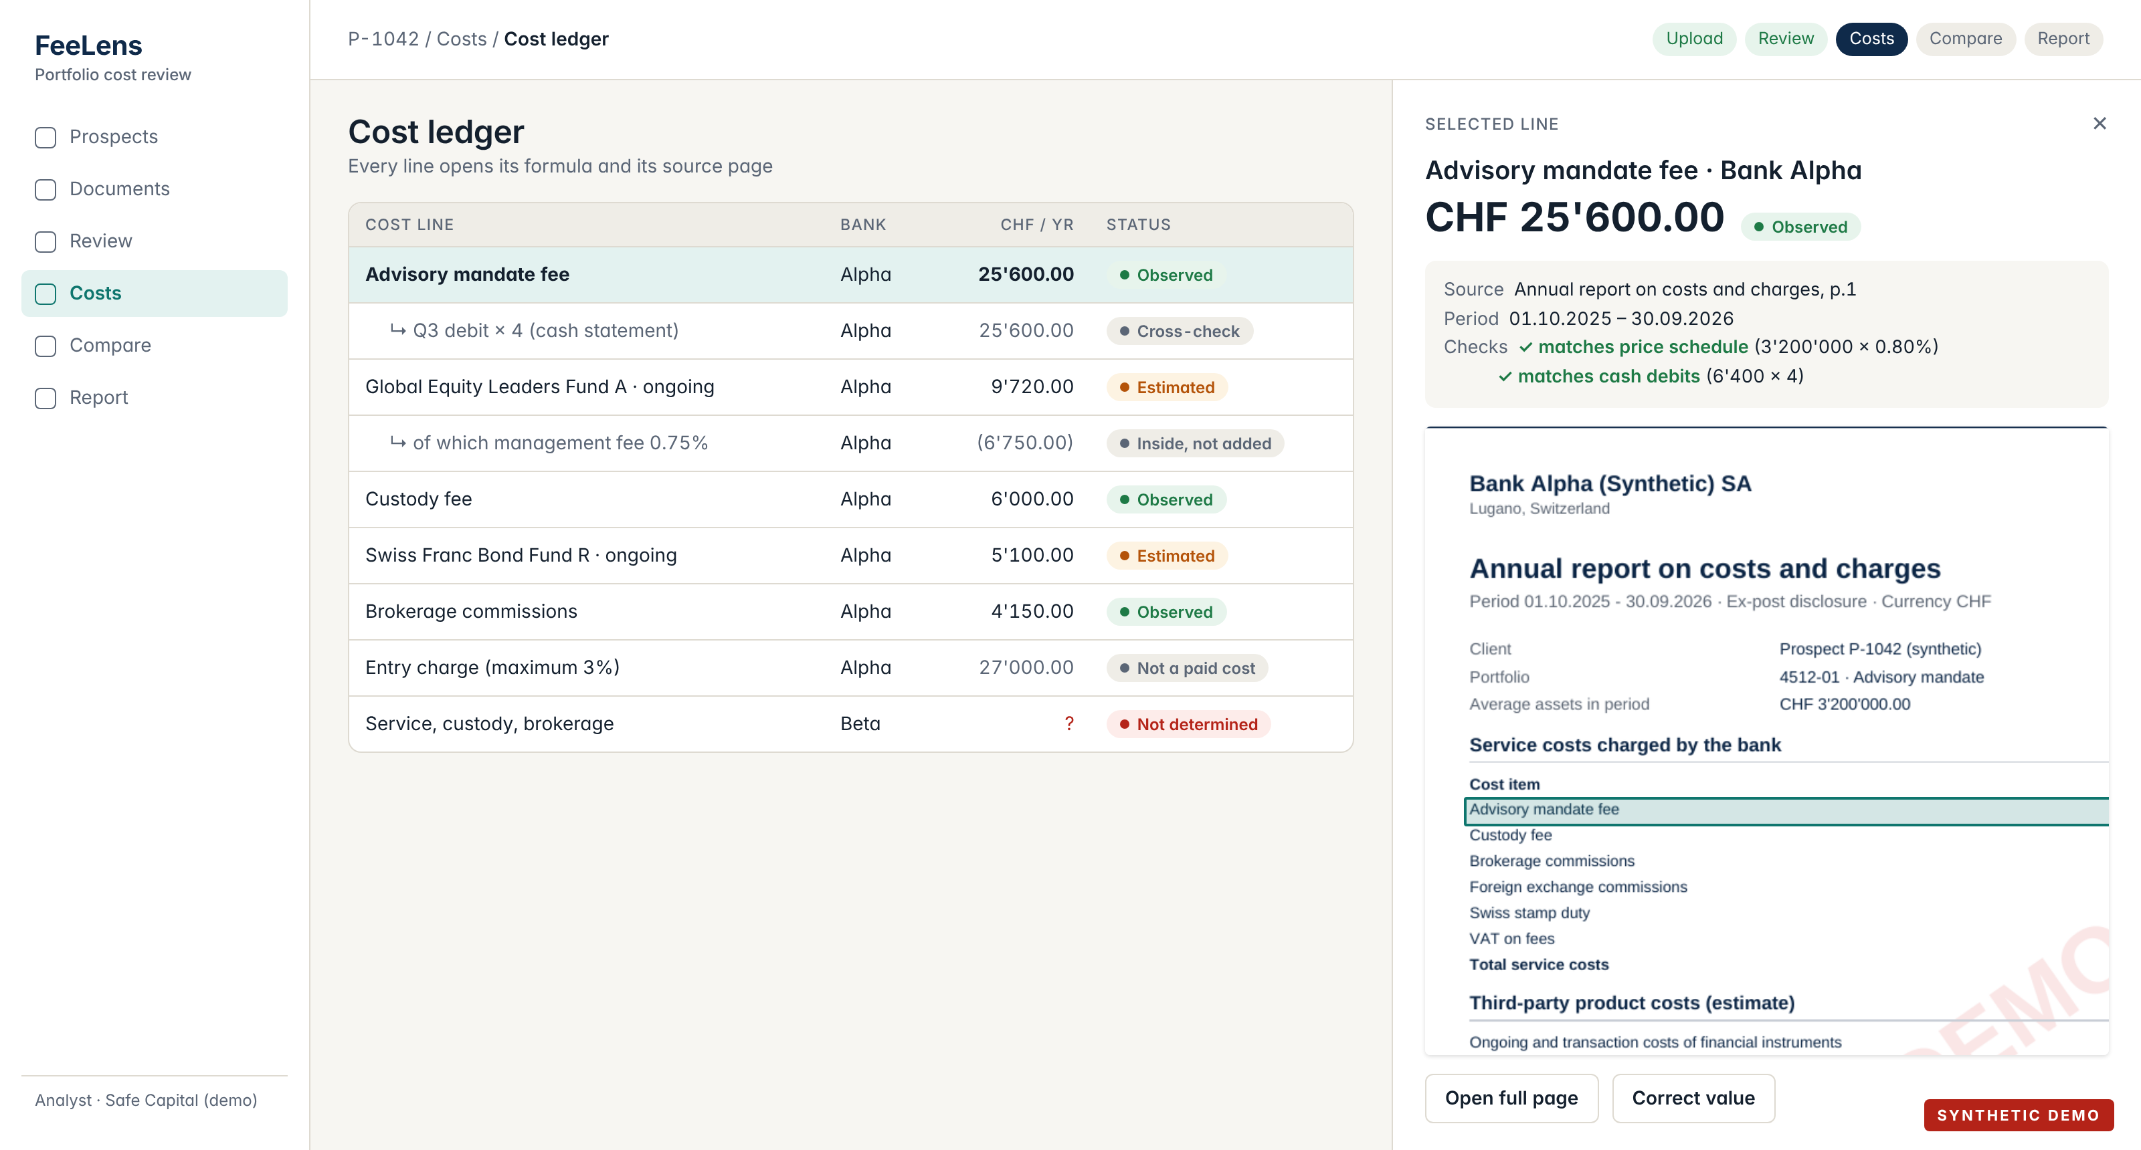
Every number opens up: formula, checks and source page
THE SCREEN
Notes:
App mockup with the engine's synthetic data. Selecting a line shows amount, status, highlighted source page, formula and the checks passed.

Slide 13
Same holdings, every Safe Capital cost included
THE RESULT
AT LEAST
CHF 6'520
less per year, same holdings
Switching cost paid back in
2.8 months
Today
CHF 60'840 · 1.41%
With Safe Capital
CHF 54'320 · 1.26%
“At least”: Bank Beta's own fees are still unknown.
Swiss stamp duty (CHF 610) left out on both sides.
New funds: shown apart, not a fee saving.
Notes:
Safe Capital is an external asset manager: assets stay at a custodian bank, so the proposal includes Safe Capital's fee (tiered 0.70% / 0.50%) and the partner custodian's custody, trading and FX. VAT 8.1% because the synthetic client lives in Switzerland; it depends on domicile. Exact saving CHF 6'520.10; switching cost CHF 1'500. New funds: at least CHF 14'700 a year, payback 3.3 months, but not like for like.

Slide 14

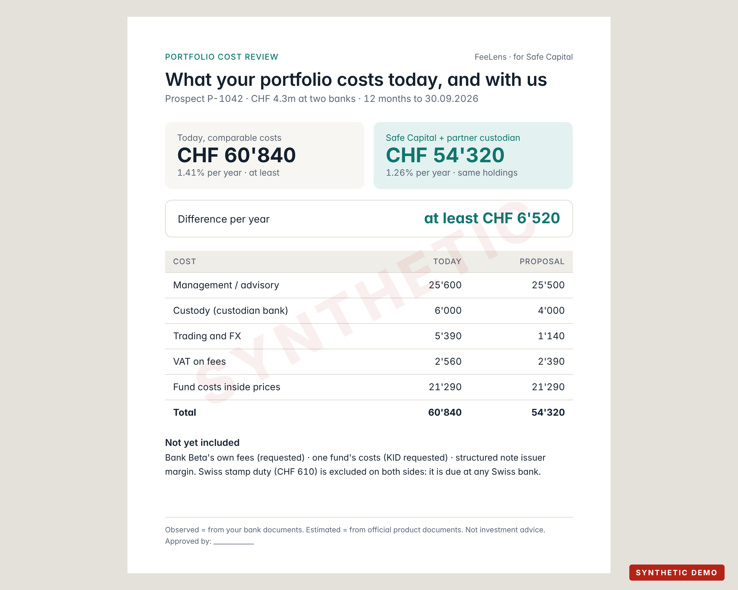



What you get at the end of every analysis
THE OUTPUTS
Client report
One page in the client's language: today vs Safe Capital, line by line, what is missing.
Request letter to the bank
Lists the missing documents and why they matter, ready to sign.
Cost ledger with sources
Every line with document, page, status and checks passed.
Internal view (staff only)
Safe Capital's margin on the prospect: never in client material.
Notes:
The report is exported from approved numbers only and states it is not investment advice.

Slide 15









Runs on Safe Capital's own infrastructure; files stay confidential
DATA AND PRIVACY
In the office
Swiss private hosting
External AI services
Recommended for the pilot
Option for production
Off by default
Client consent
Only what is needed
Encrypted
Named, logged access
No public AI on files
Deleted on schedule
The only thing that goes online: public ISIN codes, to fetch KIDs. No names, no amounts.
The revised Swiss FADP applies (in force since 1 September 2023). Banking secrecy and outsourcing rules to be checked by Safe Capital's counsel; this is not legal advice.
Notes:
Swiss hosting helps but does not by itself make processing compliant: contracts, access and retention matter too.

Slide 16
A pilot on real cases before production
THE PLAN
NOW
PHASE 1
PHASE 2
PHASE 3
Demo
Pilot
Harden
Production
Working engine on synthetic documents and real price lists
1–3 anonymised real cases; measure accuracy and time
More bank layouts, security review, logins
Live at Safe Capital after compliance sign-off
Durations are set after the pilot, once we know how many bank layouts Safe Capital's prospects bring.
Notes:
No dates before seeing real documents.

Slide 17



NEXT STEP
Let's run the pilot on one real case
WE NEED
One anonymised real case
Safe Capital's tariffs
Two confirmations
Statements, 12 months of fees, the contract
Fee and partner custodian
Where it runs (office or Swiss) and consent wording
IN RETURN the FeeLens report for that case: every cost with its source, and the comparison with Safe Capital.
No source, no verified figure · Missing is never zero · No comparable service, no savings claim
Notes:
Also to confirm: legal entity and licence to cite (Safe Capital Management SA, CHE-381.156.096, is in the commercial register; the FINMA authorisation stated on its website is not yet checked in the FINMA register) and a trademark search for the name FeeLens.

Slide 18
What the client brings and what each document proves
DEEP DIVE · DOCUMENTS
DOCUMENT | WHAT WE READ | PROVES | CANNOT PROVE | NEED
Statement of assets | ISIN, quantity, price, value, currency, date, total | Holdings at a date | Fees | Essential
Annual cost report | Service costs, product costs, third-party payments | Near-complete annual cost | FX margins not listed | Essential
Fee advices | Type, period, base, rate, amount, VAT | Every debit | Costs inside products | Essential*
Contract / price list | Rates, tiers, minimums, scope, entity | What was agreed | What was billed | Helpful
Trade confirmations | Commission, third-party, stamp duty, FX rate | Trading costs | Contract terms | Helpful
Fund KID | Ongoing, transaction, entry/exit costs | Cost rates | What the client paid | Fetched
Retrocessions | Payments from providers, refunded or kept | Conflicts, refunds | Direct cost | Ask bank
* or the cost report. Formats: PDF, scans, photos, Excel, CSV. Italian, German, French, English.
Notes:
Full taxonomy of 31 document types in data/taxonomy/document_types.csv.

Slide 19
The ten cost layers
DEEP DIVE · COST LAYERS
 | LAYER | WHAT | VISIBLE AS
L1 | Service | Management, advisory, all-in, EAM fee | Debit
L2 | Custody and account | Safekeeping (tiers, minimums), account fees | Debit
L3 | Trading | Brokerage, ticket, third-party, FX commission | In net amount
L4 | Funds and ETFs | Ongoing, transaction, performance, entry/exit | Inside NAV
L5 | Structured products | Issuer margin, distribution | Inside price
L6 | Implicit execution | FX margin, bid/ask spread | Inside rate
L7 | Insurance wrapper | Policy charges | Partly
L8 | Financing | Lombard interest | Debit
L9 | Taxes | VAT (by domicile), stamp duty | Debit
L10 | One-off / switching | Transfer per position, exit, sale | Once
Notes:
Source: docs/research/FEE_TAXONOMY.md. Retrocessions sit beside the total: they are already inside fund costs.

Slide 20
Local open-source tools, with clear rules
DEEP DIVE · TECHNOLOGY
INPUT | TOOL | WHAT IT DOES | LICENCE
Born-digital PDF | pdfplumber, Docling | Words with coordinates, tables | MIT
Scans and photos | OCRmyPDF + Tesseract | Text from images; IT, DE, FR, EN | MPL-2.0 / Apache-2.0
Excel, CSV | openpyxl | Sheet and cell as evidence | MIT
Page images | pypdfium2, PDF.js | Pages with highlighted boxes | Apache-2.0 / BSD
Avoided | PyMuPDF, cloud OCR | AGPL licence; data would leave the office | —
AI suggests; code checks it against the page text
No arithmetic by AI: deterministic sums
Every correction records who, when and why
Notes:
Source: docs/research/EXTRACTION_TOOLING.md. Accuracy measured field by field on anonymised real cases in the pilot.

Slide 21
Words used
DEEP DIVE · GLOSSARY
KID
Ongoing charges (TER/OCF)
Official cost sheet for each fund share class.
Yearly fund costs, taken from the price. Include the management fee.
Retrocession
Custodian bank
Payment from a product provider to the bank or manager.
The bank holding the assets. With an external manager the client pays both.
EAM
bps
External asset manager, like Safe Capital.
Basis points: 100 bps = 1% a year.
Like for like
Stamp duty
Same holdings, same service: only fees differ.
Federal tax on trades, due at any Swiss bank.
Notes:
Retrocession ownership follows Swiss case law; to verify against the primary source.

