Slide 1
FeeLens
See what a portfolio really costs. In minutes, with proof.
Briefing for Massimo · Safe Capital, Lugano · November 2026
Concept and working demo · every figure in this deck is synthetic
Notes:
FeeLens (working name) reads a prospect's bank and product documents, finds every cost with its source, and compares it fairly with Safe Capital's offer. Everything shown uses the synthetic demo prospect P-1042; no real client, bank or saving is represented.

Slide 2






Statements show less than half the story
THE PROBLEM
CHF 38'086
what the bank's cost report lists as charged
Costs are spread over six kinds of document
Fee statements
management, custody
Contracts & tariffs
rates, tiers, minimums
CHF 59'376
what the portfolio actually costs per year, at least
Trades & FX
commissions, FX margins
Fund prices
ongoing charges inside NAV
Synthetic prospect P-1042, CHF 4.3m at two banks. The CHF 21'290 gap is fund costs taken inside product prices, and Bank Beta's fees are still unknown.
Structured notes
issuer margin in the price
Insurance wrappers
policy fees on top
Notes:
The three lower rows never appear as a debit: they are deducted inside the product price. That is why prospects usually underestimate what they pay. Figures are synthetic, from the demo engine.

Slide 3




Upload, verify, compare: a free cost check in one meeting
WHAT FEELENS DOES
Upload
Verify
Compare
The client's statements, cost reports and contracts from any bank: PDF, scans, Excel.
Every cost is extracted, linked to its page, checked against other documents, and labelled proven, estimated or unknown.
Same holdings with Safe Capital and its custodian bank, switching costs included, on one page for the client.
No source, no verified figure
Missing is never zero
No comparable service, no savings claim
Target: a first draft within minutes of upload, then an analyst check. Speed will be measured in the pilot.
Notes:
The three rules are what make the result defensible in front of a client and a compliance officer.

Slide 4
Who does what, from documents to report
WORKFLOW
Client
Signs consent
Hands over documents
FeeLens
Classify and read every page
Reconcile documents
Find fund costs in official KIDs
Build cost ledger and scenarios
Draft the report
Safe Capital analyst
Confirm flagged values
Set Safe Capital and custodian fees (once)
Approve and sign
Output
Request letter for missing documents
One-page client report
The client sends the missing documents; the analysis updates and the gaps close.
Notes:
Dark boxes are automatic. Analyst steps are short: confirming values the engine is unsure of, setting Safe Capital's own tariff once, and signing the report. Nothing reaches a client without that signature.

Slide 5
What the client brings, and what each document can prove
DOCUMENTS
DOCUMENT | WHAT WE READ | PROVES | CANNOT PROVE | NEED
Portfolio / asset statement | ISIN, quantity, price, value, currency, date, total | Holdings at a date | Fees | Essential
Annual cost & charges report | Service costs, product costs, third-party payments | Near-complete annual cost | FX margins, if not listed | Essential
Fee advice / cash statement | Fee type, period, base, rate, amount, VAT | Every billed debit | Costs inside products | Essential*
Mandate contract / tariff | Rates, tiers, minimums, all-in scope, exclusions | What was agreed | What was billed | Helpful
Trade & FX confirmations | Commission, third-party fees, stamp duty, FX rate | Explicit trading cost | Contract terms | Helpful
Fund KID (official) | Share class, ongoing, transaction, entry/exit costs | Product cost rates | What the client paid | We fetch
Retrocession statement | Payments from product providers, refunded or kept | Conflicts and refunds | Client cost directly | Ask bank
Insurance policy statement | Policy value, wrapper charges, underlying funds | Wrapper charges | Underlying fund costs | If wrapped
* either the cost report or the fee advices. Accepted formats: PDF, scans or phone photos (OCR), Excel, CSV. Italian, German, French and English.
Notes:
Full taxonomy of 31 document types with IT/DE/EN names is in data/taxonomy/document_types.csv. In Switzerland the annual cost report is often only provided on request, so the engine drafts that request.

Slide 6




Everything extracted becomes one of five kinds of data
DATA
Positions
Fees charged
Contract terms
Product costs
Evidence
ISIN and share class
Quantity, price, value
Currency, valuation date
Bank, account
Fee type and period
Base and rate
Amount, VAT
Debit date
Rates and tiers
Minimums
All-in scope
Booking entity
Ongoing charges
Transaction costs
Entry / exit (max)
KID date and class
File and page
Box on the page
Original text
Who confirmed it
Every position, fee, term and product cost carries its evidence. Each one also gets a status: observed, contractual, estimated, not a paid cost, or not determined. A number with no evidence never reaches the cost total.
Notes:
This is the canonical data model in plain words. Bank-specific layouts all map onto these five kinds, which is what makes the tool generic for any bank.

Slide 7
Ten cost layers, in four places a client may never look
COST LAYERS
Debited from the account
Inside product prices
Inside execution rates
Wrapper and one-off
Service: management, advisory, all-in
Funds and ETFs: ongoing and transaction costs
FX margins and bid/ask spreads
Insurance wrapper charges
Custody and account
Structured products: issuer and distribution margin
Switching: transfer, exit, sale costs
Trading: brokerage, third-party
Financing: Lombard interest
Taxes: VAT, stamp duty
Beside the total, never inside it: retrocessions paid by product providers to the bank. They are already part of fund costs; only a refund to the client lowers the cost.
Notes:
The ten layers (L1 to L10) are defined in docs/research/FEE_TAXONOMY.md. Clients see the first column on statements; the second column is usually the surprise.

Slide 8
Every cost carries a status, and only some are added up
EVIDENCE
STATUS
MEANING
EXAMPLE (P-1042)
AMOUNT
IN THE TOTAL
Observed
Taken from a bank document
Advisory fee, Bank Alpha
CHF 25'600
Counted
Contractual
Calculated from an agreed tariff
Safe Capital fee, proposal
CHF 25'500
Counted
Estimated
Official rate × position value
Global Equity Leaders, 1.08%
CHF 9'720
Counted
Not a paid cost
A maximum or an illustration
Entry charge, up to 3%
CHF 27'000
Shown, not added
Not determined
No document yet
Bank Beta service fees
?
Never zero
The fund's management fee (0.75%) is part of its 1.08% ongoing charge. It is shown as detail and not added a second time.
Notes:
Statuses follow the shared design system (icon plus label, never colour alone). The KID's illustrative amounts and maximum entry charges are visible for transparency but are not costs the client paid.

Slide 9


Before trusting a number, documents are checked against each other
RECONCILIATION
Do the numbers add up?
Is what was billed what was agreed?
Is the source valid for this client?
Pass
Alpha positions = printed total, 3'200'000
Pass
Advisory fee = 3.2m × 0.80%
Rejected
Beta price list is from its Luxembourg entity: rejected
Pass
Beta positions = printed total, 1'100'000
Pass
Custody fee = 3.0m × 0.20%
Pass
Fund costs from KIDs within 2.6% of the bank's estimate
Pass
All holdings valued on 30.09.2026
Pass
Quarterly debits × 4 = annual report, counted once
Note
Retrocessions CHF 3'900: inside fund costs, not added
Mismatches stay visible for the analyst. They are never silently forced to agree.
Notes:
These are the actual checks the demo engine ran on the synthetic P-1042 documents. A tariff from a different legal entity or country (here Luxembourg for a Swiss-booked account) is rejected automatically.

Slide 10
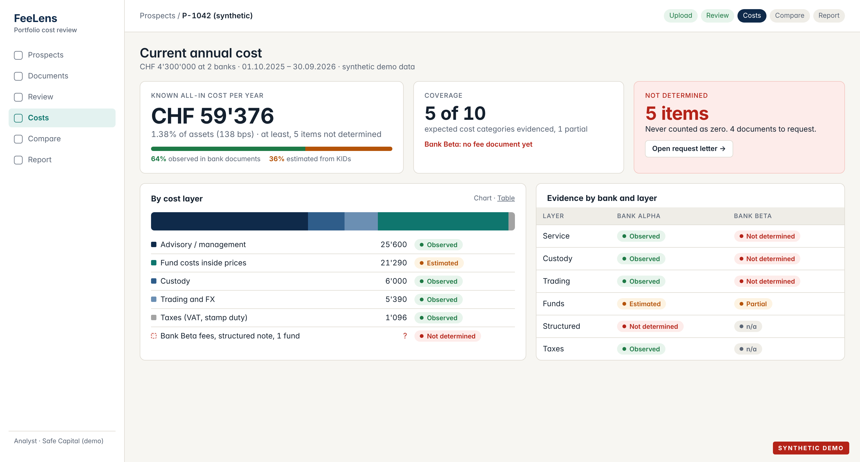
The headline always comes with its coverage
SCREEN · COSTS
Notes:
Mockup in the shared design system, with the engine's synthetic P-1042 output. Known cost CHF 59'376 (1.38%), 64% observed in bank documents, 36% estimated from KIDs, five items not determined and shown as such. The bank-by-layer grid shows at a glance where evidence is missing.

Slide 11
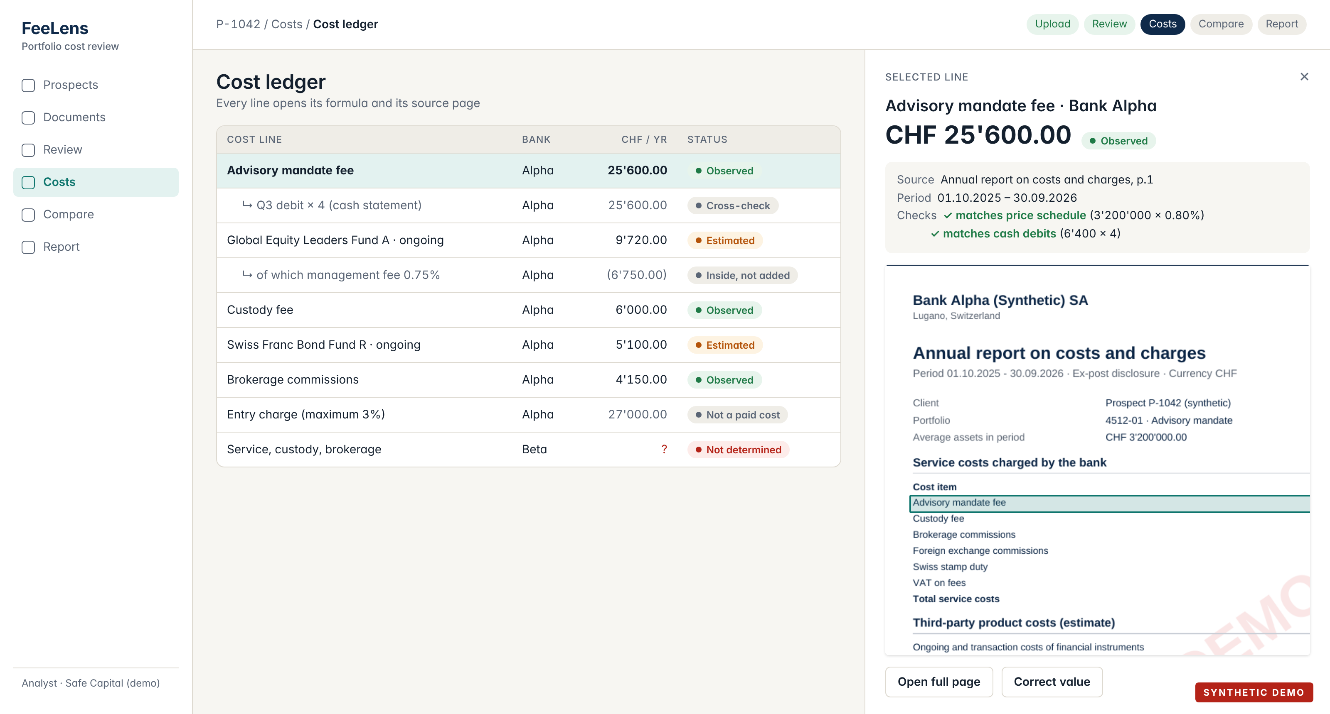
Click any number: formula, checks and source page
SCREEN · DRILL-DOWN
Notes:
Every line opens a side panel with the amount, its status, the source page with the value highlighted, the formula and the cross-checks it passed. Overlaps (management fee inside ongoing charges) and maximums are shown but not added.

Slide 12
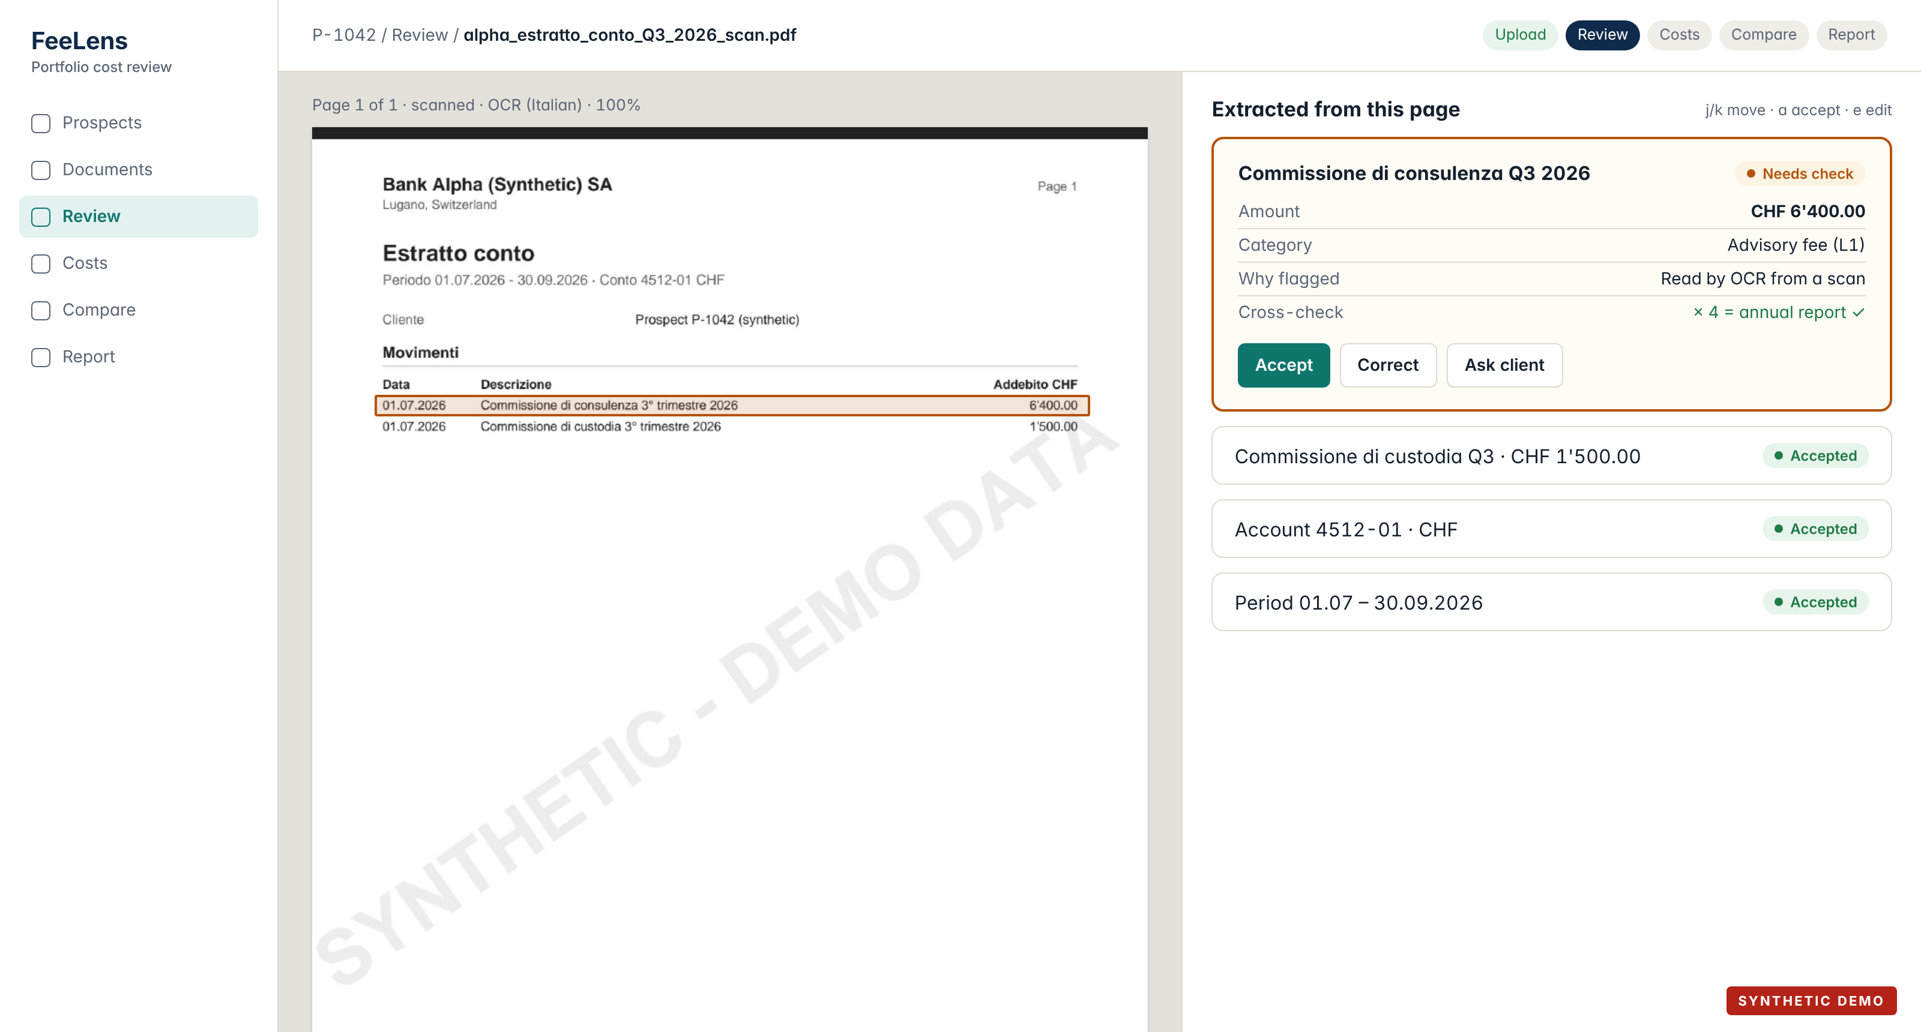
Scans and uncertain values get a human check
SCREEN · REVIEW
Notes:
The original page on the left, extracted values on the right. Values read by OCR from a scan are flagged; the analyst accepts, corrects or turns them into a question for the client. Keyboard shortcuts keep this fast.

Slide 13
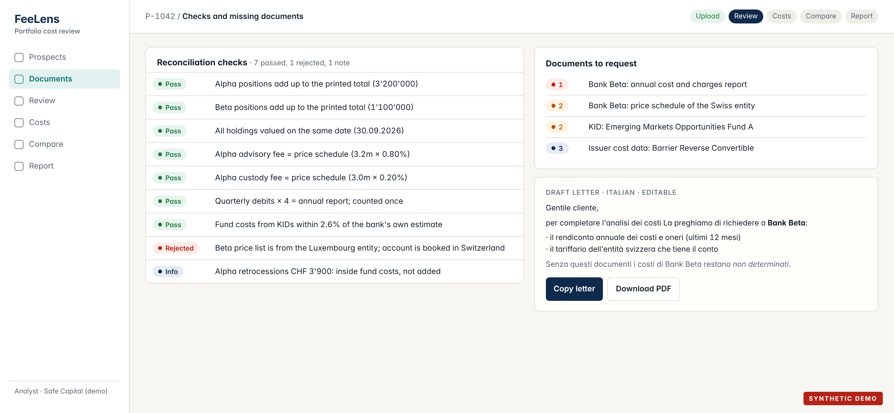
Gaps turn into a ready-to-send request letter
SCREEN · CHECKS
Notes:
Reconciliation results and the documents still needed, ranked by impact. The request letter is drafted in the client's language (Italian here) and explains why each document matters.

Slide 14
Same holdings first, with every Safe Capital cost included
COMPARE
Today, comparable
CHF 58'766
1.37%
Safe Capital, same holdings
CHF 54'320
1.26%
Safe Capital, new funds
CHF 46'140
1.07%
at least CHF 4'447 per year
same holdings, like for like
"At least": Bank Beta's own fees are still unknown, so today's real cost is higher.
Swiss stamp duty (CHF 610) is left out on both sides: it is due at any Swiss bank.
New funds change risk and products: shown apart, never as a fee saving.
Notes:
Safe Capital is an external asset manager: client assets stay at a custodian bank, so the proposal adds Safe Capital's fee (tiered 0.70% / 0.50%) and the partner custodian's custody, trading and FX fees. VAT at 8.1% applies because the synthetic client is domiciled in Switzerland; it depends on domicile. All figures come from the demo engine and are synthetic.

Slide 15

Switching costs are counted, and paid back within months here
YEAR ONE
 | Same holdings | New funds
Annual difference, at least | CHF 4'446.50 | CHF 12'626.50
One-off switching costs | – CHF 1'500.00 | – CHF 4'000.00
Net in year one | CHF 2'946.50 | CHF 8'626.50
Payback | 4.0 months | 3.8 months
Like for like? | Yes | No: products change
Payback = switching cost ÷ annual difference × 12
Switching costs come from the banks' transfer fees and the positions sold. In this synthetic case they are small; with real prospects exit fees and taxes can change the picture, and the tool shows that honestly.
Safe Capital's own margin on the prospect is calculated on a separate internal screen and never appears in client material.
Notes:
Engine output for P-1042: same holdings 1'500 transfer fees (Alpha 500, Beta estimate 1'000), payback 4.0 months; new funds 4'000 switching, payback 3.8 months. The internal view reports 'insufficient evidence' for an acquisition decision until Bank Beta's fees are known.

Slide 16
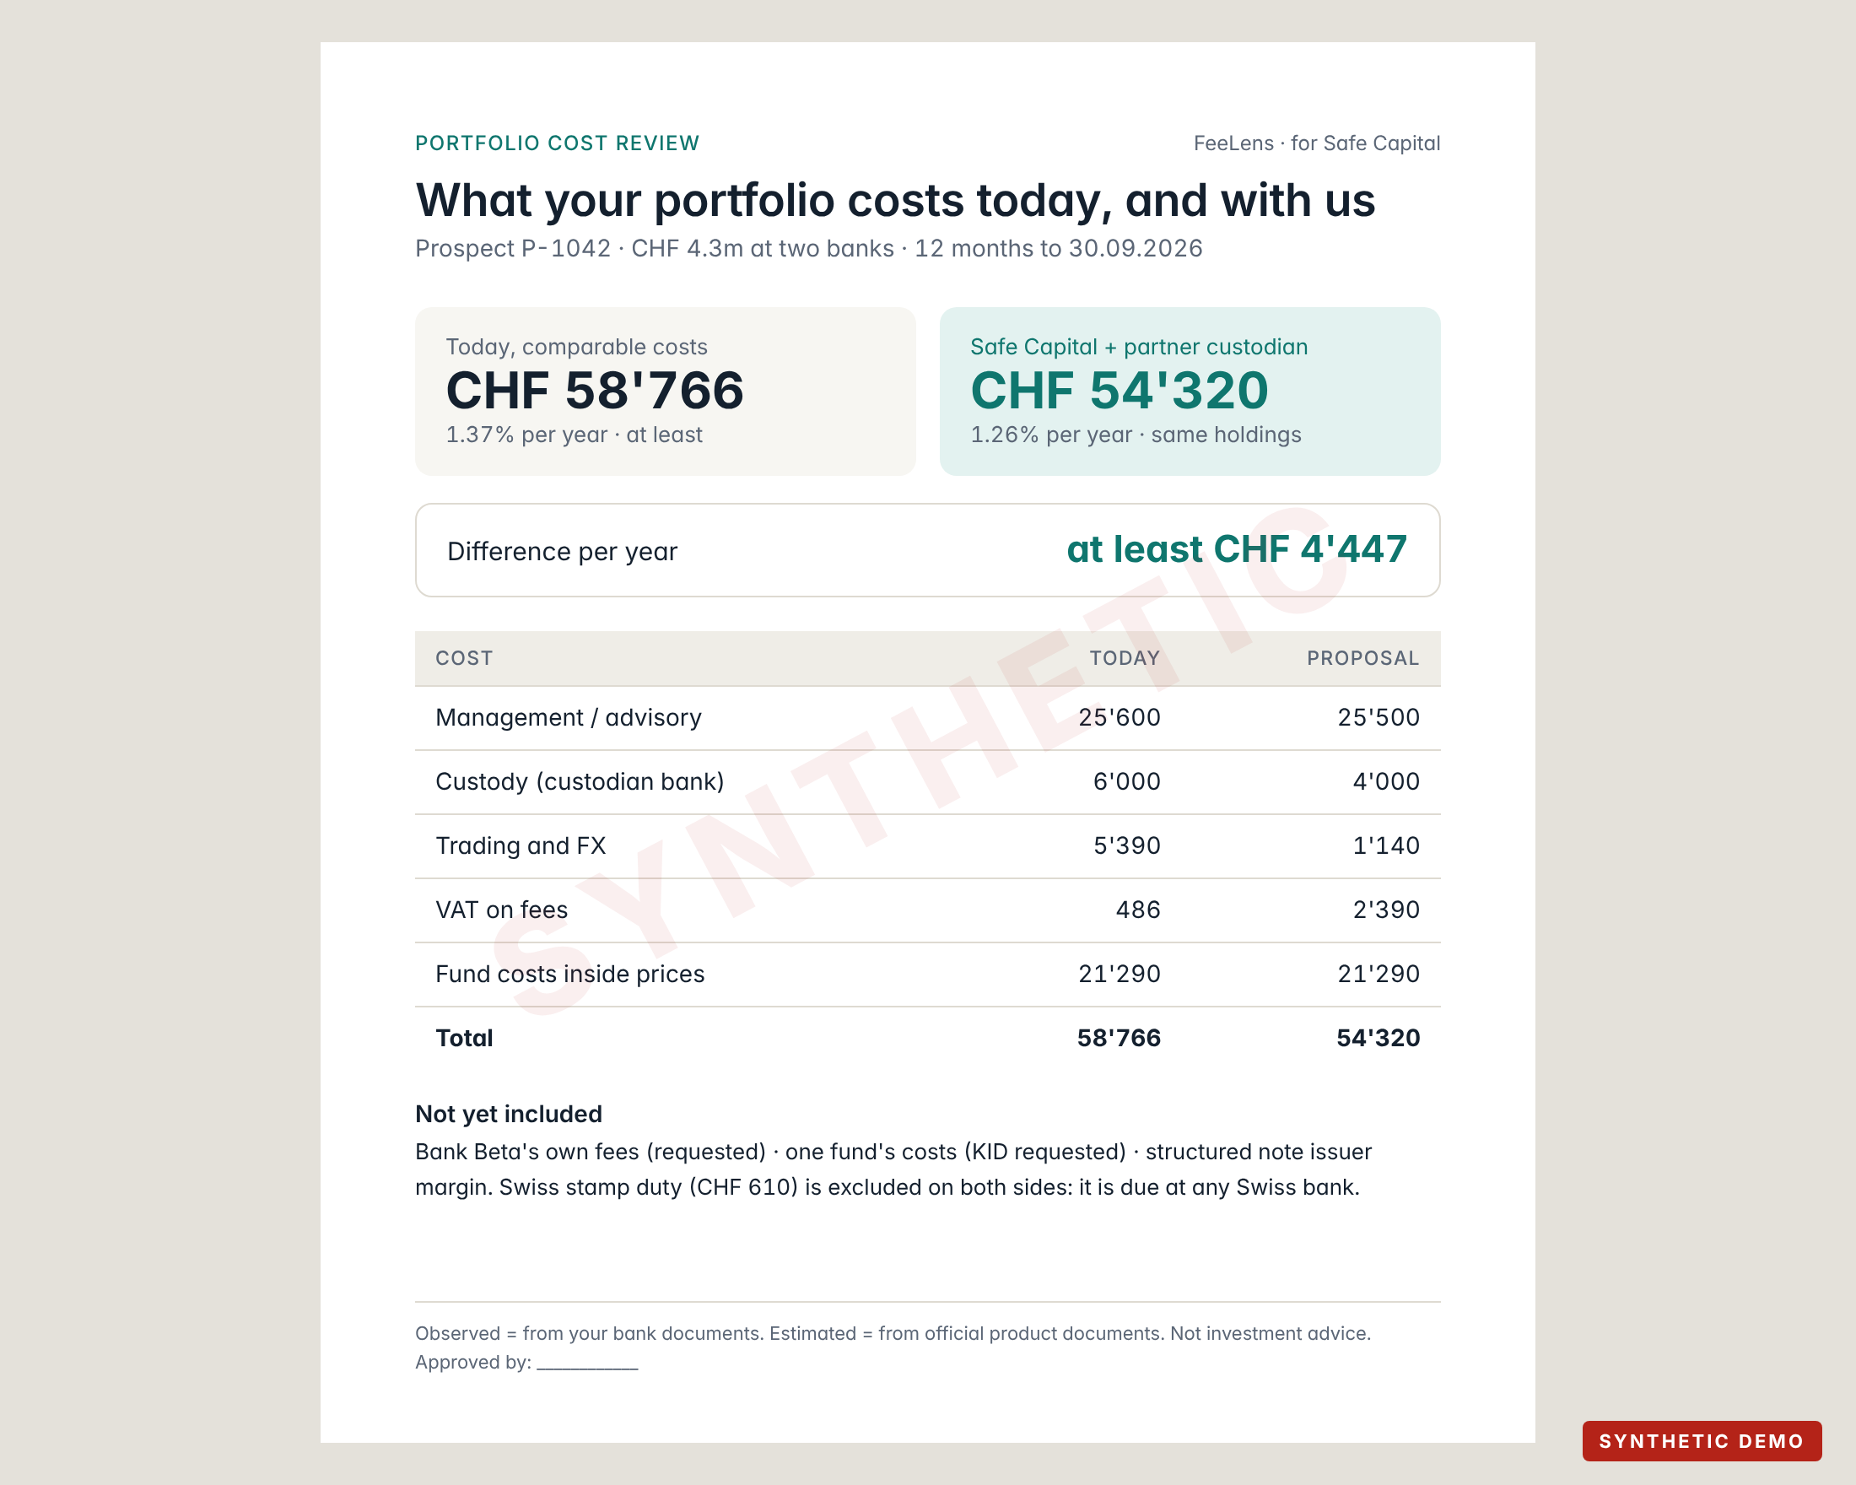




One page the client can read, approved before it leaves
CLIENT REPORT
On the page
Today vs Safe Capital, line by line, observed vs estimated
Also on the page
What is still missing, and the stamp duty exclusion, in plain words
Never on the page
Safe Capital's internal margin and analyst notes
Before it leaves
An approver signs it off; the version is frozen and logged
Notes:
PDF export from approved numbers only, in the client's language. States that it is not investment advice.

Slide 17



It runs on Safe Capital's own infrastructure by default
HOSTING
A · In the office
B · Swiss private hosting
C · External AI services
One secured machine at Safe Capital. Documents never leave the building.
Dedicated server at a Swiss provider, under a data-processing contract. For several users.
Only for hard pages, only with explicit approval, only on redacted excerpts.
Recommended for the pilot
Option for production
Off by default
The only thing that goes online: public fund codes (ISINs) to fetch official product documents. No names, no amounts, no statements.
Notes:
Swiss hosting helps but does not by itself make processing compliant; contracts, access control and retention matter as much. Final choice with Safe Capital's compliance officer.

Slide 18






Client files stay confidential from upload to deletion
PRIVACY
Client consent
Only what is needed
Encrypted
A short signed authorisation before any upload
Names can be blacked out; costs need no identity
At rest and in transit; one space per prospect
Named access
No public AI on raw files
Deleted on schedule
Personal logins, two-factor, every view logged
Unless Safe Capital approves a provider
Retention agreed up front, then erased
Swiss Federal Act on Data Protection (revised, in force since 1 September 2023) applies. Bank-client confidentiality and outsourcing rules must be checked by Safe Capital's counsel; this is not legal advice.
Notes:
Pseudonymised data can still be personal data. A data-protection impact assessment may be needed; that decision belongs to Safe Capital and its counsel.

Slide 19


The engine reads and calculates; people decide
PEOPLE AND MACHINE
Automatic, by FeeLens
A person at Safe Capital
Recognise each document, bank and language
Extract positions, ISINs and fees with their page
Fetch official fund cost documents
Run the reconciliation checks
Build the ledger and both scenarios
Draft the request letter and the report
Enter Safe Capital's and the custodian's fees, once
Confirm values the engine flags
Decide whether a comparison is like for like
Approve and sign the client report
Present it and talk to the client
Notes:
Manual configuration is mostly one-time: Safe Capital's tariff, the custodian's terms and the report template. Per prospect, the human effort depends on document quality.

Slide 20
Delivery in phases, with a real pilot before production
PLAN
NOW
PHASE 1
PHASE 2
PHASE 3
Demo
Pilot
Harden
Production
Working engine on synthetic documents; this deck
1–3 anonymised real prospects; measure accuracy and time
More bank layouts, security review, user logins
Live at Safe Capital after compliance sign-off
Durations are set after the pilot, once we know how many bank layouts Safe Capital's prospects bring.
Notes:
No dates before seeing real documents: the number of bank layouts drives the effort.

Slide 21
Six decisions to start the pilot
DECISIONS
01
02
One anonymised real case
Safe Capital's pricing
holdings, 12 months of fees, the contract
advisory fee, partner custodian and its tariff
03
04
Comparison policy
Where it runs, who sees it
same holdings only, or also a new-funds case
office machine or Swiss hosting; named users
05
06
Consent and retention
Name and legal entity
authorisation wording; how long files are kept
confirm "FeeLens", the entity and licence to cite
Notes:
Decision 6: Safe Capital Management SA (CHE-381.156.096, Lugano) is in the commercial register. Its website states FINMA authorisation with OSIF supervision; this has not yet been checked in the FINMA register, so nothing in client material should state it until confirmed. The product name also needs a trademark search.

Slide 22
Next: one real case
No source, no verified figure · Missing is never zero · No comparable service, no savings claim
Notes:
Ask: one anonymised prospect file and Safe Capital's fee schedule. With those, every synthetic figure here becomes a real, source-linked one.

Slide 23
The ten layers in detail
DEEP DIVE · COST LAYERS
 | LAYER | WHAT | EVIDENCE | VISIBLE AS
L1 | Service | Management, advisory, all-in, EAM fee | Mandate, fee advice, cost report | Debit
L2 | Custody & account | Safekeeping (tiered, minimums), account fees | Tariff, fee advice | Debit
L3 | Explicit trading | Brokerage, ticket, third-party, FX commission | Trade confirmations | In net amount
L4 | Funds & ETFs | Ongoing, fund transaction, performance, entry/exit | KID, factsheet | Inside NAV
L5 | Structured products | Issuer margin, distribution fee | KID, termsheet | Inside price
L6 | Implicit execution | FX margin, bid/ask spread | FX confirmations vs reference | Inside rate
L7 | Insurance wrapper | Policy, admin, risk charges | Policy statement, insurance KID | Partly
L8 | Financing | Lombard interest, commitment fee | Credit agreement, interest advice | Debit
L9 | Taxes & duties | VAT on fees (by domicile), stamp duty | Fee advice, confirmations | Debit
L10 | One-off & switching | Transfer per position, exit, sale costs | Tariff, transfer quote | Once
Notes:
Source: docs/research/FEE_TAXONOMY.md and data/taxonomy/fee_taxonomy.csv (fee codes, overlap rules, default evidence status).

Slide 24
From file to report: seven steps, each one traceable
DEEP DIVE · PIPELINE
Intake
Classify
Extract
Normalise
Reconcile
Ledger
Scenarios
hash, file type, size limits, quarantine, duplicates
bank, document type, period, language
text and tables with page boxes; OCR for scans
Swiss/EU number formats, currencies, rates
totals, dates, tariffs, debits vs reports
fee atoms, overlaps, statuses, Decimal arithmetic
current, same holdings, new funds, payback
Guardrails
AI output is a suggestion until code checks it against the page text
No arithmetic by AI: a deterministic Decimal engine does the sums
Document text is data, never instructions
Audit trail
Every value keeps file, page, box and original text
Every correction keeps who, when, why, before and after
Approved reports are frozen versions
Notes:
This mirrors the demo engine's modules (extraction, engine/ledger, engine/scenarios, analysis).

Slide 25
A local, open-source extraction stack
DEEP DIVE · TOOLS
INPUT | TOOL | WHAT IT DOES | LICENCE
Born-digital PDF | pdfplumber, Docling | Words with coordinates, tables, reading order | MIT
Scans and photos | OCRmyPDF + Tesseract | Adds a text layer; Italian, German, French, English | MPL-2.0 / Apache-2.0
Excel and CSV | openpyxl | Sheet and cell as evidence | MIT
Page images | pypdfium2, PDF.js | Render pages and highlight boxes in the viewer | Apache-2.0 / BSD
Hard scans (later) | PaddleOCR (local) | Benchmark on real documents before adopting | Apache-2.0
Avoided | PyMuPDF, cloud OCR | AGPL licence; client data would leave the office | —
Accuracy is measured per field on a gold set of real anonymised documents in the pilot, not taken from vendor benchmarks.
Notes:
Source: docs/research/EXTRACTION_TOOLING.md. Versions are pinned in the backend.

Slide 26
Words used in this deck
DEEP DIVE · GLOSSARY
KID
Ongoing charges (TER/OCF)
Key Information Document: the official cost sheet a fund must publish for each share class.
Yearly running costs of a fund, taken from its price. Includes the management fee.
Retrocession
Custodian bank
Payment from a product provider to the bank or manager. Belongs to the client unless validly waived.
The bank that holds the assets. With an external manager, the client pays both.
EAM
bps
External asset manager, like Safe Capital: manages assets held at a custodian bank.
Basis points: 100 bps = 1% per year.
Like for like
Stamp duty
Same holdings, same service scope, so only fees differ.
Swiss federal tax on securities trades, due at any Swiss bank.
Notes:
Retrocession ownership follows Swiss case law; marked 'to verify' in the research register until checked against the primary source.

