Slide 1
EVLibScale: A Discrete Event Simulator of EV Charging Stations
Presented by Dylan Varney
Advised by Mike Rogers

Slide 2
Project Goals
Design a multi-process implementation of the EVLib Java library
Implement a scalable discrete event simulator depicting EV Charging Stations
Demonstrate this implementation is scalable and correct

Slide 3
Justification
Electric Vehicles have risen in popularity, and sales are predicted to increase over the next decade
Contemporary Charging Infrastructure for Electric Vehicles is composed partially of a small number of purpose-built Charging Stations (CS) and some businesses which offer charging as an auxiliary service
Expansion of this infrastructure must be done carefully to not overstress the electrical grid
Overstressing the grid can lead to negative effects, such as increased costs and irregular service

Slide 4
Justification (cont.)
Placing additional stress on the grid requires careful planning
Simulation allows this careful planning to occur without affecting the grid
This simulation may depict numerous Charging Stations, and thus must be scalable to ensure speedy results
One method of simulation is discrete event, where real-world happenings are represented as events
This method could effectively represent one Charging Station over a period of time, therefore it is necessary to pursue a scalable parallel version

Slide 5
Justification (cont.)
Due to a lack of parallel discrete event simulation in CS simulation, we chose a particular serial discrete event simulator and parallelized it
This simulator, EVLibSim, implements the Java library EVLib
EVLibSim was not very scalable, and was thus used as the basis for EVLibScale.

Slide 6
Dependent Information - Terminology
A Charging Station (CS) is any public space which offers charging services to an electric vehicle
Electric Vehicles (EV) are those vehicles which fully depend on an electric power source, such as a battery
Charging occurs when an EV is assigned a charging slot
Charging slots can be fast or slow, which determines the rate electricity is transferred at
The environment is based on simulated time, which is different than the user’s time

Slide 7
Dependent Information - EVLibSim
EVLibSim was created by the writers of EVLib as a demonstration of the library
EVLibSim simulates a single Charging Station
Each Station takes a number of values
A number of charging slots
The amounts and sources of energy
The charging rate of each slot
When a Charging Station is created, the user can add events

Slide 8
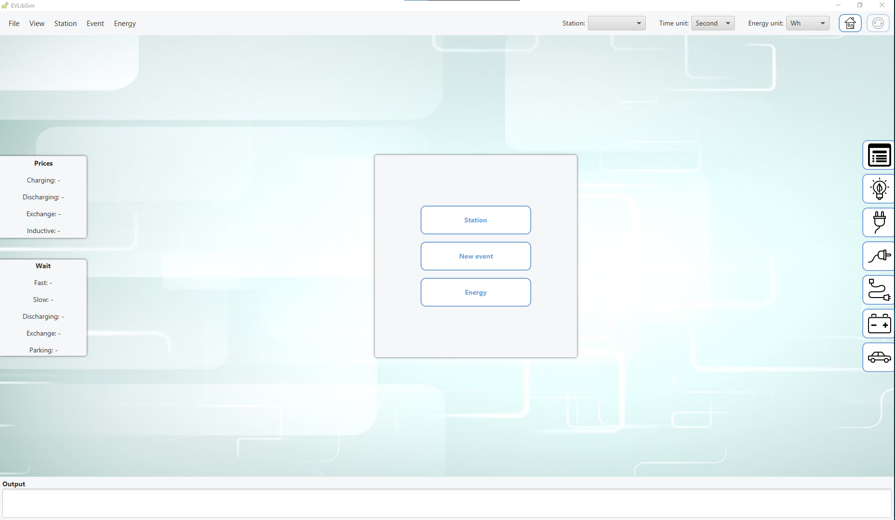
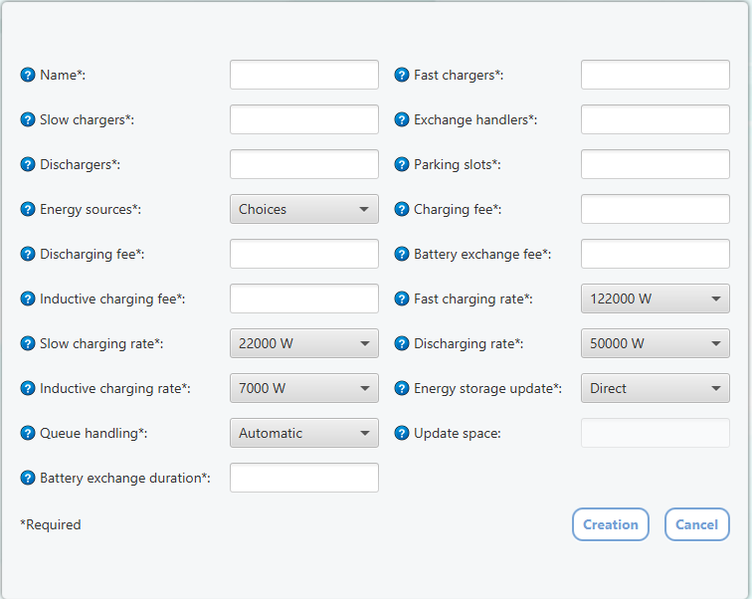
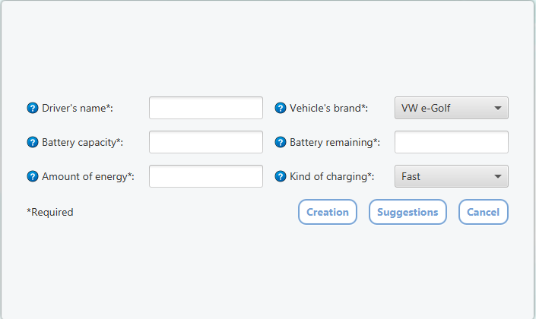
EVLibSim (cont.)
Each event requires a type of charge and the amount of energy the car requires
All information is manually input through the GUI
Multiple CSs can be created, however only one can be active
Events can be handled before the user has put in another one

Slide 9



Design Visualization

Slide 10
Design Discussion
The primary design tenant of EVLibScale is scalability
Designed to simulate multiple Charging Stations simultaneously
Each Station is assigned a process
A Monitor process keeps track of the global state, particularly time
Events, depicting cars and their actions, are randomly generated at each Station
Cars can “balk” at Stations that have high wait times
These balking cars can move between Stations

Slide 11
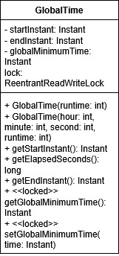
Design – Global Time
Maintains shared-memory state of the global minimum time
The Global Minimum Time is the earliest time any station has reached
This is maintained with a read-write lock
All processes can access a single instance of this class
Also ensures all Stations know what time the simulation ends

Slide 12
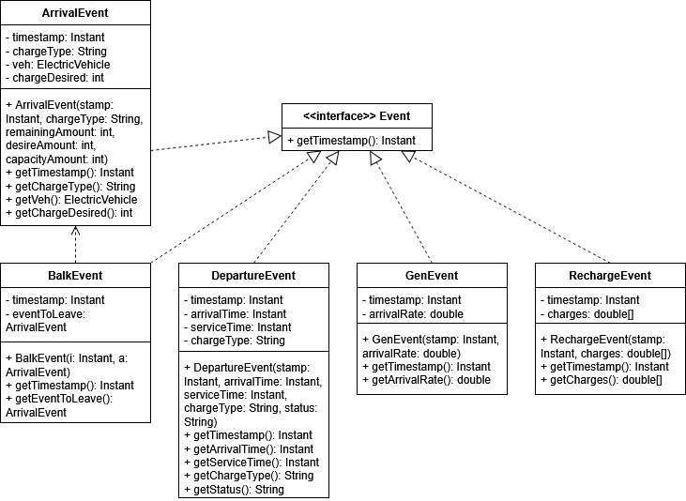
Design – Events
All events contain a timestamp
Arrival
Balk
Depicts a car arriving at a Station
Contains desired energy amount, type, and remaining energy
Depicts a car leaving a Station after not receiving a slot
Contains a reference to Arrival Event which is leaving
Gen
Used to trigger the creation of new events
Contains a number depicting the amount of cars per hour
Departure
Depicts a car leaving a Station after a successful Charge
Contains time of arrival, service time, and status
Contains type of charge
Recharge
Used to add more energy to a Station
Optional use case

Slide 13
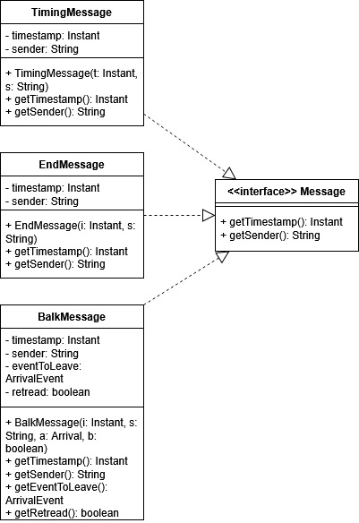
Design – Messages
All messages contain a timestamp and the name of the sender
Timing
Informs the Monitor of a Station’s Time
Sent from Station to Monitor
Balk
Sent to carry an Arrival Event to another Station
Contains a reference to the balking Arrival Event and a Boolean informing the nature of the time warp
End
Used only once, to signify that the simulation is ending
Sent from Monitor to Stations

Slide 14
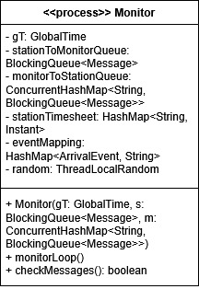
Design – Monitor
An observer of the overall state of the simulation
Only this class/process can modify the Global Minimum Time
Receives messages from every other Station to track state of the Simulation
Handles moving Arrival Events between Stations, freeing up the Stations to only simulate
Also is responsible for ending the simulation

Slide 15
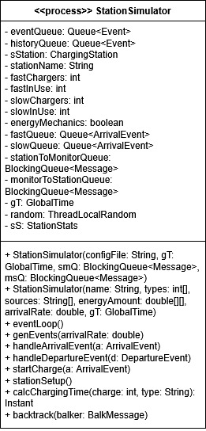
Design – Station Simulator
Represents a single CS within the greater environment
Defined by a configuration file passed by the Main
The Station maintains a single queue of events which occur at the Station. The type of events determines its handling
The Station Simulator generates its own events
Station Simulators can time warp, done when a Balk Message is received. It resets to the time of the incoming Arrival Event using Events in a History Queue

Slide 16
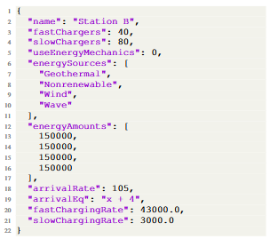
Implementation - Configuration
Configuration files define the abilities of each Station Simulator
Each Station Simulator gets a unique configuration file
On instantiation, Station Simulators are passed the name of their config file

Slide 17
Implementation – Global Time, Events and Messages
All of these classes are implemented in rather simple ways, as single classes with only getter and setter functions
Global Time contains a read/write lock to prevent race conditions when looking up or modifying the value of the Global Minimum Time
Previous iterations used message passing to update the time, which led to massive slowdown
Event and Message classes implement a Java interface, a form of inheritance
Each implementation has some unique fields

Slide 18
Implementation – The Monitor
A single instance of the Monitor is created and given its own process
The Monitor maintains hash maps to track where Balking messages come from and go
All message passing is handled by Concurrent Blocking queues. There is a shared one from the Stations to the Monitor, and unique ones from the Monitor to the Stations
The Monitor’s main execution is a loop, which reads through the Stations-to-Monitor queue and handles messages based on their type

Slide 19
Implementation – Station Simulator
Each Station Simulator is given a process
The main execution of a Station Simulator is its event loop, which handles individual events by their type
Each car on a charger calls the execution function from EVLib to perform the charge
The Station keeps track of the number of successful charges by the type of charge

Slide 20
Implementation – Balking/Time Warp
The Station Simulator keeps a history of all events it has done, starting at the Global Minimum Time
When a Balk Message occurs, the Monitor randomly sends it to another Station
That Station must then Time Warp to the time of the Balking Message, taking events off the history queue
When the Time Warp is completed, all events from the history queue from before the GlMT are removed

Slide 21
Implementation – Alterations to EVLib
When EVLib’s execution function is called, it spawns off a thread that simply sleeps for the amount of time passed to it
This would make the simulation significantly longer
This call to sleep was removed, and a call to join the thread was also added
This is to prevent race conditions between EVLib and EVLibScale
If EVLib wins, it may prevent a car from charging that should be able to according to EVLibScale’s state
These alterations make EVLib significantly more performant

Slide 22
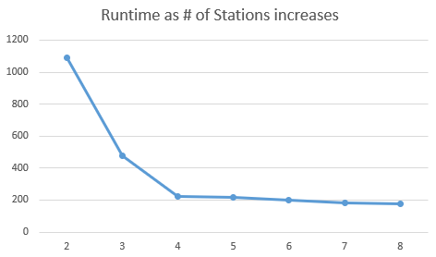

Assessment – Constant Events
A simulation was set up so 840 events would be handled every hour
The number of stations was increased, and the arrival rates of each station adjusted
Serial time was estimated from a 2-station run with all backtracking overhead removed
Speedup started small, but increased consistently, while efficiency fluctuated

Slide 23
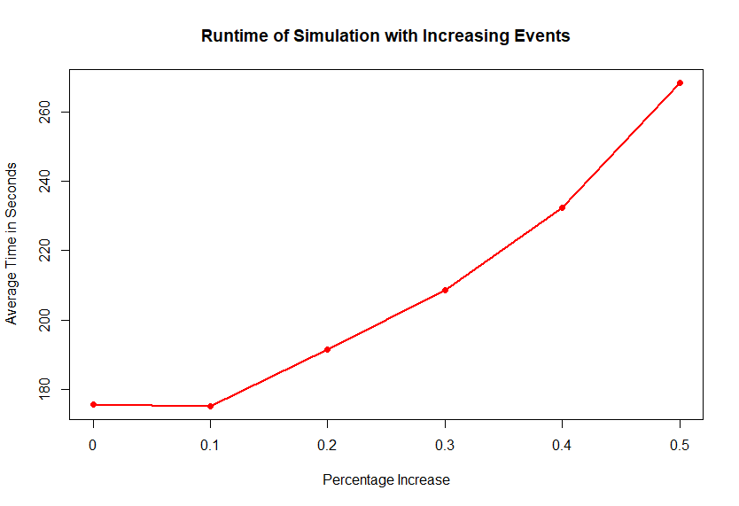

Assessment – Scalability
Eight stations started at 105 events per hour
Increased the number of events per hour by 10% for each test
EVLibScale followed a nonlinear scaling, taking proportionally less time to run than predicted

Slide 24



Assessment –Demonstration of Balking
To demonstrate Balking, screenshots were taken during the execution of EVLibScale to show events being added or removed
In the first image, the line in blue indicates an added event.
In the second and third images, the red-colored lines demonstrate events that remained in their places while the red event was removed

Slide 25
Limitations
The method of parallelization funnels more work onto one process, the Monitor, as scale increases
The number of cars that leave Stations through balking increases as the arrival rate is increased, leading to more work for the Monitor and more time warping
Not a significant amount of advanced data is tracked
Use over time
Average cars in an hour
Lack of time to add features and more thoroughly test EVLibScale

Slide 26
Future Work
Variable Arrival Rates:
Robust algorithms to less precisely define the number of cars that arrive per hour
Station Location:
Stations can have a distance from the city center which influences which other Station cars go to when balking, instead of it being random
Multi-Threaded Station Simulators
Stations could be multi-threaded to handle multiple events simultaneously
The Monitor could more easily be made multi-threaded as Messages are often not reliant on each other

Slide 27
Conclusions
EVLibScale is a solid foundation for a scalable, informative simulation of Electric Vehicle Charging Stations
The brief testing in the Constant Events and Scalability Tests indicate a desirable degree of scalability, suggesting the discrete event architecture is valuable

Slide 28
Questions

