Slide 1
Data Science Experience Overview
Ross Lewis, IBM Big Data Technical Specialist

Slide 2
Agenda
Data Science Experience Overview
Features
Architecture
Demo

Slide 3
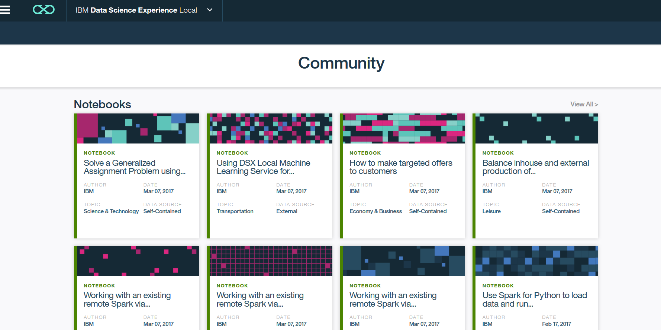
Data Science Experience – Deployment Options
IBM Data Science Experience (DSX) is a platform for developing and deploying analytics applications
Supports development, deployment, and model management
DSX is available
As a cloud offering
As an on-premise solution
As a desktop application
Notes:
IBM Data Science Experience is a platform for developing and deploying analytics applications. In addition to including best of breed development tools for analytics, DSX provides deployment and model management capabilities.
DSX is available as a cloud offering, as an on premise solution and as a desktop application.

Slide 4
DSX Local Overview

Slide 5
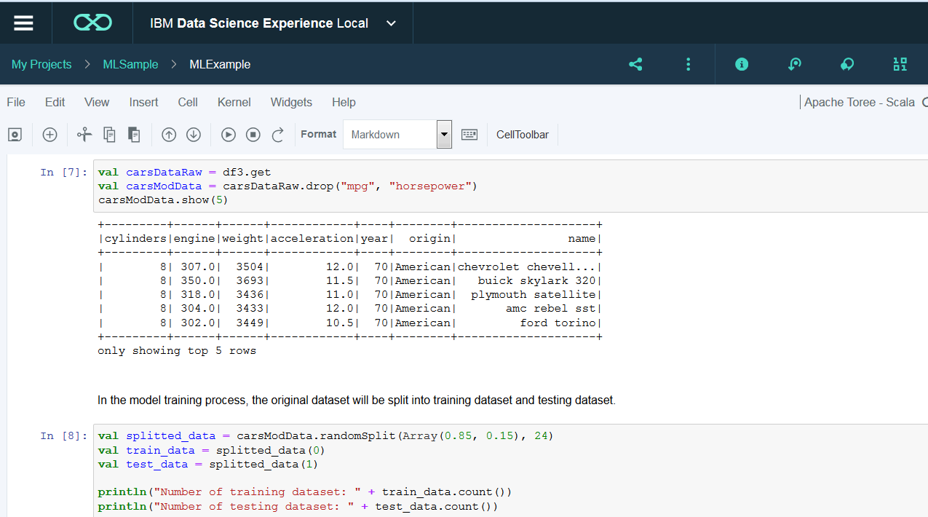
Data Science Experience Local
Self-contained and extendable platform for developing and deploying analytics applications
Includes everything needed to build and deploy analytics application
Extendable: works with remote Spark, multiple data sources, LDAP, supports adding additional libraries to IDEs
Includes
Jupiter Notebooks, Zeppelin, R Studio
Spark
IBM Machine Learning capabilities
Collaboration and Community
Platform administration
Notes:
DSX Local is a self-contained and extendable platform. It’s self-contained because it includes everything that’s needed to develop and deploy analytics applications. It’s extendible because it works with remote Spark clusters, and multiple database and Hadoop data sources. DSX Local integrates with LDAP and supports adding additional libraries to development environments.
Now let’s review what’s included with DSX. The development tools that analysts can use in DSX are Jupiter Notebooks and R studio. The runtime engine is Spark. As already mentioned, customers have an option of using Spark that’s bundled with DSX or remote Spark using Livy API. IBM Machine Learning capabilities provide functionality for building and deploying SparkML and scikit-learn models. Collaboration features help us organize analytics assets into projects which can be shared between users. Community enables sharing of information, which can include anything from code samples to tutorials and data assets, between the users.
And finally DSX local includes Platform Administration dashboards which help us monitor the status of the systems, view log files, and restart services when needed.

Slide 6















Reference Architecture – DSX Local
Define connections to
data sources
Data is loaded to Spark for processing
Data scientists develop models in DSX and deploy to ML
Integrate
Data sources
Spark – runtime
bundled or remote
DSX - IDE
JUPYTER
NOTEBOOKS
ZEPPELIN
OBJECT
STORAGE
RSTUDIO
ML Wizard
IBM Analytics
for Apache Spark
(Included with DSX)
CANVAS
Deploy models
DATABASES
Integration options
ML – UI and API
HADOOP
Additional Spark Services (for scalability)
Applications
REST API
(Real Time)
SPARK ML
Models
Static data sources
(batch)
Scikit-learn models
MESSAGE HUB
(Streaming)
Notes:
Before we take a look at DSX Local, let’s review DSX Local reference architecture.
DSX architecture
Define connections to data sources: A data scientist or a data engineer defines connections to data sources. IBM provides a custom API for connecting to data sources, and if IBM doesn’t provide an API, the driver provided by the data source vendor can be used (for example, a JDBC driver).
At runtime, data is loaded into Spark where processing takes place. As we discussed earlier, this can be the Spark cluster included with DSX or an external Spark cluster accessed by Livy API.
Data Scientists use various tools in DSX to implement analytics – Notebooks, R Studio, ML Wizard, and Canvas (currently in beta). If a data scientist implements SparkML or scikit-learn models, they can be deployed in ML. In the future, we are planning to add support for more model types.
ML supports three types of deployment: online (real time), batch, and streaming. Online (real time) models are accessed by REST API. Models that are deployed for batch scoring write output to static data sources (databases, Hadoop, object storage, etc.). Streaming deployments integrate with streaming data sources
In summary, this architecture shows end-to-end deployment of analytics: from development to deployment and integration with line of business applications.

Slide 7
Demo

Slide 8

Demo use case: Telco Churn
In our demo we’ll show how to use analytics to predict customer churn
End goal
Integrate real time analytics with a Call Center application
Real time analytics
Notes:
In our demo we will show how you can implement real time analytics to predict customer churn in Data Science Experience. Customer churn is not always predicted in real time, the deployment option depends on the type of data we are using to predict churn, but for our demo let’s assume that we want to integrate analytics with the Call Center application.
We are assuming that we are collecting some data in real time and therefore we will deploy the model that we create for real time scoring.

Slide 9
Implementation steps
In DSX
Build the model using historical data
Save the model in the repository
Deploy and test the model
Call Center application
Implement REST Client
Notes:
The implementation steps in DSX are
Build the model using historical data
Save the model in the repository
Deploy and test the model
These are the steps that I will show in the demo.
The final step, implementing a REST client application is outside of DSX. It’s a simple programming tasks that all developers are familiar with, so we will not focus on it in the demo.

Slide 10
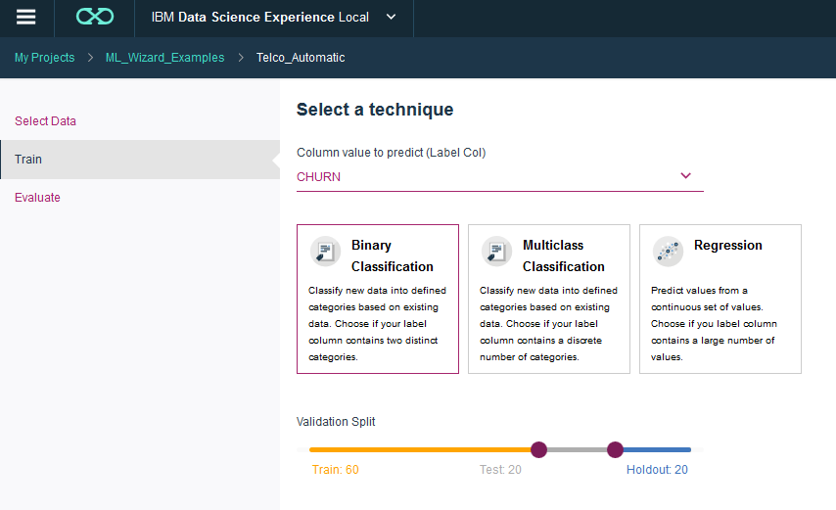
Implementation steps
Alternatively, customers can use ML wizard to create SparkML models

Slide 11
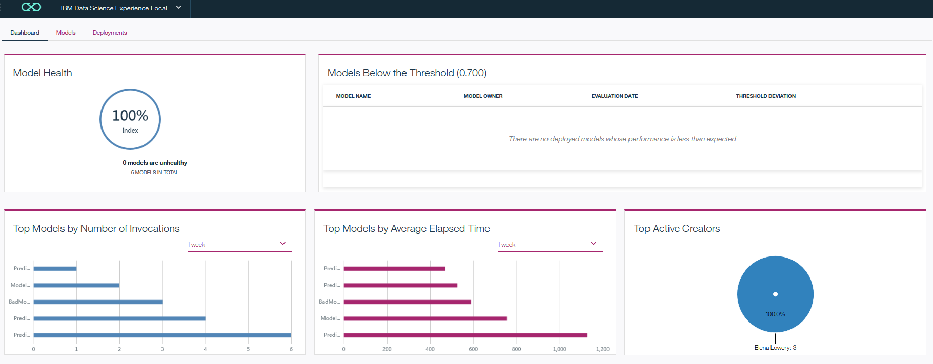
Model Management Dashboard
Monitor model performance

Slide 12
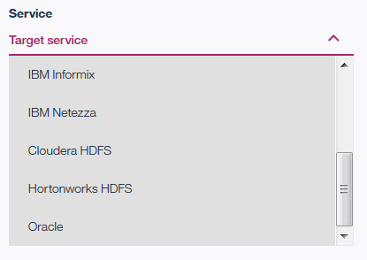
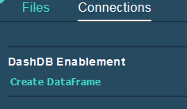
DSX Local - Data Access Summary
Wizard-based data source definition and code generation for several databases and Hadoop clusters
See IBM Compatibility reports
Add jar files for other database data sources
Access in Notebooks or R Studio
Notes:
DSX supports several types of data sources. In our demo we showed you how to access data from Object Storage.
DSX also supports connections to databases and Hadoop. Several data source types can be defined in a Connections wizard, and for these data sources we support code generation.
If the data source does not show up in the UI, you can still connect to it by adding a jdbc jar file and writing connection code in a Notebook or R Studio.

Slide 13
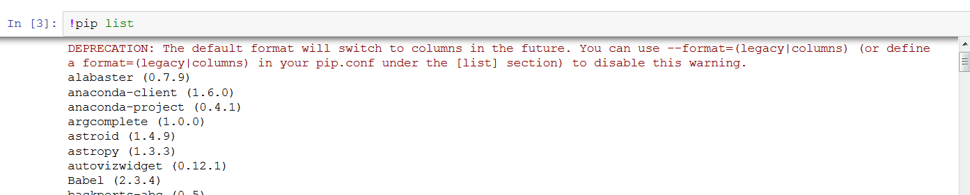
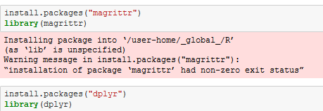
DSX Local - Development Environment Summary
DSX includes the most popular data science libraries
Look up loaded libraries in each IDE using language-specific commands
Additional libraries can be loaded both by user (session scope) and by administrator (system scope)
Notes:
DSX supports several types of data sources. In our demo we showed you how to access data from Object Storage.
DSX also supports connections to databases and Hadoop. Several data source types can be defined in a Connections wizard, and for these data sources we support code generation.
If the data source does not show up in the UI, you can still connect to it by adding a jdbc jar file and writing connection code in a Notebook or R Studio.

Slide 14
DSX Local - Development Environment Summary
Libraries provided by IBM
Machine learning: repository, deployment
Decision optimization
SPSS algorithms

Slide 15
Reference Architecture – DSX Local
Define connections to
data sources
Data is loaded to Spark for processing
Data scientists develop models in DSX and deploy to ML
Integrate
Data sources
Spark – runtime
bundled or remote
DSX - IDE
JUPYTER
NOTEBOOKS
R STUDIO
OBJECT
STORAGE
IBM Analytics
for Apache Spark
(Included with DSX)
ML Wizard
CANVAS
Deploy models
DATABASES
ML – UI and API
Integration options
HADOOP
Additional Spark Services (for scalability)
SPARK ML
Models
Applications
REST API
(Real Time)
Static data sources
(batch)
Scikit-learn models
MESSAGE HUB
(Streaming)
Notes:
To summarize, I showed you the implementation of the reference architecture that we reviewed during the presentation.

Slide 16
DSX Local Administration

Slide 17
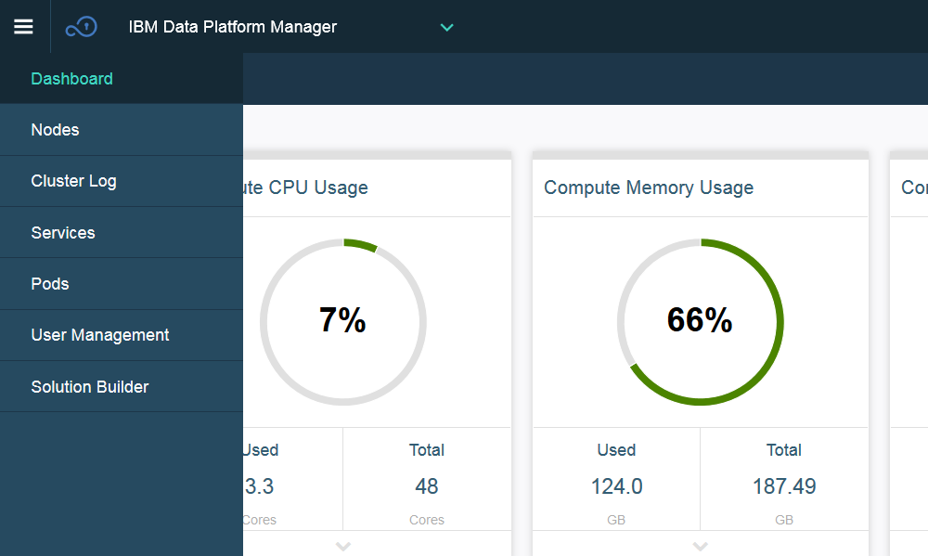
DSX Local Administration
Manage users
Monitor Servers and services
Set up alerts
Notes:
DSX Local includes functionality to manage users and servers. Let’s take a closer look at the administration capabilities.

Slide 18
Architecture

Slide 19

DSX Local Cluster Architecture
Data Scientist - Browser
Data Stores (DB2, HDFS, etc…)
LDAP/AD
Spark Cluster
Customer Systems
DSX Local Cluster
NGINX
DSX UI Service
Compute Servers
Control Servers
Storage Servers
Admin Dashboards
Redis
Download and go
Kubernetes Cluster
Metering Monitoring
Gluster
Updates
Jupyter Notebook Service
Zeppelin Notebook Service
RStudio Service
Object
Store
Spark Service
Project Service
Kubernetes Master Components
Cloudant Local
Storage
Canvas & Models
Analytic Libraries
Notes:
Here is a graphical representation of the architecture of DSX Local.
The section below the blue line is the software that IBM provides which is running in Kubernetes. Notice that the servers are divided into 3 catagories
Control servers
Compute servers
and Storage servers
The control servers run the services that kubernetes needs to maintain the cluster as well as our administration services.
The compute servers are used to run the compute intensive services, such as Spark, notebooks and RStudio. This is also where models and pipelines are run.
The storage servers are used to manage the object and filesystem storage that is used by both DSX Local itself as well as any data customers decide to store
in DSX Local.
Above the blue line are the customer supplied systems. For the initial release we support connecting to a customer's ldap service as well as connecting to many of the database and HDFS systems they might already have. We also support connecting to a customers's local Spark Cluster.

Slide 20

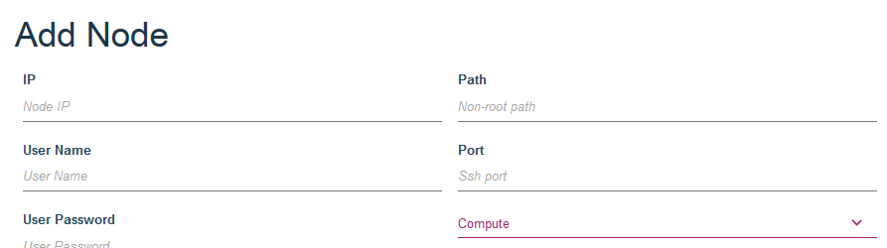
DSX Local - Scalability
Add Compute and Storage Servers
Remote Spark execution

Slide 21
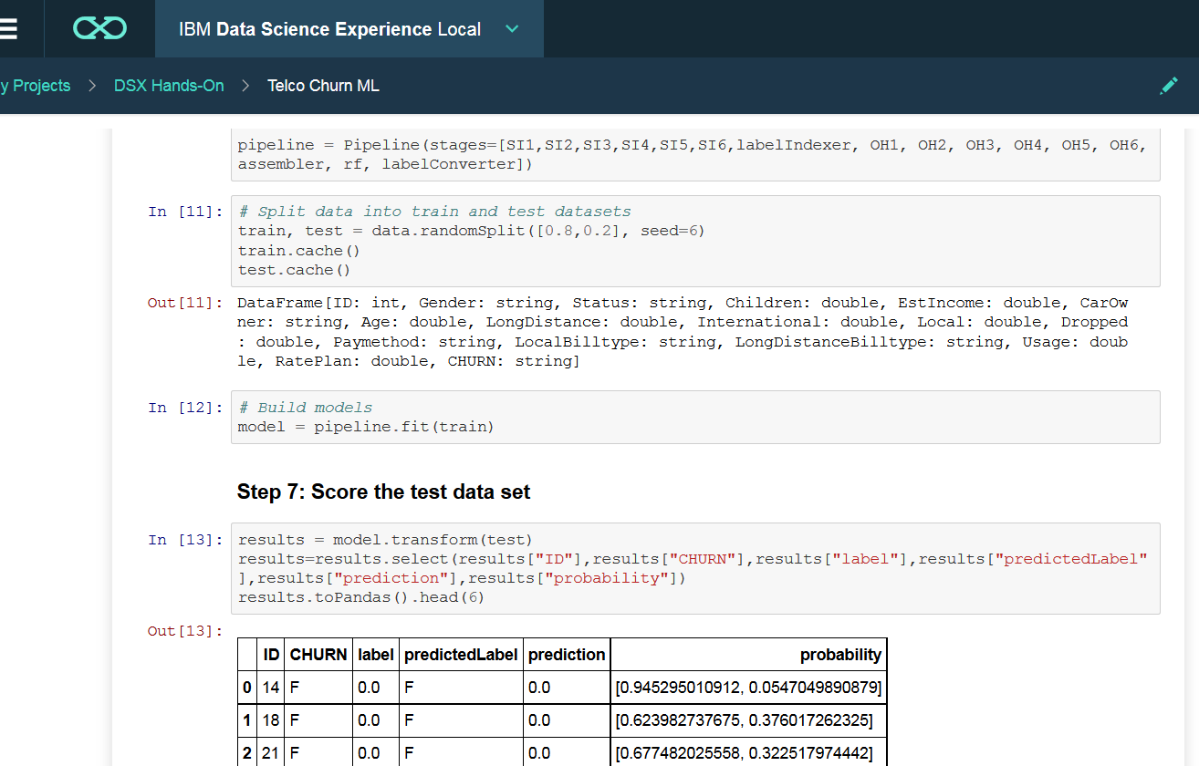
DSX Local - Remote Spark Execution
DSX Local supports remote Spark execution with Livy API
Notebooks developed in DSX can run in a remote Spark environment, for example Spark in a Hadoop cluster
DSX can run Spark jobs submitted from other applications
via REST API
DSX Local
Remote Spark
Apache Livy
Remote dev environment
Spark in DSX Local

Slide 22
DSX Local - Security Summary
SSL
Authentication
LDAP or native (included with DSX Local)
Authorization
Pre-defined roles: Administrator, User
By project: Administrator, Editor, Reader
DSX does not store data
Security is managed by data sources
The only exception is Object Storage
DSX supports full disk encryption via LUKS
DSX supports remote execution in Kerberos-enabled Spark clusters
Notes:
Let’s review security features of DSX.
DSX supports SSL – that’s the default configuration.
Either native or LDAP authentication can be used.
Authorization can be configured on two levels. Each user of DSX can be given either the Administrator or User role. In addition to that, DSX provides different roles on the project level.
Other than csv files in Object Storage, DSX does not store data and therefore data security is managed by data sources
If needed disks on the DSX systems can be encrypted
And finally, DSX supports remote execution on Kerberos-enabled Spark clusters with Livy API.

Slide 23
DSX Local – More information
DSX Local documentation
https://datascience.ibm.com/docs/content/local/welcome.html
IBM Compatibility reports (search for Data Science Experience)
OS:
http://www-969.ibm.com/software/reports/compatibility/clarity/operatingSystemCategory.html
Other related software:
http://publib.boulder.ibm.com/infocenter/prodguid/v1r0/clarity/prereqsForProduct.html

