Slide 1

Streaming Live Accidents In The City Of New York Using Kafka, Python, Clickhouse, Dbt and Preset
Sneha Kadam
Rostand Bahanack

Slide 2
Business Objective
Act as as subject matter experts by streaming the New York Police Department(NYPD) motor vehicles historical and live crash data and provide the city authorities and the NYPD with practical advises to start implementing changes in extremely risky areas in NYC.

Slide 3
Data Consumers
Both the NYPD and NYC cities authorities will be the main consumers of the processed data. Any other agency or third-party business wanting to get a deeper understanding of the NYC crash statistics for previous and current years.

Slide 4
Data Source
The data was source here which is the API end that stored the NYPD motor collision data which is being updated daily and was published on 5/7/2014.
(https://data.cityofnewyork.us/Public-Safety/Motor-Vehicle-Collisions-Crashes/h9gi-nx95)

Slide 5
Technology Overview
The Technology stack used to extract the data from the API comprise the following services:
Kafka for real time steaming the data from the API
Clickhouse which is a real-time database that servers as placeholder for to store the data collected the public NYPD API.
Amazon S3 bucket which is a storage unit for storing data obtain from the API
Preset which is a visualization tool that servers to visualize our models.

Slide 6
Data Ingestion
The data has been ingested in the system using the python Faker library, then transition to clickhouse through a Kafka producer.

Slide 7

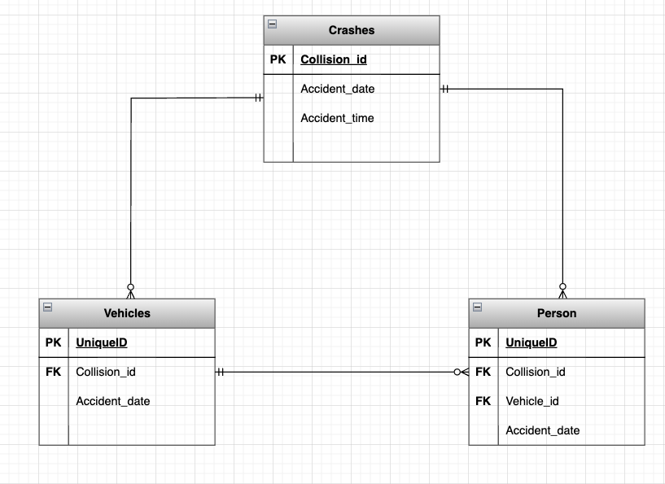
ERD Diagram

Slide 8
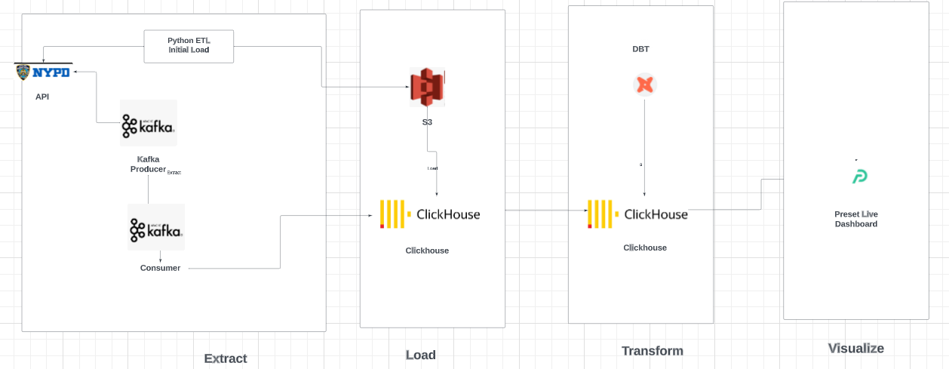
Solution Architecture

Slide 9
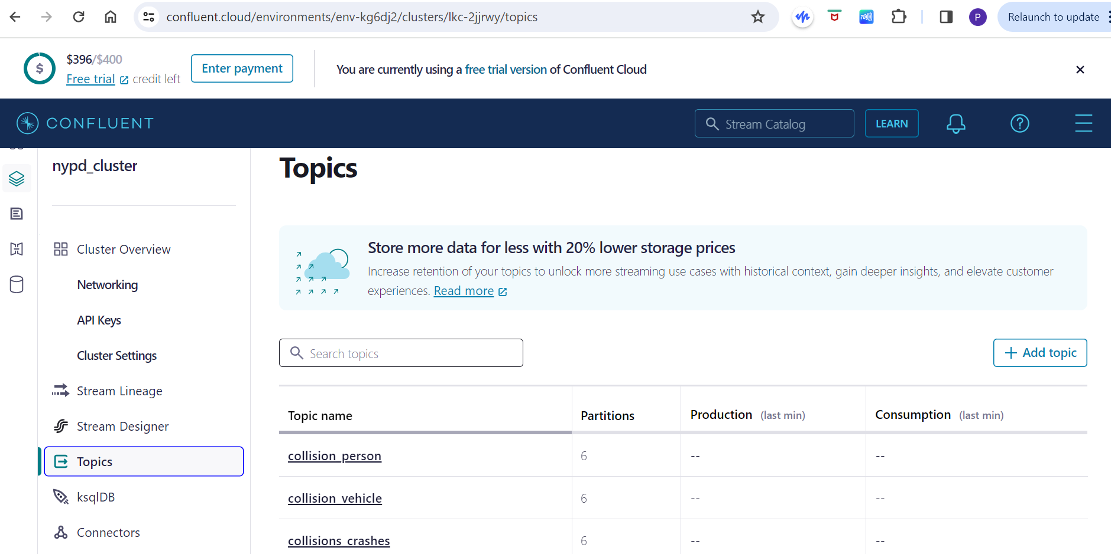
Data Orchestration

Slide 10
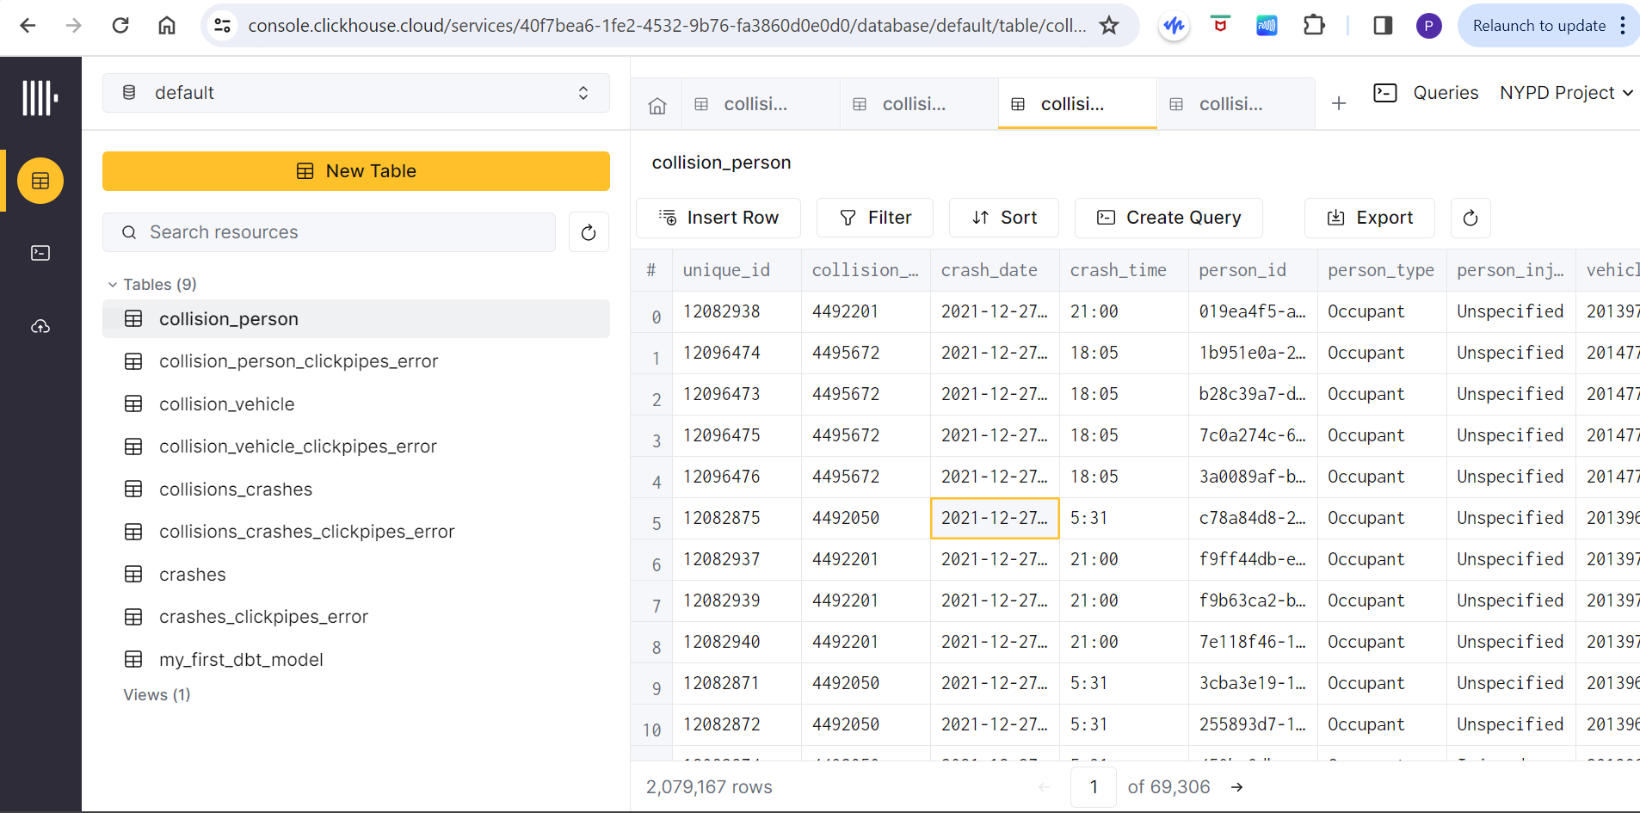
Data Orchestration2

Slide 11
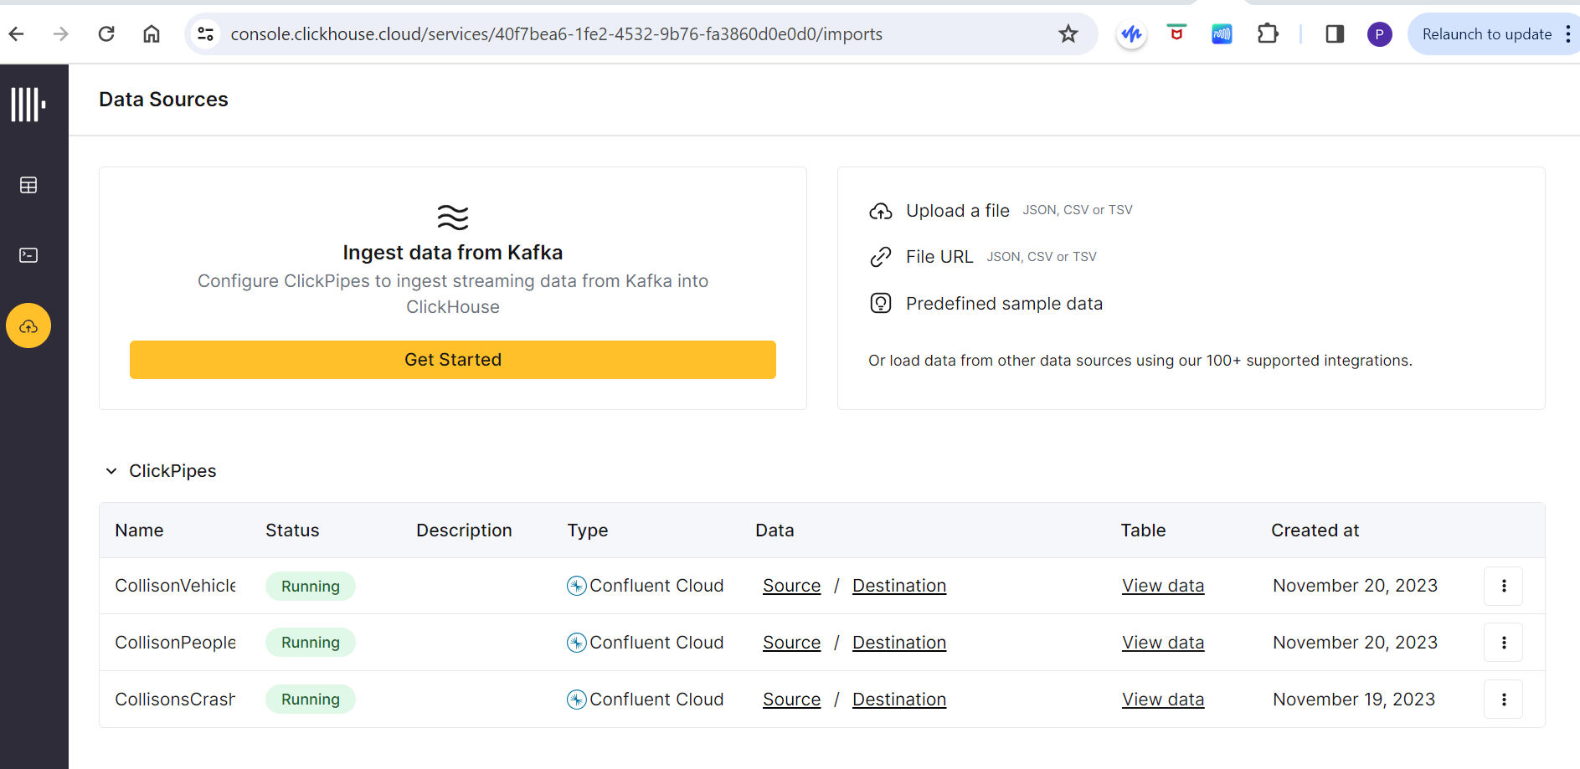
Data Orchestration3

Slide 12
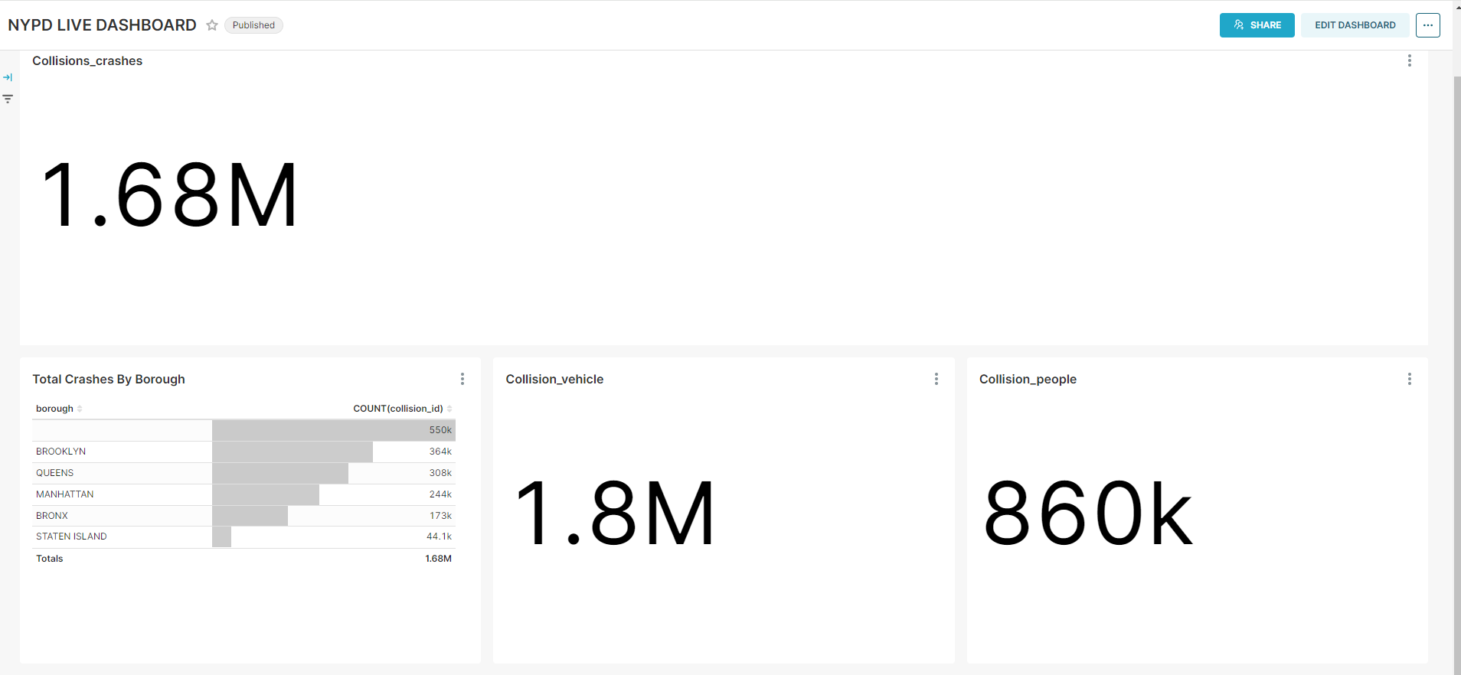
Dashboard

Slide 13
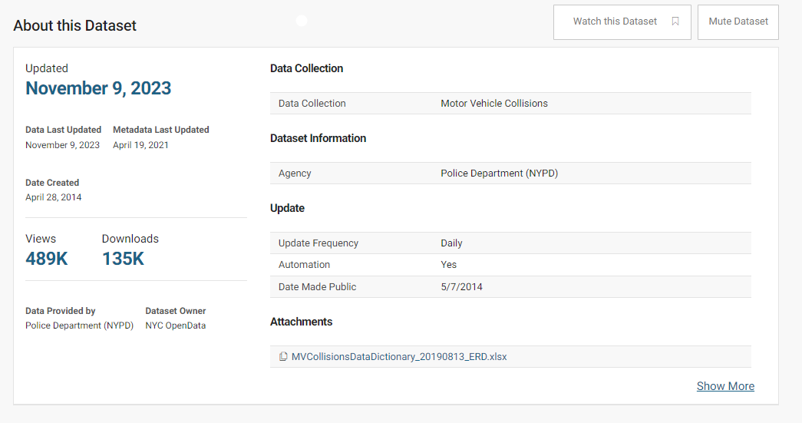
Data source parameters

Slide 14
Challenges
Complex dataset, required a lot of transformation
Dbt database driver not compatible with the version of clickhouse.
Hesitations about the technology choice (Snowflake, Clickhouse, preset. tableau)
Quite a few failures on different tests

Slide 15
Lessons Learned
Choose one technology and stick to it
Tasks prioritization and divide the project in different block
Testing is a key to knowing if the component works and will work perfectly

