Slide 1

Flexible Data Collection with Smart Phones
02265 Advanced Topics in Software Engineering
Group A
s084283 Kim Christensen
s103460 Pawel Drozdowski
s121540 Anna Walach
s124723 Piotr Milczarek

Slide 2
Problem domain
Survey in scientific studies
Collecting data from people using predefined form electronically

Slide 3

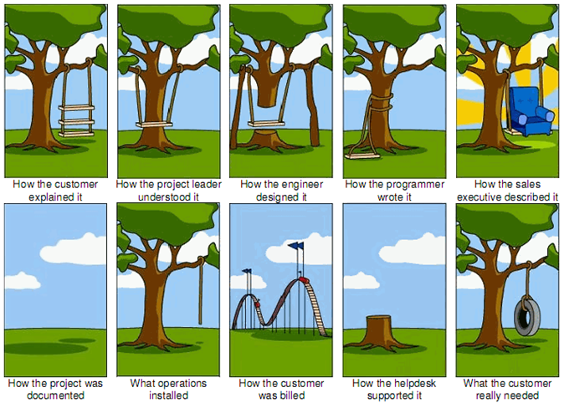
Problem description
Current survey data collection is:
Ad-hoc
Not correlated
Error prone
Non-repeating surveys
Missing out on technology benefits

Slide 4





Diverse implementations
Notes:
triple s

Slide 5



Application concept

Slide 6
Project overview
Centralized survey collection
Add additional semantics to surveys
Using a DSL for survey creation
Use the semantics for survey linking
Utilising smartphone technology for propagating surveys to respondents

Slide 7

Be notified of surveys
Using push notifications
1 survey pending

Slide 8
Use smartphone sensors
Answer selected questions automatically
Temperature is detected as 18°C.
Answer submitted.

Slide 9
Design goals
Define surveys in a near-natural language
Reuse surveys as templates
Schedule parts of surveys independently
To summarise: Make surveys more powerful, convenient and accessible

Slide 10
Application design
Question/Answer stack
Rendering survey questions in app
DSL and graphical survey editor
Cross platform smartphone app

Slide 11
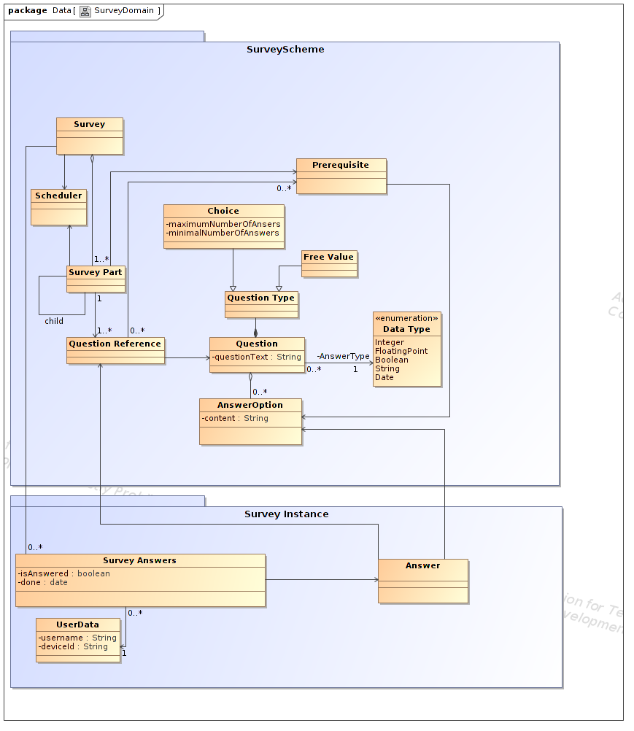
Metamodel
Survey scheme

Slide 12
Metamodel
Survey instance

Slide 13
DSL example
SURVEY Patient examination:
PART Personal information:
REPEAT: Once
QUESTION 1: What is your gender?
MANDATORY: Yes
TYPE: Single
ANSWERS: Male / Female / Other
QUESTION 2: What year were you born in?
MANDATORY: Yes
TYPE: Free
QUESTION 3: What country do you come from?
MANDATORY: Yes
TYPE: Free
PART Comfort:
REPEAT: Daily
QUESTION 1: How are you feeling today?
MANDATORY: Yes
TYPE: Single
ANSWERS: 1..10
QUESTION 2: What is the reason of your discomfort?
MANDATORY: Yes
PREREQUISITES: Q1 -> <5
TYPE: Free
QUESTION 3: How would you describe your heat comfort?
MANDATORY: No
TYPE: Single
ANSWERS: Freezing / Cold / Acceptable / Warm / Hot
QUESTION 4: What is the ambient temperature?
MANDATORY: No
TYPE: Free / Temperature sensor

Slide 14
Implementation details
XML parser written from scratch
Object serialization library
eBNF grammar for DSL
High level, intermediate and app data representations:
DSL -> AST -> JSON/XML -> OBJECTS
Xamarin for cross platform app implementation

Slide 15
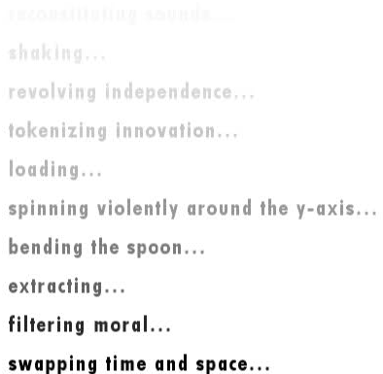
App demonstration
Loading ….
Current, first prototype state
Graphical user interface considerations
Rendering surveys and questions

Slide 16
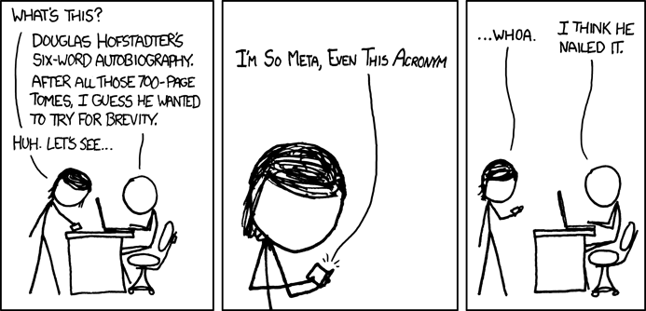
Summary
Designed a DSL for powerful and convenient survey definition
Implemented first cross platform app prototype
Laid foundation for future work and improvement of the system

