Slide 1
HIGHER-ORDER COMPONENT. STATE HOISTING. CONTROLLED INPUT
by Rostyslav Khanas

Slide 2
CONTROLLED COMPONENTS
In HTML, form elements such as <input>, <textarea>, and <select> typically maintain their own state and update it based on user input.
In React, mutable state is typically kept in the state property of components, and only updated with setState().
We can combine the two by making the React state be the “single source of truth”.
An input form element whose value is controlled by React in this way is called a “controlled component”.

Slide 3
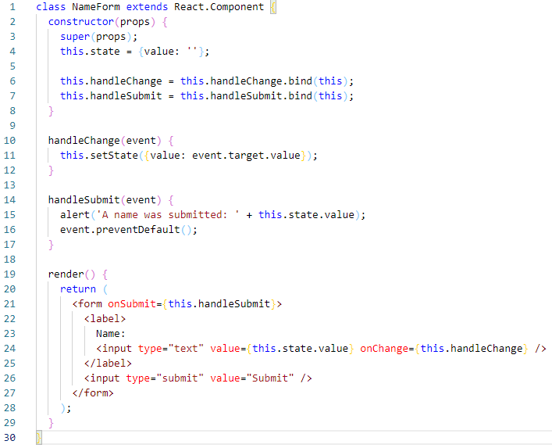
INPUT
Since the value attribute is set on our form element, the displayed value will always be this.state.value, making the React state the source of truth. Since handleChange runs on every keystroke to update the React state, the displayed value will update as the user types.

Slide 4
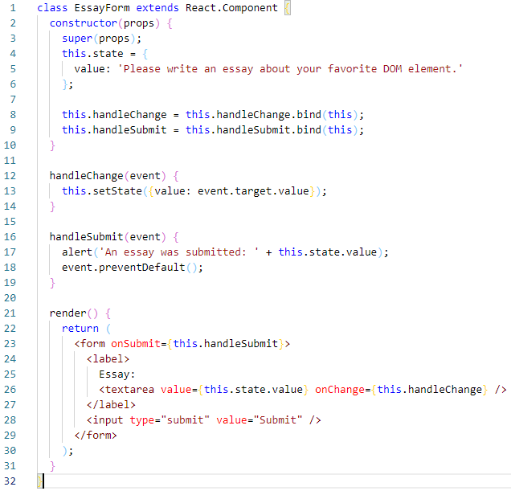
THE TEXTAREA TAG
In HTML, a <textarea> element defines its text by its children.
In React, a <textarea> uses a value attribute instead. This way, a form using a <textarea> can be written very similarly to a form that uses a single-line input.

Slide 5
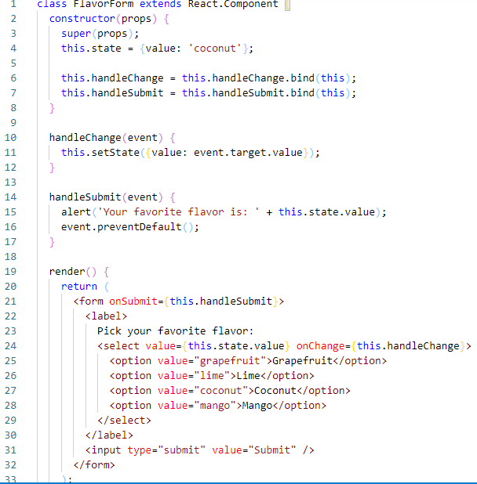
THE SELECT TAG
React, instead of using selected attribute, uses a value attribute on the root select tag. This is more convenient in a controlled component because you only need to update it in one place.

Slide 6
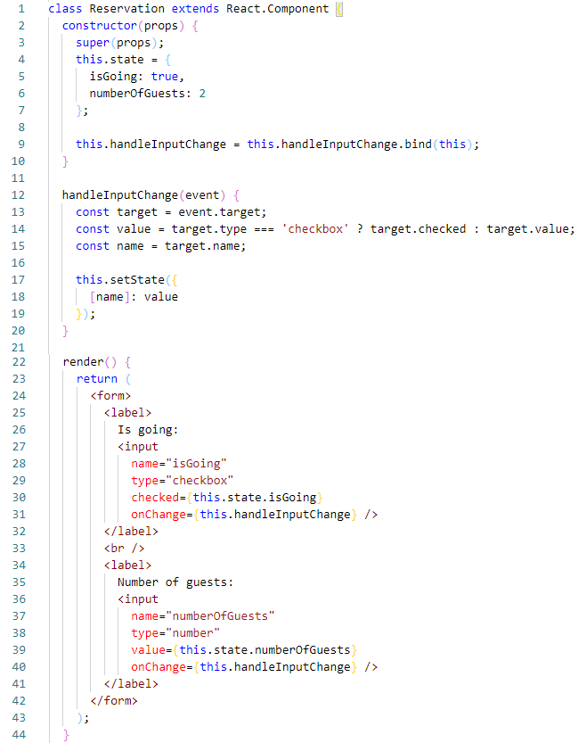
HANDLING MULTIPLE INPUTS
When you need to handle multiple controlled input elements, you can add a name attribute to each element and let the handler function choose what to do based on the value of event.target.name.

Slide 7
STATE HOISTING
Often, several components need to reflect the same changing data.
React recommend lifting the shared state up to their closest common ancestor.
In React, sharing state is accomplished by moving it up to the closest common ancestor of the components that need it. This is called “lifting state up”.

Slide 8
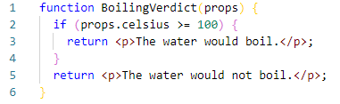
We will create a temperature calculator that calculates whether the water would boil at a given temperature.
We start with a component called BoilingVerdict. It accepts the celsius temperature as a prop, and prints whether it is enough to boil the water:

Slide 9
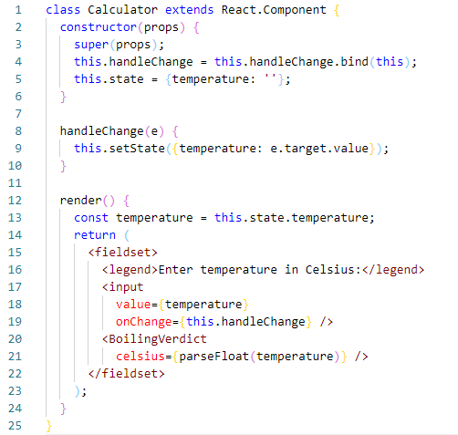
Next, we create a component called Calculator. It renders an <input> that lets you enter the temperature, and keeps its value in this.state.temperature.
Additionally, it renders the BoilingVerdict for the current input value.

Slide 10
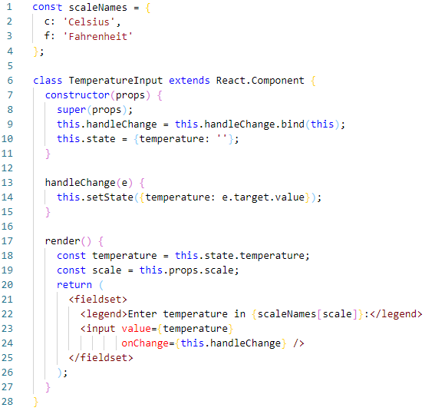
Our new requirement is that, in addition to a Celsius input, we provide a Fahrenheit input, and they are kept in sync.
We can start by extracting a TemperatureInput component from Calculator.

Slide 11
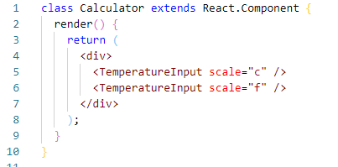
We can now change the Calculator to render two separate temperature inputs.
We have two inputs now, but when you enter the temperature in one of them, the other doesn’t update. This contradicts our requirement: we want to keep them in sync.
We also can’t display the BoilingVerdict from Calculator. The Calculator doesn’t know the current temperature because it is hidden inside the TemperatureInput.

Slide 12
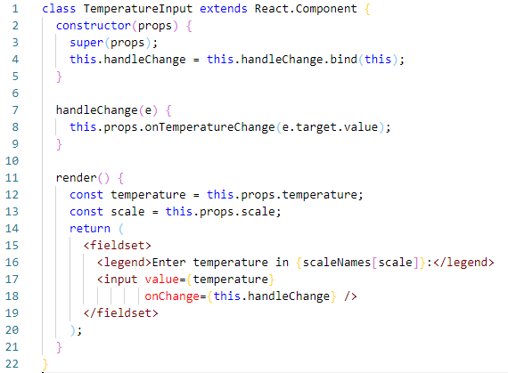
We remove the local state from the TemperatureInput and move it into the Calculator instead.
If the Calculator owns the shared state, it becomes the “source of truth” for the current temperature in both inputs. It can instruct them both to have values that are consistent with each other.

Slide 13
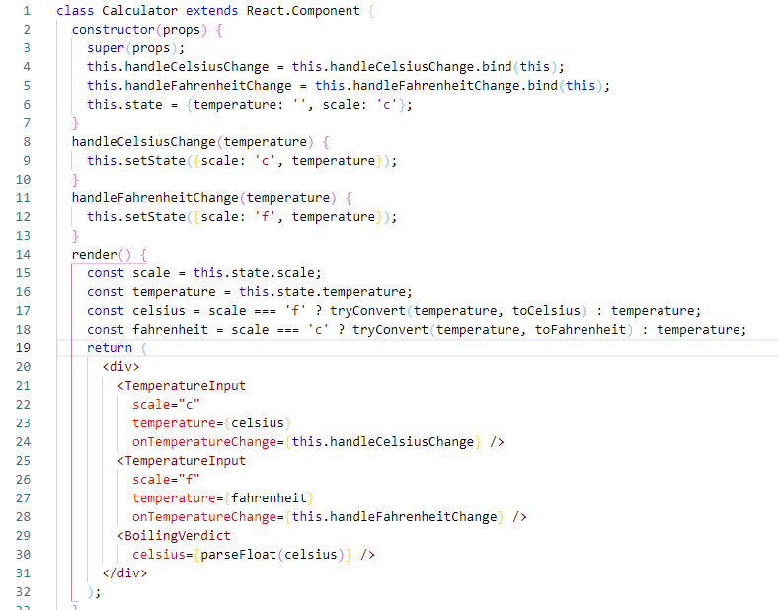
We will store the current input’s temperature and scale in its local state. This is the state we “lifted up” from the inputs.
The inputs stay in sync because their values are computed from the same state.
One of the inputs gets the value as is, so any user input is preserved, and the other input value is always recalculated based on it.

Slide 14
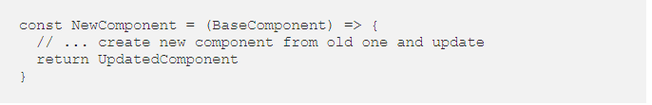
HIGHER-ORDER COMPONENT
A higher-order component(HOC) is a function that takes a component and returns a new component.
HOCs are not part of the React API, per se. They are a pattern that emerges from React’s compositional nature.
For example, two HOC’s implementations in the React ecosystem are connect from Redux and withRouter from React Router. The connect function from Redux is used to give components access to the global state in the Redux store, and it passes these values to the component as props. The withRouter function injects the router information and functionality into the component, enabling the developer access or change the route.

Slide 15
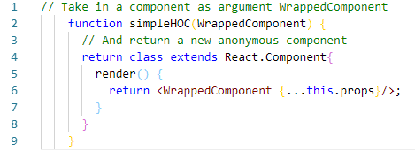
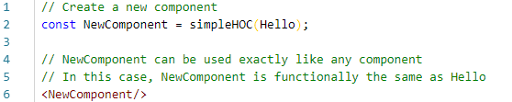
Example of the most simple HOC possible:
We use the HOC to create a new component like this:

Slide 16
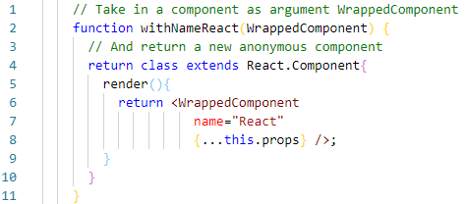
The HOC we just created does not do anything to the component, it just returns the same component with a wrapper component around it.
The idea with HOC is to enhance components with functions or data.
Let’s add a name prop with the value “React”. It would look something like this:
The other addition is that we spread the props passed to the component. This ensures that any other props that are passed to the wrapped component will be accessible via this.props in the same manner they would be called if the component was not passed through our higher-order component function.

Slide 17

Lets take a look how we can use it.
First, we define the component to send in, which uses the name prop…
…then we will enhance it with our HOC.

Slide 18
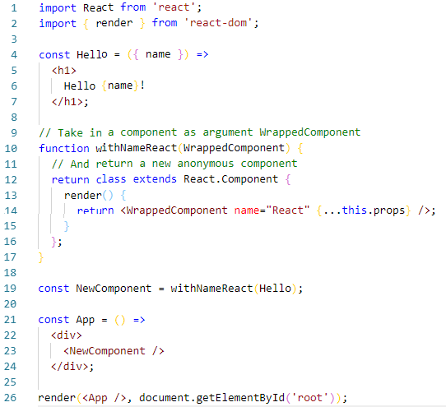

Slide 19
HOC is a powerful concept that is used to enhance a component with new functions or data. It is worth noting the following:
We don’t modify or mutate the component. We create new ones.
A HOC is used to compose components for code reuse.
A HOC is a pure function. That means it has no side effects. It only returns a new component.

Slide 20
THANKS!

