Slide 1
ASYNCHRONOUS PROGRAMMING
By Rostyslav Khanas

Slide 2
SYNCHRONOUS AND ASYNCHRONOUS
Synchronous - one thing at a time. Code is executed one at a time in the order that it appears.
Asynchronous - multiple things at a time => you don't have to finish executing the current operation in order to move on to the next one.

Slide 3
JavaScript - is a single-threaded, blocking, synchronous language,
which can also be
non-blocking, asynchronous and concurrent.

Slide 4
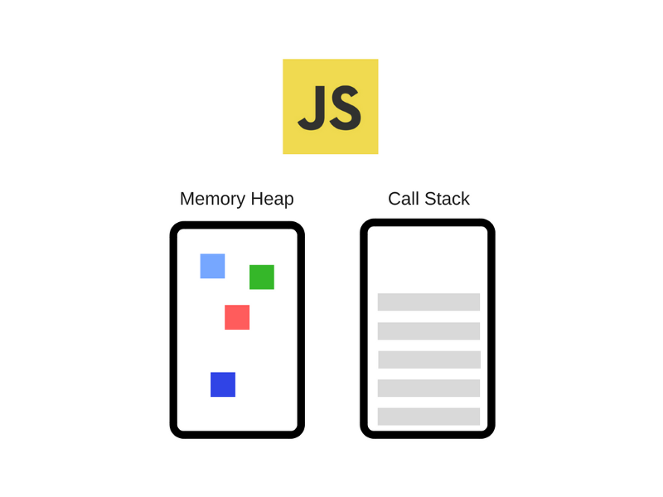
Notes:
If you clone V8 codebase and grab things like setTimeout, Dom, or ajax request – they are not there.

Slide 5
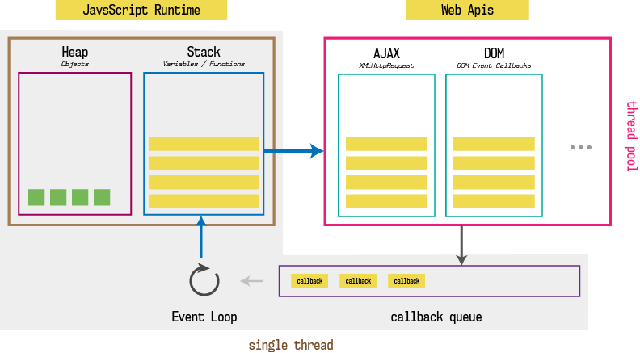

Slide 6
CALL STACK
one thread == one stack == one thing at a time
Notes:
Callstack – data structure, which records where we are in a program.

Slide 7
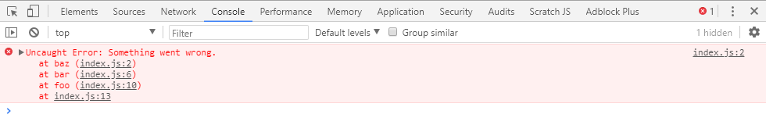
const baz = () => {
throw new Error('Something went wrong.')
}
const bar = () => {
baz();
}
const foo = () => {
bar();
}
foo();

Slide 8
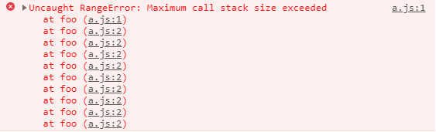
function foo() {
foo();
}
foo();

Slide 9
BLOCKING
Blocking == slow code (network requests, image processing…)

Slide 10

console.log('Getting Data1');
const data1 = getData('123');
console.log('Data is:', data1);
console.log('Getting Data2');
const data1 = getData('456');
console.log('Data is:', data2);
const sum = 1 + 1;
console.log('sum is:', sum);

Slide 11
ASYNCHRONOUS CALLBACKS
Callback - is a function that is to be executed after another function has finished executing.

Slide 12
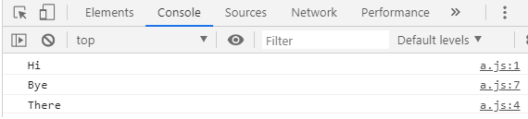
console.log('Hi');
setTimeout(() => {
console.log('There')
}, 5000);
console.log('Bye');

Slide 13
CONCURRENCY AND EVENT LOOP
Notes:
JS the runtime can do one thing at a time, but because browser is more than a runtime – we can do things concurrently.

Slide 14
PROMISES
Promise - is an object representing the eventual completion or failure of an asynchronous operation.

Slide 15
STATES OF A PROMISE
Internally, a promise can be in one of three states:
Pending, when the final value is not available yet. This is the only state that may transition to one of the other two states.
Fulfilled, when and if the final value becomes available. A fulfillment value becomes permanently associated with the promise. This may be any value, including undefined.
Rejected, if an error prevented the final value from being determined. A rejection reason becomes permanently associated with the promise. This may be any value, including undefined, though it is generally an Error object, like in exception handling.

Slide 16
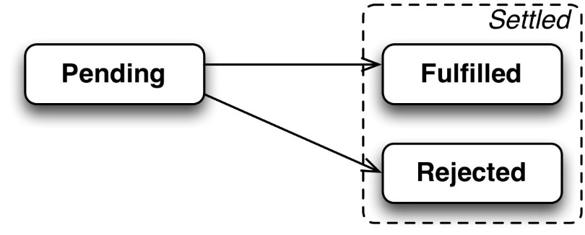

Slide 17
PROTOTYPE METHODS
There three prototype methods, that can be applied on an instance of Promise object:
Promise.prototype.catch(onRejected);
Promise.prototype.then(onFulfilled, onRejected);
Promise.prototype.finally(onFinally);
All of these methods return a promise in turn. All the following methods assigns handlers for different state transitions of a promise.
One or more of the following three methods will be run when a promise is settled based on whether it is fulfilled or rejected.

Slide 18
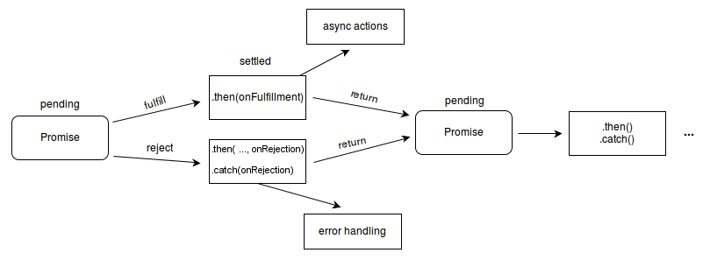

Slide 19
let momsPromise = new Promise(function(resolve, reject) {
momsSavings = 20000;
priceOfPhone = 60000;
if (momsSavings > priceOfPhone) {
resolve({
brand: "iphone",
model: "6s"
});
} else {
reject("We don’t have enough savings. Let us save some more money.");
}
});
momsPromise
.then(function(value) {
console.log("Hurray I got this phone as a gift ", JSON.stringify(value));
}).catch(function(reason) {
console.log("Mom coudn't buy me the phone because ", reason);
}).finally(function() {
console.log(
"Irrespecitve of whether my mom can buy me a phone or not, I still love her"
);
});

Slide 20


Slide 21
Promise.all()
The Promise.all() method returns a single Promise that resolves when all of the promises passed as an iterable have resolved or when the iterable contains no promises. It rejects with the reason of the first promise that rejects.

Slide 22
var p1 = Promise.resolve(3);
var p2 = 1337;
var p3 = new Promise((resolve, reject) => {
setTimeout(() => {
resolve("foo");
}, 5000);
});
Promise.all([p1, p2, p3]).then(values => {
console.log(values);
});
// after 5 seconds [3, 1337, 'foo']

Slide 23
ASYNC/AWAIT
There’s a special syntax to work with promises in a more comfortable fashion, called “async/await”.
From MDN:
“An asynchronous function is a function which operates asynchronously via the event loop, using an implicit Promise to return its result. But the syntax and structure of your code using async functions is much more like using standard synchronous functions.”
“An async function can contain an await expression that pauses the execution of the async function and waits for the passed Promise's resolution, and then resumes the async function's execution and returns the resolved value. Remember, the await keyword is only valid inside async functions.”

Slide 24
async function f() {
let promise = new Promise((resolve, reject) => {
setTimeout(() => resolve("done!"), 1000)
});
let result = await promise; // wait till the promise resolves (*)
alert(result); // "done!"
}
f();
If we try to use await in non-async function, there would be a syntax error:
function f() {
let promise = Promise.resolve(1);
let result = await promise; // Syntax error
}

Slide 25
The async keyword before a function has two effects:
Makes it always return a promise.
Allows to use await in it.
The await keyword before a promise makes JavaScript wait until that promise settles, and then:
If it’s an error, the exception is generated, same as if throw error were called at that very place.
Otherwise, it returns the result.

Slide 26
GENERATORS
A generator - is a function that can stop midway and then continue from where it stopped.
In JavaScript, a generator is a function which returns an object on which you can call next(). Every invocation of next() will return an object of shape — { value: Any, done: true|false }. When the done becomes true, the generator stops and won’t generate any more values.

Slide 27
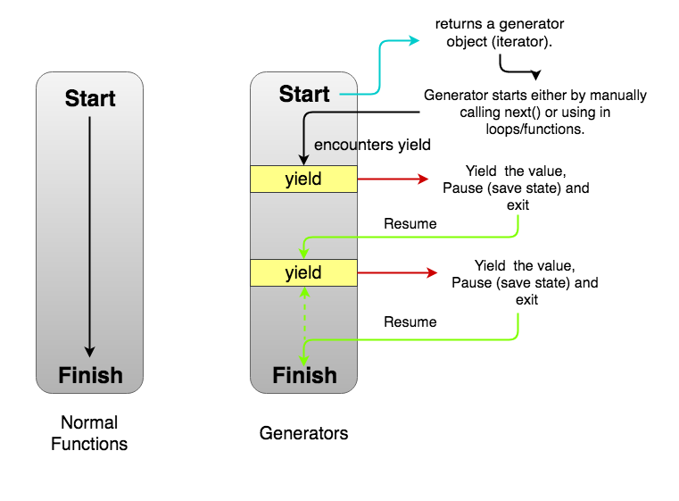

Slide 28
function * generatorFunction() { // Line 1
console.log('This will be executed first.');
yield 'Hello, '; // Line 2
console.log('I will be printed after the pause');
yield 'World!';
}
const generatorObject = generatorFunction(); // Line 3
console.log(generatorObject.next().value); // Line 4
console.log(generatorObject.next().value); // Line 5
console.log(generatorObject.next().value); // Line 6
// This will be executed first.
// Hello,
// I will be printed after the pause
// World!
// undefined

Slide 29
There are many use cases of generators. One of the most useful – implementing iterables.
function * iterableObj() {
yield 'This';
yield 'is';
yield 'iterable.'
}
for (const val of iterableObj()) {
console.log(val);
}
// This
// is
// iterable.

Slide 30
THANKS!

