Slide 1
INTRODUCTION TO NODE.JS
By Rostyslav Khanas

Slide 2
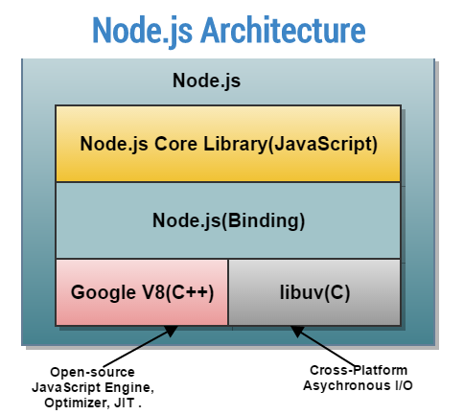
WHAT IS NODE.JS?
Node.js is a JavaScript runtime environment built on Chrome's V8 JavaScript engine.
Node.js uses an event-driven, non-blocking I/O model that makes it lightweight and efficient.
Node.js’ package ecosystem, npm, is the largest ecosystem of open source libraries in the world.

Slide 3
V8 JAVASCRIPT ENGINE
V8 is the name of the JavaScript engine, that powers Google Chrome.
V8 compiles and executes JavaScript source code, handles memory allocation for objects, and garbage collects objects it no longer needs.
JavaScript engine is independent by the browser in which it's hosted. This key feature enabled the rise of Node.js.
V8 is written in C++, and it's continuously improved. It is portable and runs on Mac, Windows, Linux and several other systems.

Slide 4
EVENT-DRIVEN NON-BLOCKING I/O MODEL
I/O refers to input/output.
It can be anything ranging from reading/writing local files to making an HTTP request to an API.
I/O takes time and hence blocks other functions.
All of the I/O methods in the Node.js standard library provide asynchronous versions, which are non-blocking, and accept callback functions.

Slide 5
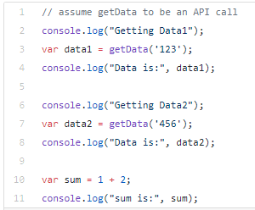
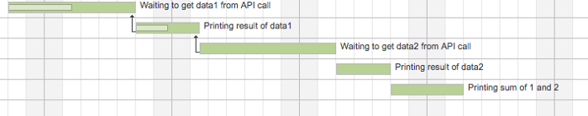
This is a perfect example of blocking I/O model where one statement waits for the other to complete.

Slide 6
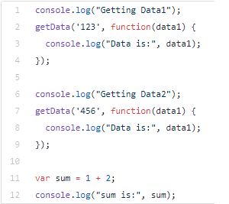
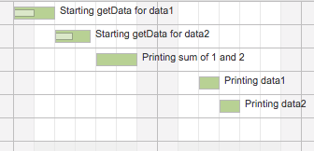

Slide 7
WHAT IS THE EVENT LOOP?
The Node.js JavaScript code runs on a single thread. There is just one thing happening at a time.
The event loop is what allows Node.js to perform non-blocking I/O operations — despite the fact that JavaScript is single-threaded.
Almost all the I/O primitives in JavaScript are non-blocking. Network requests, filesystem operations, and so on.

Slide 8
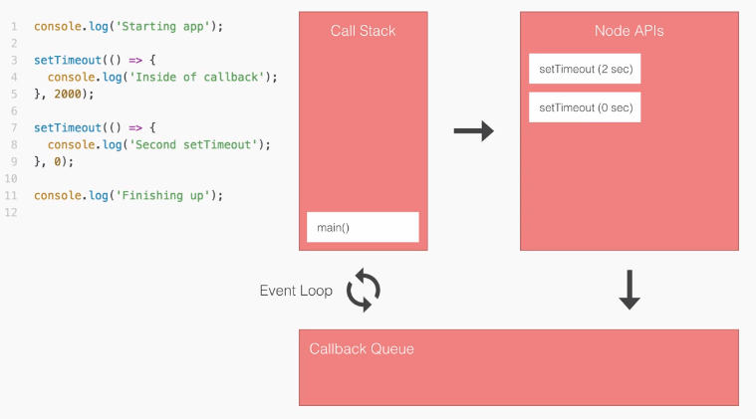

Slide 9
NPM
Node Package Manager (npm) is the standard package manager for Node.js.
A package is one or more modules (libraries) grouped (or packaged) together.
In January 2017 over 350000 packages were reported being listed in the npm registry, making it the biggest single language code repository on Earth, and you can be sure there is a package for (almost!) everything.
It started as a way to download and manage dependencies of Node.js packages, but it has since become a tool used also in frontend JavaScript.

Slide 10
If a project has a package.json file, by running npm install it will install everything the project needs, in the node_modules folder, creating it if it's not existing already.
You can also install a specific package by running npm install <package-name>.
Often you'll see more flags added to this command:
--save installs and adds the entry to the package.json file dependencies
--save-dev installs and adds the entry to the package.json file devDependencies
The difference is mainly that devDependencies are usually development tools, like a testing library, while dependencies are bundled with the app in production.

Slide 11
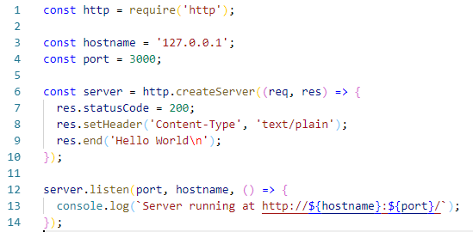
EXAMPLE OF SIMPLE WEB SERVER

