Slide 1
FLEXBOX
By Rostyslav Khanas

Slide 2
WHAT IS FLEXBOX?
The Flexible Box Module, usually referred to as flexbox, was designed as a one-dimensional layout model, and as a method that could offer space distribution between items in an interface and powerful alignment capabilities.
When we describe flexbox as being one dimensional we are describing the fact that flexbox deals with layout in one dimension at a time — either as a row or as a column. This can be contrasted with the two-dimensional model of CSS Grid Layout, which controls columns and rows together.

Slide 3
WHY FLEXBOX?
For a long time, the only reliable cross browser-compatible tools available for creating CSS layouts were things like floats and positioning. The following simple layout requirements are either difficult or impossible to achieve with such tools, in any kind of convenient, flexible way:
Vertically centering a block of content inside its parent.
Making all the children of a container take up an equal amount of the available width/height, regardless of how much width/height is available.
Making all columns in a multiple column layout adopt the same height even if they contain a different amount of content.

Slide 4
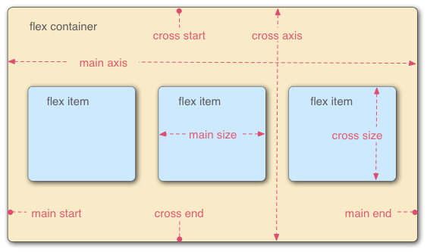
THE TWO AXEX OF FLEXBOX
When elements are laid out as flexible boxes, they are laid out along two axes: main axis and cross axis.
The main axis is the axis running in the direction the flex items are being laid out in. The start and end of this axis are called the main start and main end.
The cross axis is the axis running perpendicular to the main axis. The start and end of this axis are called the cross start and cross end.
The parent element that has display: flex set on is called the flex container.
The items being laid out as flexible boxes inside the flex container are called flex items.

Slide 5
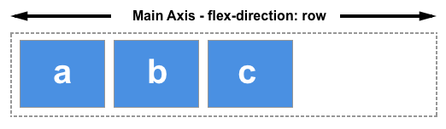
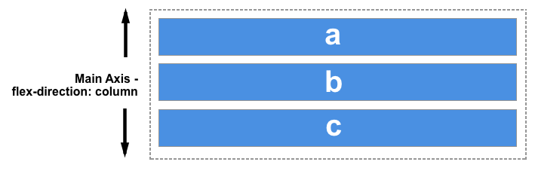
THE FLEX CONTAINER
An area of a document laid out using flexbox is called a flex container. To create a flex container, we set the value of the area's container's display property to flex.
Flexbox provides a property called flex-direction that specifies what direction the main axis runs in (what direction the flexbox children are laid out in). It can have the following values:
row (default);
row-reverse;
column;
column-reverse.

Slide 6
MULTI-LINE FLEX CONTAINER WITH FLEX-WRAP
To cause wrapping behaviour we should add the property flex-wrap with a value of wrap. Now, should our items be too large to all display in one line, they will wrap onto another line.
As flex-wrap is set to wrap, the items wrap. Set it to nowrap, which is also the initial value, and they will instead shrink to fit the container because they are using initial flexbox values that allows items to shrink. Using nowrap would cause an overflow if the items were not able to shrink, or could not shrink small enough to fit.

Slide 7
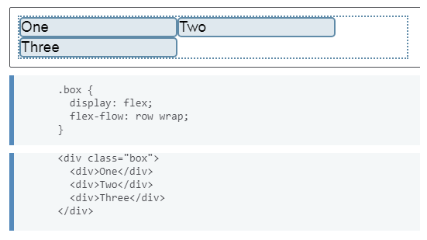
THE FLEX-FLOW SHORTHAND
You can combine the two properties flex-direction and flex-wrap into the flex-flow shorthand. The first value specified is flex-direction and the second value is flex-wrap.

Slide 8
ALIGNING ITEMS IN A FLEX CONTAINER
A key feature of flexbox is the ability to align and justify items on the main- and cross-axes, and to distribute space between flex items. Main properties that allow us to align and justify content are:
justify-content — controls alignment of all items on the main axis.
align-items — controls alignment of all items on the cross axis.
align-self — controls alignment of an individual flex item on the cross axis.
align-content — described in the spec as for “packing flex lines”; controls space between flex lines on the cross axis.

Slide 9
THE CROSS AXIS
The align-items and align-self properties control alignment of our flex items on the cross axis, down the columns if flex-direction is row and along the row if flex-direction is column. Values that can be used:
flex-start;
flex-end;
center;
stretch (default);
baseline;
auto (only align-self).
The align-self property accepts all of the same values as align-items plus a value of auto, which will reset the value to that which is defined on the flex container.

Slide 10
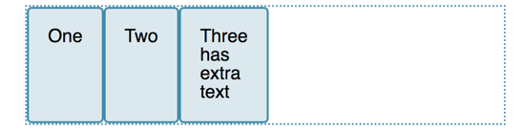

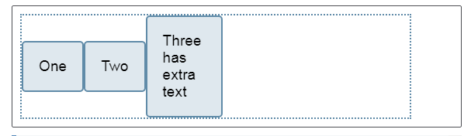

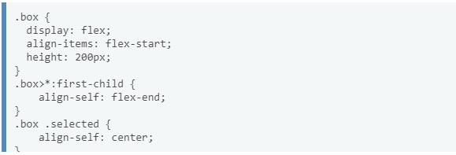
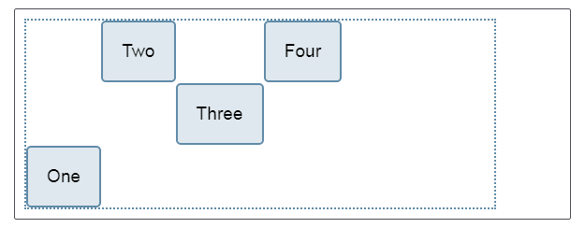

Slide 11
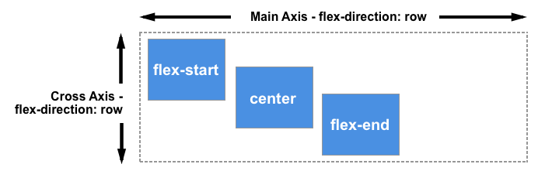
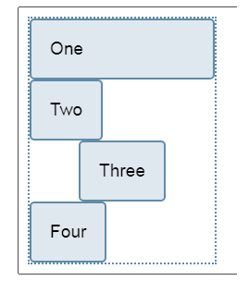
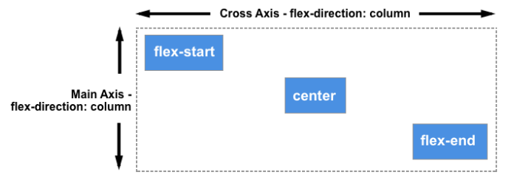
So far we have looked at the behaviour when our flex-direction is row, and while working in a language written top to bottom. This means that the main axis runs along the row horizontally, and our cross axis alignment moves the items up and down.
If we change our flex-direction to column, align-items and align-self will align the items to the left and right.

Slide 12
ALIGNING CONTENT ON THE CROSS AXIS
So far we have been aligning the items, or an individual item inside the area defined by the flex-container. If you have a wrapped multiple-line flex container then you might also want to use the align-content property to control the distribution of space between the rows. In the specification this is described as packing flex lines.
For align-content to work you need more height in your flex container than is required to display the items. It then works on all the items as a set, and dictates what happens with that free space, and the alignment of the entire set of items within it.

Slide 13
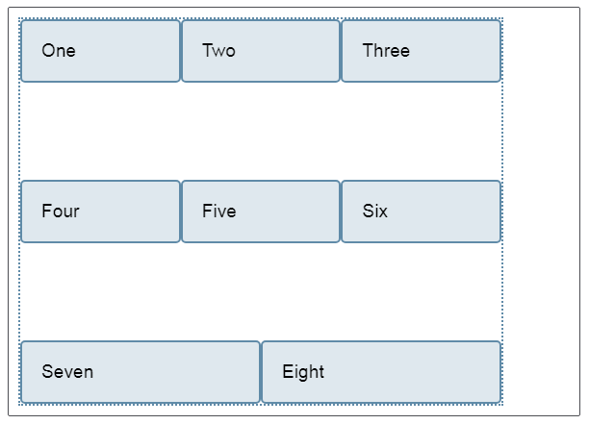
The align-content property takes the following values:
flex-start;
flex-end;
center;
space-between;
space-around;
stretch;
space-evenly (not defined in the Flexbox specification).
align-content: space-between;

Slide 14
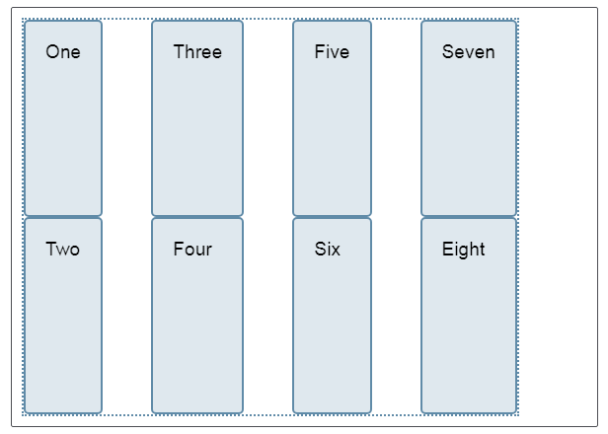
Once again we can switch our flex-direction to column in order to see how this property behaves when we are working by column. As before, we need enough space in the cross axis to have some free space after displaying all of the items.
align-content: space-between;

Slide 15
ALIGNING CONTENT ON THE MAIN AXIS
At the main axis we only have one property available to us — justify-content. This is because we are only dealing with items as a group on the main axis. With justify-content we control what happens with available space, should there be more space than is needed to display the items. The justify-content property accepts the same values as align-content:
flex-start;
flex-end;
center;
space-between;
space-around;
stretch;
space-evenly (not defined in the Flexbox specification).

Slide 16
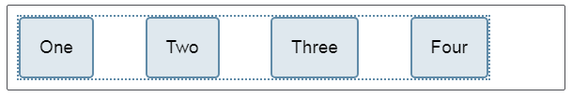
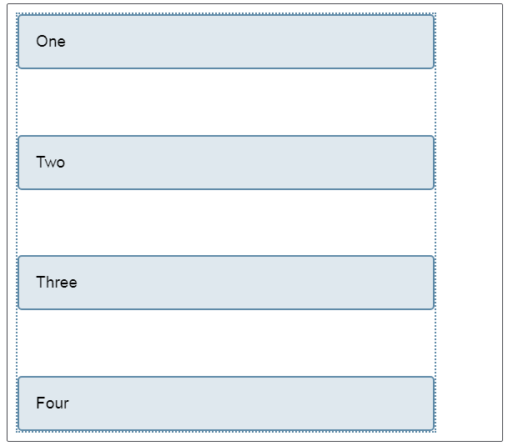
In the following examples, the value of justify-content is space-between. The available space after displaying the items is distributed between the items. The left and right item line up flush with the start and end.
If the main axis is in the block direction because flex-direction is set to column, then justify-content will distribute space between items in that dimension as long as there is space in the flex container to distribute.
justify-content: space-between;
justify-content: space-between;

Slide 17
PROPERTIES APPLIED TO FLEX ITEMS
To have more control over flex items we can target them directly. We do this by way of three properties:
flex-grow - How much of the positive free space does this item get?
flex-shrink - How much negative free space can be removed from this item?
flex-basis - What is the size of the item before growing and shrinking happens?
The properties are usually expressed as the shorthand flex property.

Slide 18
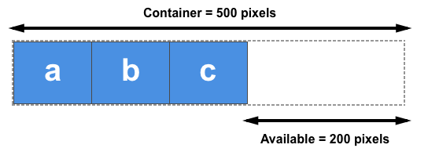
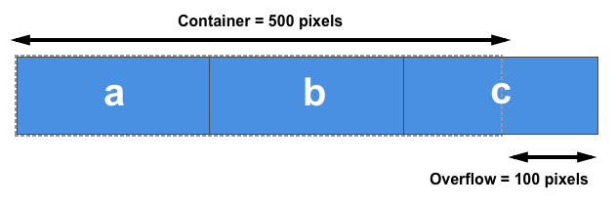
POSITIVE AND NEGATIVE FREE SPACE
To talk about these properties we need to understand the concept of positive and negative free space.
When a flex container has positive free space, it has more space than is required to display the flex items inside the container.
We have negative free space when the natural size of the items adds up to larger than the available space in the flex container. This could be removed from the items in order to make them fit the container.

Slide 19
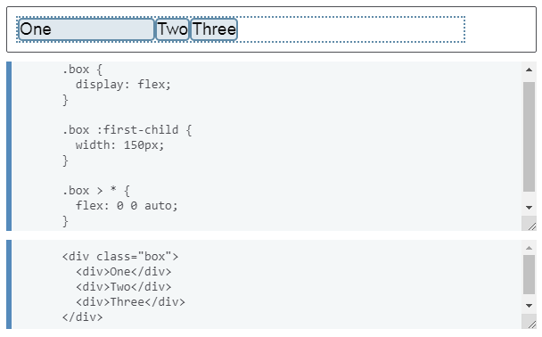
THE FLEX-BASIS PROPERTY
The flex-basis property specifies the initial size of the flex item before any space distribution happens. The initial value for this property is auto — in this case the browser looks to see if the items have a size.
If the items don’t have a size then the content's size is used as the flex-basis. This is why when we just declare display: flex on the parent to create flex items, the items all move into a row and take only as much space as they need to display their contents.
If you want flexbox to completely ignore the size of the item when doing space distribution then set flex-basis to 0.

Slide 20
THE FLEX-GROW PROPERTY
The flex-grow property specifies the flex grow factor, which determines how much the flex item will grow relative to the rest of the flex items in the flex container when the positive free space is distributed.
If all of your items have the same flex-grow factor then space will be distributed evenly between all of them. If this is the situation that you want then typically you would use 1 as the value, however you could give them all a flex-grow of 88, or 100, or 1.2 if you like — it is a ratio. If the factor is the same for all, and there is positive free space in the flex container then it will be distributed equally to all.

Slide 21
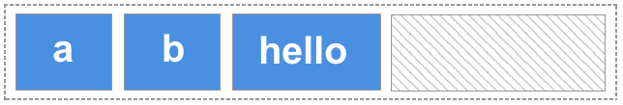
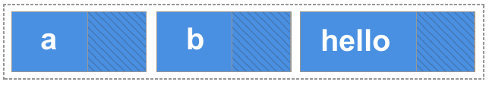
COMBINING FLEX-GROW AND FLEX-BASIS
Things can get confusing in terms of how flex-grow and flex-basis interact. Let’s consider this rule:
flex: 1 1 auto;
Our bigger item ends up bigger because it started from a bigger size, even though it has the same amount of spare space assigned to it as the others:

Slide 22
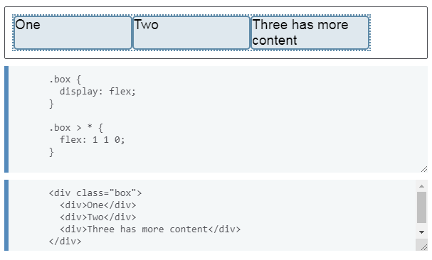
COMBINING FLEX-GROW AND FLEX-BASIS
If what you actually want is three equally-sized items, even if they start out at different sizes, you should use this:
flex: 1 1 0;
Here we are saying that the size of the item for the purposes of our space distribution calculation is 0 — all the space is up for grabs and as all of the items have the same flex-grow factor, they each get an equal amount of space distributed. The end result is three equal width, flexible items.

Slide 23
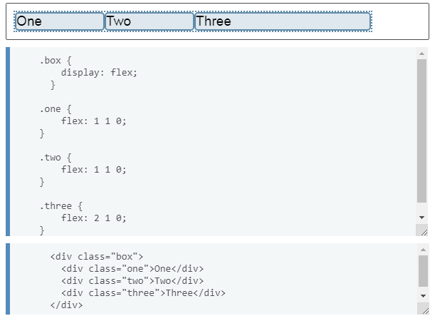
GIVING ITEMS DIFFERENT FLEX-GROW FACTORS
Our understanding of how flex-grow works with flex-basis allows us to have further control over our individual item sizes by assigning items different flex-grow factors. If we keep our flex-basis at 0 so all of the space can be distributed, we could assign each of the three flex items a different flex-grow factor.

Slide 24
THE FLEX-SHRINK PROPERTY
The flex-shrink property specifies the flex shrink factor, which determines how much the flex item will shrink relative to the rest of the flex items in the flex container when negative free space is distributed.
This property deals with situations where the browser calculates the flex-basis values of the flex items, and finds that they are too large to fit into the flex container.
So where flex-grow deals with adding available space, flex-shrink manages taking away space to make boxes fit into their container without overflowing.

Slide 25

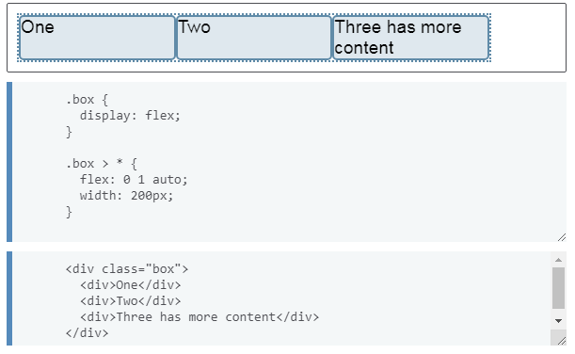
In the first example we have three items in a flex container, each of a width of 200 pixels, and the container is 500 pixels wide. With flex-shrink set to 0 the items are not allowed to shrink and so they overflow the box.
If we change the flex-shrink value to 1 and you will see each item shrink by the same amount, in order that all of the items now fit in the box. They have become smaller than their initial width in order to do so.

Slide 26
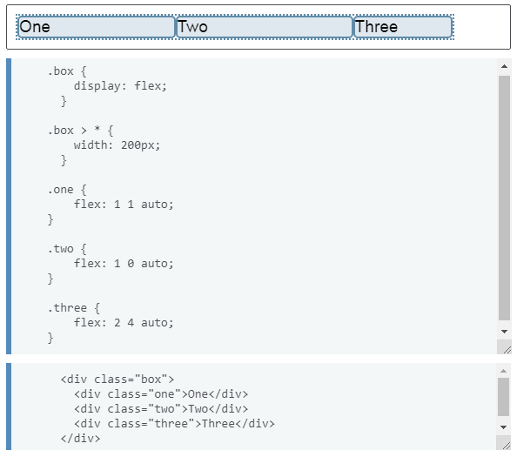
GIVING ITEMS DIFFERENT FLEX-SHRINK FACTORS
In the same way as flex-grow, you can give flex-items different flex-shrink factors. This can help change the default behavior if, for example, you want an item to shrink more or less rapidly than its siblings or not shrink at all.

Slide 27
ORDERING FLEX ITEMS
In addition to reversing the order in which flex items are visually displayed (row- column-reverse), you can target individual items and change where they appear in the visual order with the order property.
The order property is designed to lay the items out in ordinal groups. What this means is that items are assigned an integer that represents their group. The items are then placed in the visual order according to that integer, lowest values first. If more than one item has the same integer value, then within that group the items are laid out as per source order.
Flex items have a default order value of 0, therefore items with an integer value greater than 0 will be displayed after any items that have not been given an explicit order value.
You can also use negative values with order, which can be quite useful.

Slide 28
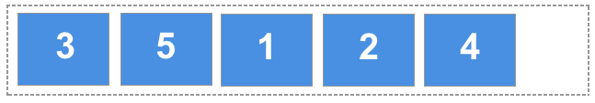
As an example, If we have 5 flex items, and we assign order values as follows:
Source item 1: order: 2;
Source item 2: order: 3;
Source item 3: order: 1;
Source item 4: order: 3;
Source item 5: order: 1.

Slide 29
THANKS!

