Slide 1

GLOBAL METHANE EMISSIONS ANALYSIS
& Sustainability Decision Support System
Final Data Analytics Project
Mina Sabry — Power BI Developer
Rosy Mohamed — SQL Developer
Nouran Mohamed — Python Data Analyst & Tableau Developer
Shahd Mohamed — Excel Data Dashboard
Faculty of Computers and Data Science
Python • SQL • Tableau • Power BI

Slide 2
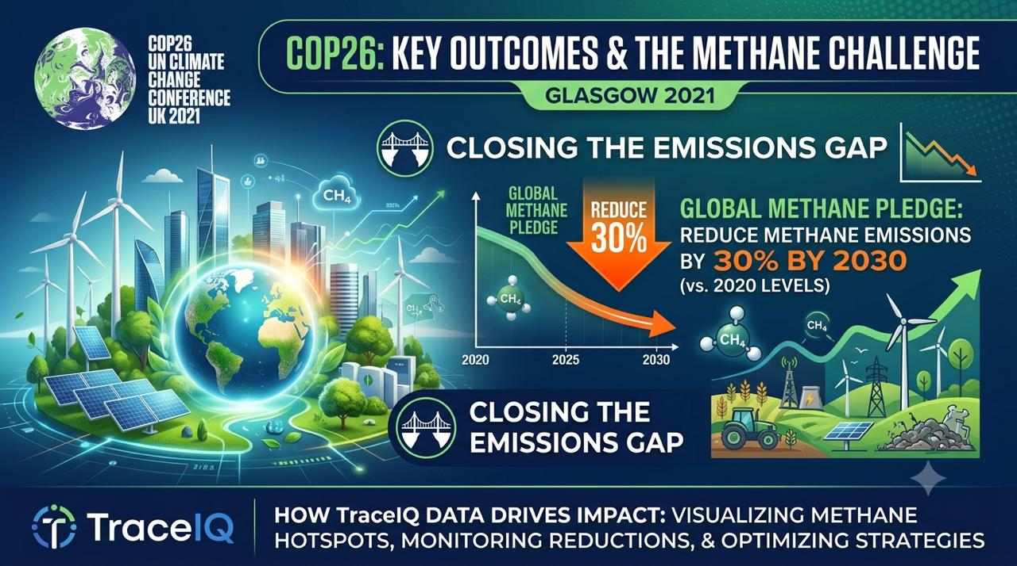


Slide 3
INTRODUCTION
Project Overview
Background
Problem Statement
Objectives
Methane is the second-largest contributor to global warming after CO₂, with roughly 80x the near-term warming potency. Oil and gas facilities are among its largest industrial sources.
Facility-level methane data is fragmented across formats and tools, leaving decision-makers without a unified, evidence-based view of where emissions are concentrated and which interventions matter most.
Consolidate 21,679 facility-level readings into a single analytics pipeline — Python for exploration, SQL for governed metrics, and Tableau / Power BI for executive reporting.
Business Goals
Expected Outcomes
Sustainability Impact
Identify high-impact facilities and operators, quantify super-emitter risk, and rank sustainability strategies by feasibility and emissions-reduction potential.
A reusable decision-support system that flags priority facilities, benchmarks countries and companies, and recommends the strategy with the best difficulty-to-impact ratio.
Targeted reduction at the top 3.1% of super-emitting facilities can deliver disproportionate cuts to global methane output at comparatively low operational cost.
INTRODUCTION
Faculty of Computers and Data Science
1
Notes:
This project addresses a fragmented view of industrial methane emissions by unifying Python analysis, SQL governance, and BI reporting into one decision-support pipeline. The goal is to help stakeholders prioritize the facilities and strategies that reduce the most emissions for the least operational difficulty.

Slide 4
INTRODUCTION
Dataset Overview
21,679
1,500
20
24
2024–2026
663
Facility Records
Unique Facilities
Countries Covered
Data Fields
Time Coverage
Super-Emitter Sites
Core Data Fields
Field | Type | Business Relevance
facility_id / facility_name | Identifier | Uniquely tracks each of the 1,500 monitored sites
source_type / subsector | Categorical | Distinguishes oil-and-gas production vs. transport operations
iso3 / lat / lon | Geographic | Enables country ranking and geospatial hotspot mapping
year / month | Temporal | Supports trend, seasonality, and peak-period analysis
emission_quantity / confidence | Numeric | Core KPI, weighted by measurement reliability
immediate_source_owner | Categorical | Attributes emissions to responsible corporate operators
recommended_strategy_name / difficulty_score | Categorical / Numeric | Feeds the sustainability recommendation engine
gdp / population / co2 / methane / energy_per_capita | Numeric | Links emissions to macro-economic and environmental context
known_super_emitter_flag | Boolean | Flags the highest-priority facilities for intervention
INTRODUCTION
Faculty of Computers and Data Science
2
Notes:
The dataset spans 21,679 records across 1,500 facilities in 20 countries over 2024-2026, combining operational, geographic, economic, and environmental fields to support a full sustainability analysis.

Slide 5


Slide 6
PYTHON ANALYSIS
Python Workflow
1
2
3
4
5
6
Import Data
→
Cleaning
→
EDA
→
Visualization
→
Insights
→
Export Results
Load the 21,679-row facility dataset into pandas
Handle missing values, standardize types, verify keys
Profile distributions, confidence levels, and outliers
Build Plotly & Matplotlib charts for every KPI
Translate patterns into sustainability findings
Hand off clean tables to SQL and BI tools
The Python stage transforms 21,679 raw facility readings into a governed, analysis-ready dataset. Every downstream SQL query and BI dashboard in this presentation is traceable back to this pipeline.
BUSINESS INSIGHT
RECOMMENDATION
A repeatable six-stage pipeline ensures every chart in this deck, and every SQL metric downstream, is built on the same validated dataset.
Automate this pipeline as a scheduled Python job so new facility readings refresh the analysis without manual rework.
PYTHON ANALYSIS
Faculty of Computers and Data Science
3
Notes:
Python is the foundation of the pipeline: import, clean, explore, visualize, and export, feeding directly into SQL and both BI tools.

Slide 7
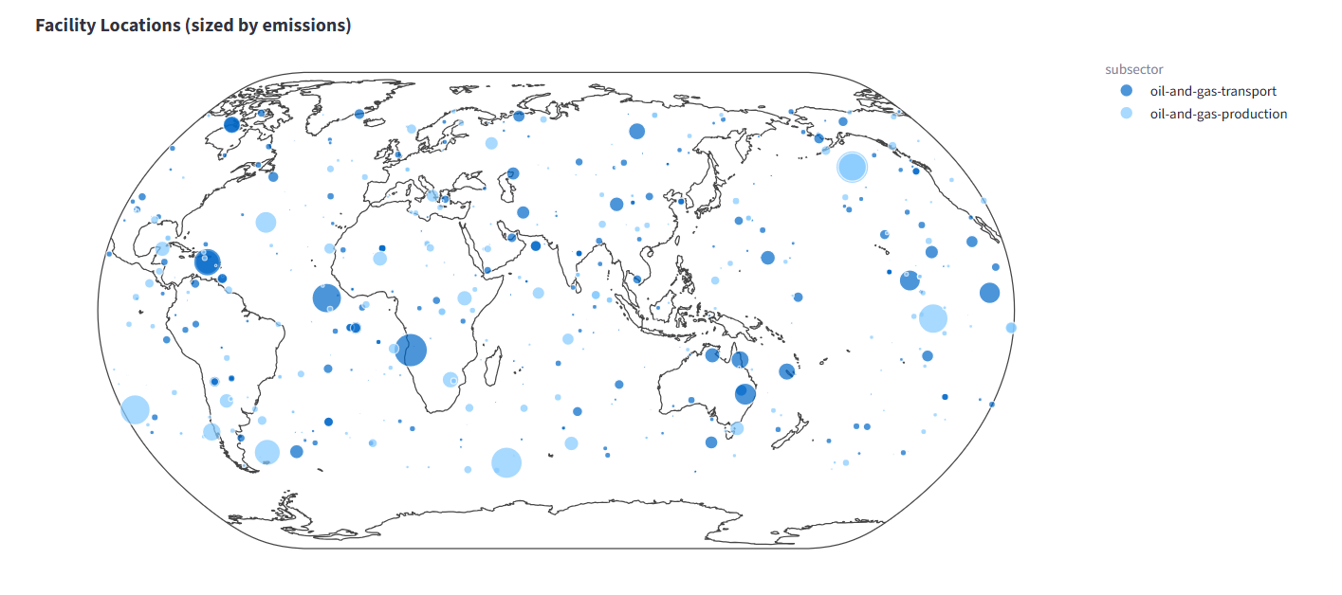
PYTHON ANALYSIS
Facility Locations Worldwide
KEY OBSERVATIONS
Bubble size represents emission_quantity — larger circles mark higher-output facilities.
Bubble color distinguishes oil-and-gas-transport (dark blue) from oil-and-gas-production (light blue) subsectors.
Emission hotspots cluster around West Africa, the Gulf, Central Asia, and the North Sea.
Facilities are dispersed across 20 countries, but intensity is highly uneven geographically.
Facility locations sized by emission quantity, colored by subsector (Python / Plotly)
BUSINESS INSIGHT
RECOMMENDATION
A small number of geographic clusters — not a uniform global spread — account for the largest visible emission bubbles, pointing to regional infrastructure and regulatory gaps.
Prioritize site inspections and monitoring investment in the identified hotspot regions before expanding oversight elsewhere.
PYTHON ANALYSIS
Faculty of Computers and Data Science
4
Notes:
This map shows the geographic distribution of all monitored facilities. Bubble size encodes emission volume and color encodes subsector, revealing clear regional hotspots.

Slide 8
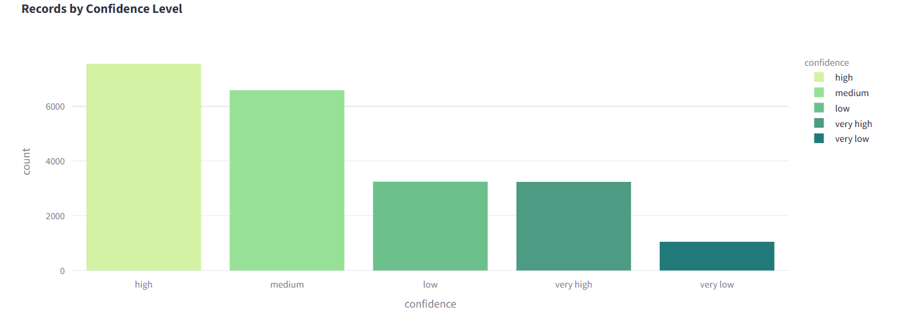
PYTHON ANALYSIS
Confidence Level Distribution
KEY OBSERVATIONS
“High” and “medium” confidence readings together make up the large majority of all records.
“Very high” and “low” confidence levels are roughly comparable in volume.
“Very low” confidence readings are the smallest group, limiting how much they should influence decisions.
Confidence level should weight how strongly any single reading drives strategy or investment decisions.
Record counts by measurement confidence level (Python / Plotly)
BUSINESS INSIGHT
RECOMMENDATION
The bulk of the dataset carries high-to-medium measurement confidence, which supports using emission_quantity as a reliable basis for facility-level prioritization.
Flag low and very-low confidence readings for re-measurement before they inform high-stakes investment or compliance decisions.
PYTHON ANALYSIS
Faculty of Computers and Data Science
5
Notes:
Confidence level reflects how reliable each emission reading is. Most records fall in the high and medium bands, which supports trusting the aggregate figures used throughout this analysis.

Slide 9
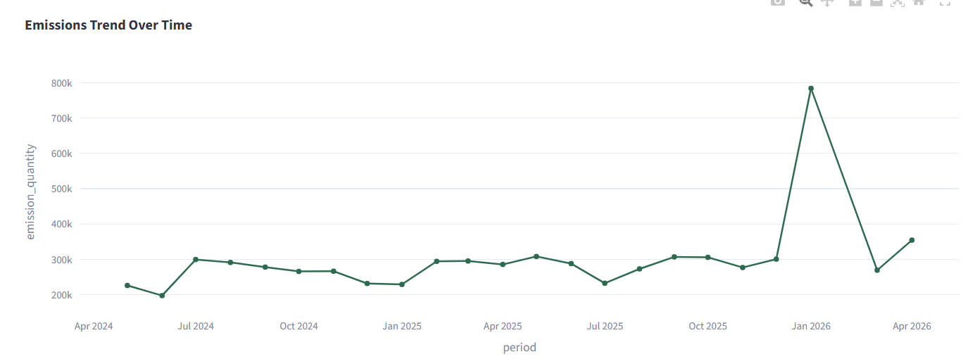
PYTHON ANALYSIS
Emissions Trend Over Time
KEY OBSERVATIONS
Monthly totals hold a relatively stable band between roughly 200K and 300K units through most of the series.
A sharp spike appears around January 2026, reaching nearly 800K units before falling back.
The spike suggests a discrete operational event — a leak, maintenance shutdown, or reporting anomaly — rather than a gradual trend shift.
Emissions return toward the historical baseline within two months of the peak.
Total emission_quantity by month, April 2024 – April 2026 (Python / Plotly)
BUSINESS INSIGHT
RECOMMENDATION
The January 2026 spike is the single most significant anomaly in the dataset and likely traces back to a small number of facilities rather than a systemic shift.
Cross-reference facility-level records from December 2025 – February 2026 to isolate the root cause and prevent recurrence.
PYTHON ANALYSIS
Faculty of Computers and Data Science
6
Notes:
This line chart tracks total monthly emissions. The dataset is largely stable except for a sharp anomaly around January 2026 that warrants root-cause investigation.

Slide 10
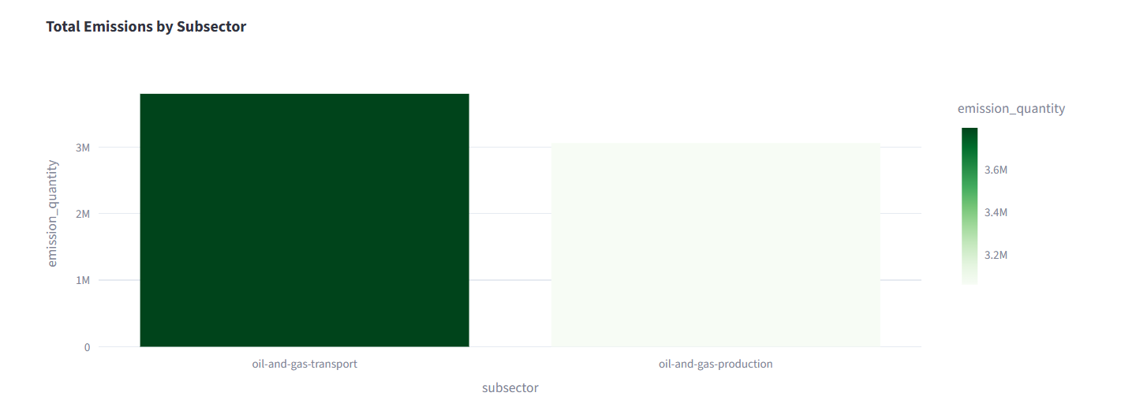
PYTHON ANALYSIS
Total Emissions by Subsector
KEY OBSERVATIONS
Oil-and-gas-transport accounts for roughly 3.7M emission units, versus about 3.2M for oil-and-gas-production.
Transport infrastructure — pipelines, compressor stations, storage — generates the larger overall share.
Every record in the dataset is classified as a point-source emission, so source_type itself is not a differentiator here.
The two subsectors are close in magnitude, implying interventions are needed on both fronts, not just one.
Total emission_quantity by subsector (Python / Plotly)
BUSINESS INSIGHT
RECOMMENDATION
Transport-related infrastructure is a marginally larger emissions contributor than production, making pipeline integrity and compressor maintenance a first-order priority alongside upstream production controls.
Launch parallel Leak Detection and Repair (LDAR) programs across both subsectors rather than concentrating resources on production sites alone.
PYTHON ANALYSIS
Faculty of Computers and Data Science
7
Notes:
Emissions split fairly evenly between transport and production subsectors, with transport slightly ahead. All records are point-source emissions, so the subsector split is the more actionable lens here.

Slide 11
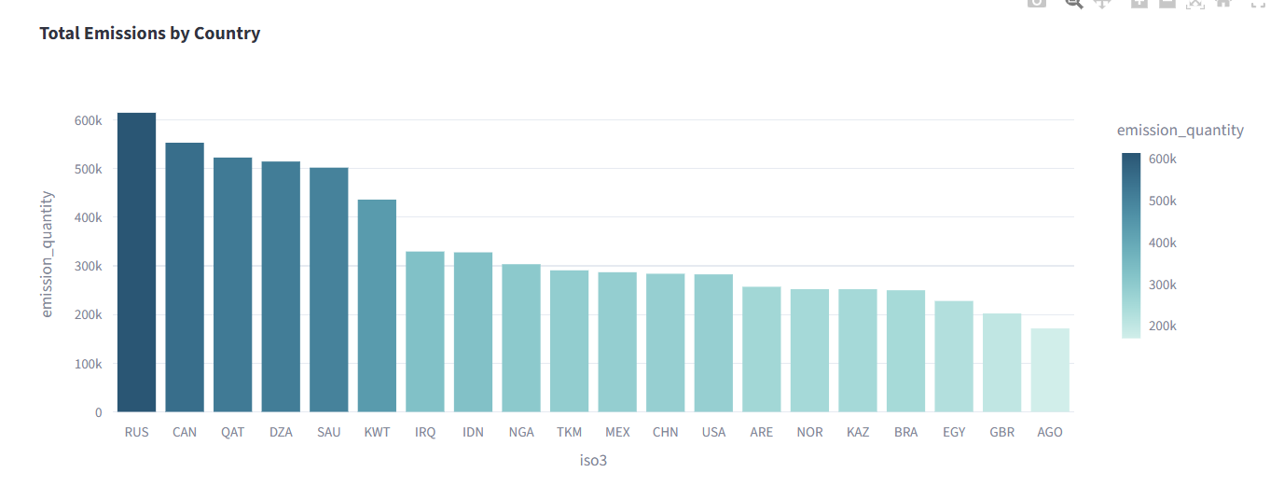
PYTHON ANALYSIS
Top Countries by Emissions
KEY OBSERVATIONS
Russia (RUS) leads all countries, followed closely by Canada (CAN), Qatar (QAT), Algeria (DZA), and Saudi Arabia (SAU).
The top five countries account for a disproportionate share of total measured emissions.
Major oil-and-gas exporting economies dominate the ranking, consistent with the dataset's industrial focus.
Emissions generally track the scale of each country's oil-and-gas production and export infrastructure.
Total emission_quantity by country, top 20 by iso3 code (Python / Plotly)
BUSINESS INSIGHT
RECOMMENDATION
Emission intensity concentrates in a handful of major hydrocarbon-exporting nations, meaning global reduction targets hinge disproportionately on policy engagement with this small group of countries.
Prioritize bilateral sustainability partnerships and technology-transfer programs with the top five emitting countries to maximize global impact per dollar invested.
PYTHON ANALYSIS
Faculty of Computers and Data Science
8
Notes:
Russia, Canada, Qatar, Algeria, and Saudi Arabia top the country ranking. These major hydrocarbon exporters offer the highest-leverage opportunities for emissions reduction.

Slide 12
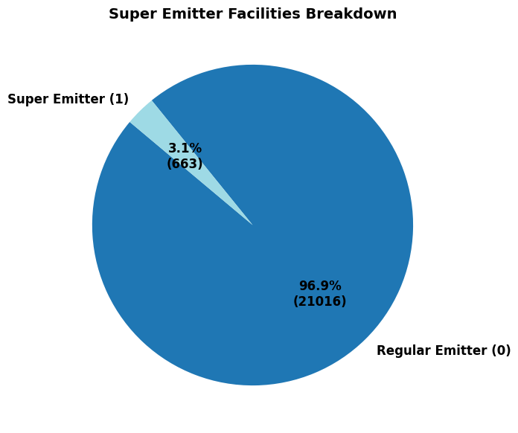
PYTHON ANALYSIS
Super-Emitters Analysis
KEY OBSERVATIONS
Only 663 facilities — 3.1% of all 21,679 records — are flagged as known super-emitters.
The remaining 96.9% (21,016 records) fall under the regular-emitter classification.
Super-emitter status is defined by the known_super_emitter_flag field in the source dataset.
A small facility subset historically drives an outsized share of methane output, consistent with global methane research.
Share of facilities flagged as known super-emitters (Python / Matplotlib)
BUSINESS INSIGHT
RECOMMENDATION
Because super-emitters represent just 3.1% of facilities, this is the highest-leverage segment in the entire dataset — a small, well-defined target list rather than a broad industry-wide mandate.
Build a standing monitoring and rapid-response program specifically for the 663 flagged super-emitter facilities, reviewed quarterly.
PYTHON ANALYSIS
Faculty of Computers and Data Science
9
Notes:
Super-emitters make up just 3.1% of facilities. This concentration is the clearest opportunity in the dataset for high-impact, low-effort intervention.

Slide 13
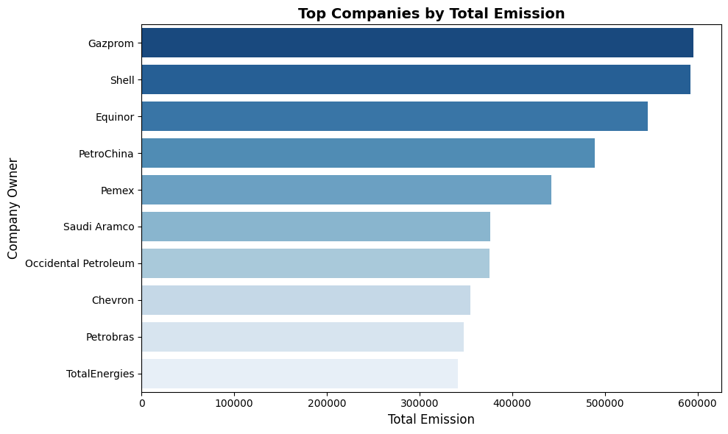
PYTHON ANALYSIS
Top Companies by Total Emissions
KEY OBSERVATIONS
Gazprom and Shell lead the ranking, each associated with roughly 590K–600K emission units.
Equinor, PetroChina, and Pemex round out the top five, each above 400K units.
Saudi Aramco, Occidental Petroleum, Chevron, Petrobras, and TotalEnergies complete the top ten, each in the 340K–380K range.
Ownership concentration means a handful of multinational operators control a large share of measured global emissions.
Total emission_quantity by immediate_source_owner, top 10 companies (Python / Matplotlib)
BUSINESS INSIGHT
RECOMMENDATION
The ten largest operators — spanning state-owned and multinational companies across Russia, Europe, North America, and the Middle East — collectively represent a concentrated, addressable set of accountability targets.
Engage the top-10 operators directly on facility-level LDAR commitments; corporate-level accountability agreements will move the aggregate number faster than country-level policy alone.
PYTHON ANALYSIS
Faculty of Computers and Data Science
10
Notes:
Gazprom and Shell top the corporate emissions ranking, with a mix of state-owned and multinational operators rounding out the top ten — a concentrated group for targeted engagement.

Slide 14
PYTHON ANALYSIS
Python Insights Summary
1
Geographic Hotspots
2
Sector Balance
West Africa, the Gulf, Central Asia, and the North Sea host the largest emission clusters.
Transport (~3.7M units) narrowly outweighs production (~3.2M units) — both need attention.
3
High-Emission Operators
4
Confidence Quality
Gazprom, Shell, and Equinor anchor a concentrated top-10 company list.
The majority of readings carry high-to-medium confidence, supporting reliable prioritization.
5
Trend Anomaly
6
Super-Emitter Leverage
A sharp January 2026 spike stands out against an otherwise stable monthly baseline.
Just 3.1% of facilities (663 sites) represent the highest-impact intervention target.
PYTHON ANALYSIS
Faculty of Computers and Data Science
11
Notes:
This slide closes the Python section by tying together the six visualizations into one coherent narrative before moving to the SQL layer.

Slide 15
SQL ANALYSIS
SQL Database Architecture & Data Quality
Database
(TraceIQ_DB)
Table
(Sheet1$)
Primary Key
(facility_id)
Data Quality Checks
Business Queries
Reporting
Data Quality Query
→
→
→
→
→
SELECT
COUNT(*) - COUNT(facility_id) AS Missing_ID,
COUNT(*) - COUNT(emission_quantity)
AS Missing_Emission
FROM Sheet1$;
Data Quality Checks Performed
Duplicate Detection
Row-count and completeness verification across all 21,679 imported records
NULL checks on facility_id, facility_name, source_type, and emission_quantity
Duplicate facility_id detection via GROUP BY / HAVING COUNT(*) > 1
Referential consistency between facility, geographic, and company fields
SELECT facility_id, COUNT(*) AS Dup
FROM Sheet1$
GROUP BY facility_id
HAVING COUNT(*) > 1;
Result: 0 missing keys, 0 duplicate facility_id values — dataset is clean and query-ready.
BUSINESS INSIGHT
RECOMMENDATION
The TraceIQ_DB architecture enforces primary-key integrity and passes all data-quality checks, giving downstream Tableau and Power BI dashboards a trustworthy foundation.
Schedule these validation queries to run automatically on every data refresh to catch quality issues before they reach the BI layer.
SQL ANALYSIS
Faculty of Computers and Data Science
12
Notes:
The SQL layer starts with database and table setup in TraceIQ_DB, followed by rigorous data quality checks — completeness and duplicate detection — before any business query runs.

Slide 16
SQL ANALYSIS
SQL Business Intelligence & Advanced Queries
Executive Metrics Delivered
Advanced SQL Techniques Applied
Metric | What It Delivers
Total Emissions | 6.86M units aggregated across all facilities
Country Ranking | DENSE_RANK() window function orders 20 countries by output
Facility Performance Score | CASE-based Critical / High / Medium / Low tiers
Emission Risk Score | Per-facility risk banding for triage and audits
Recommendation Engine | Joins strategies to facilities by reduction potential
KPI Achievement | Reduction % = recommended savings ÷ current emissions
GROUP BY / ORDER BY — aggregation and ranking
CASE WHEN — risk and performance banding
COUNT() / SUM() / AVG() — core KPI calculations
HAVING — duplicate and outlier filtering
CTE (WITH clause) — modular country-emission subqueries
DENSE_RANK() window function — tie-aware country ranking
BUSINESS INSIGHT
RECOMMENDATION
Window functions and CTEs let a single query set (Country Ranking, KPI Achievement, Facility Performance Score) power every downstream dashboard without redundant logic.
Materialize the CTE-based country ranking as a SQL view so Tableau and Power BI always read the same governed metric.
SQL ANALYSIS
Faculty of Computers and Data Science
13
Notes:
Beyond basic aggregation, the SQL layer uses CASE-based scoring, CTEs, and the DENSE_RANK window function to produce governed, reusable business metrics.

Slide 17
BI & REPORTING
Multi-Tool Business Intelligence Layer
The governed SQL metrics feed three complementary reporting tools, each serving a distinct stakeholder audience.
Tableau
Power BI
Excel
Developer: Nouran Mohamed
Developer: Mina Sabry
Developer: Shahd Mohamed
Interactive geographic filtering
Facility-level drill-down
Emission trend exploration
Cross-filtered dashboard views
Executive KPI cards & scorecards
Strategic country / facility comparison
Risk-tier management view
Slicers for on-demand analysis
Pivot-table dashboard summaries
Company & subsector breakdowns
Super-emitter distribution view
Lightweight offline sharing
BI & REPORTING
Faculty of Computers and Data Science
14
Notes:
Three tools serve three audiences from the same governed dataset: Tableau for interactive exploration, Power BI for executive and strategic reporting, and Excel for lightweight offline sharing. Live dashboard screenshots can be inserted here once available.

Slide 18
STRATEGY
Strategic Recommendations
1
Target the 3.1% Super-Emitters First
2
Deploy LDAR Across Both Subsectors
Stand up a quarterly monitoring cycle for the 663 flagged facilities — the single highest-leverage segment in the dataset.
Leak Detection and Repair is the most frequently recommended strategy (3,999 facilities) and applies to both transport and production sites.
3
Engage the Top-10 Operators Directly
4
Investigate the January 2026 Anomaly
Gazprom, Shell, Equinor, PetroChina, and peers control a concentrated, addressable share of global emissions — pursue corporate-level commitments.
Root-cause the emissions spike before it recurs; isolate the responsible facilities using the SQL trend and risk-score queries.
5
Focus Policy on the Top-5 Countries
6
Operationalize the Recommendation Engine
Russia, Canada, Qatar, Algeria, and Saudi Arabia dominate country-level output — bilateral programs here move the global number fastest.
Rank the six sustainability strategies by reduction-per-difficulty and route each facility to its best-fit strategy automatically.
STRATEGY
Faculty of Computers and Data Science
15
Notes:
These six recommendations translate the Python, SQL, and BI findings into concrete, prioritized actions for sustainability stakeholders.

Slide 19
CONCLUSION
From Raw Emissions Data to Sustainability Action
Project Achievements
Key Findings
Business & Environmental Value
Future Improvements
Unified Python → SQL → BI pipeline
21,679 records validated & analyzed
Six governed sustainability KPIs
3.1% of facilities drive outsized risk
Top 5 countries dominate output
Transport slightly exceeds production
Concentrated targets for fast wins
Recommendation engine per facility
Foundation for ongoing monitoring
Machine learning risk prediction
Real-time facility monitoring feeds
Cloud deployment of the pipeline
Thank You
Questions & Answers
Notes:
We close by tying achievements, findings, and business value back to the original problem statement, and open the floor for questions.

Slide 20


