Slide 1
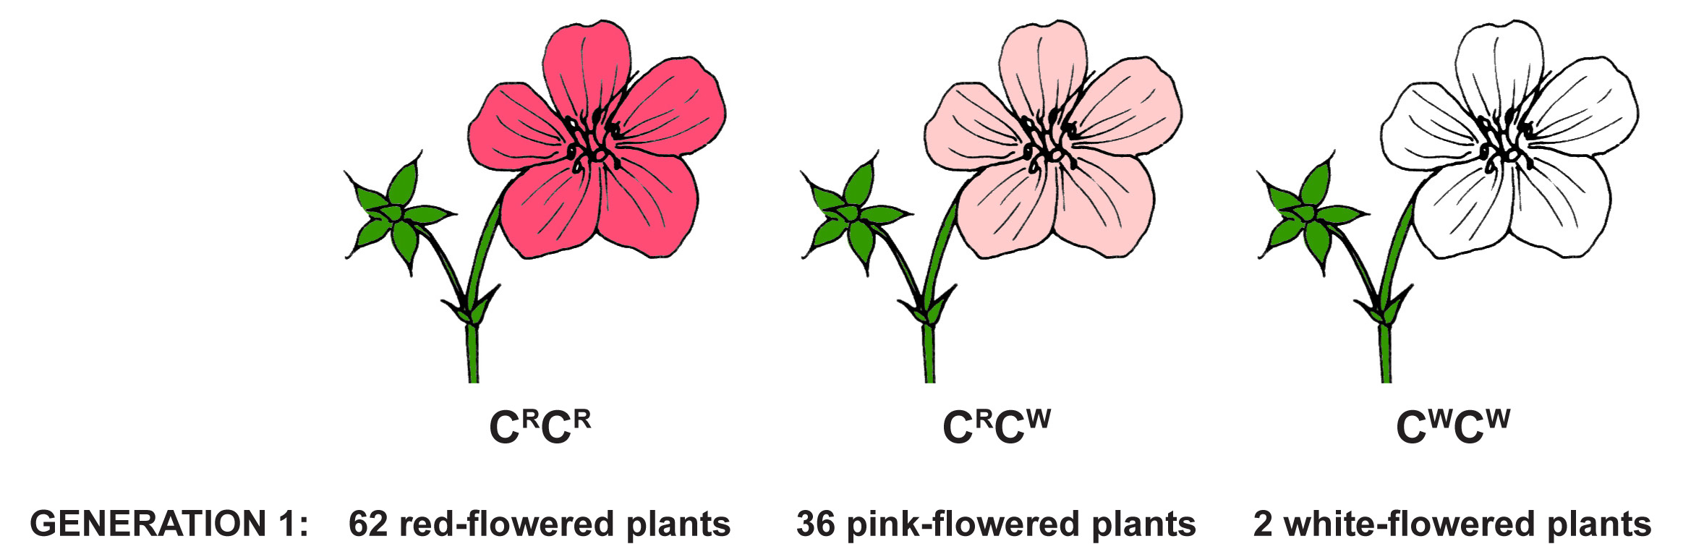

Understanding Evolution: Problem-based discussion
Population genetics calculations and Hardy Weinberg
1) What are the genotype frequencies at the flower-color locus in this generation?
2) What are the allele frequencies at the flower-color locus in this generation?
3) If the individuals in this generation mate randomly, what would you expect the genotype frequencies to be in the next generation?
Notes:
In a particular species of plant, flower color is genetically controlled, as shown here. The red allele and white allele are codominant.
In Generation 1, a population of this plant is composed of 62 red-flowered plants, 36 pink-flowered plants, and 2 white-flowered plants.

Slide 2
Understanding Evolution: Problem-based discussion
Population genetics calculations and Hardy Weinberg
4) If the individuals in this generation mate randomly, what would you expect the allele frequencies to be in Generation 2?
5) If the resulting individuals in Generation 2 mate randomly, what would you expect the allele frequencies to be in Generation 3?
6) Is this population evolving? Why or why not?

