Slide 1
WEARABLE SPEECH COMMAND BLIND ASSISTANT SYSTEM
Done by :
Roszhan raj m s 211719104108

Slide 2
Overview
India is a country with one of the largest visually impaired people. About 40 million which accounts 20% world’s blind population They are facing a lot of difficulties even in normal day to day life basis such as crossing roads, finding obstacles etc. They always need a person to help them. Their life becomes unavoidably dependent one.
Medically, lot of projects are going but the probability of outcome is very low. So, to overcome this this assistant system will help them a lot. Given the growth in the numbers of visually impaired (VI) people in low-income countries, the development of affordable electronic travel aid (ETA) systems employing devices, sensors, and apps embedded in ordinary smartphones becomes a potentially cost-effective and reasonable all-in-one solution.
This system consists of a section for Obstacle detection and another one for to find Location. We made use of Ultrasonic sensor and GPS module to achieve the Obstacle detection and location finding respectively.
The software section is done with Arduino IDE. Finally, the output will be intimated to the user through speech commands. So with all this we can assist the blind people.

Slide 3
Objectives
To make the life of the blind people easier. To lower their challenging issues in the society.
To develop an obstacle identifier and locate how far the object is presented.
To find the person location.
To convey the gathered information to the user using speech commands.

Slide 4
Organization of the project report
CHAPTER 1: Discusses the Overview of Wearable speech command Blind assistant system, states the need and overview of the project.
CHAPTER 2: Discusses some of the papers referred for the project works were summarized.
CHAPTER 3: Discusses about the block diagram, pin description and the components used in the project.
CHAPTER 4: Shows the simulation results obtained by integrating all the sensors into a complete model by dumping the code in the Arduino and working of the complete proposed model is discussed.
CHAPTER 5: Discusses the conclusion of the proposed system model and ideas that can be extended in the future.

Slide 5
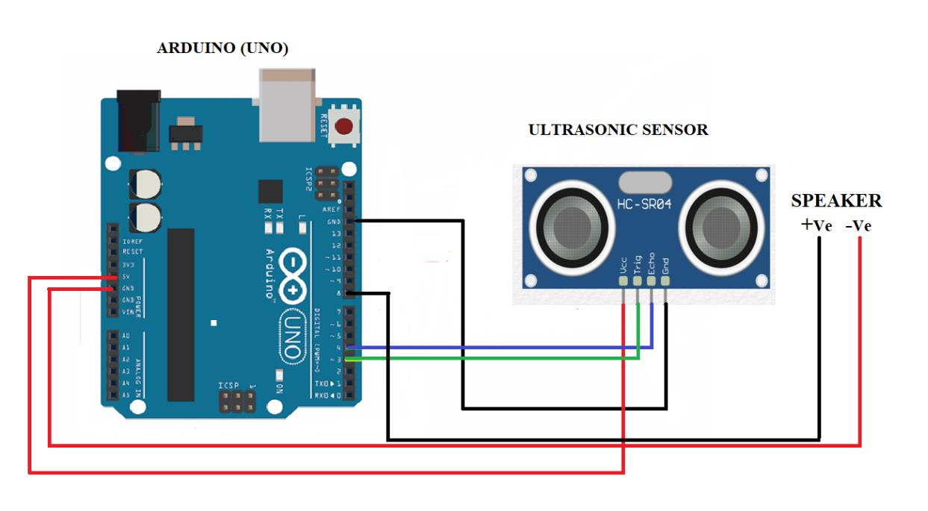
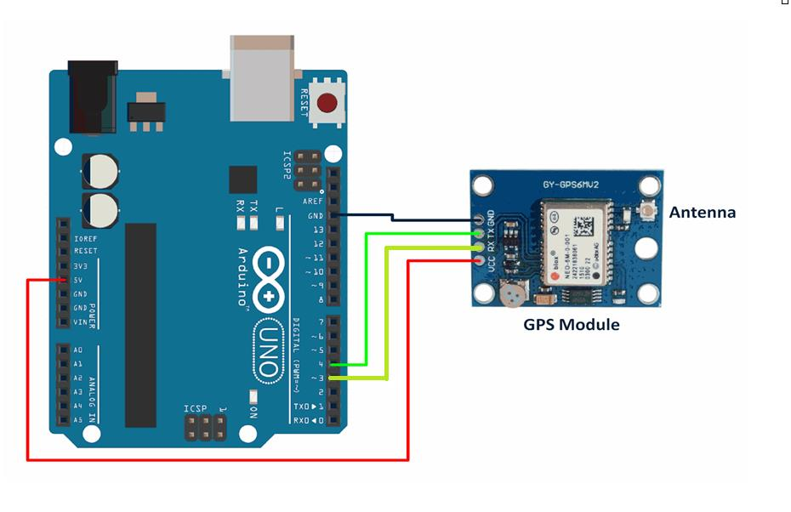
System design
1) Pseudorandom code - This will consists of the ID of satellite which is sending the information.
2) Ephemeris data - This will consists of Position and health of the satellite.
3) Almanac data - It will tell where each GPS satellite should be at any time throughout the day and shows the orbital information for the satellite.
A) block diagram of object detection B) block diagram of location detection

Slide 6
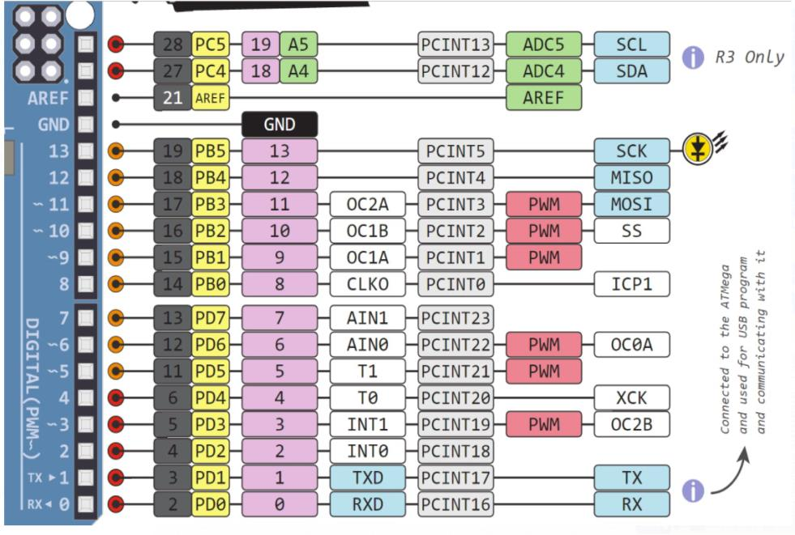
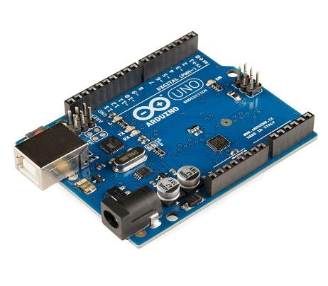
Arduino uno
The Arduino Uno is an open-source microcontroller board based on the Microchip ATmega328P microcontroller and developed by Arduino.cc. The board is equipped with sets of digital and analog input/output (I/O) pins that may be interfaced to various expansion boards (shields) and other circuits. The board has 14 digital I/O pins (six capable of PWM output), 6 analog I/O pins, and is programmable with the Arduino IDE (Integrated Development Environment), via a type B USB cable. It can be powered by the USB cable or by an external 9-volt battery, though it accepts voltages between 7 and 20 volts.
It is similar to the Arduino Nano and Leonardo. The word "uno" means "one" in Italian and was chosen to mark the initial release of Arduino Software. The Uno board is the first in a series of USB-based Arduino boards.
Pin diagram of Arduino uno
Arduino uno board

Slide 7
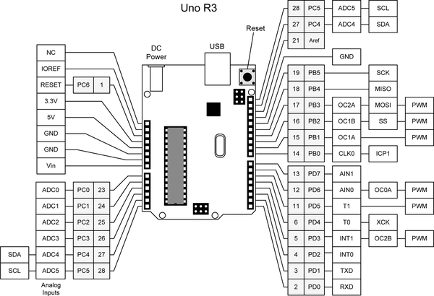
Block diagram and components
Power | Vin, 3.3V, 5V, GND | Vin: Input voltage to Arduino when using an external power source. 5V: Regulated power supply used to power microcontroller and other components on the board. 3.3V: 3.3V supply generated by on-board voltage regulator. Maximum current draw is 50mA. GND: ground pins.
Reset | Reset | Resets the microcontroller.
Analog Pins | A0-A5 | Used to provide analog input in the range of 0-
Block diagram of Uno R3

Slide 8
Sensor Pin Configuration
1 | Vcc | The Vcc pin powers the sensor, typically with +5V
2 | Trigger | Trigger pin is an Input pin. This pin has to be kept high for 10us to initialize measurement by sending US wave.
3 | Echo pin | Echo pin is an Output pin. This pin goes high for a period of time which will be equal to the time taken for the US wave to return back to the sensor.
4 | GND | This pin is connected to the Ground of the system.

Slide 9
conclusion and future scope
This paper proposes a wearable navigation system that helps the visually challenged to move freely in both indoor and outdoor settings. The proposed model has an accuracy of 90 %. The overall aim was to provide a simple wearable and economic device for the visually impaired. It can be used by people of all ages and is convenient to operate. Obstacle is sensed and distance is measured using ultrasonic sensor. Audio assistance is given in the form of speech signals using speaker which is inbuilt in arduino ide. Thus, the final audio output containing the alert sound is given through speaker to the user. This project can be used as a wearable device or it can be implemented in the cane for the comfort of the blind.
As future work, we are trying to develop and implement a more accurate navigation model which helps blind people in identifying and distancing any surrounding objects, as the present model cannot give the distance of moving objects accurately. This will be achieved using high speed microprocessor technology. This technology can also be essentially implemented in the form of a walking stick for the blind which uses similar technology to this project but is more versatile and user friendly.

Slide 10


