Slide 1
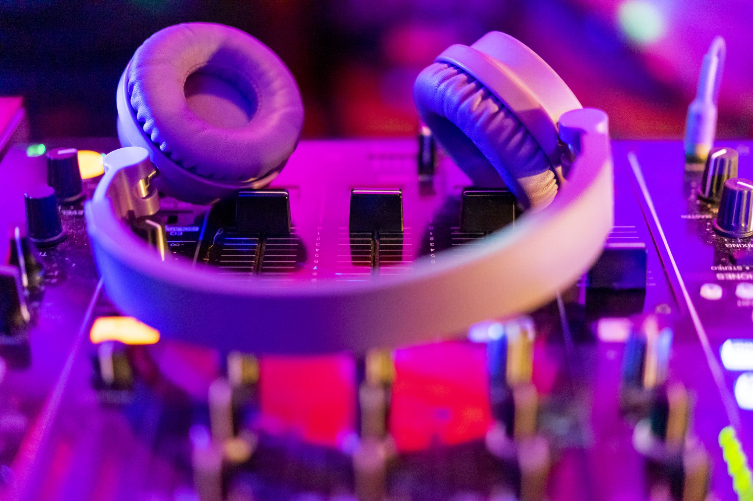
Welcome to KOBIGAAN Your Gateway to Infinite Music
Mohammed Ashraful Islam Chowdhury
Alian Ahmed
Rotan Hawlader Pranto

Slide 2
Outline
Introduction
Why KOBIGAAN? Why not other?
Solutions
Dynamic frontend with React.
Weakly contributions
Interface
Initial feature list
Priorities
Obstacles and limitations
Front view
Machine leering
Recommendation system
Conclusion and feature discussion

Slide 3
Key Features
Introduction
Vast Music Library
Personalized Playlists
Smart Recommendations
User-Friendly Interface
Anywhere, Anytime Access
Immerse in High-Quality Sound

Slide 4

Why KOBIGAAN? Why not OTHERS?
Other streaming applications lock features behind paywalls, which is expensive for average Bangladeshi people.
Local alternatives lack features and poor user interface.
Major music streaming sites steal and sell user data.

Slide 5
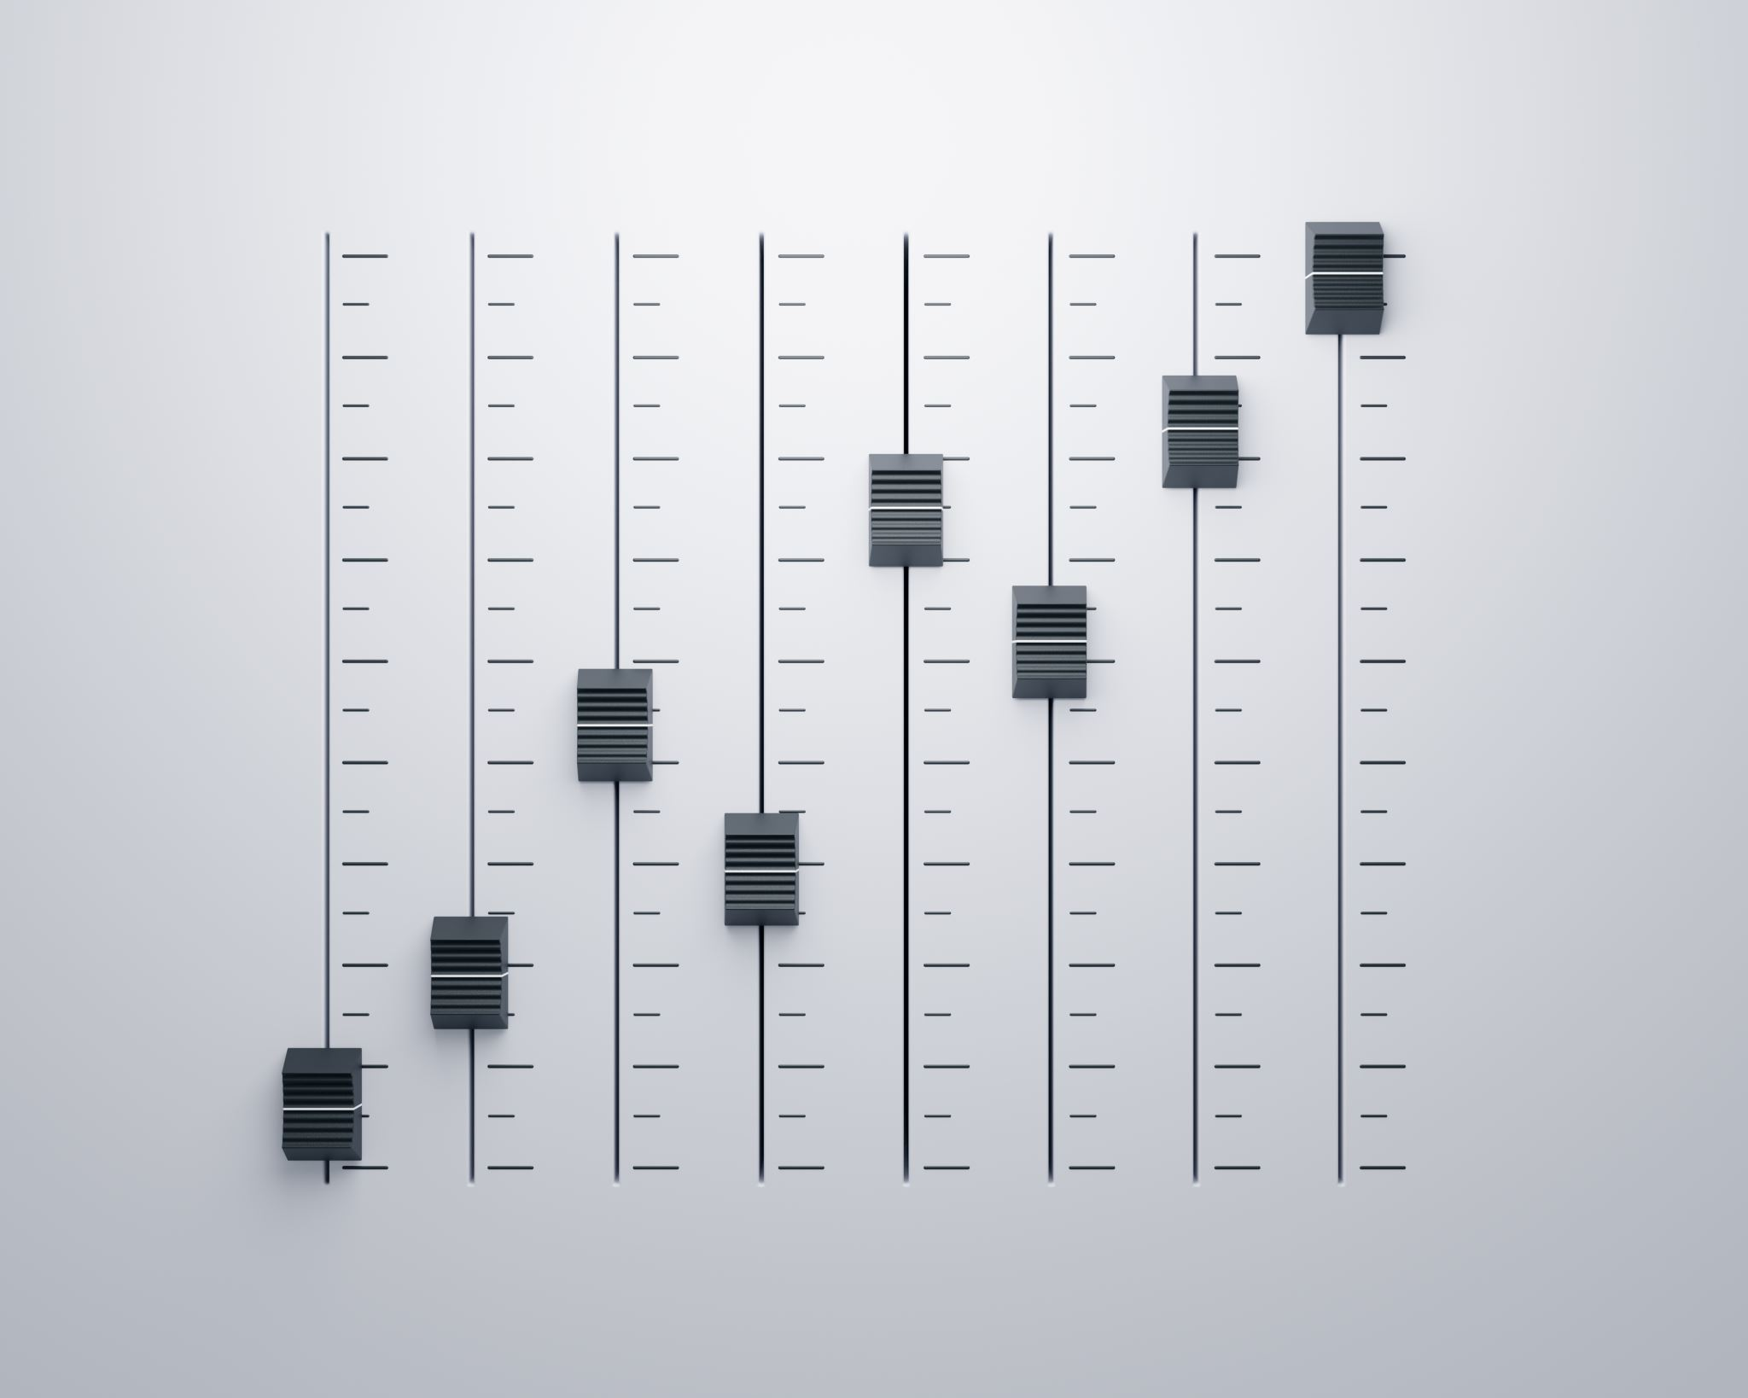
Our Solutions:
Extensive Music Library:
Overcome limitations by offering a vast collection of millions of songs
Hyper-Personalized Recommendations:
Tailor suggestions to individual tastes, ensuring accurate and exciting discoveries
3.User-Friendly Interface:
Simplify the user experience with a clean and intuitive interface
4.Selling of user data:
Our app is committed to ethical data practices, refraining from collecting and exploiting user data, and avoiding restrictive paywalls.
5. Paywall Features
Avoiding high level paywall features.

Slide 6
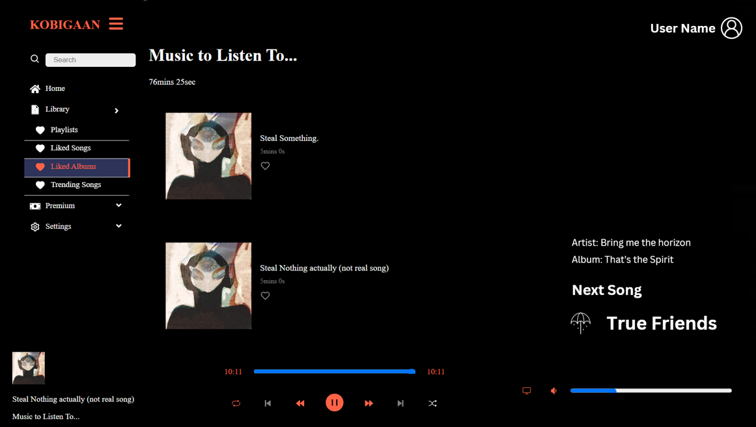
Building a Dynamic Frontend with React:

Slide 7

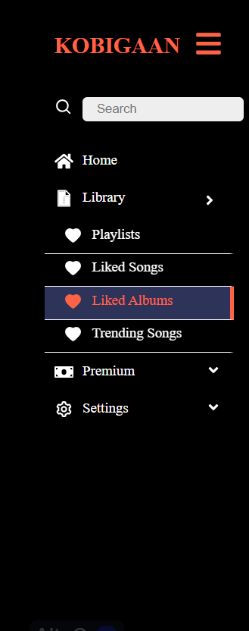
Key Components of KOBIGAAN's Frontend:
Sidebar Navigation:
Seamlessly navigate through different sections of the site
Intuitive design for easy access to playlists, liked songs, and more
Quick access to search and settings
To make this drop down menu more appealing, we used framer motion for the transitions.

Slide 8
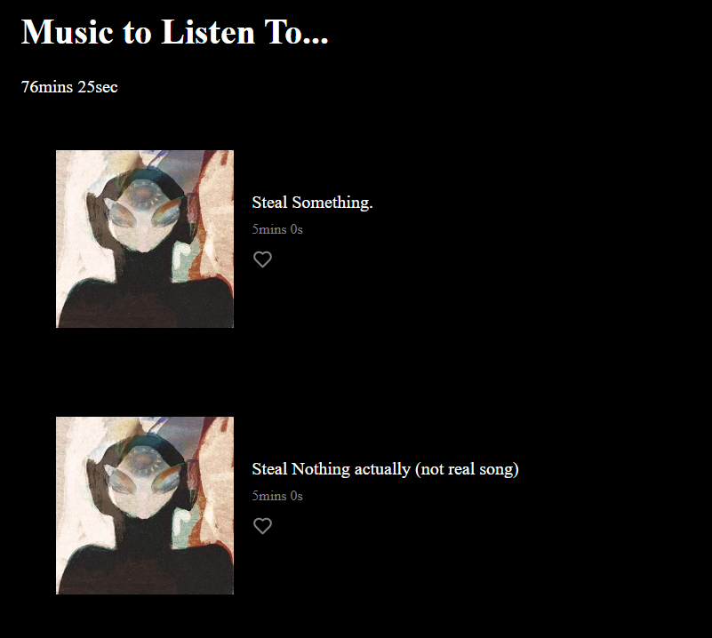
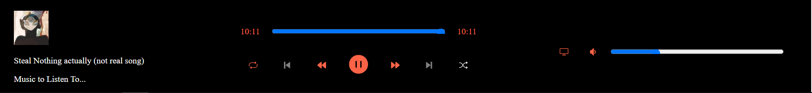
Engaging User Interface:
Responsive layouts for optimal viewing across devices
Seamless Audio Playback:
Smooth transitions between tracks for a seamless listening experience

Slide 9
Weekly contribution
Weeks | Working
Week 1-4 | Learned React
Week 5-6 | Frontpage navbar( Title and the User Profile page)
Week 7-8 | Frontpage sidebar( Home page, Search option)
Week 9-10 | Frontpage sidebar( Library design, Playlist page, liked songs and liked albums page)
Week 11-12 | Completing the CSS part
Week 13-14 | Audio Playback and volume settings
Week 15-16 | Connection with backend

Slide 10
User-Friendly Interface:
Our music streaming site is designed with a user-friendly interface that prioritizes ease of use and enhances the overall user experience.
Simplified Navigation:
Intuitive navigation menus and clearly labeled icons enable users to effortlessly explore and discover their favorite music.
Streamlined menu structure provides quick access to essential features such as search, playlists, genres, and personalized recommendations.

Slide 11
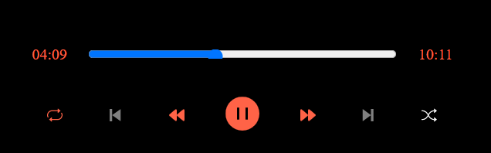
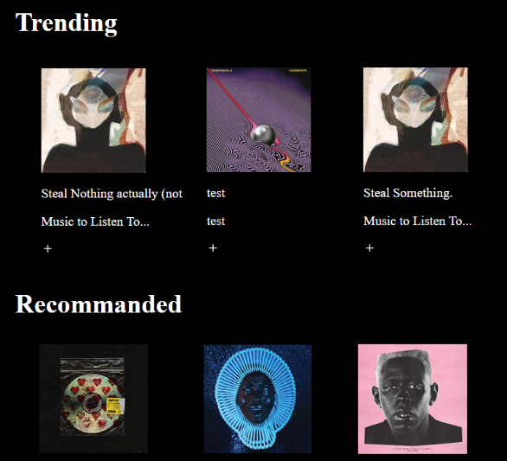
Intuitive Controls:
Easily accessible playback controls, including play, pause, skip, and volume adjustment, are intuitively placed for effortless control over music playback.
Visually Engaging:
A visually appealing design with carefully chosen colors, typography, and graphics enhances the overall aesthetic appeal of our music streaming site.
Album art, artist images, and visually rich content create an immersive atmosphere that complements the music listening experience.

Slide 12

User Data​ Safety
Selling of user data
The only data we keep from a user is their email, password, the songs they liked, and the playlist they have created
We made sure that the data that we process for our recommender is kept anonymous
And more importantly we are not planning of sell even these data

Slide 13
Initial Feature List
In the beginning, we set out with a list of initial features based on our project proposal.
Which we then divided into 3 sections of based on priority:
Main priority
Secondary priority
Optional

Slide 14
Main priority
Login and sign-up system: To provide secure access and personalized features. ✅
Music player: To play and manage audio files. ✅
Music recommendation engine: To suggest personalized music recommendations based on user preferences. ✅
Create playlist: To enable users to organize their favorite songs into playlists.✅

Slide 15
Secondary priority​
Sound visualization: To visually represent the audio waveform or spectrum.✅​
Audio equalizer and effects: To adjust the audio output according to user preferences.✅​
Social sharing: To allow users to share their favorite songs or playlists on social media platforms.❌​
Song identification via humming or singing: To allow users to identify songs by humming or singing a tune.❌​
Optional​
(Android) Music player: To develop a dedicated music player for Android devices.❌​
(Android) Sound visualization: To provide sound visualization specifically for Android.❌​
(Android) Audio equalizer and effects: To offer audio customization options on Android.❌​
Create playlist (Android): To create playlists on the Android platform.❌​
Offline playback: To enable users to listen to music even without an internet connection.❌

Slide 16
obstacles and limitations
Technical expertise: Everyone in the team was trying new technology and so we lacked technical expertise and had to go through a stipe learning curve
Technical challenges: Certain features required complex algorithms and extensive research (i.e Android), which exceeded the project timeline.
Time constraints: Although it was a long semester, the project had a strict deadline, which resulted in prioritizing core features over secondary ones.

Slide 17
Week no. | Work done
1-4 | Learning mongodb and node and implement a small project
5-6 | Designing database and backend
7-8 | Create the database and backend
9 | Making changes based on feedback
11 | Redesigning the database

Slide 18
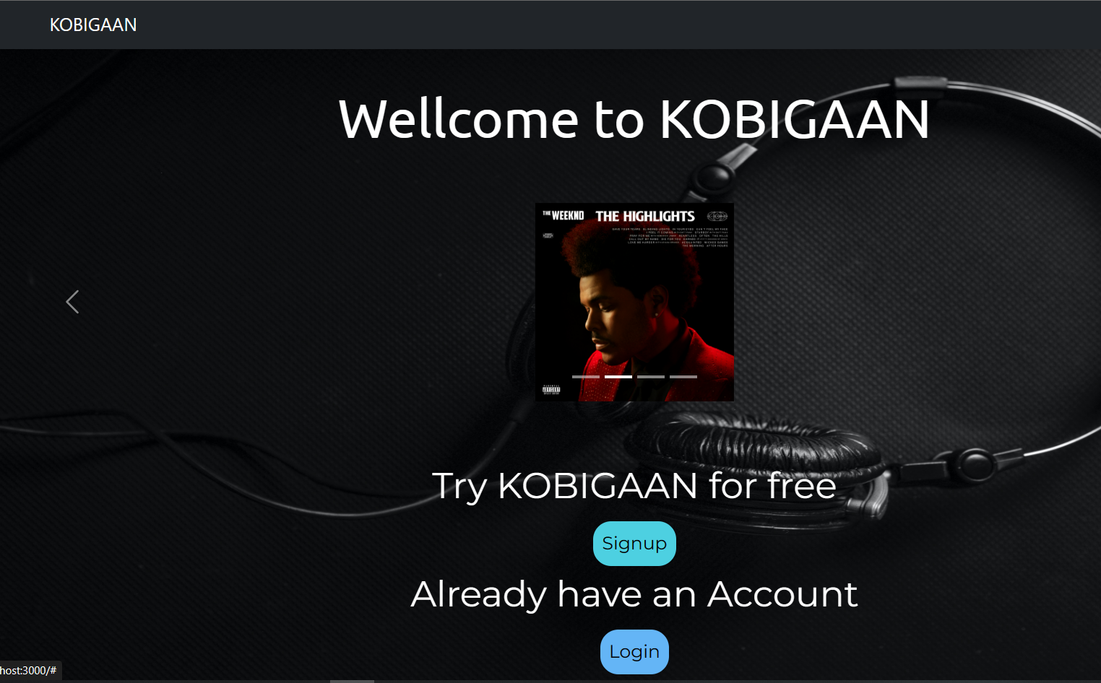
Front view

Slide 19
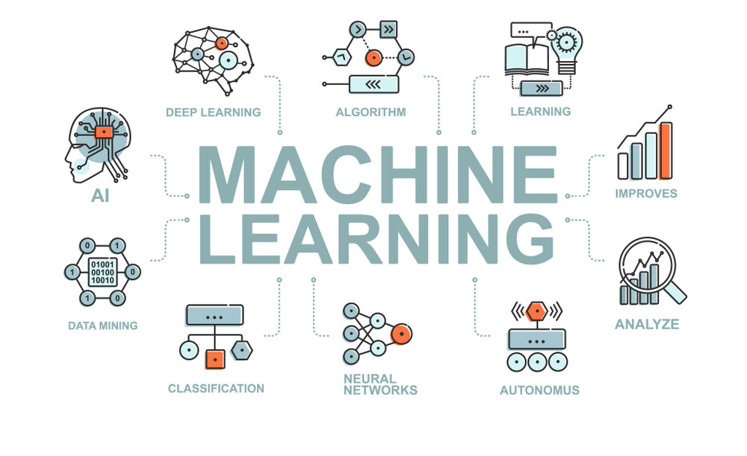
What is Machine learning?
Machine Learning is concern with computer programs that automatically improve their performance through experience.

Slide 20
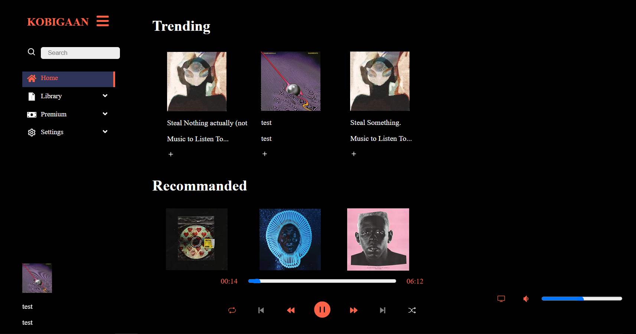
Building a recommendation system

Slide 21
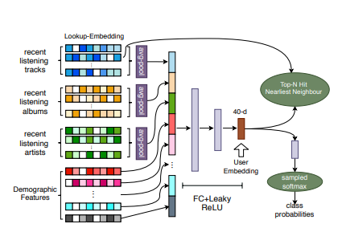
Architecture of the recommendation system model :
We used Nearest Neighbour Algorithm to track the taste of the user.
First, we track the user's past listening history. Then we calculate the average pool based on the music type. Then we embedded those data's with the demographic features. After calculation we used Nearest Neighbour Algorthim to predict the highly possible model.
Using that model we suggest song to our users.

Slide 22
Week no. | Work done
1-4 | Learning Html, CSS, Bootstrap, JavaScript, Unix Command line, node-js
5-6 | Learning React-js, python
7-8 | Create Front Page of our project
9 | Learning Mongo DB and creating login sign form's
11 | Creating machine learning algorithm for our recommendation system.

Slide 23
Conclusion and feature direction:
In conclusion, our project aim was to solve the persistent issues faced by music streaming users. Hopefully we are success, by providing a comprehensive solution through the development of a user-friendly, visually appealing, and ethically responsible music streaming applications ion.
We learned how to work as a team. Through working with MERN stack we enhanced our knowledge as a developer.
We could do something different by adding a feature where the user will able to express his feeling to our site and our site will suggest song by reading that content which provided by the user.
We are willing to extend our project by adding this feature. Hope we will be successful and make a big step in the music steaming industry.

