Slide 1
Working with Android

Slide 2
https://github.com/rotational-program/android-sample

Slide 3
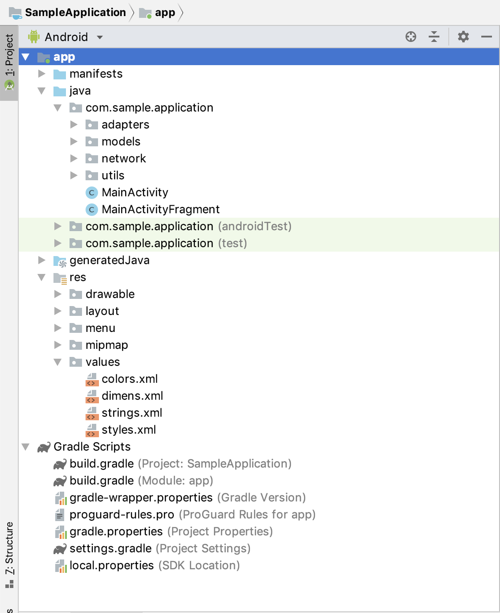
Manifests: contains AndroidManifest.xml; we set permissions, activities, services etc here
Java: contains the core java code, we have our activities, fragments and utility classes here.
Res(resource): this directory contains our UI elements; drawable/mipmap contain the icons/images/shapes that we want to use in our application, layout contains the XML representation of the screens the user interacts with (GUI), menu contains items that we place on menu elements, values contains different resource XMLs that are useful in abstracting the design of the application (ex: strings can contain all string values that we can use in the application so that we don’t hard code them in our code)
Gradle scripts: this is not a folder but this files are important when configuring your application ex: minimal android version your application will support/ libraries and dependencies your application uses

Slide 4
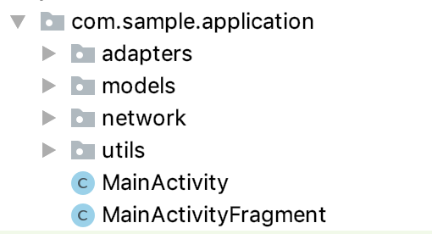
Our Sample Application Java Structure
Adapters: these classes help us create our list items, they iterate through a list of objects and display them on the UI
Models: these classes are our representation of objects in our system (ex: waterpoint, county, etc)
Network: these are helper classes that deal with network calls for interacting with APIs
Utils: utility functions that do miscellaneous tasks
MainActivity: our starting point, this is the activity that is run when our application starts
MainActivityFragment: Our fragment that loads all water points
Note: Think of activities as a windows (ex: opening google chrome),you can have multiple windows of google chrome open. Fragments on the other hand are tabs in a window, you can have multiple tabs opened in a window; similarly you can have multiple fragments manager by one activity

Slide 5
County IDs
1 Garissa
2 Isiolo
3 Marsabit
4 Turkana
5 Wajir

