Slide 1
Game Lead Finder
Automated M&A Intelligence for Mobile Games
CrazyLabs · Business Development · June 2026

Slide 2
01 · INTRODUCTION
What is this tool?
🎯
📊
⚙️
🔁
Purpose
Data source
How it works
Output
Identify mobile games worth acquiring, automatically.
Sensor Tower top 10,000 games by downloads/revenue (absolut or growth)
Google Play + App Store, worldwide.
Every game is scored using a profit model calculated with real data of over 30 games
A live HTML dashboard: 4 tabs, sortable columns, notes, review tracking.
Rebuilt every run.
2 / 10

Slide 3
02 · PROFIT MODEL
How we estimate profit
Revenue Per Download (RPD) = 90-day Revenue ÷ 90-day Downloads ÷ 3 = monthly estimate
RPD determines which model applies:
IAA Model
Blend Model
IAP High
RPD < $0.10
RPD ≥ $0.10 & Rev ≤ $1M/mo
RPD ≥ $3 & Revenue > $1M/mo
Pure ad-monetized games. Downloads drive revenue. High median error — always verify manually.
Hybrid games with both ads and in-app purchases. Medium median error — reasonable for screening.
Strong IAP titles. Revenue is the dominant signal. Medium median error — most reliable model.
3 / 10

Slide 4
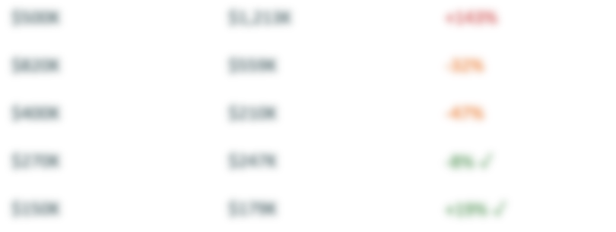
03 · CALIBRATION ANCHORS
How we validated the model
30+
2025
3
anchor games
full-year data
model types tested
Sample anchor games (known 2025 monthly profit vs. model prediction):
Game
Model type
Actual profit
Predicted
Error
Zombie Waves
IAP High
+143%
SuitU
IAP High
-32%
Lamar – Idle Vlogger
IAA
-47%
Coffee Mania
Blend
-8% ✓
Heroes vs Hordes
Blend
+19% ✓
Full calibration: 2 missing games (Dazzly, Royal Escape) — not in 2025 Sensor Tower export
4 / 10

Slide 5
04 · PUBLISHER EXCLUSIONS
Who we filter out
Hardcoded list (80+ publishers)
Auto-exclude rule
Calibration anchors (30 games)
Major publishers we would never acquire: EA, Supercell, King, Tencent, Zynga, Kabam, Playtika, and 70+ more.
Manually curated and updated as needed.
Games already on our lists or Salesforce (TBD), which didn’t have a significant change
Known benchmark games used to validate our profit model. Excluded from output so they won’t appear as new acquisition targets UNLES a dramatic change in profit
Result: output contains only independent, acquirable studios in the relevant profit range.
5 / 10

Slide 6
05 · DASHBOARD TABS
Growing · Stable · Declining · Returning
📈 Growing
➡️ Stable
📉 Declining
🔄 Returning
> +10% revenue trend
-10% to +10% revenue trend
< -10% revenue trend
Cross-platform or prior-run signal
Games gaining momentum — highest priority for outreach.
Consistent performers. Verified NOT in Salesforce — cleanest leads list.
Revenue falling. Could be a motivated seller — or a trap. Verify before pursuing.
Games found on both Google Play AND App Store, or reappeared from a prior run.
⚠️ May already exist in Salesforce. Cross-check before contacting.
✅ Safe to act on immediately.
⚠️ May already exist in Salesforce. Cross-check before contacting.
Strongest signal: performing across platforms.
Current run: 62 Growing · 66 Stable · 38 Declining · 97 Returning = 263 total leads
6 / 10

Slide 7
06 · AUTOMATION — COMING SOON
Execute & Upload
⚡ EXECUTE
Sensor Tower API — in progress
⬆ UPLOAD
Live today via local server
One-click full refresh
Manual CSV upload
– Connect to Sensor Tower API directly
– Upload one or multiple CSV files
– Pull latest 90-day data automatically
– Drag & drop or file picker
– Re-run analysis and rebuild dashboard
– Supports Google Play + App Store together
– No CSV exports, no manual steps
– Cross-platform dedup runs automatically
– Schedule: runs every 1st of the month
– Dashboard reloads when complete
7 / 10

Slide 8
07 · SALESFORCE INTEGRATION — COMING SOON
Turning leads into a deal workflow
Today
Coming soon
– Stable tab = verified not in Salesforce
Real-time dedup
Every game checked against Salesforce on each run —> no duplicates
– Growing / Declining / Returning may overlap with existing CRM records
Auto-push leads
– Manual cross-check required before outreach
New games pushed to Salesforce as Opportunities with pre-filled fields
💡 Once Salesforce is connected, all tabs will automatically show CRM deal status — no more manual cross-checking.
8 / 10

Slide 9
What we built
A fully automated, calibrated, and presentation-ready acquisition pipeline.
✓
Profit model calibrated against 30+ real games with 2025 actuals
✓
80+ publisher exclusions + auto-exclusion rule
✓
4-tab dashboard: Growing / Stable / Declining / Returning
✓
Cross-platform dedup: Google Play + App Store in one output
✓
Date tracking, notes, review progress — all persisted
✓
Upload button live today · Execute + Salesforce coming next
10 / 10

