Slide 1
Bitcoin & Cryptocurrency Seminar

Slide 2
Goals
To learn the Bitcoin protocol and surrounding ecosystem
To learn / improve presentation skills

Slide 3
Papers and slots will be up for grabs
Pick slot first, then paper
Signing up means a commitment to register to the course, and to give a lecture.
Attendance is mandatory. Must attend all lectures but 1 (otherwise, lose 5 points per missed lecture).
Grade is based on your lecture (given that you meet attendance requirement) & how well you lead discussion.

Slide 4
A good presentation
You MUST fully understand the paper
I expect you to read cited works that are necessary to understand it, and to present the ideas from these too.
Distill the main ideas of the paper
Don’t just spill out every detail in the paper.
Explain the bigger picture and the context.
Read the paper early. Don’t get to the last minute and then discover it’s too hard.

Slide 5
Give due credit to the authors
You make the slides (don’t use theirs if you find them online!)
Not too much text.
Presentations are a visual medium.
(THIS slide is BAD!)
Use animations gently, when attention is needed
A good presentation takes time to make!

Slide 6
Requirements
MUST Present a critique of the paper
MUST Present open questions / next steps
MUST motivate the work and provide context
Practice and time your lecture in advance
Bring a laptop
Test it + connectivity to projector well before the lecture

Slide 7
Preparing
Not too much text.
Presentations are a visual medium.
(THIS slide is BAD!)
Use animations gently, when attention is needed
A good presentation takes time!

Slide 8
Bitcoin (A Basic Tutorial)
Aviv Zohar
The Rachel & Selim Benin School of Eng. and Computer Science The Hebrew University

Slide 9
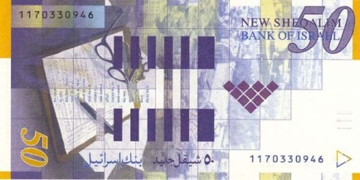
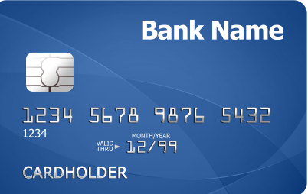




Money isn’t perfect
Currently slower and more expensive than:

Slide 10


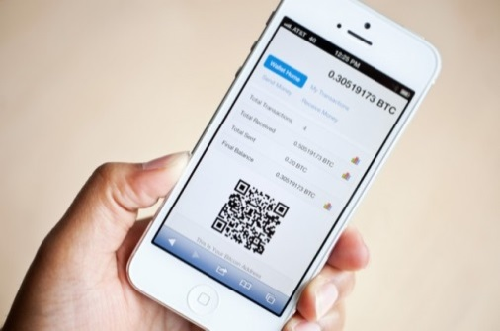
A decentralized digital currency
Invented by Satoshi Nakamoto in 2008 Launched in 2009
Built for the age of the internet

Slide 11

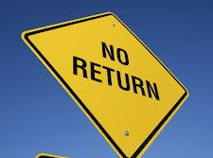

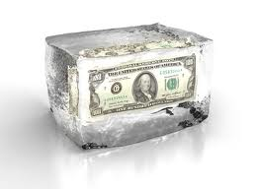

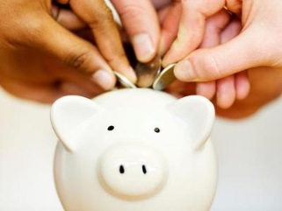
Features of Bitcoin
Pseudonymous
Fixed amount
Irreversible Transfers
Cannot be seized
Can not be frozen
Escrow
Joint accounts

Slide 12

Blue: 2
Red: 1
Bypass regulation & censorship
Increase competition
Disrupt
Please transfer $1 to Blue

Slide 13
Blue: 2
Red: 1
Blue: 2
Red: 1
Blue: 2
Red: 1
Blue: 2
Red: 1
Blue: 2
Red: 1
Blue: 2
Red: 1
Blue: 2
Red: 1
Blue: 2
Red: 1

Slide 14
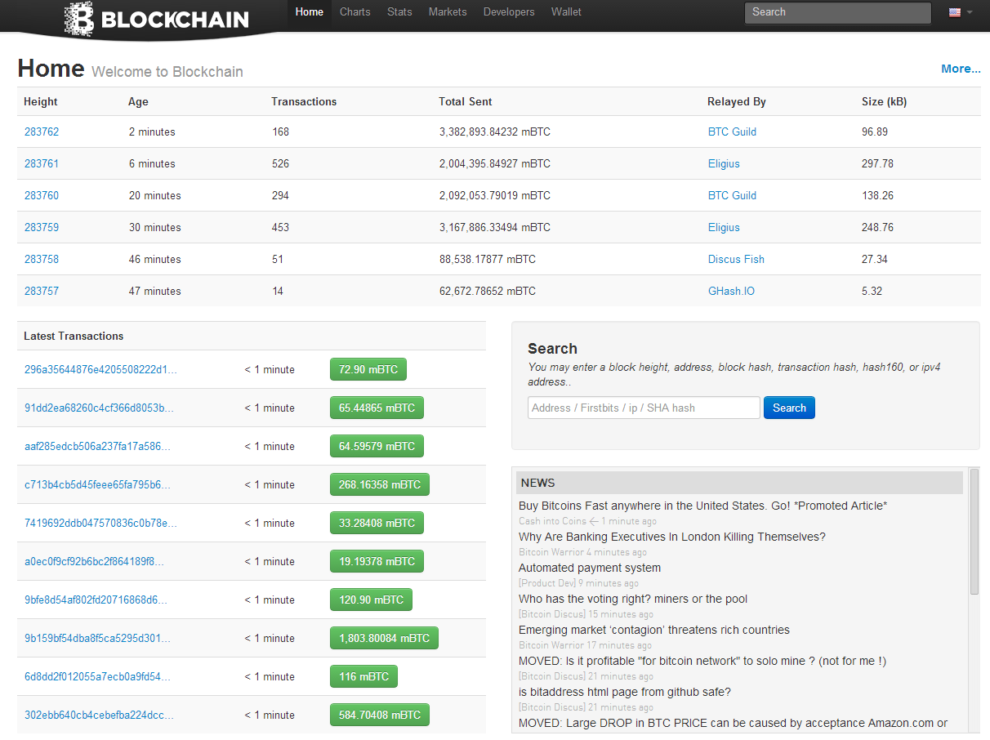
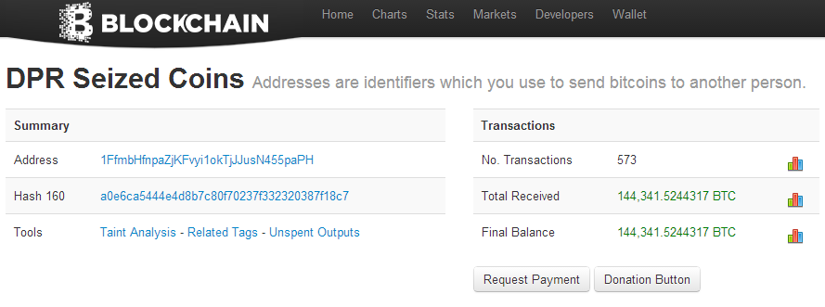
Transactions are thus public, addresses are (free) pseudonyms

Slide 15
The Double-spend problem
Blue: 2
Red: 1
Blue: 3
Blue: 2
Green: 1
Blue: 2
Red: 1
A variant of the Byzantine general’s problem (Byzantine consensus in asynchronous dist. systems)

Slide 16
Cryptographic Hash Functions
functions that deterministically map strings (of any length) to fixed-size strings.
Properties:
Efficiency: easy to compute hash(x)
Collision Resistance: Hard to find x,y such that hash(x)=hash(y)
Hash(x) reveals little about x.
Hash(x) “looks” completely random

Slide 17
Block Chain
New Block
Hash
Hash
Hash
Blocks aggregate transactions in batches
Each block contains a cryptographic hash of the prev one, “proving” it is created afterwards.
Can read ledger from start to finish to “follow the money”
Each node tries to grow the chain with recent transactions:
Create a block with recent consistent transactions
Send to peers

Slide 18
Block Chain
New Block
Hash
Hash
Hash
Hash
Inconsistency may occur if blocks are created simultaneously by different nodes
(double spend problem)
Another Node’s Block

Slide 19

Block Chain
New Block
Hash
Nonce
Hash
Nonce
Hash
Nonce
Crypt. Hash
Solution:
Make block creation hard.
00000001011011001
10101001011011001
2. Adopt conflicting blocks if they make up a longer chain.
Must be a small number for valid block (under some target value)
If not, change Nonce & try again
~ one block per 10 min. in the entire network
(Difficulty scales automatically to maintain this) Current traget has >70 zeros in most significant digits

Slide 20


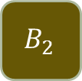


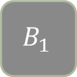






A
$${ B}_{1}$$
C
Make block creation hard (once every 10 minutes)
Adopt (conflicting) blocks iff they make up a longer chain.
A
$${ B}_{1}$$
C
A
$${ B}_{1}$$
C
A
$${ B}_{1}$$
C
$${ B}_{2}$$
A
$${ B}_{1}$$
C
A
$${ B}_{1}$$
C
A
$${ B}_{1}$$
$${ B}_{2}$$
C
A
$${ B}_{1}$$
C
A
$${ B}_{1}$$
C
$$B_{2}$$

Slide 21
The Double-Spend Attack
A payment can be reversed!
Easy if attacker has >50% of compute power
Possible with less than 50%
Bitcoin’s Guarantee [Satoshi]:
If attacker controls < 50% of compute power, probability of block replacement decreases exponentially with time.

Slide 22

To encourage nodes to authorize transactions:
New Block
Hash
Nonce
Reward the authorizer with fees from each transaction
(+ newly minted money)
Coinbase Tx
Block creation is known as “Mining”
Block size is limited (currently to 1MB)
Transactions will compete to enter – highest fee first. (An auction!)

Slide 23
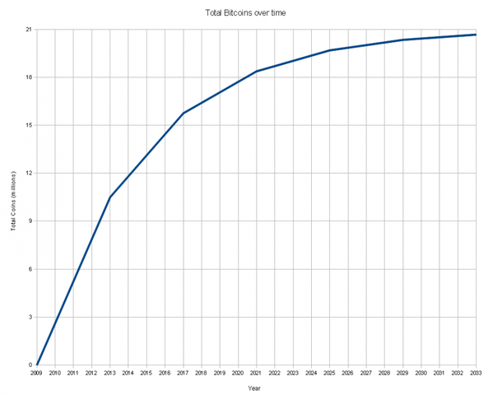

Slide 24
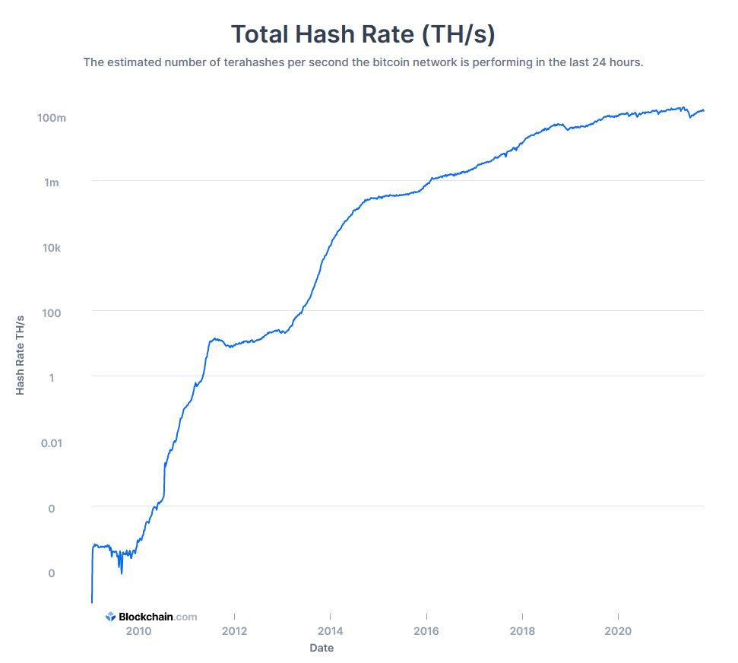
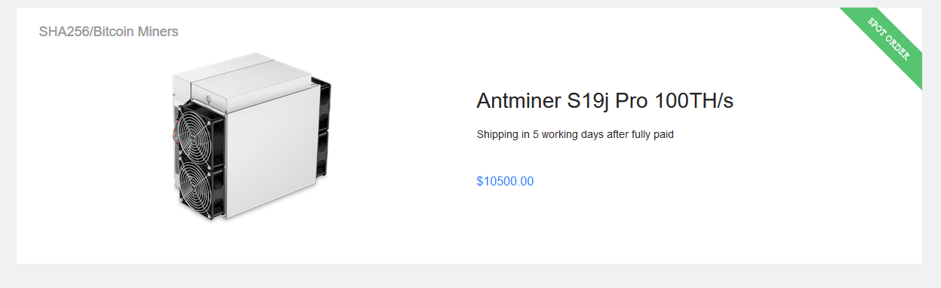

Slide 25
Analysis of the Double Spend Attack
The recipient has an acceptance strategy:
# of “confirmations” (blocks) it waits for before transaction is considered “accepted”.
Assumption: attacker has hashrate q. Yields distribution over the # of blocks in its chain.

Slide 26
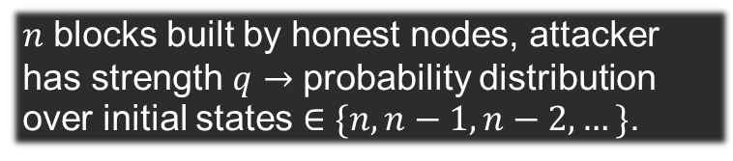
Analysis of the Attack
Consider a Markov Process representing the difference in length between the chains
Attacker creates block (q)
Network creates block (1-q)
Honest chain length minus attacker’s
-1
0
1
2
3
If we ever get here, Attacker wins
$n$ blocks built by honest nodes, attacker has strength $q$ $→$ probability distribution over initial states $∈\{n,n−1,n−2,…\}$.

Slide 27

The Result:
Attacker’s strength: $q<0.5$
Receiver’s policy: wait for $n$ confirmations
Probability of successful attack: $$r=1−\sum_{m=0}^{n}{\left(\begin{matrix}m+n−1 \\ m\end{matrix}\right)⋅}({\left(1−q\right)}^{n}q^{m}−{\left(1−q\right)}^{m}q^{n})$$
Result due to Meni Rosenfeld: “Analysis of hashrate-based double-spending”

Slide 28
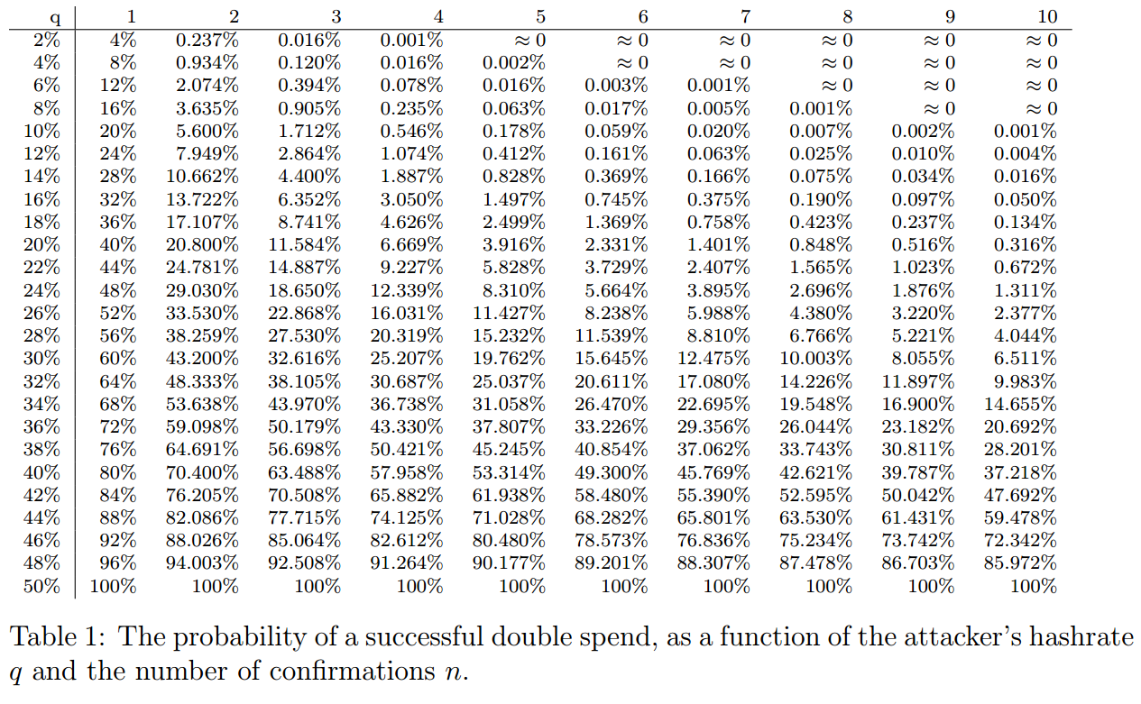
From Meni Rosenfeld’s paper “Analysis of hash-rate based double spending”.

Slide 29
Implications
To get final approval for a transaction one has to wait several blocks (confirmations).
Each block takes 10 minutes in expectation.

Slide 30
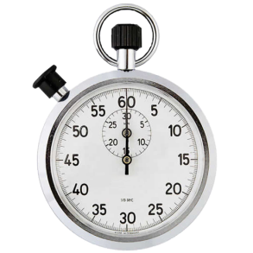
The Finney attack
Some Vendors cannot afford to wait. Accept 0-confirmation transactions.
Susceptible to a simple attack:
Alice pre-mines block with a transaction to self.
Alice creates and sends transaction paying bob. Instantly receives goods from Bob.
Alice release pre-mined block before the transaction to Bob is authorized.

Slide 31
Transactions

Slide 32


Signer
Signature
Message Contents
Secret Owned by Signer
(Private Key)
Verifier
Message Contents
Signer’s Identifier (Public Key)
Signature

Slide 33
Signature
Message Contents
Secret Owned by Signer
(Private Key)
Signature is hard to generate without the secret.
Changing even a single bit of the message contents requires a new signature
Implications:
Only owner of funds can move them.

Slide 34
How do you “own” bitcoins?
Bitcoin’s ledger associates amounts of bitcoin with a “script”.
If you can satisfy the script, you can reassign the funds.
Bitcoin’s Ledger (UTxO)
Transaction
0.6 BTC
PK2
CHECKSIG
1 BTC
PK1
CHECKSIG
SIG1
Output script
data
0.4 BTC
PK3
CHECKSIG
0.6 BTC
PK2
CHECKSIG
New outputs
0.4 BTC
PK3
CHECKSIG

Slide 35
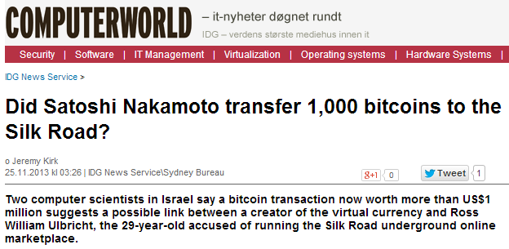
A transaction is valid if and only if
every input matches a previous unspent output
The script passes.
Txn
Txn
Txn

Slide 36
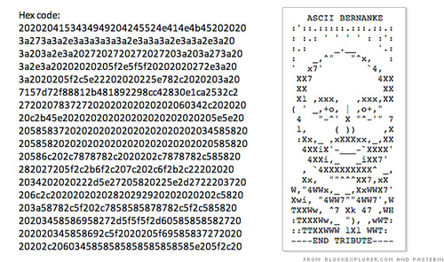
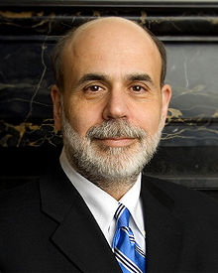
Transactions
Txn
Some outputs cannot be redeemed.

Slide 37

Scripts allow for much more…
Lightning network

Slide 38
More on Block Structure: Merkle Trees
Hash
Hash
Hash
Tx1
Tx2
Tx3
Tx4
Specifying the root, is equivalent to committing to all transactions in the tree (unless we can easily find hash collisions)

Slide 39
Root of the Merkle tree is thus included in the block header.
Block Header (80 Byte)
Block Body
…
P. Block Hash
Nonce
…
Merkle Root
Other Fields…
Hash
00001001011011001
Smaller than target value

Slide 40
Light nodes
Running a full Bitcoin node may be too expensive. (e.g. for smartphones)
To prove that transaction occurred:
Download block headers and check nonce values, Merkle root
Request Merkle “branch” leading from some block to root
root
Hash
Hash
Hash
Hash
Tx3
Tx4

Slide 41
Saving space
The same scheme allows full nodes to save space.
Hash
Hash
Hash
Tx1
Tx2
Tx3
Tx4
“Spent” transactions no longer needed
Txn
Txn
Txn

