Slide 1
Data Analysis
Roni Sheffi
Rotem Singer

Slide 2
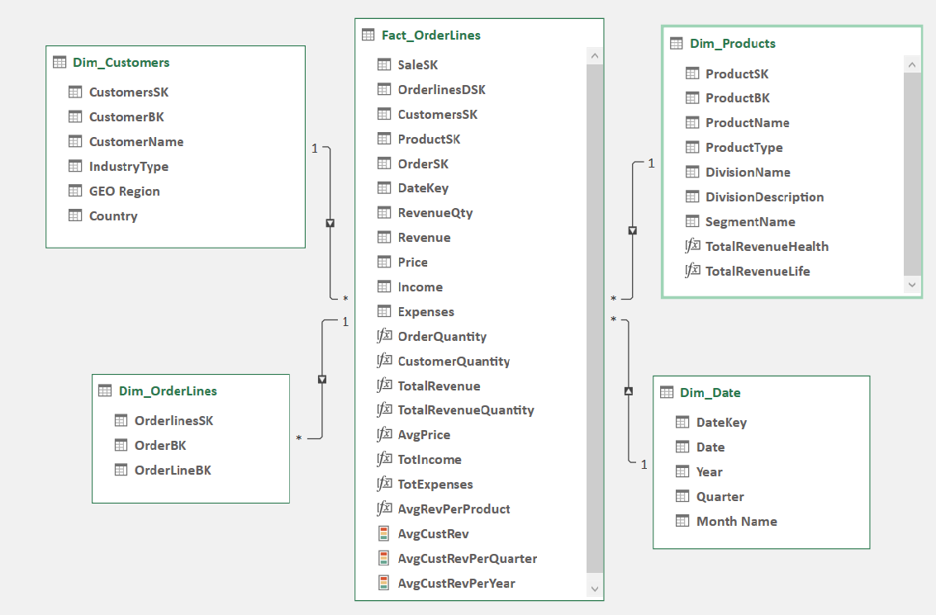

Data warehouse – Star scheme - From PowerPivot in Excel
Fact_OrderLines
Dim_Customers
Dim_OrderLines
Dim_Products
Dim_Date

Slide 3
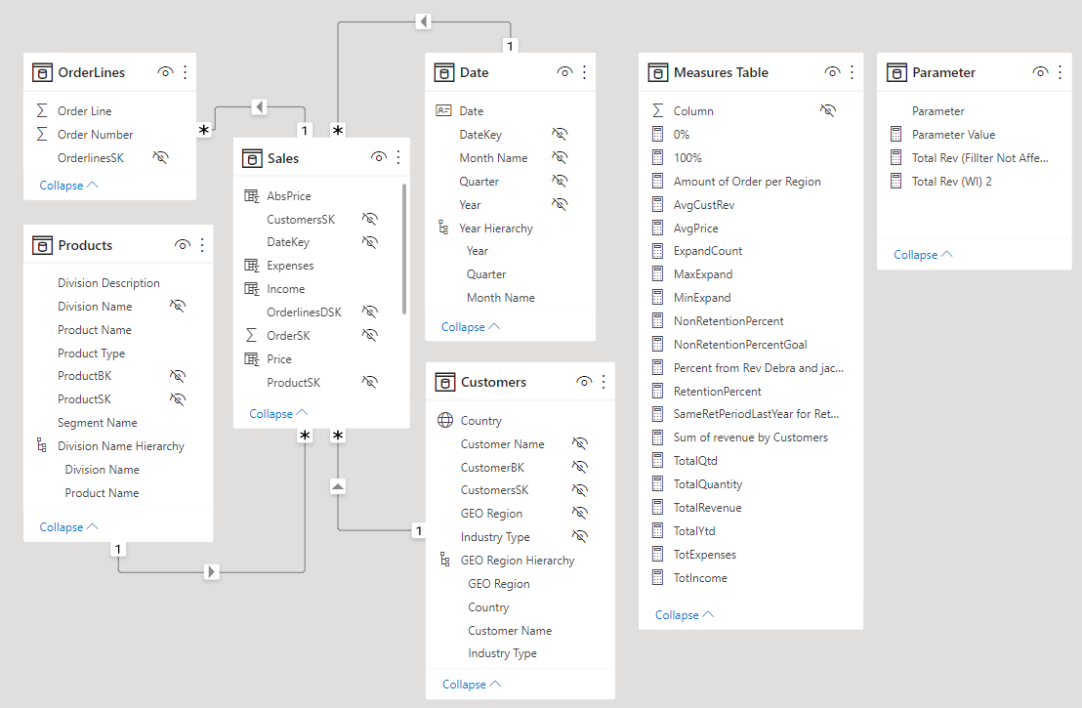
Data warehouse – Star scheme – From PowerBI
Sales
Customers
OrderLines
Products
Date
Measures Table
Parameter

Slide 4
Project development steps – ETL process - Extract
Executing the .sql file with the script that creates the Happy Insurance database in Microsoft SQL Server Management Studio
ETL process – Establishing a connection between Excel and Microsoft SQL Server Management Studio and loading the tables to PowerQuery
ETL process – Loading the .csv file into Excel

Slide 5
Project development steps – ETL process - Transform
Removing redundant columns from the tables
Deciding that the OrderLines table will be the factual table and that the Customers and Products table will be the dimensional tables
Creating a duplicate OrderLines table which will be a dimension table that holds all unique combinations of orders and order lines.
Deciding that the Divisions and Segments tables will not be part of the tabular model and will be represented through the Products table

Slide 6
Project development steps – ETL process - Transform
Creating 2 parameters for start year (2011) and end year (2013) in PowerQuery
Creating all dates between 2011 and 2013 in a new table
Expanding the Dim_Date table to include quarters, years and DateKey.

Slide 7
Project development steps – ETL process - Transform
Renaming all ID columns to BK (“business key”) columns
Creating connections between the factual table and the dimension tables by creating a “surrogate key” for each dimension table in the factual table.
Closing PowerQuery to load the tabular model back to Excel (can also be done to PowerBI)

Slide 8
Project development steps – ETL process - Load
In PowerPivot, creating 1-to-many relations between all SK (“surrogate keys”) in the factual table and the dimensional tables. The “1” is in the dimension tables and the “many” is in the factual table (can also be done in PowerBI)
Adding calculated columns in the factual table (Price, Income and Expenses)

Slide 9
Project development steps – Developing the tabular model
Creating measures from data in the tables and measures that are based on other measures
Turning some of the measures to KPIs by setting the target and boundaries for the KPI.
Gathering all the measures in a measures table (done in PowerBI)
Hiding the SK and BK columns from the tables
Creating hierarchies of columns in some of the tables (done in PowerBI)

Slide 10
Project development steps – Creating dashboards and visualizations (Excel/PowerBI)
Creating visualizations: Combo charts, slicers, maps, PowerTables (in Excel), scatter charts, pie charts, etc…
Creating drill-downs in visualizations (based on the hierarchies)
Creating tooltips
Creating a what-if scroll bar
Using DAX formulas for visualizations: variables, Calculate, Filter, SumX, Related, All, TotalYDT/TotalQTD, SamePeriodLastYear, etc…

Slide 11
Project development steps – DAX queries
Opening DAX Studio and connecting it to Excel/PowerBI
Creating DAX queries for each dashboard/visualization which will verify that the information displayed in them is correct.
Using DAX functions such as: Evaluate, CalculateTable, Summarize, Filter, Sum, etc…

Slide 12
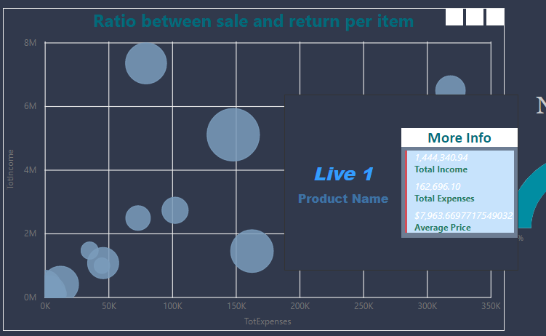
Ratio between sale and return per item
According to the scatter chart it can be seen that product “Live 1” has a high return rate and that compared to how it sells it has many returns

Slide 13
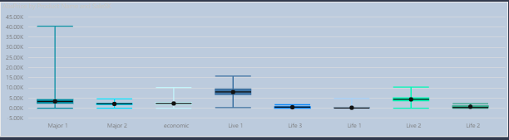
Product price as it was sold or returned
The visualization shows the price in absolute value with its’ range from maximum to minimum. It can be seen that Major 1 product has a large range of prices and that its’ mean price is located at the lower end of the price range

Slide 14
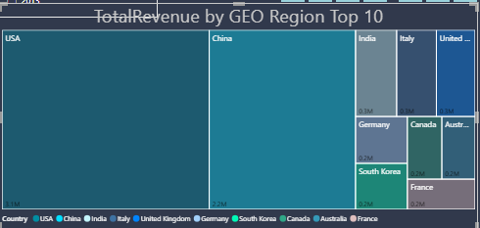
Top 10 countries by revenue
It can be seen that USA and China are the 2 the countries with the highest revenue with much higher combined revenue that the 3rd to 10th countries by revenue.

Slide 15
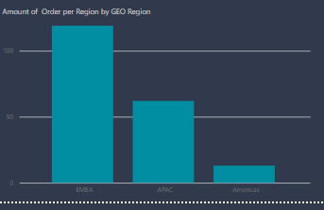
Number of orders per region
It can be seen that although the USA is country that has the highest revenue (as proved in the previous slide) it is part of Americas which is the region with the fewest orders. It can be implied that orders coming from USA have a high revenue per order.

Slide 16
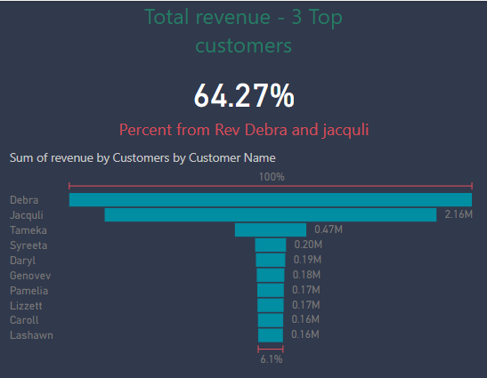
Revenue and percentage of revenue out of the top selling customer
The 3 customers with the highest revenue make up 64.27% of all revenue whereas the remaining 91 customers have much smaller revenue individually and combined.

Slide 17
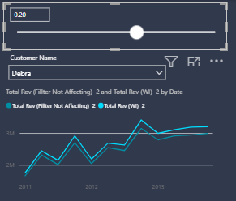
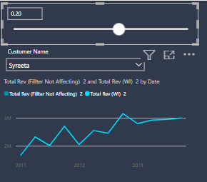
“What if” a revenue generated by customers would be multiplied
The revenue which would be generated by the top selling customer (Debra) would be much more profitable than that of the 4th highest selling customer (Syreeta). Perhaps it would be a good idea to invest more in Debra.

Slide 18
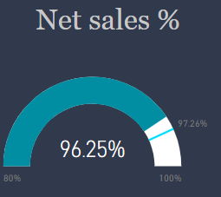
Dynamic KPI for net sales percentage
Gauge visualization for a KPI with a dynamic target which is 80% net revenue out of the total revenue. For every product it can be seen if it is within the target or not

Slide 19
Revenue of health and life insurances – comparison between USA and China
USA and China are the 2 countries with the highest revenue. It can be seen in the graph that for the USA there are bigger “spikes” (especially for health insurance) whereas for China the revenue is more steady

Slide 20
Total revenue timeline
In general, the revenue grows with time. Especially in 2013 where the growth is consistent and has no “spikes”

