Slide 1
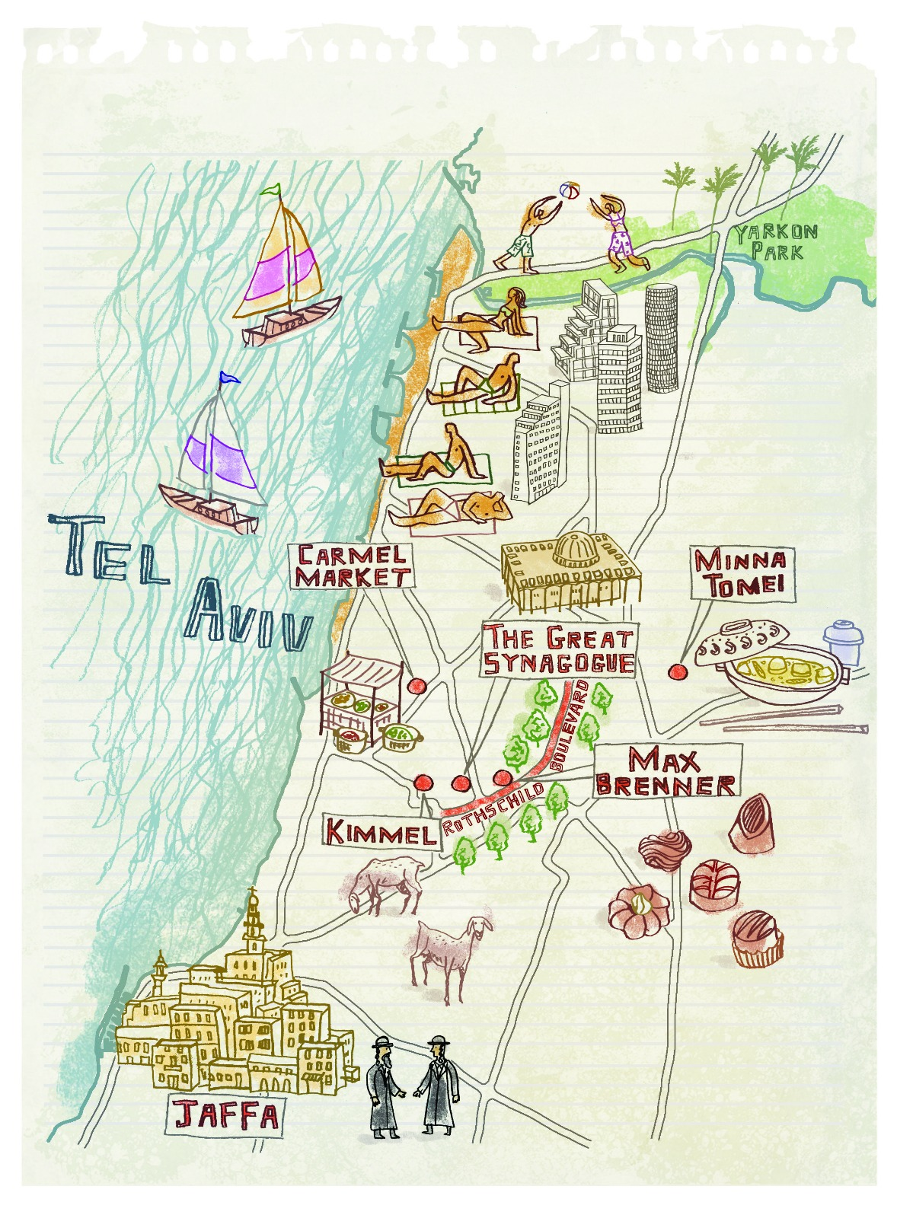
City Cycle
Fun and healthy way to explore the city
By Rotem and Nastia

Slide 2
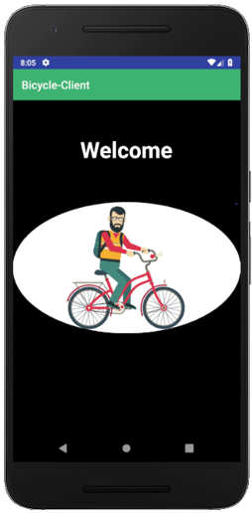
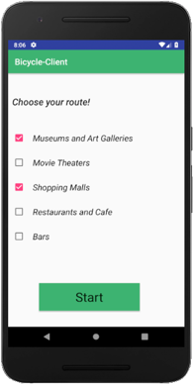
City Cycle
You choose where to go !
By Rotem and Nastia

Slide 3
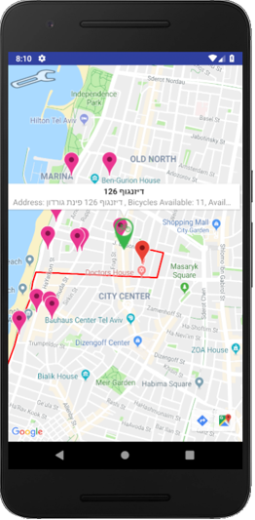
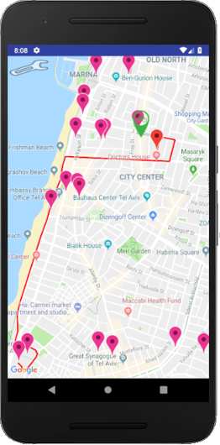
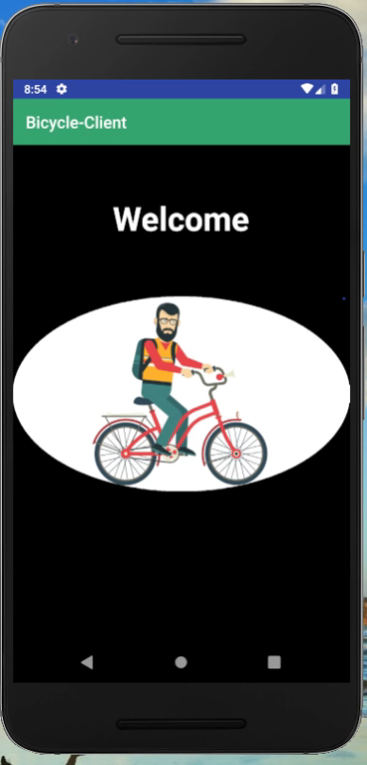
City Cycle
We will show you the way !
Present the closest “Tel-O-fun” station , with available bikes .
Build a cycling route with 5-6 points to visit in Tel Aviv.
By Rotem and Nastia

Slide 4
City Cycle
By Rotem and Nastia

