Slide 1
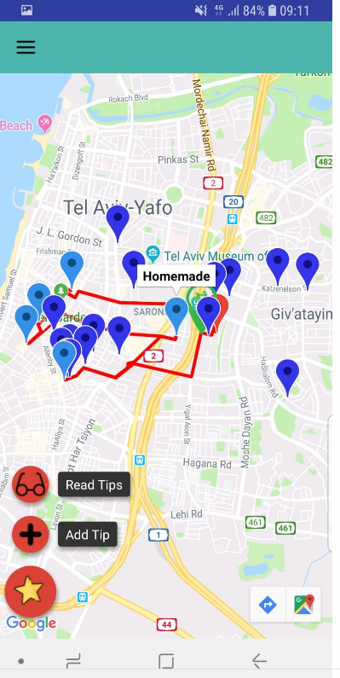
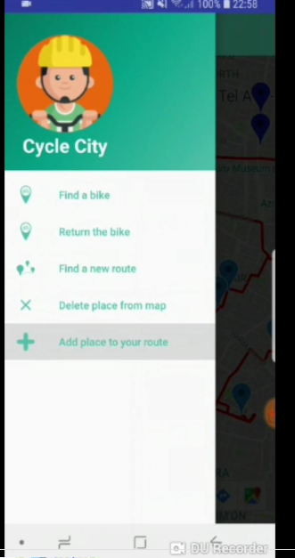
City Cycle
We will show you the way !
Main features :
“TEL–OFUN” Api in order to present available bicycles around Tel Aviv city .
Google Api for loading the places on the map and for building the cycling route .
using “FireBase” as server and database to present the user’s recommendations .
Saving and loading the previous route when the user closes the app .
Recalculate a route after deleting /adding a specific location
Link to the project :
https://github.com/noamshafran/Bicycle-Project
Main folder :
https://github.com/noamshafran/Bicycle-Project/tree/master/app/src/main/java/com/example/inbar/bicycle_client

