Slide 1
Food Management system

Slide 2
Agenda
INTRODUCTION
01
The purpose food system
02
03
Main feature in this application
04
Project Demo
05
Conclusion

Slide 3

01. INTRODUCTION
Group Member :
Suos Rattana (Leader)
Soeun Sreykhuoch
Yorn Ngornsreng
4. Soy Trikea

Slide 4

02. The purpose of food system
We can order food just use the food system app.
Easy for customer order food
Make faster and save time when we use food system
customer can choose food that you that they like in system
Notes:
Placement is the first stage in money laundering where the cash proceeds of criminal activity enter into the financial system.
Layering is the second stage in money laundering where attempts are made to distance the money from its illegal source through layers of financial transactions.
Integration is the third stage of money laundering. This stage involves the re-introduction of the illegal proceeds into legitimate commerce by providing a legitimate-appearing explanation for the funds.

Slide 5
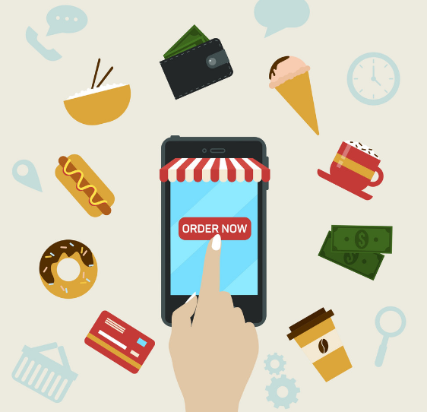
03. Main feature in this application
Search
Order
Favorites
Coupons
Payment

Slide 6
05. Conclusion
When use this system service for order can more then faster
Save time and money when we use this system
- Customer can choose that they like

Slide 7
4. Project Demo

