Slide 1
MCR Genes ROCker model summary

Slide 2
Model 1
MCR-1,2,6 Clade positive
All other clades negative

Slide 3

MCR-8
MCR-4
All shewanella
MCR-3
MCR-7
MCR-9
MCR-10
Model 1: MCR-1,2,6
Positive
Negative
MCR-1
MCR-2
MCR-6
MCR-5
Notes:
https://academic.oup.com/jac/article/73/10/2625/5055843 – mcr class allele assignments.

Slide 4
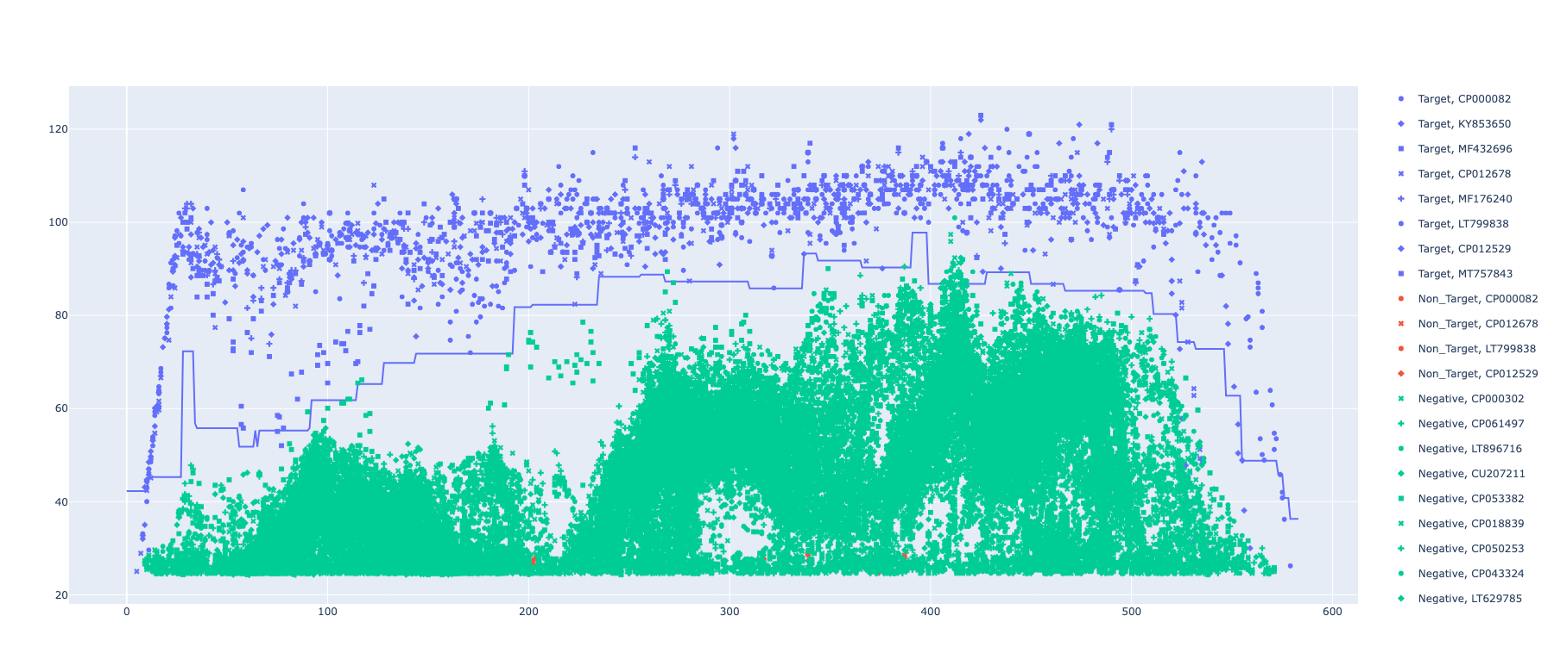
MCR-1,2,6 ROCker model using ROCkOut – 150bp reads

Slide 5
Model 2
MCR-3,7,9,10 Clade positive
All other clades negative

Slide 6
MCR-8
MCR-4
All shewanella
MCR-3
MCR-7
MCR-9
MCR-10
Model 2: MCR-3,7,9,10
Positive
Negative
MCR-1
MCR-2
MCR-6
MCR-5
Notes:
https://academic.oup.com/jac/article/73/10/2625/5055843 – mcr class allele assignments.

Slide 7
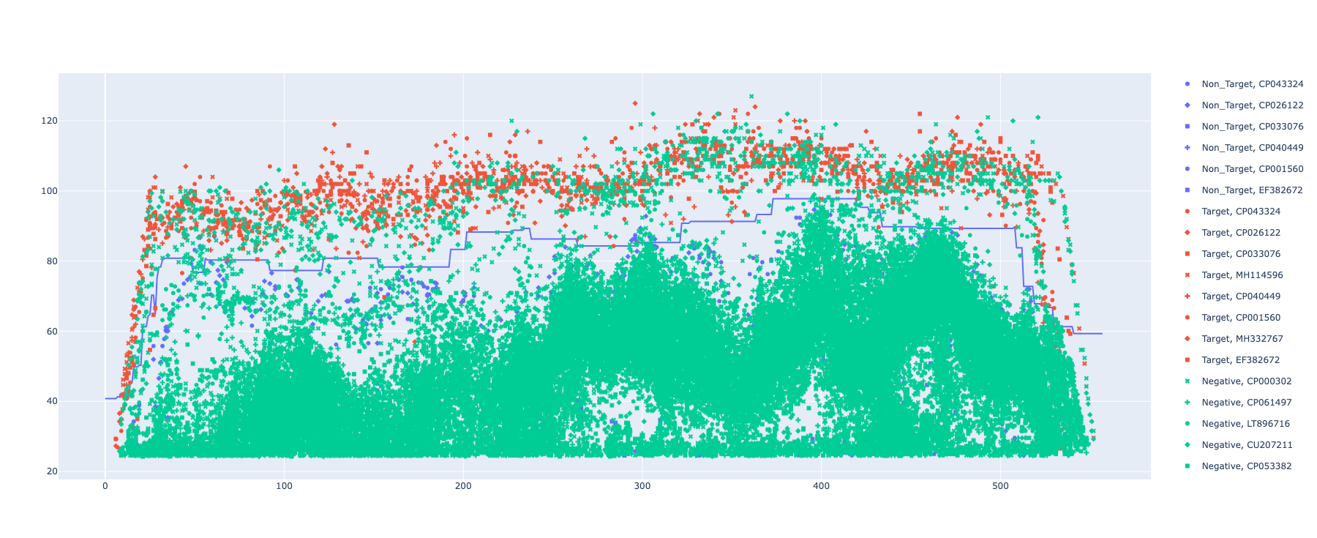
MCR-3,7,9,10 ROCker model using ROCkOut – 150bp reads

Slide 8
Model 3
MCR-5 Clade positive
All other clades negative

Slide 9
MCR-8
MCR-4
All shewanella
MCR-3
MCR-7
MCR-9
MCR-10
Model 3: MCR-5
Positive
Negative
MCR-1
MCR-2
MCR-6
MCR-5
Notes:
https://academic.oup.com/jac/article/73/10/2625/5055843 – mcr class allele assignments.

Slide 10
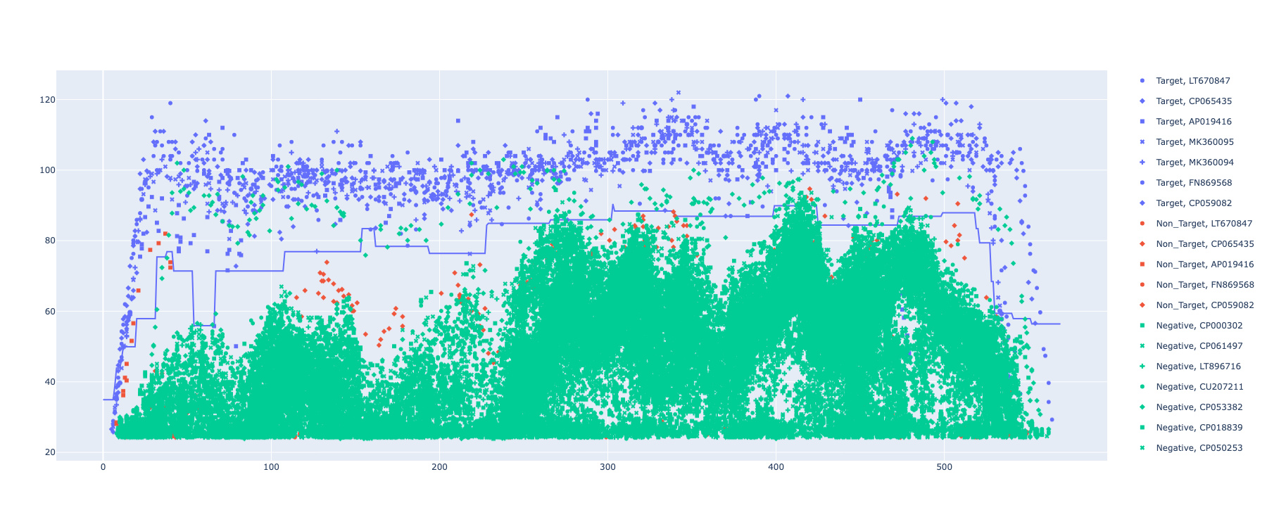
MCR-5 ROCker model using ROCkOut – 150bp reads

Slide 11
Model 4
MCR-4 Clade positive
All other clades negative

Slide 12
MCR-8
MCR-4
All shewanella
MCR-3
MCR-7
MCR-9
MCR-10
Model 4: MCR-4
Positive
Negative
MCR-1
MCR-2
MCR-6
MCR-5
Notes:
https://academic.oup.com/jac/article/73/10/2625/5055843 – mcr class allele assignments.

Slide 13
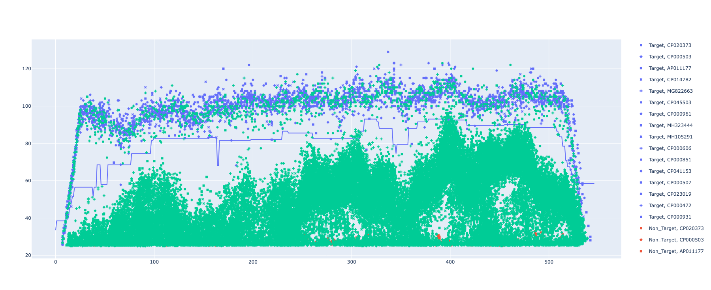
MCR-4 ROCker model using ROCkOut – 150bp reads

Slide 14
Model 5
MCR-8 Clade positive
All other clades negative

Slide 15
MCR-8
MCR-4
All shewanella
MCR-3
MCR-7
MCR-9
MCR-10
Model 5: MCR-8
Positive
Negative
MCR-1
MCR-2
MCR-6
MCR-5
Notes:
https://academic.oup.com/jac/article/73/10/2625/5055843 – mcr class allele assignments.

Slide 16
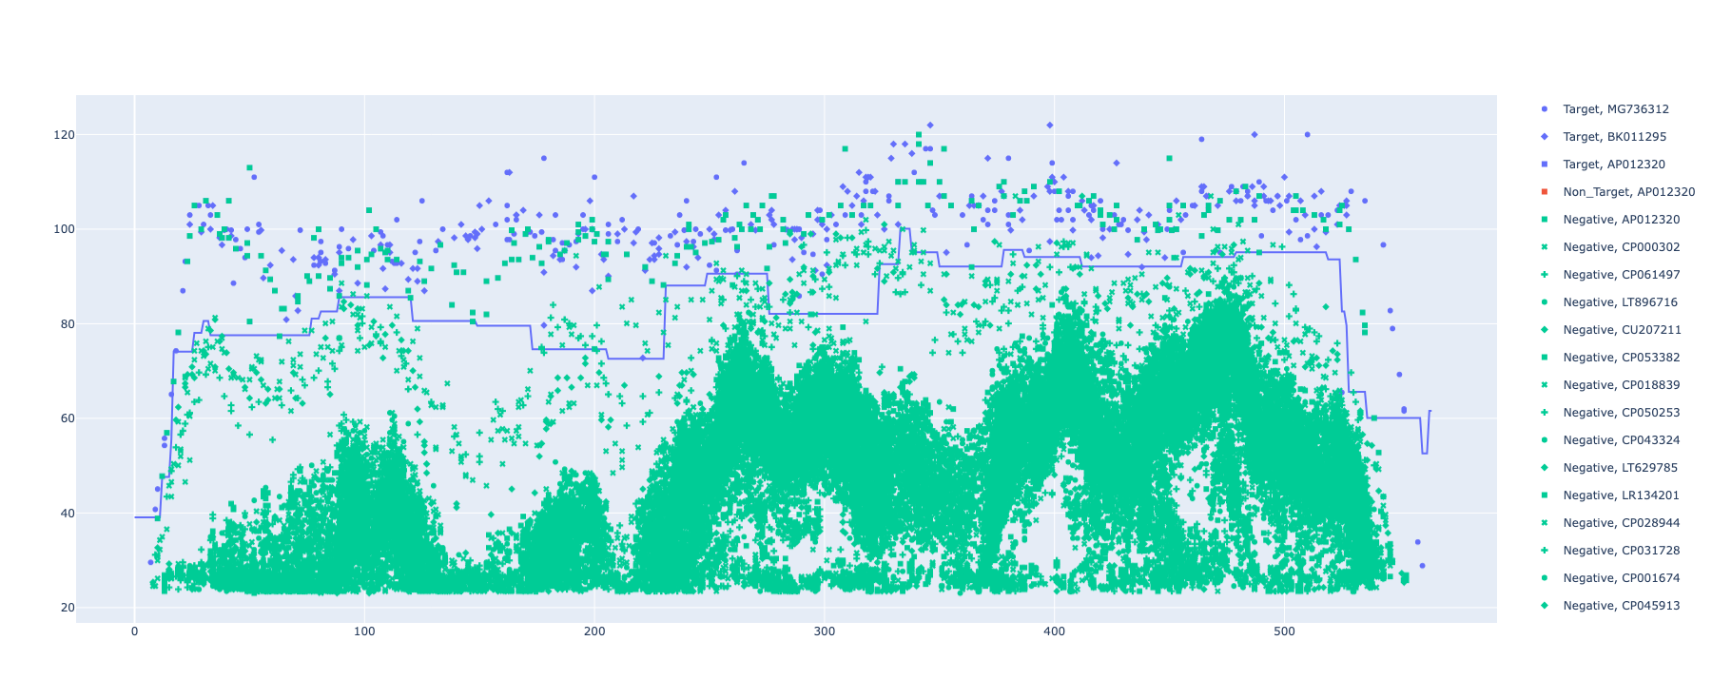
MCR-8 ROCker model using ROCkOut – 150bp reads

