Slide 1
Data Structures
Map
(a.k.a. associative array, hash table, dictionary)

Slide 2
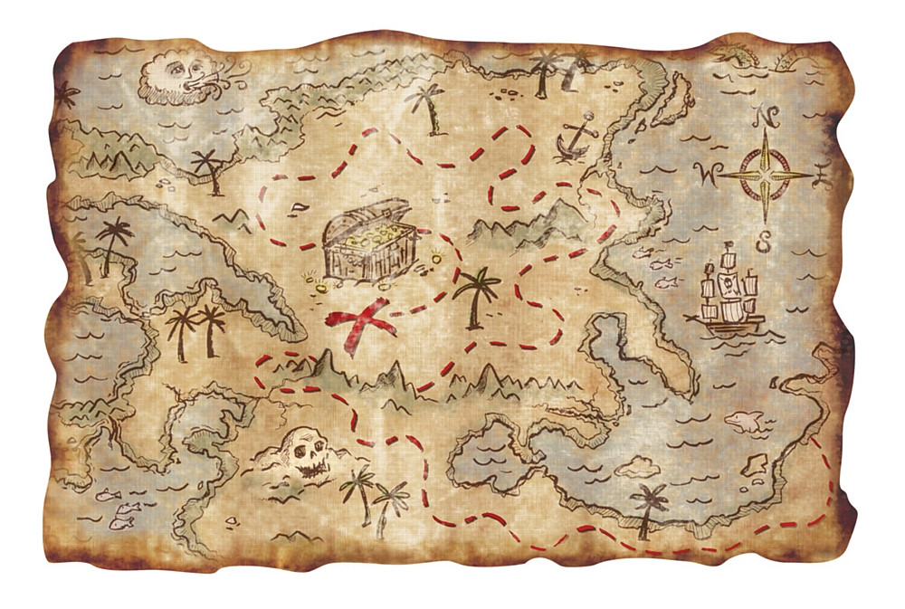
I know what a Map is!

Slide 3
I DON’T know what a Map is!

Slide 4
Remember the List?
List<String> list = new ArrayList<String>();
list.add(“Amy”);
list.add(“Divya”);
list.add(“Felix”);
list.size(); // 3

Slide 5
Remember the List?
A List is type of data structure that we use to hold an ordered sequence of stuff (or “elements”).
A List is also an object with methods that provide useful ways to do things with the stuff inside.
list.add(element): adds a new element to the end of the list
list.size(): the number of elements currently in the list
list.clear(): removes all elements from the list
etc.

Slide 6
What’s in a Map?
A Map is type of data structure that we use to hold key value associations.
A Map is also an object with methods.

Slide 7
It’s all about your keys and values
What’s a key value association?
Some real world examples:
A word has a definition
A person has an age
A city has a zipcode

Slide 8
It’s all about your keys and values
In these examples:
A word has a definition
A person has an age
A city has a zipcode
If we have a key, we can get a value.
key value
Direction is important!

Slide 9
All hail the Map!
A Map is type of data structure that we use to hold key value associations.
A Map is also an object with methods.
map.put(key, value): associates key with value
map.get(key): get the value currently associated with key
map.size(): the number of associations currently in the map
map.keySet(): a list* of all keys in the map (in no order)
map.values(): a list* of all values in the map (in no order)
* These technically aren’t lists, though you may think of them that way.

Slide 10

No! All hail the HashMap!
A HashMap is specific kind of Map, just like an ArrayList is a specific kind of List.
Sadly, it has nothing to do with hash browns.
List<String> names = new ArrayList<String>();
Map<String, Integer> ages = new HashMap<String, Integer>();
Notice that since the ages map associates Strings (names) to Integers (ages), we use <String, Integer>. I.e. keys are Strings, values are Integers.
How would you create a map to associate words with definitions?
Map<String, String> dictionary = new HashMap<String, String>();
Random fact: some languages call a map a dictionary!

Slide 11
The fine print…
Map<String, Integer> ages = new HashMap<String, Integer>();
ages.put(“Divya”, 15);
ages.get(“Divya”); // 15
ages.get(“Felix”); // null since “Felix” has no association yet
ages.put(“Felix”, 20);
ages.get(“Felix”); // 20
ages.put(“Felix”, 21); // change “Felix” association from 20 to 21
ages.get(“Felix”); // 21
ages.remove(“Felix”); // remove “Felix” association
ages.get(“Felix”); // null

Slide 12
Who cares?
Who needs a Map anyway?
Who likes CANDY!!!

Slide 13
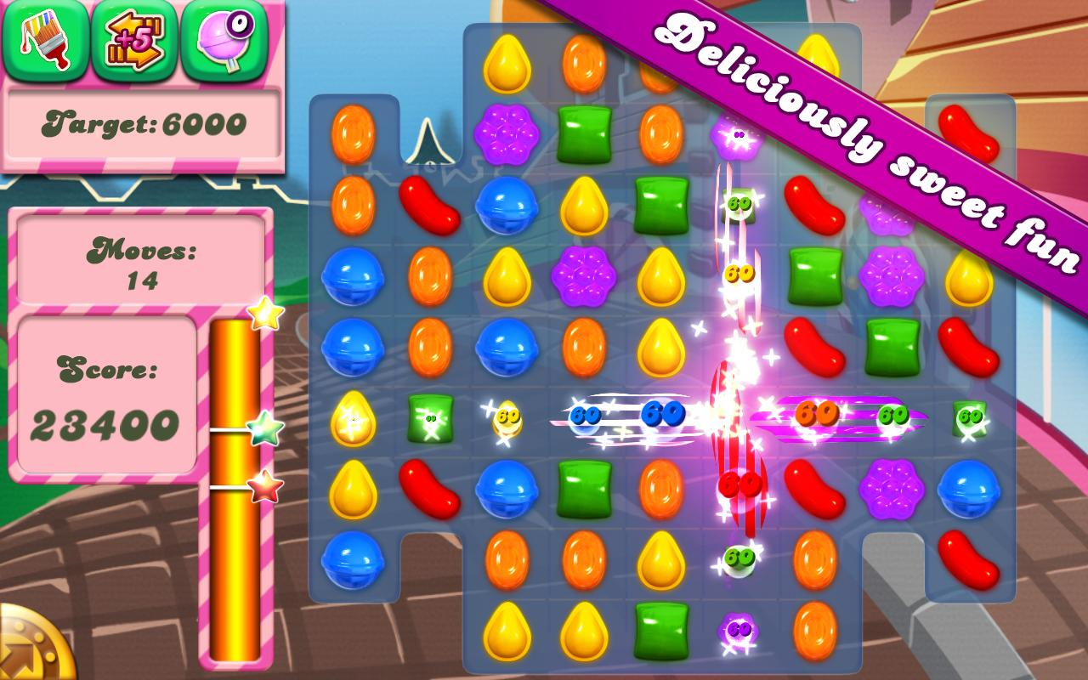
But seriously Map is deliciously sweet fun

Slide 14
Deliciously sweet fun
enum CandyCrushType {
THREE_IN_A_ROW,
FOUR_IN_A_ROW,
FIVE_IN_A_ROW,
L_SHAPE,
T_SHAPE
}
/**
* This function creates a Map that associates a point value with each
* different kind of crush listed above.
*
* We use this map to answer a question like "how many points does a 5-in-a-row score"?
*/
Map<CandyCrushType, Integer> candyCrushPoints() {
Map<CandyCrushType, Integer> pointMap = new HashMap<CandyCrushType, Integer>();
pointMap.put(CandyCrushType.THREE_IN_A_ROW, 10);
pointMap.put(CandyCrushType.FOUR_IN_A_ROW, 20);
pointMap.put(CandyCrushType.FIVE_IN_A_ROW, 30);
pointMap.put(CandyCrushType.L_SHAPE, 25);
pointMap.put(CandyCrushType.T_SHAPE, 25);
return pointMap;
}

Slide 15
Deliciously sweet fun
/**
* Computes the total score received in a game of Candy Crush for a given list of
* crushes completed during the game.
*/
int computeTotalCandyCrushScore(List<CandyCrushType> crushes) {
int total = 0;
for (CandyCrushType crush : crushes) {
// Get the point value for the current crush and add to total.
total += candyCrushPoints().get(crush);
}
return total;
}

Slide 16

Sorry

Slide 17
Counting duplicates
Recall
/**
* Counts the number of words which are duplicated in a list.
*/
int countDuplicates(List<String> words) {
List<String> duplicates = new ArrayList<String>();
for (int i = 0; i < words.size(); i++) {
String word = words.get(i);
if (duplicates.contains(word)) continue; // Already counted.
// Find words at all *other* indices and look for a duplicate.
for (int j = 0; j < words.size(); j++) {
if (i == j) continue; // Skip if we're looking at the same index.
String otherWord = words.get(j);
if (word.equals(otherWord)) {
duplicates.add(word);
break;
}
}
}
return duplicates.size();
}

Slide 18
Counting duplicates ‘mo ‘betta
int countDuplicates(List<String> words) {
Map<String, Integer> wordCounts = new HashMap<String, Integer>();
for (String word : words) {
Integer currCount = wordCounts.get(word);
if (currCount == null) { // We haven't seen the word before.
wordCounts.put(word, 1);
} else {
wordCounts.put(word, currCount + 1);
}
}
int duplicates = 0;
for (Integer count : wordCounts.values()) {
if (count > 1) {
++duplicates;
}
}
return duplicates;
}

Slide 19

Map is ‘mo ‘betta?
Some situations can benefit from the use of a Map, while others benefit from the use of a List. Some benefit from both!
So choose the right tool for the job!
But don’t forget that the Map is one of the most important and widely used data structures in computer science. If you’re stuck on a problem it’s usually worth your time to think about if a Map can help.

Slide 20
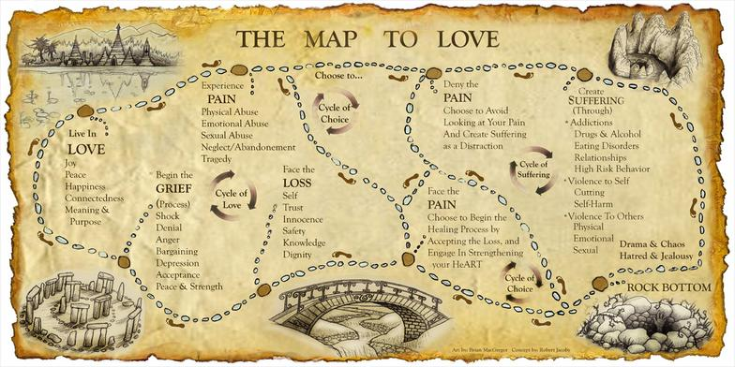

Map is your friend
A friend in need (might) need a Map, indeed.

