Slide 1


Computer Networks
Lectures (Chapter4)
Network Layer: Data Plane
Subhan Ullah, PhD
subhan.ullah@nu.edu.pk
BS(Computer Science) Fall-2024

Slide 2
Network layer: our goals
understand principles behind network layer services, focusing on data plane:
network layer service models
forwarding versus routing
how a router works
addressing
generalized forwarding
Internet architecture
instantiation, implementation in the Internet
IP protocol
Network Address Translation (NAT)

Slide 3

Network layer: “data plane” roadmap
Network layer: overview
data plane
control plane
What’s inside a router
input ports, switching, output ports
buffer management, scheduling
IP: the Internet Protocol
datagram format
addressing
network address translation
IPv6

Slide 4








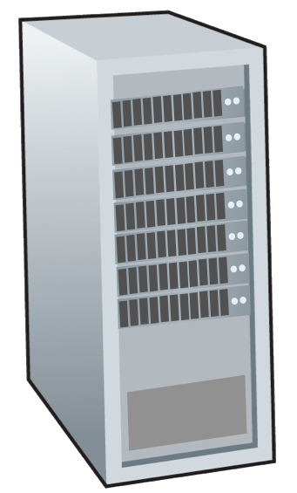







Network-layer services and protocols
transport segment from sending to receiving host
sender: encapsulates segments into datagrams, passes to link layer
receiver: delivers segments to transport layer protocol
network layer protocols in every Internet device: hosts, routers
routers:
examines header fields in all IP datagrams passing through it
moves datagrams from input ports to output ports to transfer datagrams along end-end path
mobile network
national or global ISP
application
transport
network
link
physical
network
link
physical
network
link
physical
network
link
physical
network
link
physical
network
link
physical
datacenter
network
application
transport
network
link
physical
enterprise
network

Slide 5
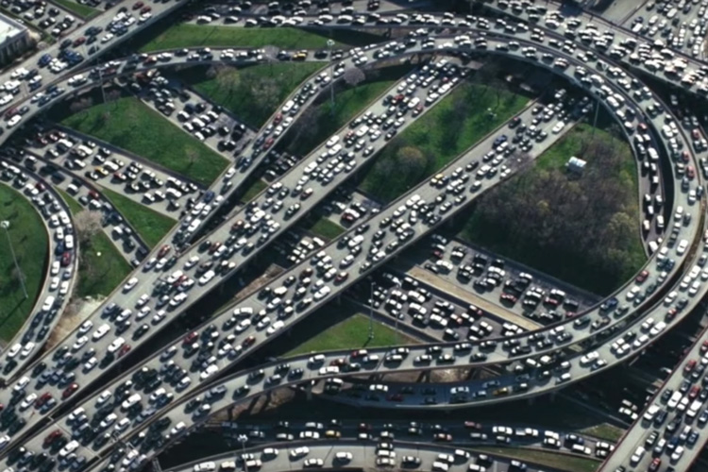
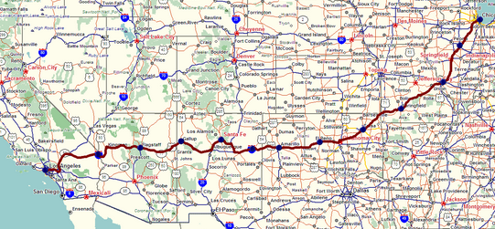
Two key network-layer functions
network-layer functions:
forwarding: move packets from a router’s input link to appropriate router output link
analogy: taking a trip
forwarding: process of getting through single interchange
routing: process of planning trip from source to destination
routing: determine route taken by packets from source to destination
routing algorithms
forwarding
routing

Slide 6
Network layer: data plane, control plane
Data plane:
local, per-router function
determines how datagram arriving on router input port is forwarded to router output port
Control plane
network-wide logic
determines how datagram is routed among routers along end-end path from source host to destination host
values in arriving
packet header
two control-plane approaches:
traditional routing algorithms: implemented in routers
software-defined networking (SDN): implemented in (remote) servers
0111
1
3
2
Notes:
Covered for Section E: 29-11-2021

Slide 7

Per-router control plane
Individual routing algorithm components in each and every router interact in the control plane
Routing
Algorithm
control
plane
data
plane
values in arriving
packet header
0111
1
3
2

Slide 8
Software-Defined Networking (SDN) control plane
Remote controller computes, installs forwarding tables in routers
Remote Controller
control
plane
data
plane
CA
CA
CA
CA
CA
values in arriving
packet header
0111
1
3
2
Notes:
Control Agents (CA)

Slide 9
Network service model
Q: What service model for “channel” transporting datagrams from sender to receiver?
example services for individual datagrams:
guaranteed delivery
guaranteed delivery with less than 40 msec delay
example services for a flow of datagrams:
in-order datagram delivery
guaranteed minimum bandwidth to flow
restrictions on changes in inter-packet spacing

Slide 10
Network-layer service model
Quality of Service (QoS) Guarantees ?
Network
Architecture
Internet
ATM
ATM
Internet
Internet
Service
Model
best effort
Constant Bit Rate
Available Bit Rate
Intserv Guaranteed
(RFC 1633)
Diffserv (RFC 2475)
Bandwidth
none
Constant rate
Guaranteed min
yes
possible
Loss
no
yes
no
yes
possibly
Order
no
yes
yes
yes
possibly
Timing
no
yes
no
yes
no
Internet “best effort” service model
No guarantees on:
successful datagram delivery to destination
timing or order of delivery
bandwidth available to end-end flow

Slide 11
Network-layer service model
Quality of Service (QoS) Guarantees ?
Network
Architecture
Internet
ATM
ATM
Internet
Internet
Service
Model
best effort
Constant Bit Rate
Available Bit Rate
Intserv Guaranteed
(RFC 1633)
Diffserv (RFC 2475)
Bandwidth
none
Constant rate
Guaranteed min
yes
possible
Loss
no
yes
no
yes
possibly
Order
no
yes
yes
yes
possibly
Timing
no
yes
no
yes
no

Slide 12
Reflections on best-effort service:
simplicity of mechanism has allowed Internet to be widely deployed adopted
sufficient provisioning of bandwidth allows performance of real-time applications (e.g., interactive voice, video) to be “good enough” for “most of the time”
replicated, application-layer distributed services (datacenters, content distribution networks) connecting close to clients’ networks, allow services to be provided from multiple locations
congestion control of “elastic” services helps
It’s hard to argue with success of best-effort service model

Slide 13
Network layer: “data plane” roadmap
Network layer: overview
data plane
control plane
What’s inside a router
input ports, switching, output ports
buffer management, scheduling
IP: the Internet Protocol
datagram format
addressing
network address translation
IPv6

Slide 14
Router architecture overview
high-level view of generic router architecture:
routing, management
control plane (software)
operates in millisecond
time frame
routing
processor
forwarding data plane (hardware) operates in nanosecond timeframe
high-speed
switching
fabric
router input ports
router output ports

Slide 15
Input port functions
lookup,
forwarding
queueing
line
termination
link
layer
protocol
(receive)
switch
fabric
physical layer:
bit-level reception
decentralized switching:
using header field values, lookup output port using forwarding table in input port memory (“match plus action”)
goal: complete input port processing at ‘line speed’
input port queuing: if datagrams arrive faster than forwarding rate into switch fabric
link layer:
e.g., Ethernet
(chapter 6)

Slide 16
Input port functions
lookup,
forwarding
queueing
line
termination
link
layer
protocol
(receive)
switch
fabric
physical layer:
bit-level reception
decentralized switching:
using header field values, lookup output port using forwarding table in input port memory (“match plus action”)
destination-based forwarding: forward based only on destination IP address (traditional)
generalized forwarding: forward based on any set of header field values
link layer:
e.g., Ethernet
(chapter 6)

Slide 17
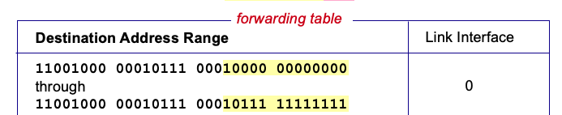

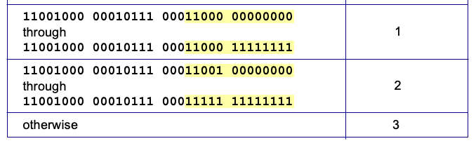
Destination-based forwarding
3
Q: but what happens if ranges don’t divide up so nicely?
Notes:
Text for this animation:
This all works out pretty nice and looks pretty simple!
But of course the devil is in the details, as the saying goes.
What happens, for example, when a subset of addresses say in this first range should go to say interface 3, rather than interface 0. Well, of course we could split the first address range into multiple pieces, and add in this new subrange with its new destination output port. But it turns out there’s a much simpler and elegant way to do this. Known as longest prefix matching.

Slide 18
Longest prefix matching
longest prefix match
when looking for forwarding table entry for given destination address, use longest address prefix that matches destination address.
Destination Address Range
11001000 00010111 00010
11001000 00010111 00011000
11001000 00010111 00011
otherwise
Link interface
0
1
2
3
***
********
********
***
********
examples:
11001000 00010111 00010110 10100001
which interface?
11001000 00010111 00011000 10101010
which interface?

Slide 19
Longest prefix matching
longest prefix match
when looking for forwarding table entry for given destination address, use longest address prefix that matches destination address.
Destination Address Range
11001000 00010111 00010
11001000 00010111 00011000
11001000 00010111 00011
otherwise
Link interface
0
1
2
3
***
********
********
match!
***
********
examples:
11001000 00010111 00010110 10100001
which interface?
11001000 00010111 00011000 10101010
which interface?

Slide 20
Longest prefix matching
longest prefix match
when looking for forwarding table entry for given destination address, use longest address prefix that matches destination address.
Destination Address Range
11001000 00010111 00010
11001000 00010111 00011000
11001000 00010111 00011
otherwise
Link interface
0
1
2
3
***
********
********
***
********
match!
examples:
11001000 00010111 00010110 10100001
which interface?
11001000 00010111 00011000 10101010
which interface?

Slide 21
Longest prefix matching
longest prefix match
when looking for forwarding table entry for given destination address, use longest address prefix that matches destination address.
Destination Address Range
11001000 00010111 00010
11001000 00010111 00011000
11001000 00010111 00011
otherwise
Link interface
0
1
2
3
***
********
********
***
********
match!
examples:
11001000 00010111 00010110 10100001
which interface?
11001000 00010111 00011000 10101010
which interface?

Slide 22
Longest prefix matching
we’ll see why longest prefix matching is used shortly, when we study addressing
longest prefix matching: often performed using ternary content addressable memories (TCAMs)
content addressable: present address to TCAM: retrieve address in one clock cycle, regardless of table size
Cisco Catalyst: ~1M routing table entries in TCAM

Slide 23
Switching fabrics
transfer packet from input link to appropriate output link
switching rate: rate at which packets can be transfer from inputs to outputs
often measured as multiple of input/output line rate
N inputs: switching rate N times line rate desirable
R
(rate: NR, ideally)
R
. . .
high-speed
switching
fabric
. . .
N input ports
N output ports
R
R

Slide 24
Switching fabrics
transfer packet from input link to appropriate output link
switching rate: rate at which packets can be transfer from inputs to outputs
often measured as multiple of input/output line rate
N inputs: switching rate N times line rate desirable
three major types of switching fabrics:
memory
memory
bus
interconnection
network

Slide 25
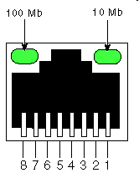
Switching via memory
first generation routers:
traditional computers with switching under direct control of CPU
packet copied to system’s memory
speed limited by memory bandwidth (2 bus crossings per datagram)
input
port
(e.g.,
Ethernet)
output
port
(e.g.,
Ethernet)
memory
system bus

Slide 26
Switching via a bus
datagram from input port memory to output port memory via a shared bus
bus contention: switching speed limited by bus bandwidth
32 Gbps bus, Cisco 5600: sufficient speed for access routers

Slide 27
Switching via interconnection network
Crossbar, Clos networks, other interconnection nets initially developed to connect processors in multiprocessor
multistage switch: nxn switch from multiple stages of smaller switches
3x3 crossbar
3x3 crossbar
exploiting parallelism:
fragment datagram into fixed length cells on entry
switch cells through the fabric, reassemble datagram at exit
8x8 multistage switch
built from smaller-sized switches

Slide 28
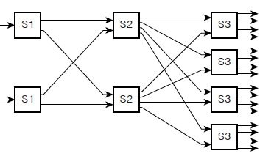
Switching via interconnection network
scaling, using multiple switching “planes” in parallel:
speedup, scaleup via parallelism
Cisco CRS router:
basic unit: 8 switching planes
each plane: 3-stage interconnection network
up to 100’s Tbps switching capacity
fabric plane 0
fabric plane 1
fabric plane 2
. . .
. . .
fabric plane 3
. . .
. . .
fabric plane 4
. . .
. . .
fabric plane 5
. . .
. . .
fabric plane 6
. . .
. . .
fabric plane 7
. . .
. . .
. . .
. . .
. . .
. . .

Slide 29
Input port queuing
If switch fabric slower than input ports combined -> queueing may occur at input queues
queueing delay and loss due to input buffer overflow!
Head-of-the-Line (HOL) blocking: queued datagram at front of queue prevents others in queue from moving forward
switch
fabric
switch
fabric
output port contention: only one red datagram can be transferred. lower red packet is blocked
one packet time later: green packet experiences HOL blocking
Notes:
Covered for Section F: (03-12-2021)

Slide 30

Output port queuing
datagram
buffer
queueing
This is a really important slide
switch
fabric
(rate: NR)
link
layer
protocol
(send)
line
termination
R
Buffering required when datagrams arrive from fabric faster than link transmission rate. Drop policy: which datagrams to drop if no free buffers?
Datagrams can be lost due to congestion, lack of buffers
Scheduling discipline chooses among queued datagrams for transmission
Priority scheduling – who gets best performance, network neutrality

Slide 31
Output port queuing
switch
fabric
switch
fabric
at t, packets more
from input to output
one packet time later
buffering when arrival rate via switch exceeds output line speed
queueing (delay) and loss due to output port buffer overflow!

Slide 32
How much buffering?
RFC 3439 rule of thumb: average buffering equal to “typical” RTT (say 250 msec) times link capacity C
e.g., C = 10 Gbps link: 2.5 Gbit buffer
more recent recommendation: with N flows, buffering equal to
.
RTT C
N
but too much buffering can increase delays (particularly in home routers)
long RTTs: poor performance for real-time apps, sluggish TCP response
recall delay-based congestion control: “keep bottleneck link just full enough (busy) but no fuller”
Notes:
You might think that more buffering is a good thing. Buffering is a bit like salt—just the right amount of salt makes food better, but too much makes it inedible!
For many years, the rule of thumb [RFC 3439] for buffer sizing was that the
amount of buffering (B) should be equal to an average round-trip time (RTT, say
250!msec) times the link capacity (C). Thus, a 10-Gbps link with an RTT of 250!msec
would need an amount of buffering equal to B = RTT # C = 2.5 Gbits of buffers.
This result was based on an analysis of the queueing dynamics of a relatively
small number of TCP flows [Villamizar 1994].

Slide 33
Buffer Management
buffer management:
drop: which packet to add, drop when buffers are full
tail drop: drop arriving packet
priority: drop/remove on priority basis
datagram
buffer
queueing
scheduling
switch
fabric
link
layer
protocol
(send)
line
termination
R
Abstraction: queue
marking: which packets to mark to signal congestion (ECN, RED)
R
packet
departures
packet
arrivals
queue
(waiting area)
link
(server)
Notes:
Random Early Detection (RED)

Slide 34
Packet Scheduling: FCFS
packet scheduling: deciding which packet to send next on link
first come, first served
priority
round robin
weighted fair queueing
FCFS: packets transmitted in order of arrival to output port
also known as: First-in-first-out (FIFO)
real world examples?
Abstraction: queue
R
packet
departures
packet
arrivals
queue
(waiting area)
link
(server)

Slide 35
Scheduling policies: priority
Priority scheduling:
arriving traffic classified, queued by class
any header fields can be used for classification
high priority queue
arrivals
classify
link
departures
low priority queue
2
send packet from highest priority queue that has buffered packets
FCFS within priority class
1
3
4
5
arrivals
packet in service
1
3
2
4
5
departures
1
3
2
4
5

Slide 36
Scheduling policies: round robin
Round Robin (RR) scheduling:
arriving traffic classified, queued by class
any header fields can be used for classification
server cyclically, repeatedly scans class queues, sending one complete packet from each class (if available) in turn
R
classify
arrivals
link
departures

Slide 37
Scheduling policies: weighted fair queueing
Weighted Fair Queuing (WFQ):
generalized Round Robin
each class, i, has weight, w_{i}, and gets weighted amount of service in each cycle:
w₁
w₂
R
w_{i}
Σ_{j}w_{j}
classify
arrivals
link
departures
w₃
minimum bandwidth guarantee (per-traffic-class)

Slide 38
Sidebar: Network Neutrality
What is network neutrality?
technical: how an ISP should share/allocation its resources
packet scheduling, buffer management are the mechanisms
social, economic principles
protecting free speech
encouraging innovation, competition
enforced legal rules and policies
Different countries have different “takes” on network neutrality

Slide 39
Sidebar: Network Neutrality
2015 US FCC Order on Protecting and Promoting an Open Internet: three “clear, bright line” rules:
no blocking … “shall not block lawful content, applications, services, or non-harmful devices, subject to reasonable network management.”
no throttling … “shall not impair or degrade lawful Internet traffic on the basis of Internet content, application, or service, or use of a non-harmful device, subject to reasonable network management.”
no paid prioritization. … “shall not engage in paid prioritization”

Slide 40
ISP: telecommunications or information service?
Is an ISP a “telecommunications service” or an “information service” provider?
the answer really matters from a regulatory standpoint!
US Telecommunication Act of 1934 and 1996:
Title II: imposes “common carrier duties” on telecommunications services: reasonable rates, non-discrimination and requires regulation
Title I: applies to information services:
no common carrier duties (not regulated)
but grants FCC authority “… as may be necessary in the execution of its functions”4

Slide 41
Network layer: “data plane” roadmap
Network layer: overview
data plane
control plane
What’s inside a router
input ports, switching, output ports
buffer management, scheduling
IP: the Internet Protocol
datagram format
addressing
network address translation
IPv6

Slide 42
Network Layer: Internet
host, router network layer functions:
transport layer: TCP, UDP
IP protocol
datagram format
addressing
packet handling conventions
Path-selection algorithms: implemented in
routing protocols (OSPF, BGP)
SDN controller
network
layer
forwarding
table
ICMP protocol
error reporting
router “signaling”
link layer
physical layer

Slide 43
IP Datagram format
32 bits
IP protocol version number
head.
len
type of
service
total datagram
length (bytes)
ver
length
header length(bytes)
“type” of service:
diffserv (0:5)
ECN (6:7)
flgs
fragment
offset
fragmentation/
reassembly
16-bit identifier
time to
live
upper
layer
header
checksum
header checksum
TTL: remaining max hops
(decremented at each router)
source IP address
32-bit source IP address
destination IP address
Maximum length: 64K bytes
Typically: 1500 bytes or less
upper layer protocol (e.g., TCP or UDP)
32-bit destination IP address
overhead
options (if any)
e.g., timestamp, record route taken
20 bytes of TCP
20 bytes of IP
= 40 bytes + app layer overhead for TCP+IP
payload data
(variable length,
typically a TCP
or UDP segment)
Notes:
Explicit cong. Control
Internet Control Messaging Protocol (ICMP)

Slide 44
Maximum Transmission Unit (MTU)
Maximum Transmission Unit (MTU)
the length of the largest link-layer frame that can be sent over a link
Arriving IP packet may be larger
MTU
IP Packet

Slide 45
IP Fragmentation
If IP packet is longer than the MTU, the router breaks packet into smaller packets
Called IP fragments
Fragments are still IP packets
MTU
IP Packet
3
2
1
IP Packets
Fragmentation

Slide 46
IP Fragmentation
What is Fragmented?
The received datagram having segment as payload
New headers are created
MTU
IP Packet
3
2
1
IP Packets
Fragmentation

Slide 47
IP Fragmentation
Who Does the Fragmentation?
The router
MTU
IP Packet
3
2
1
IP Packets
Fragmentation

Slide 48
IP Defragmentation
Who does the defragmentation?
The router? No
The end-system
keeping the network core simple!!

Slide 49

IP fragmentation, reassembly
…
fragmentation:
in: one large datagram
out: 3 smaller datagrams
reassembly
…

Slide 50
Multiple Fragmentations
Original packet may be fragmented multiple times along its route
Source
Host
Internet
Process
Destination
Host
Internet
Process
Fragmentation

Slide 51
How does it actually work?
Three main components
Identification Field
Fragment Offset Field
More Fragments Flag
Identification (16 bits)
Flags (3)
Fragment Offset (13)
Notes:
Section E: Covered (06-12-2021)
Section D: Covered (07-12-2021)

Slide 52
Identification Field
IP packet has a 16-bit Identification field
Version
(4)
Hdr Len
(4)
TOS (8)
Total Length in bytes (16)
Identification (16 bits)
Flags (3)
Fragment Offset (13)
Time to Live (8)
Protocol (8)
Header Checksum (16)
Source IP Address
Destination IP Address
Options (if any)
PAD
Data Field

Slide 53
Identification Field
IP packet has a 16-bit Identification field
Source host network process places a random number in the Identification field
Different for each IP packet

Slide 54
Identification Field
IP packet has a 16-bit Identification field
If router fragments, places the original Identification field value in the Identification field of each fragment
Purpose
Allows receiving host’s network layer process know what fragments belong to each original packet
Works even if an IP packet is fragmented several times
47
47
47
47
Original IP Packet
Fragments

Slide 55
Fragment Offset Field
Fragment offset field (13 bits) is used to reorder fragments with the same Identification field
Contains the data field’s starting point (in octets) from the start of the data field in the original IP packet
Version
(4)
Hdr Len
(4)
TOS (8)
Total Length in bytes (16)
Indication (16 bits)
Flags (3)
Fragment Offset (13)

Slide 56
Fragment Offset Field
Receiving host’s network layer process assembles fragments in order of increasing fragment offset field value
This works even if fragments arrive out of order!
Works even if fragmentation occurs multiple times
Fragment Offset Field
730
212
0

Slide 57
More Fragments flag
More Fragments field (1 bit)
1 if more fragments
0 if not
Source host internet process sets to 0
If router fragments, sets More Fragments field in last fragment to 0
In all other fragments, sets to 1
0
1
1
0
Original IP Packet
Fragments

Slide 58
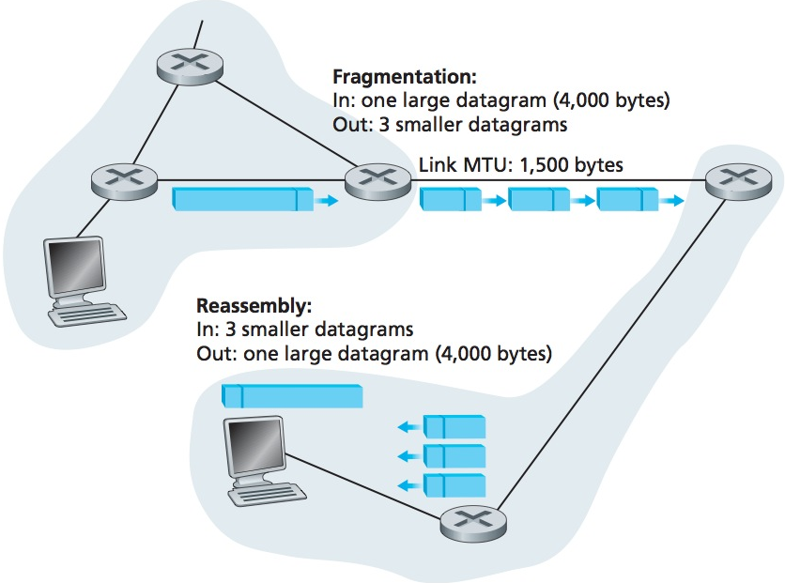
Example
A datagram of 4,000 bytes (20 bytes of IP header plus 3,980 bytes of IP payload) arrives at a router
must be forwarded to a link with an MTU of 1,500 bytes
This implies that the 3,980 data bytes in the original datagram must be allocated to three separate fragments (each of which is also an IP datagram).

Slide 59
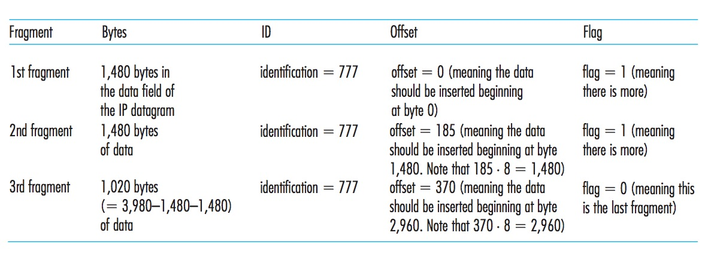
Example
The values reflect the requirement that the amount of original payload data in all but the last fragment be a multiple of 8 bytes.
The off- set value be specified in units of 8-byte chunks.
Fragmentation Calculator: https://fixmycode.github.io/IPFCalc/

Slide 60
Defragmentation
Internet layer process on destination host defragments, restoring the original packet
IP Defragmentation only occurs once
Source
Host
Internet
Process
Destination
Host
Internet
Process
Defragmentation

Slide 61
So all is fine?
Unfortunately, fragmentation also has its costs
Complexity at routers/end systems
can be used to create lethal DoS attacks
IPv6, does away with fragmentation altogether on router
End-to-end fragmentation
Minimum MTU 1280 Bytes
Hosts uses Path MTU Discovery (PMTUD) to find out maximum packet size or in IPV6 routers expect fitting IPv6 datagrams
If a router finds out, that packet size is too large for the route to the next hope, it sends the ICMPv6 message (Packet too large) to the sender
Notes:
can be used to create lethal DoS attacks:
Jolt2, no fragment with offset 0
send overlapping IP fragments
Jolt2 is piece of executable code that allows a malicious hacker to fire a
stream of illegally sized fragmented packets at a host causing it to consume
100% of the CPU resource. The packets are identical, all containing a
fragment offset value of 65520. The packets do not need to be sent at a fast
rate to have an affect (approx. 150 pack ets per second).
The maximum allowed length of a packet is 65535 however when the packet
is reassembled the values exceed the legal size (offset + IP header + data)
even though it doesn’t actually physically do this. In other words the length of
the packet is reported as 68 bytes but the length received is 29 bytes. This
exploit only affects systems that have a flaw in the code that performs IP
reassembly.
The attack lasts as long as the packets are sent to the target .
A full analysis of jolt2.c can be found at the following URL:
http://packetstormsecurity.nl/papers/general/jolt2.c -analysis.txt

Slide 62
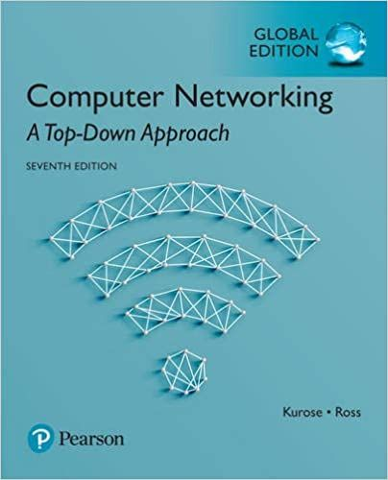

Thank You All
☺
?
A note on the origin of these ppt slides:
All material copyright 1996-2020 J.F Kurose and K.W. Ross, All Rights Reserved
These slides are freely provided by the book authors and it represents a lot of work on their part. We would like to thank J.F Kurose and K.W. Ross.
Transport Layer: 3-150
Notes:
Section F and G ended

