Slide 1


Computer Networks
Week3_Lecture1 (Chapter1)
Protocol layers, service models, Security
Subhan Ullah, PhD
subhan.ullah@nu.edu.pk
BS(Computer Science) Fall-2024

Slide 2

Chapter 1: roadmap
What is the Internet?
What is a protocol?
Network edge: hosts, access network, physical media
Network core: packet/circuit switching, internet structure
Performance: loss, delay, throughput
Protocol layers, service models
Security
History

Slide 3
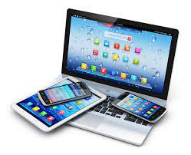
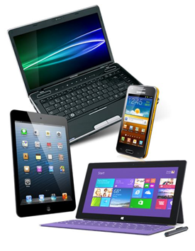

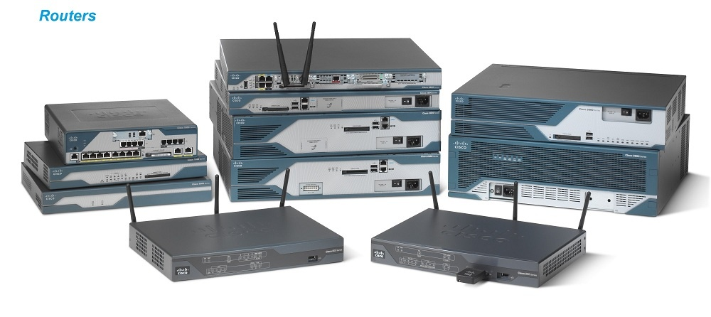

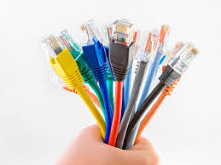
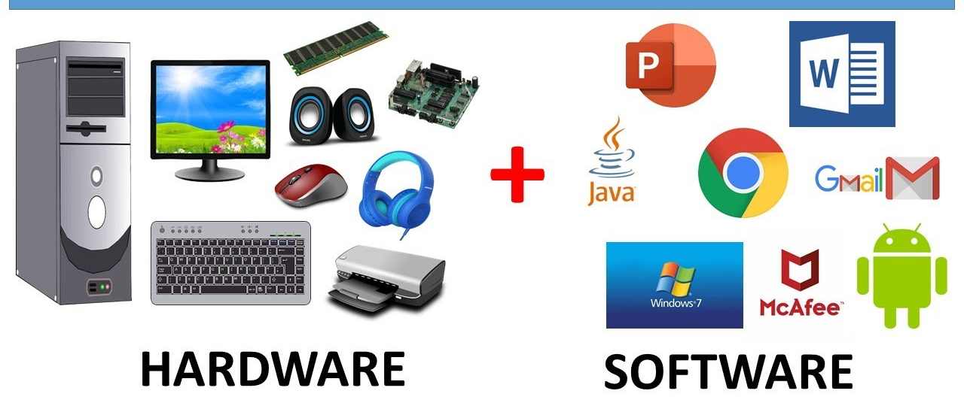
Protocol “layers” and reference models
Networks are complex,
with many “pieces”:
hosts
applications
routers
links of various media
protocols
hardware, software
HTTP, FTP, TCP, UDP,
DHCP, IPv4, ARP, DNS
Question: is there any hope of organizing structure of network?
and/or our discussion of networks?

Slide 4
Example: organization of air travel
end-to-end transfer of person plus baggage
ticket (purchase)
baggage (check)
gates (load)
runway takeoff
airplane routing
ticket (complain)
baggage (claim)
gates (unload)
runway landing
airplane routing
airplane routing
How would you define/discuss the system of airline travel?
a series of steps, involving many services

Slide 5
Example: organization of air travel
ticket (purchase)
baggage (check)
gates (load)
runway takeoff
airplane routing
ticketing service
ticket (complain)
baggage (claim)
gates (unload)
runway landing
airplane routing
baggage service
gate service
runway service
routing service
airplane routing
layers: each layer implements a service
via its own internal-layer actions
relying on services provided by layer below

Slide 6
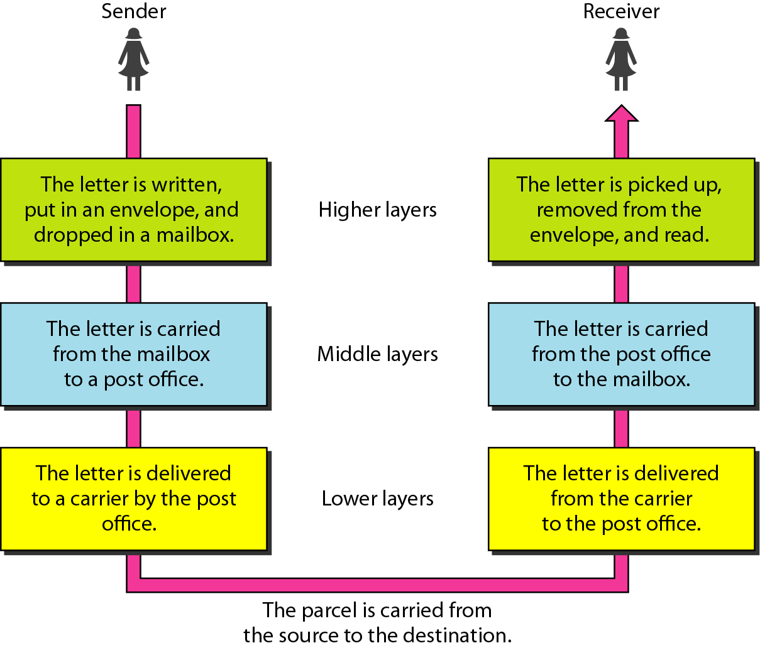
Tasks involved in sending a letter
Notes:
Covered for section C until here….

Slide 7
Why layering?
Approach to designing/discussing complex systems:
explicit structure allows identification, relationship of system’s pieces
layered reference model for discussion
modularization eases maintenance, updating of system
change in layer's service implementation: transparent to rest of system
e.g., change in gate procedure doesn’t affect rest of system
Notes:
Communication principles (connection for communicating the messages+ protocol for understanding the messages)
Communication is a two way process
We are all communicating, all the time
Timing and frequency matter
There is single method of communication requires that works for every one
Functionality: Mandatory -> Error control + Flow control + Congestion control + multiplexing/de-multiplexing
Functionality Optional -> Security (Encryption/decryption)+ checkpoints

Slide 8
Layered Internet protocol stack
application: supporting network applications
HTTP, IMAP, SMTP, DNS
transport: process-process data transfer
TCP, UDP
network: routing of datagrams from source to destination
IP, routing protocols
link: data transfer between neighboring network elements
Ethernet, 802.11 (WiFi), PPP
physical: bits “on the wire”
application
application
transport
transport
network
network
link
link
physical
physical
Notes:
Point-to-Point Protocol (PPP)
Internet Message Access Protocol (IMAP)
Physical layer: cables and connector, topologies, hardware, transmission, encoding, multiplexing/de-multiplexing
Internet Control Message Protocol (ICMP)
Services, interfaces, protocols

Slide 9
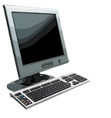
Services, Layering and Encapsulation
application
transport
network
link
physical
M
application
transport
network
link
physical
Application exchanges messages to implement some application service using services of transport layer
H_{t}
M
Transport-layer protocol transfers M (e.g., reliably) from one process to another, using services of network layer
transport-layer protocol encapsulates application-layer message, M, with transport layer-layer header H_{t} to create a transport-layer segment
H_{t} used by transport layer protocol to implement its service
source
destination
Notes:
The application layer provides services for an application program to ensure that effective communication with another application program in a network is possible

Slide 10
Services, Layering and Encapsulation
application
transport
network
link
physical
M
application
transport
network
link
physical
H_{t}
M
Transport-layer protocol transfers M (e.g., reliably) from one process to another, using services of network layer
H_{n}
H_{t}
M
Network-layer protocol transfers transport-layer segment [H_{t} | M] from one host to another, using link layer services
network-layer protocol encapsulates transport-layer segment [H_{t} | M] with network-layer header H_{n} to create a network-layer datagram
H_{n} used by network layer protocol to implement its service
source
destination
Notes:
Now, after TCP/UDP header being appended, it moves on to the Network Layer. Till this step, the remote end-point's IP address wasn't a part of the packet at all.

Slide 11
Services, Layering and Encapsulation
H_{n}
H_{t}
M
application
transport
network
link
physical
M
application
transport
network
link
physical
H_{t}
M
H_{n}
H_{t}
M
Network-layer protocol transfers transport-layer segment [H_{t} | M] from one host to another, using link layer services
H_{l}
H_{n}
H_{t}
M
Link-layer protocol transfers datagram [H_{n}| [H_{t} |M] from host to neighboring host, using network-layer services
link-layer protocol encapsulates network datagram [H_{n}| [H_{t} |M], with link-layer header H_{l} to create a link-layer frame
source
destination
Notes:
The first physical equipment at the Network Layer would be Routers
It receives SEGMENTS from the upper layer and convert it into PACKETS.
Logical addressing: The network layer adds a header to the packet coming from the upper layer, includes the logical addresses (IP) of the sender and receiver.
Makes “Best Path Determination” decision based on logical addressing.
logical link control (LLC)
Physical Layer:
Defines the physical and electrical medium for data transfer.
Physical layer components: cables, jacks, punch blocks, hubs.
Cables + topology + transmission mode + encoding+ devices+ Modulation
Link layer: stop&wait+ Go back and selective repeat+ MAC protocol+ error control
Network: IP, routing protocol + IPV4 and IPV6, Network Header
Transport: TCP, UDP, Trans-Header+ port number
Application: DNS, HTTP, SMTP

Slide 12
Services, Layering and Encapsulation
application
transport
network
link
physical
M
application
transport
network
link
physical
M
message
H_{t}
M
H_{t}
M
segment
H_{n}
H_{t}
M
H_{n}
H_{t}
M
datagram
H_{l}
H_{n}
H_{t}
M
H_{l}
H_{n}
H_{t}
M
frame
source
destination

Slide 13
Encapsulation: an end-end view
source
message
M
application
transport
network
link
physical
segment
H_{t}
M
H_{t}
datagram
H_{n}
H_{t}
H_{n}
M
frame
H_{l}
H_{n}
H_{t}
M
link
physical
switch
destination
H_{n}
H_{t}
M
network
link
physical
M
application
transport
network
link
physical
H_{l}
H_{n}
H_{t}
M
H_{n}
H_{t}
M
H_{t}
M
H_{n}
H_{t}
M
H_{l}
H_{n}
H_{t}
M
router

Slide 14
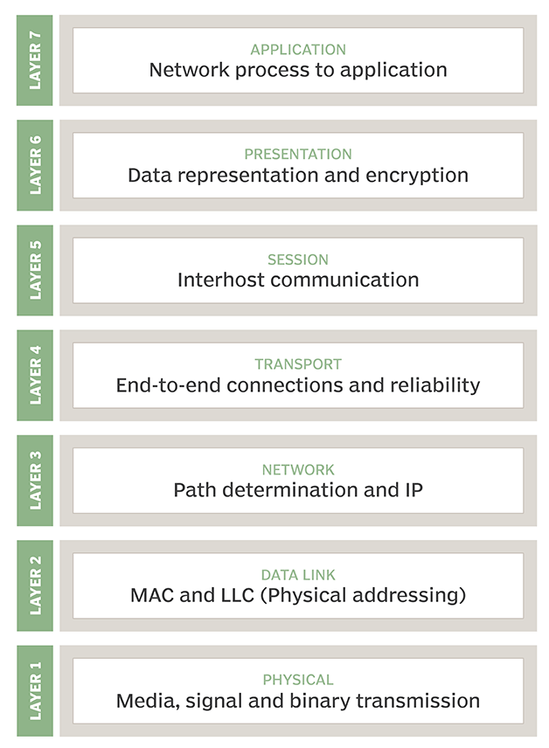
ISO/OSI reference model
Two layers not found in Internet protocol stack!
presentation: allow applications to interpret meaning of data, e.g., encryption, compression, machine-specific conventions
session: synchronization, checkpointing, recovery of data exchange
Internet stack “missing” these layers!
these services, if needed, must be implemented in application
needed?
application
presentation
session
transport
network
link
physical
Data
Data
Data
Segment
Packet
Frame
Bits
The seven layer OSI/ISO
reference model
Notes:
logical link control (LLC)
ISO Established in 1947, the International Standards Organization (ISO) is a multinational body dedicated to worldwide agreement on international standards. An ISO standard that covers all aspects of network communications is the Open Systems Interconnection (OSI) model. It was first introduced in the late 1970s.
ISO is the organization. OSI is the model.
OSI is a reference model for how applications communicate over a network
A reference model is a conceptual framework for understanding the relationships of communication networks
The purpose of the OSI reference model
To guide vendors and developers so the digital communication products and software programs they create can interoperate,
and to facilitate a clear framework that describes the functions of a networking or telecommunication system
Its goal is the interoperability of diverse communication systems with standard communication protocols
OSI model partitions a communication system into abstraction layers
The original version of the model had seven layers
Session: Authentication + Authorization + session restoration (check pointing: using session beans to store the session status) + synchronization + web-conferencing (flow control and synchronization e.g., audo+video synchronization during meeting).
Reference to book (Computer Networks:5th Edition Tanenboum, Waterfall )
Three concepts are central to the OSI model:
1. Services.
2. Interfaces.
3. Protocols.
Probably the biggest contribution of the OSI model is that it makes the distinction
between these three concepts explicit. Each layer performs some services for the
layer above it. The service definition tells what the layer does, not how entities
above it access it or how the layer works. It defines the layer’s semantics.
A layer’s interface tells the processes above it how to access it. It specifies
what the parameters are and what results to expect. It, too, says nothing about
how the layer works inside.
Finally, the peer protocols used in a layer are the layer’s own business. It can
use any protocols it wants to, as long as it gets the job done (i.e., provides the
offered services). It can also change them at will without affecting software in
higher layers.
These ideas fit very nicely with modern ideas about object-oriented programming.
An object, like a layer, has a set of methods (operations) that processes
outside the object can invoke. The semantics of these methods define the set
of services that the object offers. The methods’ parameters and results form the
object’s interface. The code internal to the object is its protocol and is not visible
or of any concern outside the object.
The TCP/IP model did not originally clearly distinguish between services, interfaces,
and protocols, although people have tried to retrofit it after the fact to
make it more OSI-like. For example, the only real services offered by the internet
layer are SEND IP PACKET and RECEIVE IP PACKET. As a consequence, the protocols
in the OSI model are better hidden than in the TCP/IP model and can be
replaced relatively easily as the technology changes. Being able to make such
changes transparently is one of the main purposes of having layered protocols in
the first place.

Slide 15
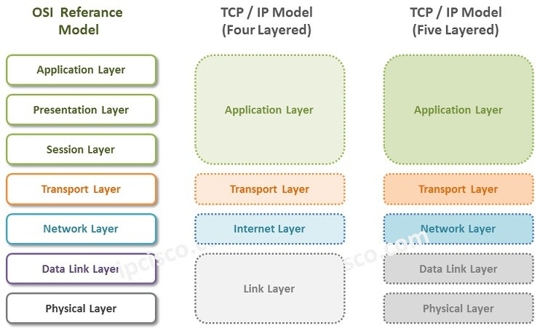
OSI Reference model vs TCP/IP stack
https://ipcisco.com/lesson/tcp-ip-model/
Notes:
ALL People Seem To need Data Processing

Slide 16
Differences between OSI and TCP/IP model
Open Systems Interconnection (OSI) Model
Developed by ISO (International Standard Organization)
Provides a clear distinction between interfaces, services, and protocols
Uses the network layer to define routing standards and protocols
Has seven layers
The transport layer is only connection-oriented
The data link layer and physical are separate layers
It has also session and presentation layers
It is defined after the advent of the Internet
The minimum size of the OSI header is 5 bytes
TCP/IP Model
Developed by ARPANET (Advanced Research Project Agency Network)
Doesn’t have any clear distinguishing points between services, interfaces, and protocols
Uses only the Internet layer
Has four or five layers.
Uses both connection-oriented and connectionless approaches
The physical and data link layers are both combined as a single host-to-network layer
There is no session and presentation layers
It is defined before the advent of the internet
The minimum header size is 20 bytes
https://www.guru99.com/difference-tcp-ip-vs-osi-model.html

Slide 17
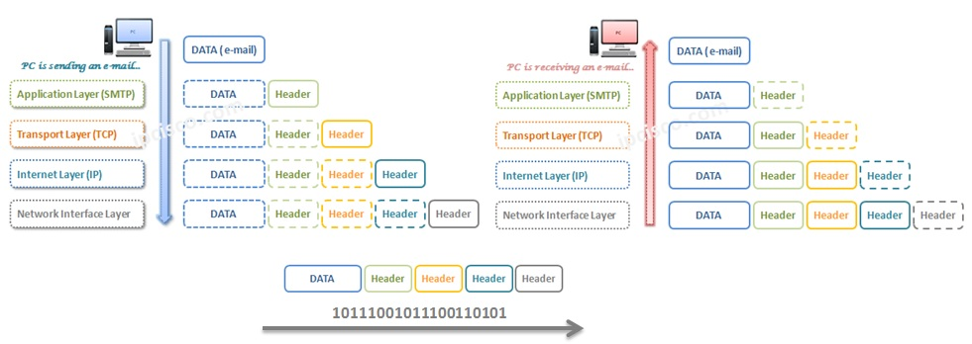
TCP/IP Model Email Example
https://ipcisco.com/lesson/tcp-ip-model/

Slide 18
Advantage and disadvantages of TCP/IP stack
Advantage
It is operated independently
It is scalable
Client/server architecture
Supports a number of routing protocols
Can be used to establish a connection between two computers
Disadvantages
The transport layer does not guarantee delivery of packets
The model cannot be used in any other application
Replacing protocol is not easy
It has not clearly separated its services, interfaces and protocols

Slide 19
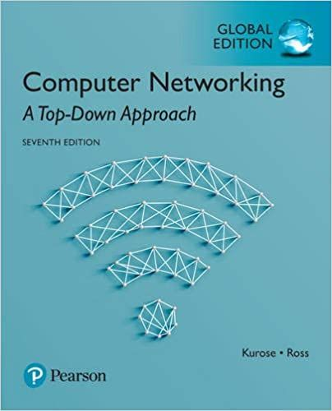

Thank You All
☺
?
A note on the origin of these ppt slides:
All material copyright 1996-2020 J.F Kurose and K.W. Ross, All Rights Reserved
These slides are freely provided by the book authors and it represents a lot of work on their part. We would like to thank J.F Kurose and K.W. Ross.

