Slide 1


Computer Networks
Week3_Lecture2 (Chapter1)
Security
Subhan Ullah, PhD
subhan.ullah@nu.edu.pk
BS(Computer Science) Fall-2024

Slide 2

Chapter 1: roadmap
What is the Internet?
What is a protocol?
Network edge: hosts, access network, physical media
Network core: packet/circuit switching, internet structure
Performance: loss, delay, throughput
Protocol layers, service models
Security
History

Slide 3
Chapter 1: roadmap
What is the Internet?
What is a protocol?
Network edge: hosts, access network, physical media
Network core: packet/circuit switching, internet structure
Performance: loss, delay, throughput
Protocol layers, service models
Security in Computer Network
History
Notes:
Segue: from performance to security.
Wartime, business, and love affair are the commonly cited human needs for secure communication. .

Slide 4
Network security
Internet not originally designed with (much) security in mind
original vision: “a group of mutually trusting users attached to a transparent network” ☺
Internet protocol designers playing “catch-up”
security considerations in all layers!
We now need to think about:
how bad guys can attack computer networks
how we can defend networks against attacks
how to design architectures that are immune to attacks

Slide 5

Bad guys: packet interception
packet “sniffing”:
broadcast media (shared Ethernet, wireless)
promiscuous network interface reads/records all packets (e.g., including passwords!) passing by
A
C
src:B dest:A payload
B
Notes:
Wireshark software used for our end-of-chapter labs is a (free) packet-sniffer.
Active and passive attacks.

Slide 6
Bad guys: fake identity
IP spoofing: injection of packet with false source address
A
C
src:B dest:A payload
B

Slide 7
Bad guys: denial of service
Denial of Service (DoS): attackers make resources (server, bandwidth) unavailable to legitimate traffic by overwhelming resource with bogus traffic
1. select target
2. break into hosts around the network (see botnet)
3. send packets to target from compromised hosts
target

Slide 8
Security: (overview)
Goals of the Lecture:
understand principles of network security:
cryptography and its many uses beyond “confidentiality”
authentication
message integrity

Slide 9
What is network security?
confidentiality: only sender, intended receiver should “understand” message contents
sender encrypts message
receiver decrypts message
authentication: sender, receiver want to confirm identity of each other
message integrity: sender, receiver want to ensure message not altered (in transit, or afterwards) without detection
access and availability: services must be accessible and available to users

Slide 10



Friends and enemies: Alice, Bob, Trudy
well-known in network security world
Bob, Alice (lovers!) want to communicate “securely”
Trudy (intruder) may intercept, delete, add messages
Alice
channel
data, control messages
Bob
secure
sender
secure
receiver
data
data
Trudy

Slide 11
Friends and enemies: Alice, Bob, Trudy
Who might Bob and Alice be?
… well, real-life Bobs and Alices!
Web browser/server for electronic transactions (e.g., on-line purchases)
on-line banking client/server
DNS servers
BGP routers exchanging routing table updates
other examples?
Notes:
Border Gateway Protocol (BGP): refers to a gateway protocol that enables the internet to exchange routing information between autonomous systems (AS).

Slide 12
There are bad guys out there!
Q: What can a “bad guy” do?
A: A lot!
eavesdrop: intercept messages
actively insert messages into connection
impersonation: can fake (spoof) source address in packet (or any field in packet)
hijacking: “take over” ongoing connection by removing sender or receiver, inserting himself in place
denial of service: prevent service from being used by others (e.g., by overloading resources)

Slide 13
Lines of defense:
authentication: proving you are who you say you are
cellular networks provides hardware identity via SIM card; no such hardware assist in traditional Internet
confidentiality: via encryption
integrity checks: digital signatures prevent/detect tampering
access restrictions: password-protected VPNs
firewalls: specialized “middleboxes” in access and core networks:
off-by-default: filter incoming packets to restrict senders, receivers, applications
detecting/reacting to DOS attacks
… lots more on security (throughout, Chapter 8)

Slide 14
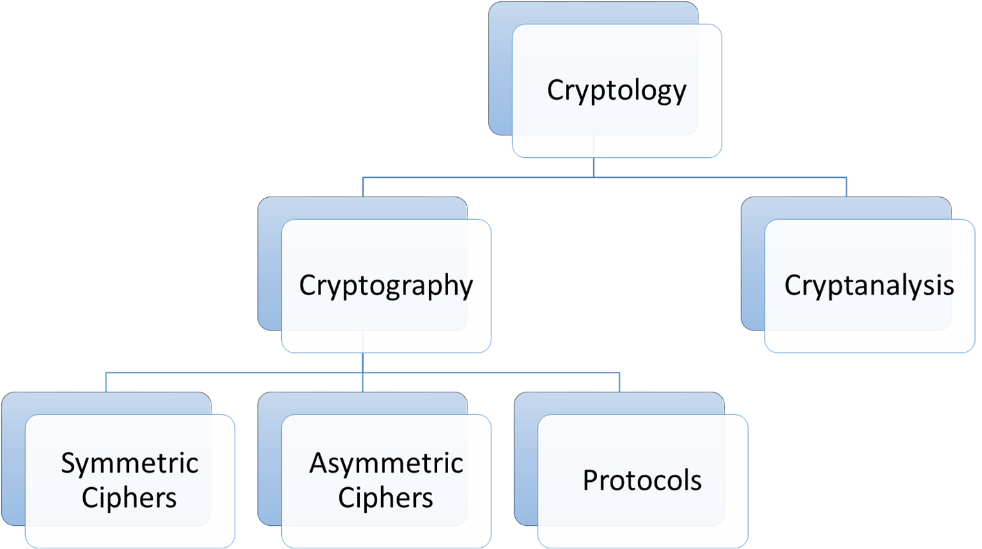
Cryptography overview
Cryptology
The most general term for the crypto field
Cryptography
Crypt means secret and graphy means writing
The science of secret writing with the goal of hiding the meaning of a message
Cryptanalysis
The science of breaking cryptosystems
The only way and an integral part of cryptology to assure that a cryptosystem is secure

Slide 15
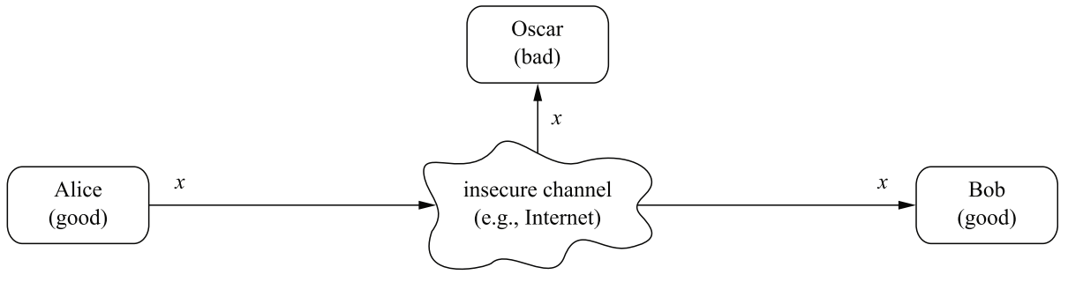
Motivation (cryptography)
Communication over an insecure channel (between Alice and Bob)
Confidentiality is required:
Data (x) need to be secure from unauthorized access (e.g., from eavesdropping attack by Oscar or Trudy)
Non-repudiation, Authentication, Integrity are also required
Source: Paar, Christof, and Jan Pelzl. Understanding cryptography: a textbook for students and practitioners. Springer Science & Business Media, 2009

Slide 16
The language of cryptography
Alice’s
encryption
key
Bob’s
decryption
key
K
A
K
B
plaintext
encryption
algorithm
ciphertext
decryption
algorithm
plaintext
m: plaintext message
K_{A}(m): ciphertext, encrypted with key K_{A}
m = K_{B}(K_{A}(m))

Slide 17
Symmetric key cryptography (overview)
Symmetric cryptographic schemes are also called shared-key, secret-key and single-key schemes
Parties use the same secret key for encryption and decryption
The encryption and decryption function are very similar (easy to implement)
Symmetric cryptography offers a powerful solution to prevent eavesdropping
No need to transfer key with messages
The set of all possible keys is called key space
Encryption/decryption algorithm is publicly known and key is secret
Modern symmetric algorithm such as AES are very secure, fast and are in widespread use

Slide 18
Symmetric key cryptography
K
K
S
S
plaintext
encryption
algorithm
ciphertext
decryption
algorithm
plaintext
K (m)
S
symmetric key crypto: Bob and Alice share same (symmetric) key: K
e.g., key is knowing substitution pattern in mono alphabetic substitution cipher
Q: how do Bob and Alice agree on key value?

Slide 19
Simple encryption scheme
substitution cipher: substituting one thing for another
monoalphabetic cipher: substitute one letter for another
plaintext: abcdefghijklmnopqrstuvwxyz
ciphertext: mnbvcxzasdfghjklpoiuytrewq
e.g.:
Plaintext: bob. i love you. alice
ciphertext: nkn. s gktc wky. mgsbc
Encryption key: mapping from set of 26 letters
to set of 26 letters
Notes:
Old one: Caesar cipher by Julius Caesar.
Polyalphabetic encryption

Slide 20
Symmetric key crypto: DES
DES: Data Encryption Standard
US encryption standard [NIST 1993]
56-bit symmetric key, 64-bit plaintext input
block cipher with cipher block chaining
how secure is DES?
DES Challenge: 56-bit-key-encrypted phrase can be decrypted (brute force) in less than a day
no known good analytic attack
making DES more secure:
3DES: encrypt 3 times with 3 different keys

Slide 21
AES: Advanced Encryption Standard
symmetric-key NIST standard, replaced DES (Nov 2001)
processes data in 128 bit blocks
128, 192, or 256 bit keys
brute force decryption (try each key) taking 1 sec on DES, takes 149 trillion years for AES

Slide 22
Breaking an encryption scheme
cipher-text only attack: Trudy has ciphertext she can analyze
two approaches:
brute force: search through all keys
statistical analysis
known-plaintext attack: Trudy has plaintext corresponding to ciphertext
e.g., in monoalphabetic cipher, Trudy determines pairings for a,l,i,c,e,b,o,
chosen-plaintext attack: Trudy can get ciphertext for chosen plaintext

Slide 23
Limitations of symmetric key cryptography
Key distribution problem: Sending a key directly over the communication channel is a convenient way for key distribution
However, symmetric key cryptosystem requires a secure channel
Dealing with large number of keys (manageability of keys)
If each pair of users needs a separate pair of keys in a network with n users, then there will be n ( n-1 ) keys 2
Each user needs to store (n- 1) keys securely
Some smarter approaches are used but they have single point of failure
No protection against cheating by users (e.g., Alice or Bob)
Non-repudiation is not possible
Hard to prove authenticity, and dictionary attacks due to static keys

Slide 24
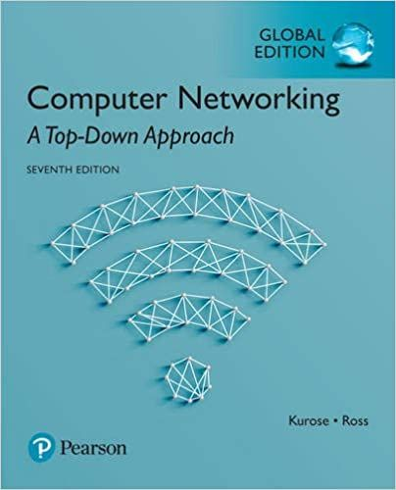
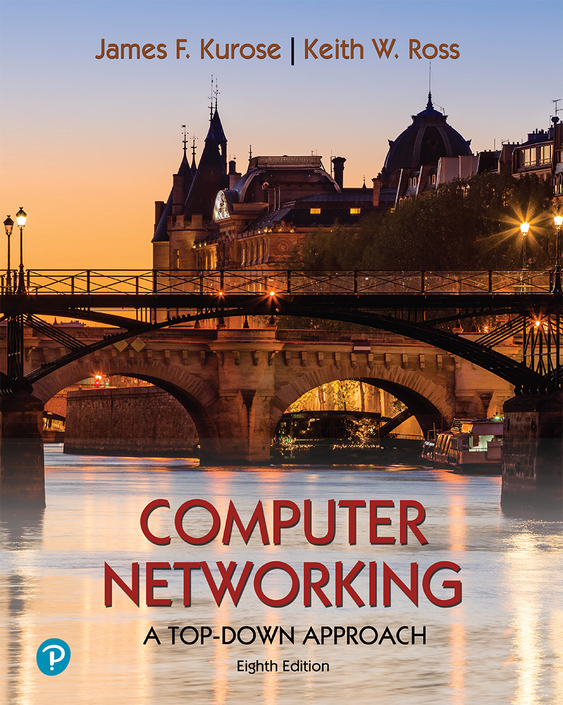
Thank You All
☺
?
A note on the origin of these ppt slides:
All material copyright 1996-2020 J.F Kurose and K.W. Ross, All Rights Reserved
These slides are freely provided by the book authors and it represents a lot of work on their part. We would like to thank J.F Kurose and K.W. Ross.

