Slide 1


Computer Networks
Week5_Lecture1 (Chapter1)
Security
Subhan Ullah, PhD
subhan.ullah@nu.edu.pk
BS(Computer Science) Fall-2024

Slide 2

Chapter 1: roadmap
What is the Internet?
What is a protocol?
Network edge: hosts, access network, physical media
Network core: packet/circuit switching, internet structure
Performance: loss, delay, throughput
Protocol layers, service models
Security
History

Slide 3
Chapter 1: roadmap
What is the Internet?
What is a protocol?
Network edge: hosts, access network, physical media
Network core: packet/circuit switching, internet structure
Performance: loss, delay, throughput
Protocol layers, service models
Security in Computer Network
History
Notes:
Segue: from performance to security.
Wartime, business, and love affair are the commonly cited human needs for secure communication. .

Slide 4

Public Key Cryptography
symmetric key crypto:
requires sender, receiver know shared secret key
Q: how to agree on key in first place (particularly if never “met”)?
public key crypto
radically different approach [Diffie-Hellman76, RSA78]
sender, receiver do not share secret key
public encryption key known to all
private decryption key known only to receiver
https://gomindsight.com/insights/blog/what-are-the-7-layers-of-security/

Slide 5


Public Key Cryptography
+
Bob’s public key
K
B
-
Bob’s private key
K
B
plaintext
message, m
encryption
algorithm
ciphertext
decryption
algorithm
plaintext
+
-
+
K (m)
m = K (K (m))
B
B
B
Wow - public key cryptography revolutionized 2000-year-old (previously only symmetric key) cryptography!
similar ideas emerged at roughly same time, independently in US and UK (classified)

Slide 6
Public key encryption algorithms
requirements:
+
.
-
.
1
need K ( ) and K ( ) such that
B
B
-
+
K (K (m)) = m
B
B
+
2
given public key K , it should be impossible to compute private key K
B
-
B
RSA: Rivest, Shamir, Adelson algorithm

Slide 7
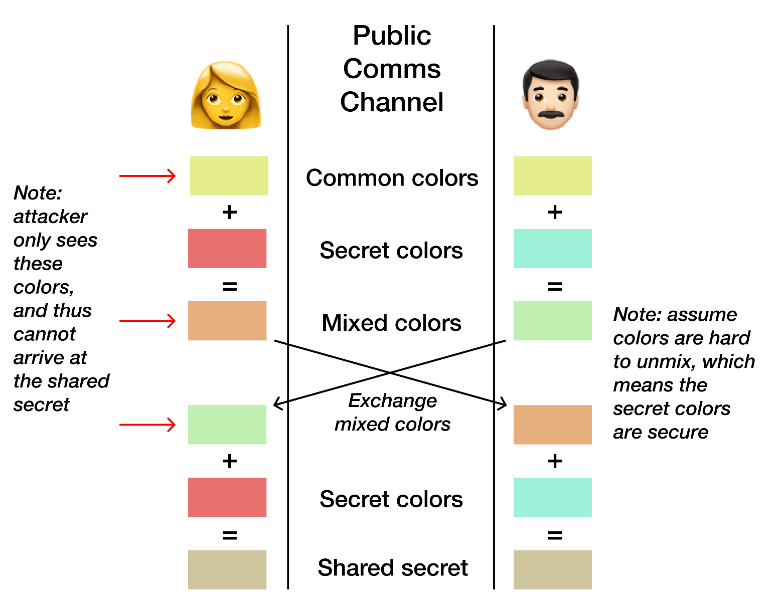
Diffie-Hellman key exchange (The big picture)
Alice
Bob
https://pencilflip.medium.com/diffie-hellman-key-exchange-7dba8e9e59d6

Slide 8
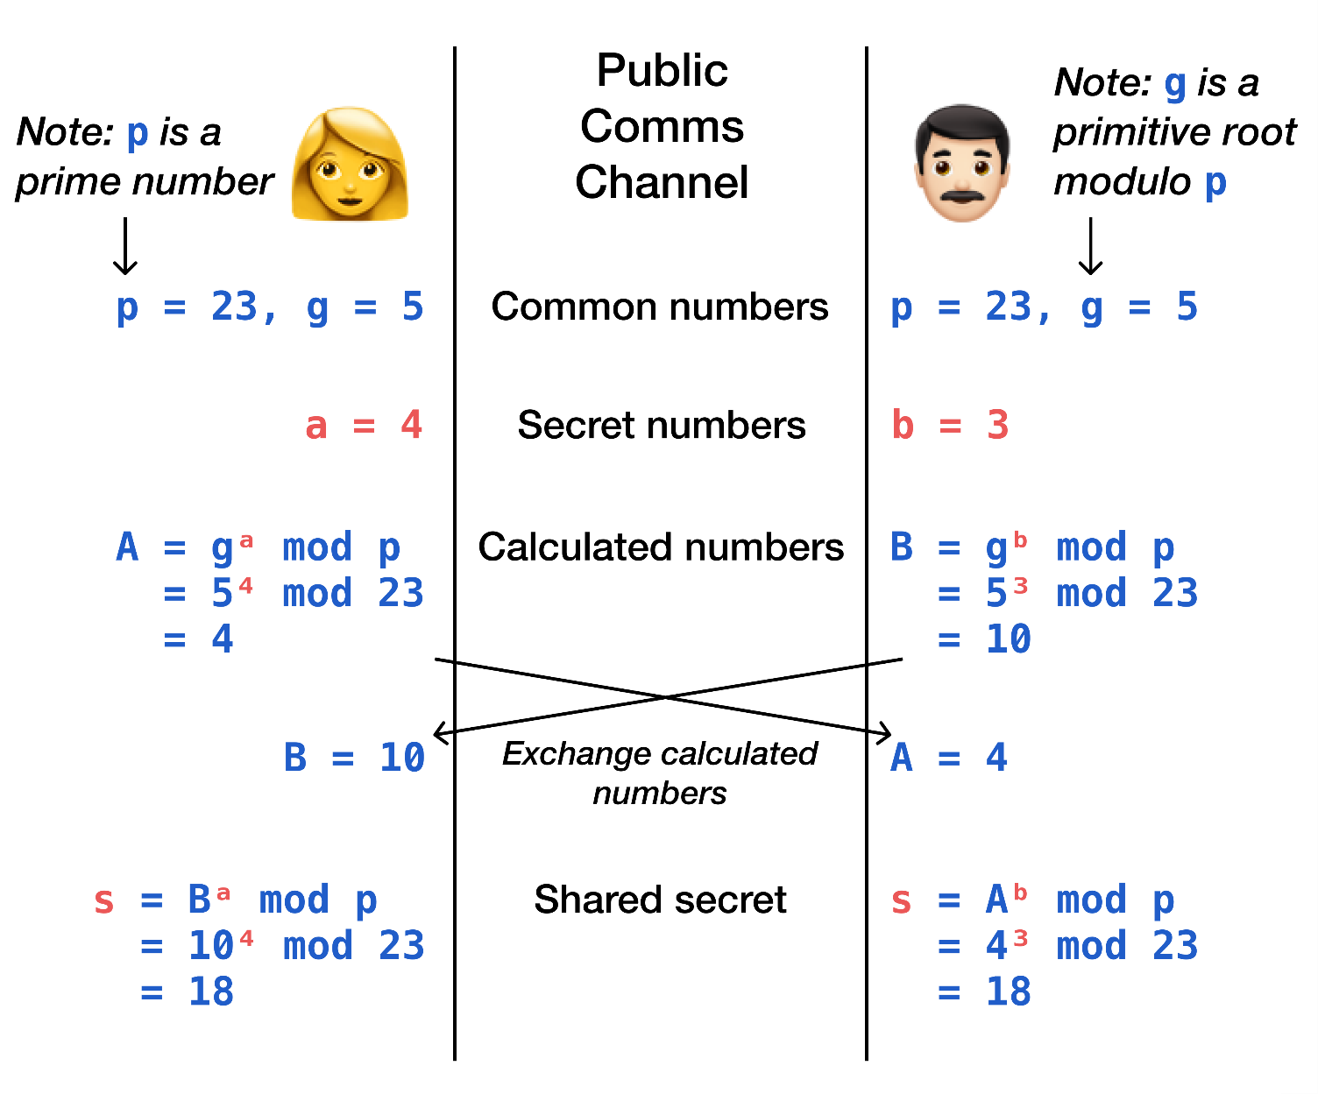
Cryptographic explanation of Diffie-Hellman KE
Alice
Bob
https://pencilflip.medium.com/diffie-hellman-key-exchange-7dba8e9e59d6

Slide 9
Cryptanalysis (recap)
The art and science of breaking crypto codes is called cryptanalysis
Attack Vectors
Security implementation
Cryptographic variable
Algorithms
Data
Social engineering
Trying all possible combinations (e.g., to find a Password)
The attacker systematically checks all possible passwords and passphrases until the correct one is found

Slide 10
Brute-force attack (Three factors)
Cost
How much money do you have for the computing devices
Time
How much time will be required
Computing power/ capability
Moore’s Law: which states that processor speeds, or overall processing power for computers will double every two years
Moore’s law depends on key space and work factor
Work factor is the amount of time required to break a cryptographic system

Slide 11

Authentication
Goal: Bob wants Alice to “prove” her identity to him
Protocol ap1.0: Alice says “I am Alice”
“I am Alice”
failure scenario??

Slide 12
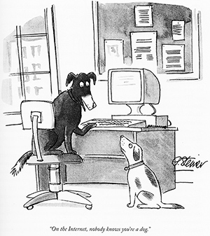
Authentication
Goal: Bob wants Alice to “prove” her identity to him
Protocol ap1.0: Alice says “I am Alice”
in a network, Bob can not “see” Alice, so Trudy simply declares herself to be Alice
“I am Alice”

Slide 13
Authentication: another try
Goal: Bob wants Alice to “prove” her identity to him
Protocol ap2.0: Alice says “I am Alice” in an IP packet containing her source IP address
Alice’s
IP address
“I am Alice”
failure scenario??

Slide 14
Authentication: another try
Goal: Bob wants Alice to “prove” her identity to him
Protocol ap2.0: Alice says “I am Alice” in an IP packet containing her source IP address
Trudy can create
a packet “spoofing”
Alice’s address
Alice’s
IP address
“I am Alice”

Slide 15
Authentication: a third try
Goal: Bob wants Alice to “prove” her identity to him
Protocol ap3.0: Alice says “I am Alice” and sends her secret password to “prove” it.
Alice’s
IP addr
Alice’s
password
“I am Alice”
failure scenario??
Alice’s
IP addr
OK

Slide 16
Authentication: a third try
Goal: Bob wants Alice to “prove” her identity to him
Protocol ap3.0: Alice says “I am Alice” and sends her secret password to “prove” it.
playback attack: Trudy records Alice’s packet
and later
plays it back to Bob
Alice’s
IP addr
Alice’s
password
“I am Alice”
Alice’s
IP addr
Alice’s
password
“I am Alice”
Alice’s
IP addr
OK

Slide 17
Authentication: a modified third try
Goal: Bob wants Alice to “prove” her identity to him
Protocol ap3.0: Alice says “I am Alice” and sends her encrypted secret password to “prove” it.
Alice’s
IP addr
encrypted
password
“I am Alice”
failure scenario??
Alice’s
IP addr
OK

Slide 18
Authentication: a modified third try
Goal: Bob wants Alice to “prove” her identity to him
Protocol ap3.0: Alice says “I am Alice” and sends her encrypted secret password to “prove” it.
Alice’s
IP addr
encrypted
password
“I am Alice”
playback attack still works: Trudy records Alice’s packet
and later plays it back to Bob
Alice’s
IP addr
encrypted
password
“I am Alice”
Alice’s
IP addr
OK

Slide 19
Authentication: a fourth try
Goal: avoid playback attack
nonce: number (R) used only once-in-a-lifetime
protocol ap4.0: to prove Alice “live”, Bob sends Alice nonce, R
Alice must return R, encrypted with shared secret key
“I am Alice”
R
K (R)
Bob know Alice is live, and only Alice knows key to encrypt nonce, so it must be Alice!
A-B
Failures, drawbacks?

Slide 20
Authentication: ap5.0
ap4.0 requires shared symmetric key - can we authenticate using public key techniques?
ap5.0: use nonce, public key cryptography
“I am Alice”
R
Bob computes
+
-
-
K
(K (R)) = R
K (R)
A
A
A
and knows only Alice could have the private key, that encrypted R such that
Send me your public key
+
K
+
-
A
K
A
(K (R)) = R
A

Slide 21
Authentication: ap5.0 – there’s still a flaw!
man (or woman) in the middle attack: Trudy poses as Alice (to Bob) and as Bob (to Alice)
I am Alice
I am Alice
?
R
-
K (R)
T
R
Where are mistakes made here?
Send me your public key
-
+
K (R)
K
Bob computes
A
T
+
-
Send me your public key
K
(K (R)) = R,
+
T
T
K
authenticating
Trudy as Alice
A
Trudy recovers m:
+
+
-
+
K (m)
Trudy recovers Bob’s m:
m = K (K (m))
Bob sends a personal message, m to Alice
-
+
K (m)
T
T
m = K (K (m))
A
T
A
A
sends m to Alice encrypted with Alice’s public key
and she and Bob meet a week later in person and discuss m, not knowing Trudy knows m

Slide 22
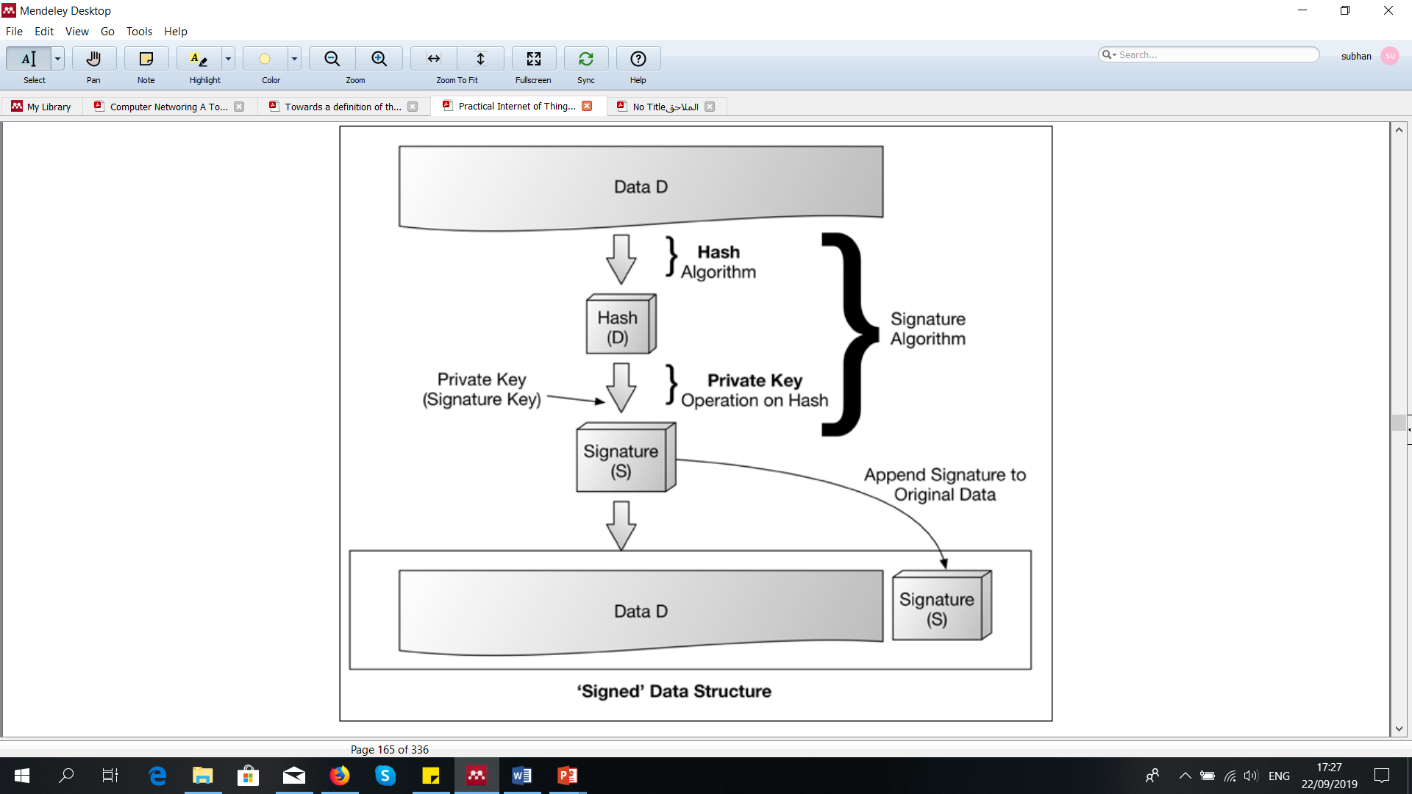
Digital Signature
Digital signature provides integrity, authentication, data origin, and nonrepudiation protections
Unique to the signer
The signature accompany the message ( signed message)
Signature verification using appropriate key
The data was, indeed, signed by a known or declared key
The data has not been corrupted or tampered
If the verification of signature fails, then the verifier should not trust the data integrity or whether it has originated from the right source
If the signature verification is successful, the data was indeed, signed by a known or declared key

Slide 23

Digital signatures (Example)
cryptographic technique analogous to hand-written signatures:
sender (Bob) digitally signs document: he is document owner/creator.
verifiable, nonforgeable: recipient (Alice) can prove to someone that Bob, and no one else (including Alice), must have signed document
simple digital signature for message m:
Bob signs m by encrypting with his private key K_{B}, creating “signed” message, K_{B}⁻(m)
-
-
Bob’s message, m
K
Bob’s private
key
m,K
(m)
B
B
Dear Alice
Oh, how I have missed you. I think of you all the time! …(blah blah blah)
Bob
Dear Alice
Oh, how I have missed you. I think of you all the time! …(blah blah blah)
Bob
Public key
encryption
algorithm
-
K
(m)
B

Slide 24
Digital signatures
-
suppose Alice receives msg m, with signature: m, K_{B}(m)
Alice verifies m signed by Bob by applying Bob’s public key K_{B} to K_{B}(m) then checks K_{B}(K_{B}(m) ) = m.
If K_{B}(K_{B}(m) ) = m, whoever signed m must have used Bob’s private key
+
-
+
-
+
-
Alice thus verifies that:
Bob signed m
no one else signed m
Bob signed m and not m’
non-repudiation:
Alice can take m, and signature K_{B}(m)to court and prove that Bob signed m
-

Slide 25
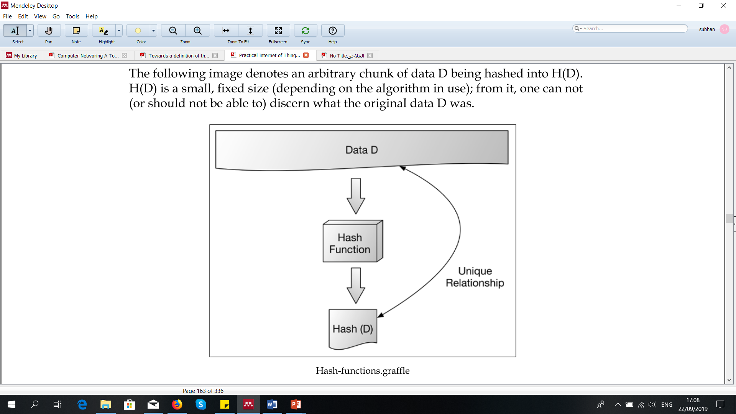
Cryptographic Hash algorithm
Hash is one-way and irreversible function
Hash is collision free function
Take variable sized inputs and create fixed size output or hashes
Produce a random looking value (e.g., hash value)
Protecting passwords and other authentication by hashing them
Checking the integrity of a large data
Preforming asymmetric Digital signatures
Foundation for message authentication codes (MAC)

Slide 26
Message digests
computationally expensive to public-key-encrypt long messages
goal: fixed-length, easy- to-compute digital “fingerprint”
apply hash function H to m, get fixed size message digest, H(m)
large
message
m
H: Hash
Function
H(m)
Hash function properties:
many-to-1
produces fixed-size msg digest (fingerprint)
given message digest x, computationally infeasible to find m such that x = H(m)

Slide 27
Digital signature = signed message digest
Bob sends digitally signed message:
Alice verifies signature, integrity of digitally signed message:
large
message
m
H: Hash
Function
H(m)
encrypted
message digest
-
K_{B}(H(m))
digital
signature
(encrypt)
Bob’s
private
key
large
message
m
-
K
B
digital
signature
(decrypt)
Bob’s
public
key
+
encrypted
message digest
H: Hash
function
K
B
+
-
K_{B}(H(m))
H(m)
H(m)
?
equal

Slide 28
Hash function algorithms
MD5 hash function widely used (RFC 1321)
computes 128-bit message digest in 4-step process.
arbitrary 128-bit string x, appears difficult to construct msg m whose MD5 hash is equal to x
SHA-1 is also used
US standard [NIST, FIPS PUB 180-1]
160-bit message digest

Slide 29
Authentication: ap5.0 – let’s fix it!!
Recall the problem: Trudy poses as Alice (to Bob) and as Bob (to Alice)
I am Alice
I am Alice
?
R
-
K (R)
T
R
Where are mistakes made here?
Send me your public key
-
+
K (R)
K
Bob computes
A
T
+
-
Send me your public key
K
(K (R)) = R,
+
T
T
K
authenticating
Trudy as Alice
A
Trudy recovers m:
+
-
+
+
Trudy recovers Bob’s m:
m = K (K (m))
K (m)
Bob sends a personal message, m to Alice
-
+
K (m)
T
T
m = K (K (m))
A
T
A
A
sends m to Alice encrypted with Alice’s public key
and she and Bob meet a week later in person and discuss m, not knowing Trudy knows m

Slide 30
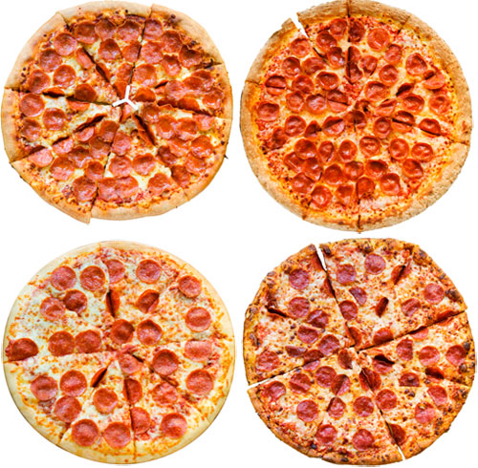

Need for certified public keys
motivation: Trudy plays pizza prank on Bob
Trudy creates e-mail order: Dear Pizza Store, Please deliver to me four pizzas. Thank you, Bob
Trudy signs order with her private key
Trudy sends order to Pizza Store
Trudy sends to Pizza Store her public key, but says it’s Bob’s public key
Pizza Store verifies signature; then delivers four pizzas to Bob
Bob doesn’t even like Pizza

Slide 31
Public key Certification Authorities (CA)
certification authority (CA): binds public key to particular entity, E
entity (person, website, router) registers its public key with CE provides “proof of identity” to CA
CA creates certificate binding identity E to E’s public key
certificate containing E’s public key digitally signed by CA: CA says “this is E’s public key”
Bob’s
public
key
digital
signature
(encrypt)
+
+
K
K
B
B
CA’s
private
key
-
certificate for Bob’s public key, signed by CA
Bob’s
identifying information
K
CA

Slide 32
Public key Certification Authorities (CA)
when Alice wants Bob’s public key:
gets Bob’s certificate (Bob or elsewhere)
apply CA’s public key to Bob’s certificate, get Bob’s public key
+
digital
signature
(decrypt)
Bob’s
public
key
K
+
B
K
B
CA’s
public
key
+
K
CA

Slide 33
Public key cryptosystem (advantage/limitations)
Advantages of asymmetric or public key cryptography
Two keys required (public and private)
Keys are more convenient to share among parties
Easy to manage the keys
Can use for generating digital signature (to achieve non-repudiation)
Provide better security
But asymmetric cryptography has also some limitations
Slower and requires more CPU power
Huge issues if private key is exposed
Man-in-the-Middle and Brute-force attack are possible
Decryption is not possible if a private key is lost

Slide 34
Chapter 1: summary
We’ve covered a “ton” of material!
Internet overview
what’s a protocol?
network edge, access network, core
packet-switching versus circuit-switching
Internet structure
performance: loss, delay, throughput
layering, service models
security
history
You now have:
context, overview, vocabulary, “feel” of networking
more depth, detail, and fun to follow!

Slide 35
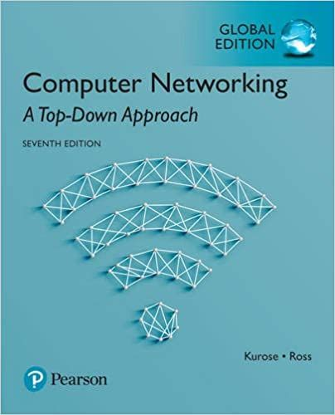
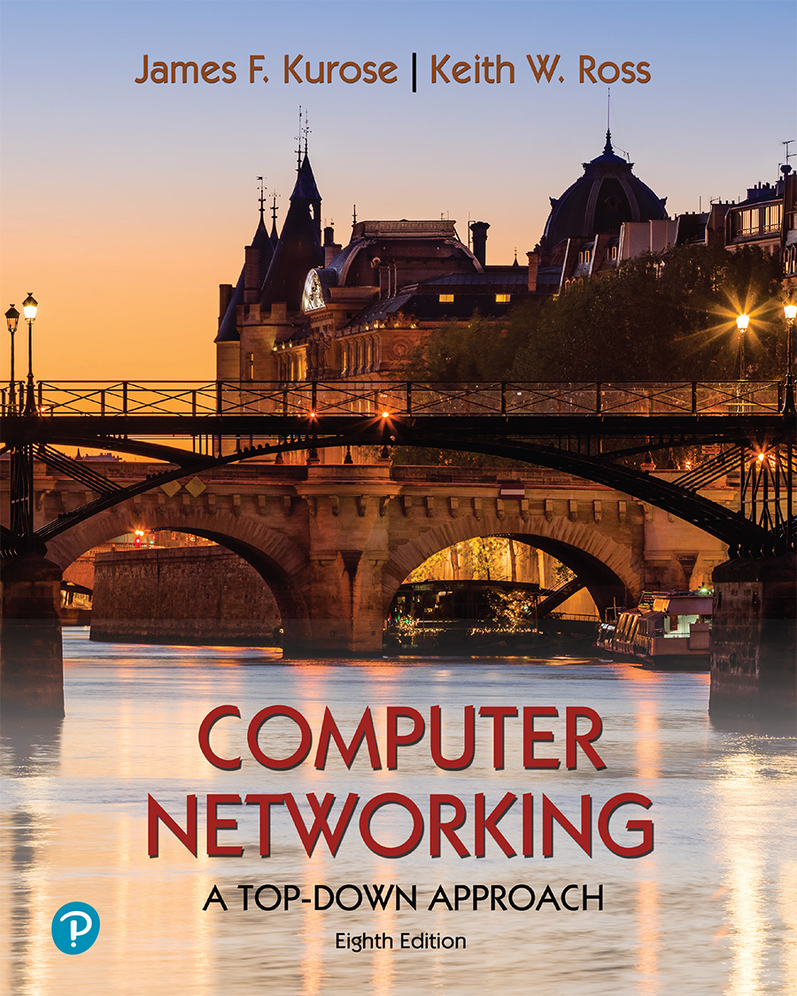
Thank You All
☺
?
A note on the origin of these ppt slides:
All material copyright 1996-2020 J.F Kurose and K.W. Ross, All Rights Reserved
These slides are freely provided by the book authors and it represents a lot of work on their part. We would like to thank J.F Kurose and K.W. Ross.

