Slide 1


Computer Networks
Week5_Lecture2 (Chapter2)
Application Layer
Subhan Ullah, PhD
subhan.ullah@nu.edu.pk
BS(Computer Science) Spring-2024

Slide 2

Application layer: overview
Principles of network applications
Web and HTTP
E-mail, SMTP, IMAP, FTP
The Domain Name System (DNS)
How Internet works: Recap of the previous chapter:
Recap: of the How Internet Works? : https://www.youtube.com/watch?v=x3c1ih2NJEg
Recap: of the OSI: https://www.youtube.com/watch?v=vv4y_uOneC0
Notes:
Internet Message Access Protocol(IMAP)

Slide 3
Application layer: overview
Our goals:
conceptual and implementation aspects of application-layer protocols
transport-layer service models
client-server paradigm
peer-to-peer paradigm
learn about protocols by examining popular application-layer protocols and infrastructure
HTTP
SMTP, IMAP
FTP
DNS
Notes:
Internet Message Access Protocol (IMAP)

Slide 4
Some network apps
social networking
Web
text messaging
e-mail
multi-user network games
streaming stored video (YouTube, Hulu, Netflix)
P2P file sharing
voice over IP (e.g., Skype)
real-time video conferencing (e.g., Zoom)
Internet search
remote login
…
Q: your favorites?
Notes:
Hulu: Stream TV and Movies Live and Online
https://www.hulu.com

Slide 5








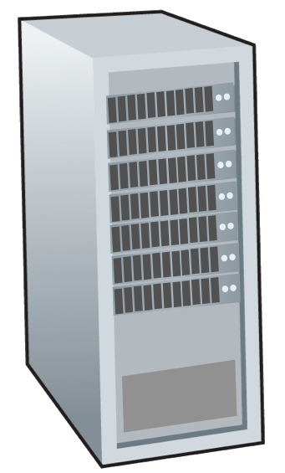







Creating a network app
application
transport
network
data link
physical
write programs that:
run on (different) end systems
communicate over network
e.g., web server software communicates with browser software
no need to write software for network-core devices
network-core devices do not run user applications
applications on end systems allows for rapid app development, propagation
mobile network
national or global ISP
local or regional ISP
home network
content
provider
network
application
transport
network
data link
physical
application
transport
network
data link
physical
datacenter
network
enterprise
network

Slide 6
Client-server paradigm
server:
always-on host
permanent IP address
often in data centers, for scaling
clients:
contact, communicate with server
may be intermittently connected
may have dynamic IP addresses
do not communicate directly with each other
examples: HTTP, IMAP, FTP
mobile network
national or global ISP
local or regional ISP
home network
content
provider
network
datacenter
network
enterprise
network
Notes:
Internet Message Access Protocol, or IMAP

Slide 7
Peer-peer architecture
no always-on server
arbitrary end systems directly communicate
peers request service from other peers, provide service in return to other peers
self scalability – new peers bring new service capacity, as well as new service demands
peers are intermittently connected and change IP addresses
complex management
example: P2P file sharing
mobile network
national or global ISP
local or regional ISP
home network
content
provider
network
datacenter
network
enterprise
network

Slide 8
Processes communicating
process: program running within a host
within same host, two processes communicate using inter-process communication (defined by OS)
processes in different hosts communicate by exchanging messages
clients, servers
client process: process that initiates communication
server process: process that waits to be contacted
note: applications with P2P architectures have client processes & server processes

Slide 9

Sockets
process sends/receives messages to/from its socket
socket analogous to door
sending process shoves message out door
sending process relies on transport infrastructure on other side of door to deliver message to socket at receiving process
two sockets involved: one on each side
application
socket
application
controlled by
app developer
process
process
transport
transport
network
network
controlled
by OS
link
Internet
link
physical
physical

Slide 10
Addressing processes
to receive messages, process must have identifier
host device has unique 32-bit IP address
Q: does IP address of host on which process runs suffice for identifying the process?
identifier includes both IP address and port numbers associated with process on host.
example port numbers:
HTTP server: 80
mail server: 25
to send HTTP message to gaia.cs.umass.edu web server:
IP address: 128.119.245.12
port number: 80
more shortly…
A: no, many processes can be running on same host

Slide 11
An application-layer protocol defines:
types of messages exchanged,
e.g., request, response
message syntax:
what fields in messages & how fields are delineated
message semantics
meaning of information in fields
rules for when and how processes send & respond to messages
open protocols:
defined in RFCs, everyone has access to protocol definition
allows for interoperability
e.g., HTTP, SMTP
proprietary protocols:
e.g., Skype, Zoom

Slide 12
What transport service does an app need?
data integrity
some apps (e.g., file transfer, web transactions) require 100% reliable data transfer
other apps (e.g., audio) can tolerate some loss
throughput
some apps (e.g., multimedia) require minimum amount of throughput to be “effective”
other apps (“elastic apps”) make use of whatever throughput they get
timing
some apps (e.g., Internet telephony, interactive games) require low delay to be “effective”
security
encryption, data integrity, …

Slide 13
Transport service requirements: common apps
application
file transfer/download
e-mail
Web documents
real-time audio/video
streaming audio/video
interactive games
text messaging
data loss
no loss
no loss
no loss
loss-tolerant
loss-tolerant
loss-tolerant
no loss
throughput
elastic
elastic
elastic
audio: 5Kbps-1Mbps
video:10Kbps-5Mbps
same as above
Kbps+
elastic
time sensitive?
no
no
no
yes, 10’s msec
yes, few secs
yes, 10’s msec
yes and no

Slide 14
Internet transport protocols services
TCP service:
reliable transport between sending and receiving process
flow control: sender won’t overwhelm receiver
congestion control: throttle sender when network overloaded
connection-oriented: setup required between client and server processes
does not provide: timing, minimum throughput guarantee, security
UDP service:
unreliable data transfer between sending and receiving process
does not provide: reliability, flow control, congestion control, timing, throughput guarantee, security, or connection setup.
Q: why bother? Why is there a UDP?

Slide 15
Internet applications, and transport protocols
application
layer protocol
FTP [RFC 959]
SMTP [RFC 5321]
HTTP 1.1 [RFC 7320]
SIP [RFC 3261], RTP [RFC 3550], or proprietary HTTP [RFC 7320], DASH
WOW, FPS (proprietary)
application
file transfer/download
e-mail
Web documents
Internet telephony
streaming audio/video
interactive games
transport protocol
TCP
TCP
TCP
TCP or UDP
TCP
UDP or TCP
Notes:
World of Warcraft is a massively multiplayer online role-playing game released in 2004 by Blizzard Entertainment.
First-person shooter (FPS) is a sub-genre of shooter video games centered on gun and other weapon-based combat in a first-person perspective, with the player experiencing the action through the eyes of the protagonist and controlling the player character in a three-dimensional space.
Session Initiation Protocol (SIP)
Real-time transport protocol (RTP)
Dynamic Adaptive Streaming over HTTP (DASH), also known as MPEG-DASH.

Slide 16
Securing TCP
TCP & UDP sockets:
no encryption
cleartext passwords sent into socket traverse Internet in cleartext (!)
Transport Layer Security (TLS)
provides encrypted TCP connections
data integrity
end-point authentication
TLS implemented in application layer
apps use TLS libraries, that use TCP in turn
cleartext sent into “socket” traverse Internet encrypted
more: Chapter 8

Slide 17
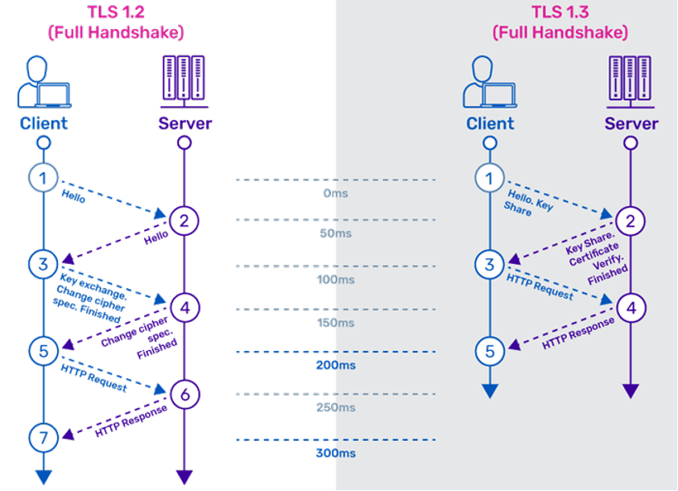
Transport Layer Security (Handshake)
Ref: https://www.a10networks.com/

Slide 18
Application layer: overview
Principles of network applications
Web and HTTP
E-mail, SMTP, IMAP, FTP
The Domain Name System DNS

Slide 19
Web and HTTP
First, a quick review…
web page consists of objects, each of which can be stored on different Web servers
object can be HTML file, JPEG image, Java applet, audio file,…
web page consists of base HTML-file which includes several referenced objects, each addressable by a URL, e.g.,
www.someschool.edu/someDept/pic.gif
host name
path name

Slide 20

HTTP overview
HTTP: hypertext transfer protocol
Web’s application-layer protocol
client/server model:
client: browser that requests, receives, (using HTTP protocol) and “displays” Web objects
server: Web server sends (using HTTP protocol) objects in response to requests
HTTP request
PC running
Firefox browser
HTTP response
HTTP request
server running
Apache Web
server
HTTP response
iPhone running
Safari browser

Slide 21
HTTP overview (continued)
HTTP uses TCP:
client initiates TCP connection (creates socket) to server, port 80
server accepts TCP connection from client
HTTP messages (application-layer protocol messages) exchanged between browser (HTTP client) and Web server (HTTP server)
TCP connection closed
HTTP is “stateless”
server maintains no information about past client requests
aside
protocols that maintain “state” are complex!
past history (state) must be maintained
if server/client crashes, their views of “state” may be inconsistent, must be reconciled

Slide 22
HTTP connections: two types
Non-persistent HTTP
TCP connection opened
at most one object sent over TCP connection
TCP connection closed
downloading multiple objects required multiple connections
Persistent HTTP
TCP connection opened to a server
multiple objects can be sent over single TCP connection between client, and that server
TCP connection closed

Slide 23
Non-persistent HTTP: example
User enters URL:
www.someSchool.edu/someDepartment/home.index
(containing text, references to 10 jpeg images)
1a. HTTP client initiates TCP connection to HTTP server (process) at www.someSchool.edu on port 80
1b. HTTP server at host www.someSchool.edu waiting for TCP connection at port 80 “accepts” connection, notifying client
2. HTTP client sends HTTP request message (containing URL) into TCP connection socket. Message indicates that client wants object someDepartment/home.index
3. HTTP server receives request message, forms response message containing requested object, and sends message into its socket
time

Slide 24
Non-persistent HTTP: example (cont.)
User enters URL:
www.someSchool.edu/someDepartment/home.index
(containing text, references to 10 jpeg images)
4. HTTP server closes TCP connection.
5. HTTP client receives response message containing html file, displays html. Parsing html file, finds 10 referenced jpeg objects
6. Steps 1-5 repeated for each of 10 jpeg objects
time

Slide 25
Non-persistent HTTP: response time
RTT (definition): time for a small packet to travel from client to server and back
HTTP response time (per object):
one RTT to initiate TCP connection
one RTT for HTTP request and first few bytes of HTTP response to return
object/file transmission time
initiate TCP
connection
RTT
request file
RTT
time to
transmit
file
file received
time
time
Non-persistent HTTP response time = 2RTT+ file transmission time

Slide 26
Persistent HTTP (HTTP 1.1)
Non-persistent HTTP issues:
requires 2 RTTs per object
OS overhead for each TCP connection
browsers often open multiple parallel TCP connections to fetch referenced objects in parallel
Persistent HTTP (HTTP1.1):
server leaves connection open after sending response
subsequent HTTP messages between same client/server sent over open connection
client sends requests as soon as it encounters a referenced object
as little as one RTT for all the referenced objects (cutting response time in half)

Slide 27
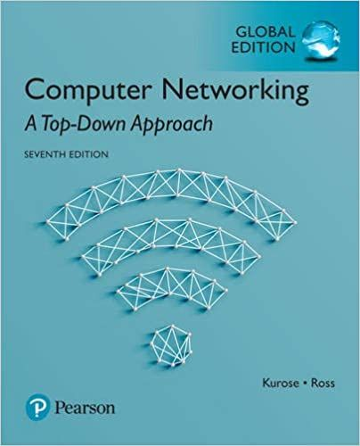

Thank You All
☺
?
A note on the origin of these ppt slides:
All material copyright 1996-2020 J.F Kurose and K.W. Ross, All Rights Reserved
These slides are freely provided by the book authors and it represents a lot of work on their part. We would like to thank J.F Kurose and K.W. Ross.

