Slide 1


Computer Networks
Week7_Lecture1 (Chapter2)
Application Layer
Subhan Ullah, PhD
subhan.ullah@nu.edu.pk
BS(Computer Science) Spring-2024

Slide 2
HTTP request message
two types of HTTP messages: request, response
HTTP request message:
ASCII (human-readable format)
carriage return character
request line (GET, POST,
HEAD commands)
line-feed character
GET /index.html HTTP/1.1\r\n
Host: www-net.cs.umass.edu\r\n
User-Agent: Mozilla/5.0 (Macintosh; Intel Mac OS X 10.15; rv:80.0) Gecko/20100101 Firefox/80.0 \r\n
Accept: text/html,application/xhtml+xml\r\n
Accept-Language: en-us,en;q=0.5\r\n
Accept-Encoding: gzip,deflate\r\n
Connection: keep-alive\r\n
\r\n
header
lines
carriage return, line feed at start of line indicates end of header lines
Notes:
Uniform resource Identifier (URI)

Slide 3
HTTP request message: general format
method
sp
URL
sp
version
cr
lf
request
line
header field name
value
cr
lf
~
~
header
lines
~
~
header field name
value
cr
lf
cr
lf
~
entity body
~
body
~
~

Slide 4
Other HTTP request messages
POST method:
web page often includes form input
user input sent from client to server in entity body of HTTP POST request message
HEAD method:
requests headers (only) that would be returned if specified URL were requested with an HTTP GET method.
PUT method:
uploads new file (object) to server
completely replaces file that exists at specified URL with content in entity body of POST HTTP request message
GET method (for sending data to server):
include user data in URL field of HTTP GET request message (following a ‘?’):
www.somesite.com/animalsearch?monkeys&banana
Notes:
POST: Create (submit data to the server)
GET: Read (retrieves data from the server)
PUT: Update (update data already on the server)
DELETE: delete contents (deletes data from the server)

Slide 5
HTTP response message
status line (protocol
status code status phrase)
HTTP/1.1 200 OK
Date: Tue, 08 Sep 2020 00:53:20 GMT
Server: Apache/2.4.6 (CentOS) OpenSSL/1.0.2k-fips PHP/7.4.9 mod_perl/2.0.11 Perl/v5.16.3
Last-Modified: Tue, 01 Mar 2016 18:57:50 GMT
ETag: "a5b-52d015789ee9e"
Accept-Ranges: bytes
Content-Length: 2651
Content-Type: text/html; charset=UTF-8
\r\n
data data data data data ...
header
lines
data, e.g., requested
HTML file
* Check out the online interactive exercises for more examples: http://gaia.cs.umass.edu/kurose_ross/interactive/

Slide 6
HTTP response status codes
status code appears in 1st line in server-to-client response message.
some sample codes:
200 OK
request succeeded, requested object later in this message
301 Moved Permanently
requested object moved, new location specified later in this message (in Location: field)
400 Bad Request
request msg not understood by server
404 Not Found
requested document not found on this server
505 HTTP Version Not Supported
Notes:
Range from 100-500
100-199->informational
200-299->successful/accepted
300-300->re-direct
400-499-> request not found
500-599->server failed to fulfil the apparently valid request.

Slide 7
Trying out HTTP (client side) for yourself
1. netcat to your favorite Web server:
% nc -c -v gaia.cs.umass.edu 80
opens TCP connection to port 80 (default HTTP server port) at gaia.cs.umass. edu.
anything typed in will be sent to port 80 at gaia.cs.umass.edu
2. type in a GET HTTP request:
GET /kurose_ross/interactive/index.php HTTP/1.1
Host: gaia.cs.umass.edu
by typing this in (hit carriage return twice), you send this minimal (but complete) GET request to HTTP server
3. look at response message sent by HTTP server!
(or use Wireshark to look at captured HTTP request/response)

Slide 8


Maintaining user/server state: cookies
Recall: HTTP GET/response interaction is stateless
no notion of multi-step exchanges of HTTP messages to complete a Web “transaction”
no need for client/server to track “state” of multi-step exchange
all HTTP requests are independent of each other
no need for client/server to “recover” from a partially-completed-but-never-completely-completed transaction
a stateful protocol: client makes two changes to X, or none at all
X
lock data record X
X
OK
update X X’
X’
OK
t’
update X X’’
OK
X’’
unlock X
OK
X’’
time
time
Q: what happens if network connection or client crashes at t’ ?
Notes:
t’

Slide 9
Maintaining user/server state: cookies
Web sites and client browser use cookies to maintain some state between transactions
four components:
1) cookie header line of HTTP response message
2) cookie header line in next HTTP request message
3) cookie file kept on user’s host, managed by user’s browser
4) back-end database at Web site
Example:
Susan uses browser on laptop, visits specific e-commerce site for first time
when initial HTTP requests arrives at site, site creates:
unique ID (aka “cookie”)
entry in backend database for ID
subsequent HTTP requests from Susan to this site will contain cookie ID value, allowing site to “identify” Susan
Notes:
t’

Slide 10
Maintaining user/server state: cookies
client
server
ebay 8734
usual HTTP request msg
Amazon server
creates ID
1678 for user
cookie file
usual HTTP response
set-cookie: 1678
backend
database
create
entry
ebay 8734
amazon 1678
usual HTTP request msg
cookie: 1678
cookie-
specific
action
access
usual HTTP response msg
one week later:
access
ebay 8734
amazon 1678
usual HTTP request msg
cookie: 1678
cookie-
specific
action
usual HTTP response msg
time
time
Notes:
t’

Slide 11
HTTP cookies: comments
aside
What cookies can be used for:
authorization
shopping carts
recommendations
user session state (Web e-mail)
cookies and privacy:
cookies permit sites to learn a lot about you on their site.
third party persistent cookies (tracking cookies) allow common identity (cookie value) to be tracked across multiple web sites
Challenge: How to keep state?
at protocol endpoints: maintain state at sender/receiver over multiple transactions
in messages: cookies in HTTP messages carry state
Notes:
t’

Slide 12

Web caches
Goal: satisfy client requests without involving origin server
user configures browser to point to a (local) Web cache
browser sends all HTTP requests to cache
if object in cache: cache returns object to client
else cache requests object from origin server, caches received object, then returns object to client
Web
cache
HTTP request
HTTP request
client
HTTP response
HTTP response
origin
server
HTTP request
HTTP response
client
Notes:
t’

Slide 13


Web caches (aka proxy servers)
Web cache acts as both client and server
server for original requesting client
client to origin server
Why Web caching?
reduce response time for client request
cache is closer to client
reduce traffic on an institution’s access link
Internet is dense with caches
enables “poor” content providers to more effectively deliver content
server tells cache about object’s allowable caching in response header:
Notes:
re: poor content providers – like in real-estate, location is everything. servers want to be close to clients.

Slide 14
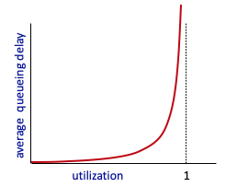


Caching example
Scenario:
access link rate: 1.54 Mbps
RTT from institutional router to server: 2 sec
web object size: 100K bits
average request rate from browsers to origin servers: 15/sec
avg data rate to browsers: 1.50 Mbps
origin
servers
public
Internet
1.54 Mbps
access link
Performance:
access link utilization = .97
LAN utilization: .0015
end-end delay = Internet delay +
access link delay + LAN delay
= 2 sec + minutes + usecs
problem: large queueing delays at high utilization!
institutional
network
1 Gbps LAN
Notes:
explain why minutes (recall earlier delay versus arrival rate curve from Chapter 1)
Total data request is 15*100 kb= 1500K bits
Average data rate = 1500K b/s 0r 1500/1000 Mbps = 1.50 Mbps
Access link utilization: 1.50/1.54 =97.4….
LAN utilization: 1.50/1 Gbps= 1.5/1000 mbps= .0015 mbps

Slide 15
Option 1: buy a faster access link
Scenario:
access link rate: 1.54 Mbps
RTT from institutional router to server: 2 sec
web object size: 100K bits
average request rate from browsers to origin servers: 15/sec
avg data rate to browsers: 1.50 Mbps
154 Mbps
origin
servers
public
Internet
154 Mbps
1.54 Mbps
access link
Performance:
access link utilization = .97
LAN utilization: .0015
end-end delay = Internet delay +
access link delay + LAN delay
= 2 sec + minutes + usecs
.0097
institutional
network
1 Gbps LAN
Cost: faster access link (expensive!)
msecs
Notes:
Access link utilization: 1.50/154 =.0097.4….
LAN utilization: 1.50/1 Gbps= 1.5/1000 mbps= .0015 mbps

Slide 16
Option 2: install a web cache
Scenario:
access link rate: 1.54 Mbps
RTT from institutional router to server: 2 sec
web object size: 100K bits
average request rate from browsers to origin servers: 15/sec
avg data rate to browsers: 1.50 Mbps
origin
servers
public
Internet
1.54 Mbps
access link
Cost: web cache (cheap!)
institutional
network
Performance:
LAN utilization: .?
access link utilization = ?
average end-end delay = ?
1 Gbps LAN
How to compute link
utilization, delay?
local web cache
Notes:
t’

Slide 17
Calculating access link utilization, end-end delay with cache:
suppose cache hit rate is 0.4:
40% requests served by cache, with low (msec) delay
origin
servers
public
Internet
60% requests satisfied at origin
rate to browsers over access link
= 0.6 * 1.50 Mbps = .9 Mbps
access link utilization = 0.9/1.54 = .58 means low (msec) queueing delay at access link
1.54 Mbps
access link
institutional
network
average end-end delay:
= 0.6 * (delay from origin servers)
+ 0.4 * (delay when satisfied at cache)
= 0.6 (2.01) + 0.4 (~msecs) = ~ 1.2 secs
1 Gbps LAN
local web cache
lower average end-end delay than with 154 Mbps link (and cheaper too!)
Notes:
t’

Slide 18
Conditional GET
client
server
Goal: don’t send object if cache has up-to-date cached version
no object transmission delay (or use of network resources)
client: specify date of cached copy in HTTP request
If-modified-since: <date>
server: response contains no object if cached copy is up-to-date:
HTTP/1.0 304 Not Modified
HTTP request msg
If-modified-since: <date>
object
not
modified
before
<date>
HTTP response
HTTP/1.0
304 Not Modified
HTTP request msg
If-modified-since: <date>
object
modified
after
<date>
HTTP response
HTTP/1.0 200 OK
<data>
Notes:
t’

Slide 19
HTTP/2
Key goal: decreased delay in multi-object HTTP requests
HTTP1.1: introduced multiple, pipelined GETs over single TCP connection
server responds in-order (FCFS: first-come-first-served scheduling) to GET requests
with FCFS, small object may have to wait for transmission (head-of-line (HOL) blocking) behind large object(s)
loss recovery (retransmitting lost TCP segments) stalls object transmission
Notes:
t’

Slide 20
HTTP/2
Key goal: decreased delay in multi-object HTTP requests
HTTP/2: [RFC 7540, 2015] increased flexibility at server in sending objects to client:
methods, status codes, most header fields unchanged from HTTP 1.1
transmission order of requested objects based on client-specified object priority (not necessarily FCFS)
push unrequested objects to client
divide objects into frames, schedule frames to mitigate HOL blocking
Notes:
t’

Slide 21
HTTP/2: mitigating HOL blocking
HTTP 1.1: client requests 1 large object (e.g., video file) and 3 smaller objects
server
GET O₄
GET O₃
GET O₂
GET O₁
object data requested
client
O₁
O₂
O₁
O₃
O₂
O₃
O₄
O₄
objects delivered in order requested: O₂, O₃, O₄ wait behind O₁
Notes:
t’

Slide 22
HTTP/2: mitigating HOL blocking
HTTP/2: objects divided into frames, frame transmission interleaved
server
GET O₄
GET O₃
GET O₂
GET O₁
object data requested
client
O₂
O₄
O₃
O₁
O₂
O₃
O₄
O₁
O₂, O₃, O₄ delivered quickly, O₁ slightly delayed
Notes:
shortest job first: decreased average delay!

Slide 23
HTTP/2 to HTTP/3
HTTP/2 over single TCP connection means:
recovery from packet loss still stalls all object transmissions
as in HTTP 1.1, browsers have incentive to open multiple parallel TCP connections to reduce stalling, increase overall throughput
no security over vanilla TCP connection
HTTP/3: adds security, per object error- and congestion-control (more pipelining) over UDP
more on HTTP/3 in transport layer
Notes:
Vanilla is an ordinary connection, with no special or extra features.

Slide 24
SMTP: observations
comparison with HTTP:
HTTP: client pull
SMTP: client push
both have ASCII command/response interaction, status codes
HTTP: each object encapsulated in its own response message
SMTP: multiple objects sent in multipart message
SMTP uses persistent connections
SMTP requires message (header & body) to be in 7-bit ASCII
SMTP server uses CRLF.CRLF to determine end of message
Notes:
Carriage Return Line Feed (CRLF).

Slide 25
Mail message format
SMTP: protocol for exchanging e-mail messages, defined in RFC 5321 (like RFC 7231 defines HTTP)
RFC 2822 defines syntax for e-mail message itself (like HTML defines syntax for web documents)
header lines, e.g.,
To:
From:
Subject:
these lines, within the body of the email message area different from SMTP MAIL FROM:, RCPT TO: commands!
Body: the “message” , ASCII characters only
header
blank
line
body
Notes:
>nslookup -type=MX subhan.ullah@nu.edu.pk

Slide 26


Retrieving email: mail access protocols
user
agent
e-mail access
protocol
user
agent
SMTP
SMTP
(e.g., IMAP, HTTP)
sender’s e-mail
server
receiver’s e-mail
server
SMTP: delivery/storage of e-mail messages to receiver’s server
mail access protocol: retrieval from server
IMAP: Internet Mail Access Protocol [RFC 3501]: messages stored on server, IMAP provides retrieval, deletion, folders of stored messages on server
HTTP: gmail, Hotmail, Yahoo!Mail, etc. provides web-based interface on top of STMP (to send), IMAP (or POP) to retrieve e-mail messages

Slide 27
FTP: the file transfer protocol
file transfer
FTP
user
interface
FTP
client
FTP
server
user
at host
remote file
system
local file
system
transfer file to/from remote host
client/server model
client: side that initiates transfer (either to/from remote)
server: remote host
ftp: RFC 959
ftp server: port 21

Slide 28
FTP: separate control, data connections
TCP control connection,
server port 21
FTP client contacts FTP server at port 21, using TCP
client authorized over control connection
client browses remote directory, sends commands over control connection (username and password, commands to change remote directory, and commands to “put” and “get” files)
when server receives file transfer command, server opens 2nd TCP data connection (for file) to client
after transferring one file, server closes data connection
FTP
client
TCP data connection,
server port 20
FTP
server
server opens another TCP data connection to transfer another file
control connection: “out of band”
FTP server maintains “state”: current directory, earlier authentication
HTTP “in-band” sends request and response header lines into the same TCP connection that carries the transferred file itself

Slide 29
FTP commands, responses
sample commands:
sent as ASCII text over control channel
USER username
PASS password
LIST return list of file in current directory
RETR filename retrieves (gets) file
STOR filename stores (puts) file onto remote host
sample return codes
status code and phrase (as in HTTP)
331 Username OK, password required
125 data connection already open; transfer starting
425 Can’t open data connection
452 Error writing file
FTP in 2021: Top Examples of Common & Unique Uses
https://www.exavault.com/blog/ftp-in-action-newsletter

Slide 30
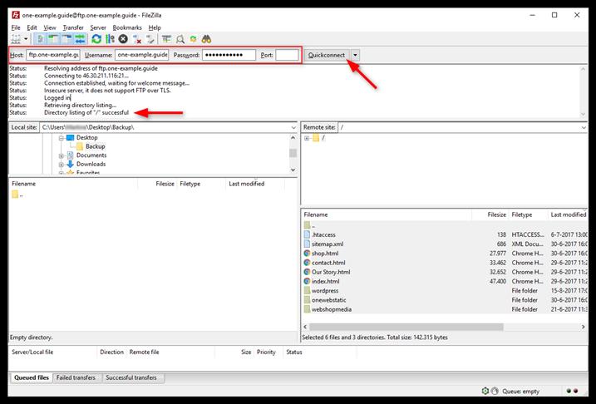
Login Filezilla via FTP
Notes:
Filezilla
Host = ftp.yourdomain.com Username = yourdomain.com Password = The password you chose under FTP & SSH

Slide 31
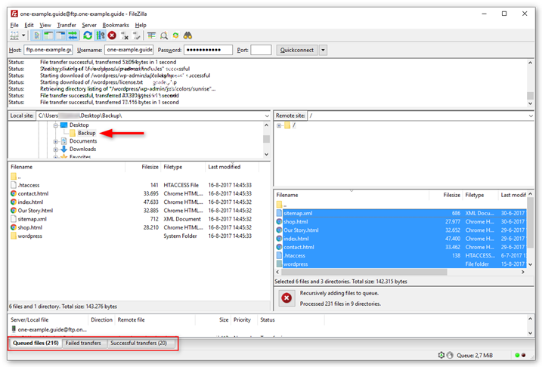
Accessing files from website using Filezilla

Slide 32


Thank You All
☺
?
A note on the origin of these ppt slides:
All material copyright 1996-2020 J.F Kurose and K.W. Ross, All Rights Reserved
These slides are freely provided by the book authors and it represents a lot of work on their part. We would like to thank J.F Kurose and K.W. Ross.

