Slide 1


Encryption Techniques for Secure Database Storage
Safeguarding Data Integrity and Privacy in Modern Systems

Slide 2
Need for DB Encryption
Rising threats to data confidentiality in the digital era.
Sensitive information at risk.
Legal and regulatory compliance requirements.
maintaining trust and operational integrity.

Slide 3
Background for the Need of Encrypting Databases
Insufficient Traditional security methods
Growing use of cloud storage

Slide 4
Examples of Major Breaches
Equifax (2017)
Records Exposed: 147 million
Cause: Failure to patch a known vulnerability in Apache Struts (a web application framework) led to unauthorized access.
Yahoo (2013–2014)
Records Exposed: 3 billion accounts
Cause: Weak encryption practices (MD5 hashing) made it easier for attackers to steal and decrypt account information.

Slide 5
Current Techniques
Transparent Data Encryption (TDE)
Strength: Seamless integration.
Limitation: Performance overhead under heavy workloads.
Column-Level Encryption
Strength: Granular security.
Limitation: Complicates query efficiency.
Homomorphic Encryption
Strength: Enables computation on encrypted data.
Limitation: Computationally intensive.
Order-Preserving Encryption (OPE)
Strength: Facilitates range queries.
Limitation: Security trade-offs due to plaintext order leakage.

Slide 6
Hybrid Encrypted Query Processing Framework

Slide 7
Features
Integrates multiple encryption methods.
Adaptive encryption based on query requirements
Balances security, performance, and query efficiency

Slide 8
Advantages
Reduced computational overhead.
Enhanced adaptability to diverse database applications.
Cost-effective implementation compared to standalone advanced techniques.

Slide 9
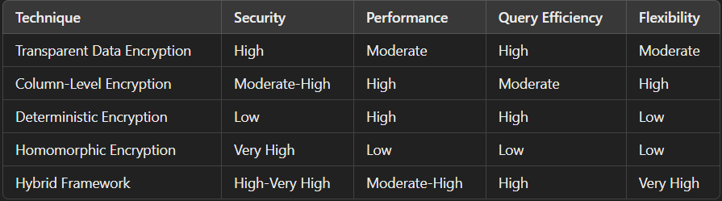
Comparison

Slide 10
Practical Applications
Financial institutions
Healthcare
E-commerce
Cloud storage

Slide 11
Conclusion
Encryption is essential
1
No single method is universally optimal.
2
The proposed framework better?
3

