Slide 1
Design, Approach, and Solution
A comprehensive system for managing client health information

Slide 2
Agenda
Introduction
Problem Statement
Objectives
Approach & Methodology
Technology Stack
System Design
Database Architecture
Features & Implementation
User Interface
Challenges & Solutions
Demo & Screenshots
Future Enhancements
Conclusion

Slide 3
1. Introduction
A comprehensive health information system for healthcare providers
Manages clients, health programs, and client enrollments
Secure and user-friendly web application
Built using modern technologies (Django & REST Framework)

Slide 4
2. Problem Statement
Manual record-keeping systems
Difficulty tracking patient enrollment in multiple programs
Limited data sharing across departments
Inefficient client search and retrieval
Lack of standardized data collection

Slide 5
3. Objectives
Create a centralized client health information repository
Enable efficient program management
Facilitate client registration and program enrollment
Provide robust search capabilities
Expose data via secure APIs for integration
Ensure data security and user authentication

Slide 6
4. Approach & Methodology
Iterative development with frequent feedback
User-centered design principles
Mobile-first responsive design
Test-driven development
Requirement gathering and analysis
System design and architecture
Database schema design
Core functionality implementation
User interface development
API development
Testing and quality assurance
Deployment and documentation

Slide 7
5. Technology Stack
Python 3.8+
Django 5.0 (Web framework)
Django REST Framework (API)
SQLite (Database, can be migrated to PostgreSQL)
HTML5, CSS3, JavaScript
Bootstrap 5 (Responsive design)
AJAX for asynchronous data loading
Git (Version control)
GitHub (Repository hosting)
VS Code (Development environment)

Slide 8
6. System Design
Model-View-Template (MVT) pattern
RESTful API architecture
Session-based authentication
Responsive frontend design
Authentication system
Client management module
Program management module
Enrollment system
Search functionality
API endpoints

Slide 9
7. Database Architecture
User (Django built-in)
Client
HealthProgram
Enrollment (Junction table)
Client ←→ HealthProgram (Many-to-Many through Enrollment)
User ←→ Client (One-to-Many)

Slide 10
8. Features & Implementation (1/2)
Secure login/logout functionality
User registration with profile information
Role-based permissions (future enhancement)
Create and manage health programs (TB, HIV, etc.)
Program status tracking (Active, Completed, Discontinued)
Filtering and search capabilities
Comprehensive client registration
Client search functionality
Client profile management
Enroll clients in multiple programs
Track enrollment status
Monitor client participation

Slide 11
9. User Interface
Intuitive navigation
Responsive layout for all devices
Consistent visual language
Accessibility considerations
Clean and professional aesthetic
Dashboard for a quick overview
Card-based program display
Client search and profile views
Modal forms for data entry
Status indicators and filters

Slide 12
10. Challenges & Solutions
Complex relationships between entities
Ensuring system performance with large datasets
Intuitive UI for non-technical users
Secure API implementation
Optimized database schema design
Efficient query optimization
User experience research and iterative design
Implementing proper authentication and permissions

Slide 13
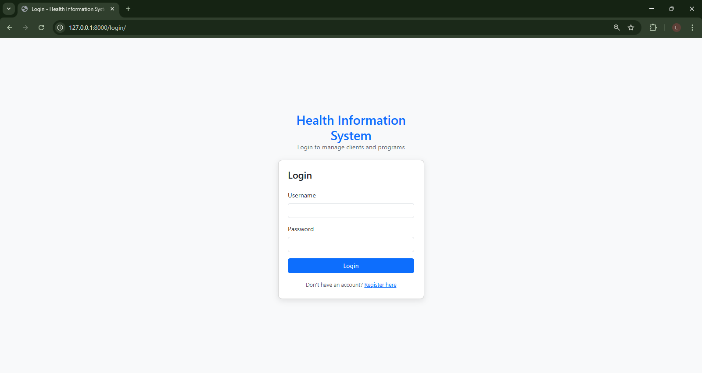
11. Demo & Screenshots (1/2)

Slide 14
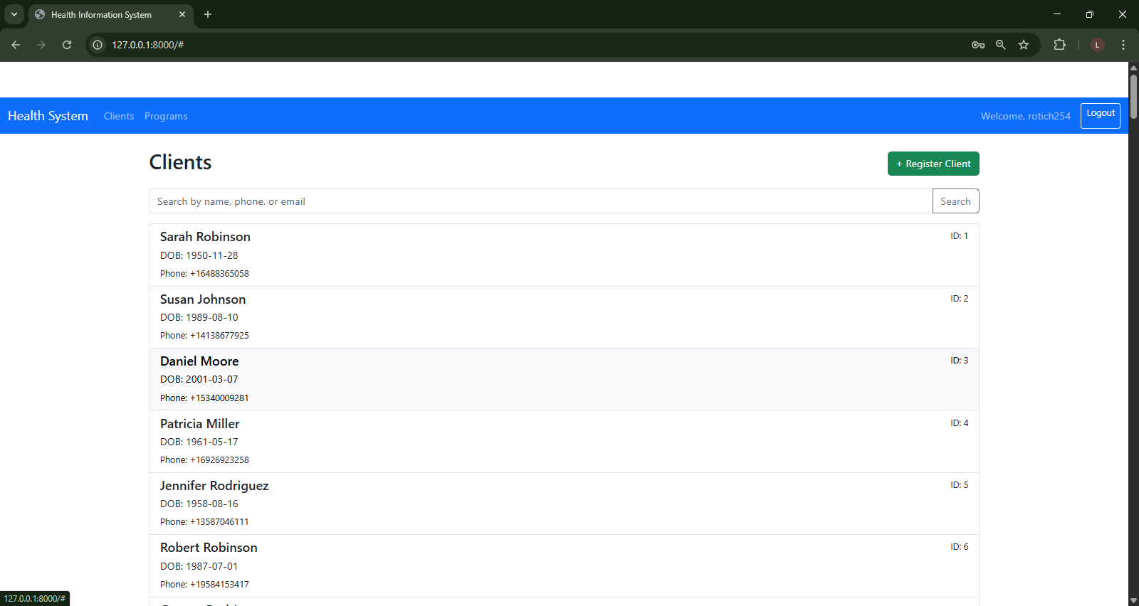
11. Demo & Screenshots (2/4)

Slide 15
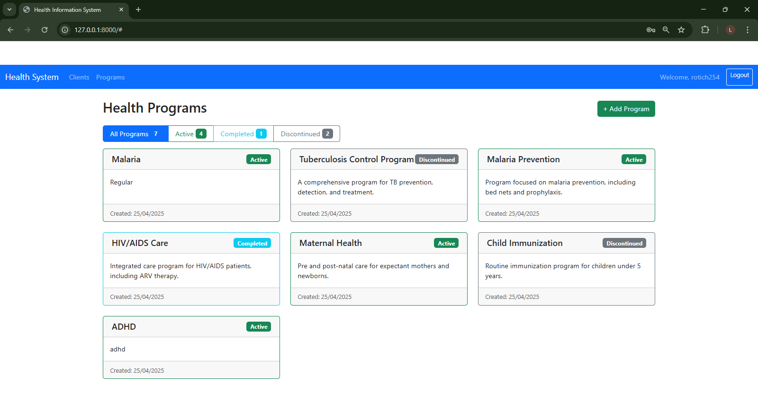
11. Demo & Screenshots (3/4)

Slide 16
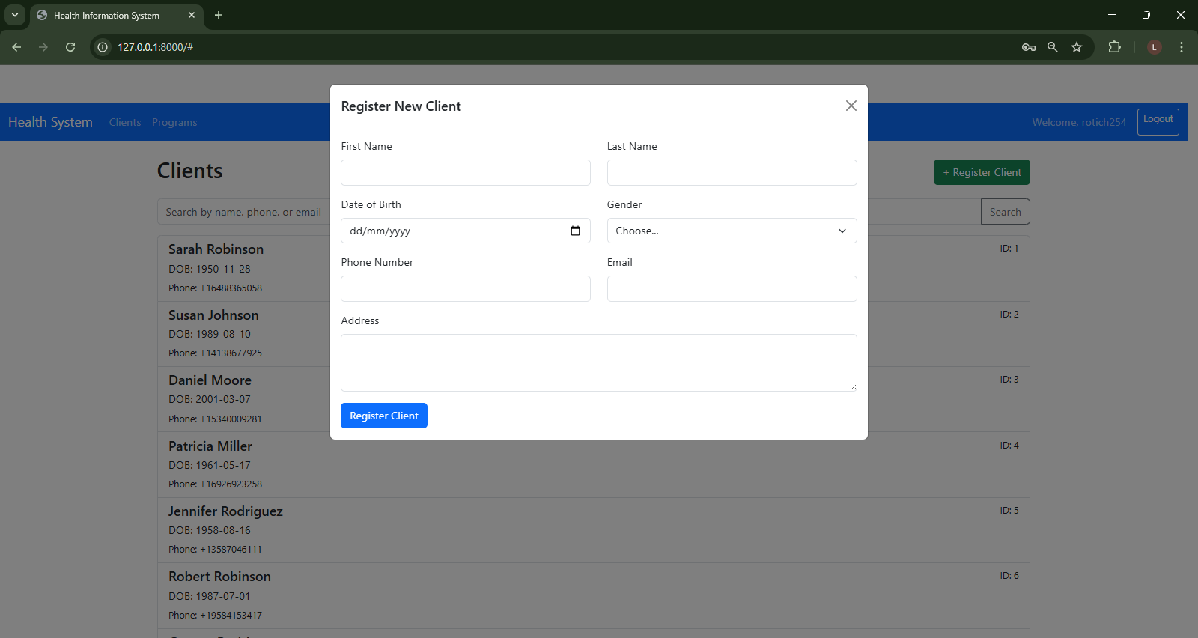
11. Demo & Screenshots (4/4)

Slide 17
12. Future Enhancements
Advanced Reporting: Generate custom reports and analytics
Mobile Application: Native mobile interface for field workers
Offline Capability: Work without internet connection
Multilingual Support: Interface in multiple languages
Integration: Connect with other healthcare systems via APIs
Document Management: Upload and manage client documents
Appointment Scheduling: Schedule and manage client appointments

Slide 18
13. Conclusion
Improved client data management
Enhanced program tracking
Efficient client search and retrieval
Centralized information repository
Secure and controlled access
API for system integration
User-centered design
Modern technology stack
Scalable architecture
Comprehensive documentation

Slide 19
Thank You!
Repository: https://github.com/rotich254/health_info_system.git
Contact: rotichk254@gmail.com

