Slide 1
CCA-F
Claude Certified Architect — Foundations
Exam-Ready Study Deck
60 questions · 120 minutes · pass = 720/1000
5 weighted domains · 4 of 8 scenarios sampled per attempt

Slide 2
Agenda
• Exam overview & domain weighting
• Theory: 13 chapters across the Claude API, Agent SDK, MCP, Claude Code
• Domain-by-domain checklist (5 domains)
• The 8 production scenarios
• Cheat sheet — patterns the exam keeps testing
• Practice questions with answers and explanations
• Practical labs — what to actually build
• Recommended resources & 4-week roadmap
• Out-of-scope topics — don't waste study time here
CCA-F Study Kit · Anthropic Skilljar prep + community guides

Slide 3
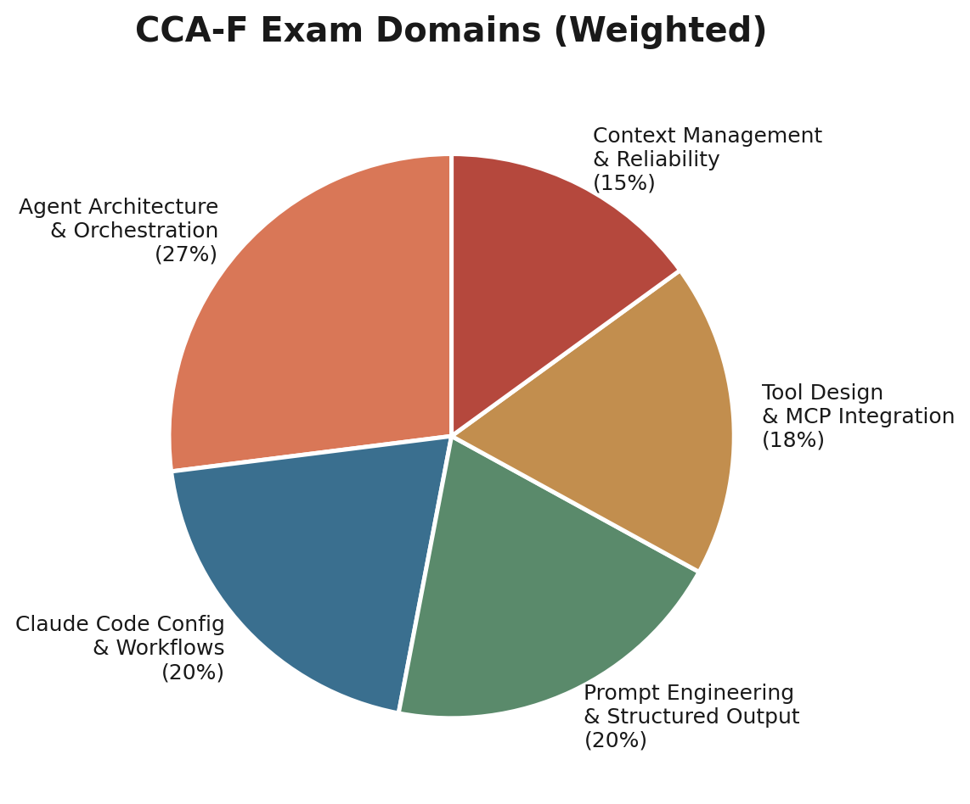
Exam at a glance
Duration: 120 minutes
Questions: 60
Format: Multiple choice (1 correct of 4) — no guessing penalty
Scoring: 100 – 1000 scale; passing = 720
Scenarios sampled: 4 of 8 scenarios are sampled per attempt
Delivery: Online proctored via Anthropic Skilljar
No guessing penalty — answer EVERY question

Slide 4
5 Domains, weighted

Slide 5
The 8 production scenarios
• Customer Support Agent
• Code Generation with Claude Code
• Multi-agent Research System
• Developer Productivity Tools
• Claude Code for Continuous Integration
• Structured Data Extraction
• Conversational AI Architecture Patterns
• Agentic AI Tools

Slide 6
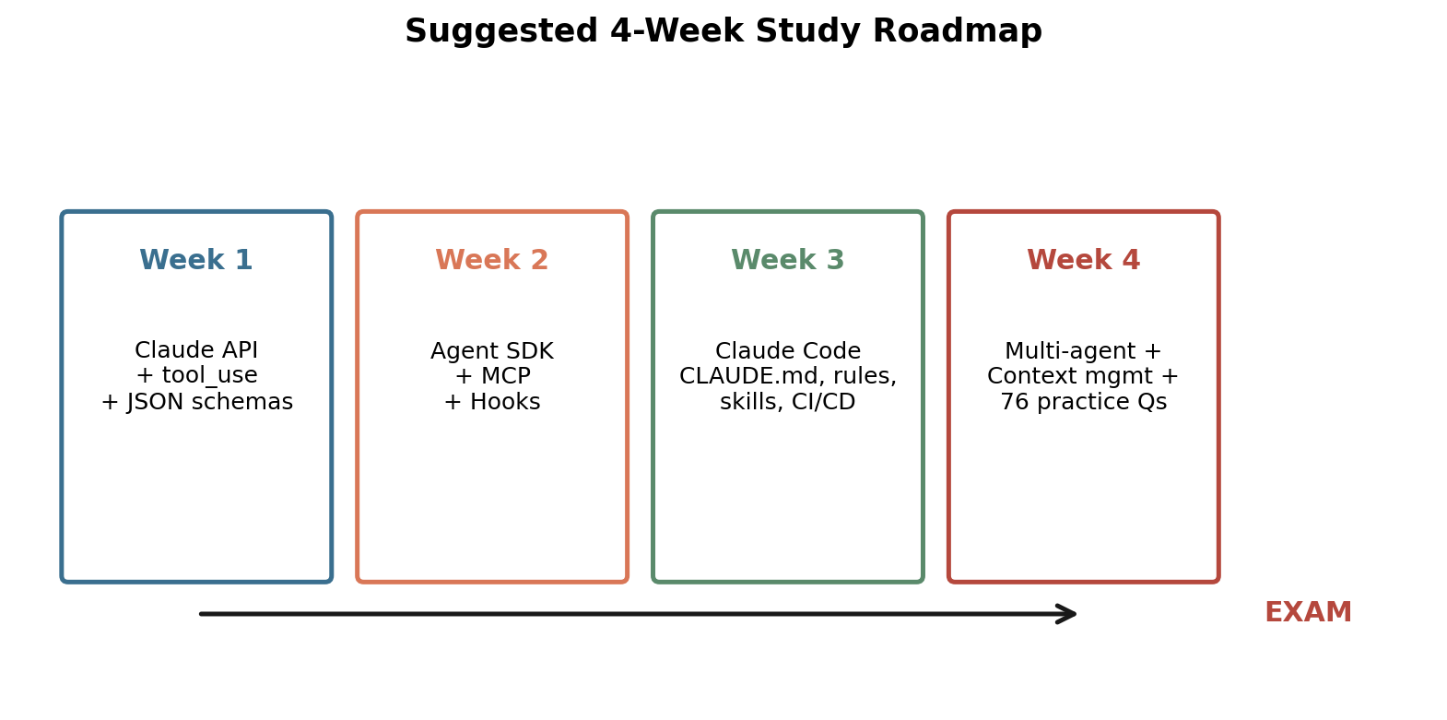
4-week study roadmap

Slide 7
1. Claude API — Fundamentals
• Stateless: every request must include the FULL prior conversation in `messages`. The model has no server-side memory.
• Request fields: `model`, `max_tokens`, `system`, `messages`, `tools`, `tool_choice`.
• Roles: `user`, `assistant`, plus tool results (sent as a `tool_result` content block on a user-role message).
• stop_reason values you must handle: `end_turn` (final answer), `tool_use` (run the tool, append result, loop), `max_tokens` (truncated — increase limit), `stop_sequence`.
• System prompt: separate field; defines persistent role/constraints/format. Wording can create unintended tool associations (e.g. forcing overuse of get_customer).
• Context window includes system prompt + full history + tool definitions + tool results. Watch for: (a) lost-in-the-middle effect, (b) tool-result accumulation, (c) detail loss in progressive summarisation.

Slide 8
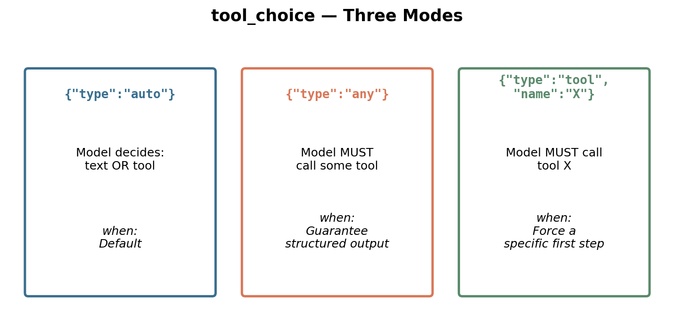
2. Tools and tool_use
• tool_use lets Claude REQUEST a tool call (a structured JSON block); your code runs the function and feeds the result back.
• Tool description is the PRIMARY selection signal. Minimal descriptions ('Gets customer info') cause tool confusion.
• Each description should include: what it does/returns, input formats with examples, edge cases, when to use vs similar alternatives.
• Avoid overlapping descriptions across tools (e.g. analyze_content vs analyze_document). Rename to remove semantic overlap.
• Built-in tools may be preferred over MCP tools. Counter this by emphasising unique data/context that built-ins cannot access.
• tool_choice modes: `auto` (default), `any` (must call SOME tool — guarantees structured output), `{type:tool, name:X}` (force a specific first step).
• JSON Schema with tool_use is the most reliable way to get structured output. It eliminates SYNTAX errors but not SEMANTIC errors.
• Schema design: required only when always present; nullable types for optional info; `enum` with `other`+detail string and `unclear` for honest fallback.

Slide 9
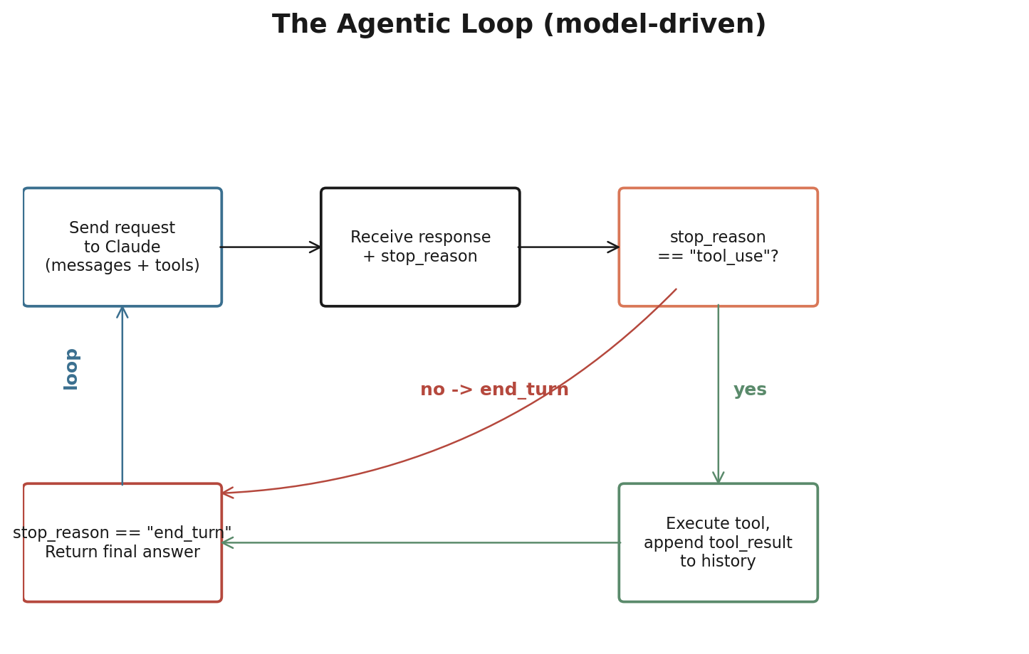
3. Claude Agent SDK — Building Agentic Systems
• Agentic loop: send → check stop_reason → if tool_use, run tool, append tool_result, loop → if end_turn, finish. The ONLY reliable completion signal is `stop_reason == 'end_turn'`.
• Anti-patterns: parsing assistant text for completion, using max_iterations as primary stop, treating presence of text content as 'done'.
• AgentDefinition fields: name, description, system_prompt, allowed_tools (least privilege).
• Hub-and-spoke: a coordinator owns decomposition, delegation, aggregation, error handling. All inter-agent comms route through the coordinator for observability.
• Subagents have ISOLATED context — they do NOT inherit the coordinator's history. Pass full required context explicitly in the Task prompt.
• Spawn subagents via the `Task` tool (must be in coordinator's `allowed_tools`). Multiple Task calls in one coordinator response run IN PARALLEL.
• Hooks intercept lifecycle events. `PostToolUse` normalises/trims tool results; `PreToolUse` blocks/redirects calls (e.g. block refunds > $500).
• Hooks provide DETERMINISTIC guarantees; prompts give PROBABILISTIC compliance. Use hooks for financial / legal / safety constraints.
• Sessions: `--resume <name>` continues prior context (risk: stale results). `fork_session` branches off a shared point for parallel approach exploration.

Slide 10
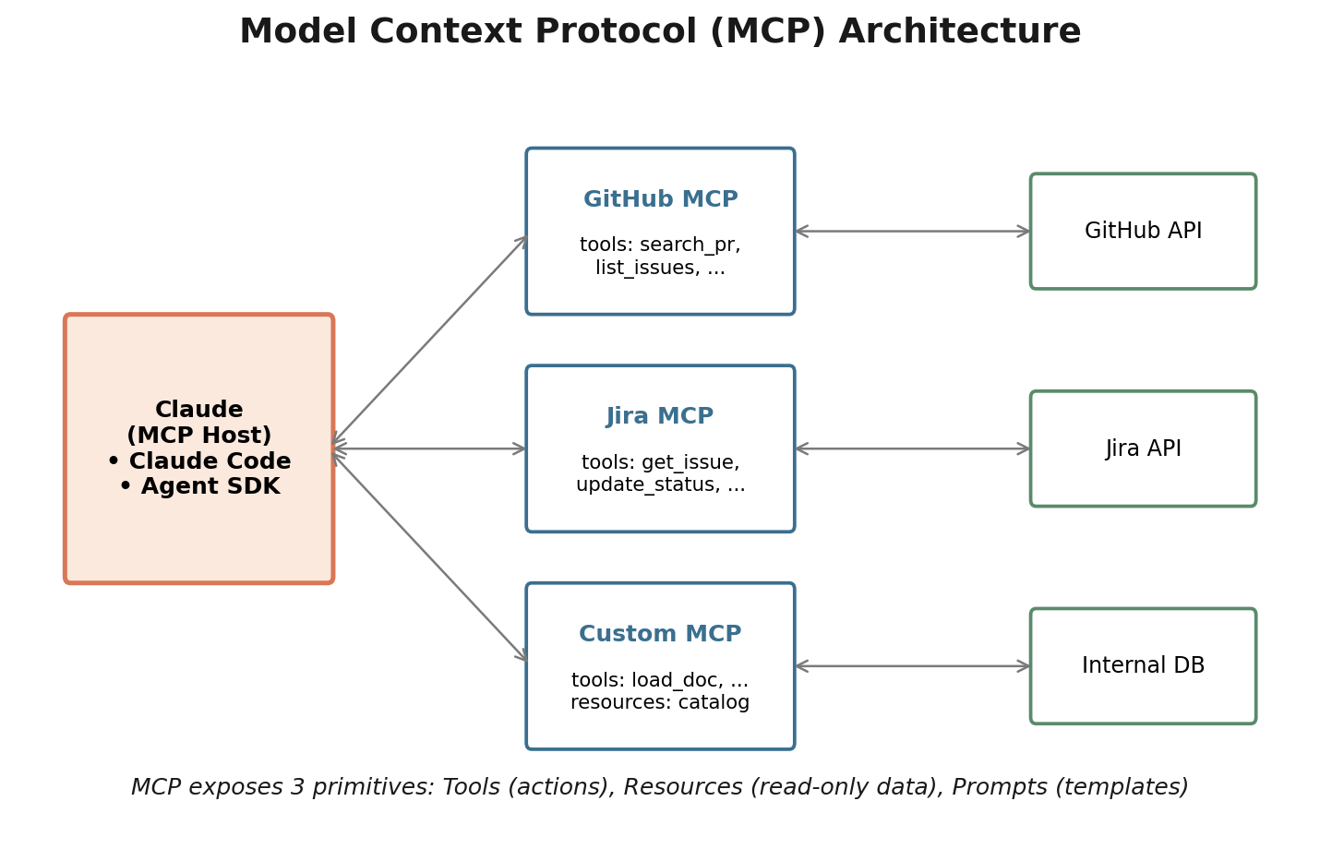
4. Model Context Protocol (MCP)
• Open protocol that exposes Tools (actions), Resources (read-only data), and Prompts (templates) to a Claude host.
• When a host connects to an MCP server, all tools are auto-discovered and merged with tools from other connected servers.
• Project config: `.mcp.json` in repo root (in VCS). Use `${ENV_VAR}` substitution so secrets are NOT committed.
• User config: `~/.claude.json` for personal/experimental servers, NOT shared via VCS.
• Prefer existing community MCP servers (GitHub, Jira, Slack); build custom only for unique team workflows.
• Errors: set `isError: true` and return STRUCTURED metadata: `errorCategory` (transient/validation/business/permission), `isRetryable`, message, attempted_query, partial_results, alternative approaches. Generic 'Operation failed' breaks coordinator decision-making.
• Resources act as a 'map': agent reads catalogues / schemas / docs without exploratory tool calls.

Slide 11
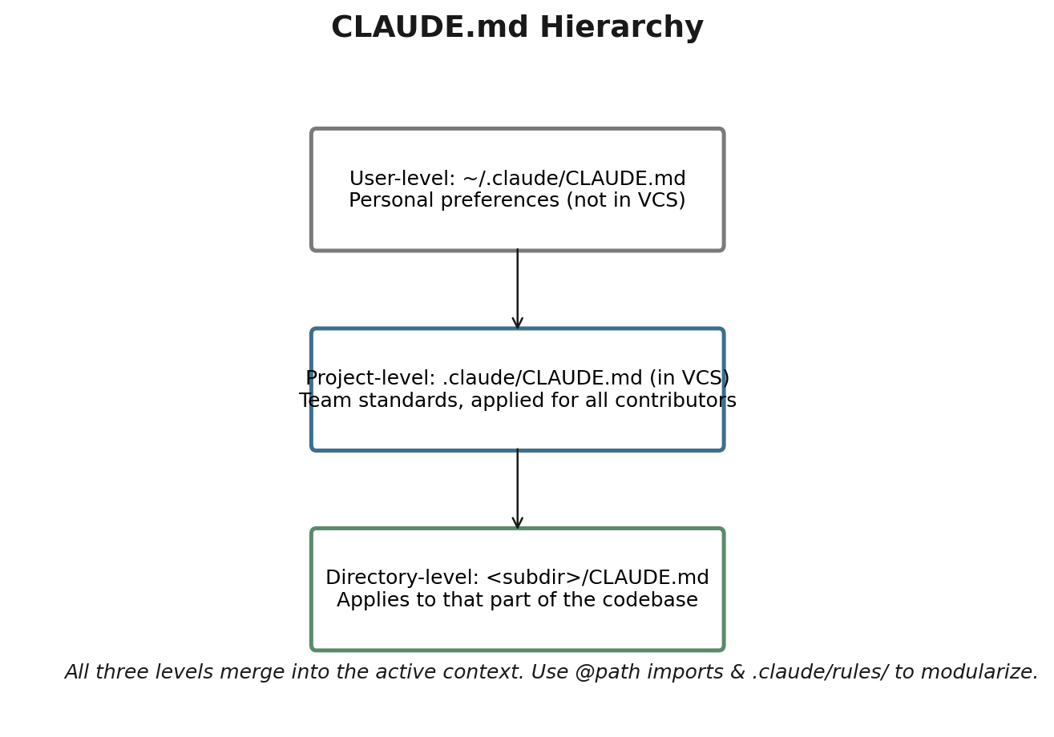
5. Claude Code — Configuration & Workflows
• CLAUDE.md hierarchy: User (~/.claude/CLAUDE.md) → Project (.claude/CLAUDE.md or root CLAUDE.md, in VCS) → Directory (subdir CLAUDE.md). Project-level guarantees teammates inherit standards.
• @path imports modularise CLAUDE.md (e.g. `@./standards/testing.md`). Max nesting depth is 5; relative paths resolve from the importing file.
• .claude/rules/ contains topical files with YAML frontmatter `paths` globs — loaded ONLY when editing matching files. Ideal for cross-cutting conventions like tests scattered across the codebase.
• Custom slash commands live in .claude/commands/ (project, in VCS) or ~/.claude/commands/ (personal).
• Skills (.claude/skills/<name>/SKILL.md) extend slash commands with frontmatter: `context: fork` (isolated subagent), `allowed-tools` (least privilege), `argument-hint` (prompts for arg).
• Personal skills at ~/.claude/skills/<name>/SKILL.md OVERRIDE same-named project skills for that user.
• Planning mode: investigate-only (Read/Grep/Glob), produces an approval-gated plan. Use for large changes, multiple approaches, architectural decisions, unfamiliar codebases.
• Direct execution: small, well-understood, single-file changes.
• Explore subagent: isolates verbose codebase exploration so it does not pollute main context.
• /compact: summarise prior history (risk: numeric/date precision loss). /memory: edit CLAUDE.md to persist facts across sessions.
• CI/CD: use `claude -p` (or --print) for non-interactive mode. Combine with --output-format json + --json-schema for parseable findings (e.g. inline PR comments via GitHub API).
• Use a SECOND independent Claude instance to review code generated by the first — avoids confirmation bias from generation context.
• When re-reviewing after new commits, include prior findings in context and instruct Claude to report only new/unresolved issues to avoid duplicate comments.

Slide 12
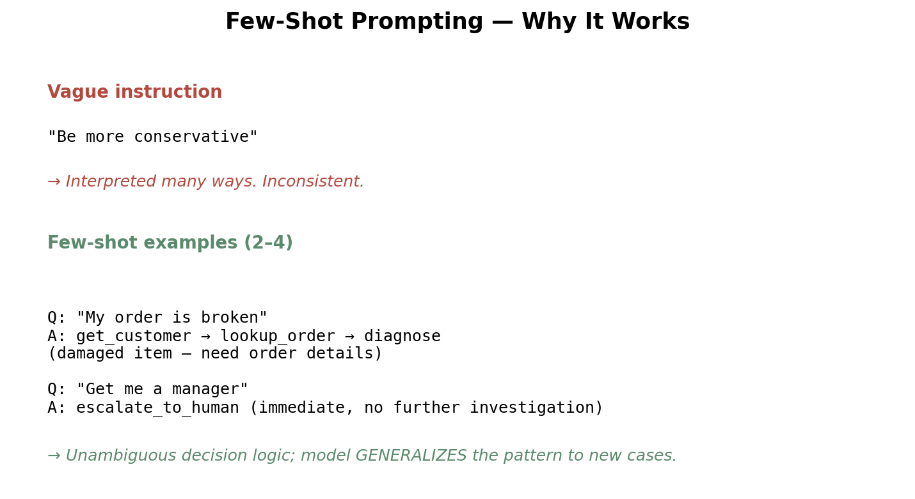
6. Prompt Engineering — Advanced Techniques
• Few-shot (2–4 input/output examples) outperforms vague instructions for ambiguity, formatting, edge cases, informal measurements.
• Add normalisation rules (dates → ISO 8601, currency as numeric+code, percentages as decimal) to prevent semantic drift in structured output.
• Replace vague instructions with EXPLICIT criteria: what to flag vs ignore, severity definitions with code examples for each level.
• Prompt chaining: split tasks into sequential focused passes (e.g. per-file analysis then a cross-file integration pass) to avoid attention dilution.
• Use prompt chaining for predictable pipelines; use dynamic decomposition for open-ended investigations.
• Interview pattern: Claude asks clarifying questions before implementing in unfamiliar domains or when multiple viable approaches exist.
• Validation + retry-with-feedback: re-prompt with the original document, the prior wrong extraction, and the specific validation error. Pydantic is the canonical validation tool.
• Retry helps with format/structural/arithmetic issues; it does NOT help when the information is absent from the source.
• Self-correction: extract `stated_total` AND `calculated_total`; flag `conflict_detected: true` for downstream handling.

Slide 13
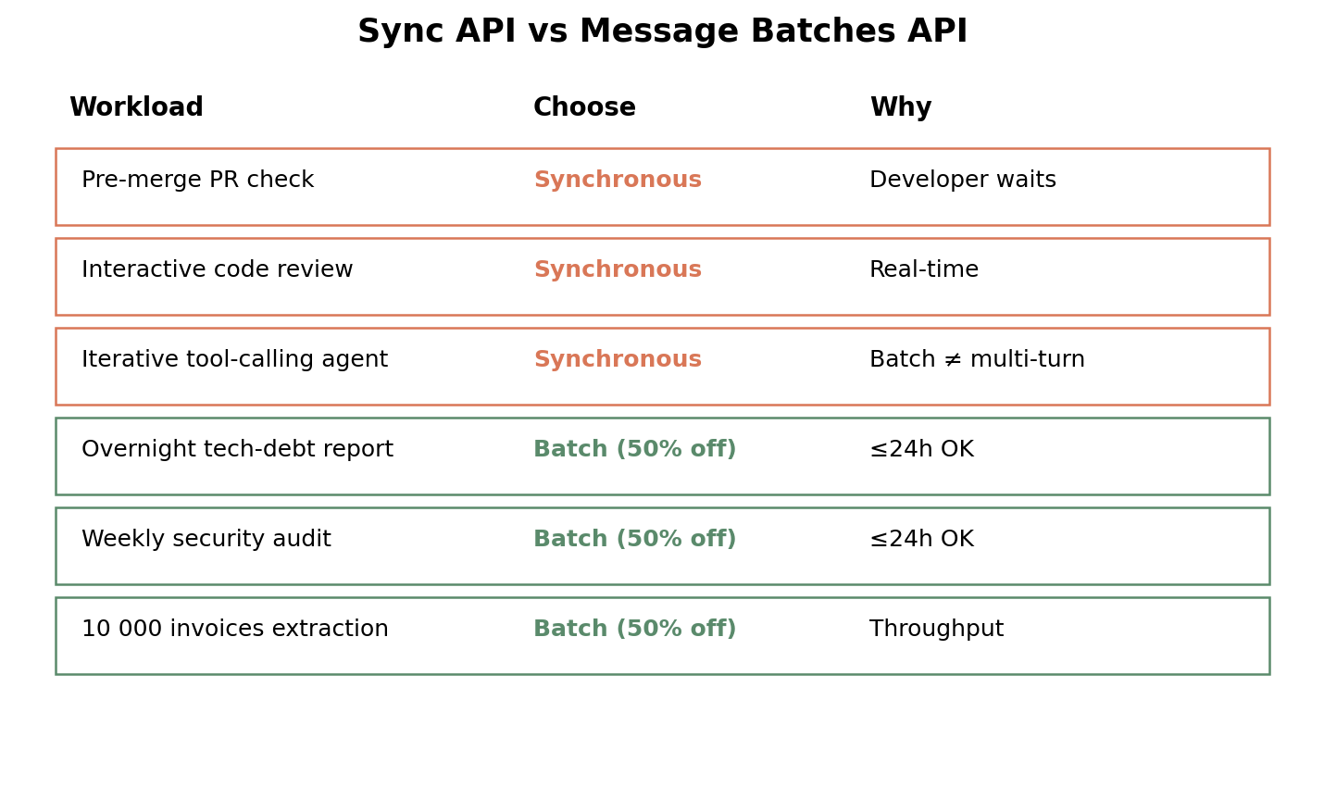
7. Message Batches API
• 50% cost saving vs synchronous; processing window up to 24h with NO latency SLA.
• Batch is asynchronous and 'fire-and-forget' — multi-turn tool calling within one request is NOT supported (a fundamental limit).
• `custom_id` correlates each request with its response; on partial failure, resubmit only the failed custom_ids.
• Decision rule: blocking workflow (pre-merge, interactive review, agent loops) → synchronous. Scheduled workload (overnight reports, weekly audits, bulk extraction) → batch.
• SLA planning: if you need results in 30h and batches take up to 24h, your submission window is the remaining 6h.

Slide 14
8. Task Decomposition Strategies
• Fixed pipeline (prompt chaining): every step pre-defined — extract metadata → extract data → validate → enrich → output.
• Dynamic adaptive decomposition: subtasks are generated from intermediate findings (legacy test coverage analysis, exploratory investigations).
• Multi-pass code review: per-file local analysis + a separate cross-file integration pass. Larger context windows do NOT fix attention dilution — focused passes do.
• Avoid 'consensus over multiple full reviews' — it suppresses real bugs by demanding agreement across inconsistent runs.

Slide 15
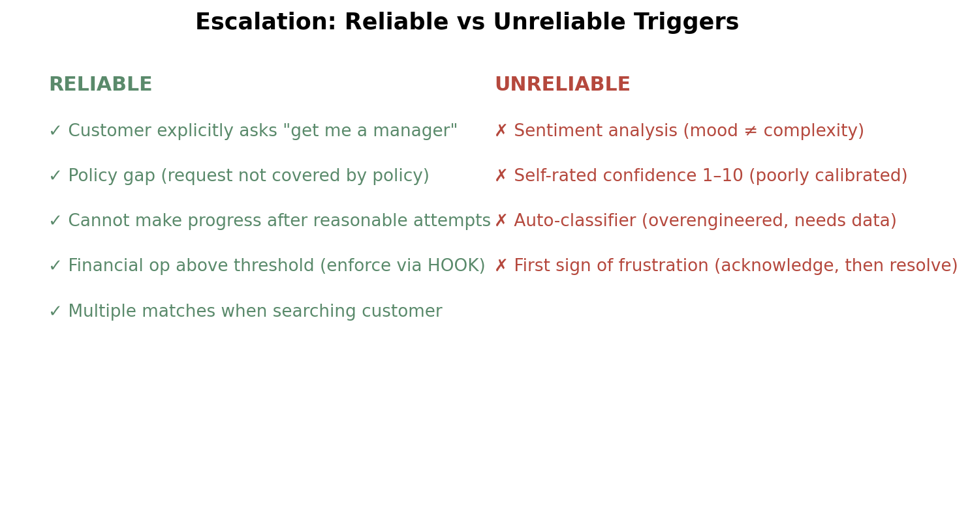
9. Escalation & Human-in-the-Loop
• Reliable triggers: explicit human request, policy gap (request not covered), inability to make progress, financial threshold (enforce via HOOK), multiple matches when identifying a customer.
• Unreliable triggers: sentiment analysis (mood ≠ complexity), self-rated confidence 1–10 (poorly calibrated — model can be confidently wrong), bespoke trained classifiers (over-engineering).
• Pattern: acknowledge emotion → propose concrete resolution → escalate only if customer reiterates the desire for a human (or explicitly asks first time).
• Structured handoff to human: customer_id, name, issue_summary, order_id, root_cause, actions_taken[], refund_amount, recommended_action, escalation_reason. Operators see ONLY this — make it self-contained.
• Confidence calibration: per-field scores; calibrate against labelled validation set; route low confidence to human review.
• Stratified random sampling: a 97% aggregate accuracy can hide 40% errors on a specific document type.

Slide 16
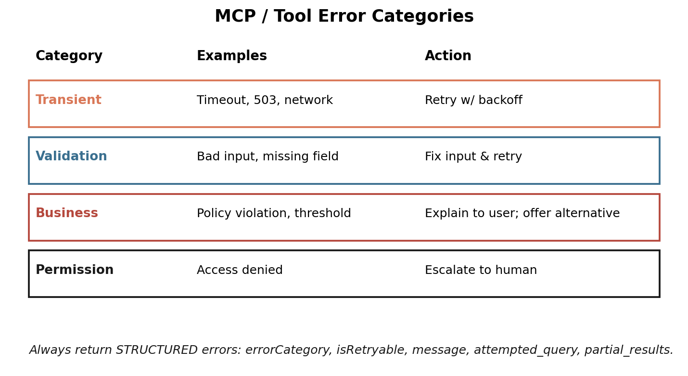
10. Error Handling in Multi-agent Systems
• Categories: Transient (retry w/ backoff), Validation (fix input & retry), Business (explain + alternative), Permission (escalate).
• Subagent does LOCAL recovery (1–2 retries) for transient failures; only propagates non-recoverable errors to coordinator.
• Anti-patterns: generic 'service unavailable' status (no recovery info), silent suppression (empty result == success), aborting whole workflow on one failure, infinite subagent retries.
• Distinguish ACCESS FAILURE (timeout — retry decision) from VALID EMPTY RESULT ('0 results' — successful query).
• Coverage annotations in synthesis: 'FULL COVERAGE' / 'PARTIAL COVERAGE — search timeout' to communicate uncertainty downstream.

Slide 17
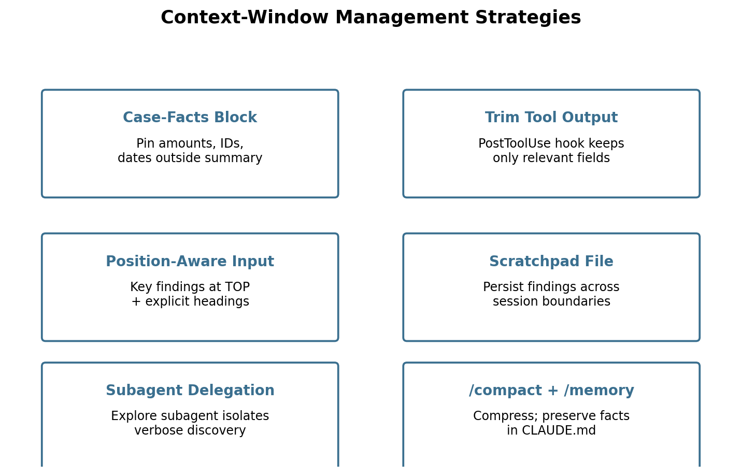
11. Context Management in Production
• Extract a Case-Facts block (customer_id, order_id, amounts, dates, issue, request, status) and pin it OUTSIDE the summarised history.
• Trim verbose tool results via PostToolUse hook (40+ fields → keep 5).
• Position-aware input: KEY FINDINGS at the TOP, action items at the BOTTOM, detailed results in middle with explicit headings (mitigates lost-in-the-middle).
• Scratchpad files (e.g. investigation-scratchpad.md) survive context boundaries and new sessions.
• Delegate exploratory work to subagents (Explore subagent) — keeps main context clean.
• Constrained subagent budgets: minimal context, structured-only return, restricted allowed_tools.
• Crash recovery: each subagent persists state to agent-state/<name>.json; coordinator reads manifest.json on resume.

Slide 18
12. Provenance Preservation in Multi-source Synthesis
• Always preserve claim → source mappings (URL, source name, publication date, methodology) — do not let attribution dissolve in summarisation.
• Conflicting data: keep both values with attribution; let the coordinator decide (do not arbitrarily pick one).
• Include dates so temporal differences are not misread as contradictions.
• Render by content type: tables for financial, prose for analysis, structured lists for technical findings, chronological for time series.

Slide 19
13. Claude Code Built-in Tools
• Glob — find files by name/extension pattern (`**/*.test.tsx`).
• Grep — search WITHIN file contents (function names, errors, imports).
• Read — full file load. Write — create new file. Edit — precise replace via unique string match.
• When Edit fails on non-unique match: fall back to Read → modify in memory → Write.
• Investigation strategy: incremental — Grep for entry points → Read those files → Grep for usages → Read consumers → repeat until full picture.

Slide 20
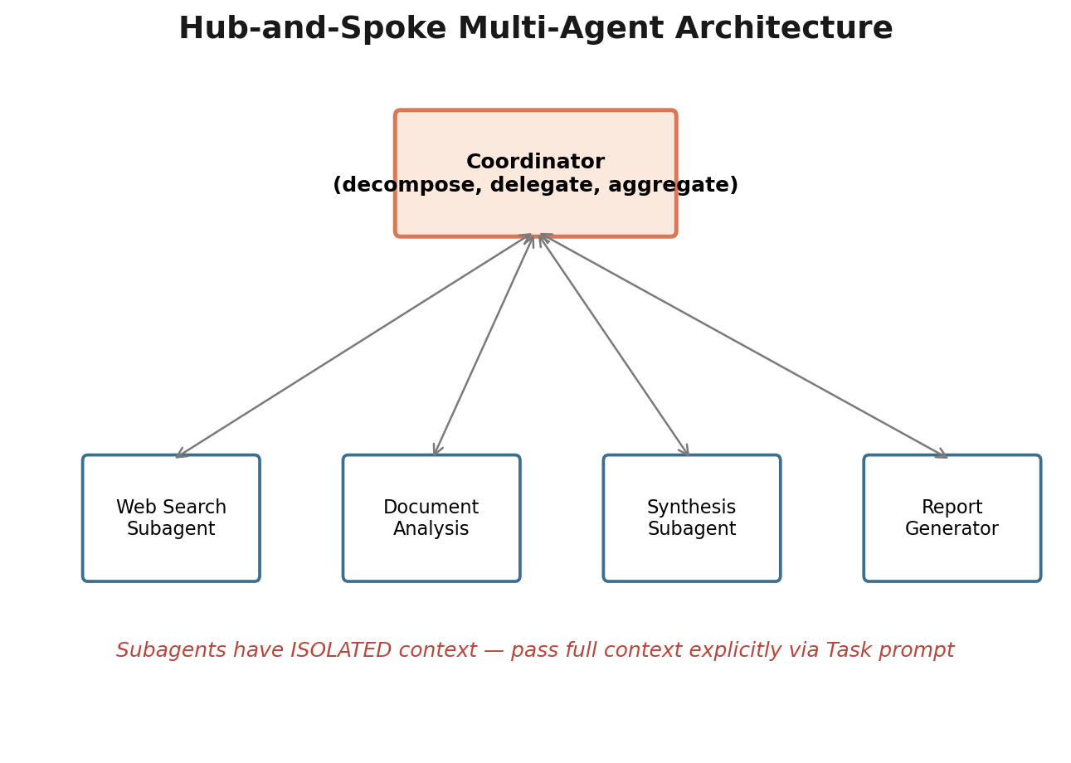
Multi-agent: Hub-and-Spoke
Coordinator owns:
decomposition, delegation, aggregation, error handling
Subagents:
isolated context — pass everything explicitly via Task prompt
Parallelism:
multiple Task calls in one coordinator turn
Watch for:
overly narrow decomposition, generic error envelopes, silent suppression

Slide 21
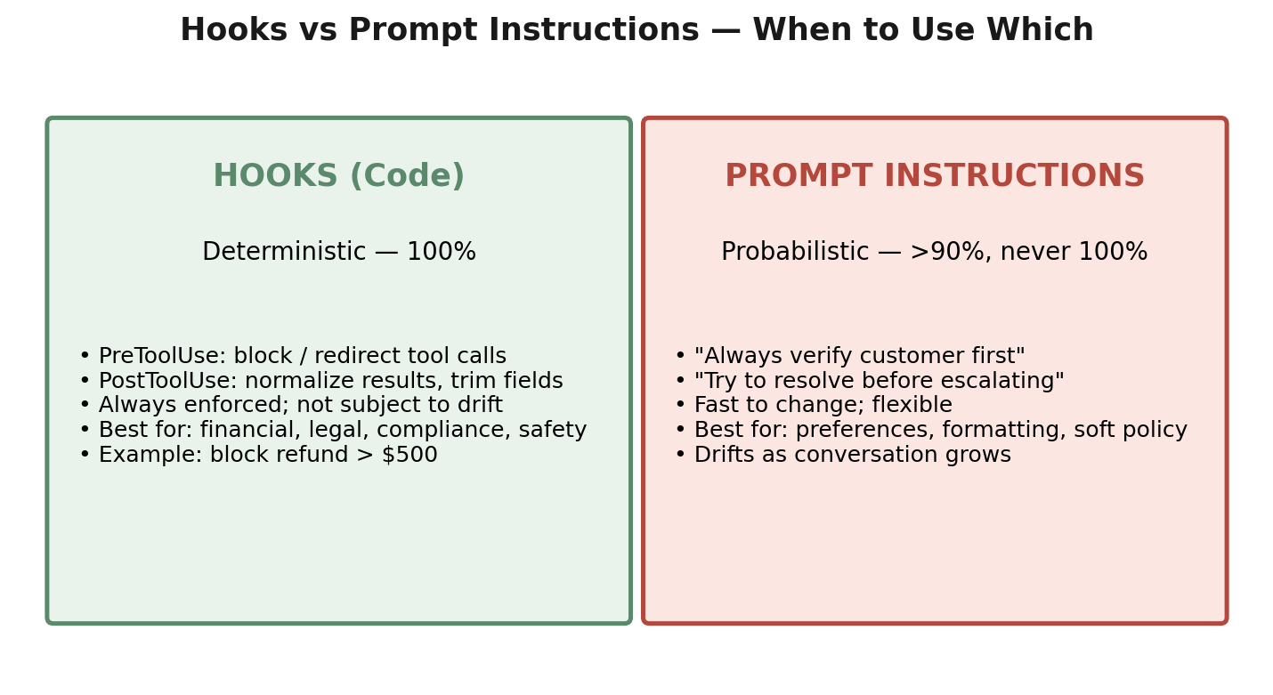
Hooks vs Prompt Instructions

Slide 22
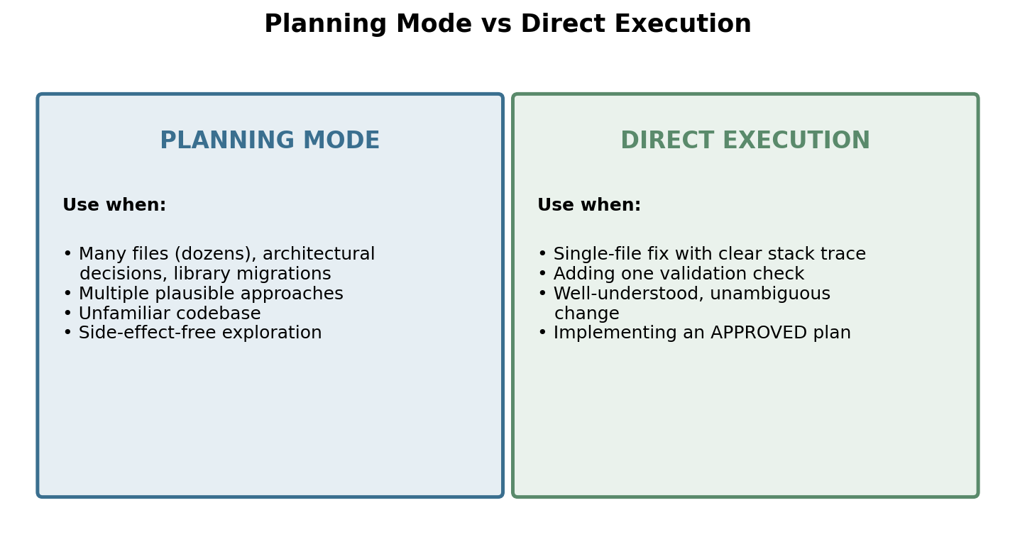
Planning Mode vs Direct Execution

Slide 23
tool_choice — three modes

Slide 24
Sync API vs Message Batches API

Slide 25
Error categories & responses

Slide 26
Context-window management strategies

Slide 27
Domain 1 — Agent Architecture & Orchestration (27%)
Designing Agentic Loops
Lifecycle: send → stop_reason check → tool_use vs end_turn → loop with appended tool_result.
Model-driven, not hard-coded decision tree.
Anti-patterns: text-parsing for completion, max_iterations as primary stop.
Multi-agent Orchestration
Hub-and-spoke topology with coordinator-mediated communication for observability.
Subagents have ISOLATED context — pass everything explicitly.
Coordinator owns dynamic subagent selection, error handling, aggregation.
Watch for OVERLY NARROW decomposition (assigning subtasks that miss whole subdomains).
Subagent Spawning & Context Passing
Task tool spawns subagents (must be in coordinator's allowed_tools).
Multiple Task calls in one turn run in parallel.
Pass full required outputs from prior agents — never assume inheritance.
Coordinator prompts: state goals + quality criteria, not step-by-step instructions.
Multi-step Workflows: Enforcement vs Guidance
Programmatic preconditions (block lookup_order until get_customer returns a verified ID) > prompt instructions for critical sequences.
Structured handoff payloads on escalation.
Agent SDK Hooks
PostToolUse: normalise dates, trim noisy fields.
PreToolUse: block policy-violating calls; redirect to escalation.
Hooks deterministic; prompts probabilistic.
Task Decomposition
Fixed pipelines (prompt chaining) vs dynamic adaptive decomposition.
Per-file + integration passes for multi-file code review.
Sessions: Resume & Fork
--resume continues; fork_session branches.
Prefer fresh session with summary when results are stale.

Slide 28
Domain 2 — Tool Design & MCP Integration (18%)
Tool Interface Design
Descriptions are the primary selection mechanism; include input formats, examples, edge cases, boundaries.
Eliminate functional overlap by RENAMING (e.g. analyze_content → extract_web_results).
Split general-purpose tools (fetch_url) into specialised ones (load_document with URL validation) — least privilege at the interface.
Structured Error Responses
isError: true with errorCategory, isRetryable, message, attempted_query, partial_results, alternative_approaches.
Distinguish access failures from valid empty results.
Local recovery in subagents; propagate only what they can't resolve.
Tool Allocation & tool_choice
≤ ~5 well-scoped tools per agent; more than that hurts selection reliability.
Subagent toolset matches its role.
tool_choice 'any' guarantees structured output; force a specific tool to enforce a first step.
MCP Configuration
Project .mcp.json (in VCS, ${ENV} for secrets) vs user ~/.claude.json (private).
Tools from all connected servers are merged.
Resources are read-only context maps.
Built-in Tools
Grep / Glob / Read / Write / Edit / Bash purposes.
Read+Write fallback when Edit can't find a unique match.

Slide 29
Domain 3 — Claude Code Configuration & Workflows (20%)
CLAUDE.md Hierarchy
User → Project → Directory levels merge.
Project-level (in VCS) is the only level new teammates inherit automatically.
@path imports modularise; .claude/rules/ scopes via glob frontmatter.
Custom Slash Commands & Skills
.claude/commands/ (legacy) and .claude/skills/<name>/SKILL.md (current) — both produce /name.
Frontmatter: context: fork, allowed-tools, argument-hint.
Personal ~/.claude/skills/<name>/SKILL.md overrides project skill for that user.
Path-specific Rules
.claude/rules/<topic>.md with `paths: ['**/*.test.tsx']`.
Loaded only when editing matching files — saves tokens.
Better than dir-level CLAUDE.md when conventions span many directories (tests, migrations).
Planning Mode vs Direct Execution
Plan first for large/architectural/multiple-approach changes.
Direct for clear single-file fixes.
Combine: plan, get approval, execute.
Iterative Refinement
Concrete I/O examples > prose specs.
Test-driven iteration; interview pattern for unknowns.
CI/CD Integration
claude -p for non-interactive mode.
--output-format json + --json-schema → parseable PR comments.
Independent reviewer instance avoids confirmation bias.
Include prior findings to suppress duplicate comments on follow-up commits.

Slide 30
Domain 4 — Prompt Engineering & Structured Output (20%)
Explicit Criteria
Replace 'be conservative' with categorical rules and severity definitions tied to code examples.
Disable categories with high false-positive rates to restore developer trust.
Few-shot Prompting
2–4 targeted examples with rationale for ambiguous decisions.
Show output format AND distinguish acceptable vs problematic patterns.
Structured Output via tool_use + JSON Schema
Eliminates SYNTAX errors; not semantic ones.
Mark optional fields nullable so the model returns null rather than fabricating.
Use enums with `other` + detail and `unclear` to capture out-of-distribution cases.
tool_choice 'any' for guaranteed call; force specific tool to lock the first step.
Validation, Retries, Feedback
Retry-with-error-feedback: original doc + wrong extraction + concrete error message.
Pydantic semantic validators for business rules (sum(items) == total, start < end).
Self-correction: stated_total + calculated_total + conflict_detected.
Batch Processing Strategies
Sync vs Batch decision = blocking vs scheduled.
Iterate prompts on a sample BEFORE bulk processing.
Resubmit failed custom_ids only.
Multi-instance / Multi-pass Review
Independent reviewer Claude instance.
Per-file + integration pass for multi-file PRs.

Slide 31
Domain 5 — Context Management & Reliability (15%)
Conversation Context
Send full history every request — model is stateless.
Lost-in-the-middle: critical info goes at top or bottom.
Trim verbose tool outputs via PostToolUse hook.
Pin transactional facts in a Case-Facts block outside summarisation.
Escalation & Ambiguity
Reliable triggers; ask for additional identifier on multiple matches; immediate handoff on explicit human request.
Error Propagation
Structured error context, partial results, alternative approaches.
Distinguish access failure from empty result.
Coverage annotations in synthesis output.
Large-codebase Context Efficiency
Explore subagent isolates discovery output.
Scratchpad files preserve findings across sessions.
/compact when verbose; /memory persists across sessions via CLAUDE.md.
Human Oversight & Confidence Calibration
Field-level confidence scores; calibrate on labelled set.
Stratified random sampling — analyse accuracy per document type / field.
Provenance Preservation
claim → source mappings; preserve conflicting values with attribution.
Always include publication dates.

Slide 32
Cheat sheet (1/3)
Stop reasons
end_turn → finished (only reliable completion signal)
tool_use → run tool, append tool_result, loop
max_tokens → truncated; raise limit
stop_sequence → application-specific
tool_choice
"auto" → model decides text vs tool (default)
"any" → must call SOME tool (guarantees structured output)
{"type":"tool","name":"X"} → must call X (force first step)
Hooks vs Prompts
Hooks: deterministic 100% — financial, legal, safety, compliance
Prompts: probabilistic — preferences, formatting, soft policy
Subagents (Task tool)
Coordinator's allowed_tools must include 'Task'
ISOLATED context — pass everything explicitly
Multiple Task calls in ONE turn run in PARALLEL
Return STRUCTURED data, not raw dumps

Slide 33
Cheat sheet (2/3)
MCP error envelope
isError: true
errorCategory: transient | validation | business | permission
isRetryable: bool
attempted_query, partial_results, alternative_approaches
CLAUDE.md scope
User: ~/.claude/CLAUDE.md (private)
Project: .claude/CLAUDE.md or root CLAUDE.md (in VCS — only level teammates inherit)
Directory: <subdir>/CLAUDE.md (scoped to that area)
Modularise via @path or .claude/rules/<topic>.md
.claude/rules/ frontmatter
paths: ['src/api/**/*.ts'] — load only when editing matching files
Use for cross-cutting conventions (tests scattered across repo)
Skill frontmatter
context: fork → isolated subagent (avoid main-context pollution)
allowed-tools: ['Read','Grep'] → least privilege
argument-hint: 'Path to analyse'

Slide 34
Cheat sheet (3/3)
CI/CD CLI
claude -p (or --print) — non-interactive
--output-format json + --json-schema — parseable findings
Run a SECOND independent instance to review (avoids confirmation bias)
Include prior findings to avoid duplicate comments on follow-up commits
Sync vs Batch
Sync: blocking workflows, agent loops with multi-turn tool use, real-time UX
Batch (50% off, ≤24h): overnight reports, weekly audits, bulk extraction
Batch does NOT support multi-turn tool calling within one request
Escalation triggers (reliable)
Explicit human request
Policy gap / silent on request
Cannot make progress
Financial threshold (enforce via hook)
Multiple customer matches → ask for additional identifier
Anti-patterns to recognise
Parsing assistant text for completion (use stop_reason)
max_iterations as primary stop
Generic 'operation failed' error responses
Aborting whole workflow on one subagent failure
Sentiment analysis for escalation
Self-rated confidence 1–10 for routing
Single-pass review of 14 files (attention dilution)
Treating empty result == access failure

Slide 35
Q1 — Customer Support Agent
Logs show that in 12% of cases the agent skips get_customer and calls lookup_order using only the customer-provided name, leading to incorrect refunds. Which change is MOST effective?
A. Add a programmatic precondition that blocks lookup_order and process_refund until get_customer returns a verified ID
B. Strengthen the system prompt requiring verification first
C. Add few-shot examples of correct sequencing
D. Add a routing classifier
Answer: A
Why: Critical sequencing must be deterministic. Hooks/preconditions guarantee 100% compliance; prompts (B,C) are probabilistic. D solves a different problem (availability, not ordering).

Slide 36
Q2 — Customer Support Agent
Agent often calls get_customer instead of lookup_order for order questions; tool descriptions are minimal and similar. First step?
A. Add few-shot examples
B. Expand each tool description with input formats, examples, edge cases, boundaries
C. Add a routing layer
D. Merge the tools
Answer: B
Why: Descriptions are the model's primary selection mechanism — fix the root cause first. Lowest-effort, highest-impact.

Slide 37
Q3 — Customer Support Agent
Agent resolves only 55% of issues vs 80% target; escalates simple cases and tries to handle complex policy exceptions. How to improve calibration?
A. Explicit escalation criteria with few-shot examples
B. Self-rated confidence 1–10 with auto-escalation
C. Train a separate classifier
D. Sentiment analysis
Answer: A
Why: Decision-boundary problem → explicit criteria + examples. Self-rated confidence is poorly calibrated; sentiment ≠ complexity; classifier is over-engineering.

Slide 38
Q4 — Code Generation with Claude Code
You need a /review slash command available to the whole team after cloning the repo. Where do you put it?
A. .claude/commands/ in the project repo
B. ~/.claude/commands/
C. Root CLAUDE.md
D. .claude/config.json
Answer: A
Why: Project-level commands in VCS are inherited by every clone. ~/ is personal-only.

Slide 39
Q5 — Code Generation with Claude Code
You need to restructure a monolith into microservices (dozens of files, boundary decisions). Approach?
A. Planning mode: explore → understand dependencies → design
B. Direct execution incrementally
C. Direct execution with detailed up-front instructions
D. Direct execution; switch to planning when it gets hard
Answer: A
Why: Planning mode is designed for large, multi-approach, architectural changes. B/C/D risk expensive rework.

Slide 40
Q6 — Code Generation with Claude Code
Codebase has different conventions per area; tests are co-located with code. You want conventions auto-applied. Best approach?
A. .claude/rules/ files with YAML frontmatter `paths` glob patterns
B. Put everything in root CLAUDE.md
C. Skills in .claude/skills/
D. CLAUDE.md in every directory
Answer: A
Why: paths-scoped rules load only when editing matching files — ideal for cross-cutting conventions like tests scattered across the codebase.

Slide 41
Q7 — Multi-agent Research System
Reports cover only visual art; coordinator decomposed into 'AI in digital art', 'AI in graphic design', 'AI in photography'. Likely root cause?
A. Synthesis agent doesn't detect gaps
B. Coordinator decomposed too narrowly
C. Web-search agent isn't thorough
D. Document analysis filters out non-visual sources
Answer: B
Why: Subagents executed correctly — the issue is what they were assigned. Watch for coordinator decomposition that misses whole subdomains.

Slide 42
Q8 — Multi-agent Research System
A web-search subagent times out. Best error propagation to coordinator?
A. Structured error: failure_type, query, partial_results, alternative_approaches
B. Internal retries, then return generic 'search unavailable'
C. Catch the timeout and return empty result marked successful
D. Propagate timeout exception, terminate workflow
Answer: A
Why: Coordinator needs context to choose: retry/alternative/partial/skip. B hides info; C masks failure; D over-aborts.

Slide 43
Q9 — Multi-agent Research System
Document agent hits 2 contradictory credible sources for a key statistic. Best handling?
A. Apply credibility heuristics, footnote the discrepancy
B. Include both, unmarked, let synthesis decide
C. Stop and ask coordinator which is authoritative
D. Complete with both values, explicitly annotate the conflict with attribution, let coordinator reconcile
Answer: D
Why: Preserve both values + attribution; reconciliation is the coordinator's job (broader context).

Slide 44
Q10 — Multi-agent Research System
fetch_url on the document analysis agent is being misused for ad-hoc web search. Most effective fix?
A. Replace fetch_url with load_document that validates URLs are document formats
B. Remove fetch_url, route all URL fetches via coordinator/web-search agent
C. Block known search-engine domains
D. Add prompt instructions saying 'don't use for search'
Answer: A
Why: Constrain capability at the interface — least privilege. Makes misuse architecturally impossible, not merely discouraged.

Slide 45
Q11 — Claude Code for CI
Pipeline runs `claude "Analyze this PR for security issues"` and hangs. Fix?
A. Use --batch flag
B. Use -p (or --print) flag
C. Redirect stdin from /dev/null
D. Set CLAUDE_HEADLESS=true
Answer: B
Why: -p / --print is the documented non-interactive mode for CI/CD.

Slide 46
Q12 — Claude Code for CI
Manager wants to move BOTH (1) blocking pre-merge checks and (2) overnight tech-debt reports to Batch API for 50% savings. How to evaluate?
A. Move both to batch with polling
B. Use sync for pre-merge checks; batch for overnight reports
C. Keep both sync to avoid ordering issues
D. Move both to batch with sync fallback
Answer: B
Why: Batch up to 24h is unsuitable for blocking workflows where developers wait, but ideal for overnight scheduled work.

Slide 47
Q13 — Claude Code for CI
Iterative review uses tool calls to fetch related files. Why is Batch API fundamentally unsuitable here?
A. Batch lacks correlation IDs
B. Async fire-and-forget cannot intercept tool calls mid-request
C. Batch doesn't support tools in request params
D. 24h latency is too slow
Answer: B
Why: Batch is single request → single response. Multi-turn tool calling within one logical interaction needs synchronous round trips.

Slide 48
Q14 — Claude Code for CI
Findings are accurate but not actionable ('complex routing logic', 'potential null pointer'). Adding instructions doesn't help. Most reliable fix?
A. More explicit instructions
B. Larger context window
C. Two-pass: identify, then generate fixes
D. 3–4 few-shot examples showing the exact required format (issue, location, concrete fix)
Answer: D
Why: Instruction-only changes produce inconsistency; concrete examples lock in format reliably.

Slide 49
Q15 — Structured Data Extraction
After two iterations, output structure still mismatches expectations (nesting, timestamp format). Best next step?
A. JSON schema validation after each iteration
B. Provide 2–3 concrete input/output examples of the expected transformation
C. Rewrite requirements with more technical precision
D. Ask Claude to explain its current understanding
Answer: B
Why: Examples remove prose ambiguity directly. Schema validation enforces structure but not the desired mapping.

Slide 50
Q16 — Conversational AI Architecture Patterns
Two messages after the user said 'I love jazz', Claude asks 'What genres do you enjoy?' Most likely cause?
A. Need a vector DB for memory
B. Context window exceeded
C. Claude API needs session_id
D. Application isn't including prior messages in the messages array
Answer: D
Why: Claude is stateless. Every request must include the full prior history.

Slide 51
Q17 — Conversational AI Architecture Patterns
remove_team_member has dry_run; agent bypasses preview by calling dry_run=false directly. Most reliable enforcement?
A. Server-side validation requiring a preceding dry_run within 60s
B. Mark the tool as 'requires confirmation' in orchestration
C. Detailed instructions + few-shot in tool description
D. Two tools: preview_remove_member returns a single-use confirmation token; execute_remove_member requires that token
Answer: D
Why: Token-binding makes execution architecturally impossible without a preview — code-level enforcement, not LLM compliance.

Slide 52
Q18 — Conversational AI Architecture Patterns
Production: customers reference '15% discount mentioned earlier' but the agent cites wrong values; details were 20+ turns ago and got summarised vaguely. Best fix?
A. Raise summarisation threshold to 85%
B. Store full history externally and retrieve on 'as I mentioned'
C. Extract transactional facts (amounts, dates, IDs) into a persistent Case-Facts block included every prompt
D. Revise summarisation prompt to preserve numbers verbatim
Answer: C
Why: Summarisation inevitably loses precision. Pin facts OUTSIDE the summarisable history so they're always present.

Slide 53
Q19 — Customer Support Agent
Tools return Unix timestamps, ISO dates, numeric status codes; some tools are 3rd-party MCP servers you cannot modify. Most maintainable normalisation?
A. PostToolUse hook intercepts outputs and normalises before the agent sees them
B. Modify tools you control + wrap 3rd-party
C. A normalize_data tool the agent calls after each retrieval
D. Document formats in the system prompt
Answer: A
Why: Centralised, deterministic, code-level transformation that works uniformly regardless of source.

Slide 54
Q20 — Customer Support Agent
Agent loop: when do you stop calling Claude vs continue with another tool result?
A. Check stop_reason: continue on tool_use, stop on end_turn
B. Parse text for 'I'm done' / 'anything else?'
C. Stop after max iterations
D. Stop if assistant produced any text content
Answer: A
Why: stop_reason is the explicit, reliable signal. Everything else is heuristic and breaks.

Slide 55
Exercise 1 — Multi-tool Agent with Escalation
• Domains: 1, 2, 5
•
• Define 3–4 MCP tools with rich descriptions (include 2 similar to test selection).
• Implement an agent loop checking stop_reason (tool_use vs end_turn).
• Add structured error responses (errorCategory, isRetryable, message).
• Add a PreToolUse hook blocking refunds > $500 and routing to escalation.
• Test with a multi-aspect customer request (refund + shipping update).

Slide 56
Exercise 2 — Claude Code for Team Development
• Domains: 3, 2
•
• Project-level CLAUDE.md with universal standards.
• .claude/rules/ files with paths globs (api, tests, deployments).
• A skill at .claude/skills/<name>/SKILL.md with context: fork and allowed-tools.
• .mcp.json with ${ENV} substitution for a community server (GitHub).
• Test planning mode vs direct execution on tasks of different sizes.

Slide 57
Exercise 3 — Structured Data Extraction Pipeline
• Domains: 4, 5
•
• Define an extraction tool with JSON schema (required/nullable/enum with 'other').
• Validation loop: on error, retry with original document + wrong extraction + concrete error.
• Few-shot examples for inline citations vs bibliography references vs informal measurements.
• Batch run via Message Batches API on 100 docs; resubmit failed custom_ids only.
• Field-level confidence; route low-confidence and ambiguous-source docs to human review.

Slide 58
Exercise 4 — Multi-agent Research Pipeline
• Domains: 1, 2, 5
•
• Coordinator with allowed_tools=['Task', ...]; 2+ subagents (web search + doc analysis).
• Spawn subagents in parallel via multiple Task calls in one coordinator turn.
• Require structured subagent output: claim, quote, source URL, publication date.
• Simulate a subagent timeout — return structured error context, continue with partial results, annotate coverage in synthesis.
• Test with conflicting data — preserve both values with attribution.

Slide 59
Skilljar prep tracks (free)
• AI Fluency: Framework & Foundations
• Introduction to Agent Skills
• Building with the Claude API
• Claude Code in Action
• Intro to Model Context Protocol
• MCP: Advanced Topics
• Prompt Engineering Interactive Tutorial
• Real-world Prompting
• Tool Use with Claude
• Customer Service Agent (cookbook walkthrough)
• Multi-agent Research Pipelines
• Structured Data Extraction Workshop
• Claude Code in CI/CD

Slide 60
Documentation to study
• Claude API: Messages, Tool Use, Message Batches
• Agent SDK: Overview, Hooks, Subagents, Sessions
• Model Context Protocol: Tools, Resources, Servers
• Claude Code: Memory (CLAUDE.md), Skills, Hooks, Sub-agents, MCP, GitHub Actions, Headless
• Prompt Engineering Guide + Anthropic Cookbook

Slide 61
Community / video
• YouTube playlist PLFz7SvAnfqLpjPCPJBkUy077BC5ecuE8c — exam walkthroughs and demos
• github.com/paullarionov/claude-certified-architect — full study guide & 76 practice Qs
• claudecertifications.com — free study guide + practice questions
• FlashGenius / Tutorialsdojo / DEV.to / Towards AI — domain primers and worked questions

Slide 62
Out of scope — don't waste time here
• Fine-tuning / training custom models
• API authentication, billing, account management
• Language/framework-specific implementation details (beyond schema/tool config)
• Hosting / infrastructure for MCP servers
• Claude internals (training, weights, RLHF, Constitutional AI)
• Embeddings & vector DB implementation details
• Computer use / browser automation
• Vision / image analysis
• Streaming API / SSE
• Rate limiting & quotas / detailed cost calculations
• OAuth, key rotation, auth protocol details
• Cloud-provider specific configurations (AWS / GCP / Azure)
• Performance benchmarks / model comparisons
• Prompt caching implementation details (beyond knowing it exists)
• Tokenisation specifics

Slide 63
You are exam-ready when you can…
…explain the agent loop end-to-end and the role of stop_reason
…choose between hook and prompt for any reliability requirement
…design 5 well-scoped MCP tools with structured error envelopes
…configure CLAUDE.md, .claude/rules, skills, .mcp.json correctly
…spot 'overly narrow decomposition' and 'attention dilution' anti-patterns
…know exactly when to choose Sync vs Batch
…enforce sequencing with preconditions and token-bound preview/execute pairs

