Slide 1


Chapter 1
Introduction
Computer Networking: A Top Down Approach
6th edition
Jim Kurose, Keith Ross
Addison-Wesley
March 2012
A note on the use of these ppt slides:
We’re making these slides freely available to all (faculty, students, readers). They’re in PowerPoint form so you see the animations; and can add, modify, and delete slides (including this one) and slide content to suit your needs. They obviously represent a lot of work on our part. In return for use, we only ask the following:
If you use these slides (e.g., in a class) that you mention their source (after all, we’d like people to use our book!)
If you post any slides on a www site, that you note that they are adapted from (or perhaps identical to) our slides, and note our copyright of this material.
Thanks and enjoy! JFK/KWR
All material copyright 1996-2012
J.F Kurose and K.W. Ross, All Rights Reserved
Introduction
1-<number>

Slide 2
Networks I - Computer Network Organization (CSE5344)
Instructor: Mike O’Dell (odell@uta.edu)
GTA: TBD
Class Web Site: http://ranger.uta.edu/~odell/
Required Text: Computer Networking - A Top-Down Approach Featuring the Internet, 6th edition, Kurose-Ross (ISBN-13: 978-0-13-285620-1)
  Companion Website will be used throughout semester: http://wps.pearsoned.com/ecs_kurose_compnetw_6/
  Students must to register and set up online account
Reference Texts (interesting supplements, but not required): Computer Networks, Tanenbaum,
and Network Security Essentials – Applications and Standards, Stallings
1: Introduction
Notes:
Mr. Jiang’s office hours ….. 1-3pm on Monday and Wednesday
Text is available online via the publisher’s web page for those who purchase it.
Online vesrion includes samle quizzes, some interesting simulations, links to relevaqnt web sites, and other interactive learning aids.

Slide 3
Networks I - Computer Network Organization (CSE5344)
Course Objective: Have some fun, and learn about how modern networks work, with emphasis on the practical applications that most of you see and use every day.
This course is:
  An overview course that primarily addresses the architecture and the key principles and protocols used in modern networks
  An opportunity to better understand how these protocols are used today’s Internet applications and to apply some of these principles
  Not a study of the OSI model, or older technologies and protocols.
  Not a certification course for Network Specialists.
  Not a study of network hardware or data communications equipment
1: Introduction
Notes:
Mr. Jiang’s office hours ….. 1-3pm on Monday and Wednesday
Text is available online via the publisher’s web page for those who purchase it.
Online vesrion includes samle quizzes, some interesting simulations, links to relevaqnt web sites, and other interactive learning aids.

Slide 4
Course Administration & Policies
Web Site: http://ranger.uta.edu/~odell/
  Schedule, Syllabus, Class Materials/Information
Email - will be used for time-critical info
  Email will be sent ONLY to MavMail email account as specified in MyMav. Make sure you stay up to date with this account or you may miss something important.
Schedule
  Ambitious... and may be modified... check web site frequently
Attendance… expected, but not explicitly graded.
  Attendance may be taken at any time.
Make-Up/Late Work Policy
  Homework, Programs/Projects: 10%/day, max of 40%, then zero
  Quizzes and Exams: NO make-ups. NO early quizzes/exams, Absence = zero grade.
  See Mr. O’Dell to discuss any extraordinary situations
1: Introduction
Notes:
Use the web site!
Homework problems… assignments usually made 1 week in advance of due date. Homework is due at the end of your CLASS PERIOD on the due date.
Programming projects … assignments usually made 2 weeks in advance of due date.
Will require some Java programming…. Most text examples are Java…. Easier to explain concepts… Should be easy to pick up with C++ experience…. Mr. Jiang will be available in the labs a couple of times prior to each assignment to help if required… programs are due on the day the assignment is due… email to me and Mr. Jiang.
Quizzes will cover materials presented to date in class… some T/F, some multiple choice, some short problems/program segments… will be given at beginning or end of class period… usually 10-15 minutes allowed.
Attendance is expected, but no grade assigned based on attendance.
Read policy now.

Slide 5
Course Administration & Policies
Grading Policy
  Homework (2 @ 5% each) 10%
  Programs/Projects (2 @ 10% each) 20%
  Quizzes (5 @ 5% each) 25%
  Final Project 15%
  Comprehensive Final Exam 30%
Final Grade Assignment (guideline only)
  Based on final numeric score out of 100% possible:
    A 100-90
    B 89- 80
    C 79-70
    D 69-60
    F 59 & below
  Probable final grade curve based on class performance compared with all previous O’Dell CSE 5344 classes (my private curve formula)
1: Introduction
Notes:
Use the web site!
Homework problems… assignments usually made 1 week in advance of due date. Homework is due at the end of your CLASS PERIOD on the due date.
Programming projects … assignments usually made 2 weeks in advance of due date.
Will require some Java programming…. Most text examples are Java…. Easier to explain concepts… Should be easy to pick up with C++ experience…. Mr. Jiang will be available in the labs a couple of times prior to each assignment to help if required… programs are due on the day the assignment is due… email to me and Mr. Jiang.
Quizzes will cover materials presented to date in class… some T/F, some multiple choice, some short problems/program segments… will be given at beginning or end of class period… usually 10-15 minutes allowed.
Attendance is expected, but no grade assigned based on attendance.
Read policy now.

Slide 6
Course Administration & Policies
Honesty… expected, dishonesty will not be tolerated
  Discussions, brainstorming are encouraged, HOWEVER
  Homework, Final Paper, Programming Assignments, Quizzes, Exam, etc. are to be solely YOUR individual work
  See the UTA Handbook of Operating Procedures or the Judicial Affairs website at http://www2.uta.edu/discipline
    Cheating
    Collusion
    Plagiarism
1: Introduction
Notes:
Use the web site!
Homework problems… assignments usually made 1 week in advance of due date. Homework is due at the end of your CLASS PERIOD on the due date.
Programming projects … assignments usually made 2 weeks in advance of due date.
Will require some Java programming…. Most text examples are Java…. Easier to explain concepts… Should be easy to pick up with C++ experience…. Mr. Jiang will be available in the labs a couple of times prior to each assignment to help if required… programs are due on the day the assignment is due… email to me and Mr. Jiang.
Quizzes will cover materials presented to date in class… some T/F, some multiple choice, some short problems/program segments… will be given at beginning or end of class period… usually 10-15 minutes allowed.
Attendance is expected, but no grade assigned based on attendance.
Read policy now.

Slide 7
Course Administration & Policies
Office Hours
  Individual grades or questions on grading of individual quizzes, exams, etc. are discussed only during scheduled appointments (i.e. NOT at the end of the class period)
  Mr. O’Dell’s Office Hours (ERB 631)
    Monday and Wednesday: 1:30pm – 3:00pm, or
  GTA’s Office Hours (TBD and on Blackboard)
    Tuesday and Thursday: TBD
1: Introduction
Notes:
Use the web site!
Homework problems… assignments usually made 1 week in advance of due date. Homework is due at the end of your CLASS PERIOD on the due date.
Programming projects … assignments usually made 2 weeks in advance of due date.
Will require some Java programming…. Most text examples are Java…. Easier to explain concepts… Should be easy to pick up with C++ experience…. Mr. Jiang will be available in the labs a couple of times prior to each assignment to help if required… programs are due on the day the assignment is due… email to me and Mr. Jiang.
Quizzes will cover materials presented to date in class… some T/F, some multiple choice, some short problems/program segments… will be given at beginning or end of class period… usually 10-15 minutes allowed.
Attendance is expected, but no grade assigned based on attendance.
Read policy now.

Slide 8
Course Administration & Policies
Various Other “Stuff”
  Quizzes and exams will cover topics from classroom discussion, presentation slides (unless specifically eliminated, whether covered in class or not), and assigned reading.
  Individual challenges to scoring will not be addressed in the classroom. See GTA (first) or Mr. O’Dell with appointment.
  Programming languages will not be “taught” in class. As computer scientists, you are expected to be able to understand/adapt to various languages. Notes: 1) Python is used to demonstrate socket programming principles. 2) Other language(s) may be specified for programming assignments.
1: Introduction
Notes:
Use the web site!
Homework problems… assignments usually made 1 week in advance of due date. Homework is due at the end of your CLASS PERIOD on the due date.
Programming projects … assignments usually made 2 weeks in advance of due date.
Will require some Java programming…. Most text examples are Java…. Easier to explain concepts… Should be easy to pick up with C++ experience…. Mr. Jiang will be available in the labs a couple of times prior to each assignment to help if required… programs are due on the day the assignment is due… email to me and Mr. Jiang.
Quizzes will cover materials presented to date in class… some T/F, some multiple choice, some short problems/program segments… will be given at beginning or end of class period… usually 10-15 minutes allowed.
Attendance is expected, but no grade assigned based on attendance.
Read policy now.

Slide 9
Course Administration & Policies
Distance Learning Students (Binghamton site)
  Quizzes and exams - will be scheduled at the same time as in classroom. Proctors will be arranged and work will be submitted by the proctor to Mr. O’Dell via email.
  Submission of homework, projects, papers – per instructions in assignment. Generally this will be done via email (“Attention Prof. O’Dell, CSE 5344”)
  Other special instructions may apply and will be determined and communicated as the situation warrants.
1: Introduction
Notes:
Use the web site!
Homework problems… assignments usually made 1 week in advance of due date. Homework is due at the end of your CLASS PERIOD on the due date.
Programming projects … assignments usually made 2 weeks in advance of due date.
Will require some Java programming…. Most text examples are Java…. Easier to explain concepts… Should be easy to pick up with C++ experience…. Mr. Jiang will be available in the labs a couple of times prior to each assignment to help if required… programs are due on the day the assignment is due… email to me and Mr. Jiang.
Quizzes will cover materials presented to date in class… some T/F, some multiple choice, some short problems/program segments… will be given at beginning or end of class period… usually 10-15 minutes allowed.
Attendance is expected, but no grade assigned based on attendance.
Read policy now.

Slide 10
Chapter 1: introduction
our goal:
get “feel” and terminology
more depth, detail later in course
approach:
  use Internet as example
overview:
What's the Internet?
What's a protocol?
network edge; hosts, access net, physical media
network core: packet/circuit switching, Internet structure
performance: loss, delay, throughput
security
protocol layers, service models
history
Introduction
1-<number>

Slide 11
Chapter 1: introduction
our goal:
get “feel” and terminology
more depth, detail later in course
approach:
  use Internet as example
overview:
What's the Internet?
What's a protocol?
network edge; hosts, access net, physical media
network core: packet/circuit switching, Internet structure
performance: loss, delay, throughput
security
protocol layers, service models
history
Introduction
1-<number>

Slide 12
Chapter 1: roadmap
  1.1 what is the Internet?
  1.2 network edge
    end systems, access networks, links
  1.3 network core
    packet switching, circuit switching, network structure
  1.4 delay, loss, throughput in networks
  1.5 protocol layers, service models
  1.6 networks under attack: security
  1.7 history
Introduction
1-<number>

Slide 13




















What's the Internet: “nuts and bolts” view
PC
millions of connected computing devices:
  hosts = end systems
  running network apps
mobile network
server
wireless
laptop
global ISP
smartphone
home
network
communication links
  fiber, copper, radio, satellite
  transmission rate: bandwidth
regional ISP
wireless
links
wired
links
Packet switches: forward packets (chunks of data)
  routers and switches
router
institutional
network
Introduction
1-<number>

Slide 14

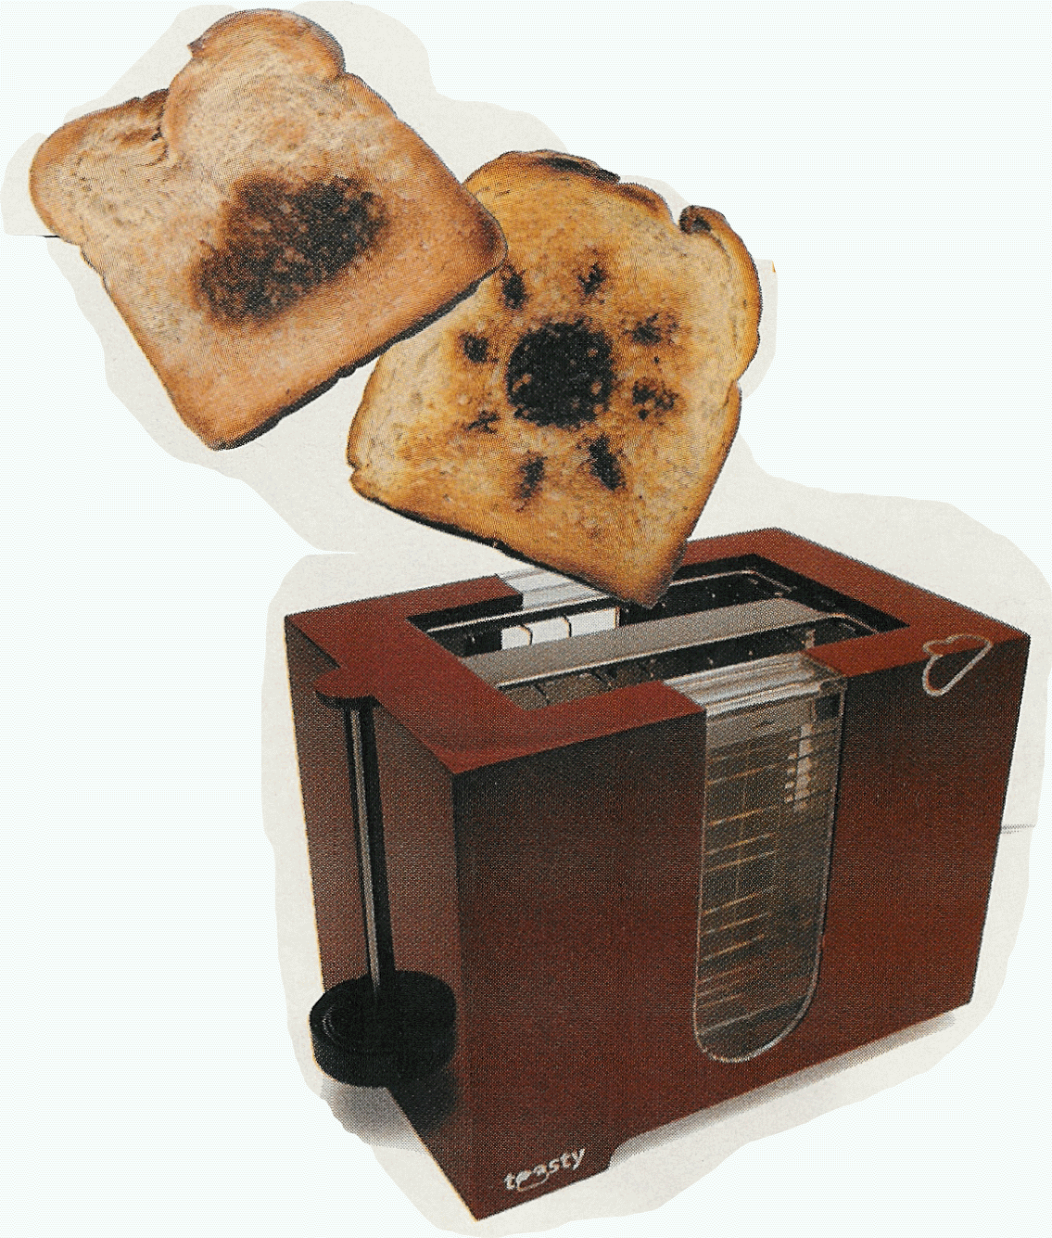
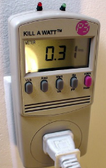
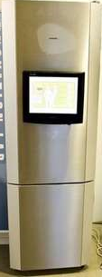
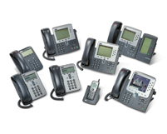

“Fun” internet appliances
Web-enabled toaster +
weather forecaster
IP picture frame
http://www.ceiva.com/
Tweet-a-watt:
monitor energy use
Slingbox: watch,
control cable TV remotely
Internet
refrigerator
Internet phones
Introduction
1-<number>

Slide 15
What's the Internet: “nuts and bolts” view
Internet: “network of networks”
  Interconnected ISPs
protocols control sending, receiving of msgs
  e.g., TCP, IP, HTTP, Skype, 802.11
Internet standards
  RFC: Request for comments
  IETF: Internet Engineering Task Force
mobile network
global ISP
home
network
regional ISP
institutional
network
Introduction
1-<number>

Slide 16
What's the Internet: a service view
mobile network
Infrastructure that provides services to applications:
  Web, VoIP, email, games, e-commerce, social nets, …
provides programming interface to apps
  hooks that allow sending and receiving app programs to “connect” to Internet
  provides service options, analogous to postal service
global ISP
home
network
regional ISP
institutional
network
Introduction
1-<number>

Slide 17
What's a protocol?
human protocols:
“What's the time?”
“I have a question”
introductions
… specific msgs sent
… specific actions taken when msgs received, or other events
network protocols:
machines rather than humans
all communication activity in Internet governed by protocols
protocols define the format, and order of msgs sent and received among network entities, and actions taken on msg transmission, receipt
Introduction
1-<number>

Slide 18



What's a protocol?
a human protocol and a computer network protocol:
Hi
TCP connection
request
Hi
TCP connection
response
Got the
time?
Get http://www.awl.com/kurose-ross
2:00
<file>
time
Q: other human protocols?
Introduction
1-<number>

Slide 19
Chapter 1: roadmap
  1.1 what is the Internet?
  1.2 network edge
    end systems, access networks, links
  1.3 network core
    packet switching, circuit switching, network structure
  1.4 delay, loss, throughput in networks
  1.5 protocol layers, service models
  1.6 networks under attack: security
  1.7 history
Introduction
1-<number>

Slide 20

A closer look at network structure:
network edge:
  hosts: clients and servers
  servers often in data centers
mobile network
global ISP
access networks, physical media: wired, wireless communication links
home
network
regional ISP
network core:
  interconnected routers
  network of networks
institutional
network
Introduction
1-<number>

Slide 21


Access networks and physical media
Q: How to connect end systems to edge router?
residential access nets
institutional access networks (school, company)
mobile access networks
keep in mind:
bandwidth (bits per second) of access network?
shared or dedicated?
Introduction
1-<number>

Slide 22

Access net: digital subscriber line (DSL)
central office
telephone
network
DSL
modem
splitter
DSLAM
ISP
voice, data transmitted
at different frequencies over
dedicated line to central office
DSL access
multiplexer
  use existing telephone line to central office DSLAM
    data over DSL phone line goes to Internet
    voice over DSL phone line goes to telephone net
  < 2.5 Mbps upstream transmission rate (typically < 1 Mbps)
  < 24 Mbps downstream transmission rate (typically < 10 Mbps)
Introduction
1-<number>

Slide 23
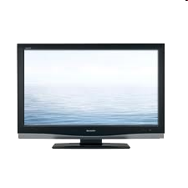


Access net: cable network
cable headend
…
cable
modem
splitter
C
O
N
T
R
O
L
V
I
D
E
O
V
I
D
E
O
V
I
D
E
O
V
I
D
E
O
V
I
D
E
O
V
I
D
E
O
D
A
T
A
D
A
T
A
1
2
3
4
5
6
7
8
9
Channels
frequency division multiplexing: different channels transmitted
in different frequency bands
Introduction
1-<number>

Slide 24
Access net: cable network
cable headend
…
cable
modem
splitter
CMTS
cable modem
termination system
data, TV transmitted at different
frequencies over shared cable
distribution network
ISP
HFC: hybrid fiber coax
  asymmetric: up to 30Mbps downstream transmission rate, 2 Mbps upstream transmission rate
network of cable, fiber attaches homes to ISP router
  homes share access network to cable headend
  unlike DSL, which has dedicated access to central office
Introduction
1-<number>

Slide 25





Access net: home network
wireless
devices
to/from headend or central office
often combined
in single box
cable or DSL modem
wireless access
point (54 Mbps)
router, firewall, NAT
wired Ethernet (100 Mbps)
Introduction
1-<number>

Slide 26









Enterprise access networks (Ethernet)
institutional link to
ISP (Internet)
institutional router
Ethernet
switch
institutional mail,
web servers
typically used in companies, universities, etc
  10 Mbps, 100Mbps, 1Gbps, 10Gbps transmission rates
  today, end systems typically connect into Ethernet switch
Introduction
1-<number>

Slide 27








Wireless access networks
shared wireless access network connects end system to router
  via base station aka “access point”
wide-area wireless access
  provided by telco (cellular) operator, 10’s km
  between 1 and 10 Mbps
  3G, 4G: LTE
wireless LANs:
  within building (100-200+ ft)
  802.11b/g/n (WiFi): 11, 54, 150(x4) Mbps transmission rate
to Internet
to Internet
Introduction
1-<number>

Slide 28


Host: sends packets of data
host sending function:
takes application message
breaks into smaller chunks, known as packets, of length L bits
transmits packet into access network at transmission rate R
  link transmission rate, aka link capacity, aka link bandwidth
two packets,
L bits each
2
1
R: link transmission rate
host
packet
transmission
delay
time needed to
transmit L-bit
packet into link
L (bits)
R (bits/sec)
=
=
1-<number>

Slide 29

Physical media
bit: propagates between
transmitter/receiver pairs
physical link: what lies between transmitter & receiver
guided media:
  signals propagate in solid media: copper, fiber, coax
unguided media:
  signals propagate freely, e.g., radio (WiFi)
twisted pair (TP)
two insulated copper wires
  Category 5: 100 Mbps, 1 Gpbs Ethernet
  Category 6: 10Gbps
Introduction
1-<number>

Slide 30


Physical media: coax, fiber
coaxial cable:
two concentric copper conductors
bidirectional
broadband:
  multiple channels on cable
  HFC
fiber optic cable:
glass fiber carrying light pulses, each pulse a bit
high-speed operation:
  high-speed point-to-point transmission (e.g., 10’s-100’s Gpbs transmission rate)
low loss/error rate:
  repeaters spaced far apart
  immune to electromagnetic noise
Introduction
1-<number>

Slide 31
Physical media: radio
signal carried in electromagnetic spectrum
no physical “wire”
bidirectional
propagation environment effects:
  reflection
  obstruction by objects
  interference
radio link types:
terrestrial microwave
  e.g. up to 45 Mbps channels
LAN (e.g., WiFi)
  11Mbps, 54 Mbps, 150+
wide-area (e.g., cellular)
  3G cellular: ~ few Mbps
satellite
  Kbps to 45Mbps channel (or multiple smaller channels)
  270 msec end-end delay (high)
  geosynchronous versus low altitude
Introduction
1-<number>

