Slide 1
Addressing Distributional Shifts in Order Fulfillment
A
B
Md. Al Imran · Rangpur, Bangladesh

Slide 2
Overview
1
The question
2
The approach
This paper studies how manufacturers can obtain reliable throughput time predictions when future orders differ systematically from historical ones (a distributional shift).
The authors propose training a neural network with Wasserstein distance-guided representation learning (WDGRL), which uses the unlabeled features of the forthcoming orders to align the learned representations of old and new orders.

Slide 3
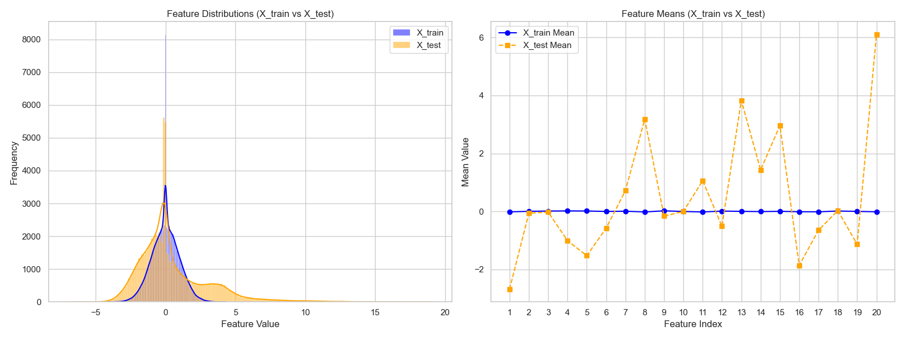
Business Problem
Goal
Throughput time
Distributional shift
Manufacturers aim to deliver orders on time.
How long each order takes to complete.
Future orders can look different from past data.
Feature distributions and means: historical orders vs. forthcoming orders

Slide 4
Case Study: Aker Solutions
A
Setting A · Historical, labeled
B
Setting B · Forthcoming, unlabeled
5,830 spools
3,866 spools
Johan Castberg vessel, January to September 2019.
Johan Sverdrup modification, September 2019 to April 2020.
20 features per spool. Semi-synthetic experiments: Gaussian features, shift strength θ = 1 to 4, labels from a random forest plus noise.

Slide 5
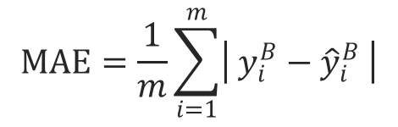
Two-Stage Decision Problem
Predict-then-optimize under shift
1
Stage 1: Prediction
Predict throughput times; accuracy is measured by MAE on the forthcoming orders (B).
2
Stage 2: Scheduling
Schedule orders using the predictions; cost penalizes early and tardy completion.

Slide 6
Proposed Method
Core idea: learn a representation that looks the same for A and B.
The authors use Wasserstein distance-guided representation learning (WDGRL), which trains three small neural networks jointly:
fe
Feature extractor
fr
Regressor
fc
Critic
Maps the 20 raw features into a shared latent space.
Predicts throughput time from the labeled setting A.
Estimates the Wasserstein distance between A and B. Used in training only.

Slide 7
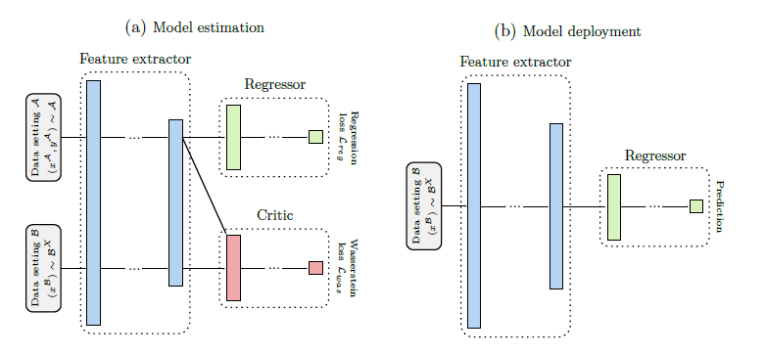
Model Architecture of WDGRL
Critic f_{c}
Objective: Maximize the Wasserstein loss
Intuition: Detect the distributional differences between A and B
Feature extractor f_{e}
Objective: Minimize the regression loss and the estimated distance
Intuition: Preserve predictive information while reducing domain differences
Regressor f_{r}
Objective: Minimize the regression loss
Intuition: Predict the source throughput times accurately

Slide 8
Experiments
Semi-synthetic design
Models compared
1
Compute the mean and covariance of the real Aker features for A and B.
Elastic Net
Regularized linear regression model
2
Sample synthetic features for A. For B, shift the mean from A toward B by a factor θ ∈ {1, 2, 3, 4}; larger θ means a stronger shift.
Baseline neural network
Non-linear model
3
Generate throughput times as y = φ(x) + noise, where φ is a random forest fitted to real Aker data.
WDGRL
Proposed Wasserstein distance-guided representation learning model

Slide 9
Result Analysis (1/2)
Strongest shift (θ = 4); same method ranking at every θ
Method | MAE |  | Scheduling cost
 | Paper | Replication | Paper | Replication
Elastic Net | 31.5 | 29.6 | 4,454 | 4,205
Neural network | 31.4 | 28.4 | 4,568 | 4,259
WDGRL | 23.8 | 22.6 | 2,954 | 2,668
WDGRL cost reduction vs. neural network (θ = 4)
Cost change from θ = 1 to θ = 4
35.3%
37.4%
 | Paper | Replication
Neural network | +55.8% | +51.0%
WDGRL | +6.2% | −3.1%
Paper
Replication

Slide 10
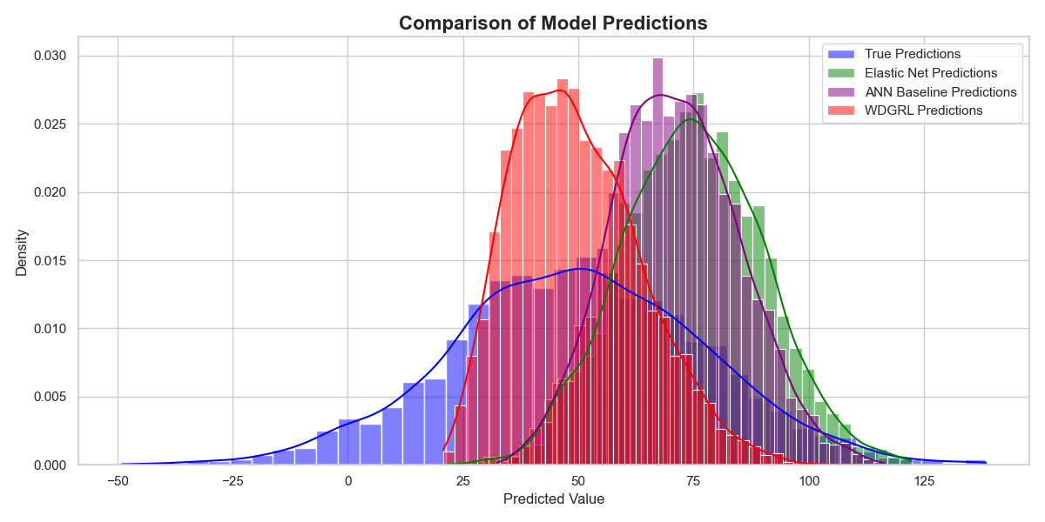
Result Analysis (2/2)
Predictions of the three models vs. true target values at θ = 4
Key takeaway
At strong shift, WDGRL is clearly better than the other models.

Slide 11
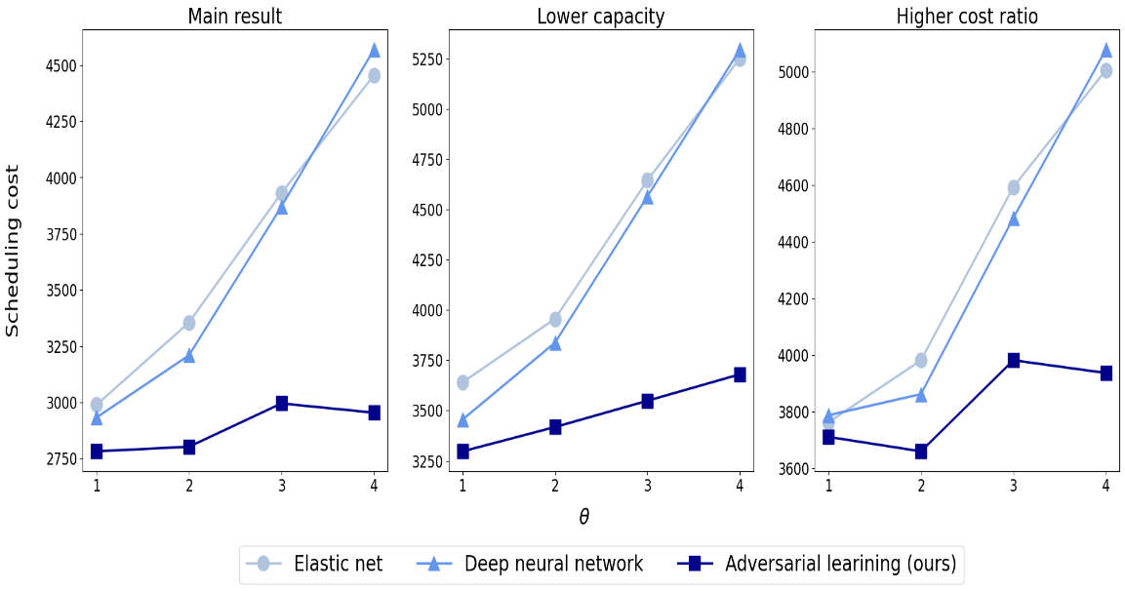
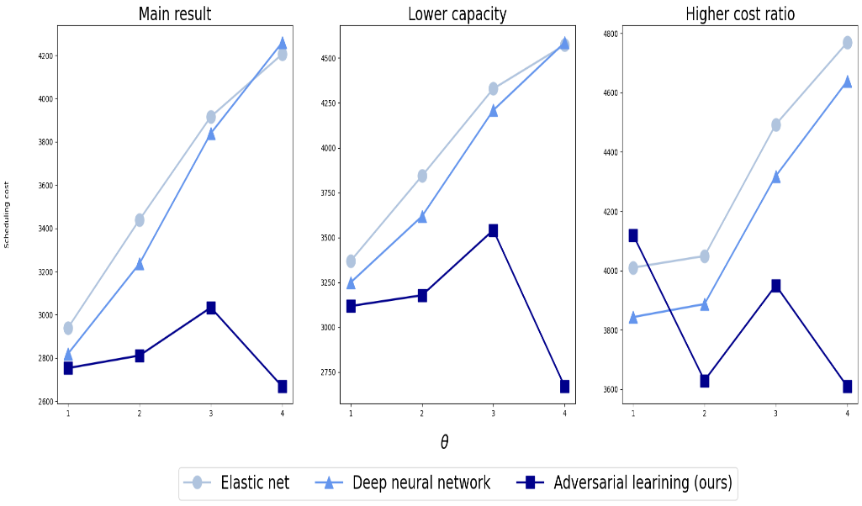
Robustness Experiments
Lower production capacity
Higher tardiness cost
Different noise distribution
Different outcome-generating function
Authors: scheduling cost for the main setting, lower capacity, and higher tardiness cost
Replication: scheduling cost for the main setting, lower capacity, and higher tardiness cost

Slide 12
Limitations and Future Work
1
2
3
Covariate shift only
Similarity of old and new orders
Semi-synthetic design
4
5
6
Simplified scheduling
Single solver and decoupled design
Baseline architecture

Slide 13
Conclusion
WDGRL turns unlabeled future data into more robust predictions and schedules.
1
The qualitative result is reproduced; numerical values differ moderately.
2
Evidence is semi-synthetic and should be confirmed on real post-shift data.
3
Resource Link: github.com/rotoncsedu/phd_evaluation_task

Slide 14



