Slide 1
Fall Detection using 24 Ghz MM wave radar sensor
Akash Jena

Slide 2
Project Overview
Objective: Detect and classify human activities (Sitting, Standing, Walking, Falling) to identify fall-prone behaviors using radar data.
Hardware Used:
Seeed Studio 24GHz mmWave Sensor (MR24D11C10): Detects movement and presence.
XIAO BLE Sense Board: Microcontroller used to read sensor data.
SD Card Module: Used to log raw radar data for training.
Approach:
Use raw byte data from the radar sensor.
Train a 1D CNN model to classify activities based on those bytes.

Slide 3
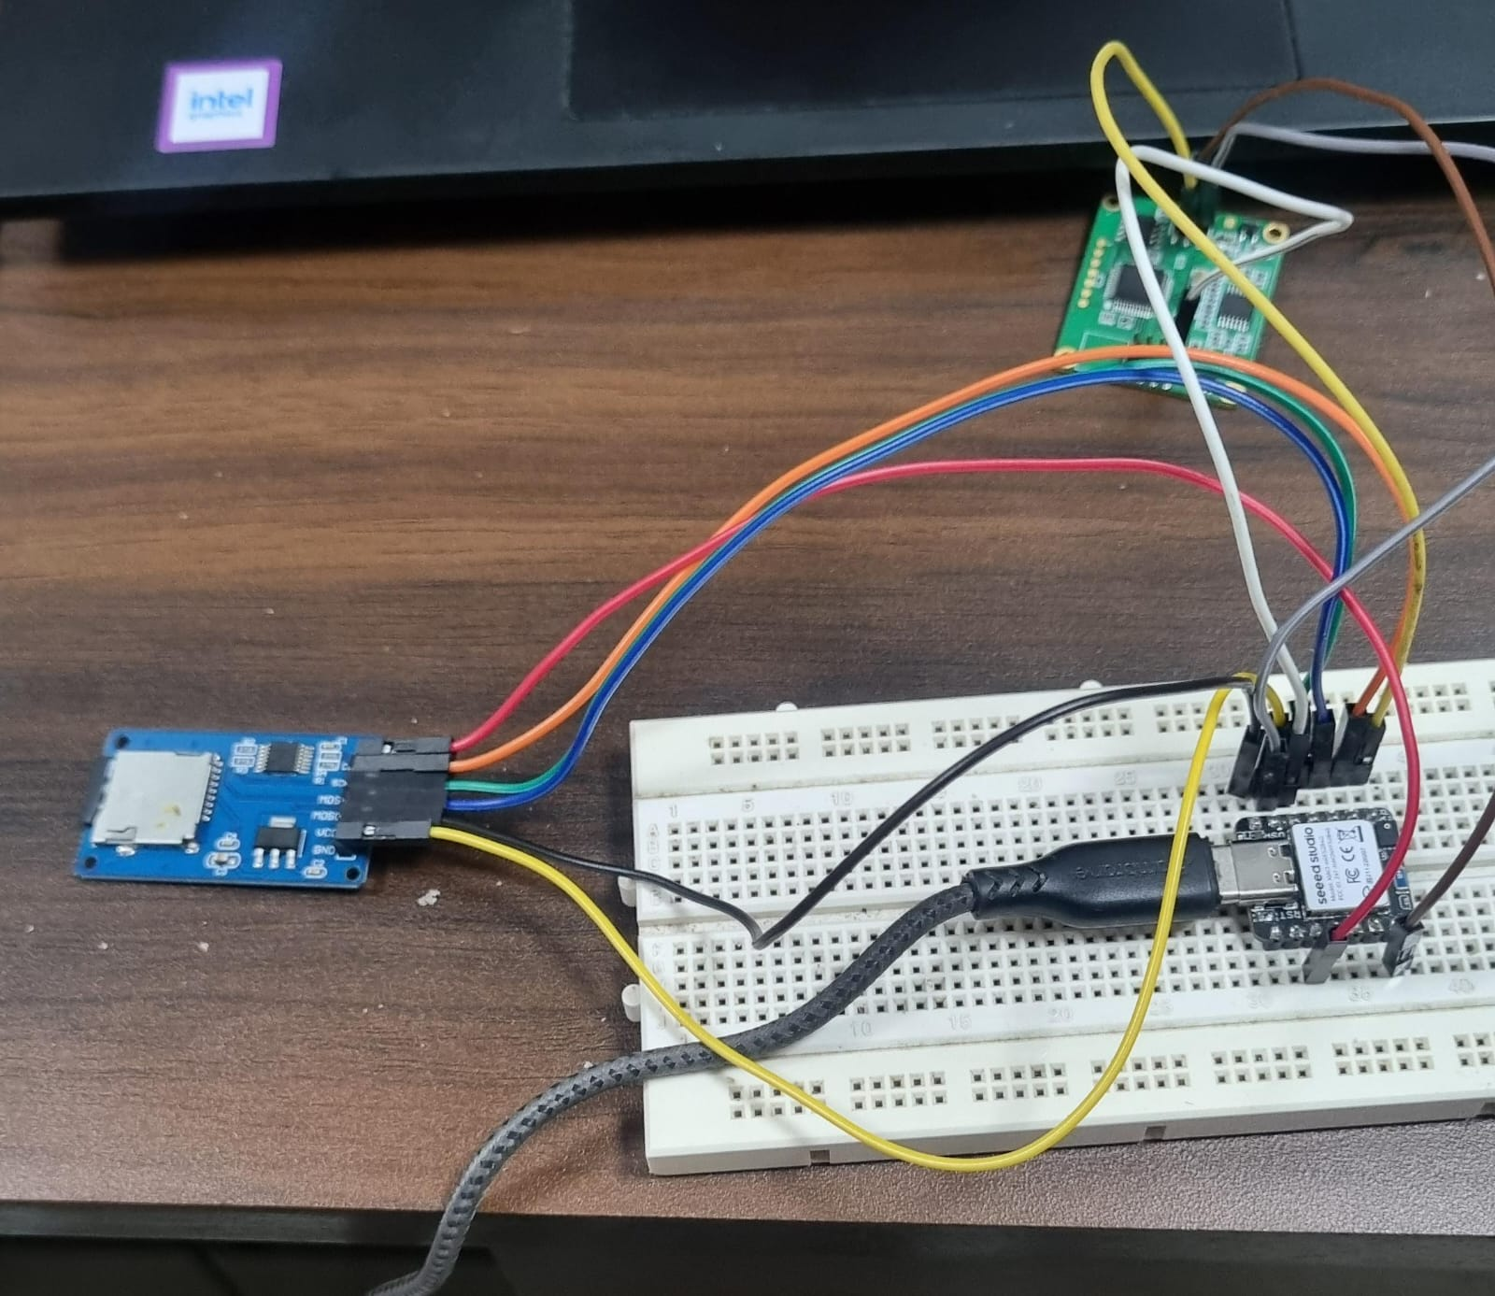
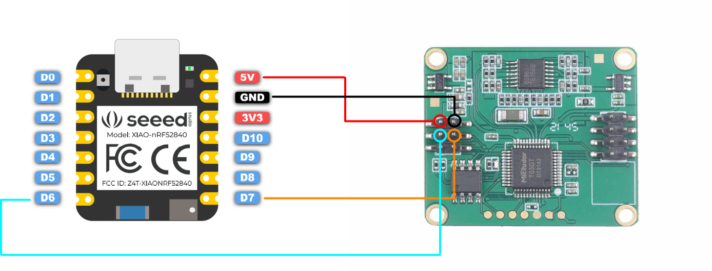
Setup

Slide 4
Data Collection
Sensor Output Details:
Each radar frame outputs bytes representing various features.
Bytes at index 4 (Presence byte) and 8 (energy signal byte) selected for training (2 features per timestep).
Arduino Logging:
Radar bytes collected and logged to SD card via serial interface.
Sampling:
300 samples per class initially collected (Sitting, Standing, Walking).
Each sample consists of a fixed number of timesteps.

Slide 5
Preprocessing Steps
Hex to Int Conversion:
Raw bytes are in hexadecimal format and converted to integers.
Activity Labeling:
Sitting: Label 0
Standing: Label 1
Walking: Label 2
Reshape for CNN:
Final shape: (samples, timesteps, 2 features)
Normalization:
All features normalized to ensure stable training.

Slide 6
Model Architecture
Model Type: 1D Convolutional Neural Network (CNN)
Layer Breakdown:
Conv1D Layer: Captures temporal features across byte sequences.
MaxPooling1D: Reduces dimensionality and computation.
Flatten Layer: Converts output to 1D vector.
Dense (ReLU): Learns complex patterns.
Output Dense (Softmax): Predicts class probabilities.
Training Setup:
Loss Function: Categorical Crossentropy
Optimizer: Adam
Accuracy Metric Used

Slide 7
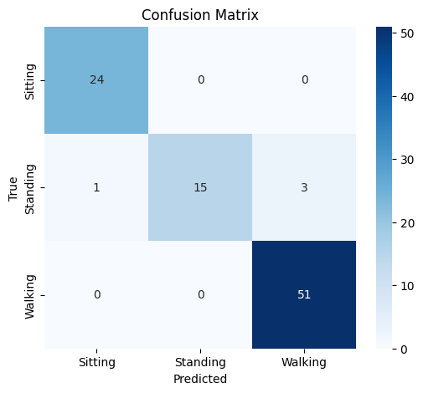
Experiment 1 - Imbalanced Data
Class Distribution:
Sitting: 120 samples
Standing: 120 samples
Walking: 300 samples
Split: 80% Training, 20% Testing
Results:
Achieved 98% accuracy on test set
Analysis:
Model biased towards walking due to class imbalance
Overfitting likely due to small sample size for Sitting/Standing

Slide 8
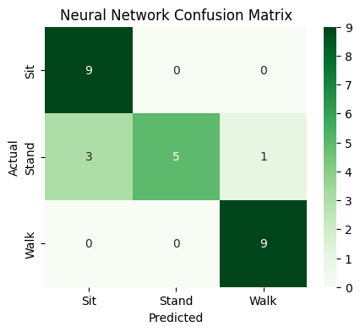
Experiment 2 - Balanced Data
Balanced Class Distribution:
300 samples each for Sitting, Standing, and Walking
Split: 80% Training, 20% Testing
Results:
Accuracy dropped to 85%
Analysis:
Better data balance but poor generalization
Model may need more data or tuning

Slide 9
Analysis and Next Steps
Key Takeaways:
Balanced data gives realistic accuracy.
Accuracy drop indicates model needs improvement.
Problems Identified:
Limited training samples (only 300/class)
Radar bytes used might not be optimal features.
Next Steps:
Collect 1000 samples/class
Divide each class into: 800 training, 100 validation, 100 testing
Tune model using validation data
Try alternate models (LSTM, 2D CNN)
Apply data smoothing or filtering techniques

Slide 10
Conclusion
Achievements:
Successfully implemented basic activity classification using radar and 1D CNN
Challenges:
Accuracy varies significantly with dataset balance
Planned Improvements:
Expand dataset for robustness
Experiment with different byte selections and models
Apply validation techniques for better generalization

Slide 11
THANK YOU

