Slide 1
Git - theory

Slide 2
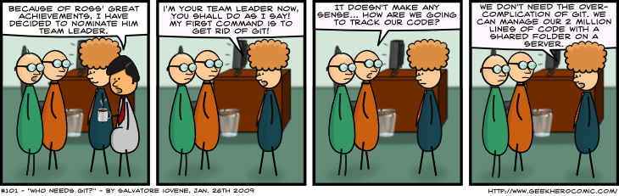
Who needs Git?

Slide 3
Topics
What is Git?
SCM concepts used in Git
Git object model
Representation of Git objects as files
References

Slide 4
Git
A collection of tools developed by Linux kernel group for SCM
Now used by several other groups, and apparently growing in popularity

Slide 5
Git has a lot of commands
Learn a core subset of them
And one of the GUI tools (e.g., gitk)
Then learn the rest as you need them

Slide 6
Groups of Git commands
Setup and branch management
init, checkout, branch
Modify
add, delete, rename, commit
Get information
status, diff, log
Create reference points
tag, branch

Slide 7
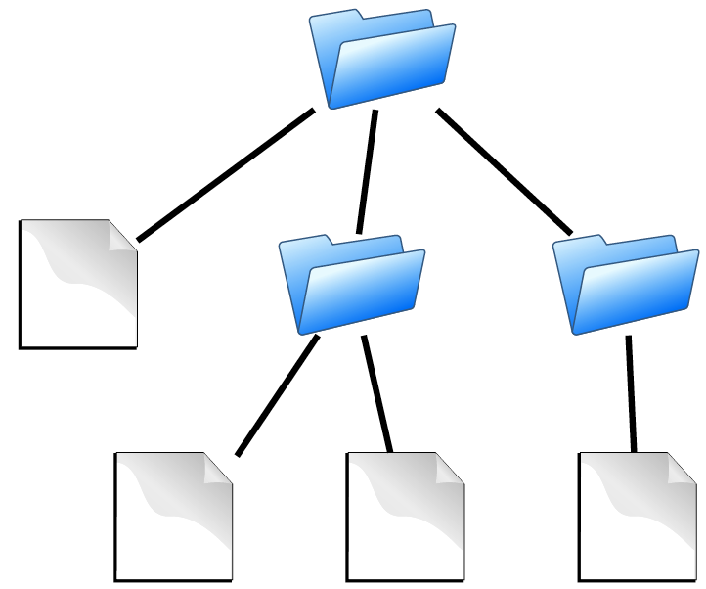
Source code
contains
Directories
Files

Slide 8
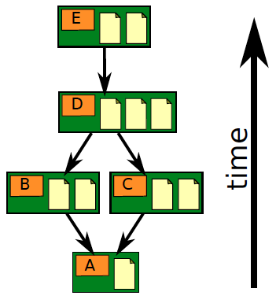
Repository
Contains
files
commits
ancestry relationships

Slide 9
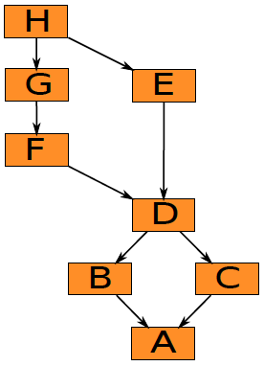
Ancestry relationships
form a directed acyclic graph (DAG)

Slide 10
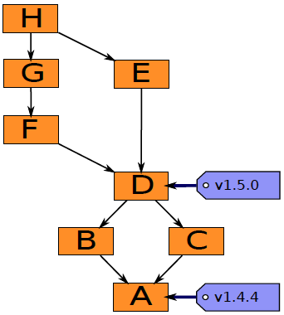
Ancestry graph features
Tags
identify versions of interest
including “releases”

Slide 11
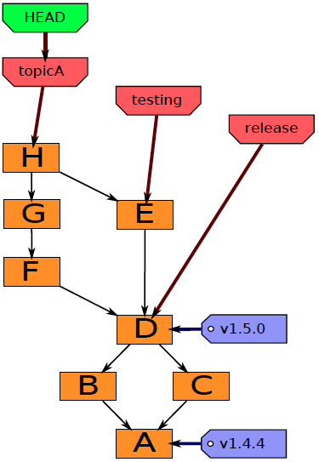
Ancestry graph features
HEAD
is current checkout
usually points to a branch

Slide 12
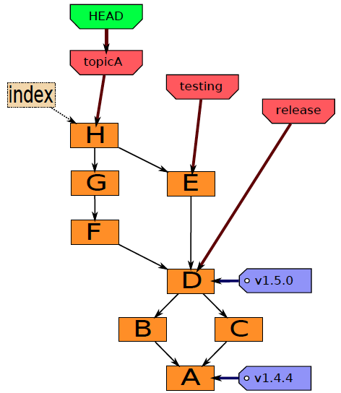
Git components
Index
“staging area”
what is to be committed

Slide 13
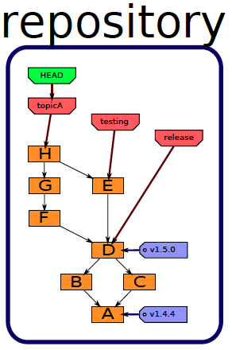
History
A database, stored in directory “.git”.

Slide 14
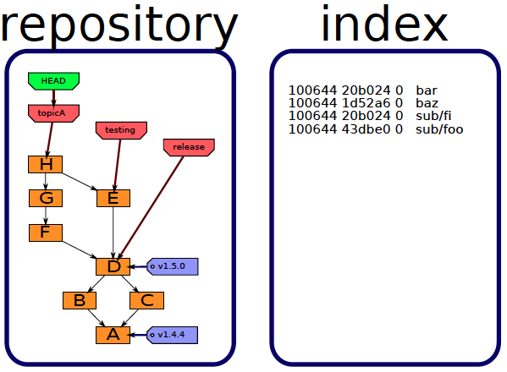
Staging area
Also stored in directory “.git”.

Slide 15
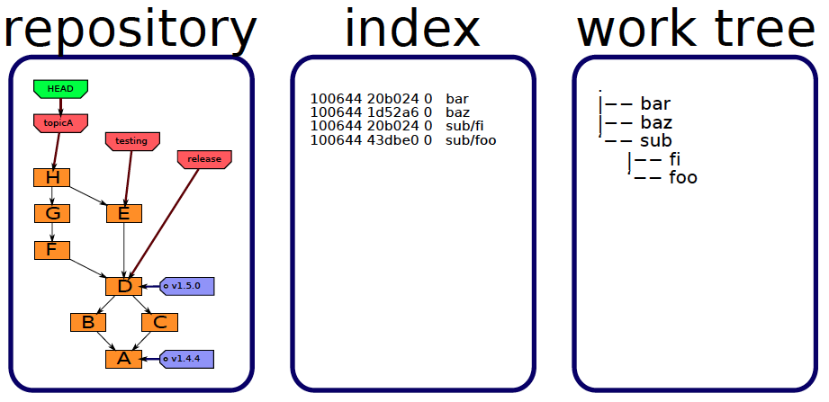
Files you edit
Stored in the directory containing directory “.git”.

Slide 16
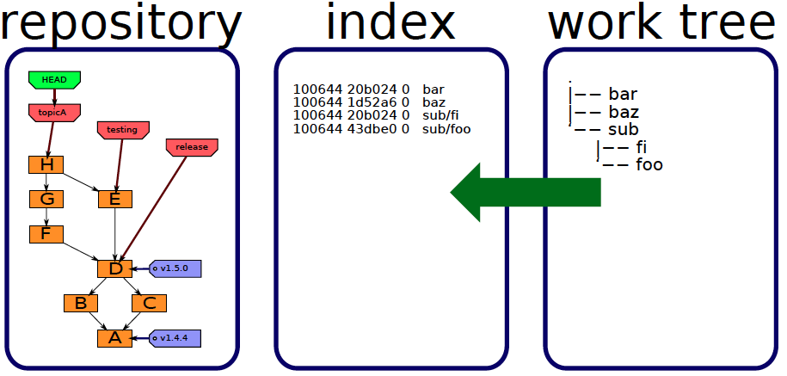
Staging
add

Slide 17
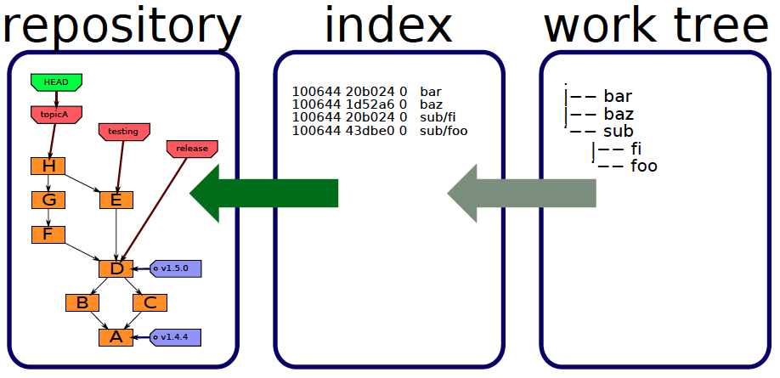
Committing
commit

Slide 18
Push - Update remote repo

Slide 19
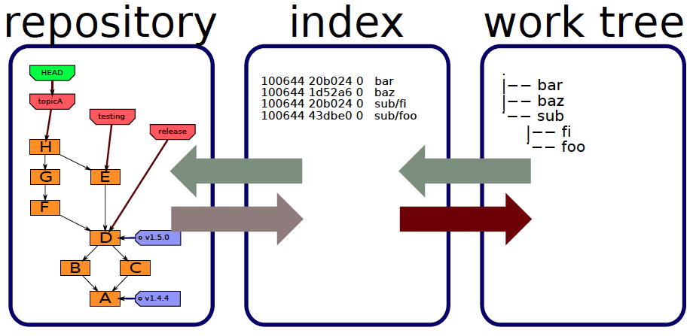
Checking out
checkout
checkout

Slide 20
Local checkout/brunch Operations
Local Repo
Index (staging area)
Working directory
checkout the project
add (stage) files
commit

Slide 21
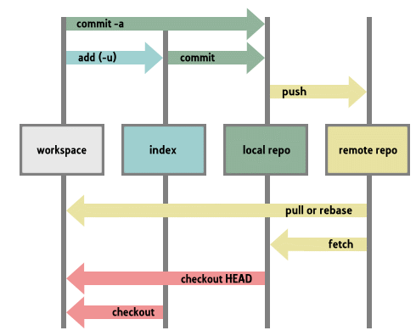
Full picture

Slide 22
Brunch Operations
Initial commit
Second commit
Third commit
Bob’s commit
Fourth commit
Bob’s commit
Merge

Slide 23
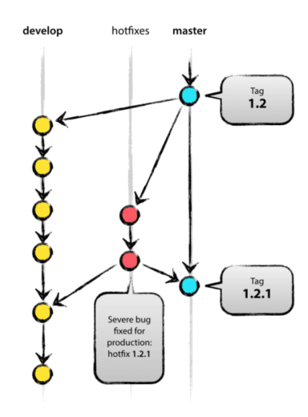
Feature branches (topic branches)
May branch off from:
○ develop
● May merge back into:
○ develop
● Branching name convention:
○ anything except master,
develop,release-* or hotfix-*

Slide 24
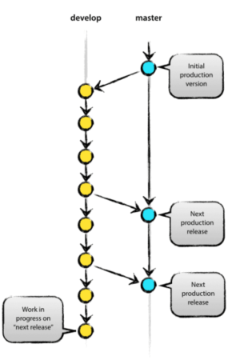
The main branches
master
○ contains production ready code
develop
○ an integration branch
○ contains the latest changes
○ used for nightly builds
○ getting a production release when merging with master

Slide 25
Feature branches (topic branches)
May branch off from:
○ develop
● May merge back into:
○ develop
● Branching name convention:
○ anything except master,
develop,release-* or hotfix-*

Slide 26
Some other repository files
.git/config
.git/description – used by gitweb
.git/info/exclude – files to ignore
...

Slide 27
תכלס
Create brunch (Unique name)
git checkout -b develop
Switch back to the master
git checkout master
Merge
git merge develop --no-ff
see details of using brunch

Slide 28
Tools
tortoisegit
gitHub desktop
eclipse build in support

Slide 29
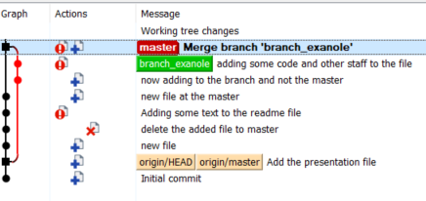
Exercise - Hand on
clone repo https://github.com/rotshtein/gitintro.git
add file to the master
create branch called <your name> and switch
add file and commit
switch to master - verify no new file
Merge <your name> branch into the master
commit and push (poll if needed)
wait until all finish
pull
see log

Slide 30
Q & a

