Slide 1


CDI and OSGi
So happy together!
Raymond Augé
raymond.auge@liferay.com
Notes:
“La ingeniería de eq de fases comprende la aplicación del conocimiento fenomenológico del comportamiento de sistemas homogéneos y multifásicos, y su predicción mediante herramientas termodinámicas, con la finalidad de contribuir al desarrollo de procesos químicos. El diseño del equilibrio de fases es un nexo entre los requerimiento de un dado proceso y las actividades académicas de medición y modelado de datos experimentales.
[…] Esta disponibilidad (de simuladores computacionales) hace necesario estudiarla, con la finalidad de alcanzar un uso más fehaciente y efectivo de éstos, a través del desarrollo de criterios generales que faciliten la comprensión del potencial y limitaciones del proceso químico.”
Pereda, tesis doctoral, PLAPIQUI/UNS 2003, pp 4.1.

Slide 2
Disclaimer
Everything in this presentation is subject to change at any time as it consists of in-progress specification work.

Slide 3
CDI - Key Goals
Develop a simple and intuitive model for existing CDI developers
Simplify OSGi challenges for new adopters
Take advantage of CDI’s SPI as much as possible to ensure compatibility
Enable the simplest migration path for existing applications

Slide 4
OSGi - Key Goals
Provide services (of all service scopes)
Optional, greedy/reluctant, static/dynamic, unary/n-ary, ordered service dependencies
Integration with Configuration Admin (& factory configurations)
Lazy dependency management (no damping!)

Slide 5
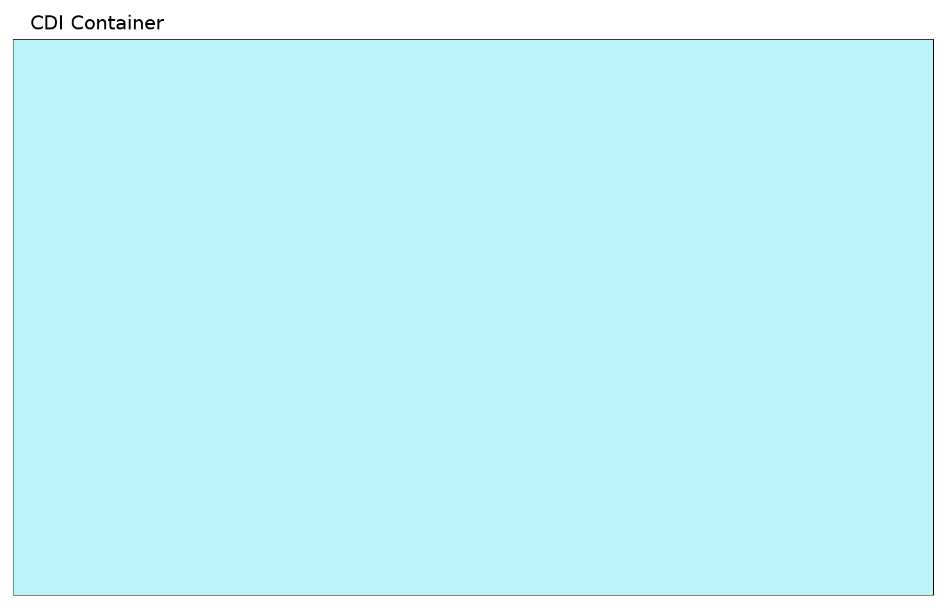
CDI Container

Slide 6
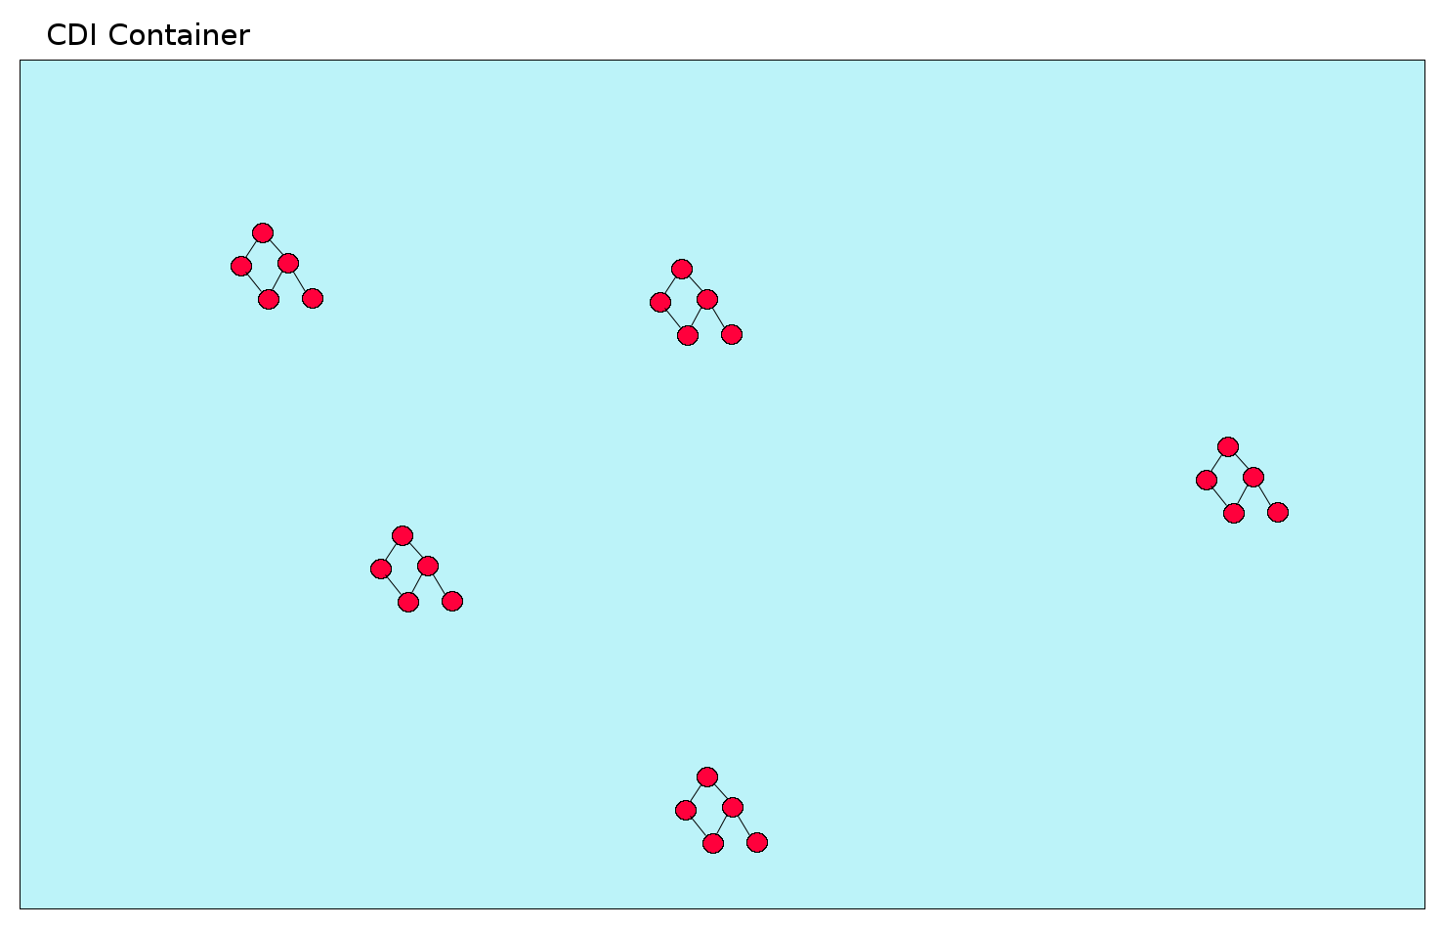
CDI Container holds Managed Beans define graphs instances

Slide 7
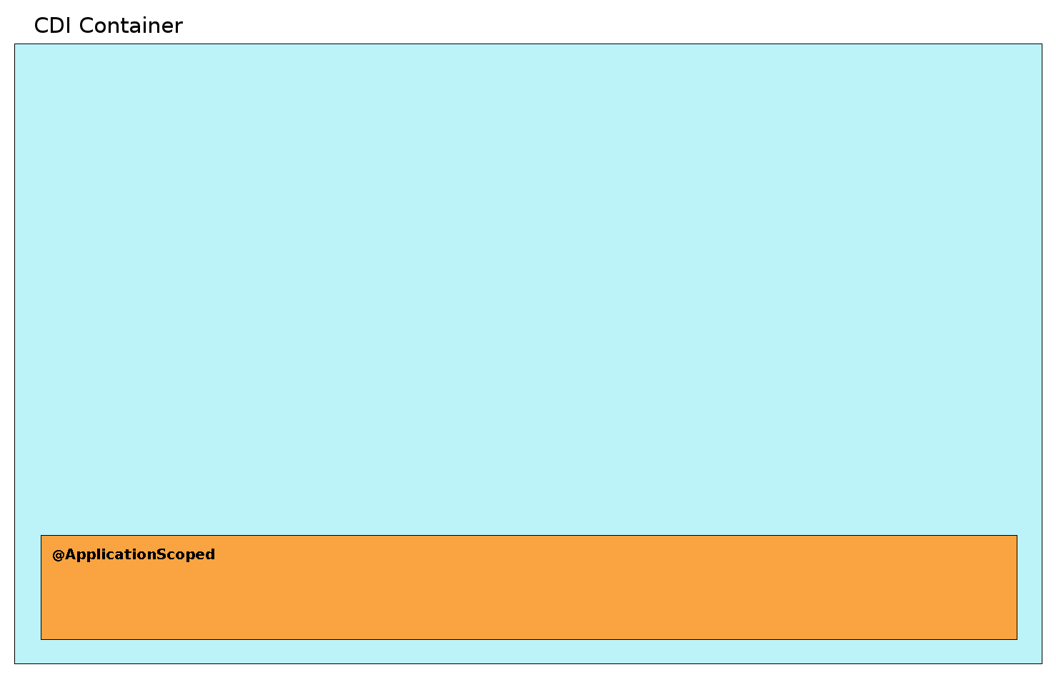
Managed Beans have a Scope

Slide 8
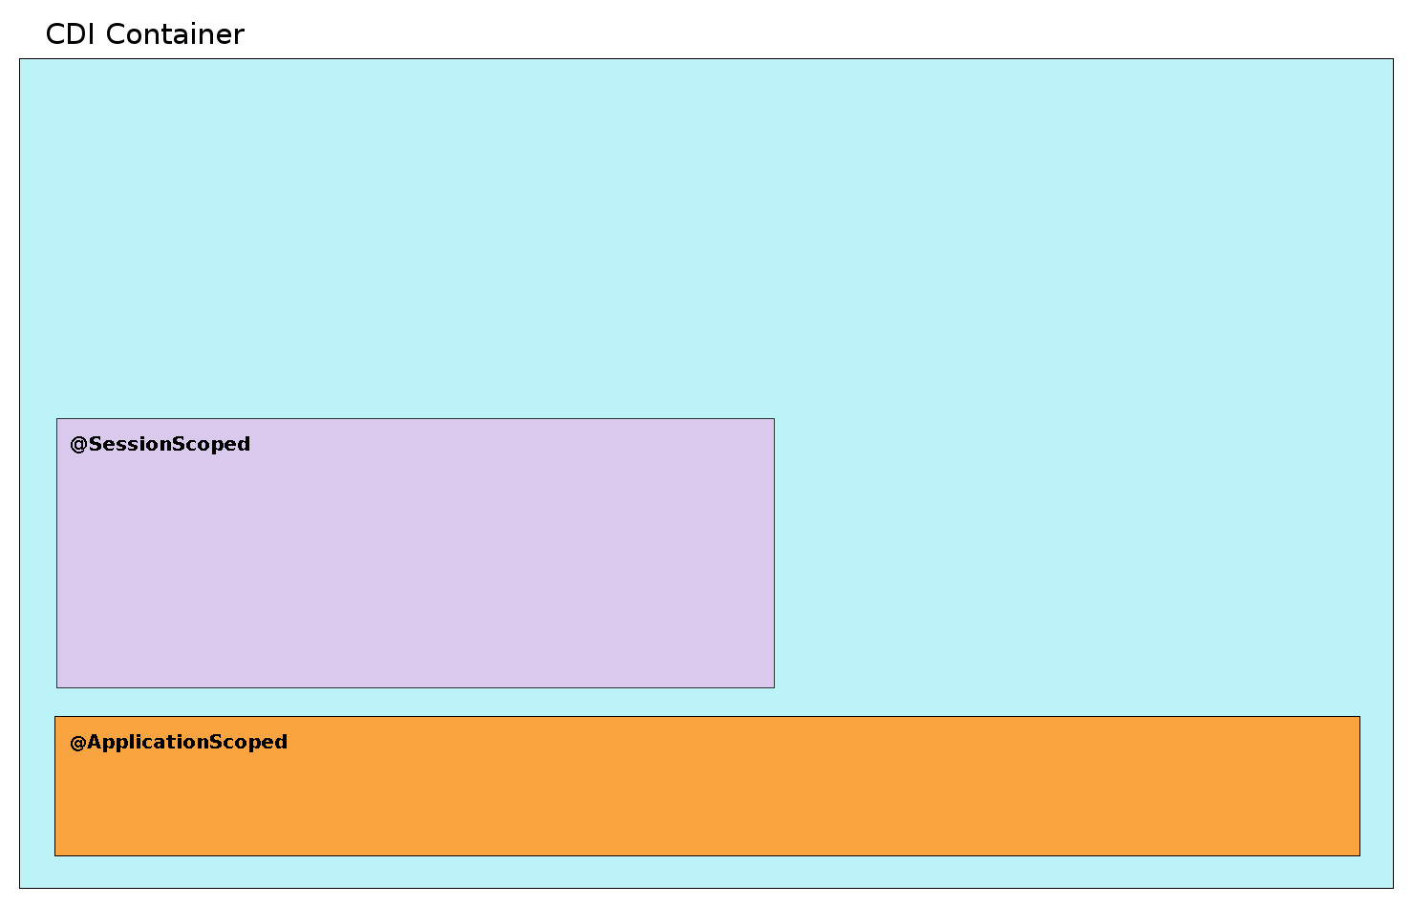
Scopes define Lifecycle of managed beans

Slide 9
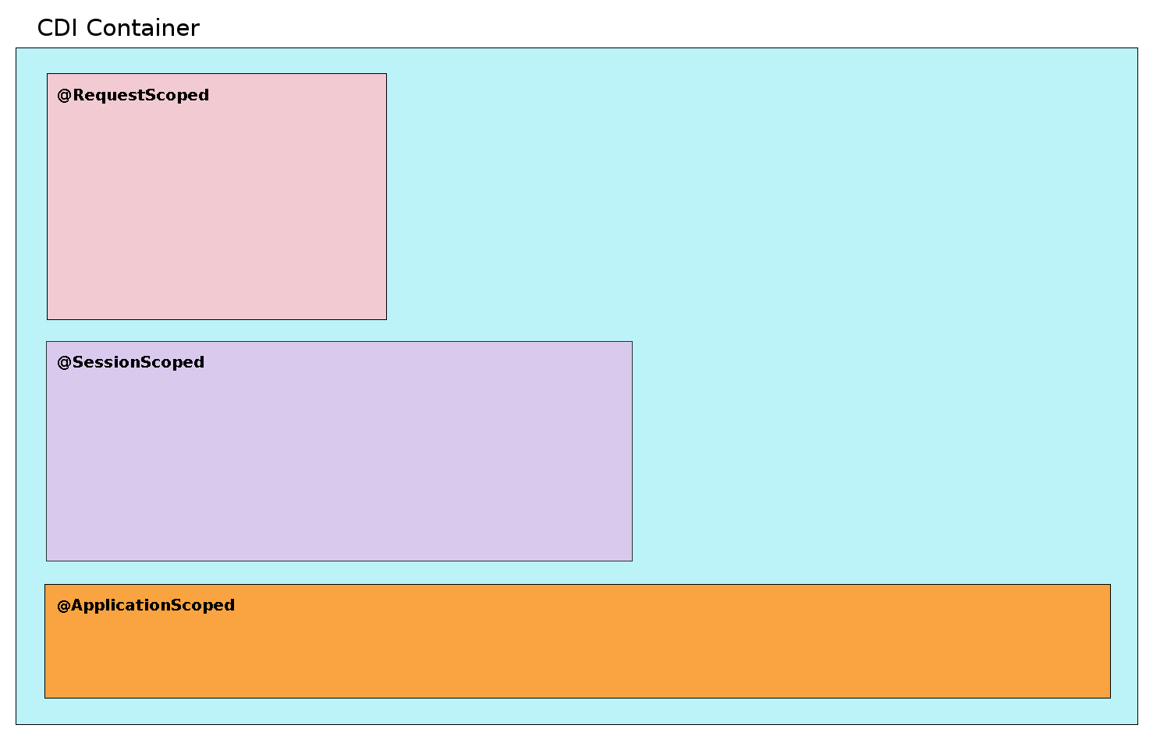
Lifecycle follow edges of business logic resulting in Contexts which hold contextual instances

Slide 10
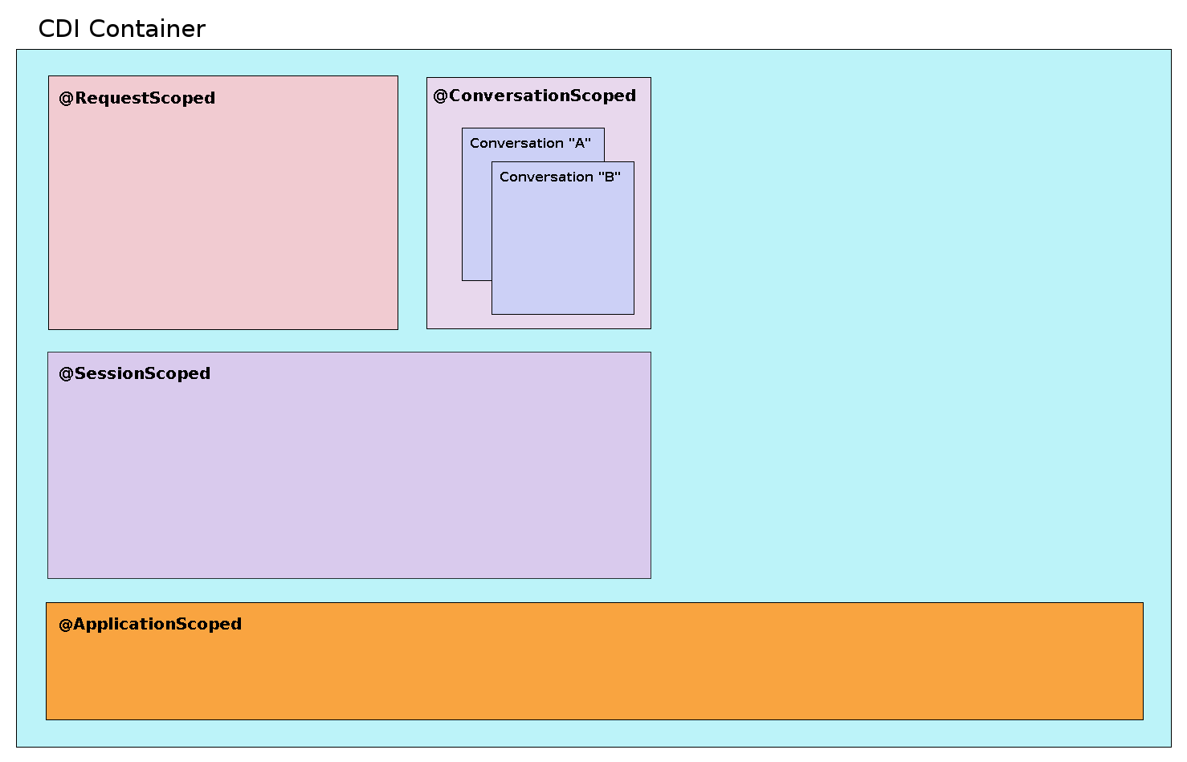
Scope’s lifecycle is guided by business rules, may include aspects like identity

Slide 11
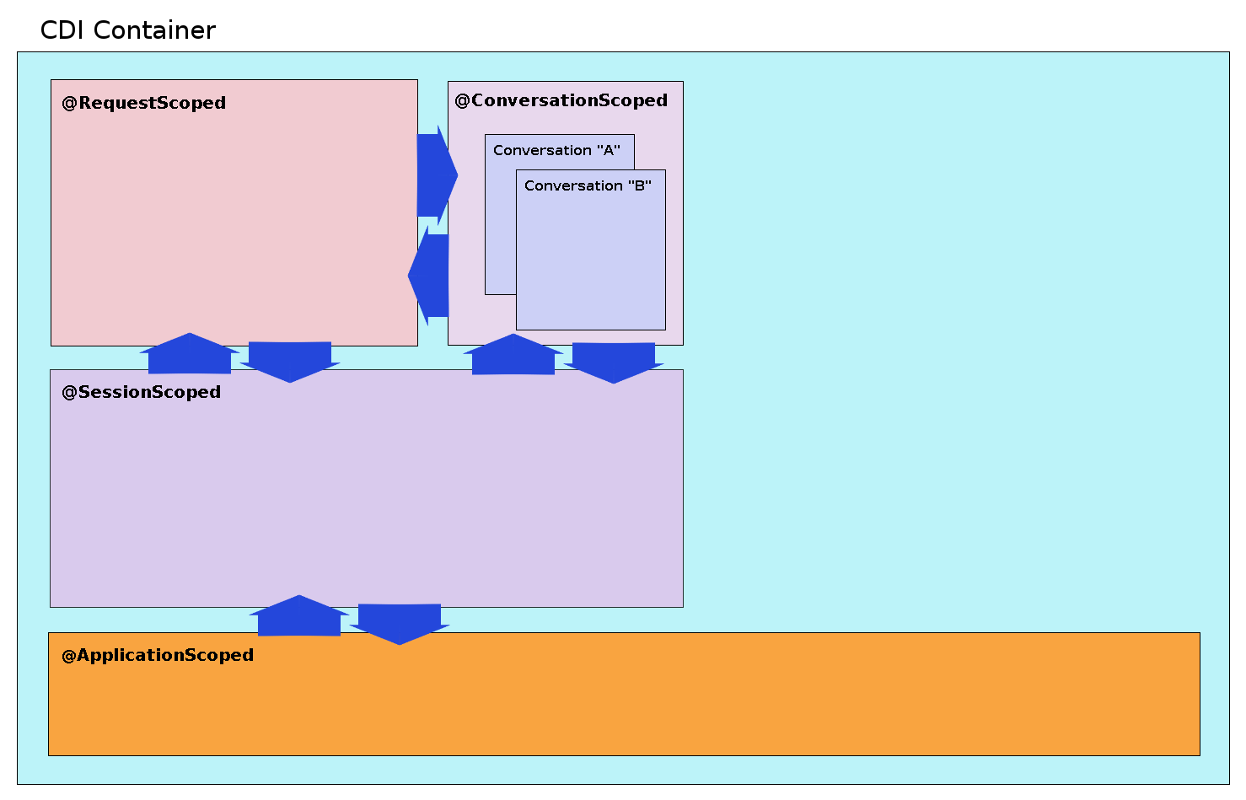
Interactions defined by which scopes are Active as well as business rules

Slide 12
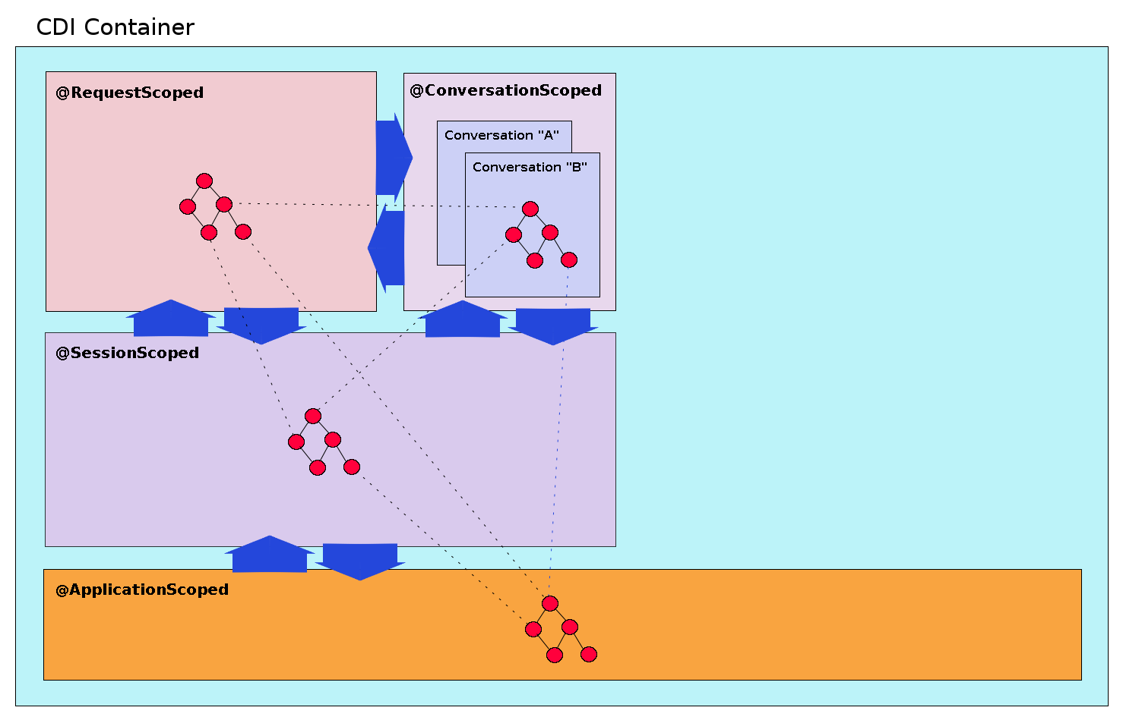
Injection across scopes requires visibility

Slide 13
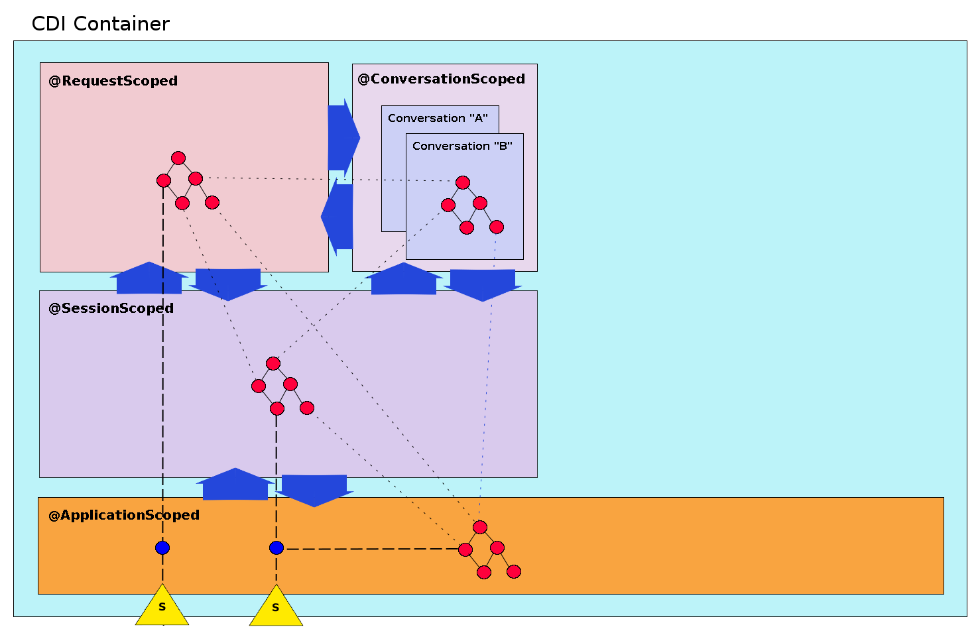
Services are available to traditional scopes via synthetic reference bean

Slide 14
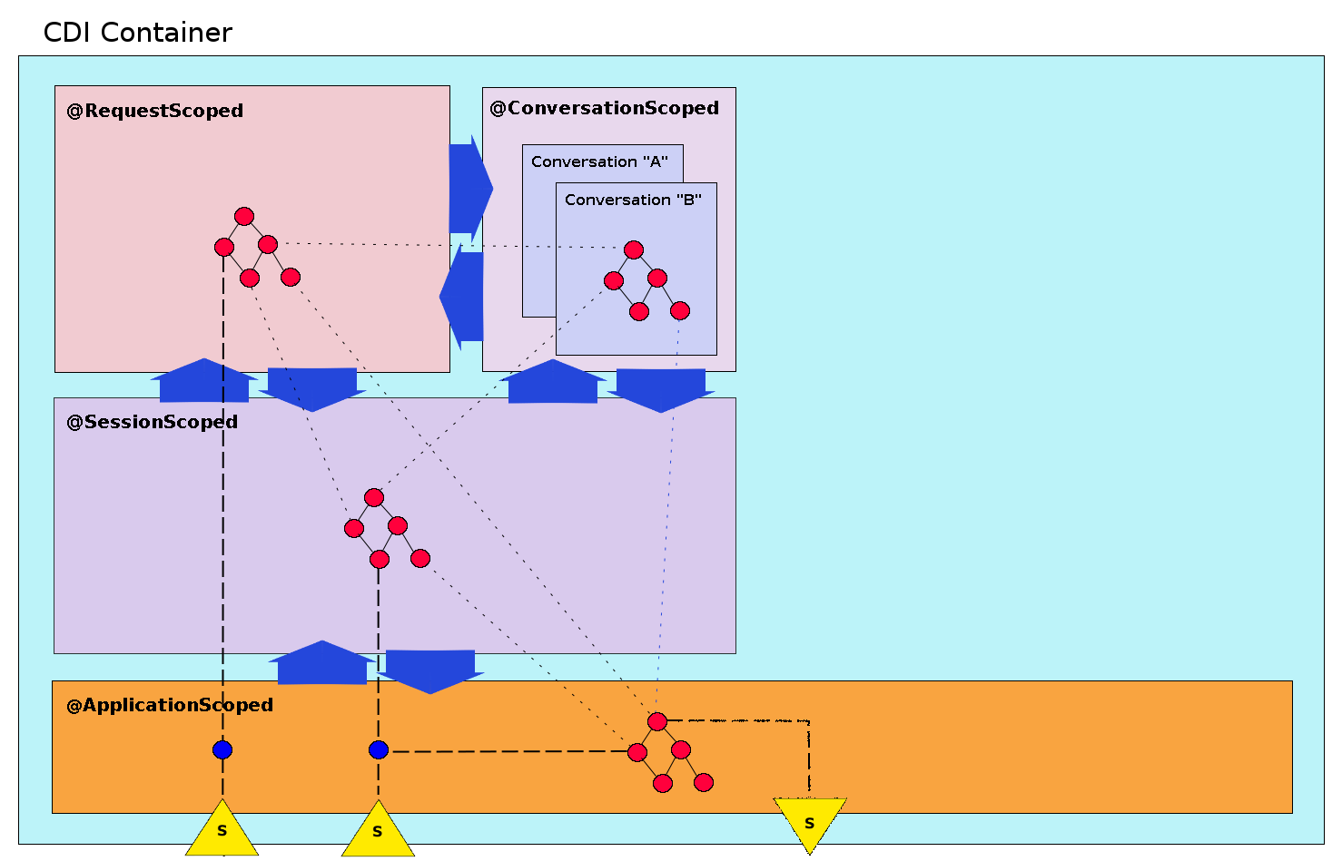
@ApplicationScoped beans can provide services

Slide 15
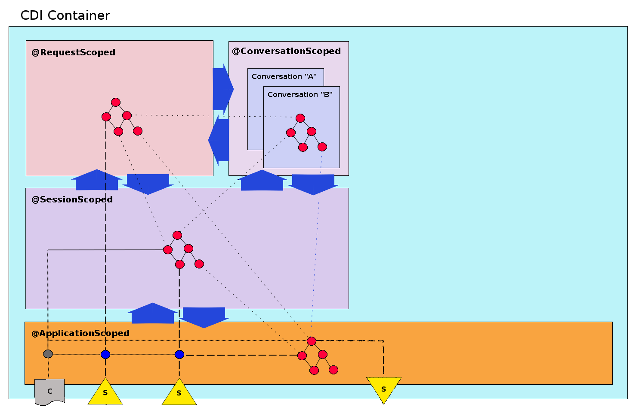
Configuration available for direct injection, to configure references and published services

Slide 16
Dynamism of dependencies affect this whole region of the container as a single component: Application Component

Slide 17
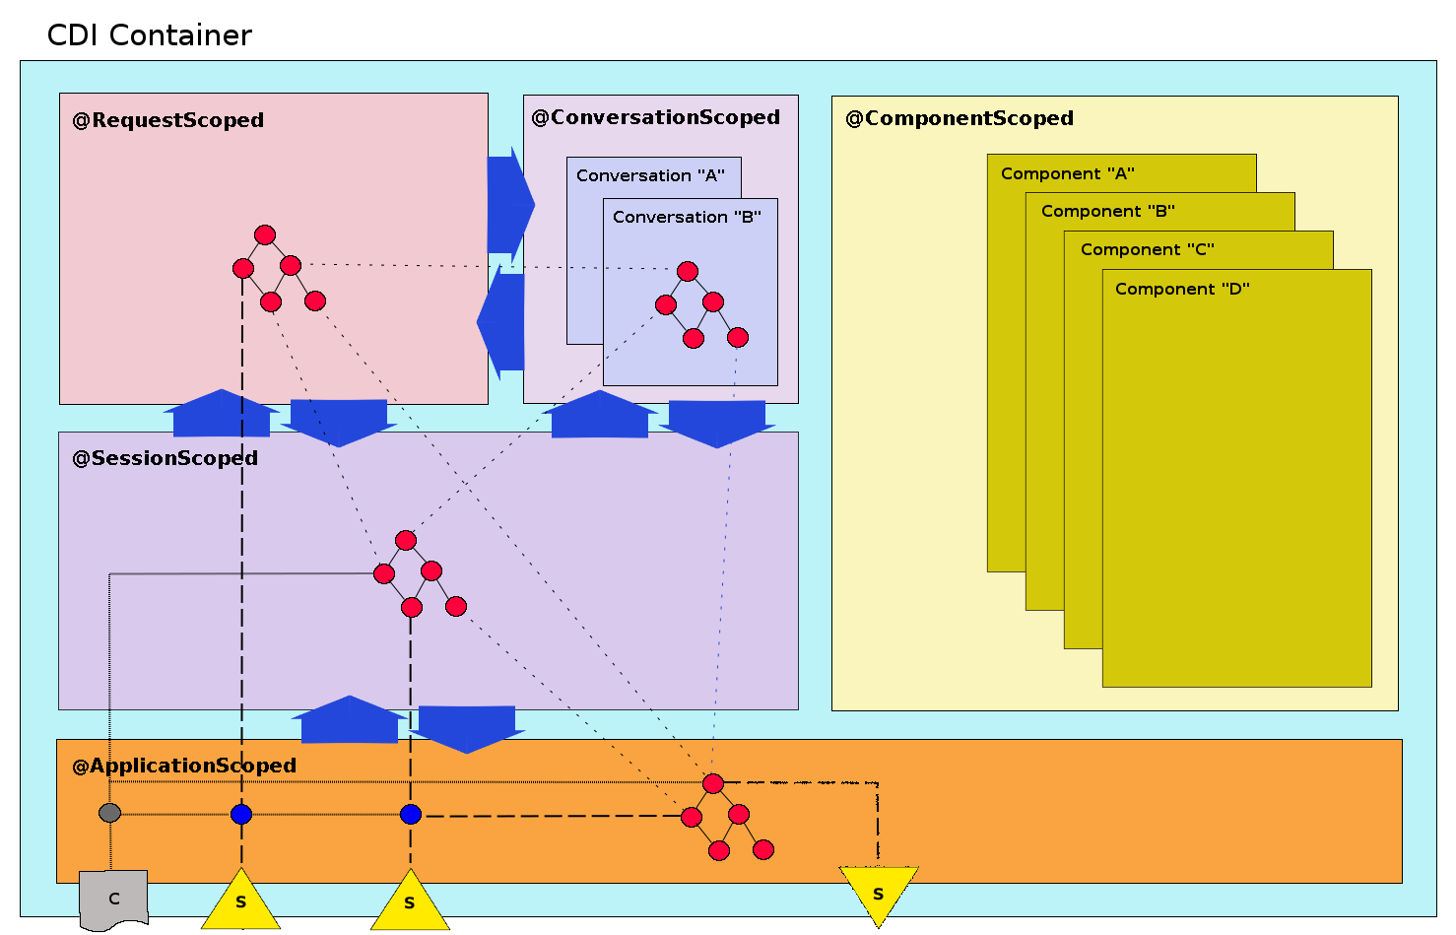
Pseudo @ComponentScoped encapsulates OSGi’s business rules

Slide 18

@ComponentScoped beans form a graph of contextual instances within a context rooted in the @Component bean, identified by name

Slide 19
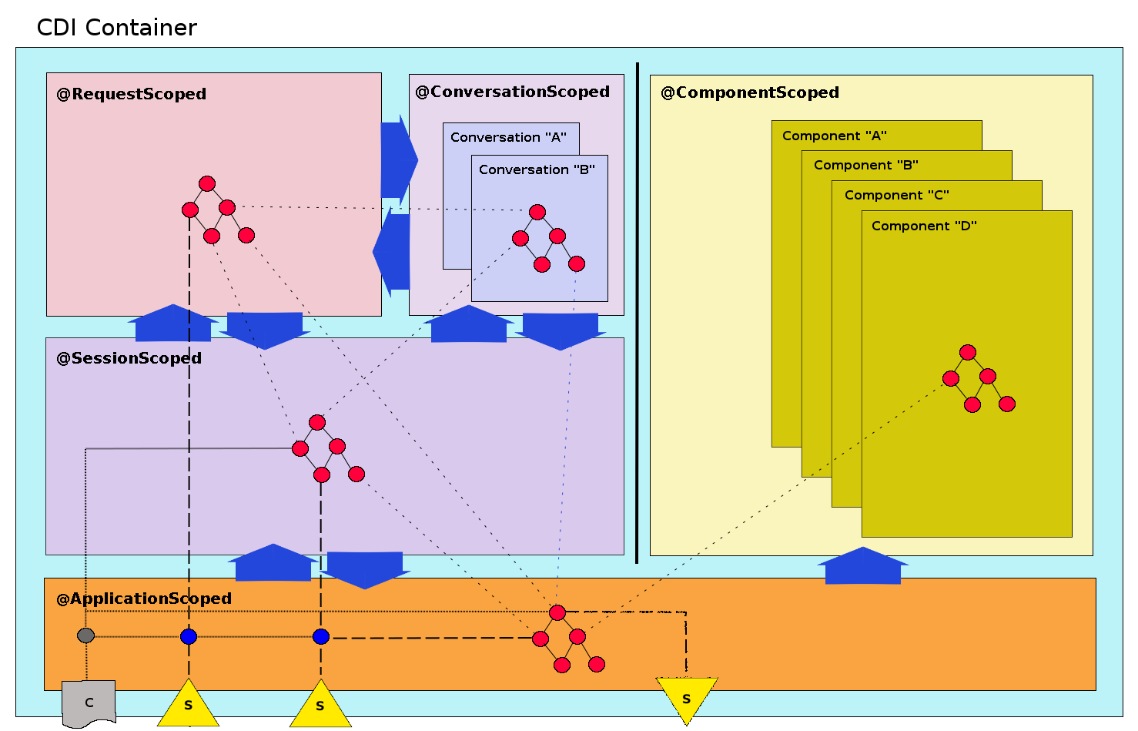
Controlled visibility allows OSGi’s integration to fully support Dynamic Component Lifecycle

Slide 20

@Reference to a service provided via synthetic bean scoped to the component context

Slide 21

@Component can provide services

Slide 22
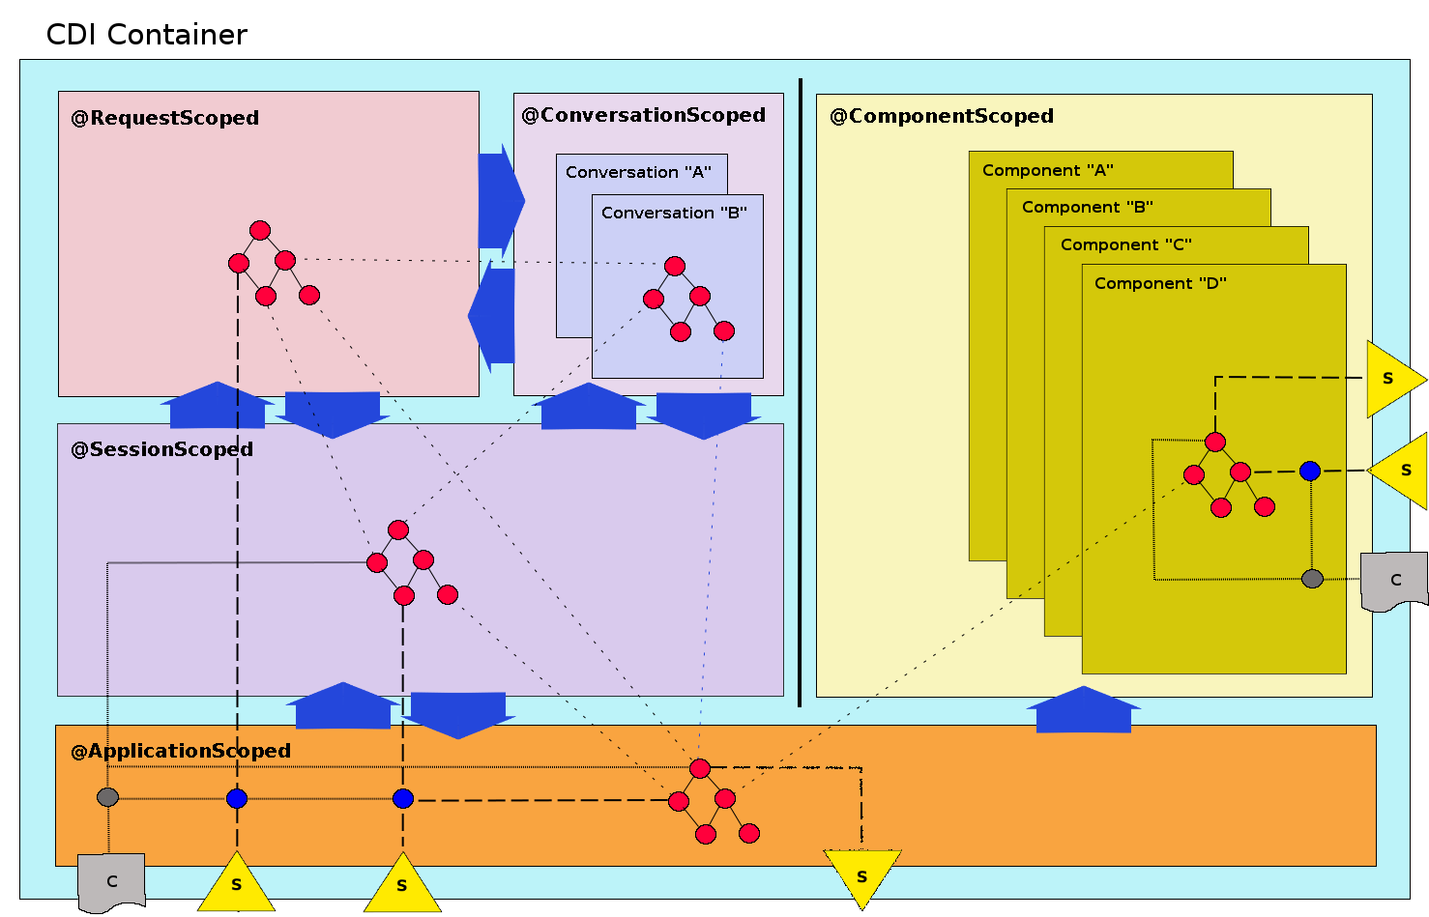
Configuration available for direct injection, to configure references and published services

Slide 23
That’s a lot of detail, but...
What does it look like?

Slide 24
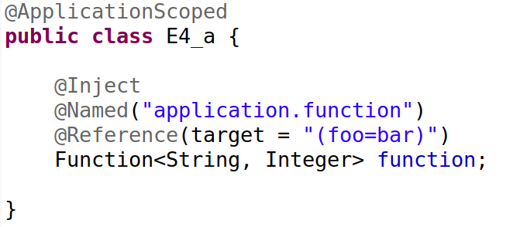
@Reference a service in a normal bean

Slide 25
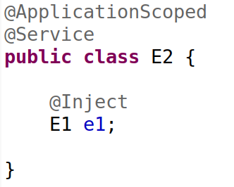
Provide a @Service from regular bean

Slide 26
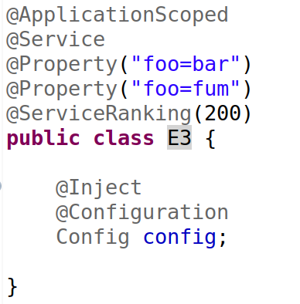
@Configuration @Property @Service

Slide 27
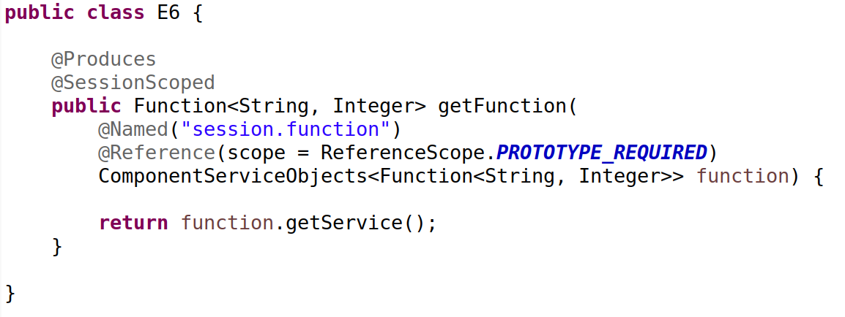
Producer method, @SessionScoped instance, prototype service

Slide 28
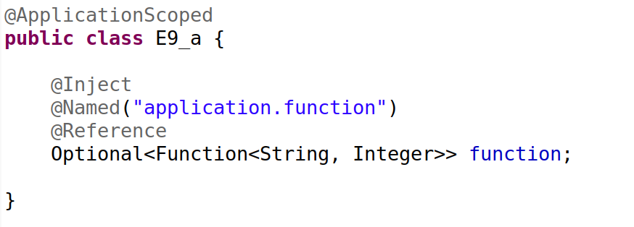
Optional @Reference

Slide 29
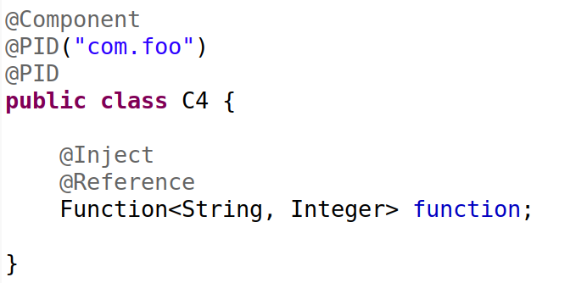
@Component with @Reference & multi-configuration interests

Slide 30
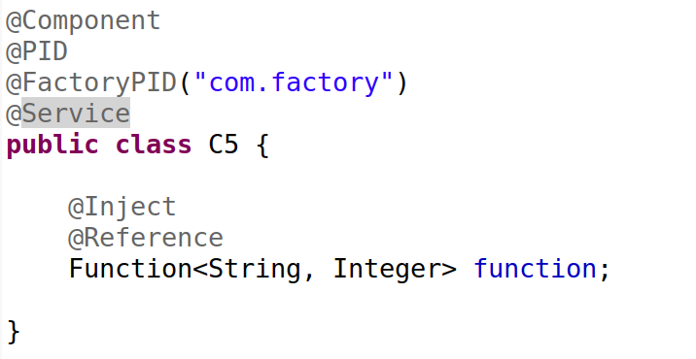
Factory component providing a service

Slide 31


