Slide 1
POF-23
Aerodynamic Limitations

Slide 2
Aerodynamic Limitations
Structural Strength
The Maneuver Envelope
Design and Operating Speeds
Aeroelasticity

Slide 3
At the end of this lesson you will be able to:
Understand load factor limitations
Identify maneuver envelop
Identify Operating speeds

Slide 4
STRUCTURAL STRENGTH
The strength of the aeroplane structure is its ability to withstand a load or force.
  The Load Limit is the maximum load to be expected in service.
  The Ultimate load is the failing load of the structure.
  The Factor of Safety (Safety Factor) is the ratio of the ultimate load to the limit load.
For aeroplanes, the factor of safety is 1.5.
To remain within the safe limit, we use a chart (shown on the next page) called the maneuver envelope.

Slide 5
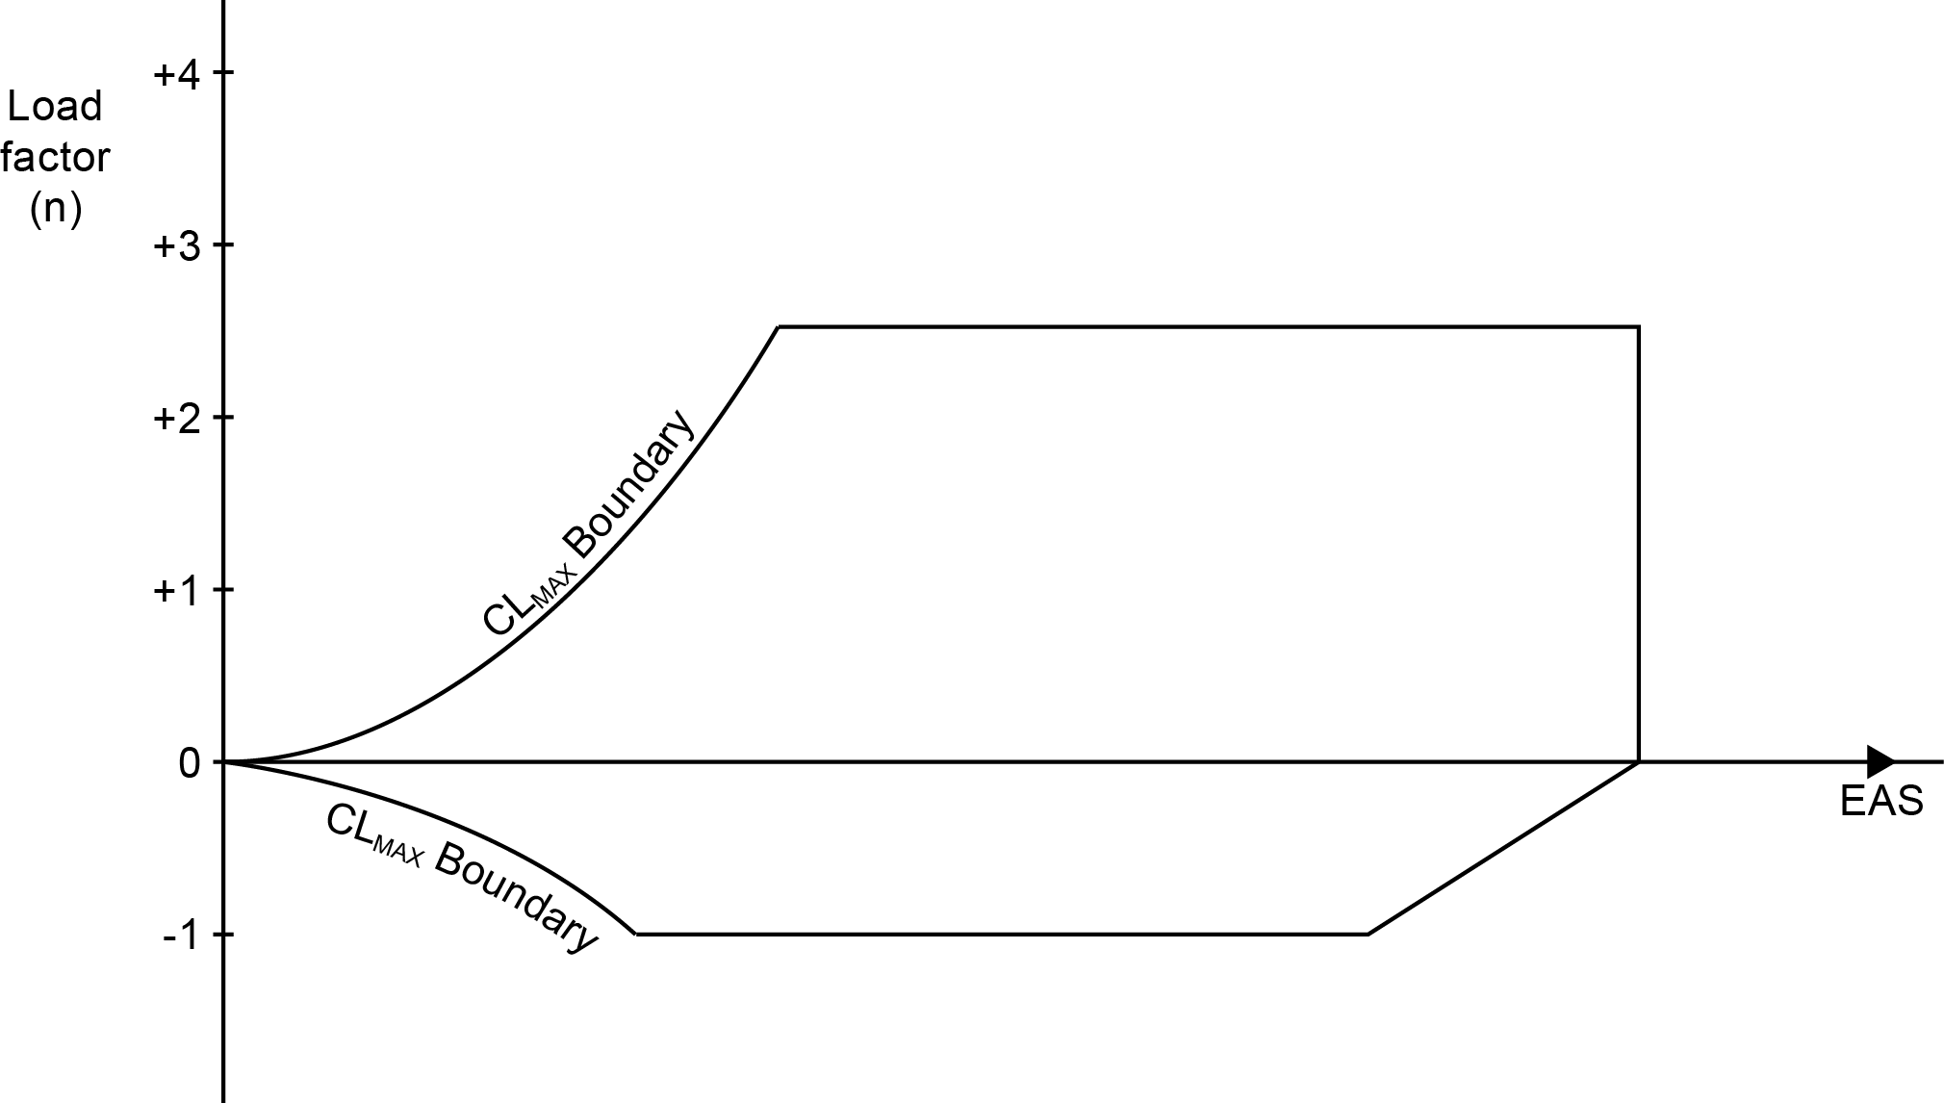
THE MANEUVER ENVELOPE
The manoeuvre envelope provides an envelope for safe flight.
The axes are speed (EAS) and load factor (n). Hence the name ‘V-n diagram’.

Slide 6
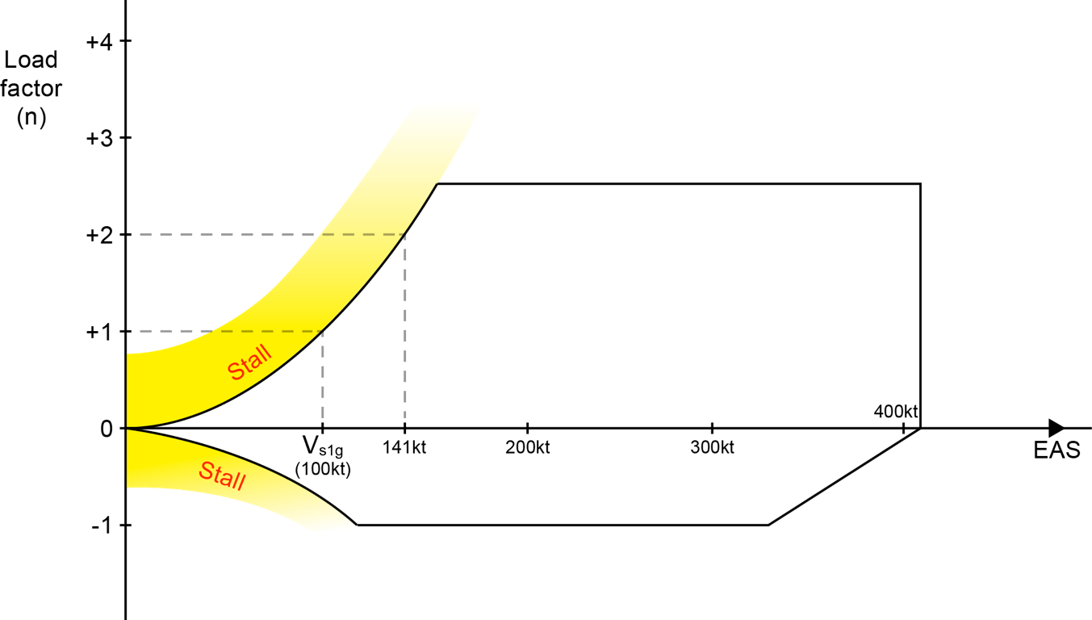
THE MANEUVER ENVELOPE
The left side of the manoeuvre envelope is bounded by flight at CLMAX.

Slide 7
THE MANEUVER ENVELOPE
At speeds slower than the intersection of the stall boundary with the positive load limit of 2.5, the aeroplane will stall before distorting or failing.
At faster speeds, the aeroplane will exceed the limit load factor and may bend or fail completely.

Slide 8
THE MANEUVER ENVELOPE

Slide 9
Design and Operating Speeds
V_{A} (The Design Maneuver Speed) is the highest speed at which sudden, full up elevator deflection can be made without exceeding the limit load factor.
Below V_{A} the aeroplane will stall before reaching the limit load.
At speeds a little faster than V_{A} (less than 22%), the airframe will distort before the stall.
At faster speeds the ultimate load factor can be exceeded before the stall thus the structure may fail.
There are many other speeds to consider besides V_{A}.

Slide 10
Design and Operating Speeds 1
VMO - Maximum Operating Speed. The maximum speed that must not be intentionally exceeded during any phase of flight.
VNE - Never Exceed Speed is applicable to small aeroplanes.
VNO - Maximum Structural Cruise Speed is applicable to small aeroplanes.
VNO - is the normal operating cruise speed and is applicable to small aeroplanes. It is at the slow end of the yellow arc and at the fast end of the green arc on the ASI.
>>

Slide 11
Design and Operating Speeds 2
VLE - Maximum Landing Gear Extended Speed. The maximum speed at which the aeroplane can be flown with the landing gear down and locked.
VLO - Maximum Landing Gear Operating Speed. Although VLO may be the same as VLE, it is often a slower limiting speed because the gear and gear doors are not properly braced when travelling.
VFE - Maximum Flap Extension Speed. The maximum speed at which the aeroplane can be flown with the flaps extended in prescribed position.

Slide 12
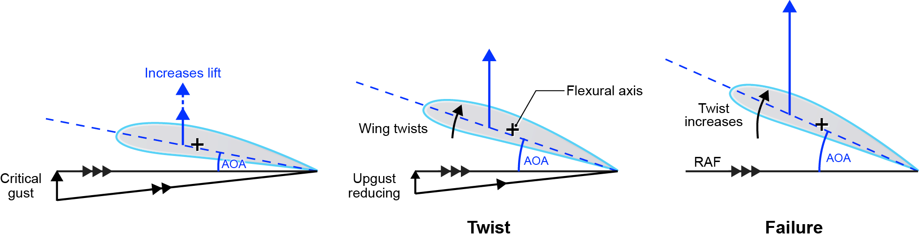
AEROELASTICITY
When aerodynamic forces acting on a structure become large enough, they can cause the structure to twist about its torsional axis.
This is opposed by the elastic properties of the structure.
As speed increases the aerodynamic force eventually equals the opposing elastic force.
Any further increase in speed (beyond the torsional divergence speed) will cause structural failure.

Slide 13
AEROELASTICITY
The distribution of mass in a structure and the structure’s stiffness determine its natural frequency of oscillation.
If subjected to a forcing frequency at its natural frequency the structure will vibrate strongly; this is known as resonance.
Aerofoils can resonate around their torsional axis – flutter.
The oscillations can become divergent leading to structural failure.
Aileron, elevator or rudder flutter occurs when the inertia of the control surface interacts with the torsional twisting of its associated main surface.
Flutter can be prevented using mass balancing to move the control surface’s CG onto or forward of the hinge line.

Slide 14
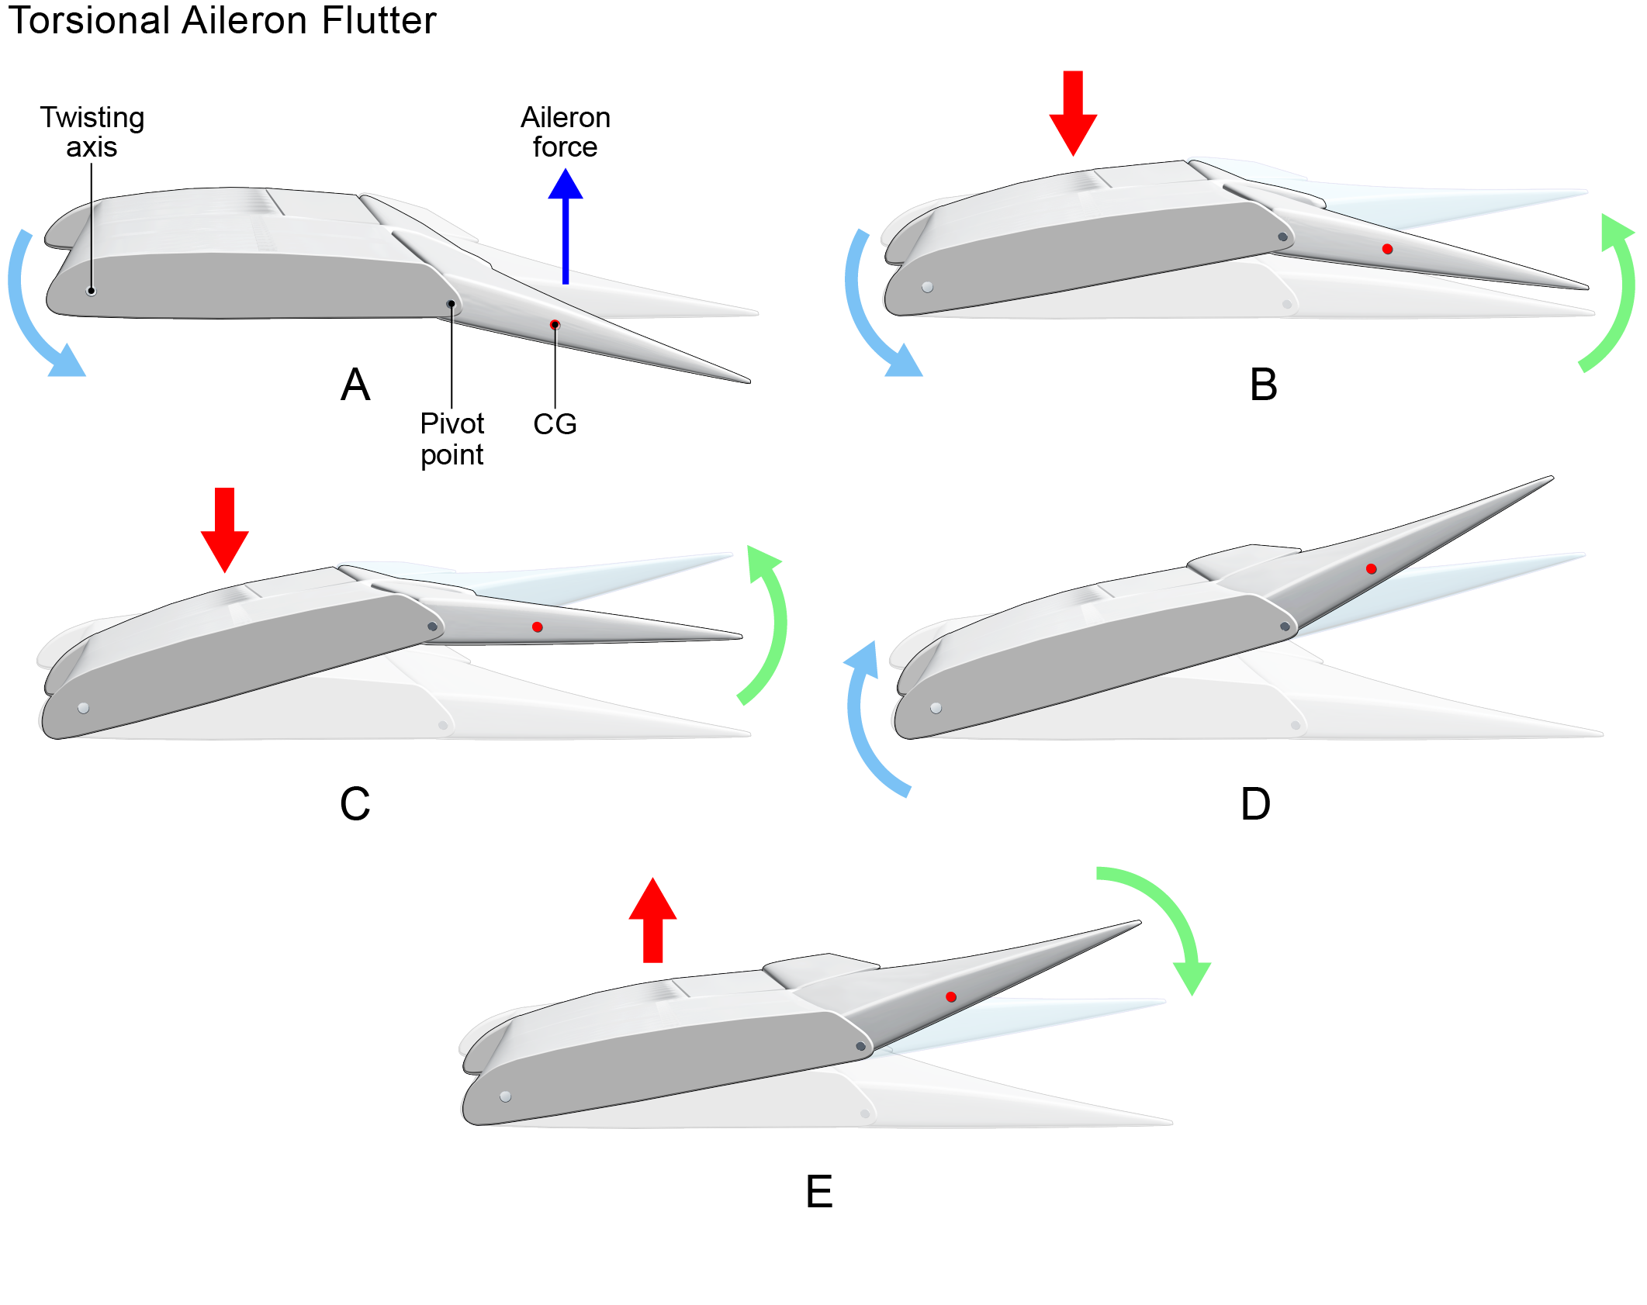
AEROELASTICITY

Slide 15
END OF POF

