Slide 1

Multikernel: Operating system solution to generalized functional safety
Yijing Song, Huasheng dai, jinhu jiang, weihua zhang
Presented by Abdur Rouf
Notes:
Hello everyone, This is Abdur Rouf. Today, I’m going to review the article named “Multikernel: Operating system solution to generalized functional safety”. The article is published by Yijing song, huasheng dai, jinghu jiang and weihua zhang.

Slide 2
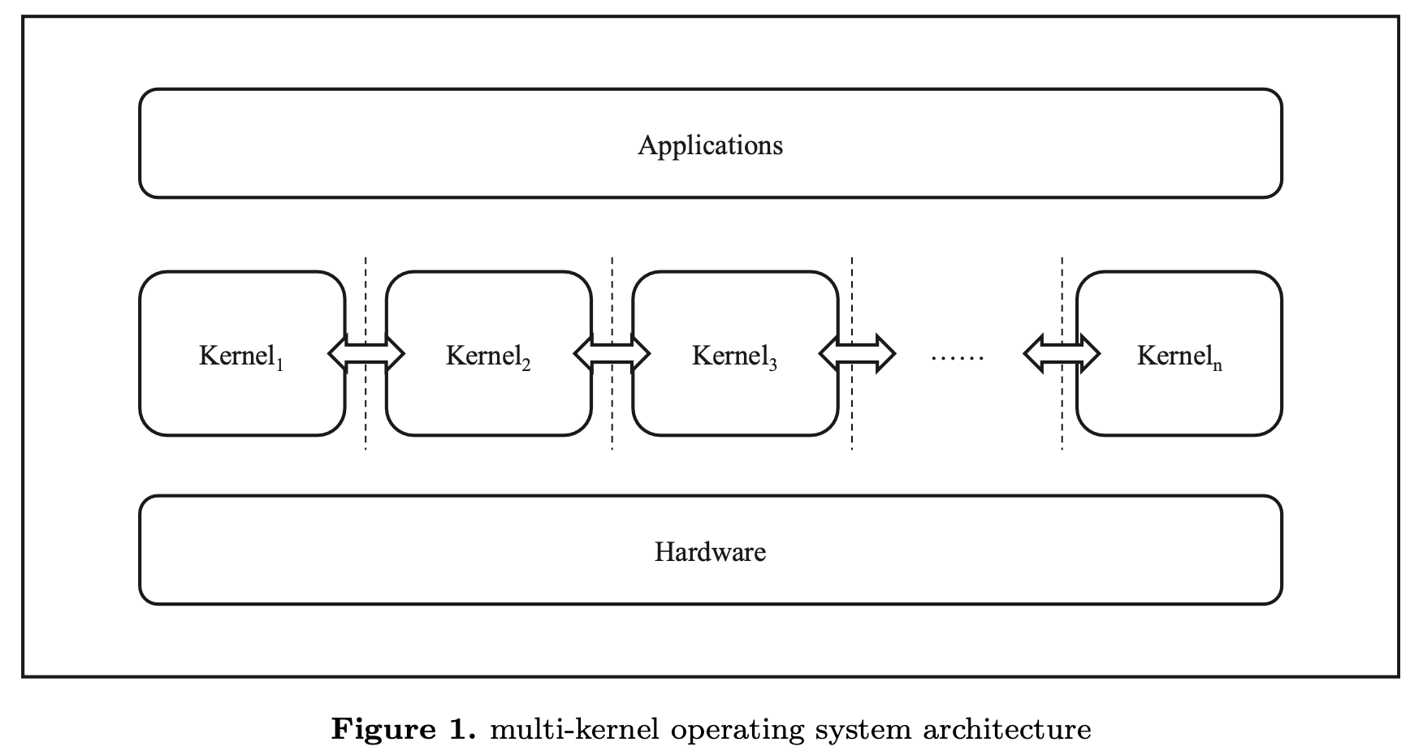
What is Multikernel OS?
Presented by Abdur Rouf
Notes:
What is multikernel? A multikernel operating system is an operating system architecture that fundamentally differs from traditional monolithic or microkernel-based systems. It revolves around the concept of using multiple specialized kernels running concurrently, each handling specific tasks or functionalities of the operating system.
CLICK
In this case, the authors focused on single host multikernel architecture where multiple kernel manages user application and gives those applications to execution environment by isolating hardwares such as cpu, memory etc. This figure demonstrates the conceptual diagram of multikernel OS.

Slide 3





What is generalized functional safety?
Functional safety is the part of safety that deals with the correct operation of a system.
Hazard
Analysis
Risk
Assessment
Safety
Requirements
Safety
Design
Safety
Verification
Presented by Abdur Rouf
Notes:
The next question is “What is generalized functional safety?” CLICK In the context of OS, functional safety is assurance of system which can tolerate any types of failures and recover from the hazardous situation. That means, it guarantees the single point of failure or crashes. These are the steps of functional safety. CLICK Hazard analysis, CLICK
risk assessment, CLICK
safety requirements, CLICK
safety design CLICK
and safety verification. In this cases, they dealt with functional safety that satisfy all types of failure of an operating systems and that is generalized version of it.

Slide 4






Goal
Design an OS that is
By incorporating multikernel with
Resilient to kernel level
Cyber-attack
Dynamism
DHR
Architecture
Heterogeneity
Fault-tolerant
in case of failure
Redundancy
Presented by Abdur Rouf
Notes:
So their goal CLICK
was to design an Operating system which was CLICK
Resilient to kernel level cyber attack CLICK
And Fault tolerant in case of failure. CLICK
And they can achieve the goal by incorporating the multikernel with CLICK
Dynamism CLICK
Heterogeneity CLICK
Redundancy. Here, they took the first letter from each attribute CLICK
And conclude this with DHR. So, Here . they propose an theoretical multikernel Operating system that followed DHR architecture.

Slide 5



Issues in current OS
Fragility
Monotony
Rigidity
Weakness in protection
Lack of redundancy
Lack of differential feature
Difficulty in sharing solution
Static temporal change
Lack of fallback after defense failure
Presented by Abdur Rouf
Notes:
Before dive into the new OS scheme, we need to know what are issues in current OS CLICK
Current OS is fragile. This fragility exists mainly for weekness in protection in kernel level and there is no redundancy. CLICK Next issue is current OS is monotony. It refers that current OS limits functional variation that is lack of differential feature. Another monotonous feature of current OS is most of the functional implementations are not generalized. So, it’s difficult to share same solution throughout the OS.
CLICK
Another issue of current OS is rigidity. It can only allow very small amount of static temporal change and there are also lack of fallback after any type of defense system failure.

Slide 6
Multikernel offers
Dynamism
DHR
Architecture
Heterogeneity
Redundancy
Presented by Abdur Rouf
Notes:
As I mentioned in the previous slide, the author proposed multikernel Operating System with DHR architecture. In next few slides I’ll discuss on these attributes briefly.

Slide 7
Dynamism
Support for Dynamic Iteration of Execution Environments
Dynamic Iteration Strategy Design
Support for Hot-Plugging and Runtime Optimization
Presented by Abdur Rouf
Notes:
First attribute is dynamism,
multikernel operating system is really flexible and can change things while it's running. It's designed so that it can quickly adjust and improve itself as it works. Also, it can add or take away parts like adding a new device even when it's already up and running.

Slide 8
Heterogeneity
Construction of Heterogeneous Execution Environments
Maintenance of Functional Equivalence
Designing a Consensus Mechanism
Presented by Abdur Rouf
Notes:
Second is heterogeneity
A multikernel operating system is like a system made of different types of building blocks that work together. These blocks are not all the same—they have their own special abilities and jobs. However, they are designed to work together smoothly, making sure that even though they're different, they can still do the same important tasks.

Slide 9
Redundancy
Multiple Execution Environments with Single Application Image
Isolation between Execution Environments
Transparent Redundancy for Applications
Presented by Abdur Rouf
Notes:
The last one is redundancy. In multikernel OS provides multiple kernel for running same user application simultaneously so that single kernel execution crash doesn’t hamper the whole systems. Also, every execution environment runs isolately that facilitates the fault tolerant of systems.

Slide 10
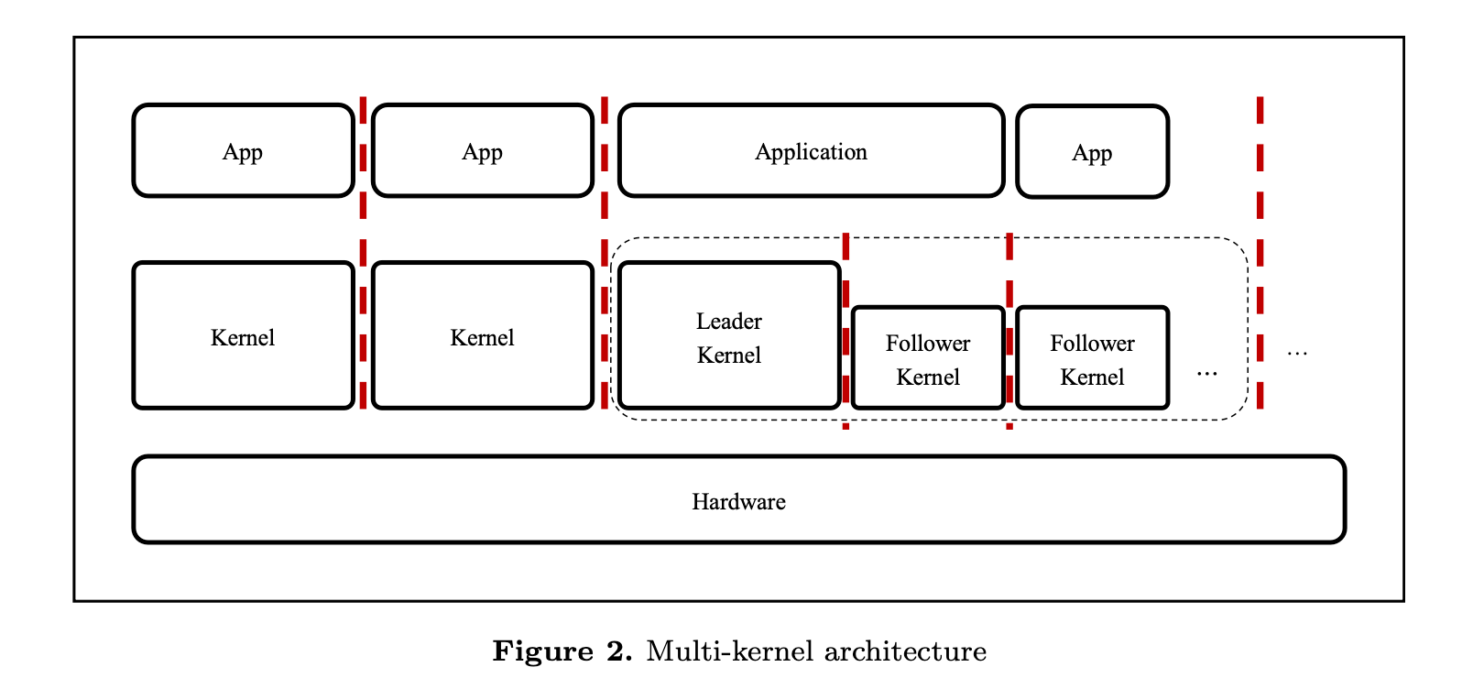
Design multi-kernel architecture
Presented by Abdur Rouf
Notes:
This is how a multikernel OS has been designed. In the figure, we can see that, there is a leader kernel who is responsible to decide which followers’ kernel will be assigned to run user application. When, a subset of kernels is running a specific user application, any anomalies or misbehavior of the user application has been detection by making consensus among kernels.

Slide 11



Underlying technologies
Multi-kernel architecture
Resource partitioning
Inter-kernel communication
Presented by Abdur Rouf
Notes:
In this proposed theoretical DHR architecture based multikernel OS can be achieved by incorporating these underlying technologies
CLICK
Multikernel architecture that we discussed already
CLICK
Resource partitioning. As, we’re running multiple kernel on top of single host, so it’s necessary to partition resources properly to avoid race condition and other types of errors.
CLICK
Another important technologies that will be needed is Inter kernel communication. Since, we’re running an user application on different kernel simultaneously in different compilation scheme, it’s mandatory to communicate with other kernel about the running status of the user applications which helps to make consensus on this. Here, the author mentioned same byzantine consensus algorithm to make consensus of detecting failure of an user program execution.

Slide 12
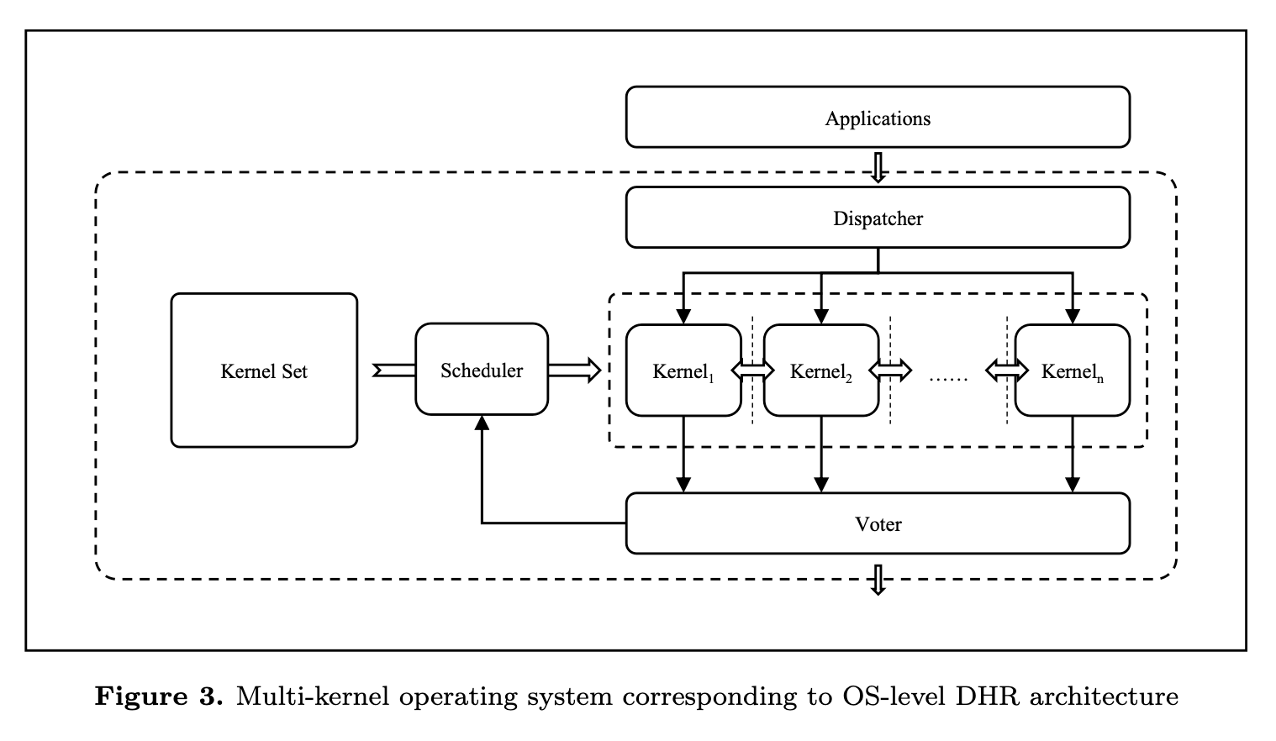
Multi-kernel OS with DHR
Presented by Abdur Rouf
Notes:
Based on the application of consensus in DHR multikernel OS, the diagram of the multikernel OS looks like this where a dispatcher is responsible to choose a set of kernel to run an user program. And a voting unit decides running application is prone to be failure or not. This voting system pass the consensus data to schedular which control the dispatch of new user applications.

Slide 13
Related work
Barrelfish
FOS (Femto Operating System)
HeliOS and Popcorn Linux
Presented by Abdur Rouf
Notes:
These are some related works which are also based on multikernel OS. These are some OS names. Barrelfish, FOS abbreviated from Femto OS and HeliOS and Popcorn. In the next following slides I’ll mention a brief description of each OS.

Slide 14

Presented by Abdur Rouf
Notes:
Thank you.

