Slide 1
Explainable AI for Genomic Tasks with Genome Language Model
CAP 5610 - Machine Learning
Spring 2025
Instructor - Mengxin Zheng

Slide 2





Group Members
Sourav Saha
Graduate Research Assistant
Dept of Computer Science
Deep Learning, Bioinformatics, Language Models
Nowfel Mashnoor
Graduate Research Assistant
Dept of Computer Engineering
Hardware Security Systems
Abdur Rouf
Graduate Research Assistant
Dept of Computer Engineering
Deep Queue Networks, Speculative SDN
Sagor Biswas
ORCGS Doctoral Fellow
Dept of Computer Engineering
AI Security, ViT, LoRA

Slide 3

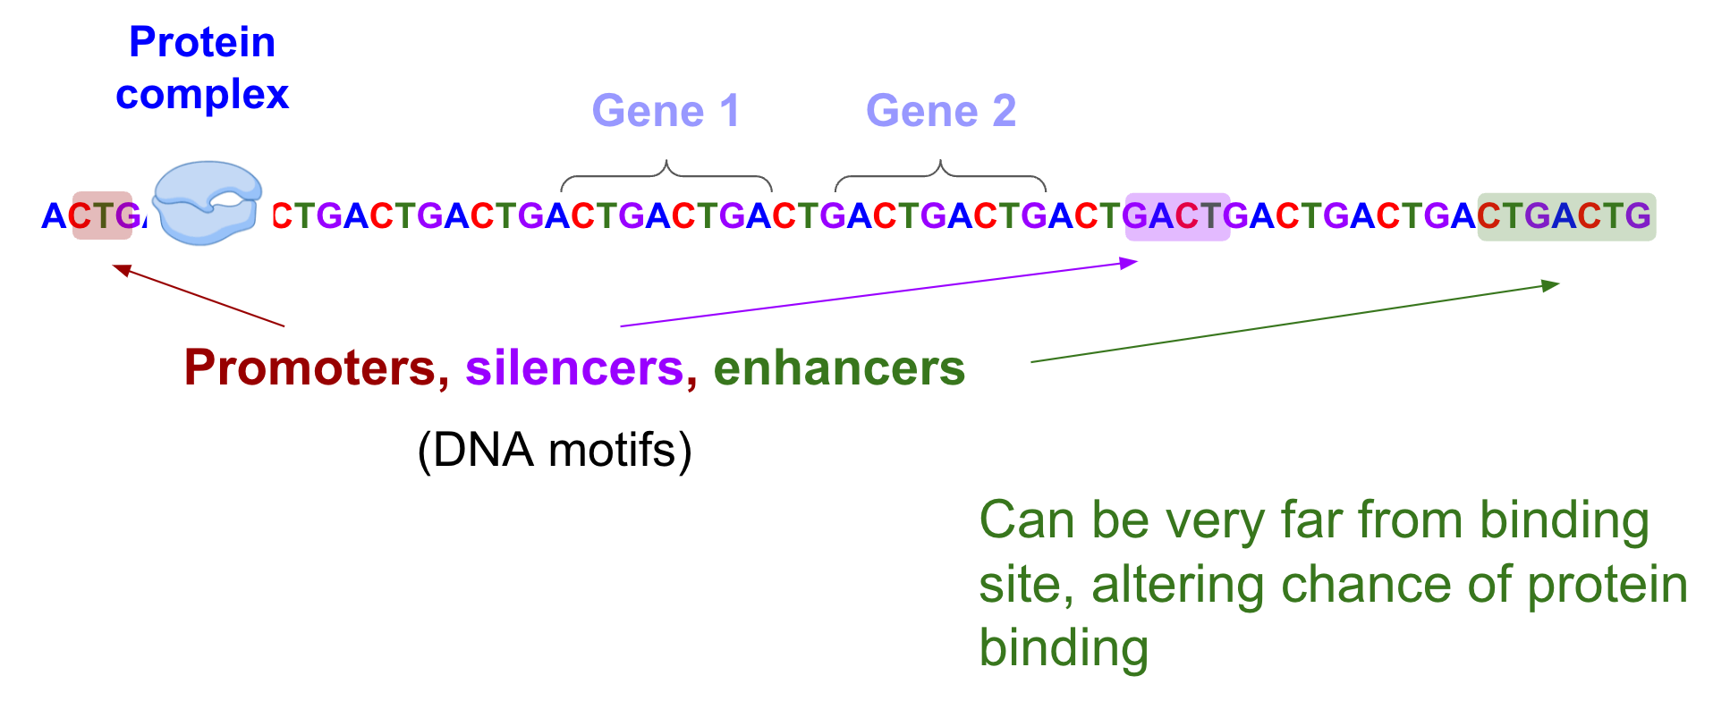
Lets Talk DNA

Slide 4

Motivation
Advanced Genome Language Models: Transformer-based models such as DNABERT, DNABERT2, Nucleotide Transformers, and HyenaDNA have demonstrated strong performance on various genome-specific classification tasks.
Knowledge Gap: Despite their success, the depth of these models’ understanding of genomic concepts remains unclear.
Explainability Focus: This project aims to investigate how well these models can explain their predictions by applying them to a downstream interpretability task.

Slide 5

Task Description
Objective: Use advanced genomic language models (e.g., DNABERT, HyenaDNA) for promoter detection.
Focus: Investigate whether these models truly leverage the presence of TATA boxes for classification.
Hypothesis: TATA boxes are key signals that significantly influence the model’s decision-making in identifying promoters.
Explainability Goal: Demonstrate how attention or feature-attribution methods can reveal the role of TATA box motifs in the models’ predictions.

Slide 6

Dataset
Category | Details
Dataset Used | Genome Understanding Evaluation (GUE) for human promoter detection
Sequence Length | 300 Nucleotides
Dataset Split | Training Set: 47.4k samples Validation Set: 5.2k samples Test Set: 5.2k samples
Class Distribution | Balanced (Positive:Negative = 50:50)

Slide 7




Why this dataset?
Standard Benchmark
Explainability
Provides a strong foundation for model interpretability analysis.
GUE is widely used for evaluating genomic sequence classification tasks.
High-Quality Annotations Ensures reliable ground truth for training and evaluation.
Proper Testing
Helps test deep learning models' ability to distinguish promoter regions.

Slide 8

Models Used
Model | Purpose
DNABERT | Transformer-based model for DNA sequence analysis
DNABERT2 | Improved version of DNABERT with enhanced performance
Nucleotide Transformers (NT) | General-purpose nucleotide sequence transformer
HyenaDNA | A novel architecture designed for genomic data

Slide 9

Tools for Explainability in ML
LIME (Local Interpretable Model-Agnostic Explanations)
Works with any black-box model and provides human-interpretable explanations. Used on text classification(NLP), image classification, and Tabular Data (fraud detection, medical diagnosis)
SHAP (SHapley Additive Explanations)
Works with various model types (tree-based, deep learning, linear models) and provides both local and global explanations)
ANCHOR (High-Precision Model-Agnostic Explanations)
More stable model-agnostic tool that provides high-confidence explanations. Used for Text classification, Image classification, Fraud detection, and healthcare )
Captum (PyTorch-Based Explainability Library)
Captum is a PyTorch-native explainability library that provides various interpretability techniques

Slide 10

Project Schedules
Week | Task | Expected Outcome
1st | Dataset Collection, Preprocessing and Exploratory Analysis | A cleaned and formatted dataset with insights into sequence distributions and quality.
2nd | Baseline Model Training (DNABERT, DNABERT2) | Initial training results for DNABERT models, serving as a reference for further improvements.
3rd | Fine tuning pipeline optimization | Optimized training setup with hyperparameter tuning
4th | Fine-Tuning Nucleotide Transformers (NT) & HyenaDNA | Trained NT and HyenaDNA models with comparative performance analysis.
5th | Explainability Analysis and Model Evaluation | Evaluation of models using SHAP, LIME, and Captum for interpretability insights.
6th | Result generation and report preparation | Consolidated findings, performance comparisons, and a well-structured report ready for submission.

Slide 11







Evaluation Plan
Measuring change in predictions when important features are removed or added
Measures the importance of features by retraining models without certain features.
Deletion /
Insertion Scores
ROAR (RemOve And Retrain)
Consistency of explanations for similar inputs.
Questionnaires measuring trustworthiness and usability.
Explanation Stability
User Trust and Satisfaction
Deletion/Insertion Scores: Measuring change in predictions when important features are removed or added.
Explanation Stability: Consistency of explanations for similar inputs.
ROAR (RemOve And Retrain): Measures the importance of features by retraining models without certain features.
Human Interpretability: Surveys assessing whether users find explanations clear, helpful, or actionable.
User Trust and Satisfaction: Questionnaires measuring trustworthiness and usability.

Slide 12

Any
Questions?

