Slide 1
Replication Study
on
A Machine Learning Approach for Improving the Movement of Humanoid NAO’s Gaits
Abdur Rouf, Nowfel Mashnoor and Arman Malik
CSE, UNR

Slide 2
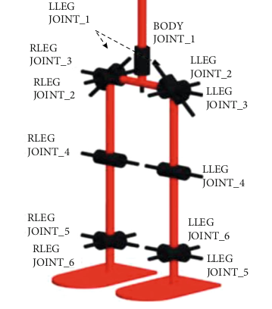
Dataset Description
4 ZIP archives: CSVs from RoboCup tournaments (2019, 2022).
Detailed file naming: Date, teams, joint angles (radians).
Segmented data: 12ms intervals, continuous walking segments.
Extensive dataset: 12M+ time steps, 2,432 minutes.

Slide 3
Experiment Design
Developed neural network model that predicted NAO gait’s angles from sensor data.
Simulated the predicted data on NAO robot simulator.
Showed the simulation of NAO gaits to 20 participants
Collected feedback based on some questionnaire.
Analyzed the responses and summarized in results.

Slide 4
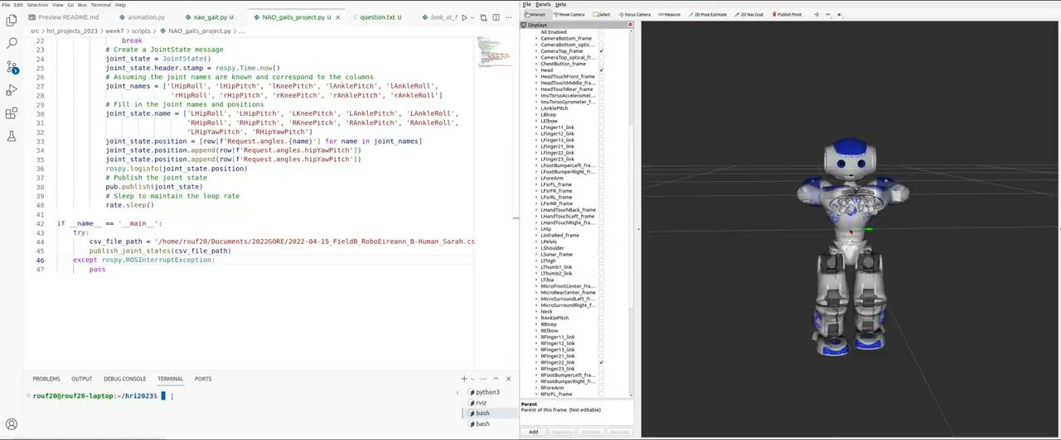
Simulation Demo

Slide 5
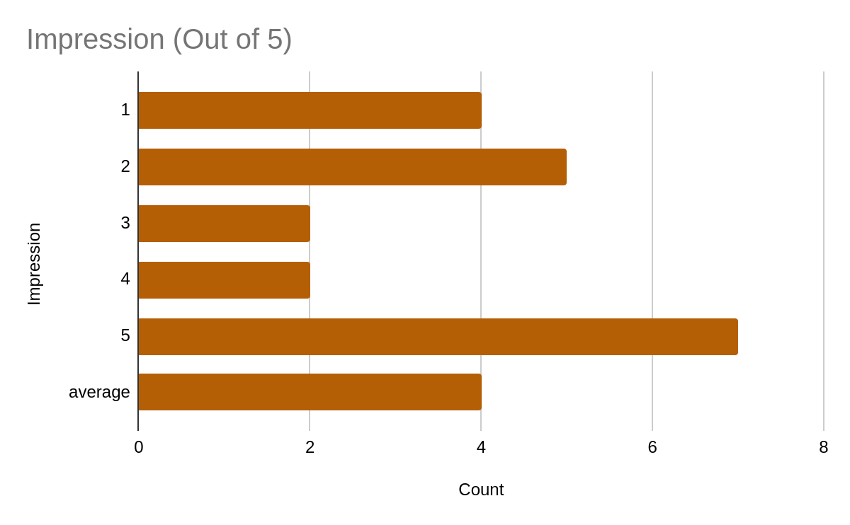
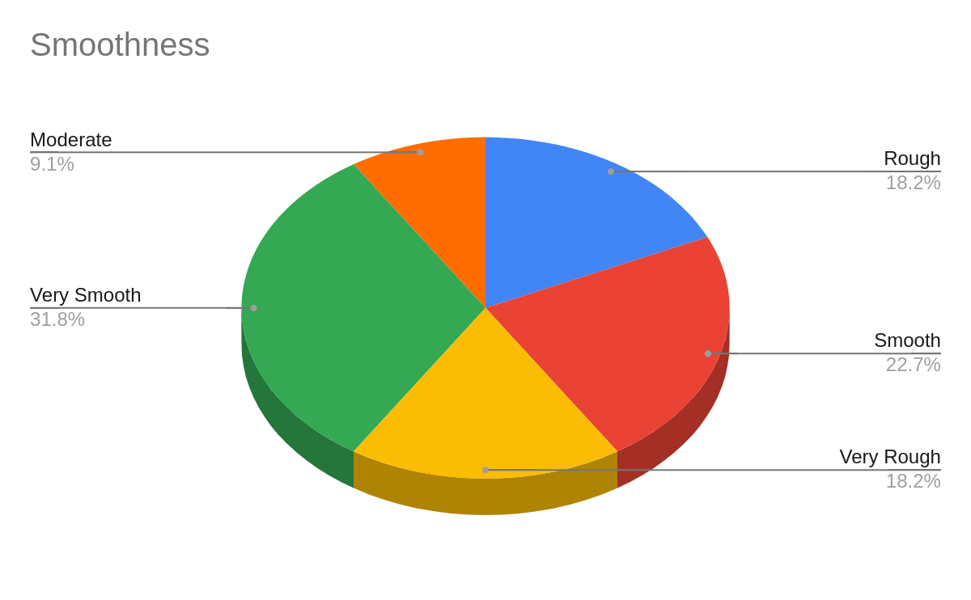
Survey Results

Slide 6
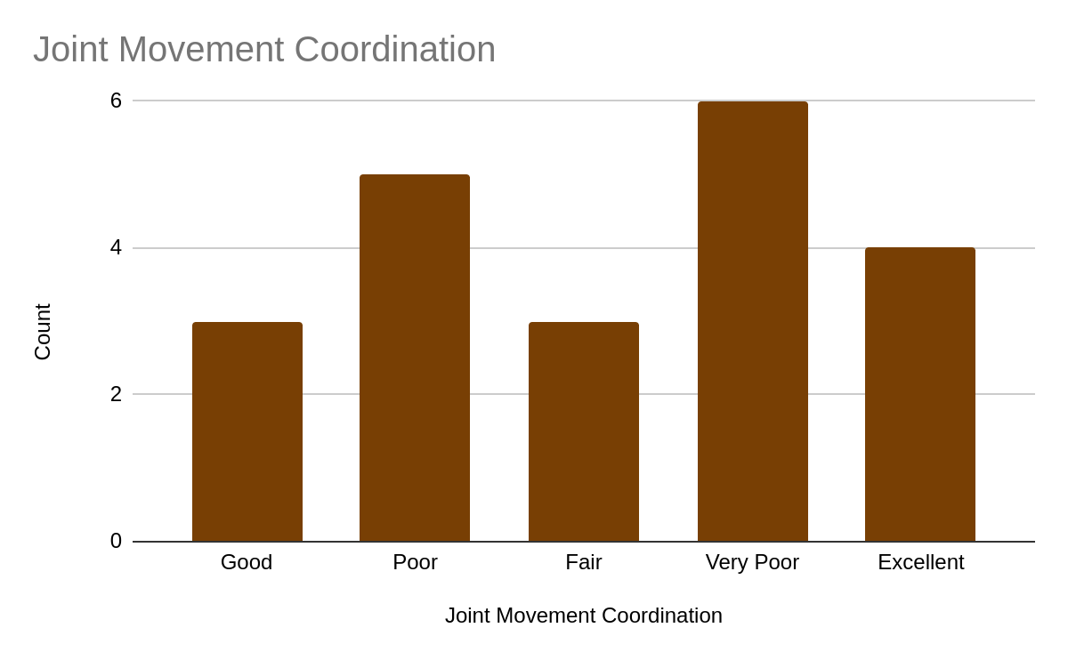
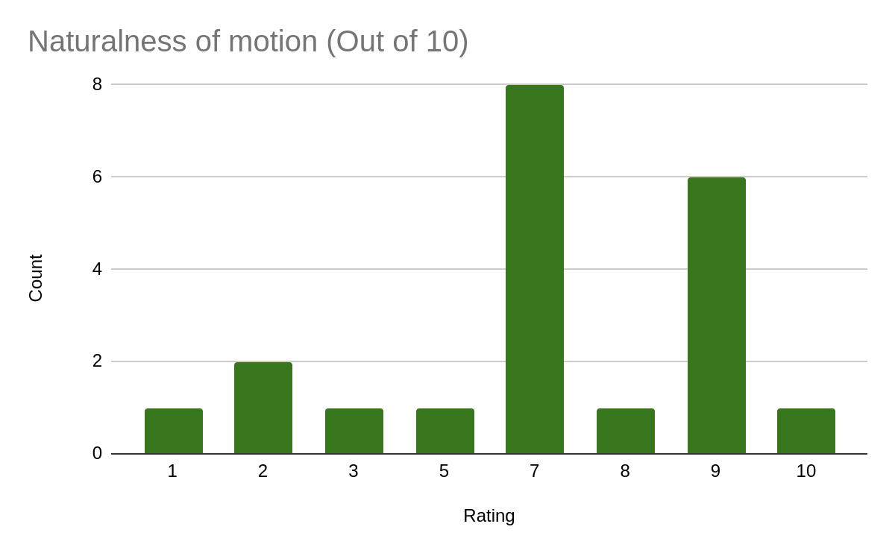
Survey Results (Cont.)

Slide 7
Thank you

