Slide 1
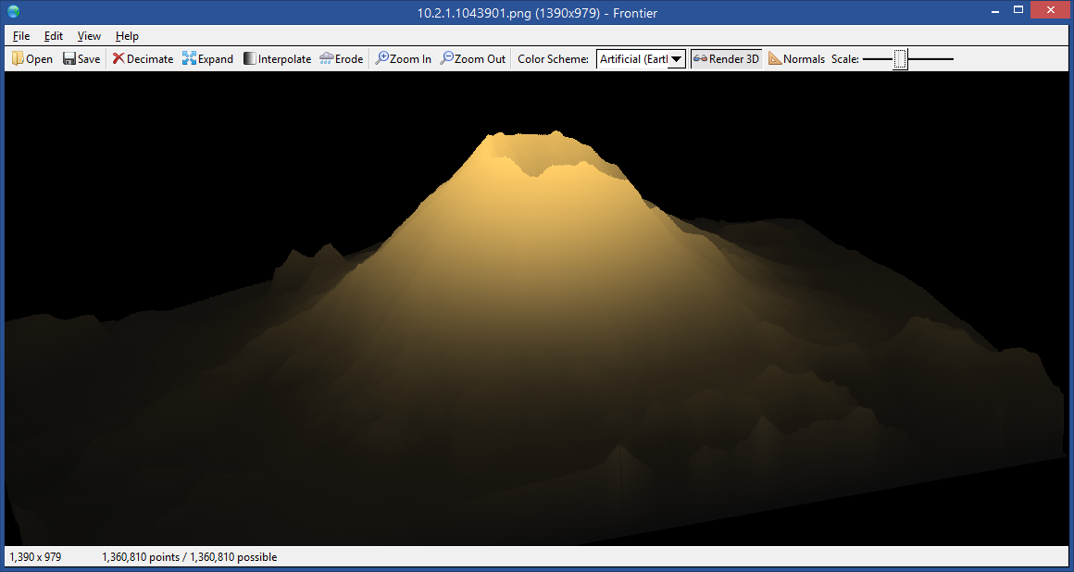
Frontier: A Procedural Terrain Generator
Remy Oukaour, 107122849
CSE 528, Stony Brook University

Slide 2
Functions of Frontier
Load digital terrain elevation data (DTED) saved as PNG
The gdal_convert utility from the Geospatial Data Abstraction Library (GDAL) can convert other DTED formats to PNG
Fill in missing “holes” in DTED, or generate wholly new terrain, using diamond-square midpoint displacement
Randomly decimate terrain to simulate such missing data
Expand terrain over a larger area, again filling in the gaps with interpolation
Simulate the effects of physical erosion, both thermal and hydraulic

Slide 3

DTED input format
Three RGB color channels (0–255 each)
Red stores elevation e
Green stores hardness h, used by thermal erosion
Blue stores solubility s, used by hydraulic erosion

Slide 4
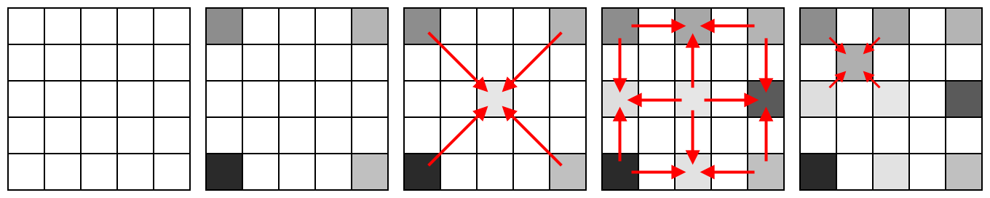
Interpolation: diamond-square algorithm
Start with an empty grid of elevations
Assign a random elevation to the four corner points
Assign the average of the corners, plus a random displacement, to the center point
Find the height of the square’s edges as the average of their adjacent corners and centers, plus noise
Do the same for each of the four sub-squares, recursively until the grid is filled

Slide 5
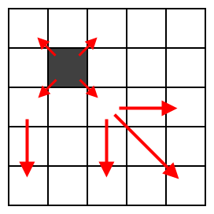
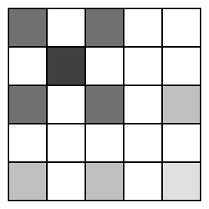
Interpolation: constrained diamond-square
If a pre-set point is only reached after many recursions of diamond-square, its “parent” points’ elevations may not match with it
A bottom-up process propagates smooth elevations from pre-set points to their parents before running diamond-square on the rest
The parents of a single pre-set point
Parent elevations now match the child

Slide 6

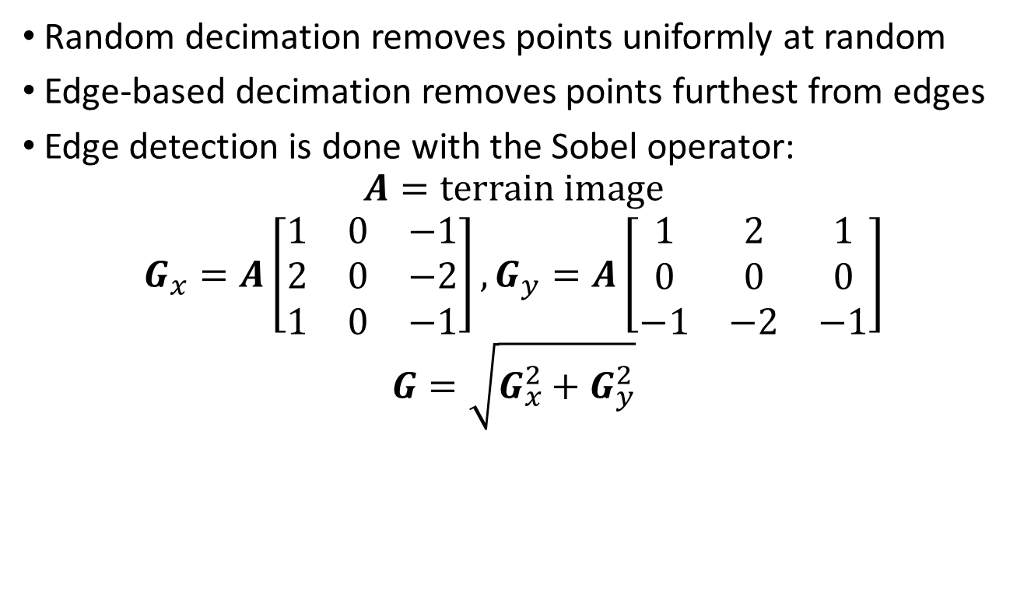
Decimation: random or edge-based
Random decimation removes points uniformly at random
Edge-based decimation removes points furthest from edges
Edge detection is done with the Sobel operator:
$$A=terrain image$$
$$G_{x}=A\left[\begin{matrix}1 & 0 & −1 \\ 2 & 0 & −2 \\ 1 & 0 & −1\end{matrix}\right],G_{y}=A\left[\begin{matrix}1 & 2 & 1 \\ 0 & 0 & 0 \\ −1 & −2 & −1\end{matrix}\right]$$
$$G=\sqrt{G_{x}^{2}+G_{y}^{2}}$$

Slide 7

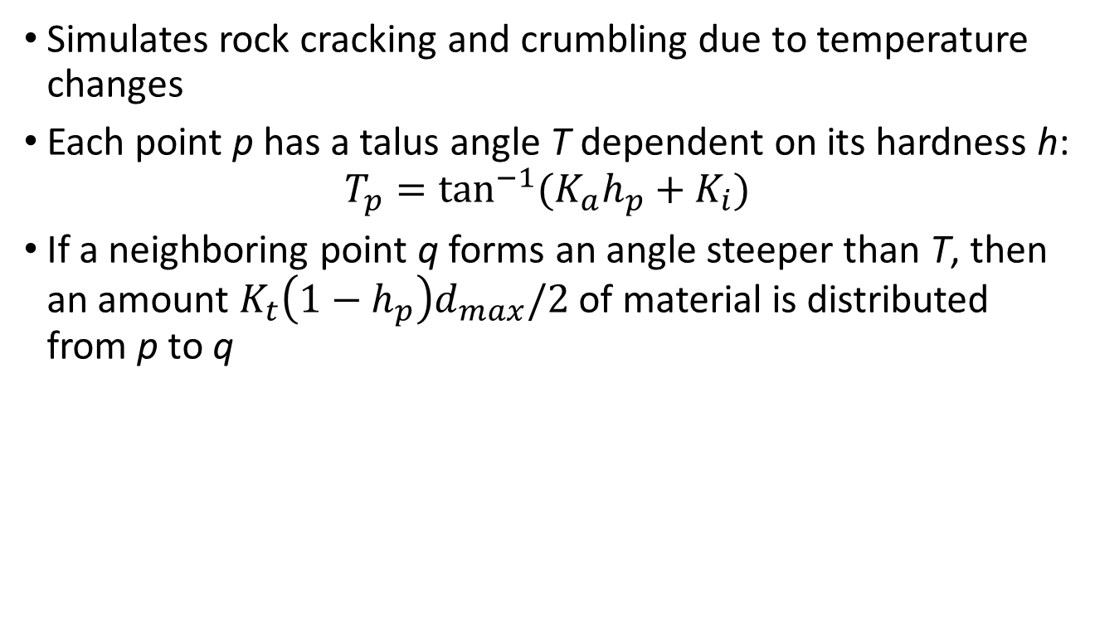
Thermal erosion
Simulates rock cracking and crumbling due to temperature changes
Each point p has a talus angle T dependent on its hardness h:
$$T_{p}=\tan^{−1}{(K_{a}h_{p}+K_{i})}$$
If a neighboring point q forms an angle steeper than T, then an amount $K_{t}\left(1−h_{p}\right)d_{max}/2$ of material is distributed from p to q

Slide 8
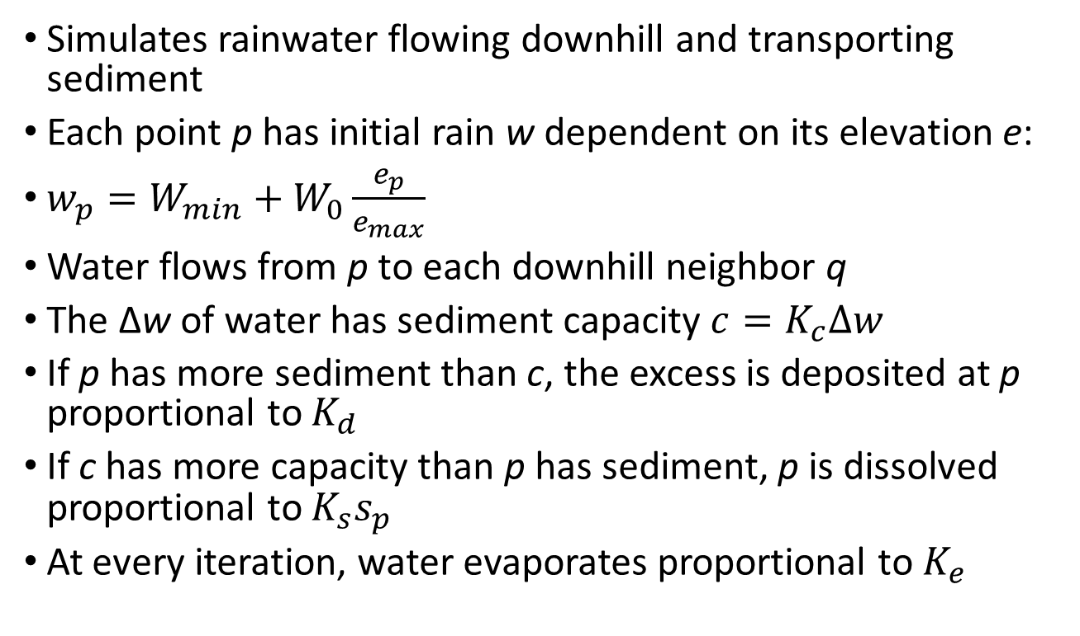
Hydraulic erosion
Simulates rainwater flowing downhill and transporting sediment
Each point p has initial rain w dependent on its elevation e:
$w_{p}=W_{min}+W_{0}\frac{e_{p}}{e_{max}}$
Water flows from p to each downhill neighbor q
The Δw of water has sediment capacity $c=K_{c}∆w$
If p has more sediment than c, the excess is deposited at p proportional to $K_{d}$
If c has more capacity than p has sediment, p is dissolved proportional to $K_{s}s_{p}$
At every iteration, water evaporates proportional to $K_{e}$

Slide 9
References
M. A. Pumar. 1996. “Zooming of Terrain Imagery Using Fractal-Based Interpolation.” In Computers & Graphics, Vol. 20.
F. Belhadj. 2007. “Terrain Modeling: A Constrained Fractal Model.” In AFRIGRAPH ‘07 Proceedings of the 5th international conference on Computer graphics, virtual reality, visualisation and interaction in Africa.
F. K. Musgrave, C. E. Kolb, and R. S. Mace. 1989. “The Synthesis and Rendering of Eroded Fractal Terrains.” In Computer Graphics, Vol. 23.
N. H. Ahn, A. Sourin, and P. Aswani. 2007. “Physically based hydraulic erosion simulation on graphics processing unit.” In GRAPHITE ‘07 Proceedings of the 5th international conference on Computer graphics and interactive techniques in Australia and Southeast Asia.
B. Jákó. 2011. “Fast Hydraulic and Thermal Erosion on the GPU.” In Proceedings of CESCG 2011: The 15th Central European Seminar on Computer Graphics.

